Slide 1
HANDS ON LESSON 8
Question #1 code
d <- ggplot(mtcars, aes(x = hp, y = qsec))
d + geom_point() + geom_smooth(method = lm, se = FALSE)
#negative correlation, as the hp goes up the qsec goes down

Slide 2
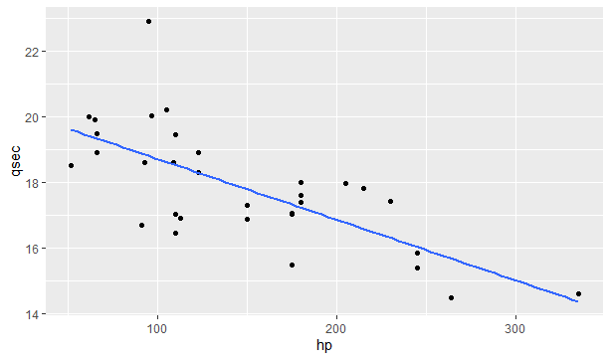
Question #1 scatterplot

Slide 3
Question #1
The scatterplot shows negative correlation. As the hp gets higher the faster the quarter mile time.

Slide 4
Question #2 code
lin_reg <- lm(qsec ~ hp, mtcars)
lin_reg
Equation: lm(formula = qsec ~ hp, data = mtcars)
R squared value:
Coefficients:
(Intercept) hp
20.55635 -0.01846
This was the results expected.

Slide 5
Question #3 code
d <- ggplot(mtcars, aes(x =wt, y = qsec))
d + geom_point() + geom_smooth(method = lm, se = FALSE)
The scatterplot on the next slide shows that there is no correlation between the weight of the vehicle and the quarter mile speed.

Slide 6
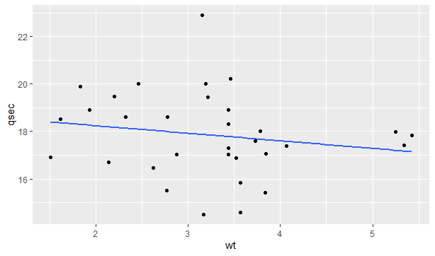
Question #3 scatterplot

Slide 7
Question #4 code
lin_reg <- lm(wt ~ qsec)
lin_reg
Equation: lm(formula = qsec ~ hp, data = mtcars)
R squared value: Coefficients:
(Intercept) hp
20.55635 -0.01846
This is not the results I expected, I thought there would be a correlation.

