Slide 1
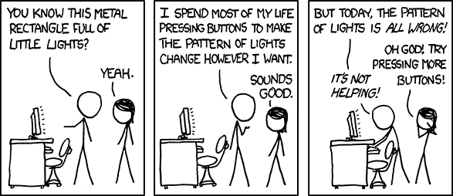
xkcd.com

Slide 2




Stimulus Precision
using Psychopy
Jonas Kristoffer Lindeløv
Email: jonas@cnru.dk
Twitter: @jonaslindeloev
Blog for general public: ”hjernebloggen” at videnskab.dk
Blog for neuroscientists: lindeloev.net

Slide 3
Appearance
Visual angle
Luminance

Slide 4
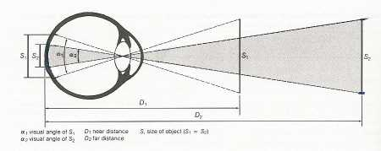
Size and location
  Use cm or visual angle as general unit for size!
  win = visual.Window(units='deg')
  stim = visual.GratingStim(units='degFlat')
  Check the actual size and adjust as needed.
  print ppc.deg2cm(angle=2, distance=60)
  Text = visual.TextStim(win, height=2 * 1.6)
http://www.psychopy.org/general/units.html

Slide 5
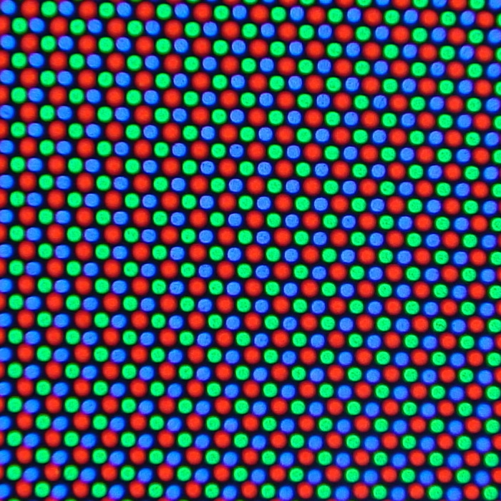
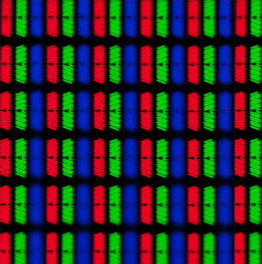
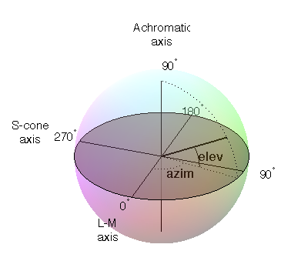
Isoluminant color
  Get isoluminant colors using DKL colorspace.
  visual.ShapeStim(win, colorSpace='dkl', fillColor=[0, 0, 1])
  ppc.dkl2rgb([0, 0, 1])
Adjust monitor using photometer.
CRT
LCD
DKL colorspace
http://www.psychopy.org/general/colours.html

Slide 6
Timing stimulation

Slide 7
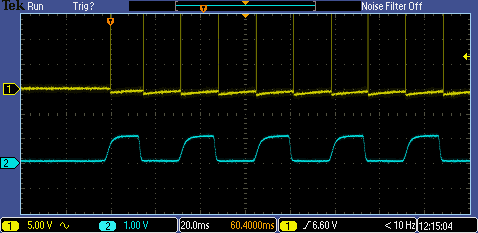
Digital sound is pretty continuous.
Digital video is not.
  All about resolution!
  Video (ms)
  60 Hz: 16.7, 33.3, 50.0, 66.7, 83.3, 100 ms, …
  100 Hz: 10.0, 20.0, 30.0, 40.0, 50.0, 60.0 ms, ...
  Audio (ms)
  44100 Hz: 0.02, 0.05, 0.07, 0.09, 0.11 ms, …
  11025 Hz: 0.09, 0.18, 0.27, 0.36, 0.45 ms, …
Slow motion videos
of minitors:
Visual frames on LCD + CRT + TFT
One frame on big LCD
Visual frames on CRT

Slide 8
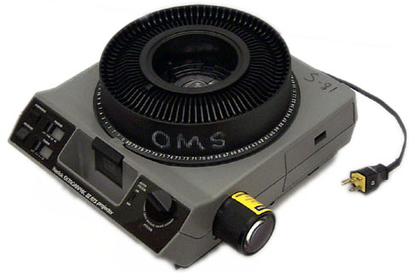
Digital sound is pretty continuous.
Digital video is not.
  Modern monitors are just fast slide projectors!
  … that draw on the slides just before they are shown and discard them afterwards.

Slide 9
Visual timing to frames
  Use frames for visual timing, NOT core.wait()!
  For frame in range(3):
  stim.draw()
  win.flip()
  Check your actual frame rate. I'ts not 60 Hz!
  ppc.getActualFrameRate()
  Triggers and logging AFTER stimulus presentation!
Yes:
win.flip()
duration = clock.getTime()
port.setData(15)
No:
duration = clock.getTime()
port.setData(15)
win.flip()

Slide 10
Visual timing to frames
Test timing of everything in the win.flip() loop except win.flip() and make sure that processing duration is way below frame interval.
Script = ”””
stimA.setOri(1.1, '*')
stimA.setOpacity(0.01, '-')
stimB.setPos([0.1, 0.1], '+')
stimA.draw()
stimB.draw()
# win.flip()
duration = clock.getTime()
clock.reset()
”””
ppc.timer(script, setup='stimA, stimB, clock')

Slide 11
Timing sound
  Sound: Use winsound on Windows and discard first play. PsychoPy is not precise enough yet.
  beep = ppc.Sound('myBeep.wav')
  beep.play()

Slide 12
Timing input

Slide 13
Timing input
psychopy.event run in same process as stimulation.
Light and easy but bad for simultaneous events.
psychopy.iohub runs in parallel. Good with ”wait functions”, simultaneous inputs, and key releases.
from psychopy import iohub
io = iohub.launchHubServer()
keyboard = io.devices.keyboard
flip_times = []
for frame in range(60):
stim.draw()
flip_times += [win.flip()]
response = keyboard.getPresses()
print response[0].time - flip_times[0]
# Or use one of these:
keyboard.getReleases()
response = keyboard.getKeys()
from psychopy import event
flip_times = []
for frame in range(60):
stim.draw()
flip_times += [win.flip()]
response =
event.getKeys(timeStamped=True)
print response[0][0] - flip_times[0]
http://www.psychopy.org/api/iohub/device/keyboard.html
Notes:
Takes a while to start iohub
No reason to use iohub for waitKeys() function

Slide 14
General advice

Slide 15
General advice on precision
  A log is suggestive.
  Physical measurement is proof.
  Timing: run the code once before the critical presentation. Slow first-run functions include:
  core.wait()
  ppc.sound.play()
  stim.draw()

Slide 16

You're the python god and python functions are your slaves.
(Monty Python's impression)

Slide 17
You're the python god and python functions are your slaves.
  You should be in total control. They should do everything that you tell them to and nothing else. Complex modules are threads!
  Test them frequently, don't trust them until they've prooved that they are true to your wishes for all eternity!
  Good functions should be able to serve you properly. Give them proper hardware!

