Slide 1





What is psychopy?
Jonas Kristoffer Lindeløv
Email: jonas@cnru.dk
Twitter: @jonaslindeloev
Blog for general public: ”hjernebloggen” at videnskab.dk
Blog for neuroscientists: lindeloev.net

Slide 2
What stimulus presentation software should I choose?
Name | Free | Platform | GUI | Scripting
E-Prime | No | Windows | Yes | E-Basic
Presentation | No | Windows | Yes | Custom
DirectRT | No | Windows | Yes | Custom
Experiment Builder | No | Windows | Yes | Python
Inquisit | No | Windows | Yes | Custom
SuperLab | No | Windows | Yes | Custom
Vision Egg | No | All | No | Yes
MEL | No | IBM PC | No*** | Custom
MATLAB Psychophysics Toolbox | Yes** | All | No | MATLAB
Cogent | Yes** | Windows XP! | No | MATLAB
DMDX | Yes* | Windows | No | Custom
PsyToolkit | Yes | Linux | No | Custom
PsyScope | Yes | Mac OS | Yes | Custom
PyEPL | Yes | Mac, Linux | No | Python
Tscope | Yes | Windows**** | No | C/C++
PEBL | Yes | All | No | Custom
PsychoPy | Yes | All | Yes | Python
OpenSesame | Yes | All | Yes | Python

Slide 3
Which stimulus presentation software should I choose?
Name | Free | Platform | GUI | Scripting | Score
E-Prime | No | Windows | Yes | E-Basic | 1
Presentation | No | Windows | Yes | Custom | 1
PsyToolkit | Yes | Linux | No | Custom | 1
Vision Egg | No | All | No | Python | 2
MATLAB Psycho- physics Toolbox | Yes** | All | No | MATLAB | 2
Cogent | Yes** | Windows XP | No | MATLAB | 2
PyEPL | Yes | Mac, Linux | No | Python | 2
OpenSesame | Yes | All | Yes | Custom | 3
PsychoPy | Yes | All | Yes | Python | 4
Adapted from Mathôt, S., Schreij, D., & Theeuwes, J. (2011). OpenSesame: An open-source, graphical experiment builder for the social sciences. Behavior Research Methods.

Slide 4
PsychoPy! Here's additional reasons why:
Timing to frames: ability to time-lock visual stimuli to monitor frames instead of milliseconds.
Actual stimulus appearance: specify/calibrate monitor properties and use ”deg” as unit.
Power of Python: statistics, visualizations or web? Only an ”import” away!
Active development: updates about every month. Fast bugfixing.
Notes:
About timing tests (E-Prime)
---
Audio – pyo?
---
Show run.py

Slide 5
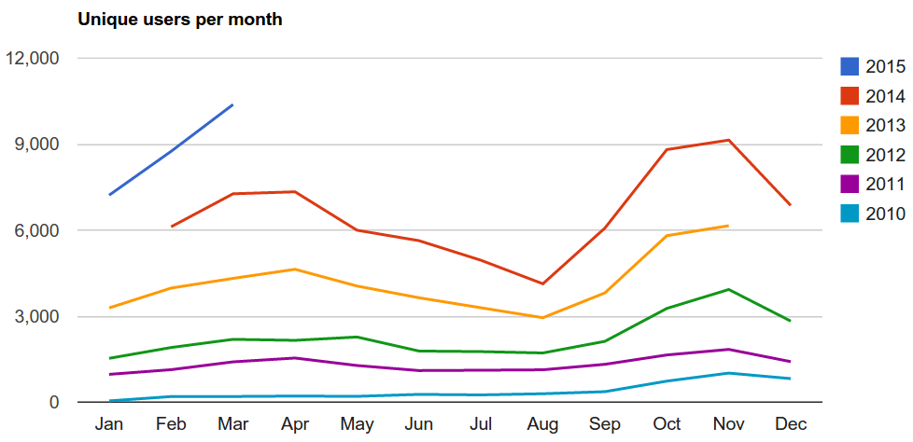
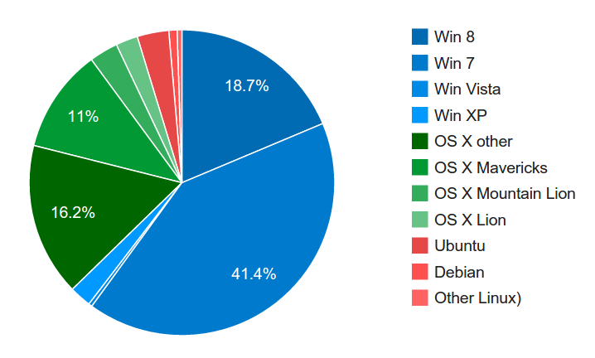
Usage

Slide 6


Developers
Jonathan Pierce
Jeremy Gray
and Mike MacAskill, Sol Simpson, Yaroslav Halchenko, Jonas Lindeløv,
Erik Kastman, William Hogman, Hiroyuki Sogo,
and many more...

Slide 7
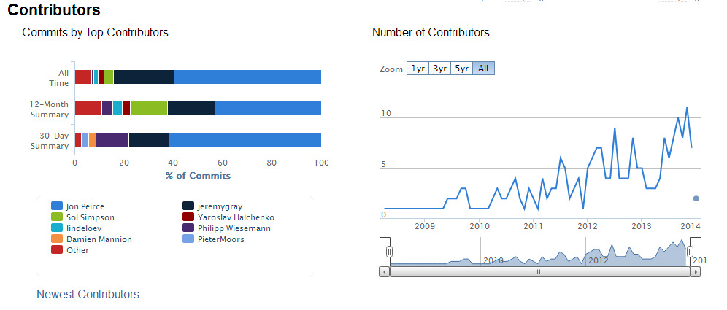
Developers

Slide 8
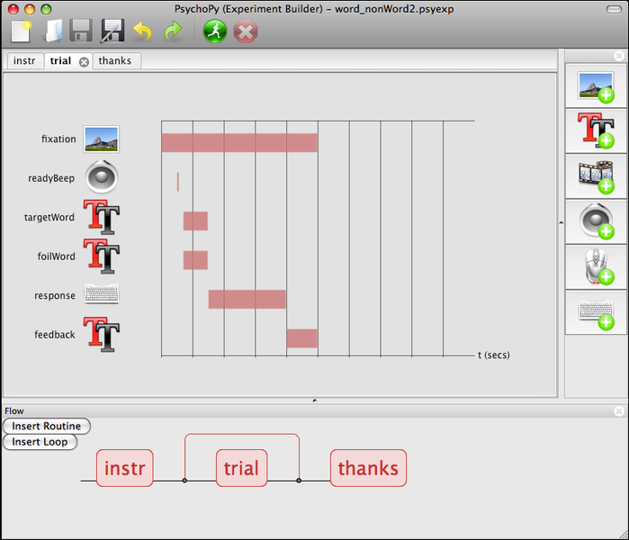
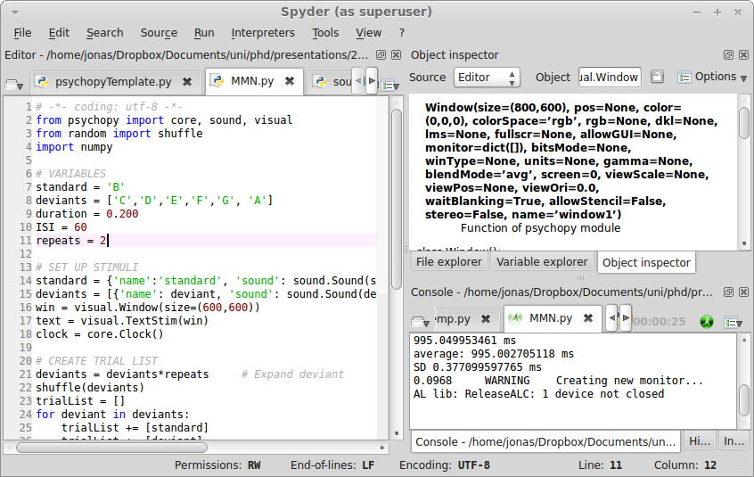
PsychoPy overview
Python module: scripting
Builder: graphical interface
Notes:
About python!
----
Builder also in python – generates script

Slide 9
Power at your fingertips
MATLAB:
import numpy as np
MATLAB plotting:
import matplotlib as plt
R data.frame:
import pandas as pd
Statistical modeling
import statmodels as sm

Slide 10
Getting started
In general:
  Play around with demos in Builder and Coder.
  Follow tutorials on www.psychopy.org
  Search psychopy-users Google group.
Graphical interface:
  Video tutorial: www.youtube.com/watch?v=VV6qhuQgsiI
  Also, check out OpenSesame: http://osdoc.cogsci.nl/
Scripting:
  Python syntax: www.korokithakis.net/tutorials/python/
  Use Spyder instead of Coder. Then the API
  (www.psychopy.org/api/api.html) will be in-app.
  Check out useful code snippets and tips on www.lindeloev.net/?page_id=134

