Slide 1
UI 开发指南
Linder Wang
Jul 17, 2013

Slide 2
培训内容与目标
内容
HTML
CSS
Javascript
jQuery 的用法
jQuery UI 的用法
jQuery 相关插件的用法
jQuery 插件的开发

Slide 3
培训内容与目标
目标
熟练掌握 html和css的基本用法，了解前端制作相关注意事项，比如：Layout、Float、Position、Block Formatting Context（块格式化上下文）以及各大浏览器兼容性等。
熟练掌握Javascript：包括用法、编码规范、性能优化等。
记住所有jQuery API（至少知道有这样的API）
知道jQuery UI 中有哪些Widgets，能熟练从官方网站查询API的用法，另外需要掌握几个常用的API，主要有$.fn.position(options ) 等。
项目中设计到的jQuery plugins 有jqgrid、ztree、validate等，对于这些插件不要求完全掌握，会用即可。
Javascript调试

Slide 4
HTML
HTML 书写规范
DOCTYPE与浏览器模式
HTTP协议之HTTP消息
浏览器渲染原理简介
HTML 常用标签
书写HTML标签注意事项

Slide 5
CSS
CSS选择器优先级
CSS常用样式
CSS浮层
CSS定位
Block Formatting Context（块格式化上下文）
CSS核心可视化格式模型(visual formatting model)

Slide 6
Javascript
Javascript编码规范
Javascript性能优化
Javascript正则表达式
JavaScript doc生成器
HTML 常用标签
书写HTML标签注意事项

Slide 7
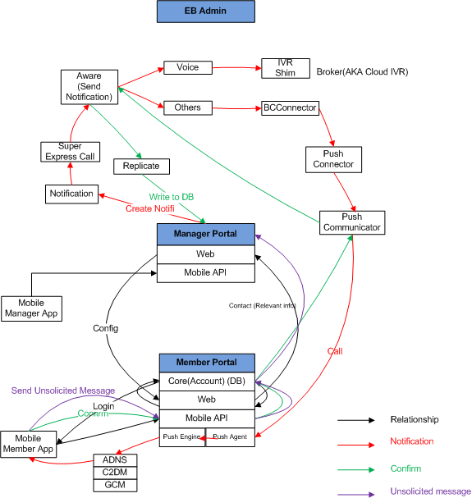
High Level Overview
Relationship of Portal and
Mobile App
Notification workflow
Confirm workflow
Unsolicited message workflow

Slide 8
Mobile Manager Business Process
An Organization or Group Leader access the Everbridge Mobile Application using existing credentials in Login page
Select an Org in Landing page
Launch to a New Notification Page to send a notification
Input a title and Body
Record a voice
Insert an image
Type an event
Select contacts
To Modify Broadcast settings
Click the button Send
Get Report
Stop
ReBC or Follow Up
Report

Slide 9
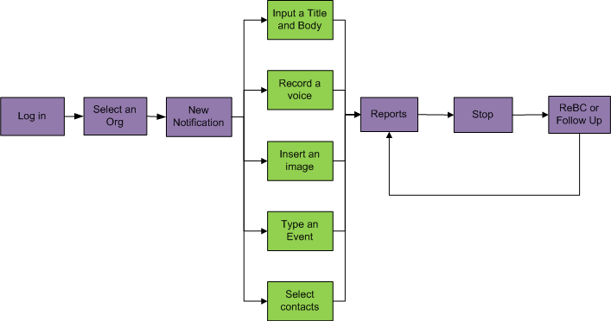
Mobile Manager Workflow Diagram

Slide 10
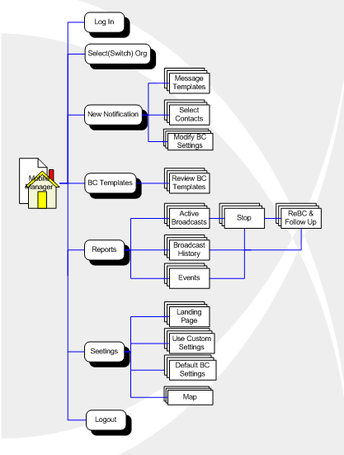
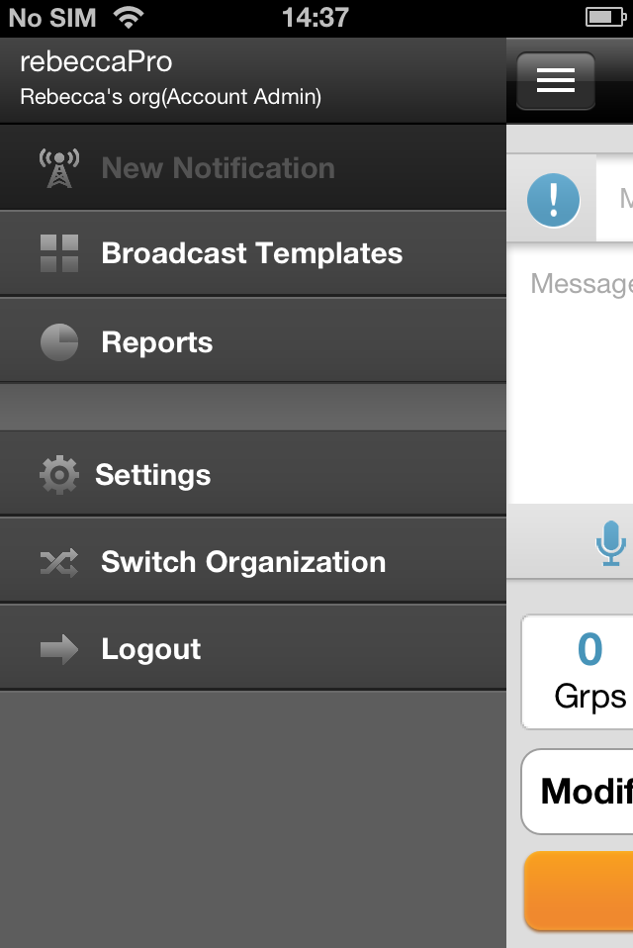
Mobile Manager Functions Diagram

Slide 11
Logic of Settings
There are 3 settings in the system: Remote Settings (Org Settings), Custom Settings, and Broadcast Settings. Remote Settings (Org Settings) is from server, Custom Settings is saved location, and there is Broadcast Settings when sending a notification. Below is basic relationship of three settings:
Custom Settings will be synchronized from Remote Settings (Org Setting) when a user first logs in App.
Custom Settings synchronize to Broadcast Settings when Custom Settings is ON in Settings of client
Broadcast Settings in New Notification page will overwrite Custom Settings when clicking Save as Default.
Remote Settings (Org Settings) synchronize to Broadcast Settings when Custom Settings is OFF in Settings of client.

Slide 12
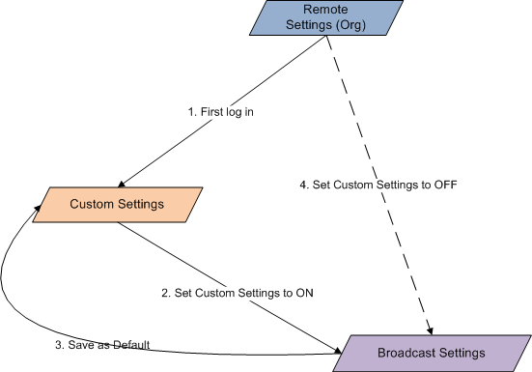
Settings Logic Diagram

Slide 13
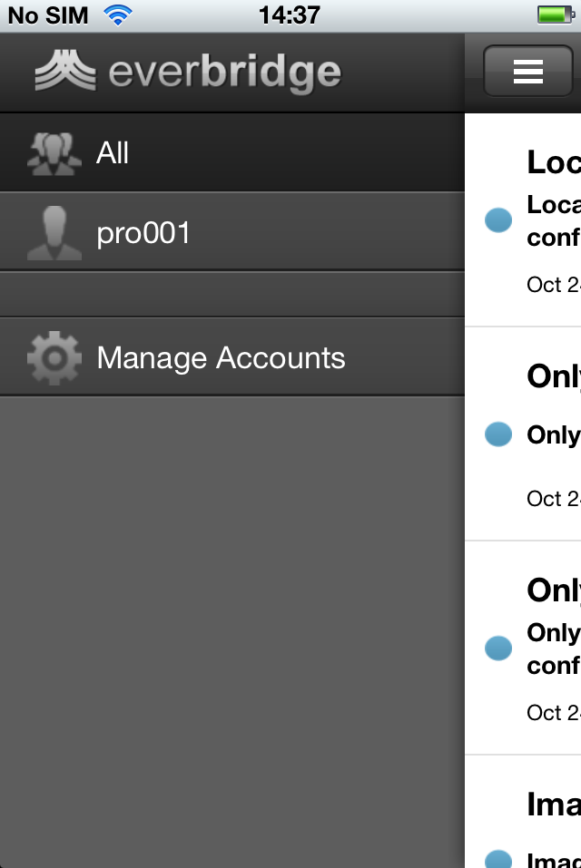
Mobile Member Introduction
Members can log in with their Everbridge credentials to connect with their Organization,
share their location and communicate in real time.
End-Recipients can send a message to their
Organization without having been contacted first.
An example use case for this might be if a fire has broken out and the user is on the scene. The user can report that there is a fire and this message can trigger an alert if the user has defined thresholds.

Slide 14
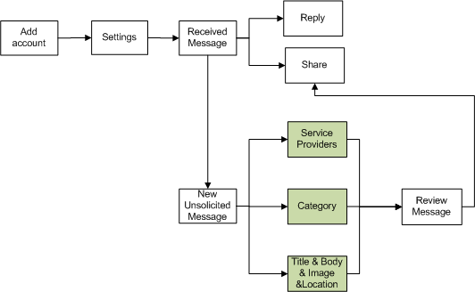
Mobile Member Workflow Diagram

Slide 15
Thanks~

