Slide 1

Vehicle Routing Problem: Wisdom of Crowds using Genetic Algorithms
Lindie Chenou

Slide 2
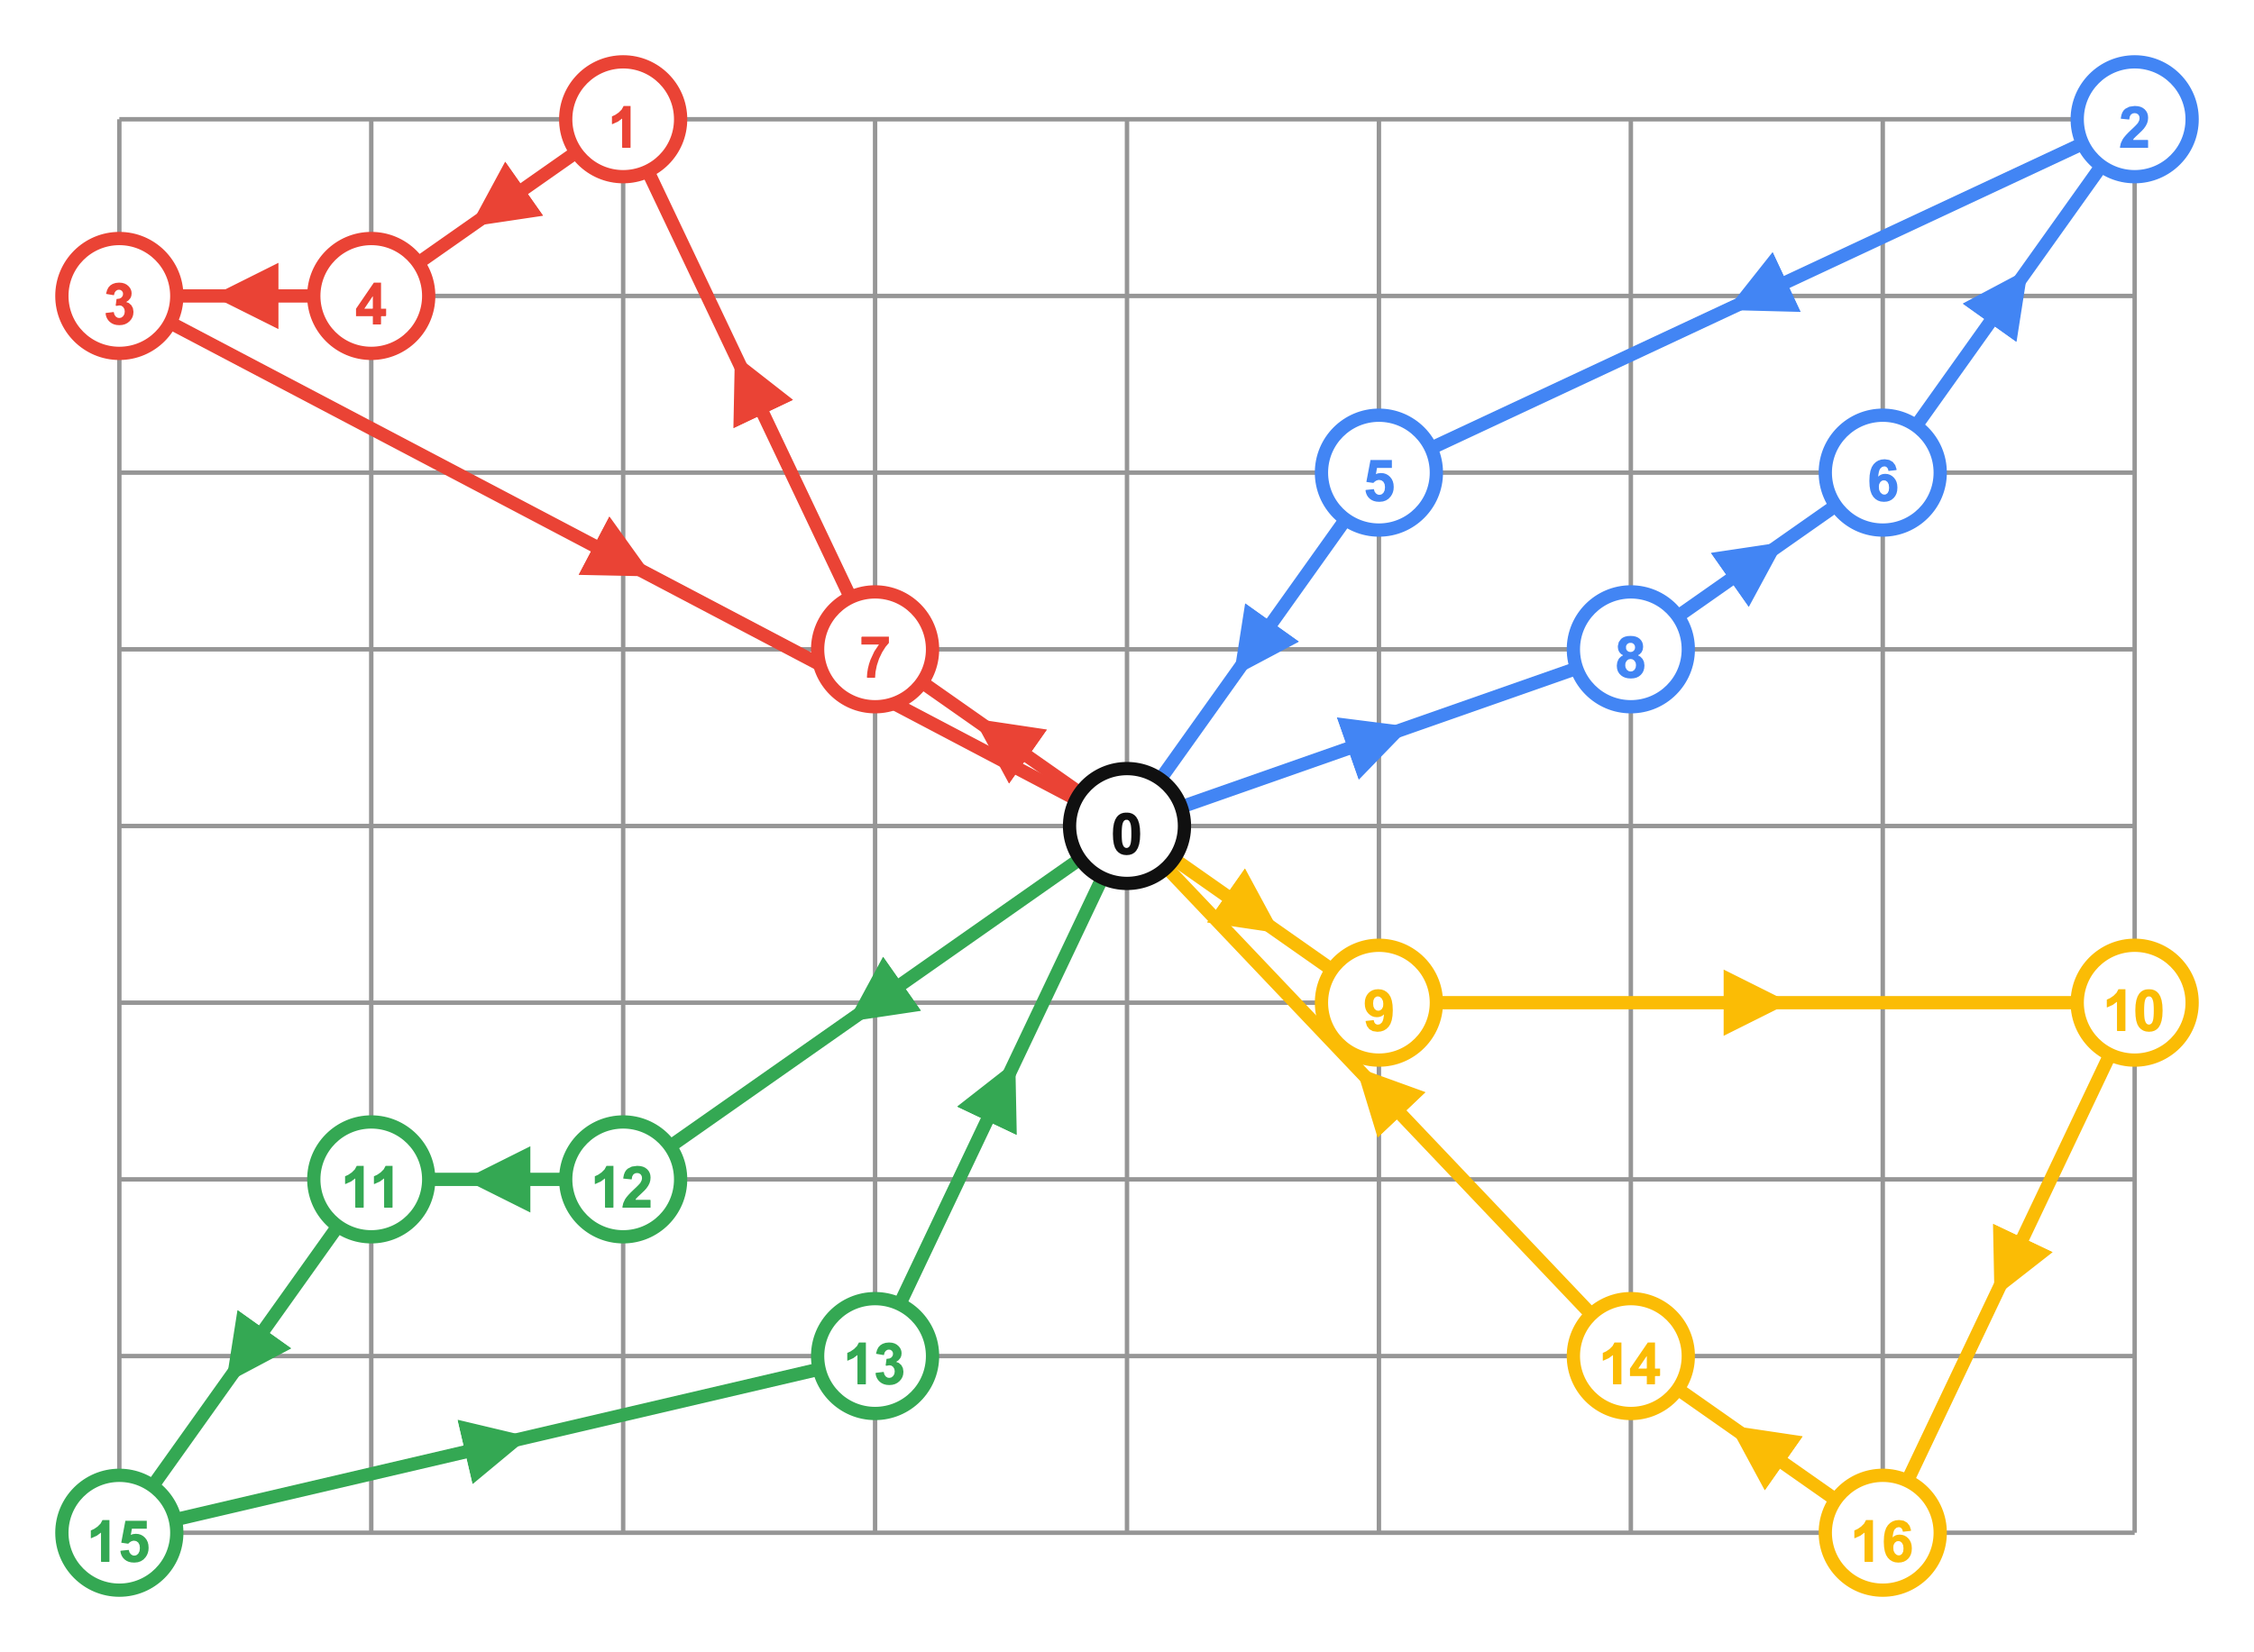
The Vehicle Routing Problem
It first appeared in a paper published in 1959 by George Dantzig and John Ramser in which the first algorithmic methods were written and applied to supplies of fuel
The VRP’s aim is to minimize the cost of the total path
Given a set of customers, and a fleet of vehicles to make deliveries, find a set of routes that services all customers at minimum cost.

Slide 3
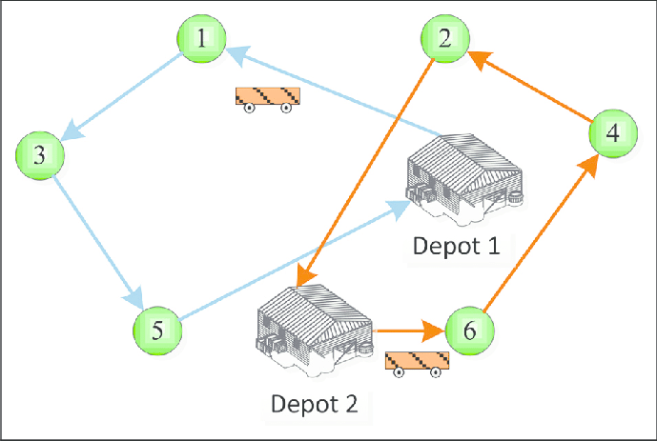
Genetic Algorithms
A genetic representation of a solution
A function to generate new solutions
Fitness function
A selection function
Crossover function
Mutation function

Slide 4
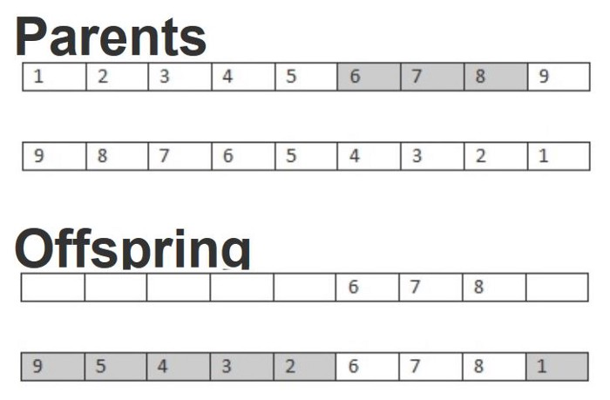
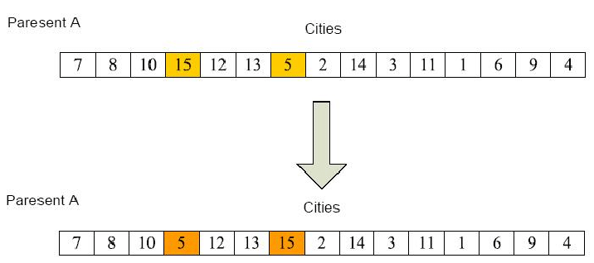
Genetic algorithm
Crossover Method
  Using the ordered crossover.
Mutation Method
  Swap mutation

Slide 5
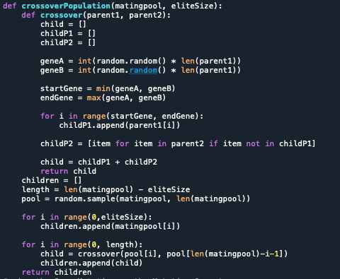
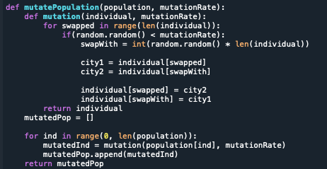
Genetic Algorithm

Slide 6
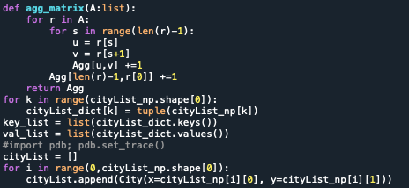
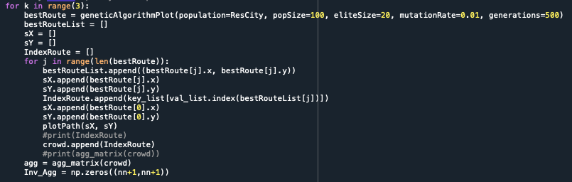
Wisdom of Crowds

Slide 7
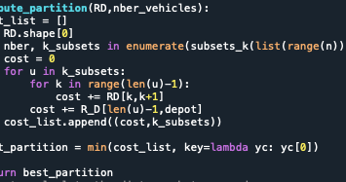
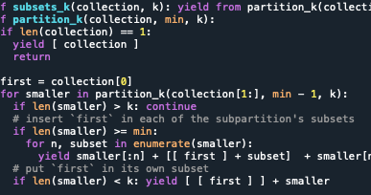
Approach for VRP

Slide 8
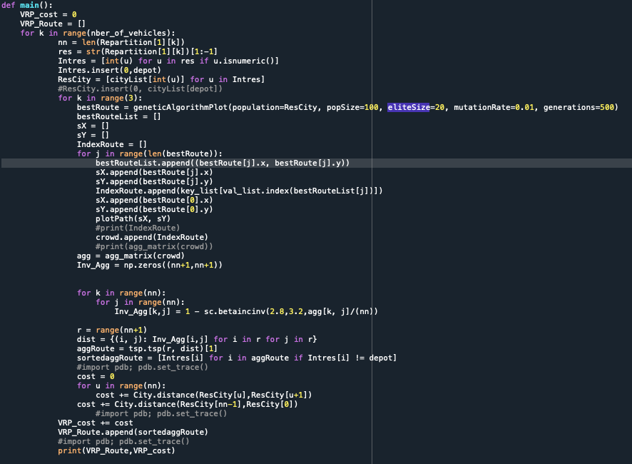
Approach for VRP

Slide 9
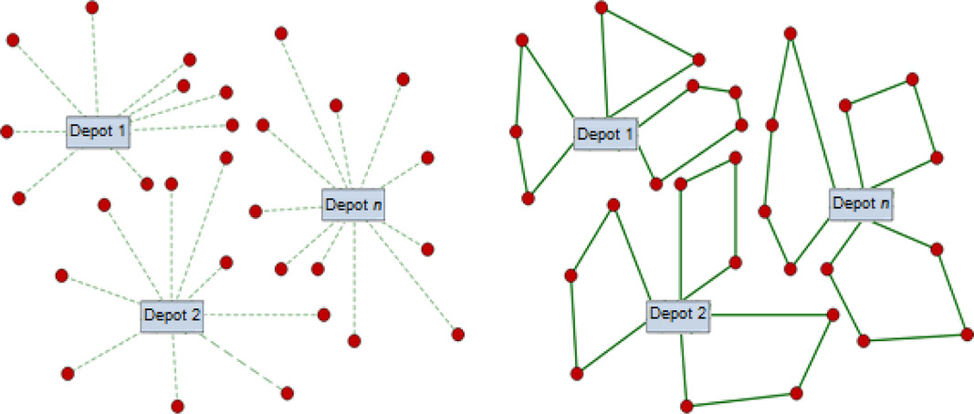
results

Slide 10
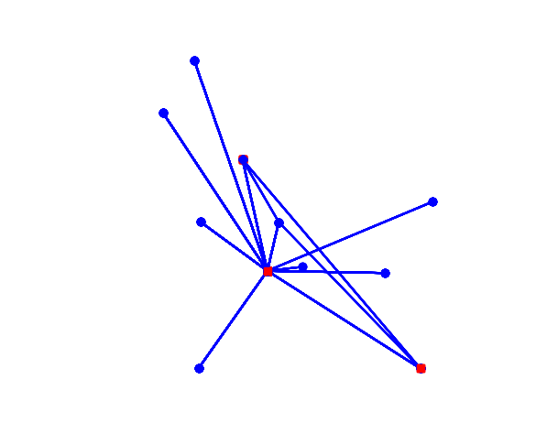
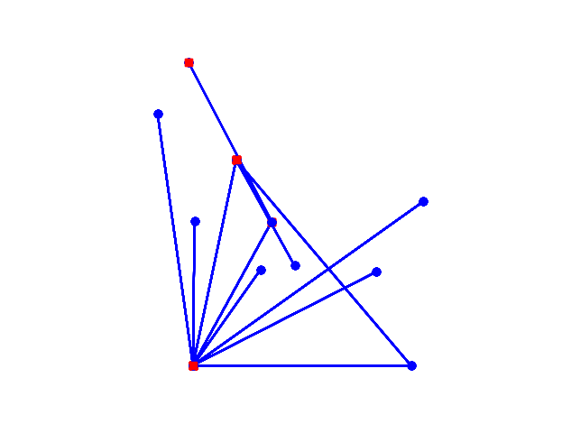

Slide 11
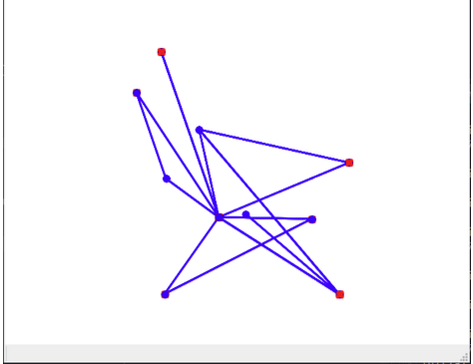

Slide 12
findings
It was difficult to perform a comparison result with just the genetic algorithm.
The WoC results didn’t perform as expected they would. Depending on the number of Vehicles the result will fluctuate.
It seems like the vehicle would make multiple trips back to the original depo instead of going straight to the next stop.

Slide 13
Future Work
Fixing the code.
Brute Force
Implements more crossover methods and mutation methods from publications on genetic algorithms.

Slide 14
References
https://towardsdatascience.com/evolution-of-a-salesman-a-complete-genetic- algorithm-tutorial-for-python-6fe5d2b3ca35
https://www.sciencedirect.com/topics/engineering/genetic-algorith
https://towardsdatascience.com/introduction-to-optimization-with-genetic- algorithm-2f5001d9964b
B. L. Golden, S. Raghavan, and E. A. Wasil, The vehicle routing problem: latest advances and new challenges. New York: Springer, 2011.

