Slide 1
An Analysis Tool for Railway Network Management
Design of Algorithms (DA) – Spring 2023
Luís Ganço (202004196)
Linda Rodrigues (202005545)
Eduardo Gonçalves (201907116)

Slide 2
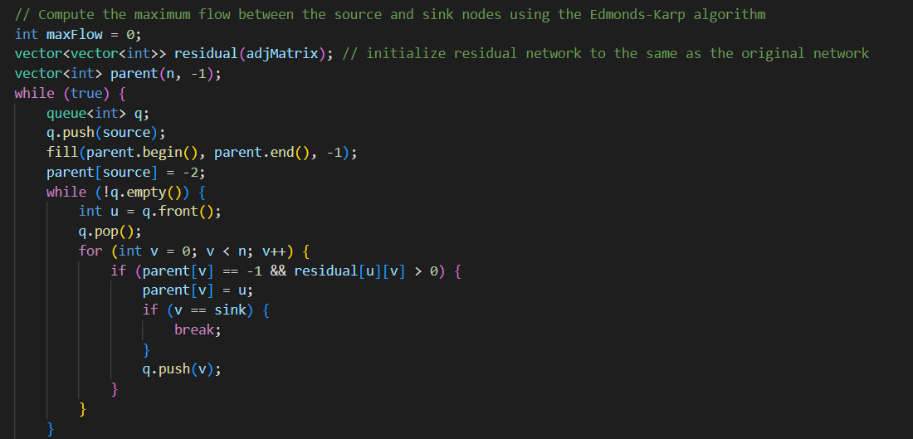
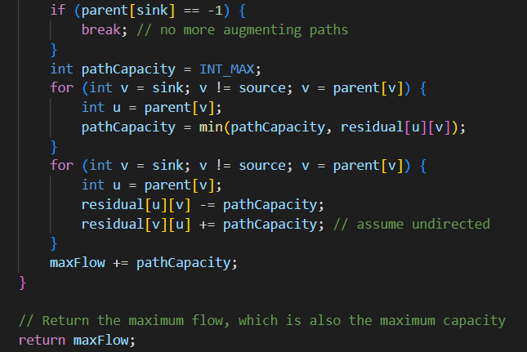
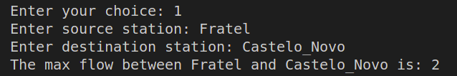
T2.1: Calculate the maximum number of trains that can simultaneously travel between two specific stations
The implementation uses the Edmonds-Karp Algorithm
Use of the getMaxCapacity function

Slide 3
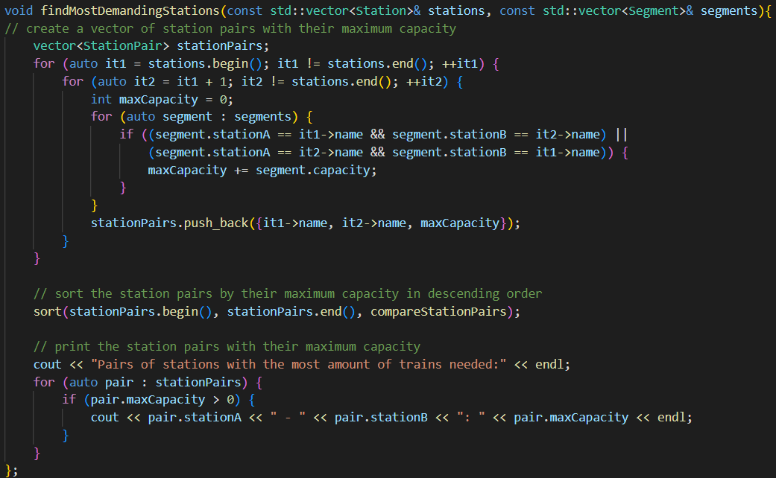
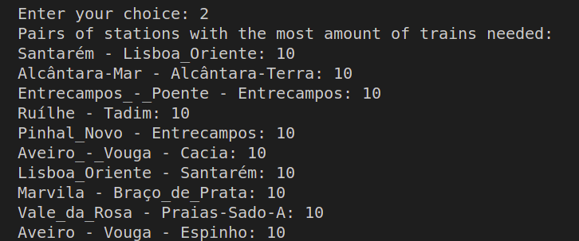
T2.2: Determine, from all pairs of stations, which ones require the most amount of trains when taking full advantage of the existing network capacity
Use of iterators
Sorts the pairs of stations in descending order of max capacity

Slide 4
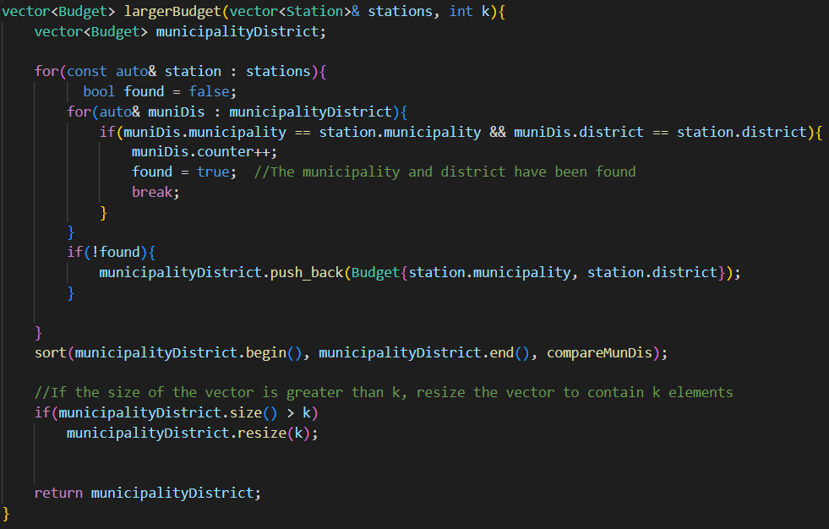
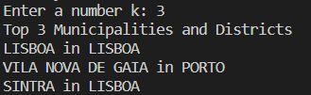
T2.3: Indicate where management should assign larger budgets for the purchasing and maintenance of trains
The implementation should report the top-k municipalities and districts.
To do this, we used two files: budgets.h and largerBudget.h, with two functions: compareMunDis and largerBudget

Slide 5
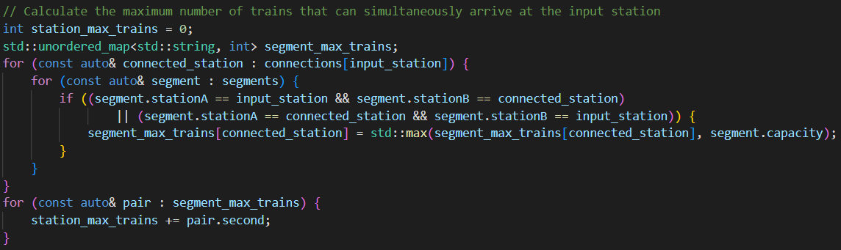
T2.4: Report the maximum number of trains that can simultaneously arrive at a given station, taking into consideration the entire railway grid
Use of an unordered map to build a set of connected stations
Then, it calculates the desired number, based on the network

Slide 6
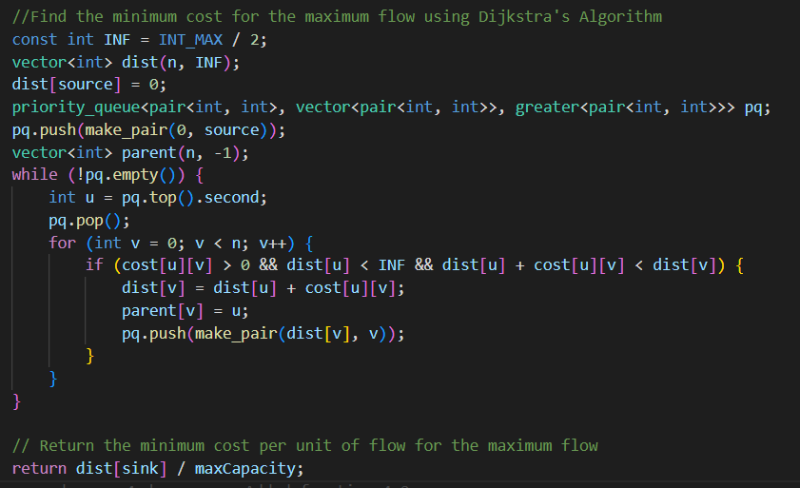

T3.1 Calculate maximum amount of trains that can simultaneously travel between two specific stations with minimum cost for the company
Algorithm used: Dijkstra
Resource: getMaxCapacity function used previously

Slide 7
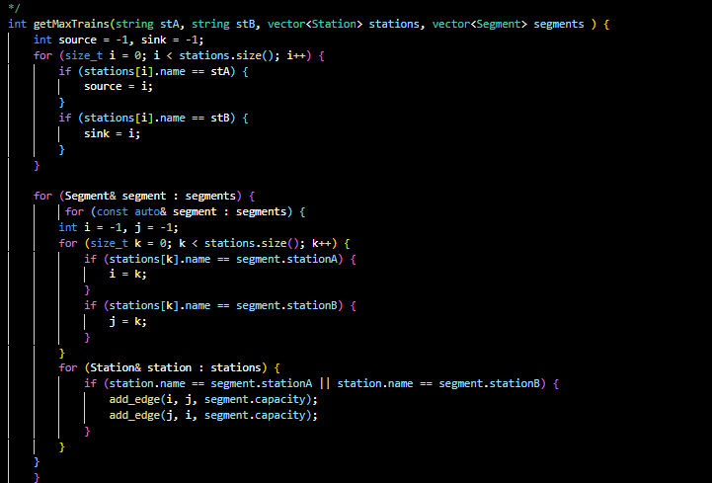
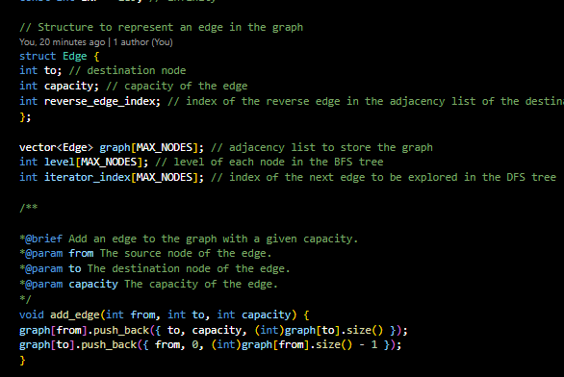
T4.1: Maximum number of trains that can simultaneously travel between two specific stations in a network of reduced connectivity
Creating the subgraph

Slide 8
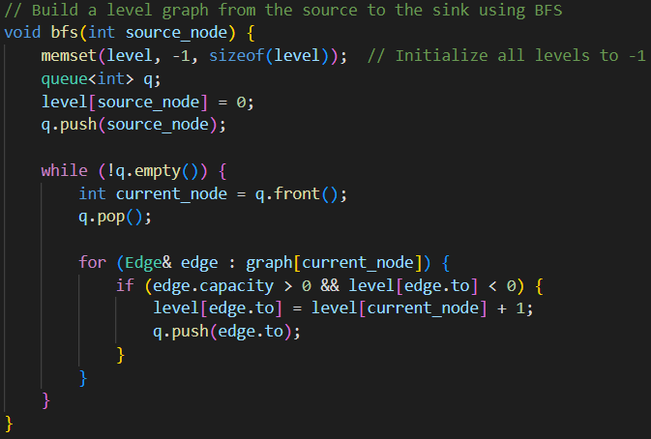
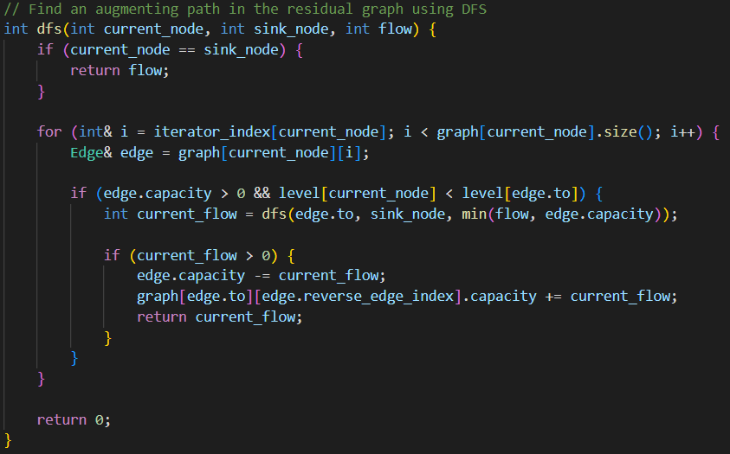
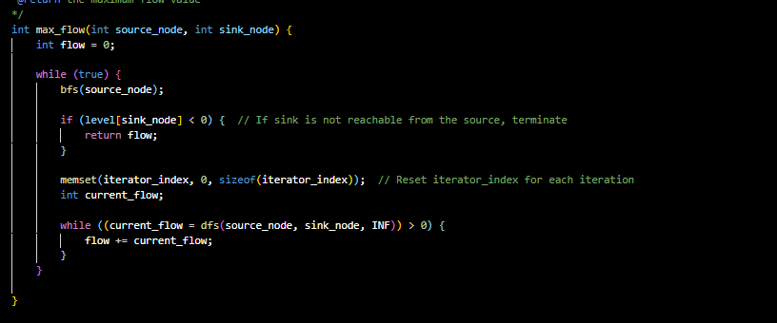
Applying Ford-Fulkerson algorithm with the Edmonds-Karp optimization.

Slide 9
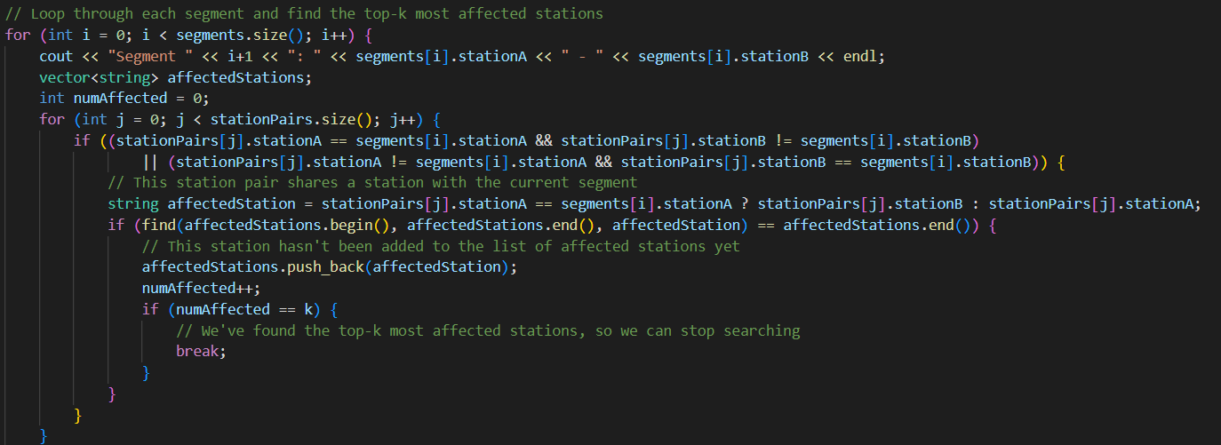
T4.2: Provide a report on the stations that are the most affected by each segment failure

