Slide 1

S A I L P E R F _ N2K
S A I L P E R F _ N2K

Slide 2





S A I L P E R F _ N2K
Functions and Dataflows
4
7
1
Course Simulator
WebServer
Actisense_WiFi_W2K
Device Status
Current Readings
Perf Graphs
Data Export
5
8
OR
2
NMEAHandler
SensorPipeline
Signal K NMEA
6
10
NMEA 2000
3
StreamReader
9
NMEA File Reader
Raw Logs
Formatted logs.
SQLite
Database
threaded environment
Data Copy for external analysis

Slide 3
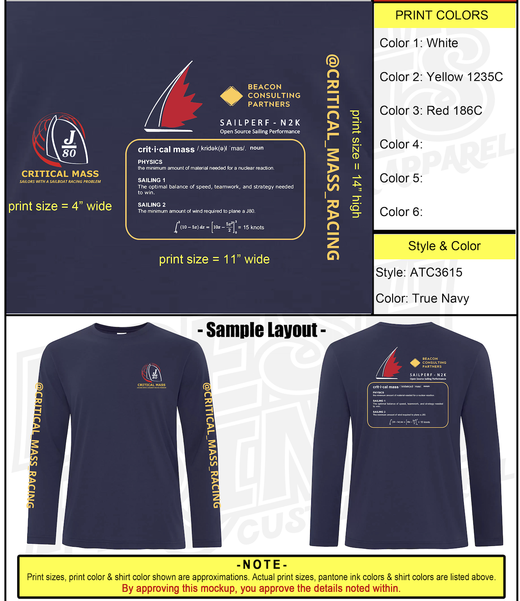

Slide 4
I found some funding for shirts. We each get two free. They are a Moisture-wicking / UV 40+. Let me know what sizes you want. Sizes need to be in for next week.

Slide 5

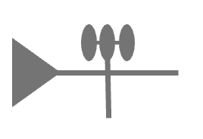


ActiSense
PI CAN-M Hat
S A I L P E R F _ N2K
OR
Device Status
Current Readings
Perf Graphs
Data Export
Data Reader(s)
SensorPipeline
WebServer
NMEA 2000 Backbone
Data Base
Other analysis tools.

