Slide 1
Interpreting Spectra
AstroNuc Practical Session
Lindsey Kwok

Slide 2
What you will learn:
Basics of identifying spectral lines (in transients)
Line ID rules of engagement
Practice using the Atomic Line List
Interpreting line profile shapes
Understanding of limitations
  Dust, 3D effects/anisotropies, line blending
Using/ comparing with models
Beginner level

Slide 3
Nebular Emission Lines
Assumptions: optically thin, axisymmetry

Slide 4
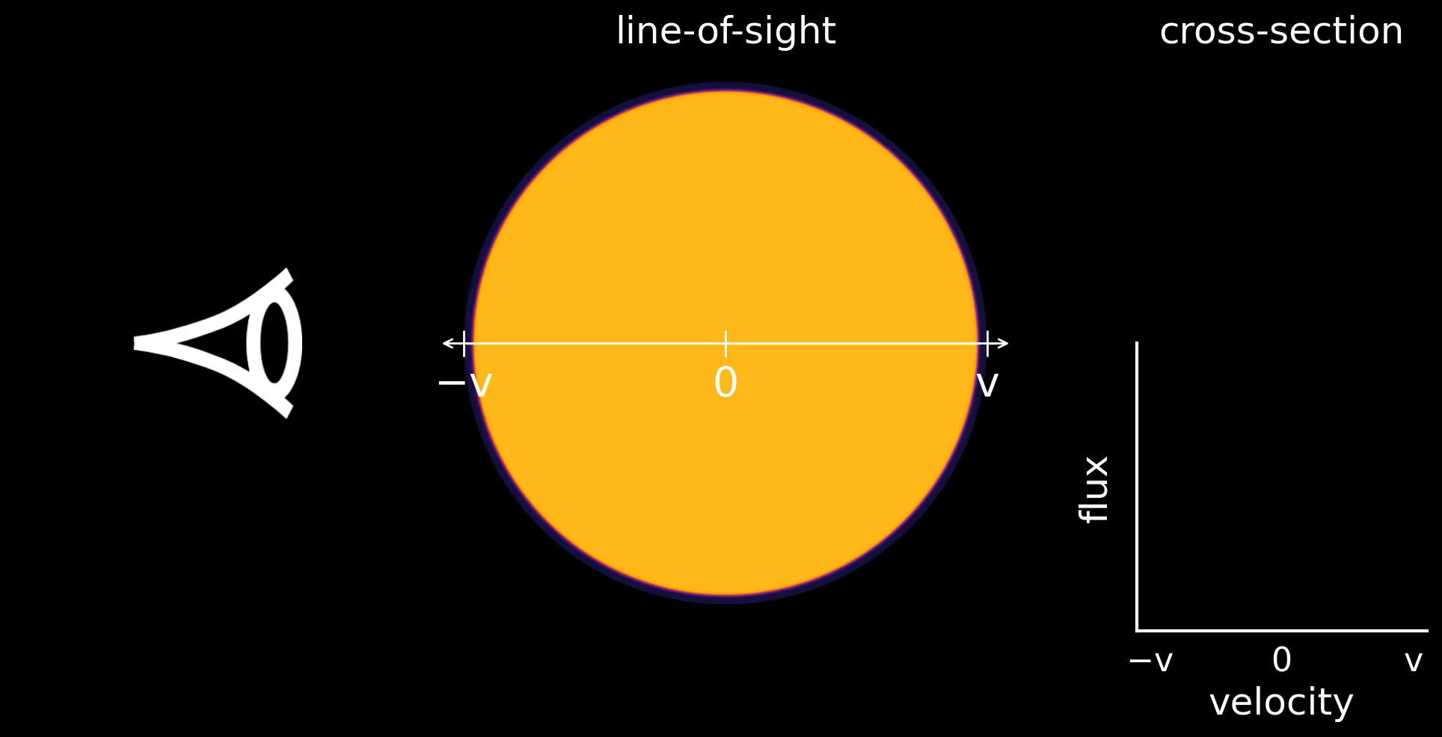
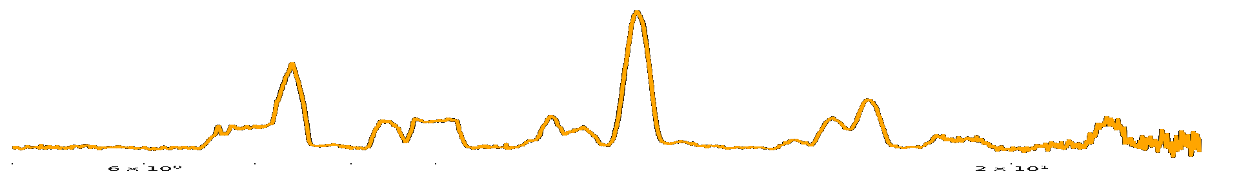
Line profiles: uniform distribution
5 µm
25 µm
SN 2024gy
Notes:
The transition isn't working here

Slide 5
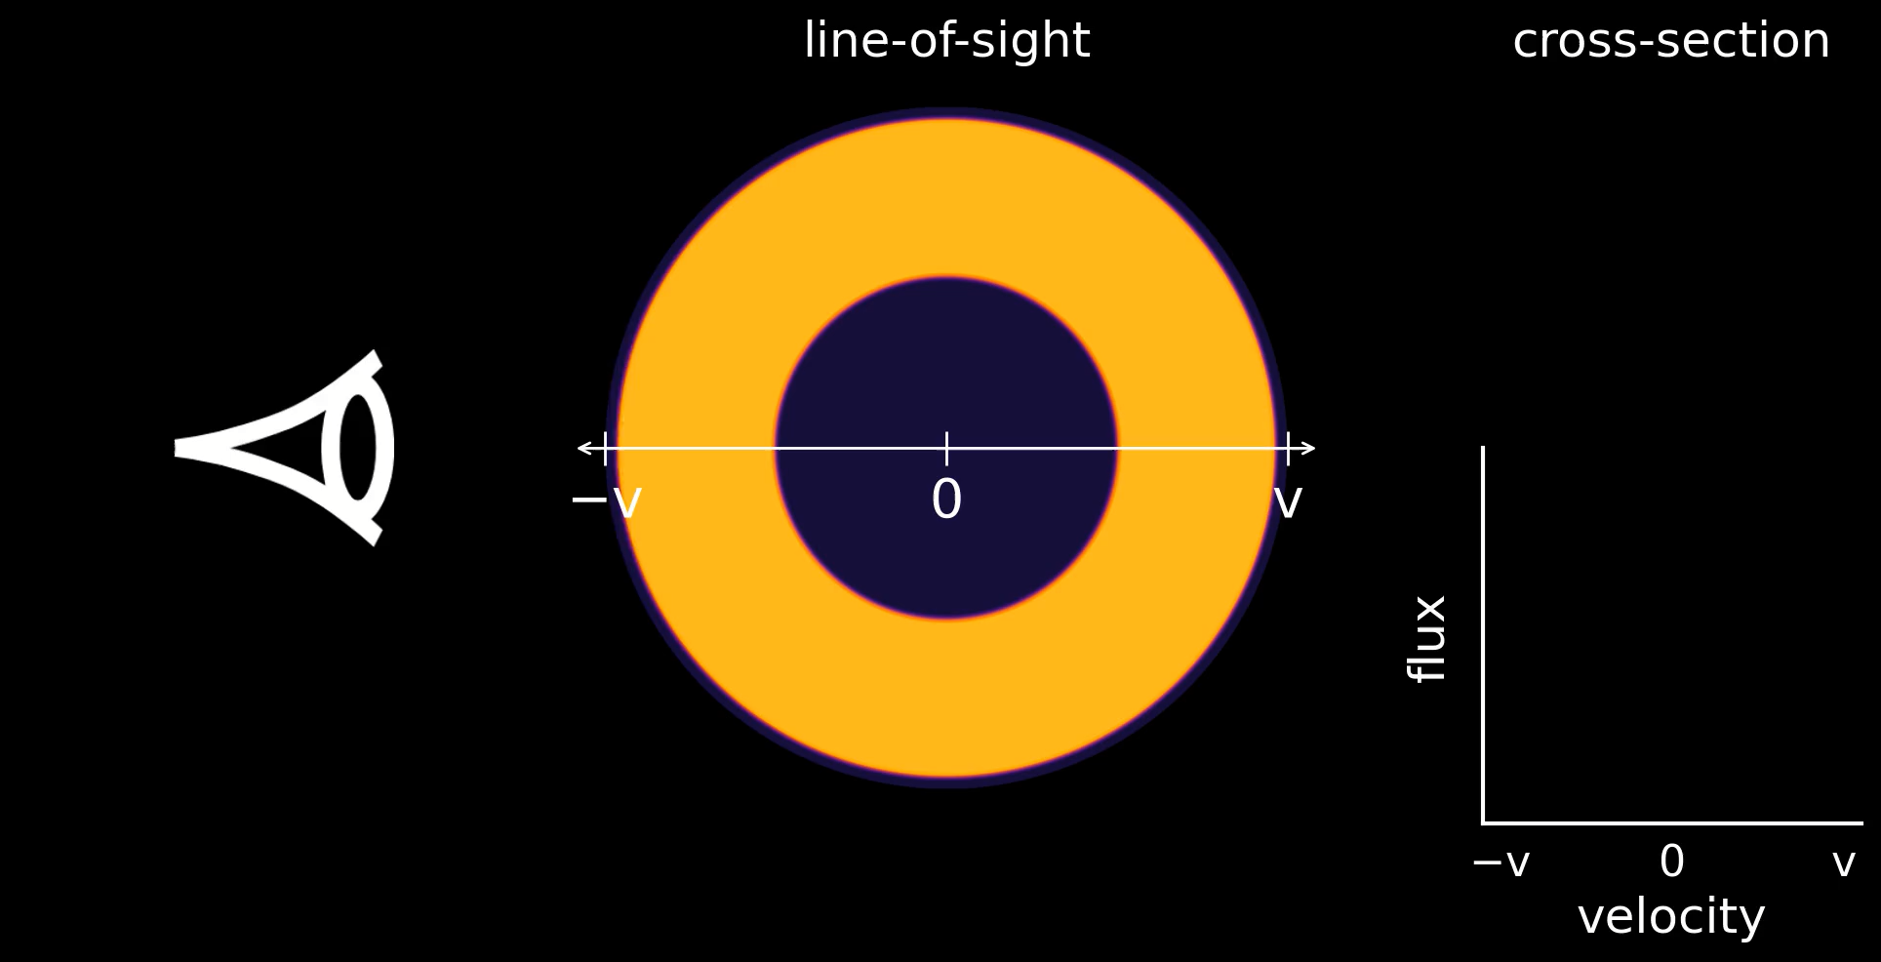
Line profiles: thick shell distribution
5 µm
25 µm
SN 2024gy
Notes:
The transition isn't working here

Slide 6
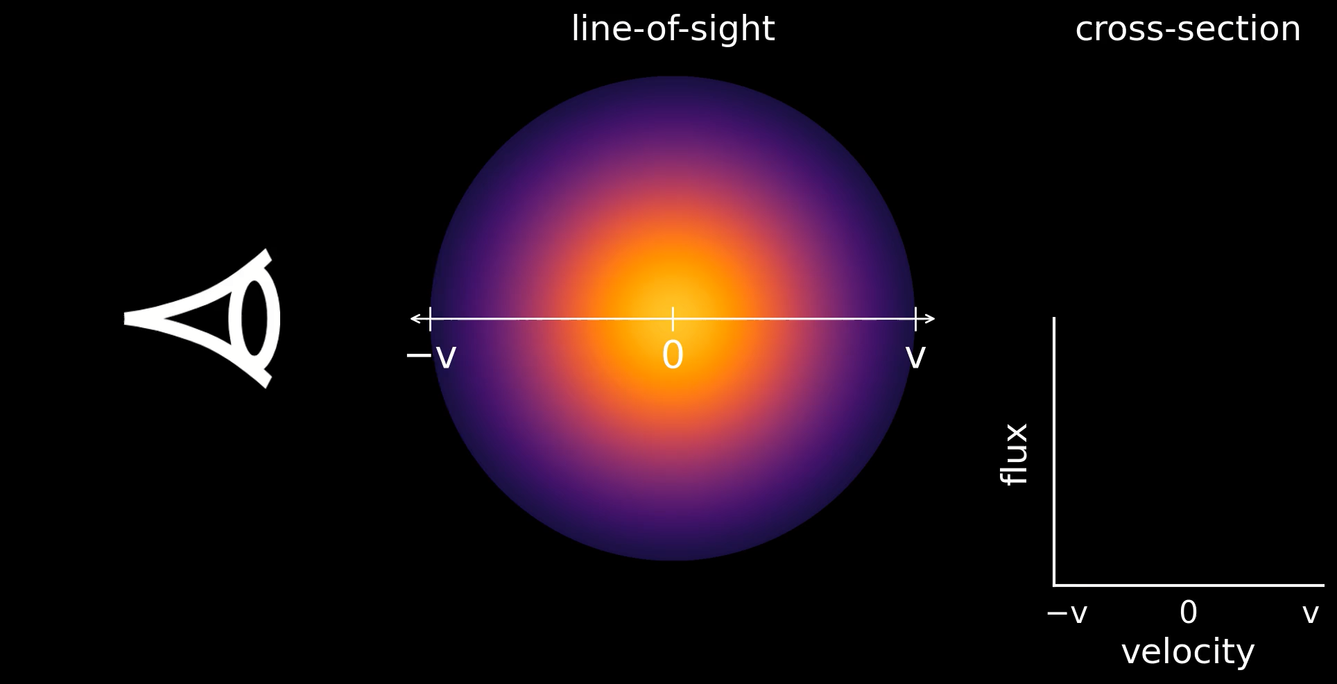
SN 2024gy: ~Gaussian distribution
Kwok et al, in prep
⁵⁶Co traces radioactive IGEs
→ high densities
5 µm
25 µm
SN 2024gy

Slide 7
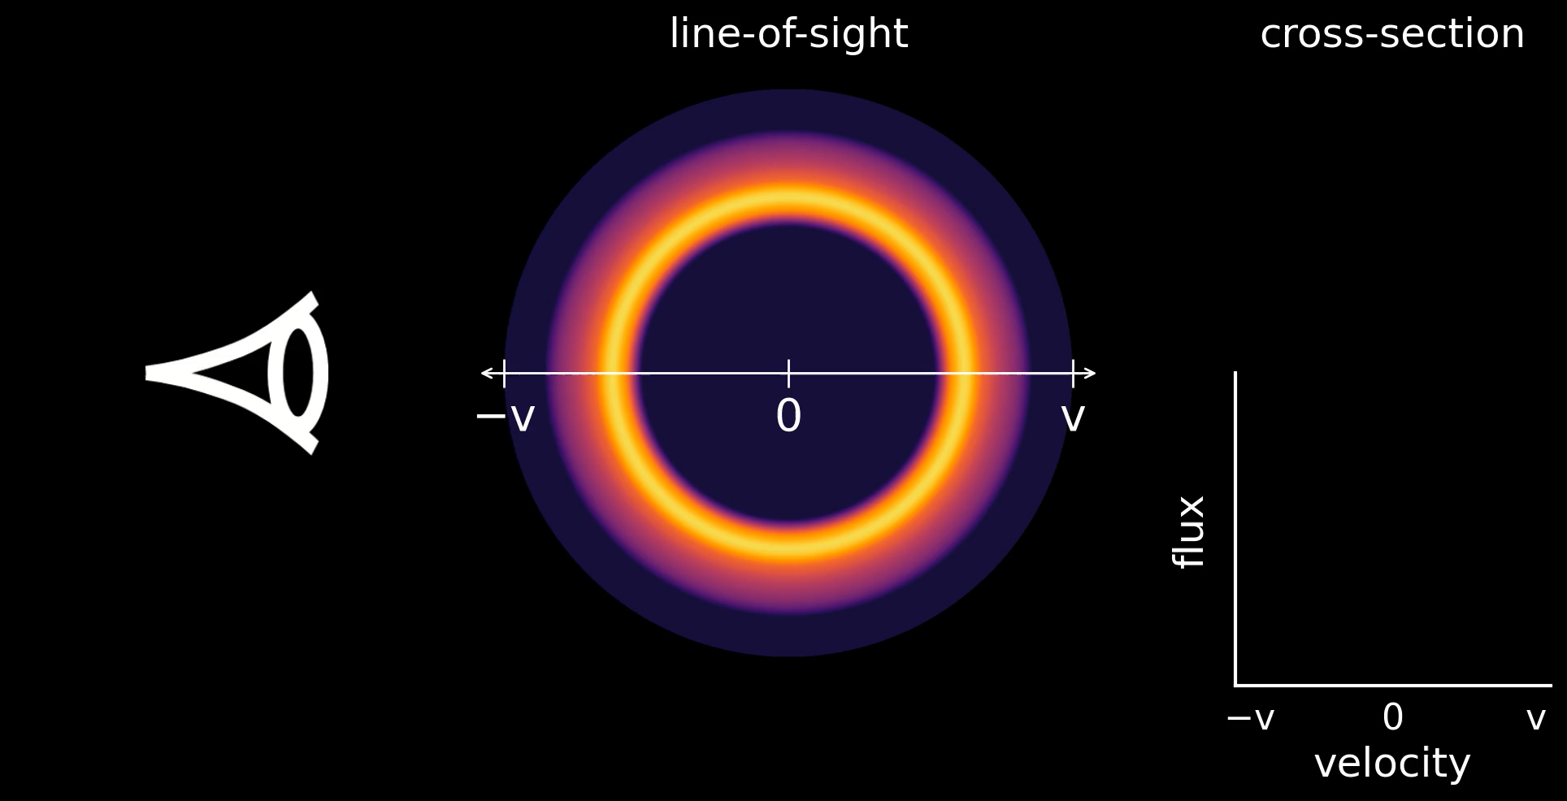
SN 2024gy: non-uniform thick shell
Kwok et al, in prep
Ar traces IMEs
→ lower densities
5 µm
25 µm
SN 2024gy

Slide 8
Line ID Rules of Engagement
Split into multiple slides
Show plots with examples
Let the physics inform your assumptions:
  Which ionization levels make sense? (e.g., [Ni X] NOT expected in SN Ia)
  Which elements are probable/possible? (e.g., no r-process in SN Ia)
Transitions from the same ion (e.g. [Ni II]) should share similar shape and velocities (FWHM and offset)
Forbidden transitions down to the ground state should be stronger than transitions between upper levels
In the nebular phase, stronger transitions are generally between lower levels, closer to the ground state.
Check whether there are lines from your ion at other wavelengths that are expected to be strong
If you have a line that *might* be something exciting, check whether it could be explained instead by a more mundane line
If model line lists (with expected strengths of lines) are available, check against them
Check line IDs from the literature
If there are multiple bumps/peaks to a feature, check carefully for possible line blending
Higher A_ki generally means line is expected to be stronger, but be careful to only compare within a small wavelength range

Slide 9
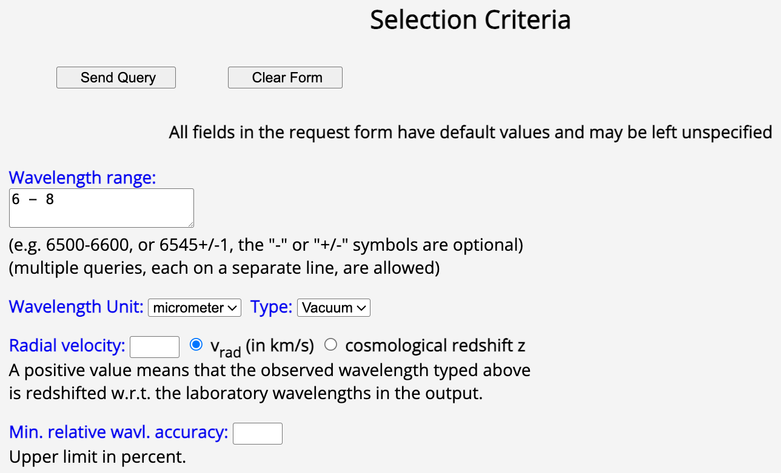
Atomic Line List demo
Atomic Line List (https://linelist.pa.uky.edu/newpage/)
specify a wavelength range
don’t forget your units!

Slide 10
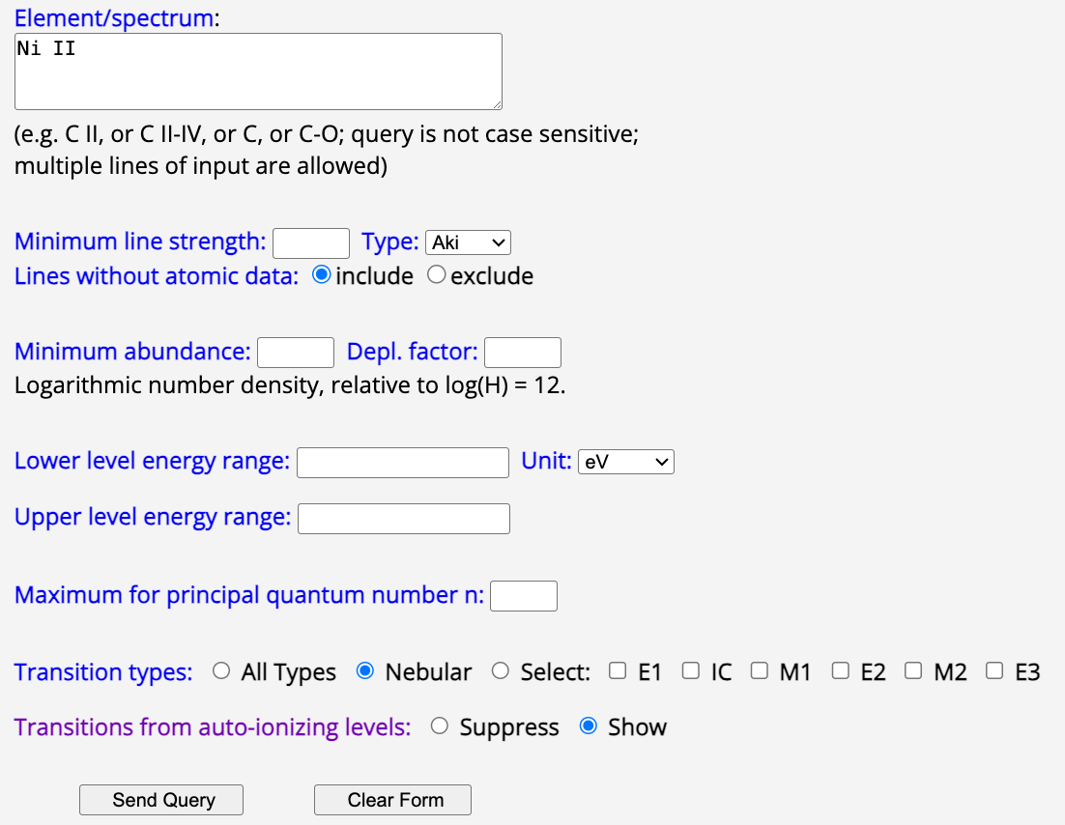
Atomic Line List demo
Atomic Line List (https://linelist.pa.uky.edu/newpage/)
specify your ion(s) of interest
change unit to eV
(much easier to tell whether the transition is between low-lying levels)
select nebular if you want forbidden transitions
(otherwise you will get a lot more lines to sort through)

Slide 11
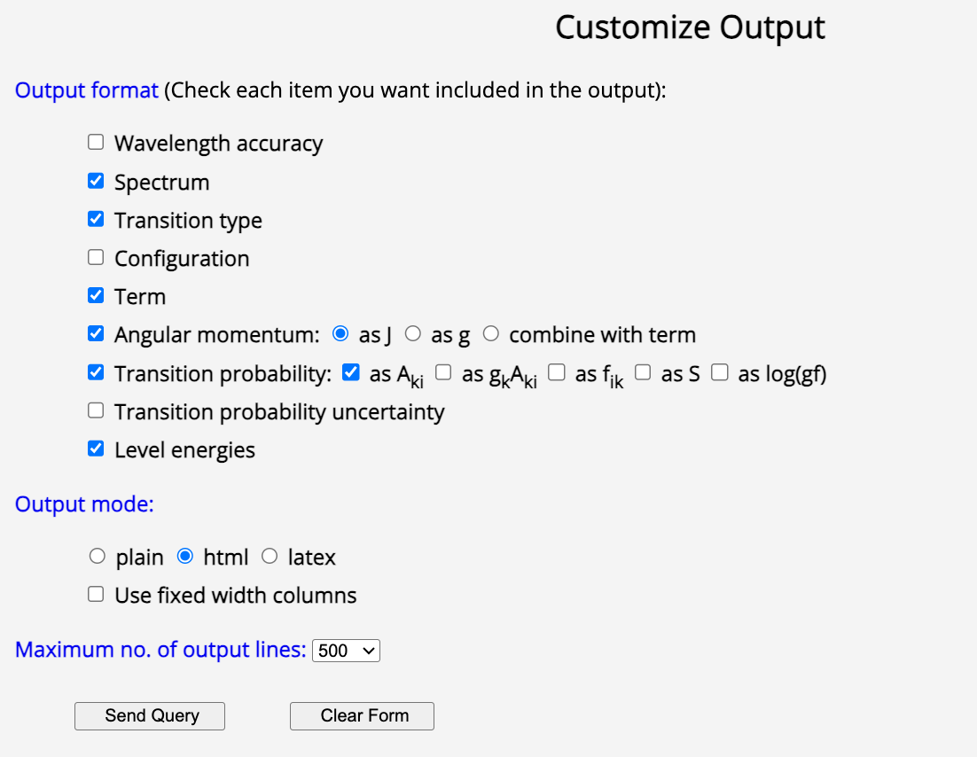
Atomic Line List demo
Atomic Line List (https://linelist.pa.uky.edu/newpage/)
select transition probability
(I find this useful for gauging relative expected strength of lines reasonably close in wavelength)

Slide 12
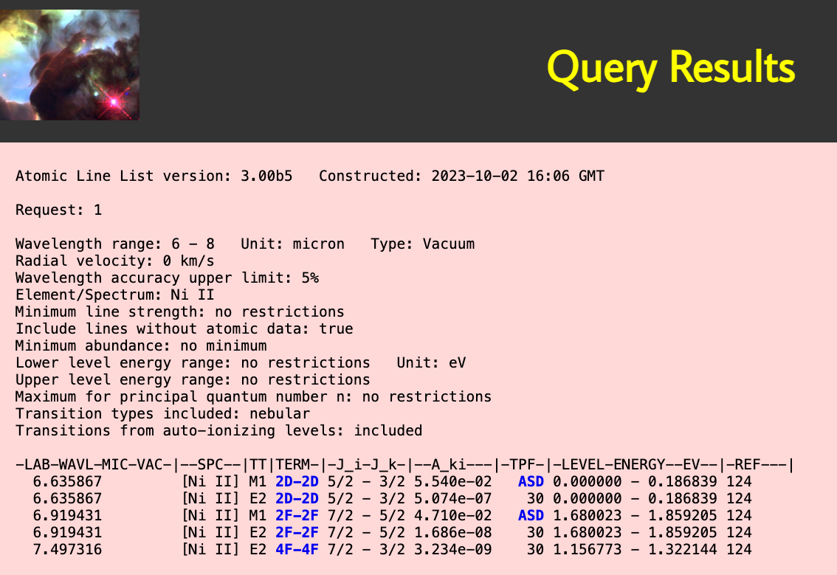
Atomic Line List demo
Atomic Line List (https://linelist.pa.uky.edu/newpage/)
ground-state transition
Relatively high A_ki value, transition to the ground state from a low-lying energy level
→ Likely a strong line
Relatively high A_ki value, transition between low-ish energy levels
→ Possibly a contributing line
Very small A_ki value, transition between low-ish energy levels
→ Likely irrelevant

Slide 13
Complications
Line blending
  Optical and NIR can be much harder than MIR, depending on source
Dust and molecules
  Optical lines can be attenuated if dust is forming in the ejecta
  Molecular emission can arise in the NIR and MIR
    CO at 2.3 + 4.6 microns
    PAH lines at 3.3, 6.X, 7.5, 11.3 microns
    Generally broader and smoother
Asymmetries/anisotropies
3D effects we can’t fully reconstruct
Be aware of degeneracies

Slide 14
Takeaways

