Slide 1

Dasking in the Sun
Applying Parallel Operations to your Pandas Transformations

Slide 2
What do you do when your data become too large? Is it CPU-bound? Or memory-bound?

Slide 3

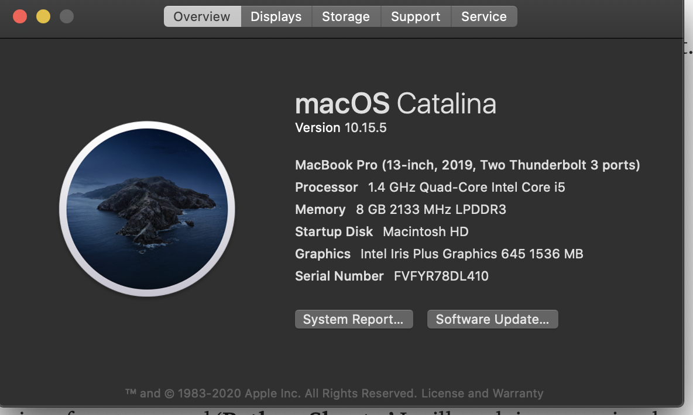
RAM: Your computer’s short-term data storage. Can be accessed quickly.
Cores: Modern CPUs offer cores and hyper-threading. A dual-core has 2 CPUs, quad-core has 4 CPUs, octo-core has 8, and so on.
Processes tend to be memory-bound or CPU-bound, meaning that either the data are very large and you might run out of memory, or the number of computations is so great that you might run out of CPU.

Slide 4
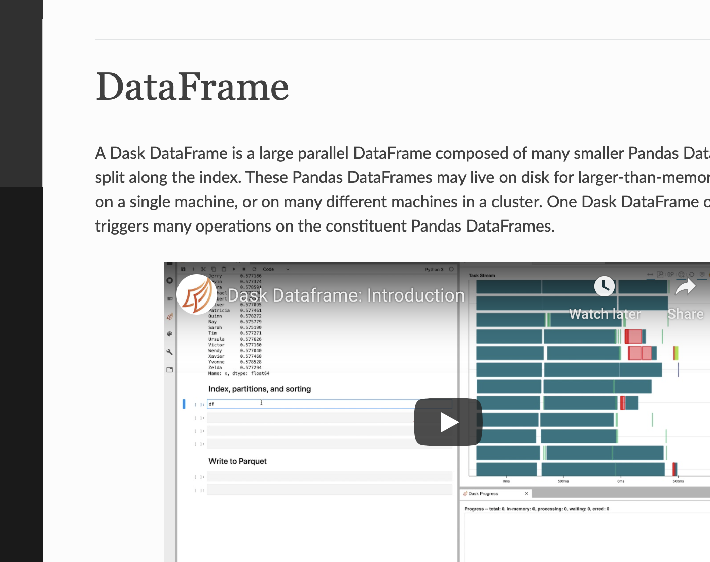
DASK

Slide 5

Multiprocess: https://docs.python.org/3/library/multiprocessing.html
Modin: https://modin.readthedocs.io/en/latest/
Swifter: https://pypi.org/project/swifter/
Ray: https://pypi.org/project/ray/
Pandarallel: https://pypi.org/project/pandarallel/
Dask: https://dask.org/

Slide 6

vectorization
.iterrows()
.apply()
.itertuples
https://medium.com/swlh/why-pandas-itertuples-is-faster-than-iterrows-and-how-to-make-it-even-faster-bc50c0edd30d

