Slide 1
Predicting Ames Housing Sale Prices
By: Lindsey Roeder
Notes:
Hi my name is lindsey roeder and I’m a data scientist.
My presentation today will be about predicting sale prices on homes in Ames, Iowa by using historical data provided to me.

Slide 2
Problem:
How can we predict the sale price of homes?
Model Construction Timeline
Feature selection
Fitting a model
Evaluating the model
Notes:
Our main question to answer is - how can we predict the sale price of homes?
I’ve created a model with the data provided and i’ll be walking you through the steps and results
First i’ll talk about how i selected the features, as I was given over 70 possible options
Then I will explain how I fit and evaluated the model i chose to use.

Slide 3
Feature Selection Process

Slide 4
Quantitative Data Cleaning
Excellent
Good
Typical
Fair
Poor
No Basement
5
4
3
2
1
0
Notes:
For my feature selection, I’ll start with the quantitative data:
I based my search on most features in the data set. Any columns that had 1000 or more null values were not considered.
I converted any ordinal results into number ranges in order to be included.
For example, Basement Quality was rated on a scale from poor to excellent , so I converted to 0 through 5.
After converting features I ran tests to see which columns were most correlated and which had the highest significance in a linear model

Slide 5
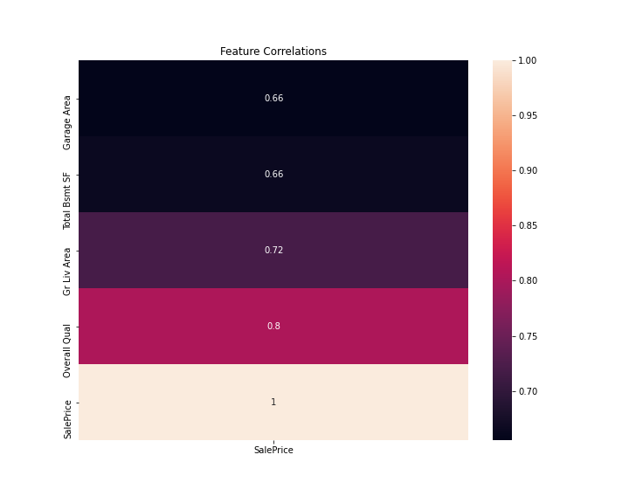
Quantitative Features Correlation
4 numeric features
Overall Quality
Living Area
Total Basement Sq Ft
Garage Area
Notes:
The winners are the ones shown here
In my original selection I had one more called 1st Floor Square Footage that was highly correlated and significant.
Upon comparing each of the chosen features I found that 1st floor sq ft was too similar to basement sq ft and decided to keep only one.

Slide 6
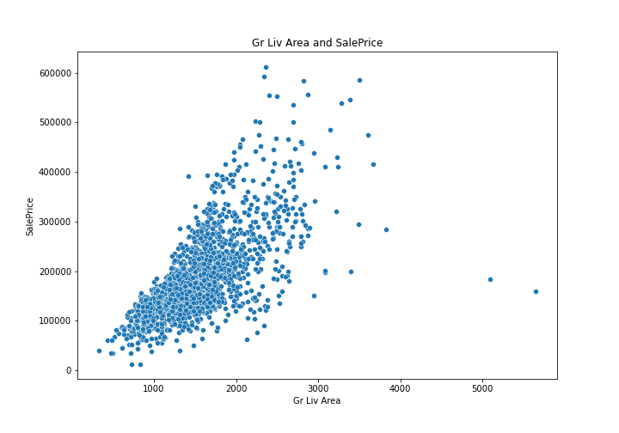
Living Area Square Footage
In general, sq ft and sale price has a correlated relationship
If the sq ft is over 4,000 the sale price becomes unpredictable
Notes:
In the dataset there are 5 observations with over 4000 square feet
Three of them are true outliers, likely to be Partial Sales that don’t represent actual market values
two of them are simply unusual sales (very large houses priced relatively appropriately).
In the data I used to train my model, 2 of them appeared
I tested keeping them in vs removing and found it performed better with the data points taken out.

Slide 7
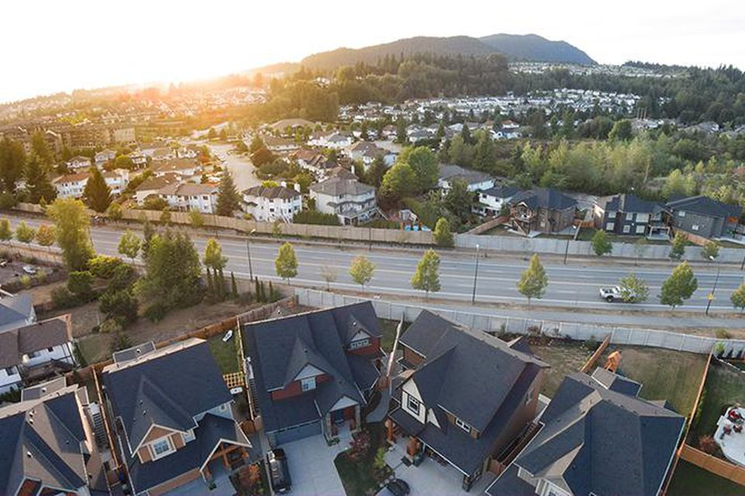
Selection of Categorical Data
Top 3 Qualitative Factors:
Location
Time Period/Style
Renovations
https://www.forbes.com/sites/trulia/2016/02/19/whats-my-home-worth-9-factors-that-affect-resale-value-2/?sh=552de5343be2
Notes:
According to a Forbes article written by Trulia, the top 3 factors contributed to home price are the following:
Location - Where the property is located is a large factor in determining housing prices.
Time Period/House Style - There is a sweet spot for determining if a house is too old or not old enough. Newer houses are obviously sought after, but older houses can have desired characteristics that give it historic charm.
Renovations - If home renovations are outdated or too suited to a specific taste, they will not attribute to a high sale price.
Assuming renovations should be covered in overall home quality, I can choose two other features from our dataset: Neighborhood and MS Subclass

Slide 8
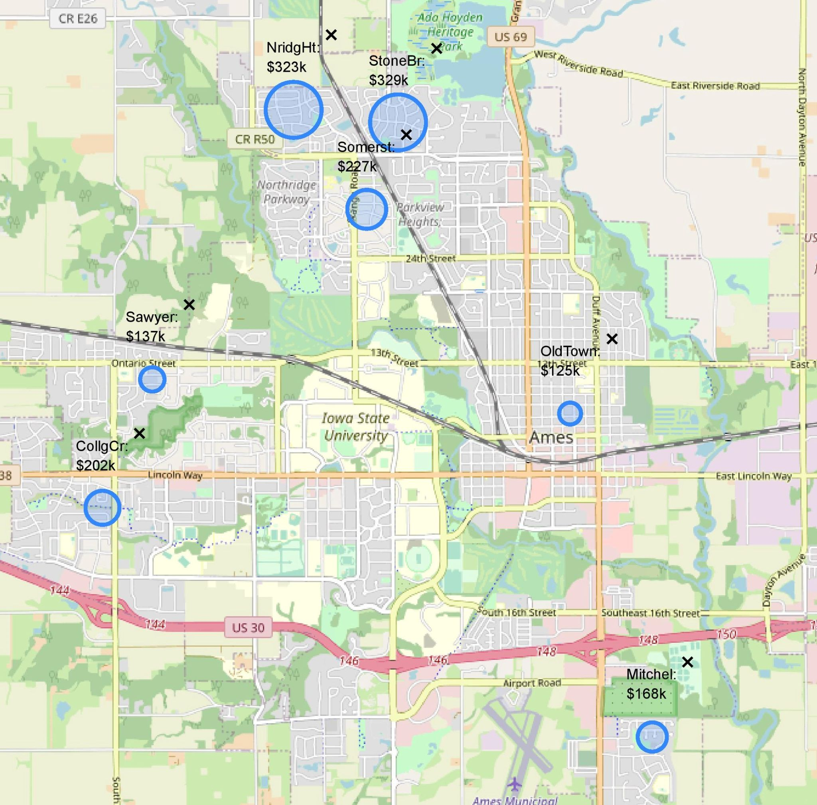
Average Sale Price by Neighborhood
Notes:
I chose a handful of neighborhoods to show the range in sale price across them.
The size of the circles indicate how large the average sale was for each area.
Ranging from $100k in one neighborhood to $330k in another

Slide 9
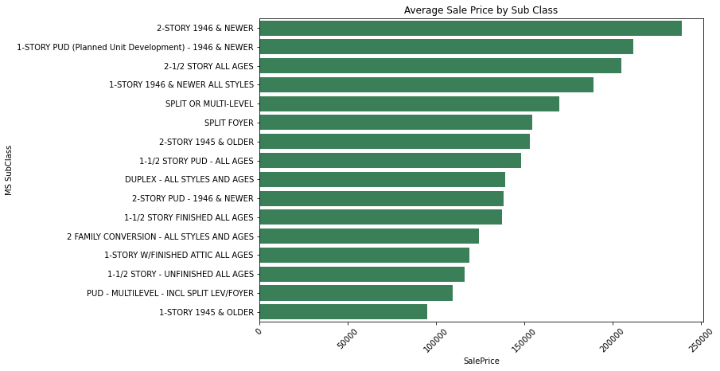
Average Sale Price by Home Type
Notes:
MS SubClass is one that i found to have interesting data
Identifies the type of dwelling that was sold. This categorizes the home by age, number of floors, and style.
Ranging from $95k on average for 1-STORY that was built in 1945 or earlier
To $239k on average for a 2-STORY built in 1946 or newer
So clearly newer homes with more stories are worth more money

Slide 10
Fitting the Model

Slide 11
Model Construction Process
Cleaning Data
Scaling
Elastic Net
Adjustments:
Transform categorical data into quantifiable data
Standardize features based on:
Individual averages
Distribution of data points from average
Prevents overfitting by:
Adjusting for highly correlated variables
Eliminating unnecessary features
Notes:
Since i want to add categorical data, I need to convert these to numerical columns in order to work within a model. This is done first.
Scaling is necessary when features are measured in multiple different ranges. They are transformed in this step by using the average value of each feature individually and standardizing the scale of variances.
The estimator I chose is called Elastic Net. This is linear based, but operates in a way that allows to adjust for overfitting. It will correct any errors due to highly correlated variables or features that are not being used significantly in my dataframe.
Elastic Net combines feature elimination from Lasso and feature coefficient reduction from the Ridge model to improve your model's predictions.
Lasso will eliminate many features, and reduce overfitting in your linear model.
Ridge will reduce the impact of features that are not important in predicting your y values.
The difference between ridge and lasso regression is that it tends to make coefficients to absolute zero as compared to Ridge which never sets the value of coefficient to absolute zero
The Ridge is best suited to deal with multicollinearity.
Lasso also deals with multicollinearity between variables, but in a more brutal way (it "zeroes out" the less effective variable).
The Lasso is particularly useful when you have redundant or unimportant variables. If you have 1000 variables in a dataset the Lasso can perform "feature selection" automatically for you by forcing coefficients to be zero.
Elastic Net combines both.

Slide 12
Evaluating the Model

Slide 13
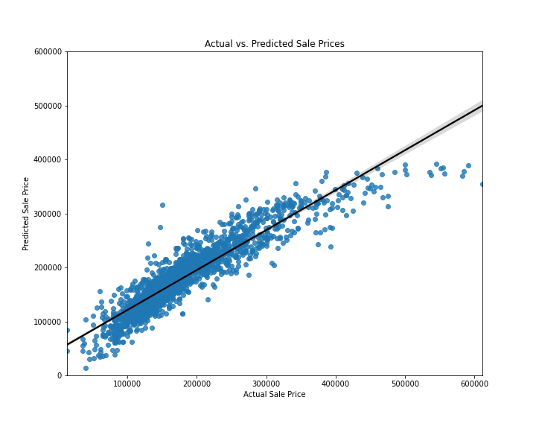
Evaluating the Model
On average, the model explains 84% of the variance in Sale Price
Model performs better with prices under $300k
Improve by adding variables
Notes:
On average the model explains 84% of the variance in Sale Price
I found that Greater Living Area and Overall Quality had the highest impacts on increasing the price
EXPLAIN GRAPH
My model does better with homes that are sold at under $300k, which only accounts for about 8% of the original dataframe.
In order to improve this percentage we could add more variables or create features that are based on the relationship of existing variables
This could result in overcomplicating or overfitting the data.

Slide 14
Conclusion
Feature selection
Model & Estimator
Adjust Categorical Data
Scale Features
Elastic Net
Evaluation & Improvements
Notes:
In conclusion, a large part of the process is simply selecting the features that will perform best
Next is choosing how to fit the model and which estimator to use, landing with Elastic Net
Finally, some improvements could be made by adding more columns or further transforming the data to better estimate the Sale Price, but we may sacrifice the simplicity of this model, which is important for future use
Thank you for your time and I’m happy to take any questions

