Slide 1
Pokemon Android Application
Two Player Battle Game
By: C(++)’s Get Degrees
Lindsey Volk, Shaurya Atal, Kevin Arseneault, Katie Lewis, Cooper Salmon, Ashley Hamlin

Slide 2

Introduction
Choose your starter Pokemon!
Fill your roster with Pokemon you catch in the wild!
Battle your buddies with three actions to choose from!
Will you be the very best?!

Slide 3
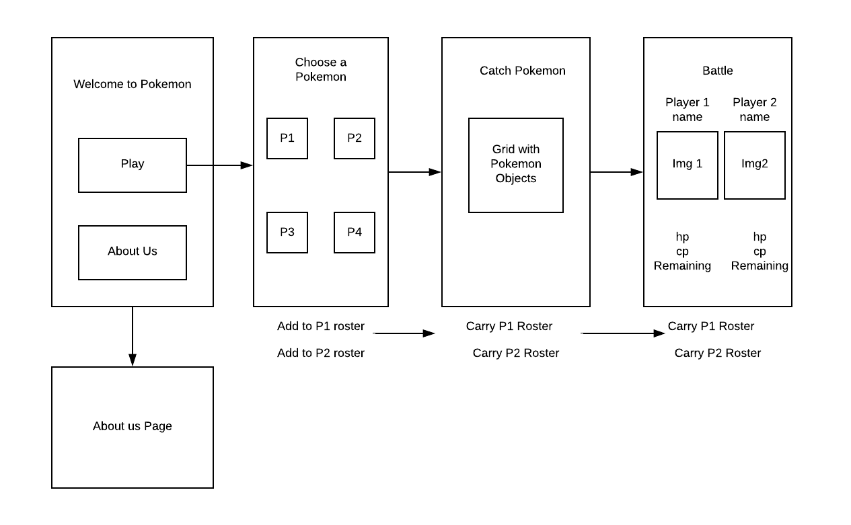
Game Walkthrough

Slide 4
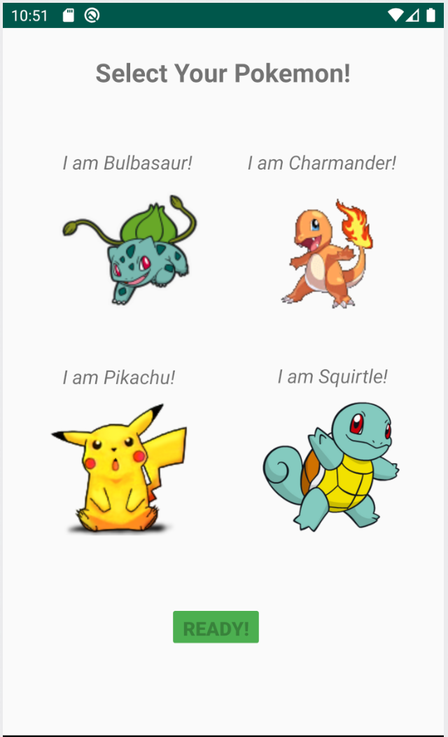
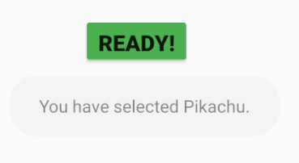
Pokemon Selection Interface
The button interface will be changed to include two more
Player 1 Ready
Player 2 Ready
Catch!
Buttons will be disabled after player selection to prevent repeat choices
PLAYER 1
Click Ready to being catching
PLAYER 2
Your selection is displayed
Select Pikachu
Ready becomes available

Slide 5
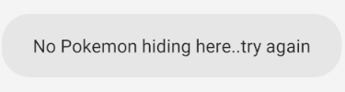
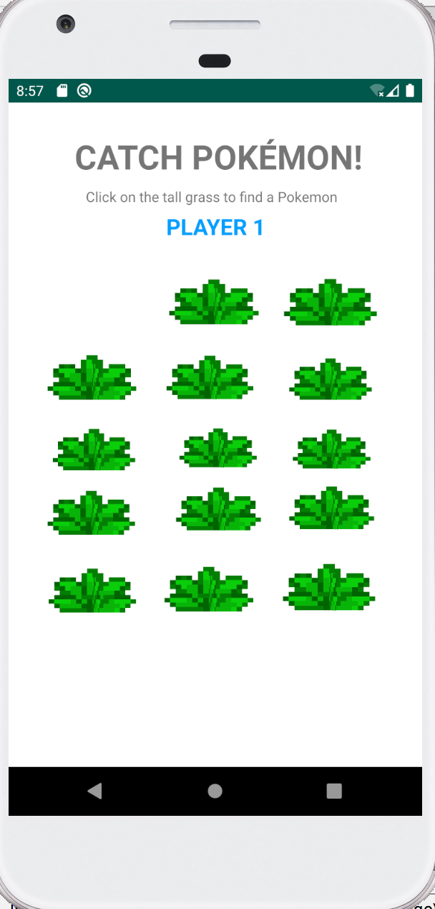
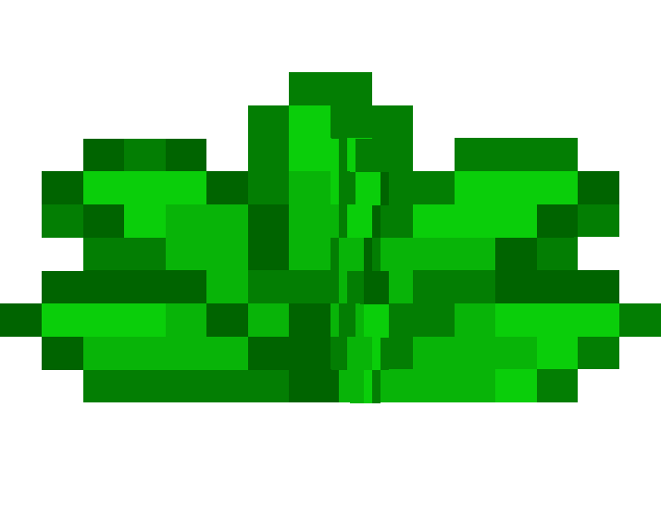
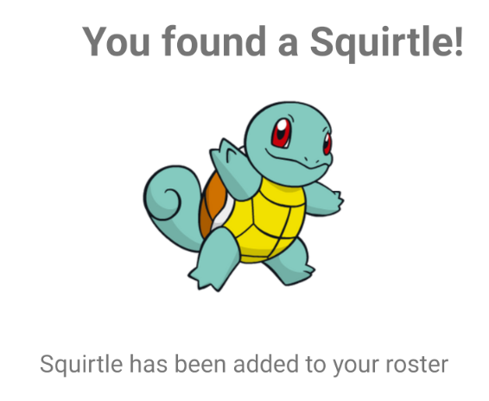
Catching Pokemon
If there is no Pokemon present, this message appears
PLAYER 1
PLAYER 2
This goes back and forth between Players until both rosters are full
Click on the tall grass to search for hiding Pokemon
If there is a Pokemon, this pop-up appears. The Pokemon’s data is added to the roster

Slide 6
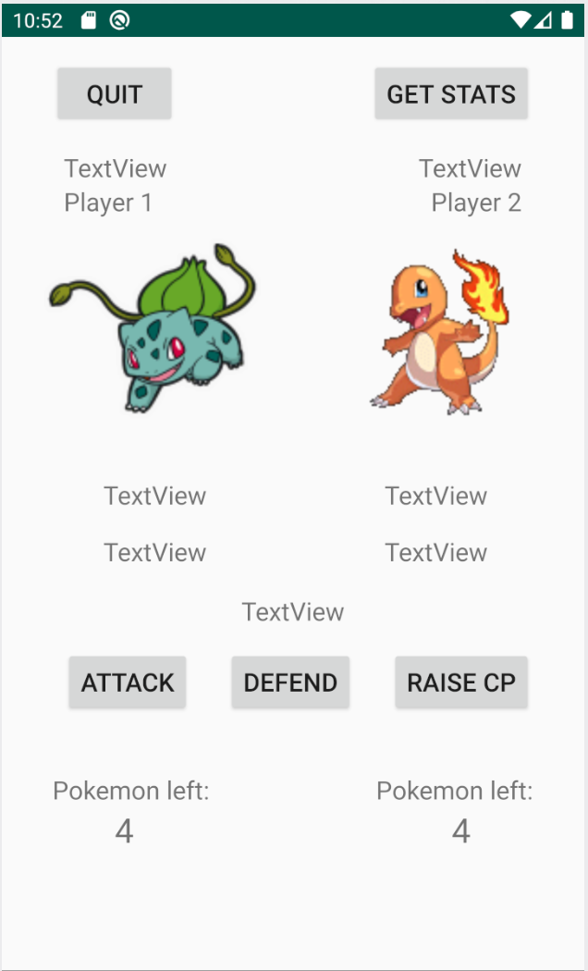
Battle Interface
After each turn:
Pokemon name, image, HP, CP, Player turn, and Pokemon left are updated from alive Pokemon roster
Pokemon Name
Attack: Damages the opponent
damage = (100.0 - this.defense)/100 * damage
Current Pokemon
Health Points
Combat Points
Defend: Decreases the amount of damage your pokemon takes
Player Turn
Raise CP: Increases the amount of damage your pokemon inflicts

Slide 7
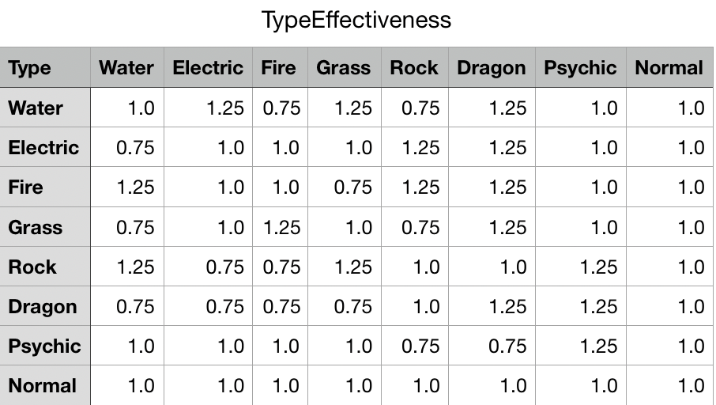
All of our pokemon have attributes according to the following table:
The Pokemon types are received from a CSV file in order to determine the most effective attacks. The displayed values are the effectiveness of attacks.

Slide 8

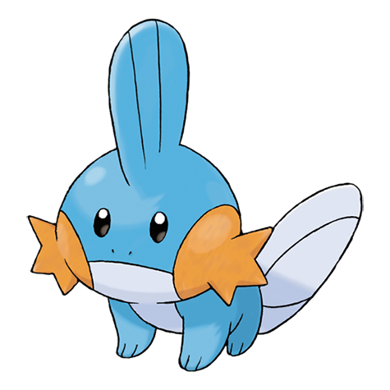
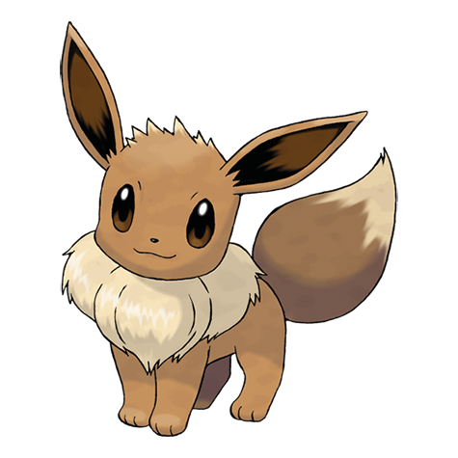
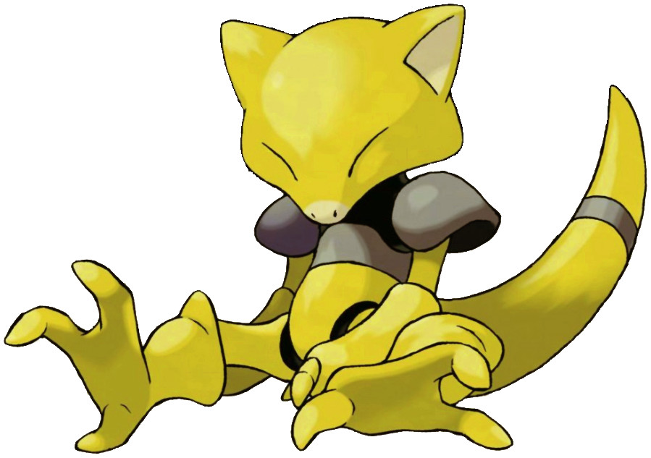

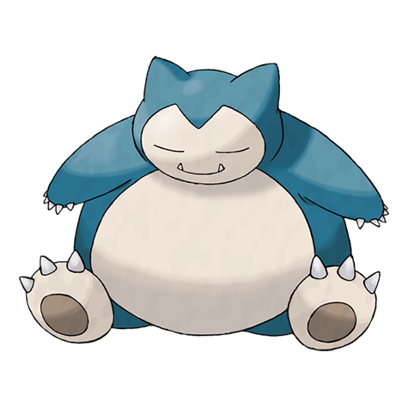


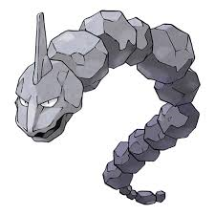

Current Pokemon

Slide 9
Enjoy!

