Slide 1
BUSINESS ANALYTICS CASE STUDY
Understanding & Reducing
Customer Churn
A data-driven look at why telecom customers leave — and what to do about it
Telco Customer Churn Dataset
AnalystLab Africa Data Analytics Internship — Week 5
Prepared by: Lindsly Muyonda

Slide 2
THE BUSINESS PROBLEM
Why are customers leaving —
and who is most at risk?
1
2
3
Retention beats acquisition
Churn isn't random
The ask
Keeping an existing customer is far cheaper than winning a new one, so even small drops in churn move the bottom line significantly.
It clusters around specific contract types, service tiers and payment habits which means it's predictable and preventable.
Identify the strongest drivers of churn and turn them into a prioritized, actionable retention plan for the business.
AnalystLab Africa · Week 5 Case Study · Lindsly Muyonda
2

Slide 3
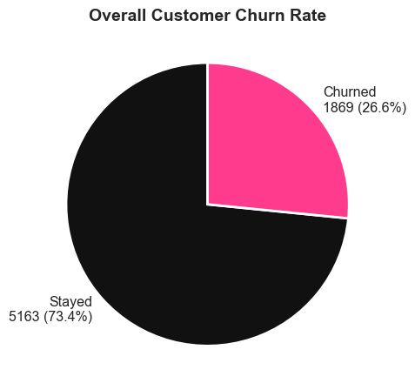
DATASET OVERVIEW
7,043 customers, 21 attributes
7,043
Total customers
21
Attributes per customer
26.5%
Overall churn rate
11
Rows with missing charges (removed)
AnalystLab Africa · Week 5 Case Study · Lindsly Muyonda
3

Slide 4
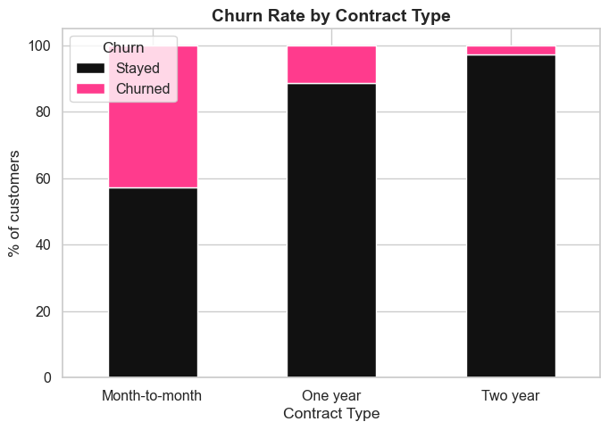
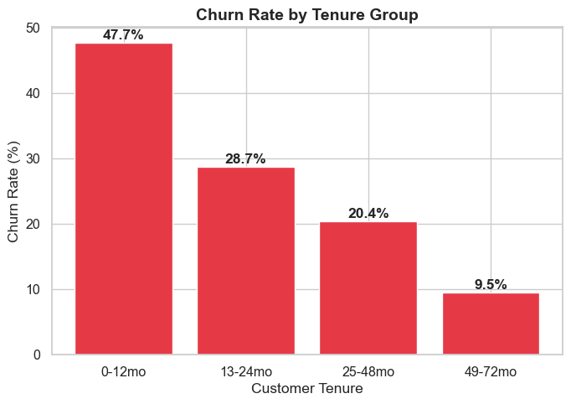
KEY DRIVER NO. 1
Contract type is the single strongest predictor of churn
Month-to-month customers churn far more than one- or two-year contract holders. Risk is also concentrated early: churn is highest in a customer's first 12 months, and drops sharply as tenure increases.
AnalystLab Africa · Week 5 Case Study · Lindsly Muyonda
4

Slide 5
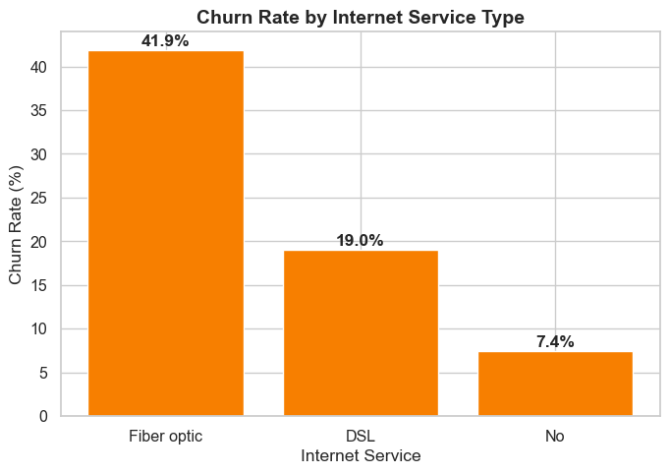
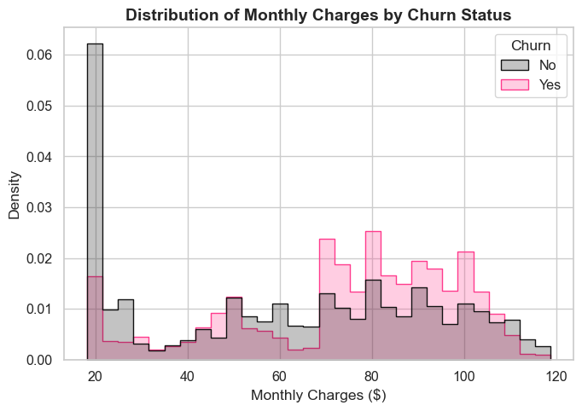
KEY DRIVER NO. 2
Fiber optic customers churn most —
and pay the most
Fiber optic customers churn at more than double the DSL rate. The monthly charges distribution shows churned customers cluster at higher price points than retained customers — a pricing/value gap worth investigating.
AnalystLab Africa · Week 5 Case Study · Lindsly Muyonda
5

Slide 6
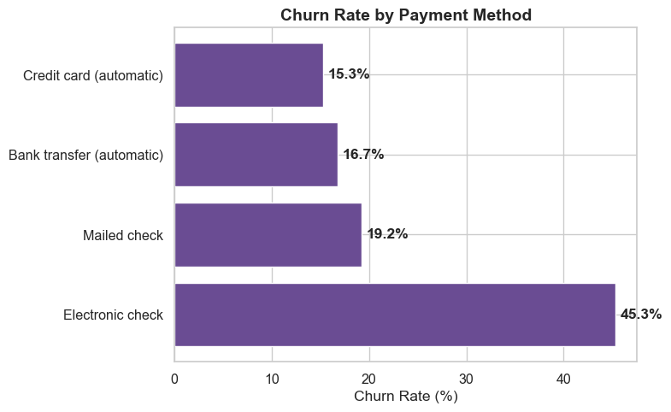
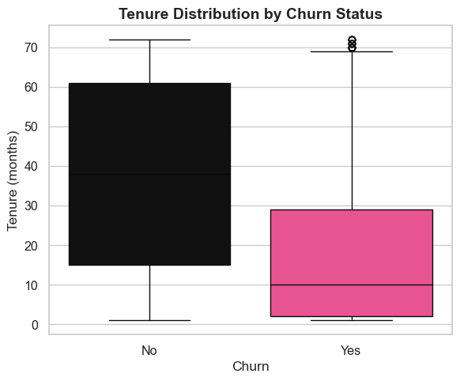
KEY DRIVER NO. 3
Manual payments and short tenure
both signal high churn risk
Electronic check payers churn at nearly 3x the rate of customers on automatic payment methods. Churned customers also show a much shorter tenure distribution than retained customers.
AnalystLab Africa · Week 5 Case Study · Lindsly Muyonda
6

Slide 7
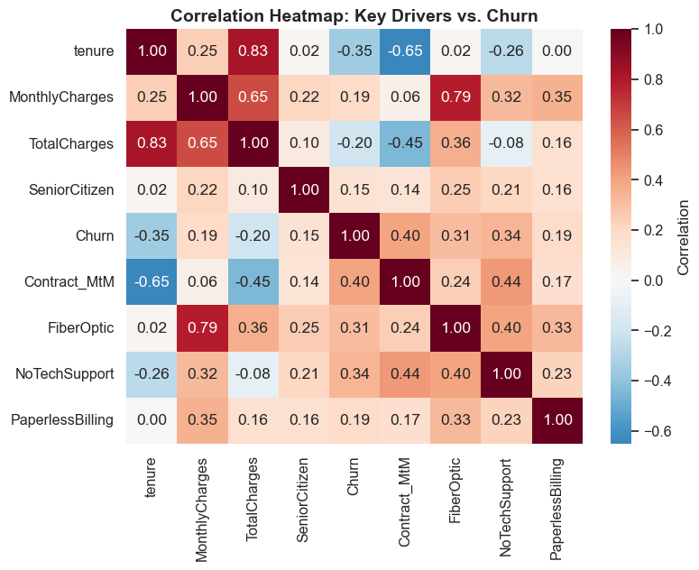
CONFIRMING THE PATTERN
The correlation heatmap confirms the same drivers dominate
AnalystLab Africa · Week 5 Case Study · Lindsly Muyonda
7

Slide 8
PRIORITY SEGMENT
Stack the risk factors and
churn more than doubles
Month-to-month contract + Fiber optic internet + Electronic check payment
1,307
customers fit this profile
60.4%
2.3x
the company average churn rate
churn rate
in this segment
$1.67M
estimated annualized revenue at risk, company-wide
AnalystLab Africa · Week 5 Case Study · Lindsly Muyonda
8

Slide 9
BUSINESS INSIGHTS
What the data tells us
1
Churn is a first-year problem — nearly half of churn happens within a customer's first 12 months.
2
Premium service isn't translating to loyalty — fiber optic customers pay the most, yet churn the most.
3
Payment friction signals disengagement — manual electronic-check payers churn far more than autopay customers.
4
Add-on services act as retention tools — Tech Support and Online Security correlate strongly with staying.
5
Risk compounds when factors overlap — the highest-risk segment churns at more than double the company average.
AnalystLab Africa · Week 5 Case Study · Lindsly Muyonda
9

Slide 10
RECOMMENDATIONS
Six actions to reduce churn
1
2
3
Incentivize contract upgrades
Launch a first-year retention program
Investigate the fiber optic experience
Offer month-to-month customers a discount to move to 1- or 2-year plans.
Proactive check-ins and milestone offers at month 6 and 12.
Review reliability, pricing and service quality for this segment.
4
5
6
Migrate electronic check users
Bundle protective add-ons
Build a churn risk score
Incentivize switching to automatic bank/card payment.
Promote Tech Support + Online Security as a default package.
Combine key drivers to flag high-risk accounts for outreach.
AnalystLab Africa · Week 5 Case Study · Lindsly Muyonda
10

Slide 11
CONCLUSION
Churn is concentrated,
Measurable and fixable
The highest-risk customers share a clear profile: new, month-to-month, fiber optic subscribers paying by electronic check with no protective add-ons. Because the drivers are concentrated and identifiable, targeted ,not blanket , interventions can meaningfully cut revenue loss.
26.5%
$139K
$1.67M
customers churned
monthly revenue lost
annualized revenue at risk
Thank you
AnalystLab Africa · Week 5 Case Study · Lindsly Muyonda
11

