Slide 1
Superstore Sales Dashboard
Lindsly Tashinga Muyonda
Data Analytics Internship — Week 4 | AnalystLab Africa
$2.30M
$286K
5,009
12.5%
Total Revenue
Total Profit
Total Orders
Profit Margin
Tool: Microsoft Power BI | Dataset: Superstore Sales (Kaggle) | June 2025
Notes:
SPEAKER NOTES — SLIDE 1: TITLE Good [morning/afternoon], everyone. My name is [Your Name], and I am a Batch B intern at AnalystLab Africa. This presentation showcases my Week 4 project — a complete interactive Sales Dashboard built using Microsoft Power BI, based on the Superstore Sales dataset from Kaggle. As you can see on this slide, I have already summarised the 4 most important KPIs from the dashboard: • Total Revenue of $2.30 million • Total Profit of $286 thousand • 5,009 unique orders • A Profit Margin of 12.5% In the next slides, I will walk you through the dataset, the business questions I answered, the dashboard I built, and the key insights and recommendations I discovered. Let's begin.

Slide 2
Dataset Overview
About the Dataset
Key Columns Used
📦 9,994 total order rows
Sales
Revenue earned per order
📅 Data spans 2014 – 2017
Profit
Earnings after costs
🗂️ 21 columns of information
Category
Furniture / Office / Tech
🏪 1 retail company (US-based)
Region
East, West, Central, South
📍 Source: Kaggle (Superstore)
Order Date
Date of each purchase
🛠️ Tool: Microsoft Power BI
Segment
Consumer / Corporate / Home Office
AnalystLab Africa | Week 4 | Power BI Dashboard
Notes:
SPEAKER NOTES — SLIDE 2: DATASET OVERVIEW The dataset I used is the Superstore Sales dataset, downloaded for free from Kaggle. It contains 9,994 rows of order data from a fictional US-based retail store, covering 4 years from 2014 to 2017. There are 21 columns in total. The most important columns I used in my analysis were: • Sales — the revenue earned from each order • Profit — how much money was actually made after costs • Category and Sub-Category — to understand which products perform best • Region and State — for geographic analysis • Order Date — to track trends over time • Customer Segment — Consumer, Corporate, or Home Office I loaded this data into Power BI Desktop, cleaned the column data types in Power Query Editor, and created 5 custom DAX measures to calculate KPIs. The dataset gave me everything I needed to answer real business questions about sales performance.

Slide 3
Business Problem
What business questions did I set out to answer?
01
Which region generates the most profit and which region underperforms?
02
Which product categories and sub-categories drive the most revenue?
03
Are there any products that are losing money despite high sales volume?
04
What are the seasonal sales and profit trends over the 4-year period?
05
Which customer segment (Consumer, Corporate, Home Office) is most valuable?
06
What recommendations can management take to improve overall profitability?
AnalystLab Africa | Week 4 | Power BI Dashboard
Notes:
SPEAKER NOTES — SLIDE 3: BUSINESS PROBLEM Before building the dashboard, I defined clear business questions that the data needed to answer. This is an important step because dashboards should answer specific questions, not just display random charts. The 6 key questions I focused on were: 1. Which region is most profitable? — Understanding geographic performance helps management allocate resources. 2. Which product categories drive the most revenue? — Technology, Furniture, and Office Supplies each contribute differently. 3. Are there products losing money? — Some items may have high sales but negative profit due to discounting. 4. What are the sales trends over time? — Identifying seasonal patterns helps plan promotions and inventory. 5. Which customer segment is most valuable? — Consumer, Corporate, and Home Office customers behave differently. 6. What recommendations can be made? — The final goal is actionable insights, not just charts. My dashboard was built specifically to answer all 6 of these questions.

Slide 4
KPIs Defined
Key Performance Indicators measured using DAX formulas in Power BI
Total Revenue
Total Profit
Total Orders
$2,297,201
$286,397
5,009
Total money earned from all 9,994 orders combined
Total earnings after deducting all product costs
Unique customer orders placed between 2014 and 2017
Profit Margin
Total Quantity
12.47%
37,873
Percentage of revenue that becomes actual profit
Total number of individual product units sold across all orders
AnalystLab Africa | Week 4 | Power BI Dashboard
Notes:
SPEAKER NOTES — SLIDE 4: KPIs DEFINED KPIs, or Key Performance Indicators, are the most important numbers a business tracks. In Power BI, I created these using DAX formulas — which are custom calculations written in the formula bar. Here are the 5 KPIs I built and what they tell us: 1. Total Revenue = $2,297,201 This is the total sales amount across all orders. I calculated it using SUM of the Sales column. 2. Total Profit = $286,397 This is the actual money earned after costs. I used SUM of the Profit column. 3. Total Orders = 5,009 This counts unique orders using DISTINCTCOUNT on Order ID — this avoids counting the same order twice. 4. Profit Margin = 12.47% This shows what percentage of revenue becomes profit. I used the DIVIDE function: Total Profit divided by Total Revenue. 5. Total Quantity = 37,873 Total units sold across all orders, calculated using SUM of the Quantity column. All 5 of these measures appear as KPI cards at the top of my dashboard pages in Power BI.

Slide 5
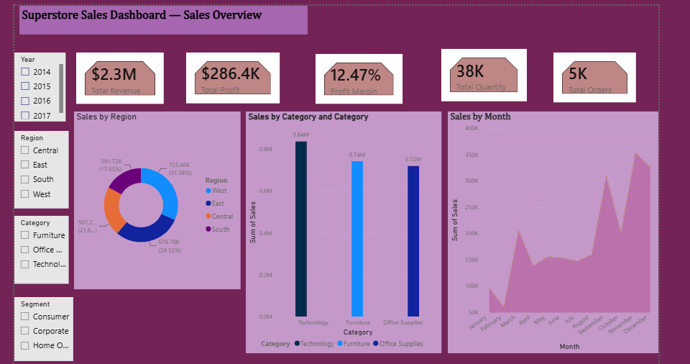
Dashboard — Page 1: Sales Overview
📌 PASTE YOUR POWER BI SCREENSHOT HERE
Page 1: Sales Overview
(4 KPI Cards + Bar Chart + Line Chart + Donut Chart + Slicers)
4 KPI Cards
Bar Chart
Line Chart
Donut Chart
3 Slicers
Notes:
SPEAKER NOTES — SLIDE 5: DASHBOARD PAGE 1 (SALES OVERVIEW) IMPORTANT: Before presenting, replace the placeholder box on this slide with a screenshot of your actual Power BI dashboard Page 1. To take a screenshot: Press Windows + Shift + S, select the dashboard, paste into Paint, save as PNG, then insert into this slide. --- WHAT TO SAY WHEN PRESENTING --- This is the first page of my Power BI dashboard — the Sales Overview page. At the top, you can see 4 KPI cards showing the most important business metrics at a glance: Total Revenue, Total Profit, Total Orders, and Profit Margin. Below the KPI cards, I have 3 main charts: • A bar chart showing Sales by Product Category — Technology leads with the highest revenue • A line chart showing Monthly Sales Trends — you can see sales peak in November and December • A donut chart showing Sales by Region — the West region has the largest share On the side, I have 3 interactive slicers: Year, Region, and Category. When a user clicks any of these, all charts on the page update automatically — this is what makes the dashboard interactive. For example, if I click '2017' on the year slicer, all charts filter to show only 2017 data.

Slide 6
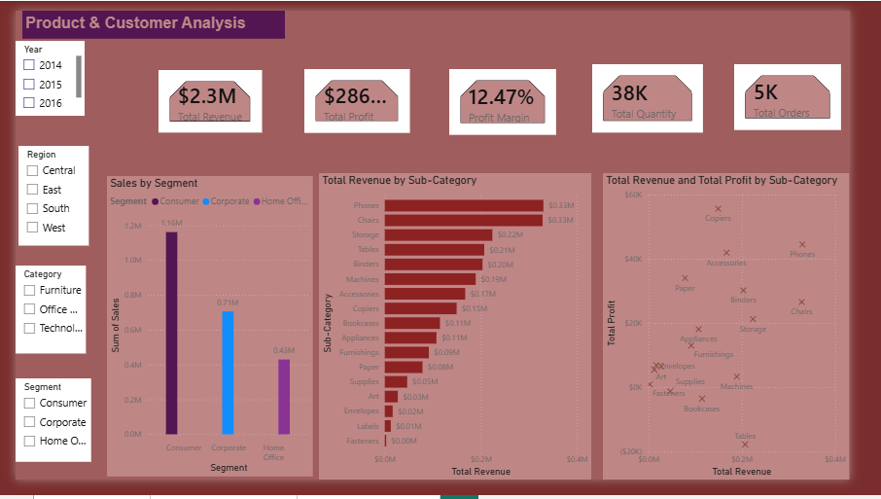
Dashboard — Pages 2 & 3
📌 PASTE PAGE 2 SCREENSHOT HERE
Product & Customer Analysis
(Bar + Scatter + Segment + Table)
📌 PASTE PAGE 3 SCREENSHOT HERE
Geographic & Profit Analysis
(Map + Region Profit + Sub-Cat + Trend)
Page 2: Product & Customer Analysis
Page 3: Geographic & Profit Analysis
All 3 pages are interactive — slicers filter every chart in real time
AnalystLab Africa | Week 4 | Power BI Dashboard
Notes:
SPEAKER NOTES — SLIDE 6: DASHBOARD PAGES 2 & 3 IMPORTANT: Replace the two placeholder boxes with screenshots of your actual Pages 2 and 3 from Power BI. --- WHAT TO SAY WHEN PRESENTING --- PAGE 2 — Product & Customer Analysis: This page focuses on understanding which products and customers drive the business. • The top bar chart shows the Top 10 Sub-Categories by revenue • The scatter plot compares Sales vs Profit for each sub-category — allowing us to spot products with high sales but low profit • The segment bar chart shows Consumer customers generate the most revenue • The table at the bottom lists the Top 10 customers by revenue PAGE 3 — Geographic & Profit Analysis: This page focuses on WHERE profit comes from and which products make or lose money. • The filled map of the USA shows which states generate the most sales — California and New York stand out • The region bar chart confirms the West region leads in profit • The sub-category profit chart reveals that Tables and Bookcases have NEGATIVE profit • The monthly profit trend line shows profit growing steadily over the years All 3 pages share the same slicers, so filtering by year or region updates everything simultaneously.

Slide 7
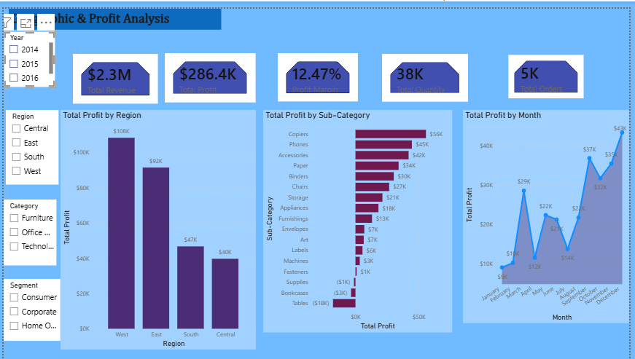
Dashboard — Pages 2 & 3
📌 PASTE PAGE 2 SCREENSHOT HERE
Product & Customer Analysis
(Bar + Scatter + Segment + Table)
📌 PASTE PAGE 3 SCREENSHOT HERE
Geographic & Profit Analysis
(Map + Region Profit + Sub-Cat + Trend)
Page 2: Product & Customer Analysis
Page 3: Geographic & Profit Analysis
All 3 pages are interactive — slicers filter every chart in real time
AnalystLab Africa | Week 4 | Power BI Dashboard
Notes:
SPEAKER NOTES — SLIDE 6: DASHBOARD PAGES 2 & 3 IMPORTANT: Replace the two placeholder boxes with screenshots of your actual Pages 2 and 3 from Power BI. --- WHAT TO SAY WHEN PRESENTING --- PAGE 2 — Product & Customer Analysis: This page focuses on understanding which products and customers drive the business. • The top bar chart shows the Top 10 Sub-Categories by revenue • The scatter plot compares Sales vs Profit for each sub-category — allowing us to spot products with high sales but low profit • The segment bar chart shows Consumer customers generate the most revenue • The table at the bottom lists the Top 10 customers by revenue PAGE 3 — Geographic & Profit Analysis: This page focuses on WHERE profit comes from and which products make or lose money. • The filled map of the USA shows which states generate the most sales — California and New York stand out • The region bar chart confirms the West region leads in profit • The sub-category profit chart reveals that Tables and Bookcases have NEGATIVE profit • The monthly profit trend line shows profit growing steadily over the years All 3 pages share the same slicers, so filtering by year or region updates everything simultaneously.

Slide 8
Key Insights
What the data revealed about the Superstore business
🏆
West Region Leads in Profit
💻
Technology is the Top Category
The West region generates the highest profit, making it the most valuable territory for the business. This is because customers in the West purchase more high-value products and fewer heavy discounts are applied there
Technology drives the highest revenue ($836K) with the best profit margins among all 3 product categories. . Products like Phones, Copiers, and Accessories sell at healthy prices without requiring the deep discounts that damage profitability in other categories
📉
Tables Sub-Category Loses Money
📅
Sales Peak in Nov–Dec
Tables have negative profit despite significant sales — excessive discounting is erasing all profitability. The root cause is excessive discounting. Corporate customers place larger individual orders, meaning even a small number of Corporate clients can significantly impact revenue.
The last quarter (Q4) shows the highest sales volume every year, driven by end-of-year and holiday demand. This is driven by end-of-year company budgets being spent and holiday season purchasing across all customer segments.
👥
Consumers Drive Revenue
💸
High Discounts Hurt Profit
The Consumer segment accounts for over 50% of total sales, making it the most important customer group. Corporate customers place larger individual orders, meaning even a small number of Corporate clients can significantly impact revenue.
Sub-categories with discounts above 30% consistently show low or negative profit margins. When discounts exceed 30 to 40 percent, the selling price often drops below what it costs the business to source and deliver the product.
AnalystLab Africa | Week 4 | Power BI Dashboard
Notes:
SPEAKER NOTES — SLIDE 7: KEY INSIGHTS This is the most important slide in the presentation. Here I explain what the data actually MEANS for the business — not just what the charts look like. Walk through each insight: INSIGHT 1 — West Region Leads in Profit: The West region consistently outperforms other regions in profitability. Management should invest more in this region to maximize returns. INSIGHT 2 — Technology is the Top Category: Technology products generate the most revenue ($836K) AND have the healthiest profit margins. This is the most valuable product category for the business. INSIGHT 3 — Tables Sub-Category Loses Money: Despite selling a significant number of tables, the business is actually losing money on them. The main reason is deep discounts being applied — sometimes 40-50% off — which wipes out all profit. INSIGHT 4 — Sales Peak in November and December: Every year, sales spike in Q4. This suggests strong holiday/end-of-year purchasing patterns. The business should stock up inventory and run campaigns before November. INSIGHT 5 — Consumers Drive Revenue: Over 50% of all sales come from Consumer segment customers. Retention strategies for consumers should be a top priority. INSIGHT 6 — High Discounts Hurt Profit: The scatter plot clearly shows that sub-categories with high discounts have the lowest profit margins. A discount policy review is urgently needed.

Slide 9
Recommendations & Conclusion
01
Cap Discounts at 20% Maximum
Immediately reduce discounts on Tables and Bookcases. These sub-categories should never exceed 20% discount to stay profitable.
02
Invest More in Technology Products
Technology has the highest revenue AND best margins. Increasing the product range and stock in this category will boost profit.
03
Double Down on the West Region
The West region leads in profitability. Allocate more sales resources, marketing budget, and inventory to this region.
04
Run Q1 & Q2 Promotions
Sales slow significantly in January–June. Targeted promotions in these months can help smooth out seasonal revenue gaps.
Power BI transformed raw Superstore data into clear, actionable business insights 🚀
Notes:
SPEAKER NOTES — SLIDE 8: RECOMMENDATIONS & CONCLUSION Based on all the insights discovered from the data, here are 4 clear business recommendations: RECOMMENDATION 1 — Cap Discounts at 20%: The data clearly shows that sub-categories with high discounts (especially Tables) are losing money. I recommend setting a company-wide maximum discount policy of 20% to protect profit margins. RECOMMENDATION 2 — Invest More in Technology: Technology is the star category — high revenue AND high margins. The business should expand the Technology product range and increase inventory to capture more market share. RECOMMENDATION 3 — Focus on the West Region: The West region is the most profitable. By allocating more budget, staff, and marketing to the West, the business can maximize returns on its best-performing territory. RECOMMENDATION 4 — Run Q1 and Q2 Promotions: Sales are slow in the first half of the year. Strategic promotions in January through June can help smooth out seasonal revenue gaps and maintain consistent cash flow. --- CONCLUSION --- To conclude, this project taught me how to use Microsoft Power BI to transform a raw CSV dataset into a 3-page interactive dashboard with KPI cards, bar charts, line charts, maps, and interactive slicers. Most importantly, I learned that data visualization is not just about making charts — it is about telling a story that helps business leaders make better decisions. Thank you for your attention. I am happy to take any questions.

