Slide 1



Tenant Health Assessment {{Customer}}
{Date}

Slide 2
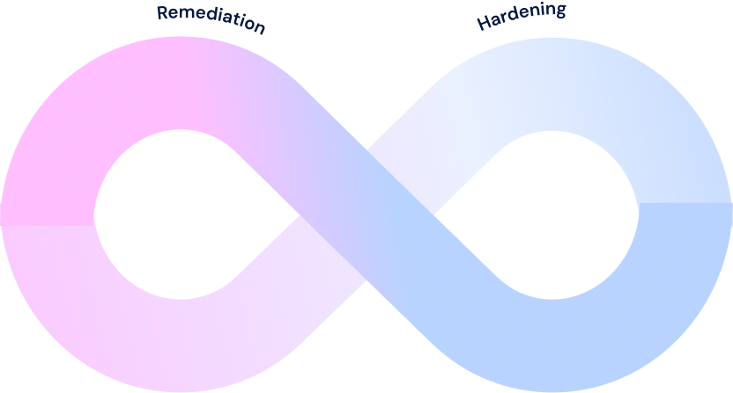
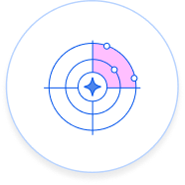


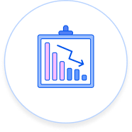
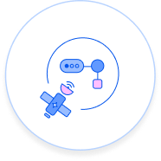
Wiz Adoption & Democratization
Maturity Model
Where are you?
EMBED AND AUTOMATE SECURITY
SELF SERVICE SECURITY FOR DEVELOPERS
Enforce security policies consistently across cloud, code, and runtime
Automate remediation and security lifecycle actions with automation rules
Continuously reduce risk without manual intervention
SHARED SECURITY CONTEXT WITH ENGINEERING
Enable developers to identify and remediate risk independently
Deliver security context directly into engineering processes with Workflows, integrations, and WizExtend
Map issues to an owner, application, or environment via Projects and Service Catalog
Prioritize issues by business context and real exposure
Align security and engineering on what matters most
CENTRALIZE SECURITY ACROSS SECURITY TEAMS
Security ownership is centralized across security teams
Standardize policies and prioritization across security teams
Goal: Risk is continuously mitigated and remediated by default
Goal: Security is a natural part of development
Goal: Engineers have what they need to remediate
Goal: Full visibility into vulnerabilities across all environments

Slide 3




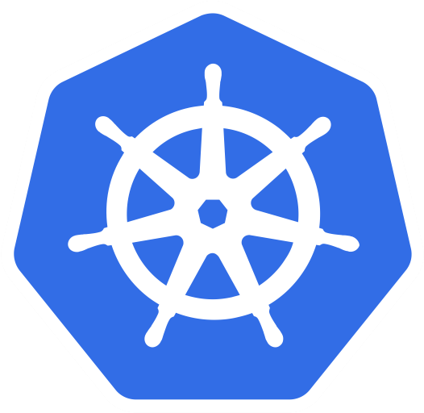
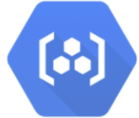
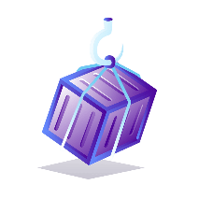
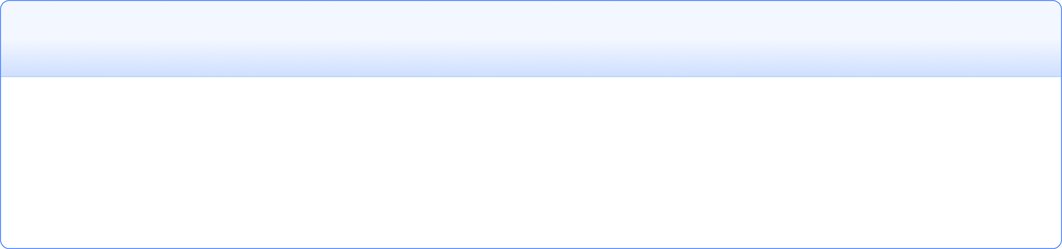
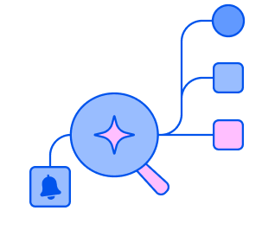

Cloud and AI Visibility Snapshot
Cloud Visibility
Deployments / Connectors ↗
Cloud Events ↗
{{CON_TOT}} Total Connectors
{{CON_EN}} Active Connectors
{{CLOUD_EVENTS_1}}
{{CE_1}}
{{C_AWS}} AWS Connectors
{{CLOUD_EVENTS_2}}
{{CE_2}}
{{CLOUD_EVENTS_3}}
{{CE_3}}
{{C_GCP}} GCP Connectors
{{OUT_DEP}} Outpost Deployments
{{CON_VCS}} VCS Connectors
{{CLOUD_EVENTS_4}}
{{CE_4}}
{{C_AZ}} Azure Connectors
{{CLOUD_EVENTS_5}}
{{CE_5}}
{{CLOUD_EVENTS_6}}
{{CE_6}}
{{K8S}} K8s Clusters {{KG_NC}} Not Connected via Connector
{{CON_DIS}} Inactive Connectors
{{CON_BRO}} Broker Deployments
{{CLOUD_EVENTS_7}}
{{CE_7}}
{{CLOUD_EVENTS_8}}
{{CE_8}}
{{C_OTH}} Others {{C_OTH_NAMES}}
{{CON_R}} Registry Connectors
{{CON_K8S}} Kubernetes Connectors
{{CLOUD_EVENTS_9}}
{{CE_9}}
{{CLOUD_EVENTS_10}}
{{CE_10}}
{{CLOUD_EVENTS_11}}
{{CE_11}}
{{R_TOT}} Container Registries
{{CON_R}} Admission Controllers
{{CON_WOS}} WizOS Workloads
{{CLOUD_EVENTS_12}}
{{CE_12}}
{{SERVERLESS_CT_COUNT}} Serverless Containers
{{CLOUD_EVENTS_13}}
{{CE_13}}
{{SERVERLESS_FN_COUNT}} Serverless Functions
AI Visibility / Inventory ↗
{{CON_WE}} Connectors With Cloud Events {{CON_NE}} Connectors Without
{{AI_MODELS_COUNT}} AI Models
{{AI_AGENTS_COUNT}} AI Agents
{{AI_PIPELINES_COUNT}} AI Pipelines
{{AI_WORKLOADS_COUNT}} AI Workloads
{{AI_DATASETS_COUNT}} AI Datastores
{{L_SE}} Wiz Runtime Sensors Deployed
{{AI_GUARDRAILS_COUNT}} AI Guardrails
{{AI_MCP_SERVERS_COUNT}} MCP Servers
{{AI_TECHNOLOGIES_COUNT}} AI Technologies
{{AI_CODE_REPOS_COUNT}} Code Repos with AI
{{AI_CA_COUNT}} Coding Agents (IDE)

Slide 4
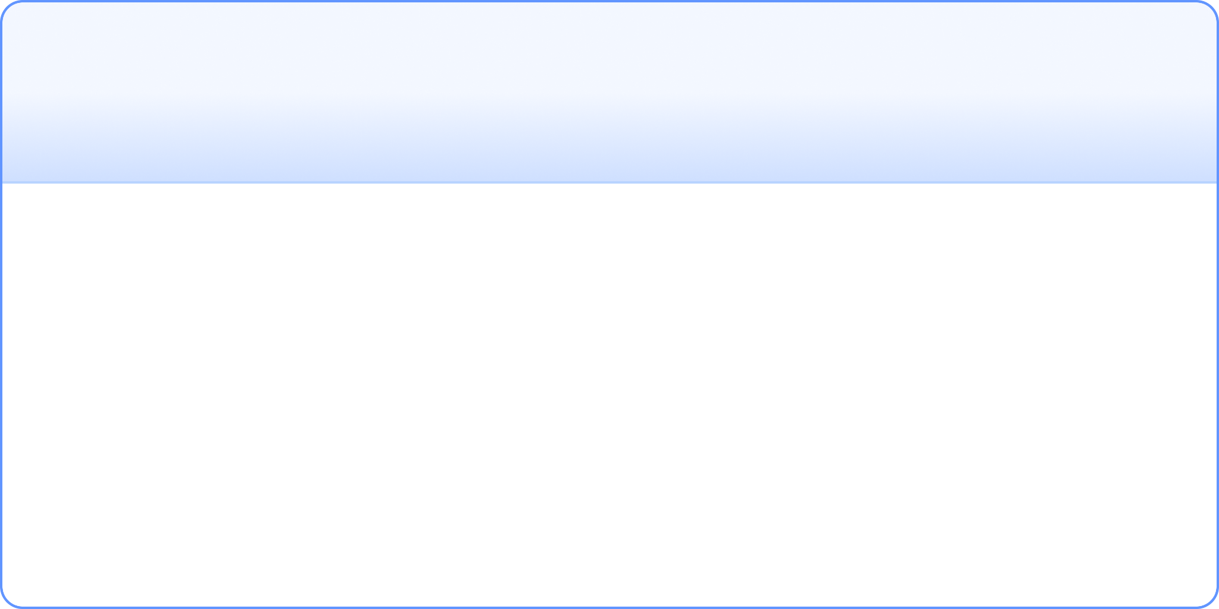




Wiz Adoption & Usage Snapshot
Product Usage
Time With Wiz
Unscanned Resources ↗
{{CUS_NOD}} Days as Wiz Customer
{{L_CL_PCT}} Cloud Advanced
Current Contract End {{CONTRACT_END_FMT}}
{{U_RES}} Unscanned Resources Cloud Organizations, Code Repositories & Subscriptions
{{CL_CP}}% {{CL_DP}}% {{CL_NRVP}}% {{CL_WOP}}% {{CL_UVMP}}% {{CL_ASMP}}%
{{CL_REDA}}% {{CL_SUP}}%
- Compute - Data
- Non-OS / Registry / VM Image
- WizOS
- Unified Vulnerability Mgmt
- Advanced ASM
- Red Agent
- SaaS Users
{{D_U_R}} Days Until Renewal
Kubernetes / Containers & Wiz CLI
Red Agent Scans ↗
DAST Attacker: {{RA_DAST}}
Runtime Sensor {{L_SE}}
K8s Clusters
{{K8S}}
Web Crawler: {{RA_WC}}
Container Images
{{TI}}
Secret Impact: {{RA_SI}}
Wiz Defend Ingestion {{L_DE}} Units
Container Registries
{{R_TOT}}
Total Monthly Scans: {{RA_TOTS}}
Wiz CLI SCANS (30d) ↗
Wiz Code {{L_CO}} Developers
{{CLI}}

Slide 5
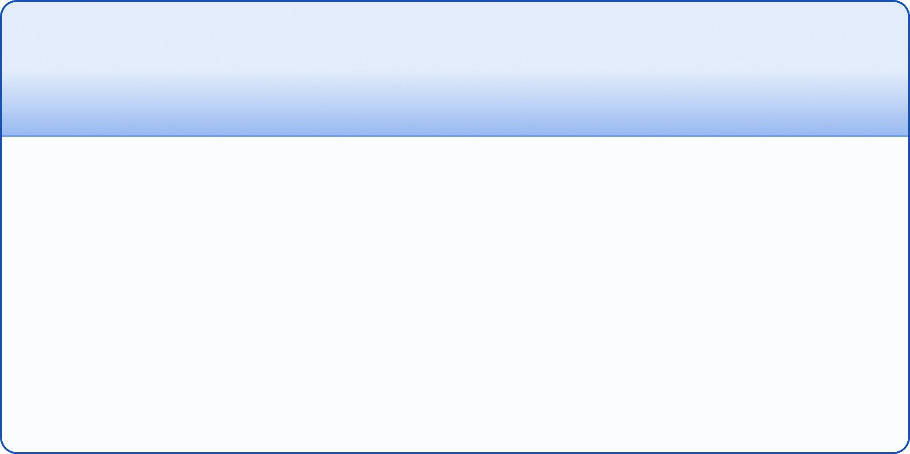
Wiz System Health & Scans Snapshot
System Health Issues
Workload Scans
Data Security (DSPM) Scans
Critical SHIs
{{SHI_C}}
Total: {{WS_T}}
Total: {{DS_T}}
High SHIs
{{SHI_H}}
Failed: {{WS_F}}
Failed: {{DS_F}}
Resolved SHIs in Past 30 Days
Skipped: {{WS_SK}}
Skipped: {{DS_SK}}
Resolved Critical SHIs
{{SHI_R_C}}
Scan Coverage: {{WS_P}}
Resolved High SHIs
{{SHI_R_H}}
Data Scan Coverage: {{DS_P}}
Non-OS, Registry & VM Image Scans
System Health Issues Counts by Resource Type
Data Security Scans Counts by Resource Type
Non-OS Disk Scans: {{NON_T}}
Failed: {{NON_F}} / Skipped: {{NON_S}}
Cloud Connectors: {{SHI_CC}}
Non-OS Disk Scan Coverage: {{NON_C}}
Buckets: {{DS_B}}
Outposts: {{SHI_O}}
Container Image Scans: {{RCI_T}}
PaaS Databases: {{DS_PD}}
Integrations: {{SHI_I}}
Failed: {{RCI_F}} / Skipped: {{RCI_S}}
Data Warehouses: {{DS_DW}}
Registry Connectors: {{SHI_RC}}
Container Image Scan Coverage: {{RCI_C}}
Virtual Drives: {{DS_VD}}
K8S Connectors: {{SHI_KC}}
VM Image Scans: {{VMI_T}}
AI Datastores: {{DS_AI}}
VCS Connectors: {{SHI_VCS}}
Failed: {{VMI_F}} / Skipped: {{VMI_S}}
VM Image Scan Coverage: {{VMI_C}}
File System Services: {{DS_FSS}}
Brokers: {{SHI_B}}

Slide 6
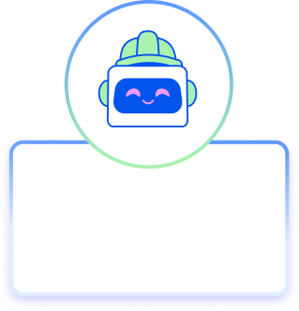
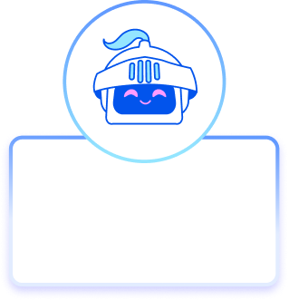
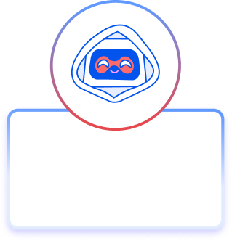
Democratization Snapshot
Active Integrations ↗
Features / Functionality Usage
Users & Engagement
Integration Last Seen
{{F_FW}}
Custom Compliance Frameworks
Total Users
{{U_TOT}}
{{IA_1}}
{{F_TR}}
Active (Last 30 Days)
{{U_ACT}}
{{IR_1}}
Resource Tag Rules (On / Off)
{{IA_2}}
{{IR_2}}
{{F_DR}}
Engagement Rate
{{U_ENG}}
Service Catalog Discovery Rules
{{IA_3}}
{{IR_3}}
{{F_IR}}
Inventory Management Rules
{{IA_4}}
{{IR_4}}
{{F_PP}}
{{IA_5}}
User Created Posture Policies
{{IR_5}}
{{F_MM}}
{{IA_6}}
{{IR_6}}
User Created Monitored Metrics
Projects
{{CC_TOT}}
{{IA_7}}
{{IR_7}}
Champion Center Owners
{{F_BE}}
Total Parent
{{P_TOT}}
{{IA_8}}
{{IR_8}}
Using Wiz Browser Extension
{{F_WMCP}}
Total Child
{{PC_TOT}}
{{IA_9}}
{{IR_9}}
Wiz MCP Users
{{IA_10}}
{{IR_10}}
HBI (High Business Impact)
{{P_HBI}}
MBI (Medium Business Impact)
{{P_MBI}}
Automation Workflows
{{F_WF}}
LBI (Low Business Impact)
{{P_LBI}}
Automation Rules (On / Off)
{{F_AR}}
Preventive Security
Reactive Security
Proactive Security
Build securely and remediate at the source
Green Agent
Investigate and triage high-fidelity threats
Blue Agent
Red Agent
Identify high-risk issues before they can be exploited
Enabled {{F_GA}}
Enabled {{F_BA}}
Enabled {{F_RA}}

Slide 7
Preview Hub Availability vs Usage
Public Future-Billable Previews ↗
Public Non-Billable Previews ↗
Advanced License: {{BILLABLE_ADVANCED}} Sensor / Defend License: {{BILLABLE_SENSOR}} {{BILLABLE_DEFEND}}
Wiz Code License: {{BILLABLE_CODE}}
{{ALL_NON_BILLABLE_PREVIEW}}

Slide 8
Preview Hub Availability vs Usage
Private Future-Billable Previews ↗
Private Non-Billable Previews ↗
{{PRIVATE_BILLABLE}}
{{PRIVATE_NON_BILLABLE}}
**Private Features are typically only available upon request and approval

Slide 9
Roadmap Tracker Usage
Discover, track, and monitor roadmap features. All quarters listed refer to the calendar year, and represent Wiz goals, meaning some features will be pushed to later quarters. Also, the quarters listed may reflect when features become available to preview, with general availability (GA) following. Some support tiers allow you to track up to 20 non-highlight features, of which 5 can be marked high priority. Product managers review the most popular features when deciding what to work on next, so your votes really count. Features remain trackable until one quarter after release. Some features may not have a timeline. A planned timeline is added once available.
Tracked Roadmap Items ↗
{{ROADMAP_TRACKER}}

Slide 10
Reducing Critical Risk and Beyond

Slide 11

Wiz Security
Maturity Model
Where are you?
BACKLOG PREVENTION - DEVELOP SECURELY
POSTURE HARDENING
Enforce code-to-cloud guardrails to prevent issues from ever being deployed with Wiz Code
Give devs cloud context directly in IDEs and code for secure by design
Address non-urgent findings impacting overall security posture, including Posture Issues
Manage exposures in the environment with Wiz XM
Consolidate remediation for greater impact in a shorter time frame
REDUCE CRITICAL RISK
Prioritize immediately exploitable attack paths (validate with Wiz ASM)
Achieve Zero Critical Risk Issues
Prioritize external findings (UVM) with Wiz context
GAIN VISIBILITY
Goal: Harden the SDLC while maintaining “Zero Criticals” and SLA compliance requirements
100% code-to-cloud visibility into any repo, pipeline, or cloud
Centralize visibility across on-prem, hybrid, cloud, code with UVM
Goal: Meet all SLAs for Posture Issues
Goal: Achieve “Zero Critical” Risk Issues
Goal: Full visibility into vulnerabilities across all environments

Slide 12
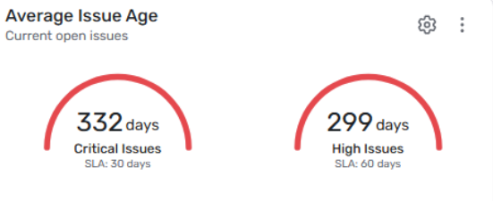

Cloud Security Posture Snapshot
Current Security Score
Industry Benchmark
Open Critical Issues ↗
Open High Issues ↗
{{SS}}%
Industry: {{SS_I}}
{{OC}}
{{OH}}
{{SP}}%
90 Day Trend {{s1d}}
Security Score Gap {{SG}}%
Resolved Criticals ↗ {{RC}}
Resolved Highs ↗ {{RH}}
Ignored Issues
AI Findings ↗
{{RJ}}
Security Findings: {{AI_SF}} Configuration Findings: {{AI_MF}}
AI Inventory Findings: {{AI_IF}}
Total Ignored Issues
{{AVG_AGEC}} Days
{{AVG_AGEH}} Days
Threats MTTR ↗
Open Threats ↗
{{MTTR_O}}
{{OT}}
Days
Resolved Threats: {{RT}} Past 90 Days

Slide 13
Cloud Security Risk Snapshot
Proactive Security
External Exposure
Identify high-risk issues before they can be exploited
HTTP Application Endpoints {{AE_HTTP}}
Estimated # of Additional Workloads to Scan via Advanced ASM
= {{AE_TOT}} Workloads
Non-HTTP Application Endpoints {{AE_NHTTP}}
Red Agent
Enabled {{F_RA}}
Top 3 Wiz Critical Risk Issues by Count ↗
Preventive Security
{{CI_CBC_1}} Issues
{{CI_CBC_2}} Issues
{{CI_CBC_3}} Issues
Build securely and remediate at the source
{{CI_CONTROL_1}}
CRITICAL
{{CI_CONTROL_2}} CRITICAL
{{CI_CONTROL_3}} CRITICAL
Green Agent
Enabled {{F_GA}}
Top 3 Wiz High Risk Issues by Count ↗
Reactive Security
Investigate and triage high-fidelity threats
{{HI_CBC_1}} Issues
{{HI_CBC_2}} Issues
{{HI_CBC_3}} Issues
{{HI_CONTROL_1}}
HIGH
{{HI_CONTROL_2}} HIGH
{{HI_CONTROL_3}} HIGH
Blue Agent
Enabled {{F_BA}}

Slide 14
Develop Securely

Slide 15

Secure Development Snapshot
Kubernetes Clusters ↗
Kubernetes Coverage
Gaps & Exposure
{{K8S_1}}
{{K8C_1}}
{{K8S_2}}
{{K8C_2}}
Wiz Connector Deployed
{{KC_WC}}
Internet-Accessible
{{KG_IA}}
{{K8S_3}}
{{K8C_3}}
Admission Controller
{{KC_AC}}
No Wiz Connector Deployed
{{KG_NC}}
{{K8S_4}}
{{K8C_4}}
K8S Audit Logs Onboarded
{{KC_SE}}
No K8S Audit Logs
{{KG_NA}}
{{K8C_5}}
Sensor Active (Runtime)
{{KC_CLI}}
{{K8S_5}}
{{KG_NS}}
No Runtime Sensor
{{K8C_OTH}}
Other
Total {{K8C_TOT}}
Do you have full visibility?
Container Images Lifecycle ↗
Container Registries ↗
{{RC_1}}
Scanning Config Type
Cloud (Workload/K8s)
{{R_1}}
{{CL_CLD}}
{{RC_2}}
Store (Registry Scans)
{{R_2}}
{{CL_STR}}
{{CL_CODE}}
{{CL_BLD}}
{{CL_STR}}
{{CL_DEP}}
{{CL_CLD}}
{{CL_RT}}
{{RC_3}}
Runtime (Sensor)
{{R_3}}
{{R_CON}}
{{CL_RT}}
{{RC_4}}
Connector
{{R_4}}
Global
Code (Wiz Code)
{{R_AUT}}
{{CL_CODE}}
Understanding where your images are scanned allows you to pinpoint and intercept vulnerabilities at the earliest possible moment. Identifying these specific scan sources is the key to an effective "shift left" strategy, ensuring you apply fixes where they have the most impact before they ever reach production.
Are you tagging your Images? Correlate the Docker image to the CI phase, gain further insights, and potentially improve your CI/CD pipeline conduct
{{RC_5}}
{{R_5}}
Custom
Build (Wiz CLI + Tagged Images)
{{R_CUS}}
{{CL_BLD}}
{{RC_6}}
{{R_6}}
Deploy (Admission Controller)
{{CL_DEP}}
Total Registries {{R_TOT}}
Do you have visibility into all of your Registries? jFrog, Sonatype Nexus, etc.
Total Images {{TI}}

Slide 16
Best Practice Review

Slide 17

Scanner Configuration — Workload & Attack Surface
✓ = Aligned with Wiz Recommendation ✗ = May want to revisit configuration
N/A = Informational, customer preference
Current workload scanner and attack surface management configuration settings.
WORKLOAD SCANNER ↗
ATTACK SURFACE MANAGEMENT ↗
Setting
Status
Recommended
Setting
Status
Recommended
Scanning Non-OS Disks
{{WS_NONOS}}
{{WS_NONOS_R}}
Scanner Mode (Basic/Advanced)
{{ASM_MODE}}
{{ASM_MODE_R}}
Virtual Machine Scanning
{{WS_VM}}
{{WS_VM_R}}
Advanced Scan Source: Custom Targets
{{ASM_CUST}}
{{ASM_CUST_R}}
Shared AWS CMKs
{{WS_CMK}}
Advanced Scan Source: Reconnaissance
{{ASM_RECON}}
{{ASM_RECON_R}}
{{WS_CMK_R}}
Advanced Scan Source: Code
{{ASM_CODE}}
AWS Scanning via Temp Volumes
{{WS_TVOL}}
{{WS_TVOL_R}}
{{ASM_CODE_R}}
Advanced Scan Source: API Security
{{ASM_API}}
{{ASM_API_R}}
AWS LightSail Scanning
{{WS_LSAIL}}
{{WS_LSAIL_R}}
Advanced Scan Source: Runtime Sensor
{{ASM_RS}}
{{ASM_RS_R}}
AWS Lambda Version Scanning
{{WS_LAMB}}
{{WS_LAMB_R}}
Advanced Scan Source: SaaS
{{ASM_SAAS}}
{{ASM_SASS_R}}
Custom Scanner Tags
{{WS_TAGS}}
{{WS_TAGS_R}}
Rules: Misconfiguration Detection
{{ASM_MISC}}
{{ASM_MISC_R}}
Workload Scanning Exclusions
{{WS_EXCL}}
{{WS_EXCL_R}}
Rules: Default Credentials Detection
{{ASM_CRED}}
{{ASM_CRED_R}}
Compute Instance Group Sampling
{{WS_CIGS}}
{{WS_CIGS_R}}
Rules: High-Profile Threat Detection
{{ASM_HPT}}
{{ASM_HPT_R}}
ADE Private Endpoints (Disabled Public)
{{WS_ADE1}}
{{WS_ADE1_R}}
Rules: DAST
{{ASM_DAST}}
{{ASM_DAST_R}}
ADE Private Endpoints (Selected VNets)
{{WS_ADE2}}
Rules: Vulnerability Exploitability
{{ASM_VEXP}}
{{ASM_VEXP_R}}
{{WS_ADE2_R}}
Rules: Early Access Rules
{{ASM_EAR}}
Near Real-Time Scanning
{{WS_NRT}}
{{WS_NRT_R}}
{{ASM_EAR_R}}
Risk: Vulnerability Assessment
{{ASM_VULN}}
{{ASM_VULN_R}}
Include NRT Workload Scanning
{{WS_NRTW}}
{{WS_NRTW_R}}
Risk: Sensitive Data Findings Detection
{{ASM_DATA}}
{{ASM_DATA_R}}
Agentless File Integrity Monitoring
{{WS_AFIM}}
{{WS_AFIM_R}}
Risk: Secret Findings Detection
{{ASM_SEC}}
{{ASM_SEC_R}}
Risk: Secret Validation
{{ASM_SV}}
{{ASM_SV_R}}
Application Endpoint Exposure Level
{{ASM_EXPL}}
{{ASM_EXPL_R}}

Slide 18

Scanner Configuration — Vulnerability & Data Security
✓ = Aligned with Wiz Recommendation ✗ = May want to revisit configuration
N/A = Informational, customer preference
Current vulnerability scanner tuning and data security scanning coverage.
VULNERABILITY SCANNER ↗
DATA SECURITY SCANNER ↗
Setting
Status
Recommended
Setting
Status
Recommended
OS-Package Managed Code Libraries
{{VS_OSPKG}}
Data Security Scanner
{{DSS_ON}}
{{DSS_ON_R}}
{{VS_OSPKG_R}}
Buckets (Public & Private)
{{DSS_BUCK}}
{{DSS_BUCK_R}}
Windows App Bundled Libraries
{{VS_WINB}}
{{VS_WINB_R}}
Storage: Azure PE (Disabled Public)
{{DSS_AZ1}}
{{DSS_AZ1_R}}
Go Standard Library
{{VS_GOSTD}}
{{VS_GOSTD_R}}
Storage: Azure PE (Selected VNets)
{{DSS_AZ2}}
{{DSS_AZ2_R}}
Code Library Exclusion Paths (Legacy)
{{VS_EXCL}}
{{VS_EXCL_R}}
CosmosDB: Azure PE (Disabled Public)
{{DSS_CDBAZ1}}
{{DSS_CDBAZ1_R}}
Ignore Red Hat OpenShift Vulns
{{VS_RHOS}}
{{VS_RHOS_R}}
CosmosDB: Azure PE (Selected VNets)
{{DSS_CDBAZ2}}
{{DSS_CDBAZ2_R}}
Virtual Drives
{{DSS_VDRV}}
{{DSS_VDRV_R}}
Manifest Files
{{VS_MANIF}}
{{VS_MANIF_R}}
Cloud Managed Databases (PaaS)
{{DSS_PAAS}}
{{DSS_PAAS_R}}
Lock Files
{{VS_LOCK}}
{{VS_LOCK_R}}
Data Warehouses
{{DSS_DW}}
{{DSS_DW_R}}
Artifacts
{{VS_ARTIF}}
{{VS_ARTIF_R}}
Google BigQuery
{{DSS_BQ}}
{{DSS_BQ_R}}
Dependency Scopes: Maven
{{VS_MAVEN}}
Amazon DynamoDB
{{DSS_DDB}}
{{DSS_DDB_R}}
{{VS_MAVEN_R}}
Snowflake
{{DSS_SNOW}}
{{DSS_SNOW_R}}
Dependency Scopes: JS (npm/pnpm/Yarn)
{{VS_JSDEP}}
{{VS_JSDEP_R}}
Hosted Databases (IaaS)
{{DSS_IAAS}}
{{DSS_IAAS_R}}
Dependency Scopes: Gradle
{{VS_GRADL}}
{{VS_GRADL_R}}
VM Disks (OS and non-OS)
{{DSS_VMD}}
{{DSS_VMD_R}}
End of Life Detection
{{VS_EOL}}
Serverless Functions
{{DSS_SLS}}
{{DSS_SLS_R}}
{{VS_EOL_R}}
Vertex AI
{{DSS_AIV}}
{{DSS_AIV_R}}
Linux Vulnerabilities
{{VS_LVULN}}
{{VS_LVULN_R}}
Azure OpenAI
{{DSS_AIAO}}
{{DSS_AIAO_R}}
OpenAI
{{DSS_AIOA}}
{{DSS_AIOA_R}}
Shadow Data
{{DSS_SHAD}}
{{DSS_SHAD_R}}

Slide 19
Potential Technology Overlap
Third-party principals detected in your cloud environments, grouped by functional overlap with Wiz platform capabilities.
CLOUD SECURITY PLATFORM ↗ Potential Overlap with Wiz CNAPP, CSPM, CIEM, DSPM
CODE SECURITY ↗ Potential Overlap with Wiz Code, SAST, SCA, Wiz CLI
Technology
# of SAs
First / Last Created
Technology
# of SAs
First / Last Created
{{PI_T1_1}}
{{PI_T1_1_SA}}
{{PI_T1_1_FA}} / {{PI_T1_1_LA}}
{{PI_T2_1}}
{{PI_T2_1_SA}}
{{PI_T2_1_FA}} / {{PI_T2_1_LA}}
{{PI_T1_2}}
{{PI_T1_2_SA}}
{{PI_T1_2_FA}} / {{PI_T1_2_LA}}
{{PI_T2_2}}
{{PI_T2_2_SA}}
{{PI_T2_2_FA}} / {{PI_T2_2_LA}}
{{PI_T1_3}}
{{PI_T1_3_SA}}
{{PI_T1_3_FA}} / {{PI_T1_3_LA}}
{{PI_T2_3}}
{{PI_T2_3_SA}}
{{PI_T2_3_FA}} / {{PI_T2_3_LA}}
{{PI_T1_4}}
{{PI_T1_4_SA}}
{{PI_T1_4_FA}} / {{PI_T1_4_LA}}
{{PI_T2_4}}
{{PI_T2_4_SA}}
{{PI_T2_4_FA}} / {{PI_T2_4_LA}}
{{PI_T1_5}}
{{PI_T1_5_SA}}
{{PI_T1_5_FA}} / {{PI_T1_5_LA}}
{{PI_T2_5}}
{{PI_T2_5_SA}}
{{PI_T2_5_FA}} / {{PI_T2_5_LA}}
{{PI_T1_6}}
{{PI_T1_6_SA}}
{{PI_T1_6_FA}} / {{PI_T1_6_LA}}
{{PI_T1_7}}
{{PI_T1_7_SA}}
{{PI_T1_7_FA}} / {{PI_T1_7_LA}}
RUNTIME / WORKLOAD PROTECTION ↗ Potential Overlap with Wiz Sensor, Defend, CWPP,, TDR
{{PI_T1_8}}
{{PI_T1_8_SA}}
{{PI_T1_8_FA}} / {{PI_T1_8_LA}}
Technology
# of SAs
First / Last Created
{{PI_T3_1}}
{{PI_T3_1_SA}}
{{PI_T3_1_FA}} / {{PI_T3_1_LA}}
{{PI_T3_2}}
{{PI_T3_2_SA}}
{{PI_T3_2_FA}} / {{PI_T3_2_LA}}
{{PI_T3_3}}
{{PI_T3_3_SA}}
{{PI_T3_3_FA}} / {{PI_T3_3_LA}}
{{PI_T3_4}}
{{PI_T3_4_SA}}
{{PI_T3_4_FA}} / {{PI_T3_4_LA}}
{{PI_T3_5}}
{{PI_T3_5_SA}}
{{PI_T3_5_FA}} / {{PI_T3_5_LA}}

Slide 20

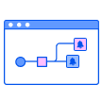

Top Three Focus Areas to Improve
Cloud Visibility & Coverage
Review Unscanned Resources for Coverage Gaps
Adopt Additional Features & Functionality in Wiz
Expand Coverage 3rd Party Resources & Telemetry
An unscanned resource is one in which Wiz can identify but cannot directly scan, such as unconnected repositories, cloud accounts, and organizations.
Classify these resources, determine if they belong to your organization or a third party, and identify gaps in your security coverage.
Enable DSPM more widely to extend visibility to your sensitive data and complement your existing tools. Discover PII, PHI and PCI across private buckets, PaaS, IaaS and AI buckets.
Enable Near Real-Time Scanning to cut misconfiguration detection from 24-hour to an hour or less.
Enable Akamai Connector provide better visibility in terms of exposure
Fold in third-party telemetry. Integrating with additional tools to provide stronger attribution. I.e. Pull findings from tools like ServiceNow, Armorcode, Crowdstrike, etc.) across cloud and on-prem.
Normalize, deduplicate and enrich existing Wiz data, in one view.

Slide 21

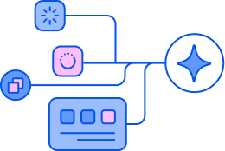



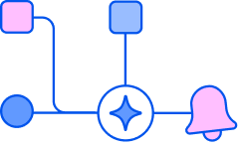

Top Three Focus Areas to Mature
for Democratization Improvements
Assigning Ownership
Leverage Integrations
Automation (Workflows)
Service Catalog democratizes ownership to developers. Auto-group resources by applications
Resource Tag Rules convert Security Graph queries into auto-assigned tags, that can then be used as conditions to route tickets to the right owners
Get Issues in front of the right people, using the tools they’re accustomed to. Jira, ServiceNow, Teams, etc.
Send prescriptive data to SIEM / SOAR
Route by team, severity or environment. Integration + per-team Action templates = Cutting the noise and operationalizing Wiz
Take the human out of the routing. Auto-assign Issues to the right owners and notify accordingly
Enable self-service remediation with Worklows. Designed to offer more granular control around which context to include (i.e. Remediation steps, Investigation details, etc).
What is your current issues resolution flow? What is your ideal state? Is there anything blocking you from further democratization?
Is Wiz completely integrated into your workflow? What could help make it part of day to day?

Slide 22
Top Three Focus Areas to Improve
Security Posture & Risk Reduction
Prioritize Investigation by Severity & Criticality
Prioritize Remediation by Greatest Impact
Using Wiz Tools to Remediate More Efficiently
How do you determine what to work on first?
Why are the custom TWDC Graph Controls marked as “Critical”? Is this still relevant?
How are you alerted on Critical Issues, when they arise?
You only have “MBI” (Medium Business Impact) resources defined, why?
Grouping filters or queries to identify the “low hanging fruit” Issues (i.e. resources exhibiting the same Issue)
Are you using Posture Policies to identify and group high-impact vulnerabilities?
Utilize Green Agent for automated investigation and remediation context
Utilize Advanced ASM to validate which external exposures are truly exploitable
Utilize Red Agent to actively probe your web apps and APIS to proactively identify high-impact exposures

Slide 23
Top Three Focus Areas to Mature
for Developing Securely Improvements
K8S Connectors
WizOS & Image Tagging
Full Code-to-Cloud Context Wiz Code POV
Map Cluster architectures more effectively in Wiz.
Allows Wiz to assess K8S clusters directly via the Kubernetes API, to identify risks associated with K8S specific identities, secretes, configs, etc.
Build on a clean image base with WizOS. Hardened, minimal, near-zero-CVE base images.
Allows Enforce quality with proper image tagging via Wiz CLI. Stamps each image by digest, giving full code-to-cloud traceability.
Scan your repos for vulnerabilities, SAST flaws, IaC misconfigurations, secrets and Malware
Allow Developers to scan their code at the IDE
Scan PRs and (optionally) block merges that introduce risk
Trace every risk back to its origin. Catch risks at the source, before they ship.

