Slide 1
VPN Project
IK2206
Hüseyin Kayahan
kayahan@kth.se
2016

Slide 2
Introduction
Deadline 9th of December
Max 3 students in a group
Visit Canvas group selection module
Perform the work on given Virtual Machine (VM)
Tasks are verified to be working in this VM
Present a demo
20 minutes presentation slots
Submit your source code and the presentation slides
Visit Canvas submission module

Slide 3
Introduction
Project consists of two major tasks
Tunnel Creation
Securing the tunnel
Code for creating tunnels is provided
You need to modify it to make it a secure tunnel (i.e. a VPN application)
Using VirtualBox for emulating the scenarios
Need to master virtual machine networking
Using OpenSSL API for securing the tunnel
Example codes provided

Slide 4
VirtualBox
LIVE WORKSHOP

Slide 5
OpenSSL - Initialziation
SSL_library_init()
Loads up the algorithms that will be used by OpenSSL
SSL_load_error_strings()
Load error strings for error reporting
SSL_CTX * ctx = SSL_CTX_new(SSLv23_client_method());
Structure to hold SSL information.
Created via SSL_CTX_new()
Referred to as context
SSL * ssl;
Structure to hold the SSL connection
Constructed by passing a context

Slide 6
Identity certificate and private key
SSL_CTX_use_certificate_file(ctx,“/path/to/myCert.pem”, SSL_FILETYPE_PEM)
Loads the identity certificate
You create this certificate following section 4.4 of project instructions (CSR)
Returns int. int < 0 indicates error
SSL_CTX_use_PrivateKey_file(ctx, “/path/to/myKey.key”, SSL_FILETYPE_PEM)
Loads the private key of the identity certificate
You create the private key following section 4.4 of project instructions
Returns int. int < 0 indicates error
Used in conjunction with SSLCTX_set_default_passwd_cb() if the key file is password protected
SSL_CTX_check_private_key(ctx)
Checks if the loaded public and private keys match
Returns True/False

Slide 7
Peer certificate validation
SSL_CTX_load_verify_locations(ctx, “/path/to/TrustStore.pem”, NULL)
Loads the trust certificate store for given context
This store holds trusted root CA certificates
Path can be a folder or a .pem file that includes all trusted root CA certs
We will have only one trusted root CA cert so use above format
SSL_CTX_set_verify(ctx, mode, NULL)
Configure how the context shall verify peer’s certificate. Mode variable can take,
SSL_VERIFY_PEER: Attempt to do certificate-based client but don’t require it
SSL_VERIFY_PEER | SSL_VERIFY_FAIL_IF_NO_PEER_CERT
SSL_VERIFY_NONE

Slide 8
Establishing a secure connection - Server
bio=BIO_new_ssl(ctx,0)
Construct SSL and BIO for server
BIO_get_ssl(bio, &ssl)
Retrieves the address of SSL obj of BIO
bbio = BIO_new(BIO_f_buffer())
Create a buffering BIO
bio = BIO_push(bbio, bio)
Add buffered BIO to the BIO chain
BIO *acpt = BIO_new_accept(“port")
BIO_set_accept_bios(acpt,bio) ->
-> BIO_do_accept(acpt)
bio = BIO_pop(acpt);
Remove the accept BIO on connection success (If you don’t have to listen for new connections anymore)
BIO_free_all(acpt);
Frees up BIO resources
BIO_do_handshake(bio)
Wait for handshake from the client

Slide 9
Establishing a secure connection - Client
BIO *bio = BIO_new_ssl_connect(ctx)
Creates a TCP wrapper for BIO with a new ssl object
BIO_get_ssl(bio, &ssl)
Retrieves the SSL pointer of BIO
SSL_set_mode(ssl, SSL_MODE_AUTO_RETRY)
If the server suddenly wants a new handshake, OpenSSL handles it in the background.
BIO_set_conn_hostname(bio, “IP:PORT")
Set the destiantion for the underlying socket
BIO_do_connect(bio)
BIO_do_handshake(bio);

Slide 10
Reading/Writing from/to secure channel
BIO_read(bio, buffer, buffersize)
BIO_write(bio, buffer, buffersize)
BIO_flush(bio)
Writes out any internally buffered data.
In some cases it is used to signal EOF and that no more data will be written.

Slide 11
Some notes
Previous example will establish a secure TCP channel.
You can use this as the control channel. We want DATA channel to be on UDP
Read/Write to channel when you are managing your own memory may handled differently.
Further reading on UDP vs TCP
http://net-snmp.sourceforge.net/wiki/index.php/DTLS_Implementation_Notes
Every packet that enters the tunnel must be encrypted
Simpletun.c is your base code. Improve it to work with UDP and OpenSSL for security.

Slide 12
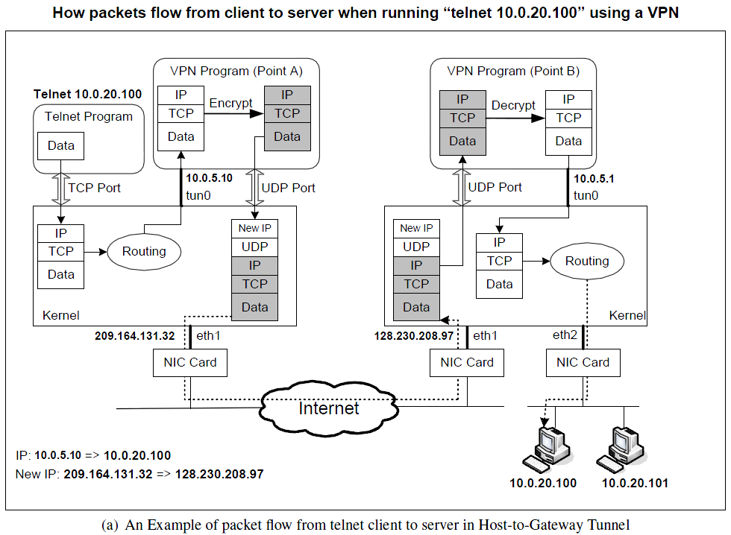
Notes:
1. The data of the packet starts from the telnet program.
2. The kernel will construct an IP packet, with the destination IP address being 10.0.20.100.
3. The kernel needs to decide which network interface the packet should be routed through: eth1 or
tun0. You need to set up your routing table correctly for the kernel to pick tun0. Once the decision
is made, the kernel will set the source IP address of the packet using the IP address of the network
interface, which is 10.0.5.10.
4. The packet will reach our VPN program (Point A) through the virtual interface tun0, then it will be
encrypted, and then be sent back to the kernel through a UDP port.
This is because our VPN program use the UDP as our tunnel.
5. The kernel will treat the encrypted IP packet as UDP data, construct a new IP packet, and put the
entire encrypted IP packet as its UDP payload. The new IP’s destination address will be the other end
of the tunnel (decided by the VPN program we write); in the figure, the new IP’s destination address
is 128.230.208.97.
6. You need to set up your routing table correctly, so the new packet will be routed through the interaface
eth1; therefore, the source IP address of this new packet should be 209.164.131.32.
7. The packet will now flow through the Internet, with the original telnet packet being entirely encrypted,
and carried in the payload of the packet. This is why it is called a tunnel.
8. The packet will reach our gateway 128.230.208.97 through its interface eth1.
9. The kernel will give the UDP payload (i.e. the encrypted IP packet) to the VPN program (Point B),
which is waiting for UDP data. This is through the UDP port.
10. The VPN program will decrypt the payload, and then feed the decrypted payload, which is the original
telnet packet, back to the kernel through the virtual network interface tun0.
11. Since it comes through a network interface, the kernel will treat it as an IP packet (it is indeed an IP
packet), look at its destination IP address, and decide where to route it. Remember, the destination IP
address of this packet is 10.0.20.100. If your routing table is set up correctly, the packet should
be routed through eth2, because this is the interface that connects to the 10.0.20.0/24 network.
12. The telnet packet will now be delivered to its final destination 10.0.20.100.

Slide 13
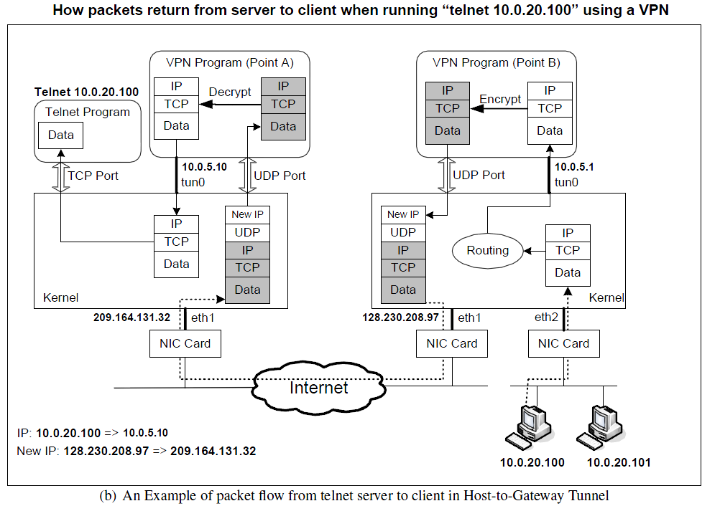

Slide 14
Questions?

