Slide 1

1
COMP1117 Tutorial 2
AI USE AND TESTING
AI-GENERATED CODE
Notes:
50-minute tutorial for first-year students. The teaching sequence is requirements discussion, student review, test design, implementation with AI, execution and repair. The course-result rules are fictional classroom rules. Preparation before class: Python and VS Code installed, GitHub Copilot access configured if used, and the student workspace downloaded. The tutor should check the classroom account and network in Hong Kong. Do not spend class time waiting for student-benefit approval. If live AI access is unavailable, students can work with a partner, use HKU GenAI for discussion, or use the supplied offline materials. The teaching draft is deliberately faulty and is not presented as an observed AI response. Screenshot placeholders A–E are intended for the tutor to replace with their own VS Code captures.

Slide 2

2
Learning outcomes
Use AI to question and clarify a programming requirement.
Review requirements.md and explain the decisions yourself.
Choose tests with expected answers before generating code.
Use execution evidence to repair and retest the program.
Notes:
By the end, students should be able to explain a reviewed requirements file, a small test plan and actual results. Use the tutor demonstration to connect each decision to a requirement.

Slide 3
3
Our 50-minute tutorial
Time | Activity
0–8 min | AI use, HKU access and VS Code Chat
8–18 min | Workspace and requirements demonstration
18–28 min | Test groups, boundaries and branch coverage
28–40 min | Implement, run tests and investigate failures
40–47 min | Independent check: a changed requirement
47–50 min | Exit questions and evidence checklist
Follow the demonstration and explain the decisions as we go.
Notes:
Hard stop at 50 minutes. Use a tutor-led requirements demonstration, followed by a class walkthrough of the test cases. Show the prepared screenshots. Finish the requirements review at minute 18 and test design at minute 28. Use the prepared teaching draft if live implementation takes more than two minutes. At minute 40 move to the independent check. Leave the detailed reference code for follow-up reading if time is tight.

Slide 4
4
Constructive ways to use AI
Learning purpose | A useful request
Clarify a task | What is ambiguous in these requirements?
Compare decisions | Give two options and explain their consequences.
Check understanding | Ask me to predict a result and explain my reasoning.
Review evidence | Which requirement does this failing test contradict?
Do not paste the whole assignment into Chat
and ask AI to “Solve it for me”.
Notes:
Explain that these are ways to support learning while retaining the student's own reasoning. Pasting the entire assignment into Chat and asking for a complete solution bypasses the learning task. Students should use focused questions and follow the permitted uses in the assignment rubric. The first interaction in the tutorial asks AI to clarify requirements.
Course guidance supplied by the instructors, 11 September 2026.

Slide 5
5
Your decisions still matter
AI may fill in a missing rule without asking.
You confirm the rules with the task brief or tutor.
You work out expected outputs independently.
You accept an edit only when you can explain it.
Notes:
Ask for one example of a decision that AI should not invent, such as a pass threshold. Students can reject a suggested rule and document why.

Slide 6
6
The workflow for this session
Stage | Evidence you keep
Understand and agree | Reviewed requirements.md
Prepare tests | Inputs, expected results and a reason for each case
Implement with AI | Code and a record of the changes you accepted
Run, repair and retest | Actual outputs and a short explanation of failures
Implementation starts after the requirements and tests are reviewed.
Notes:
This ordering is the main lesson. Students should be able to defend the requirements and expected answers before seeing an implementation.

Slide 7
7
AI use and testing in assignments
AI use and test-case verification count towards your assignment grade.
Keep a record of your prompts and changes to AI-generated code.
Document test inputs, expected outputs and actual results.
Explain failures and verify the program again after fixes.
Follow the assignment rubric for the required evidence and marking details.
Notes:
Course policy supplied by the instructor: AI use and test-case verification are included in assignment marking. Students should retain the evidence required by the specific assignment rubric. No weighting is invented here. The fictional 40/60 weights used later belong only to the programming exercise.
The assessed record of AI use does not authorise outsourcing an assignment solution. Students must do and understand their own work and follow the permitted uses in the assignment rubric. Course guidance supplied by the instructors, 11 September 2026.

Slide 8
8
HKU AI access for this tutorial
HKU GenAI: genai.hku.hk
Sign in with your HKU Portal account.
Ask for explanations, examples and feedback to help you learn.
Students receive 500,000 AI Credits each month.
Use GenAI to support your learning.
Do not use this chat to complete your assignments.
HKU ITS service details
Notes:
HKU GenAI can support concept explanations, worked examples and feedback during learning. The course instructors explicitly advise students not to use this chat to complete their assignments. Focused learning support remains subject to the assignment rubric. Students need to do and understand their own work.
Students sign in with their HKU Portal account. The student allocation is 500,000 AI Credits per month. Credits renew on the 1st and cover the App and API together.
[Sources]
https://its.hku.hk/services/ai-as-a-service/hku-chatgpt/
Service information checked 10 September 2026. Course-use guidance supplied by the instructors, 11 September 2026.
[/Sources]

Slide 9
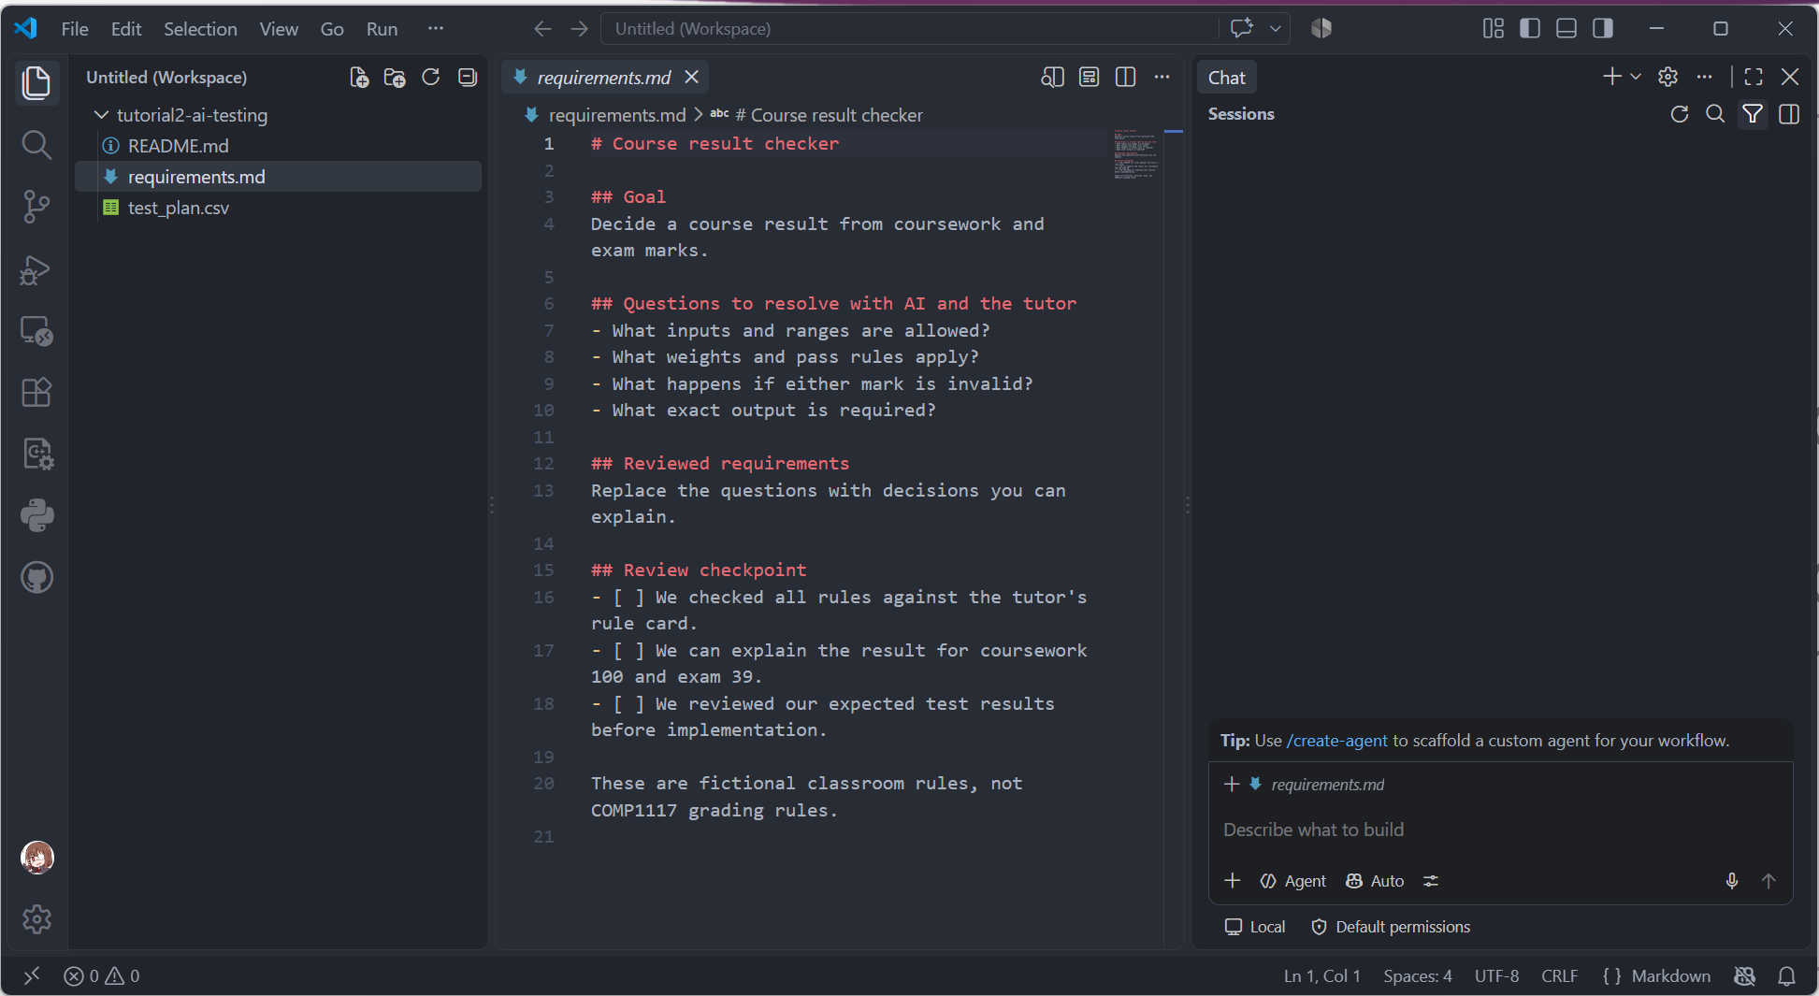
9
Chat inside VS Code
Sign in with your GitHub account.
Open the built-in Chat view.
Type a question and send it.
Keep the discussion beside the files you are working on.
Notes:
Use the Chat view in the main VS Code window. The tutor screenshot should show where to type, where to send and where to select a model. Use the Copilot session, not a separate provider extension. Follow HKU ITS setup instructions before class, including its privacy settings. Account and plan access need to be working before the session. HKU ITS documents GitHub Copilot use for its community. Avoid a lengthy application demonstration during the tutorial. Screenshot A: crop the Chat area and enough of the editor to establish context. Hide personal email addresses and private repositories.
[Sources]
https://code.visualstudio.com/docs/chat/chat-overview
https://its.hku.hk/software/github-copilot/
Checked 10 September 2026.
[/Sources]

Slide 10
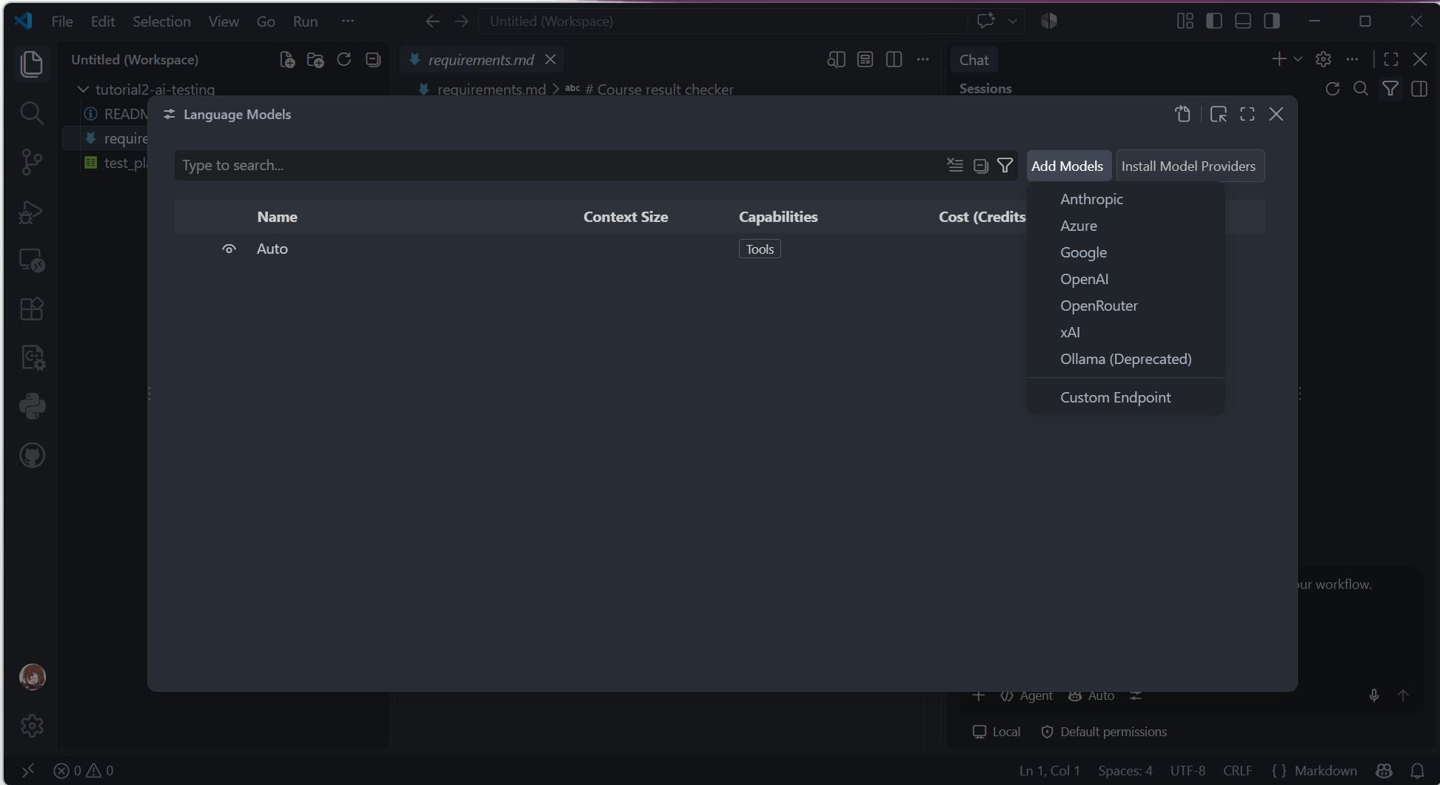
10
Choosing a chat model
Open the model picker in Chat.
Select an available model.
Repeat one question and compare the explanation.
Available choices depend on your account, location and service settings.
Notes:
The model picker is in the chat input area. Demonstrate one supported selection on the classroom account. Auto is an option when available. Do not use a fixed provider-model list in the slides. Check actual availability in Hong Kong before capturing the screenshot, and crop or hide unavailable choices. Switching models may change the explanation but does not change the agreed requirements. If a workspace is in Restricted Mode the picker can show only Auto; this is a setup issue to resolve before the class using a folder you created or trust. Screenshot B should show the real picker, not a recreated interface.
[Sources]
https://code.visualstudio.com/docs/agent-customization/language-models
Checked 10 September 2026.
[/Sources]

Slide 11
11
AI agents and your review
An agent can choose actions, edit files and run tools, then use the results to decide what to do next.
Stage | How we use the AI
Requirements discussion | Ask questions and review proposed wording.
Implementation | After review, let Copilot edit and run code.
You decide the expected behaviour and review the evidence.
Notes:
Agent capability can reduce repetitive editing and test-running steps and provide execution feedback. It does not guarantee correctness. Use a review-only or Ask role if your installed version provides it for the requirements conversation. Otherwise explicitly request discussion only and do not accept premature edits. The precise role controls depend on the installed version. Later allow implementation and terminal actions only in this tutorial workspace. No additional agent service needs to be installed for the exercise.
[Sources]
https://code.visualstudio.com/docs/agents/concepts/agents
Checked 10 September 2026.
[/Sources]

Slide 12
12
Our project: a course result checker
A student wants a small program to decide a course result from coursework and exam marks.
The result depends on weighted marks and an exam minimum.
The program must recognise marks outside the allowed range.
We need to agree the exact rules before writing Python.
All grading rules in this exercise are fictional.
Notes:
Do not reveal code. Invite one ambiguity such as the weighting or whether an excellent coursework mark can compensate for a low exam mark. The rule card on slide 16 supplies the authoritative exercise decisions. These are not COMP1117 assessment weights.

Slide 13
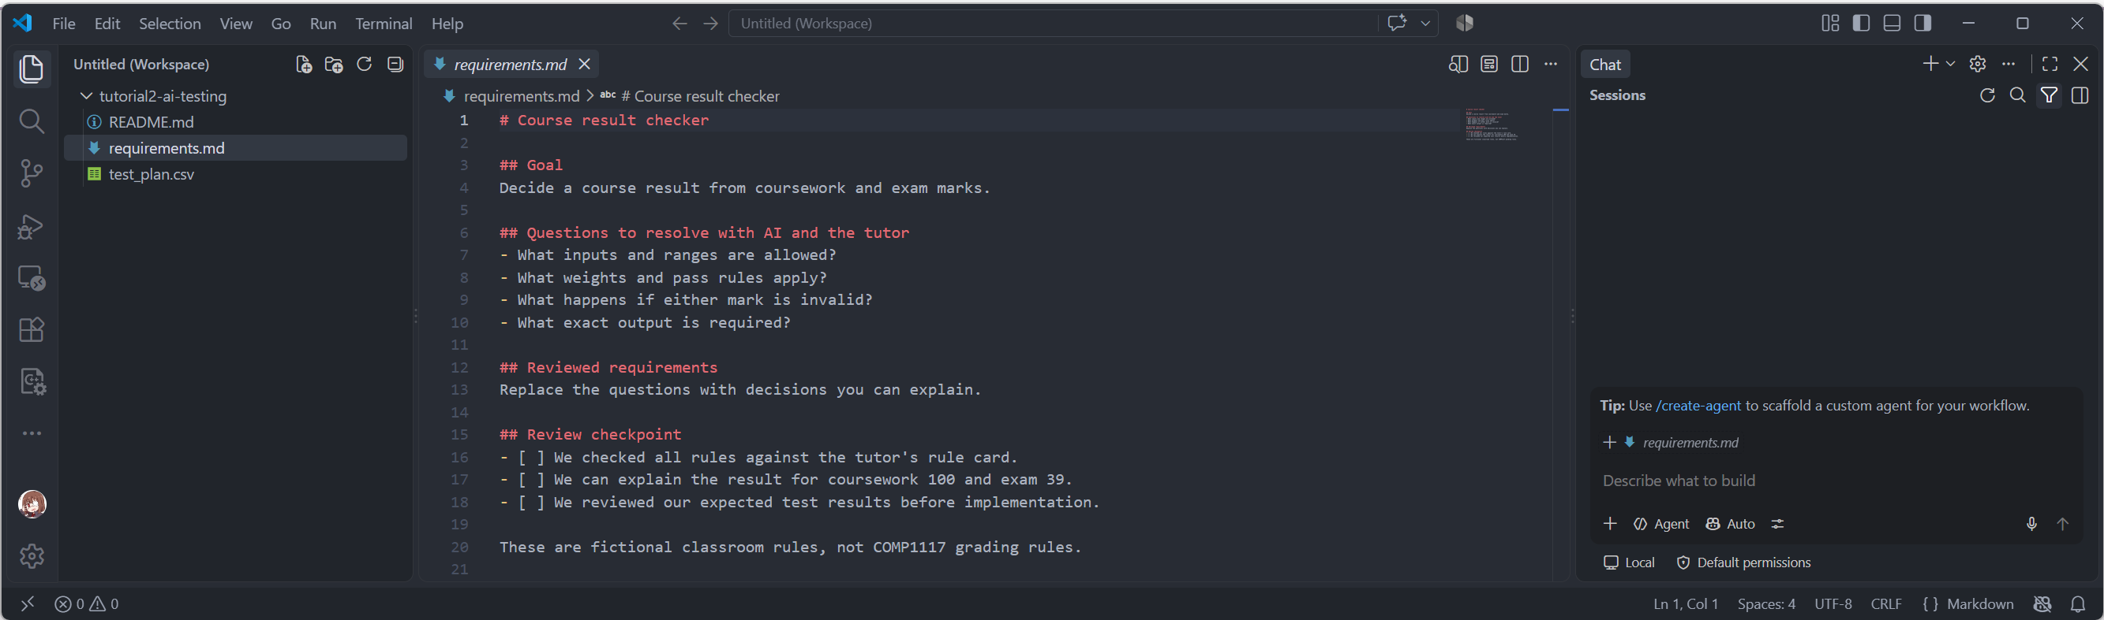
13
A workspace for the tutorial
Create tutorial2-ai-testing, then open it using File > Open Folder.
Save all files for this task in the same folder.
Notes:
Use the supplied student folder or create the same files manually. Opening a folder makes it the current workspace. The student folder contains a requirements template and an empty test table, with no implementation. Screenshot C should show the Explorer and the Markdown editor together. Before class, check Python runs in this workspace.
[Sources]
https://code.visualstudio.com/docs/editing/workspaces/workspaces
Checked 10 September 2026.
[/Sources]

Slide 14
14
Start requirements.md
# Course result checker
## Goal
Decide a result from coursework and exam marks.
## Questions to resolve
- What inputs and ranges are allowed?
- What weights and pass rules apply?
- What should happen for an invalid mark?
- What exact output is required?
This file records the decisions that your code must follow.
Notes:
A Markdown file is an ordinary text file with simple headings. The starter deliberately records questions instead of silently choosing rules. Students will replace unresolved questions with reviewed requirements. They should not implement the unanswered template.

Slide 15
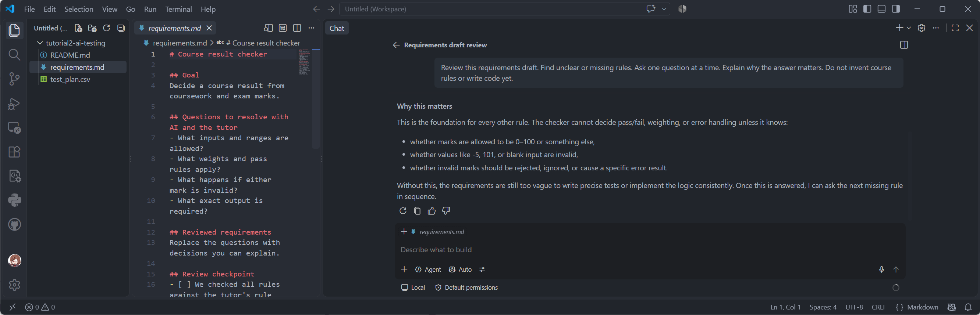
15
AI as a requirements reviewer
Attach requirements.md using Add Context or a # file mention.
Ask: “Find unclear requirements. Ask one question at a time. Do not invent course rules or write code yet.”
Answer from the brief. Ask why a missing detail matters.
Notes:
Use the supplied reviewer prompt. Attach the actual file using Add Context, a file mention selected from the menu, or drag and drop. A filename typed as ordinary text is not proof that the file was included. Ask the AI for one question at a time. If it starts writing a program, steer it back to requirements. Screenshot D must be a real conversation with questions and the student or tutor response, rather than a fabricated answer.
[Sources]
https://code.visualstudio.com/docs/chat/copilot-chat-context
Checked 10 September 2026.
[/Sources]

Slide 16
16
The tutor’s rule card
Topic | Agreed rule for this exercise
Inputs | Coursework first, exam second. Both are integers.
Valid range | Each mark is from 0 to 100 inclusive.
Weighted total | 40% coursework + 60% exam. Do not round.
Pass decision | Total is at least 50 AND exam is at least 40.
Invalid marks | If either mark is out of range, print Invalid.
Output / scope | Print only Pass, Fail or Invalid. One pair per run.
Use these fictional rules to answer the AI’s questions.
Notes:
This card supplies the facts that the AI cannot invent. Students can still discuss how to word the requirements clearly. Both endpoints are inclusive. Validate the inputs before deciding Pass or Fail. The output is one word followed by a newline. Inputs are guaranteed to be integer text for this exercise, so text/decimal parsing and repeated sessions are out of scope. The weighted total is used for the decision, not printed.

Slide 17
17
Reviewed requirements.md
# Course result checker
R1: Read coursework, then exam, as integers.
R2: Validate both marks: 0 to 100 inclusive.
R3: total = 0.4 * coursework + 0.6 * exam.
R4: Pass needs total >= 50 AND exam >= 40.
R5: Print Invalid, Pass or Fail only.
R6: Handle one pair of integer inputs per run.
Checkpoint: explain Invalid, Fail and Pass without looking at code.
Notes:
Review this compact reference with the class before implementing the program. R2 includes validating both marks before the pass decision. R4 applies only to valid marks. R5 means exactly one output word and a newline, with no input prompts or printed total. The full requirements document in the tutor materials gives these details. Ask a student to explain why coursework 100 and exam 39 gives Fail.

Slide 18
18
Predict outputs before coding
Coursework | Exam | Your prediction
50 | 50 | Pass or Fail? Why?
100 | 39 | Pass or Fail? Why?
80 | 101 | Valid or Invalid? Why?
Derive the answer from requirements.md before asking AI.
Notes:
Answers: 50 and 50 gives Pass because the total is 50 and the exam exceeds 40. 100 and 39 gives Fail because the exam minimum is not met. 80 and 101 gives Invalid because the exam exceeds 100. Ask for the relevant requirement as well as the output.

Slide 19
19
What is a test case?
A test records the inputs and the result required by the specification.
Coursework | Exam | Expected | Actual
100 | 39 | Fail | Fill in after running
Purpose: checks the exam minimum when the weighted total is high.
Notes:
Expected output is a prediction from the agreed requirement. Actual output is an observation from running the program. A useful purpose explains what fault the test could reveal. Keep these distinct in the test plan.
[Sources]
https://istqb.org/wp-content/uploads/2024/11/ISTQB_CTFL_Syllabus_v4.0.1.pdf
Checked 10 September 2026.
[/Sources]

Slide 20
20
Test groups and boundaries
What could go wrong? | Useful tests
Input validation | Check each mark at 0 and 100, and just outside.
Weighted threshold | Keep exam at 50. Try coursework 49, 50 and 51.
Exam minimum | Keep coursework at 100. Try exam 39, 40 and 41.
Ordinary behaviour | Try a clear pass and a clear fail.
Your test groups should cover every reachable if/elif/else branch.
Notes:
Holding one mark fixed makes the reason for a result easier to interpret. The exam-minimum tests use coursework 100 so the weighted total already exceeds 50. These tests isolate the exam rule. Check the range of each input independently. This combines equivalence groups and boundary-value reasoning.
[Sources]
https://istqb.org/wp-content/uploads/2024/11/ISTQB_CTFL_Syllabus_v4.0.1.pdf
Checked 10 September 2026.
[/Sources]
After grouping inputs, check that the groups contain tests for every reachable conditional branch. Use the next slide as a checklist, then verify against the actual code after implementation. An uncovered branch may reveal a missing group or test case. If a branch cannot be reached, inspect the requirement and code rather than assuming a test can exercise it.

Slide 21
21
Test groups and branch coverage
After implementation, check that your tests exercise both
True and False outcomes of each if/elif decision.
Example mapping for the reviewed implementation:
Branch taken | Coursework / Exam | Expected
if: a mark is outside 0–100 | 80 / 101 | Invalid
elif: both pass conditions hold | 80 / 80 | Pass
else: valid marks fail a pass rule | 100 / 39 | Fail
An uncovered branch means a missing test group or case.
Branch coverage is a minimum check. Keep boundary and separate-input tests.
Notes:
Here, groups means groups of input values, not groups of students. Start from requirements when choosing test groups. Once the implementation exists, run representative cases and check the paths actually taken. Each reachable if/elif decision should have both its True and False outcomes exercised.
The table maps three cases to the reviewed implementation: 80/101 takes the invalid branch, 80/80 takes the pass branch, and 100/39 takes the final else branch. Together they exercise the True and False outcomes of both decisions. Keep the more detailed tests that check each input range, the weighted threshold and the exam minimum. Branch coverage alone cannot show that all requirements are implemented correctly. An unreachable branch requires investigation.
[Sources]
https://istqb.org/wp-content/uploads/2024/11/ISTQB_CTFL_Syllabus_v4.0.1.pdf
Section 4.3.2, checked 11 September 2026.
[/Sources]

Slide 22
22
Reference tests and their purpose
Coursework | Exam | Expected | Purpose
80 | 80 | Pass | Ordinary passing case
49 | 50 | Fail | Weighted total just below 50
50 | 50 | Pass | Weighted total exactly 50
100 | 39 | Fail | Exam just below its minimum
100 | 40 | Pass | Exam exactly at its minimum
−1 | 80 | Invalid | Coursework below its range
80 | 101 | Invalid | Exam above its range
This is a starting set. Add the remaining input-range edges.
Notes:
Walk through the purpose and expected output of each reference test with the class before requesting implementation. The weighted totals for the first five cases are 80, 49.6, 50, 63.4 and 64. Invalid input takes priority over scoring. Use test_plan.csv to record expectations before execution. The groups collectively cover Invalid, Pass and Fail. More boundary cases, ordinary failing inputs and extreme invalid inputs are in the tutor reference CSV. No finite example set proves correctness for all possible inputs.

Slide 23
23
Implementation after the review
Attach requirements.md and test_plan.csv.
“We have reviewed these requirements and expected results.
Explain your plan and wait for my review. After approval, create result_checker.py using beginner-level Python. Keep the agreed requirements and test expectations.
Run the cases and report the command, actual output and any mismatch. Explain every change you make.”
Review the plan and code. Keep the required evidence.
Notes:
This implementation request comes after students have understood and reviewed the requirements and designed tests. That sequence is essential. In a live demo, first request the plan and wait for students to approve it. Then permit implementation and terminal execution in the tutorial workspace. Review the file changes and actual command outputs. If the live attempt takes over two minutes, move to the supplied teaching draft for the test-and-repair exercise.
[Sources]
https://code.visualstudio.com/docs/chat/copilot-chat-context
https://code.visualstudio.com/docs/agents/concepts/agents
Checked 10 September 2026.
[/Sources]

Slide 24
24
A teaching draft with bugs
Use this deliberately faulty draft to practise verification.
cw = int(input())
exam = int(input())
total = (4 * cw + 6 * exam) / 10
if cw < 0 or cw > 100:
print("Invalid")
elif total > 50:
print("Pass")
else:
print("Fail")
Notes:
This code is a prepared teaching example, not a claimed result from any specific AI prompt. Save or open tutor-materials/teaching_draft.py. It contains three independent faults: it validates only coursework, uses a strict greater-than comparison for the total, and ignores the exam minimum. Do not reveal all faults before students run and interpret the tests.

Slide 25
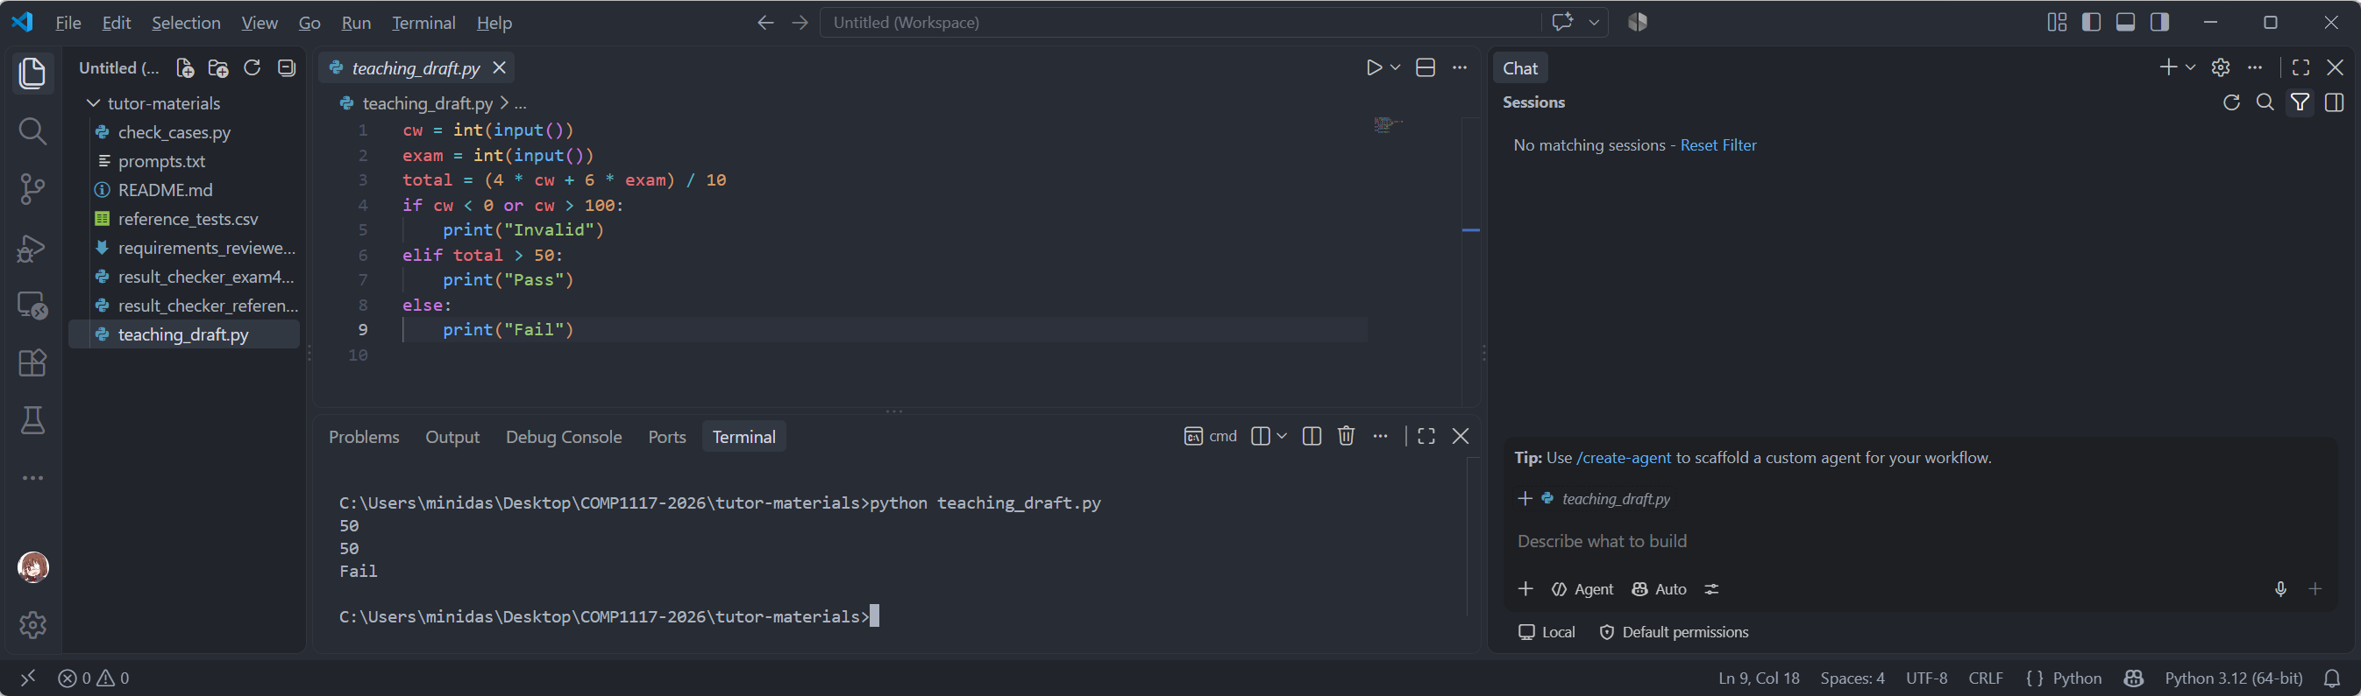
25
Run tests and record evidence
Run the program again for each input pair. Record what it prints.
SCREENSHOT E: Terminal input and actual output
Run teaching_draft.py. Enter 50, then 50. Show the command, both inputs and the actual output Fail.
Expected: Pass. Actual from this draft: Fail.
Notes:
Screenshot E must show a real terminal run of the supplied teaching draft, using python teaching_draft.py on Windows or python3 teaching_draft.py where needed. The program reads coursework on the first line and exam on the second line. Inputs 50 then 50 produce Fail in this deliberately faulty draft. Run the code again for the next case. Students using their own generated implementation should record their actual output, which may already be correct. Do not replace an observed result with the reference draft result.
[Sources]
https://docs.python.org/3/tutorial/controlflow.html
Checked 10 September 2026.
[/Sources]

Slide 26
26
What the tests reveal
Coursework / Exam | Expected | Draft output | Verdict
80 / 80 | Pass | Pass | Passed
50 / 50 | Pass | Fail | FAILED
100 / 39 | Fail | Pass | FAILED
80 / 101 | Invalid | Pass | FAILED
A passed ordinary test can coexist with several broken rules.
Notes:
These results were verified by executing the prepared teaching draft. Ask students to map each failure to R2 or R4. 50/50 identifies the weighted threshold; 100/39 identifies the exam minimum; 80/101 identifies missing exam-range validation. The reference results do not describe every possible AI-generated implementation.

Slide 27
27
A bug report tied to a requirement
Field | Example
File and inputs | teaching_draft.py: coursework 100, exam 39
Expected / actual | Expected Fail, but the program printed Pass.
Requirement | R4 requires the exam mark to be at least 40.
Why this case helps | Total is 63.4, so it isolates the exam-minimum rule.
Describe the failing rule before suggesting a code change.
Notes:
This report includes a reproducible input, observed output and an explicit rule. Students can ask the AI to diagnose the mismatch, but should assess the proposed cause themselves.

Slide 28
28
Repair with AI, then retest
“For coursework 100 and exam 39, the program printed Pass. R4 requires Fail because the exam minimum is 40.
Explain the cause and propose a small fix. Keep the expected results unchanged. After the fix, rerun the full test plan and show the actual outputs.”
Inspect the change and the run results before accepting the repair.
Notes:
Let students review a proposed repair before accepting it. They should insist on rerunning the whole test plan, since a local fix may leave the other two faults unresolved or introduce a regression. If AI claims a test passed, look for the executed command and output.

Slide 29
29
A reviewed implementation
cw = int(input())
exam = int(input())
if cw < 0 or cw > 100 or exam < 0 or exam > 100:
print("Invalid")
elif exam >= 40 and 4 * cw + 6 * exam >= 500:
print("Pass")
else:
print("Fail")
4 × coursework + 6 × exam ≥ 500 means a weighted total ≥ 50.
Notes:
cw is an abbreviation for coursework. Explain the validation branch first, then the conjunction in the pass condition. Multiplying the weighted-total threshold by 10 gives an equivalent integer comparison, avoiding a rounding decision. The code prints exactly one word. Students need to understand the branches, not memorise them. Keep this page as follow-up reading if the demonstration is running late.

Slide 30
30
Regression and missing cases
Retest | Reason
Original test plan | Check behaviour that worked before the repair.
Other input-range edges | Try 0, 100 and the missing out-of-range side.
Ordinary fail: 20 / 20 | Check ordinary behaviour as well as failures.
Every test that exposed a bug | Detect the same fault if it returns.
A code fix keeps the agreed requirements and expected answers.
Notes:
Ask students to add 0/100 (Pass), 100/0 (Fail), 101/80 (Invalid) and 80/−1 (Invalid). Non-integer input is outside the agreed contract here. Later, a requirement change can legitimately change expected answers, which is the point of the next exercise.
[Sources]
https://istqb.org/wp-content/uploads/2024/11/ISTQB_CTFL_Syllabus_v4.0.1.pdf
Checked 10 September 2026.
[/Sources]

Slide 31
31
Independent check: a changed rule
4 minutes: predict first, then discuss with AI.
Change only the minimum exam mark from 40 to 45.
Keep the weighting and the weighted pass threshold unchanged.
Update R4 in requirements.md.
Design a pair of tests at the new exam boundary.
Identify an old expected answer that must now change.
Notes:
Move here at minute 40. Students work independently for four minutes, then compare answers with the class. They should update the requirement and the affected expected results before requesting a code change. Coursework 100 with exams 44 and 45 isolates the new boundary.

Slide 32
32
Compare your new tests
Coursework | Exam | New expected | Reason
100 | 44 | Fail | Just below the new exam minimum
100 | 45 | Pass | Exactly at the new minimum
100 | 40 | Fail | An old Pass now changes to Fail
50 | 50 | Pass | Weighted threshold is unchanged
Change expected answers when the requirement changes, and explain why.
Notes:
For 50/50, the weighted threshold remains exactly 50 and the exam satisfies 45. This is an unaffected weighted-boundary case. Ask students to distinguish changing a requirement from changing a test just to make faulty code pass. After reviewing the new tests, they may ask AI to implement the revised requirement and rerun the plan.

Slide 33
33
Exit check and evidence
Which requirement did AI help you clarify?
Why can 100 / 39 expose a bug that 80 / 80 misses?
Which actual output shows that your repair worked?
Can you explain the final code without asking AI?
Keep requirements.md, the test plan, code and the required AI-use record.
Notes:
Use the final three minutes for two short answers and the evidence checklist. Remind students that the assignment rubric determines what to submit and how it is graded. The tutorial files are examples of evidence, not a newly invented submission policy.

Slide 34
34
References and setup links
HKU GenAI access
HKU Copilot setup
VS Code Chat
Choosing a chat model
Adding files as context
Test design: ISTQB syllabus
Python control flow
Notes:
Service guidance was checked against HKU ITS and Microsoft VS Code documentation on 10 September 2026. Only HKU GenAI and the HKU-documented GitHub Copilot route are presented as services for this tutorial. Model availability must be confirmed for the classroom account and Hong Kong location. The coursework/exam requirements and all test cases are fictional teaching materials. The testing terminology follows the ISTQB Foundation Level syllabus.
[Sources]
https://its.hku.hk/services/ai-as-a-service/hku-chatgpt/
https://its.hku.hk/software/github-copilot/
https://code.visualstudio.com/docs/chat/chat-overview
https://code.visualstudio.com/docs/agent-customization/language-models
https://code.visualstudio.com/docs/chat/copilot-chat-context
https://code.visualstudio.com/docs/editing/workspaces/workspaces
https://code.visualstudio.com/docs/agents/concepts/agents
https://istqb.org/wp-content/uploads/2024/11/ISTQB_CTFL_Syllabus_v4.0.1.pdf
https://docs.python.org/3/tutorial/controlflow.html
Checked 10 September 2026.
[/Sources]

