Slide 1

1
COMP1117 Tutorial 5
ADVANCED GITHUB · BRANCHING, FORKING & MERGING

Slide 2

2
Learning outcomes
Tutorial 5: Advanced GitHub
  Conceptual differences between Forking, Branching, and Cloning.
  How to Fork a template repository on GitHub and Clone it using VS Code.
  How to create, switch, and publish feature branches in VS Code.
  How to open, review, and merge a Pull Request (PR) on GitHub.
  How to identify and resolve Merge Conflicts using VS Code's diff editor.
Notes:
Overview of today. Today is mostly hands-on setup; the two tasks near the end are where students practise on their own laptop.

Slide 3
3
From Basics to Advanced Workflows
Last Tutorial (Tutorial 4): Introduced Git vs. GitHub, creating local repositories, commits, pushes, and pulls on the main branch
This Tutorial: Advanced team collaboration using repository forks, VS Code cloning, isolated feature branches, Pull Requests, and merge conflicts.
Quick Check: Open VS Code and ensure Git is authenticated with your GitHub account.
Notes:
Overview of today. Today is mostly hands-on setup; the two tasks near the end are where students practise on their own laptop.

Slide 4
4
Our 50-Minute Tutorial Agenda
Time | Topic / Activity
0-10 min | Collaboration Models — Branching, Forking, and Important Terms.
10-20 min | Branch Management — Creating & publishing branches in VS Code.
20-32 min | Pull Requests — Submitting and reviewing PRs on GitHub.
32-44 min | Merge Conflicts — Simulating and resolving conflicting code.
44-50 min | Best practices, summary, and exit check
Notes:
Leave this slide on screen during the exercise time.

Slide 5
5
What is a Branch?
Concept: An independent line of development extending from your repository history.
Why Branching Matters:
  Isolation: Develop new features without breaking working code on main.
  Parallel Work: Multiple team members work on separate tasks simultaneously.
  Safe Experimentation: Test changes freely before merging into production.

Slide 6
6
Important Terms
Key Vocabulary:
  main: The primary, stable default branch of a repository.
  Feature Branch: A temporary branch dedicated to a specific task or feature.
  Switch / Checkout: Moving your working environment from one branch to another.
  Merge: Integrating history and changes from one branch into another.
  Pull Request (PR): A GitHub request to review and merge branch changes.
  Fork: A personal server-side copy of another user's GitHub repository.

Slide 7
7
Fork vs. Clone vs. Branch
Fork
Clone
Branch
Copies a remote repo to your personal GitHub account
GitHub Account A → Account B
Used when you lack write access to the original, e.g., contributing to open-source or template repos.
Downloads a local copy of a remote repo to your computer
Remote GitHub → Local PC
Used for individual work on a local copy
Creates an isolated line of work inside the same repository
Inside the same Repo
Used for course group projects with teammates
Notes:
Key analogy for the whole tutorial: Python = the translator who understands Python; VS Code = the notebook you write in. The notebook cannot calculate; the translator has no nice place to write. Install both.

Slide 8
8
Which Workflow Should You Use?
In-Repo Branching Model (Shared Repository):
  Used when all team members have direct write access.
  Everyone creates feature branches directly inside the group repository.
  Best for: Group projects and private team repos.
Forking Model (Cross-Repository):
  Used when you do not have write access to the original repository
  You fork the template to your account → clone your fork → push to your fork → submit a PR back to the original repo.
  Best for: Contributing to open-source projects.

Slide 9
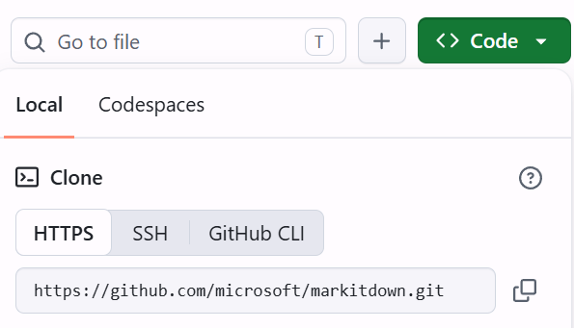
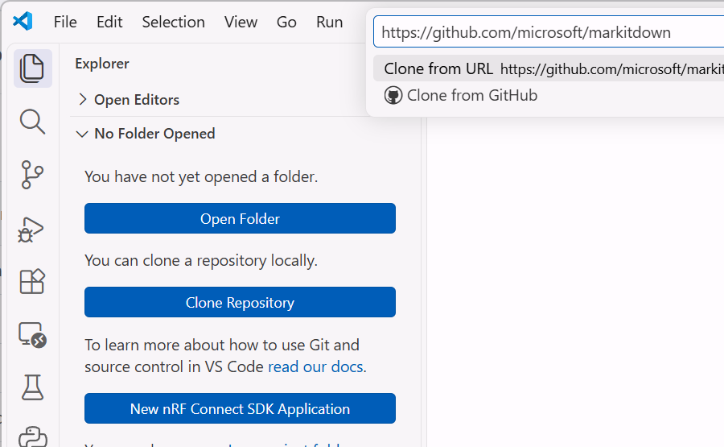
9
How to Clone a Repository in VS Code
Copy the repository HTTPS URL from GitHub (click green Code button → copy URL).
Open VS Code with no folder loaded.
Click the Clone Repository button directly in the Explorer view (or Source Control panel / Welcome tab).
Paste the copied HTTPS URL into the top prompt and press Enter.
Select a local directory on your PC and click Open when prompted.
① Copy URL
④ Paste URL and press Enter
③ Click Clone Repository

Slide 10
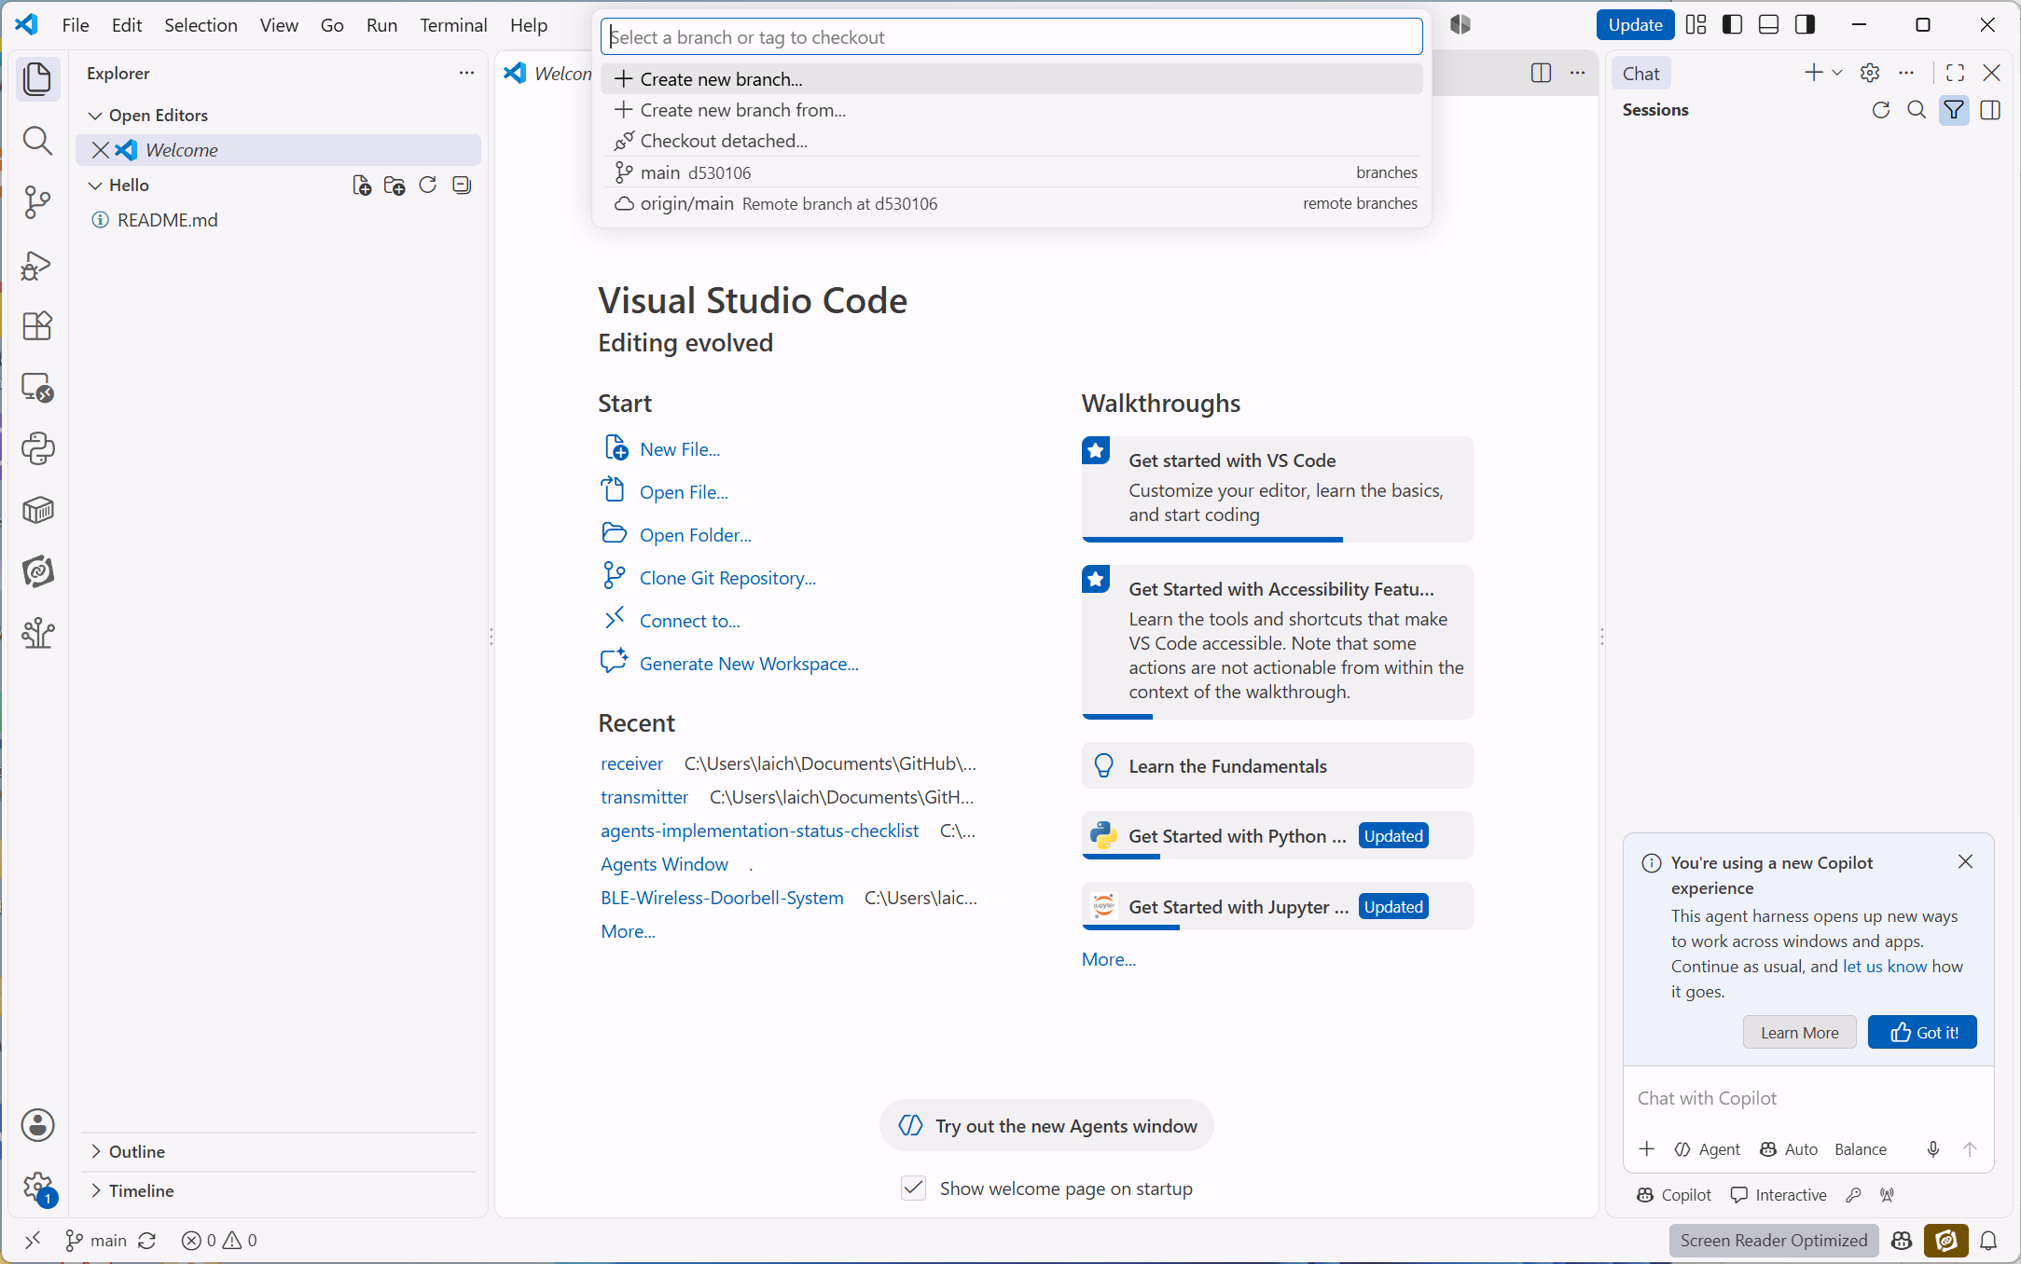
10
Branching Workflow:
Step 1 - Create a Feature Branch
Click the current branch name (e.g., main) in the bottom-left status bar.
Select + Create new branch... from the top Command Palette.
Enter a descriptive branch name: E.g., feature-add-greeting.
②
①

Slide 11
11
Make changes, commit, publish
Edit & Stage
Commit Locally
Publish to Github
Modify files and click the Stage (+) icon in the Source Control panel.
Type a meaningful message and click Commit.
Click Publish Branch to upload to the server.
These changes are isolated - the main branch remains untouched!

Slide 12
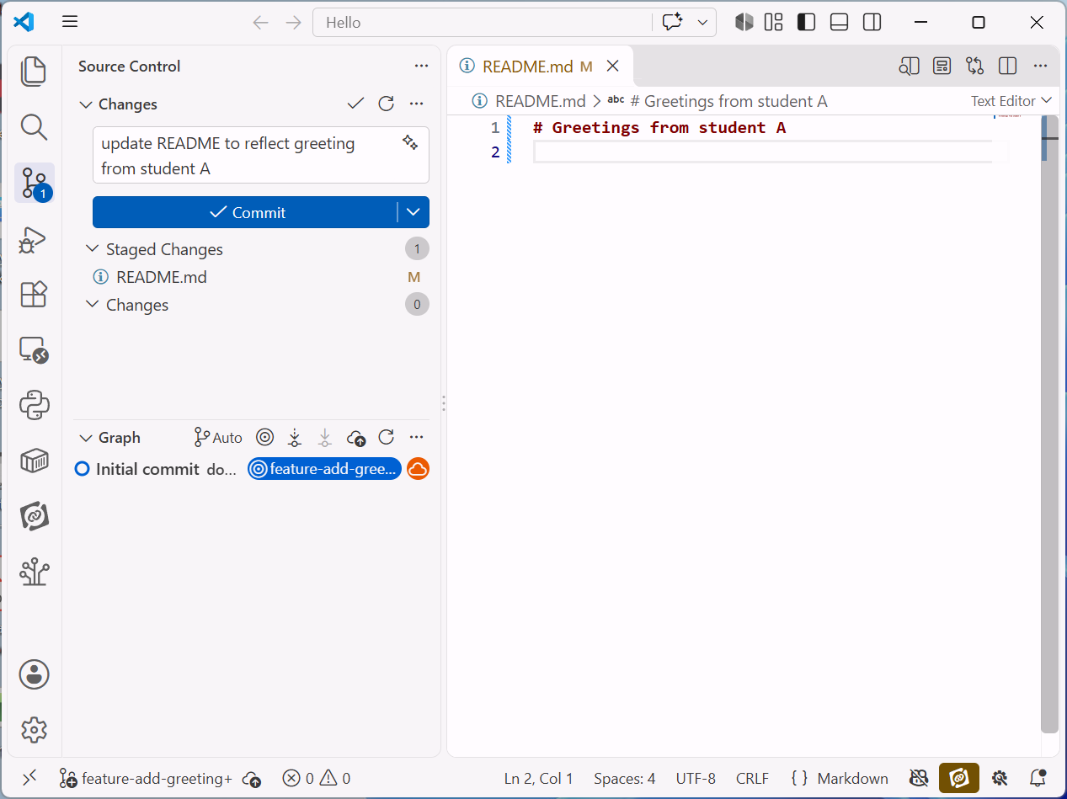
12
Branching Workflow:
Step 2: Make & Commit Changes
Source Control
Generate Commit Message
Hands-on Practice:
  Edit README.md or a Python script on your new branch.
  Open the Source Control panel in VS Code.
  Stage your changes using the + icon, type a commit message (e.g., "Add personalized greeting function"), and click Commit.
Tip - Responsible AI Collaboration:
You can use AI tools (e.g., GitHub Copilot / VS Code Chat) to summarise staged diffs into clear commit messages.
Human Oversight Rule: Always review, verify, and take responsibility for AI-suggested messages before committing.
Current branch

Slide 13
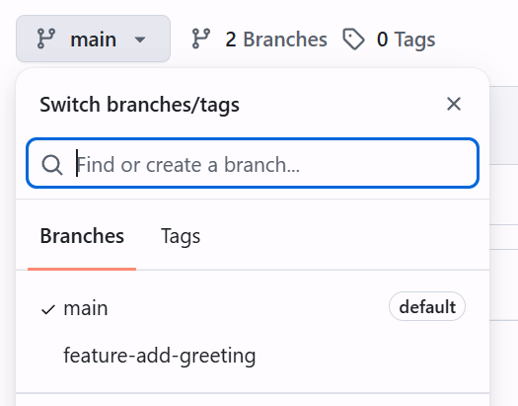
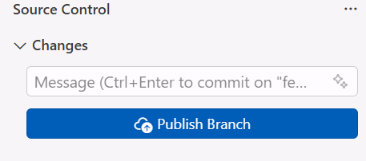
13
Branching Workflow:
Step 3: Publish the Branch to GitHub
In the Source Control panel, click Publish Branch.
VS Code uploads your local feature branch to GitHub.
Refresh your GitHub repository page to verify the new branch in the branch dropdown menu.
① Publish Branch in VS Code
③ Verify the new branch in GitHub page

Slide 14
14
Pull Request (PR) & Branch Protection
Definition: A GitHub feature for proposing and discussing code changes before incorporating them into main.
Key Benefits:
  Enables peer review and discussion on code quality.
  Displays inline visual diffs showing added and deleted lines.
  Allows automatic testing checks before merging.
Branch Protection Rules:
  Real-world projects block direct pushes to main to prevent accidental breaking changes.
  All updates must go through a feature branch and an approved Pull Request.

Slide 15

15
Create a PR on GitHub
Open your repository on github.com.
Click the "Compare & pull request" banner for feature-add-greeting.
Fill in a descriptive title and summary of changes (e.g., "Add personalized greeting function to README.md").
Click "Create pull request".
Click "Merge pull request" → "Confirm merge".
AI Tip: Use Copilot / GenAI to draft PR summaries, but verify accuracy before publishing!

Slide 16
16
What is a Merge Conflict?
Scenario: Occurs when two branches edit the same lines of the same file differently before merging.
Conflict Markers:
  <<<<<<< Current Change (Your current branch edits)
  ======= (Separator)
  >>>>>>> Incoming Change (Edits from the branch being merged)
Resolution Actions:
  Accept Current Change | Accept Incoming Change | Accept Both Changes

Slide 17
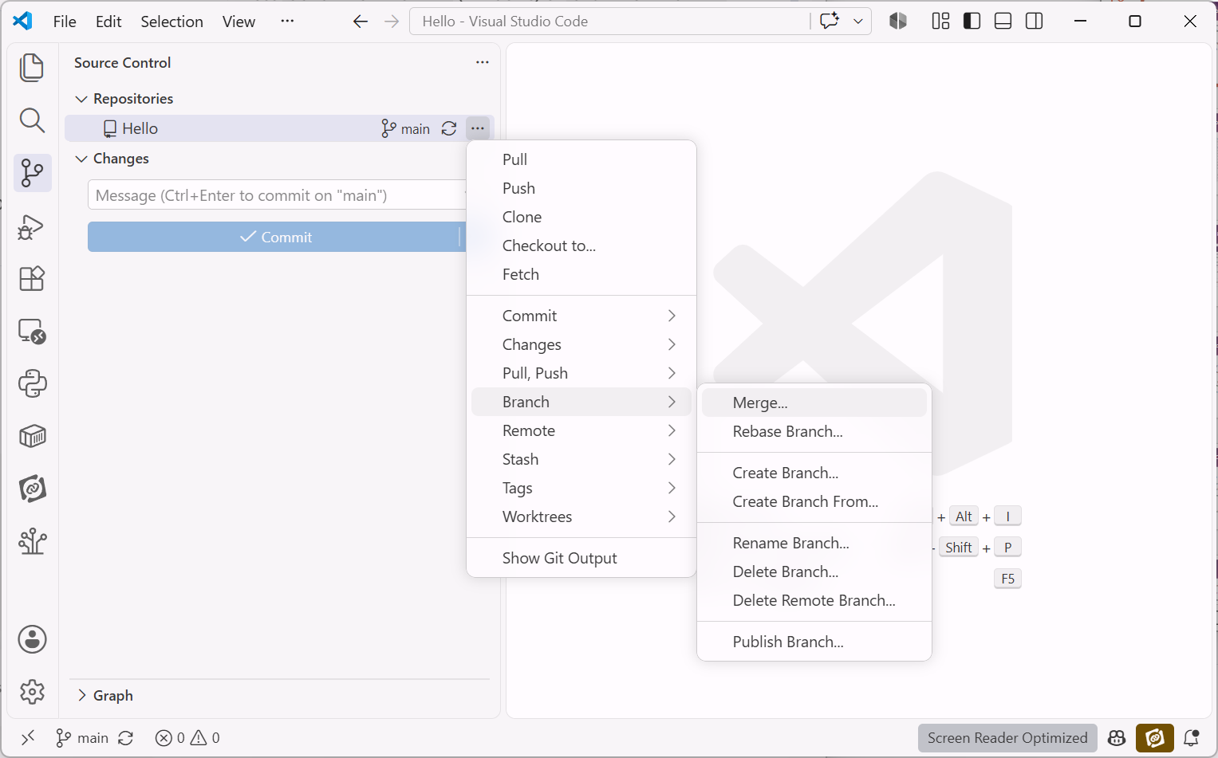
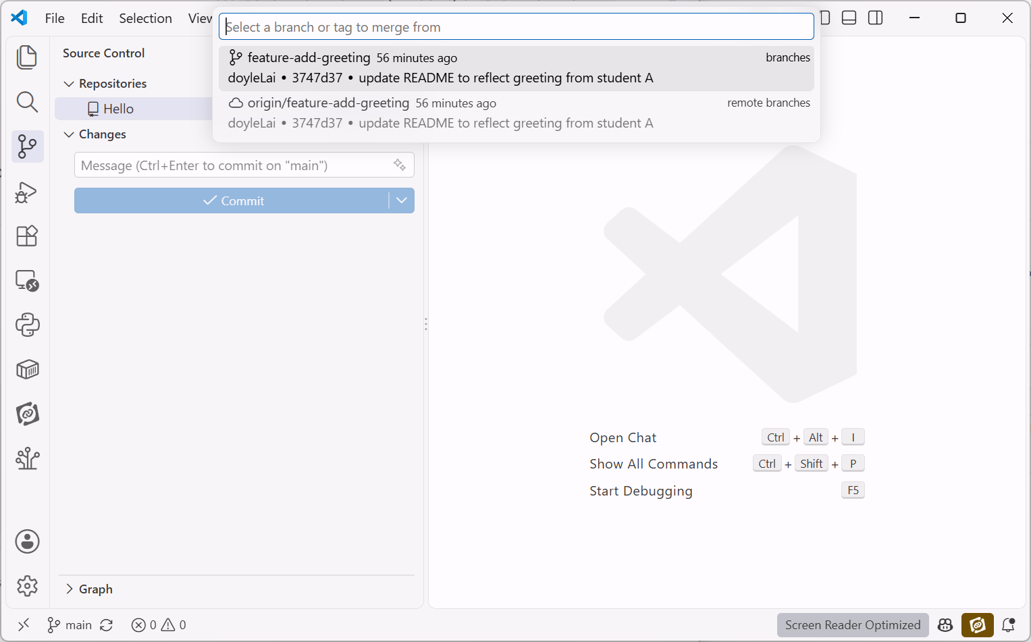
17
Practical Conflict Resolution Exercise
Edit line 1 of README.md on main and push to GitHub.
Edit line 1 of README.md differently on feature-branch.
Try to merge feature-branch into main
  Switch back to the main branch using the bottom-left status bar.
  Click … → Branch → Merge → select main

Slide 18
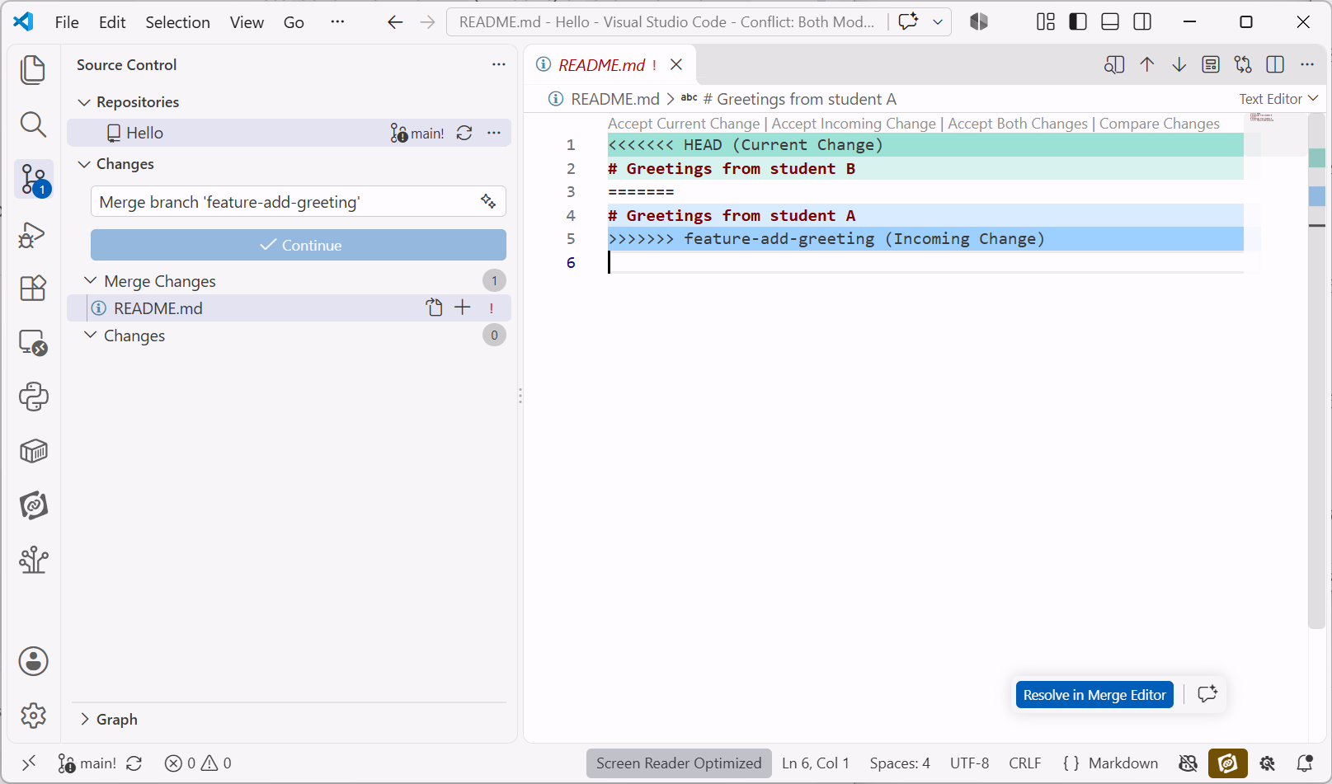
18
Practical Conflict Resolution Exercise
Open README.md flagged under Merge Changes in the Source Control panel.
Click Accept Current Change (keep main) or Accept Incoming Change (use feature branch)
⑤ Click to resolve conflict
④ Open the flagged file

Slide 19
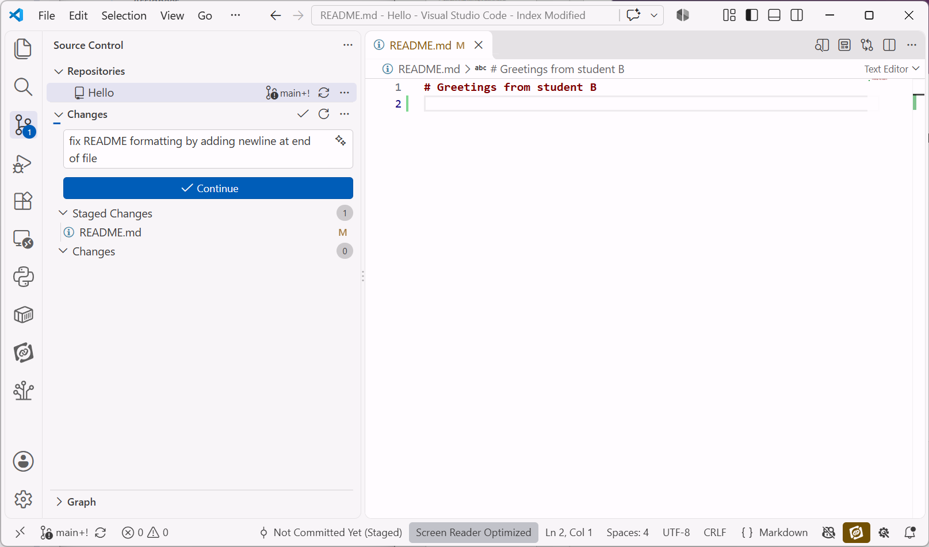
19
Practical Conflict Resolution Exercise
After resolving conflicts, save the file
Click + (Stage) next to README.md in the Source Control panel.
Type change message.
Click Continue, then click Sync Changes to push to GitHub.
⑨ Click Continue

Slide 20
20
Troubleshooting Checklist
You see… | Likely Cause | How to Fix
Permission Denied (403) when pushing | Trying to push directly to a repository where you lack write access. | Fork the repository first, push to your fork, and submit a Pull Request.
Push Rejected / Non-Fast-Forward | Remote branch contains newer commits than your local laptop. | Click Sync Changes / Pull first to incorporate remote updates before pushing.
Accidentally edited code on main | Forgot to switch to a feature branch before typing. | Click main in status bar → + Create Branch (VS Code safely carries your uncommitted edits over!).
<<<<<<< markers inside file | Unresolved merge conflict. | Open file in VS Code, click Accept Current / Incoming, stage (+), and commit.

Slide 21
21
Good Practices for Team Collaboration
Best Practices:
  Keep main clean: Never code directly on main; always use feature branches.
  Pull before branching: Run pull on main before creating a new branch to stay up to date.
  Meaningful branch names: Use clear prefixes like feature/add-greeting, bugfix/fix-greeting-bug, or docs/update-readme.
  Clean up: Delete feature branches on GitHub after merging.

Slide 22
22
Common Branching Workflow
Workflow Steps:
  Fork repo on GitHub (if template) → Clone in VS Code via Clone Repository button.
  Pull on main to ensure latest changes.
  Create and switch to a feature branch (feature-add-greeting).
  Edit files, stage (+), write a commit message (with AI assistance + human check), and commit.
  Publish branch to GitHub.
  Open a Pull Request on GitHub, resolve any merge conflicts, and merge into main.

Slide 23
23
Today You Have Learnt & Exit Check
Recap:
  The difference between Forking, Branching, and Cloning.
  How to Fork on GitHub and Clone via VS Code's Explorer/Source Control button.
  How to create, switch, and publish branches in VS Code.
  How to create and merge Pull Requests.
  How to resolve merge conflicts and troubleshoot common Git errors.
Exit Check:
  Can you create a branch, commit a change, and open a PR?

Slide 24
24
Q & A
Please feel free to post on Moodle Forum if you have questions.
But don’t copy and paste your own code to the Moodle forum.
When asking about an error, paste the error message (the last few lines in the terminal) or a screenshot of it — it helps us help you.
Notes:
Encourage forum questions with screenshots of the error (terminal lines), not full code.

