Slide 1

Bolotova Ekaterina
Illarionov Alexey
BANK DATA ANALYSYS (v1)
Big Data Based Marketing Analytics

Slide 2

DATA DESCRIPTION
Age
Country
City
Registration date
Last visit date
Has email
Has app
Has phone
Has push
Date
MCC id
Customer id
Sum
Quantity
TRANSACTIONS DATASET
CUSTOMERS DATASET
MCC CODES
(Id & name)

Slide 3

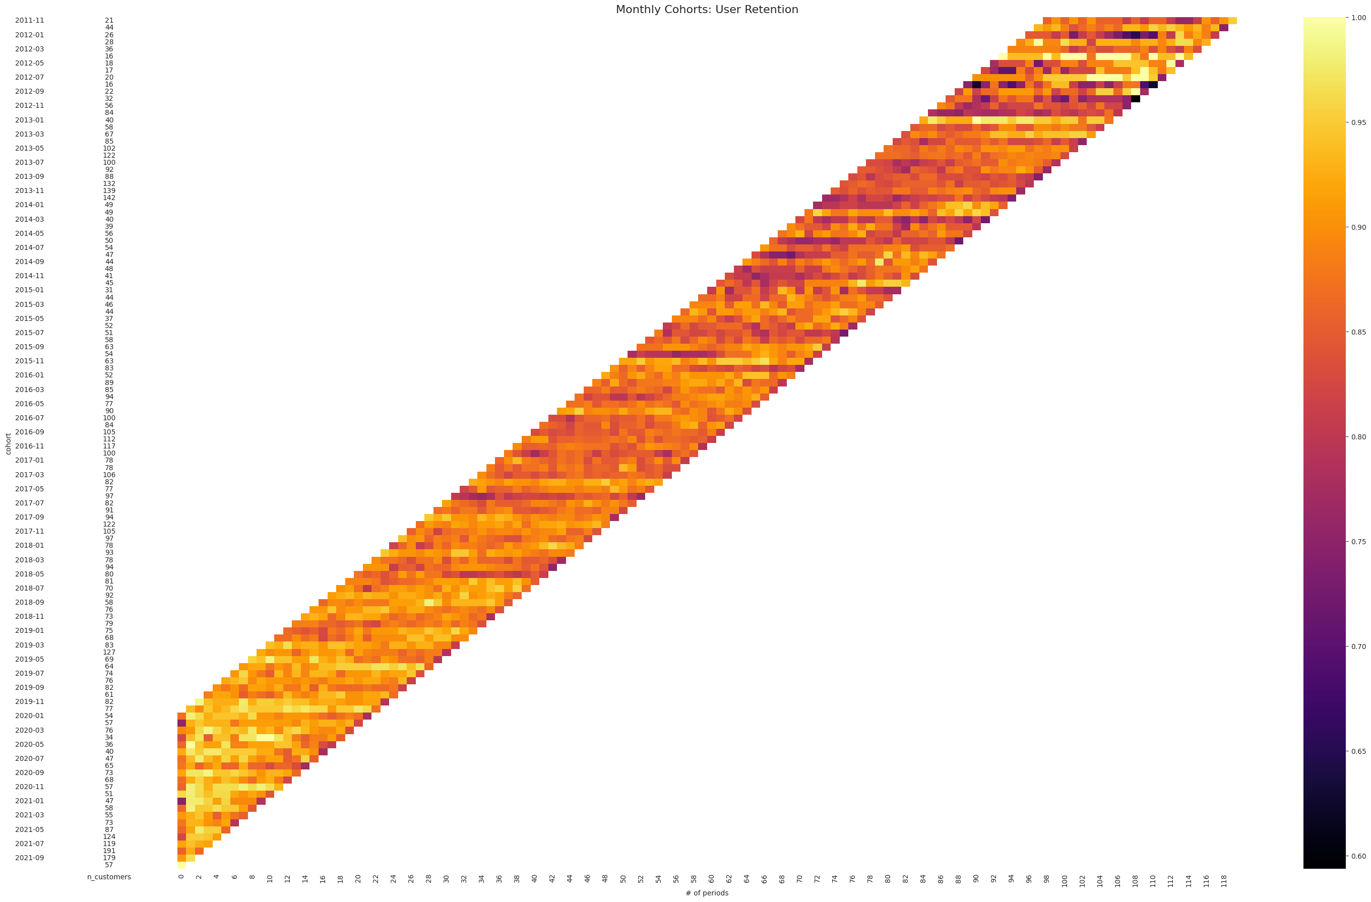
COHORT ANALYSIS
As part of the cohort analysis of available data, we identified cohorts based on the date of user registration. Next, for each cohort, we analyzed whether transactions were made within months following registration.
The first conclusion that can be drawn from analyzing the diagram is that transactions within the bank did not start at the moment of user registration. This either indicates that our data is limited to 2019 and 2020, or that this is a new feature released in 2019.
The second conclusion is that previously registered users use transactions averagely less actively, especially in the upper half of the graph

Slide 4

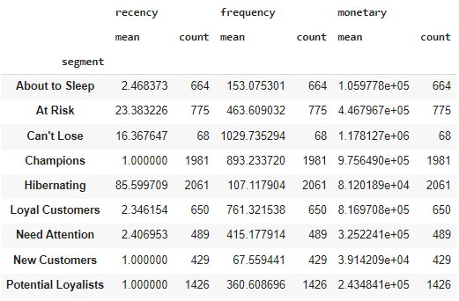
RFM ANALYSIS
Next, we conducted an RFM analysis, in which we calculated recency as the number of days before the current date (2021.10.13), frequency as the total number of transactions, and monetary as the total amount of all transactions.
Next, we divided the data into quartiles and calculated the final RAM score according to the quartile obtained, taking into account R_Quartile, the average of F_quartile and M_quartile. And we defined the end segment based on the mapping of values.

Slide 5
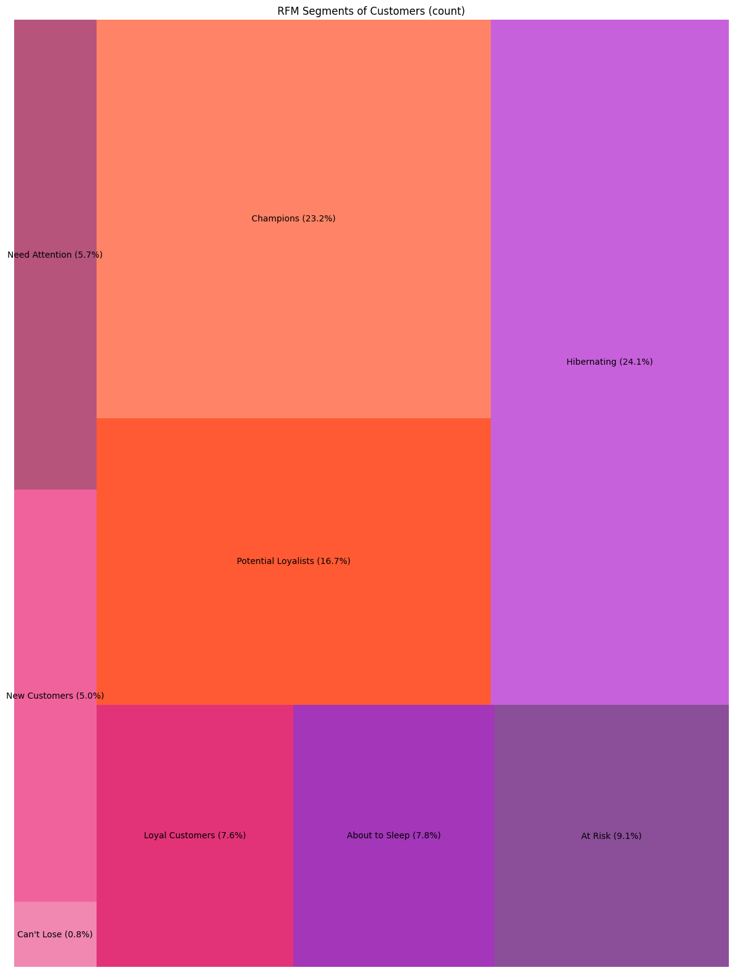
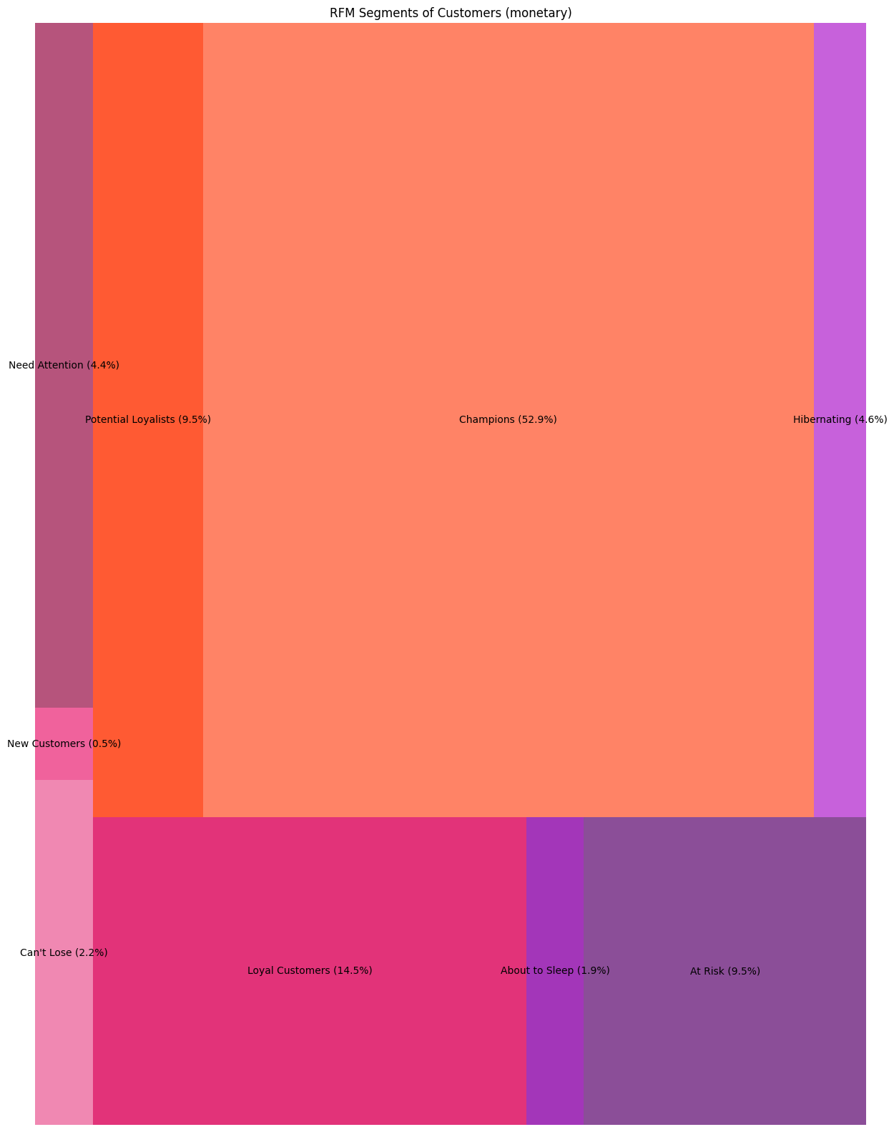
RFM ANALYSIS

Slide 6
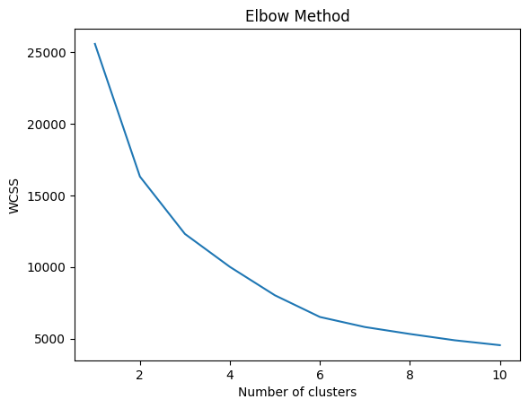
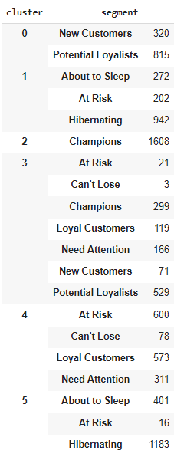
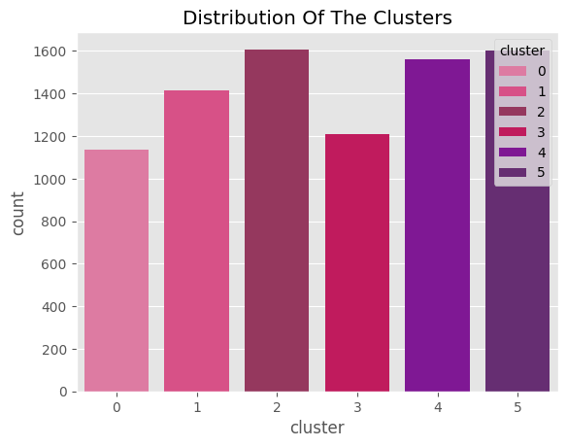
CLASTER ANALYSIS
When using these features, it was possible to exclude clusters with a small number of users and divide the current segments by age
Based on the following features: FM quartile, R quartile and user’s age, we calculated the optimal number of clusters, which is 6.

Slide 7
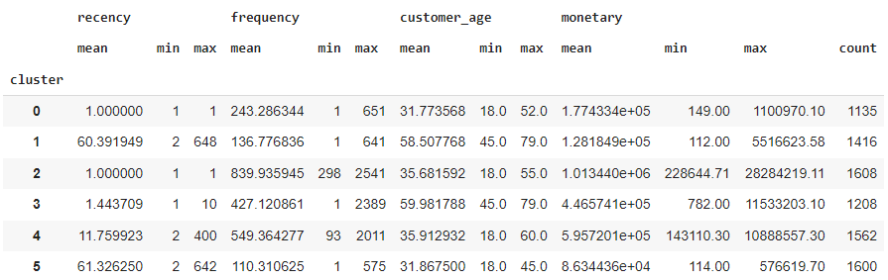
KPI METRICS
0 - Transaction Frequency, Average Transaction Value
1 - Customer Retention Rate
2 - Average Transaction Value
3 - Customer Retention Rate, Transaction Frequency
4 - Customer Retention Rate
5 - Customer Retention Rate

Slide 8
MARKETING INITIATIVES
0 | Cashback Implementation on certain products to increase frequency and monetary.
1 | Marketing campaigns with current bonuses and special offers; Informative Guides how to you use mobile app. Loyalty program.
2 | -
3 | Marketing campaigns with current bonuses and special offers; Informative Guides how to you use mobile app. Loyalty program.
4 | Marketing campaigns with current bonuses and special offers; Cashback Implementation on certain products to increase frequency and monetary; Loyalty program.
5 | Marketing campaigns with current bonuses and special offers; Cashback Implementation on certain products to increase frequency and monetary; Loyalty program.

Slide 9
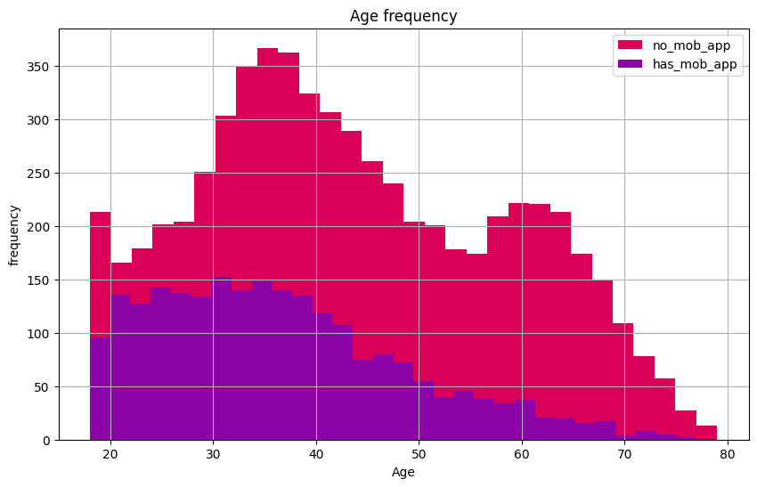
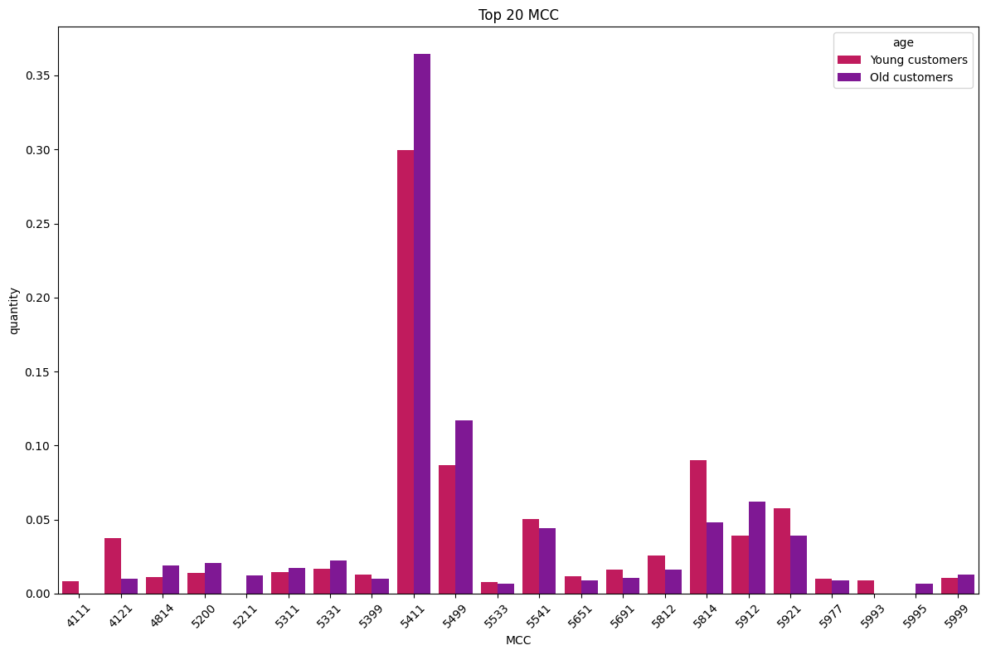
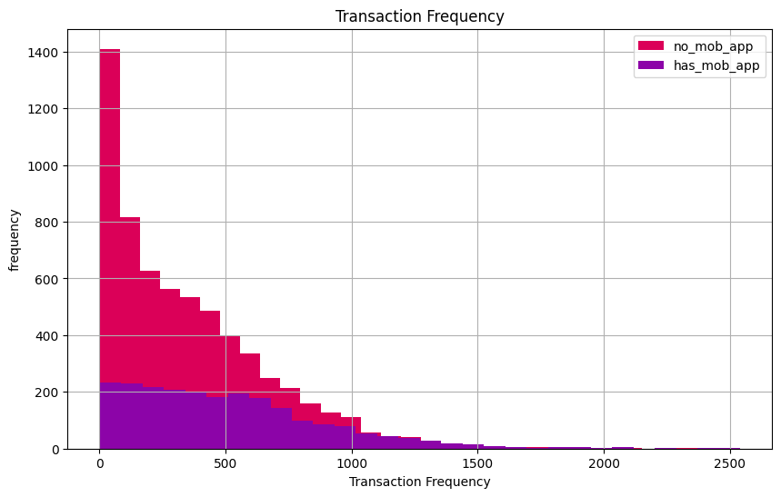
SEVERAL HYPOTHESES
It was also necessary to assess the impact of the application on the number of transactions made by users.
Since the division into clusters was made with regard to the age of users, it is worthwhile to check the hypothesis of a difference between young and older customers using the app.
In the end, we also checked whether there is a difference between the preferred products in the context of younger and older generations.

Slide 10

MARKETING STRATEGY
1
Cashback Implementation on certain products (for example “Grocery Stores and Supermarkets”) to increase TF and ATV
2
Email marketing campaigns for older customers and app marketing campaigns with current bonuses and special offers to increase CRR
3
Informative guides how to you use mobile app for older customers to increase app usage and TF as consequences
4
Develop and implement loyalty program to increase CRR
Of course, it requires additional research on the impact

Slide 11

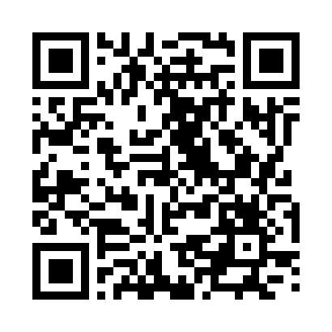
BANK DATA ANALYSYS (v1)
Big Data Based Marketing Analytics
Bolotova Ekaterina, Illarionov Alexey
Link to github

