Slide 1
Project Scherzo
TeamX Project COMP361
2011-2012

Slide 2
Overview
What:
A music player that allows other users request songs from a predefined list.
Like a jukebox.
Why:
Would allow a single person to set a list of “allowed” songs and have many people request them.
Restaurant setting is used a model for the project.

Slide 3
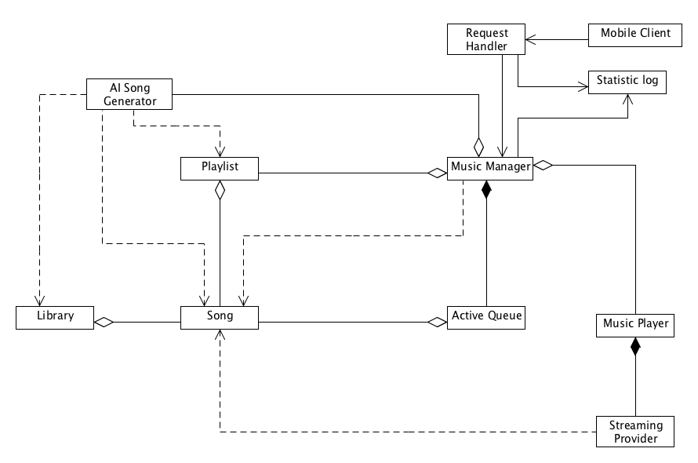
Music Manager
Maintains:
Current playlist
Currently playing list
Stack of requests from clients

Slide 4
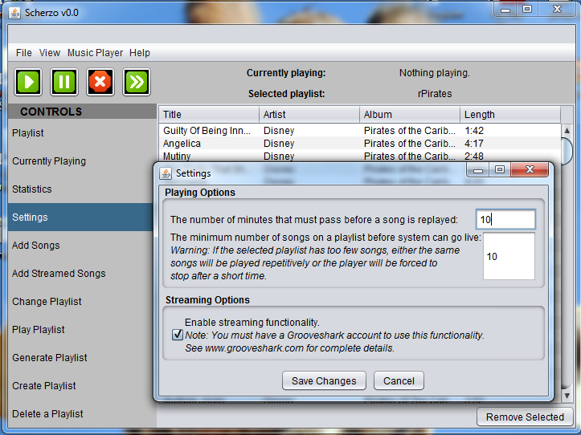
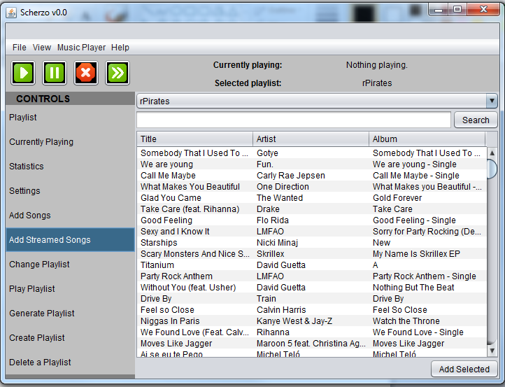
Server Application Interface
Java Swing
Ugly but supports cross-platform compatibility

Slide 5
Features
Concurrency
Currently playing
UI
Requests
Etc.
Satisfying requests
Song play limit
User requests have priority over “filler” songs
User requests with a time attached have priority over other requests

Slide 6
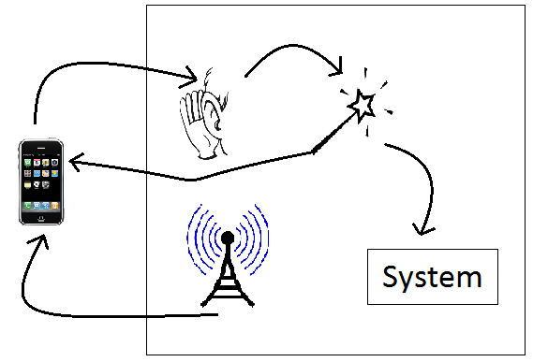
Request Handler
A listening thread that queues requests
A processing thread that executes or forwards requests
A multicasting thread that broadcasts IP and port

Slide 7
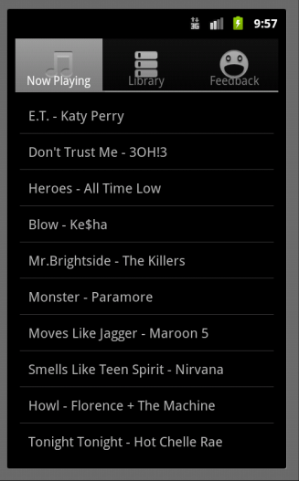
Android Device
Shows playing songs, playlist, and song info
Can sent feedback and song request
Must follow Android Application development standards

Slide 8
Song Generator
Create a request with constraints and return a playlist that satisfies them
Constraints: number of songs, song traits, maximization/minimization

Slide 9
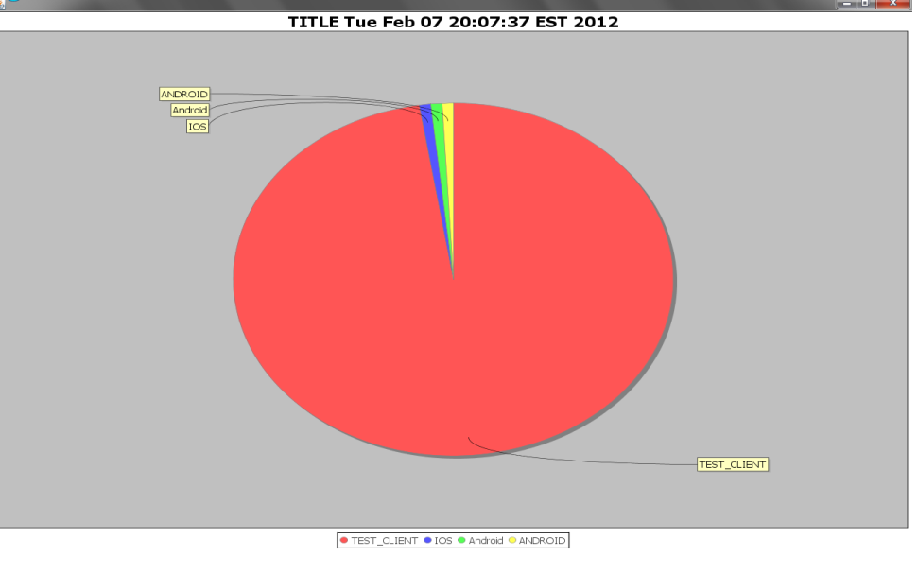
Statistics Generator
Select data and format to display
Display chart using database as data source and JFreeChart to create graphics
Save as .png or .csv

