Slide 1
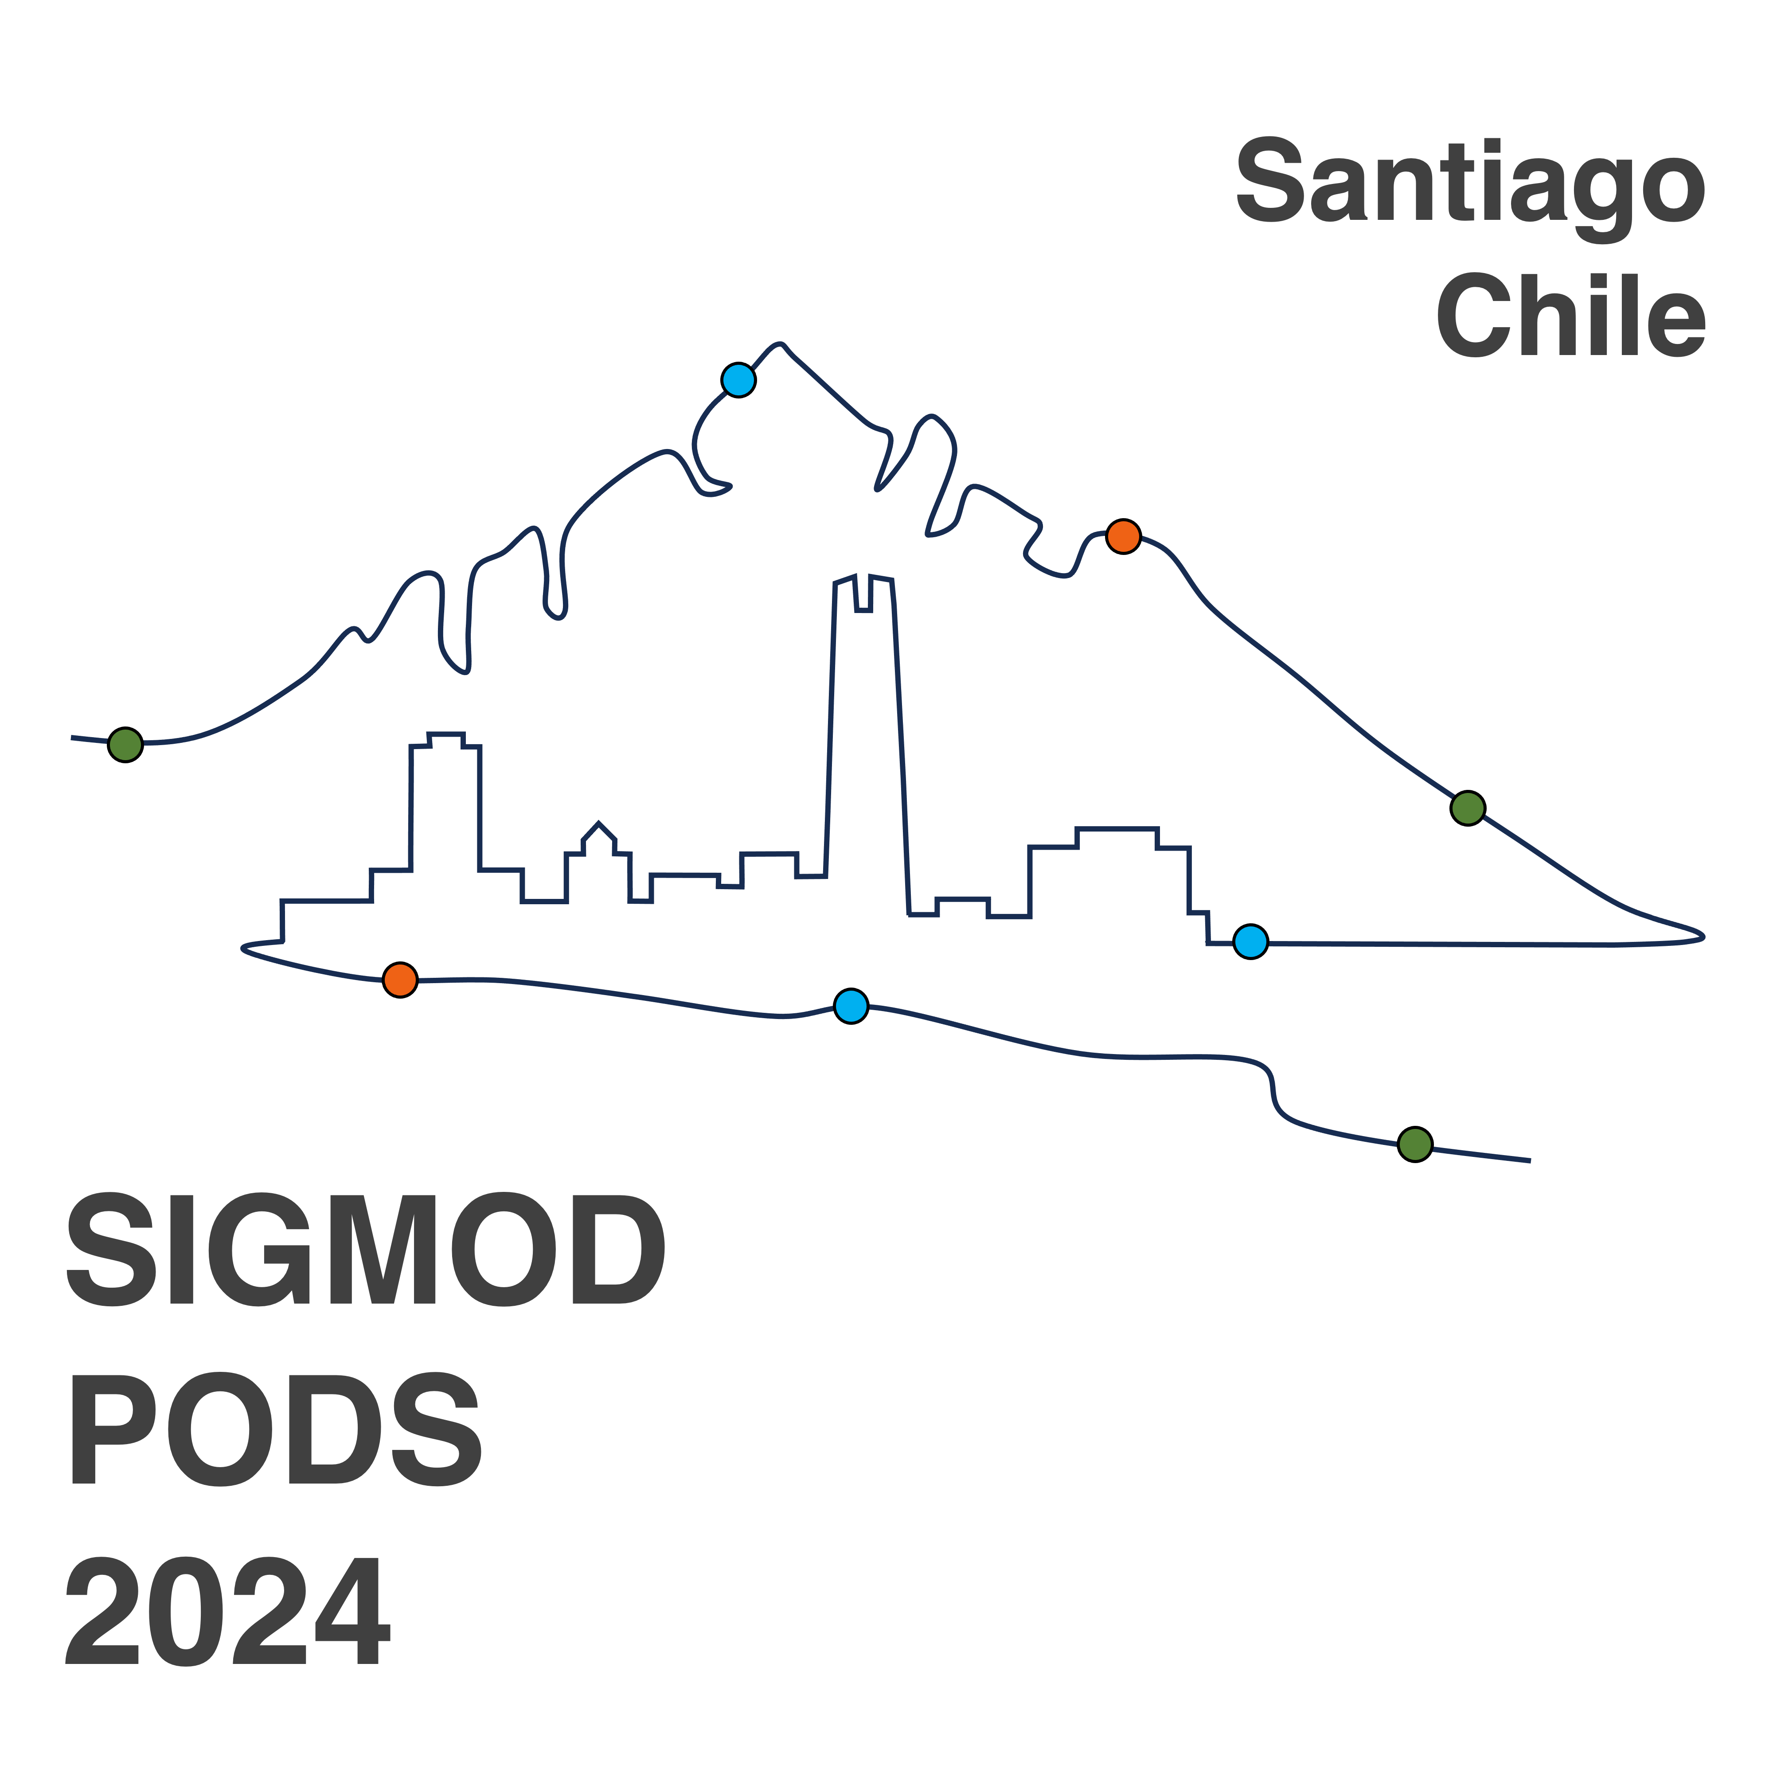

FedKNN: Secure Federated k-Nearest Neighbor Search
[SIGMOD 2024]
Xinyi Zhang¹, Qichen Wang¹, Cheng Xu¹, Yun Peng², and Jianliang Xu¹
¹Hong Kong Baptist University, ²Guangzhou University
Notes:
Good day, everyone. My name is Zhang Xinyi, and this presentation will introduce our paper titled "FedKNN: Secure Federated k-Nearest Neighbor Search." This is a joint work between Hong Kong Baptist University and Guangzhou University.

Slide 2




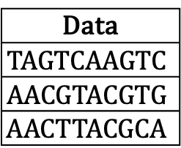
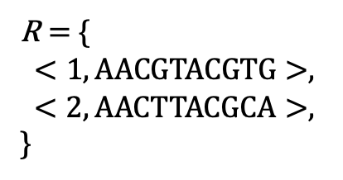
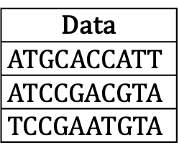
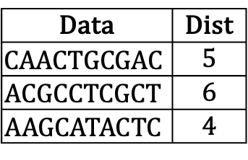
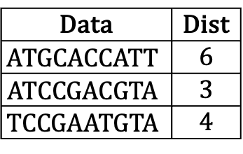

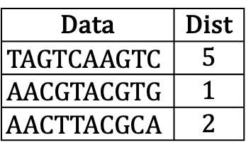
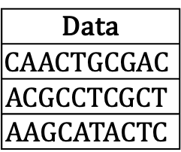
Introduction
Motivation
Federated kNN search on distributed data
Example: Top-2 data with the smallest edit distances in DNA records across hospitals
Data Federation
Data
$$ATGCACCATT$$
$$ATCCGACGTA$$
$$TCCGAATGTA$$
Data | Dist
$$ATGCACCATT$$ | 6
$$ATCCGACGTA$$ | 3
$$TCCGAATGTA$$ | 4
$$Q= <2,AACGTACGTA>$$
R $=$ {
$<1,AACGTACGTG>$,
$<2,AACTTACGCA>$,
}
User
Data
$$TAGTCAAGTC$$
$$AACGTACGTG$$
$$AACTTACGCA$$
Data
$$CAACTGCGAC$$
$$ACGCCTCGCT$$
$$AAGCATACTC$$
Data | Dist
$$TAGTCAAGTC$$ | 5
$$AACGTACGTG$$ | 1
$$AACTTACGCA$$ | 2
Data | Dist
$$CAACTGCGAC$$ | 5
$$ACGCCTCGCT$$ | 6
$$AAGCATACTC$$ | 4
Challenge: How can we securely and efficiently obtain kNN search results?
ZHANG Xinyi
csxyzhang@comp.hkbu.edu.hk
ZHANG Xinyi
ZHANG Xinyi
SIGMOD’24
SIGMOD’24
SIGMOD’24
Notes:
As kNN search across many data owners is a crucial technique in many areas like information retrieval and machine learning, the motivation for this work is illustrated through the following example. Consider a data federation composed of three hospitals, which provide user interfaces to conduct kNN queries.
[Click 3 times]
A user has a DNA sequence and seeks to identify the top-2 sequences with the smallest edit distances.
[Click 1 times]
The challenge for this system is how to securely and efficiently retrieve the kNN search results.

Slide 3
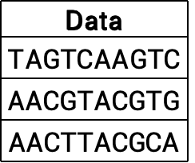
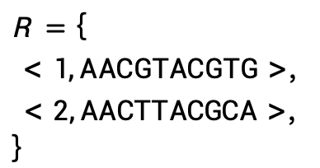
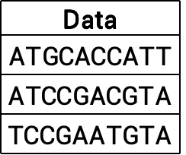
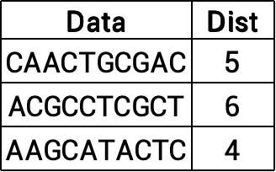
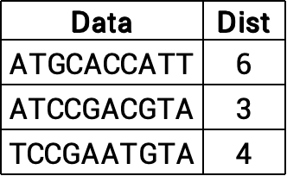

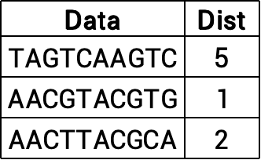
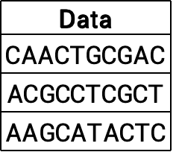
Introduction
Privacy Protection
Data providers don’t want extra information leakage except for results
Only these should be known
Data Federation
Data
$$ATGCACCATT$$
$$ATCCGACGTA$$
$$TCCGAATGTA$$
Data | Dist
$$ATGCACCATT$$ | 6
$$ATCCGACGTA$$ | 3
$$TCCGAATGTA$$ | 4
$$Q= <2,AACGTACGTA>$$
R $=$ {
$<1,AACGTACGTG>$,
$<2,AACTTACGCA>$,
}
User
Data
$$TAGTCAAGTC$$
$$AACGTACGTG$$
$$AACTTACGCA$$
Data
$$CAACTGCGAC$$
$$ACGCCTCGCT$$
$$AAGCATACTC$$
Data | Dist
$$TAGTCAAGTC$$ | 5
$$AACGTACGTG$$ | 1
$$AACTTACGCA$$ | 2
Data | Dist
$$CAACTGCGAC$$ | 5
$$ACGCCTCGCT$$ | 6
$$AAGCATACTC$$ | 4
We need a security tool to help us process the query securely
csxyzhang@comp.hkbu.edu.hk
csxyzhang@comp.hkbu.edu.hk
ZHANG Xinyi
csxyzhang@comp.hkbu.edu.hk
ZHANG Xinyi
ZHANG Xinyi
SIGMOD’24
SIGMOD’24
SIGMOD’24
Notes:
Within the data federation, data providers are concerned with preventing the leakage of any extra information beyond the final results. During the query process, the user will only know the query and the final result; no intermediate information is disclosed to any party.
To achieve this goal, a secure tool is needed for query processing.

Slide 4

Introduction
Trusted Execution Environment (TEE)
Hardware-enforced secure execution environment
Using the concept of enclaves
E.g. , Intel SGX, AMD SEV, and ARM TrustZone
Encrypted enclave memory
Accessible only from the same enclave
Protect against the powerful attacker
Pros
Full functionality
Native CPU performance
Code
Secret data
Enclave
Untrusted OS
ZHANG Xinyi
csxyzhang@comp.hkbu.edu.hk
ZHANG Xinyi
ZHANG Xinyi
SIGMOD’24
SIGMOD’24
SIGMOD’24
Notes:
In this work, we use Trusted Execution Environments (TEE) to execute secure queries. TEE, such as Intel SGX, provides a hardware-enforced secure environment using enclaves with protected memory and isolated processing. Only the same enclave can access its memory, which ensures its security. TEE allows secure programs to utilize full CPU functionality and perform at near-native speeds, enabling efficient and secure query processing.

Slide 5



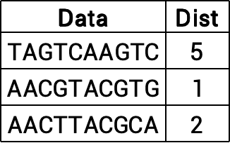

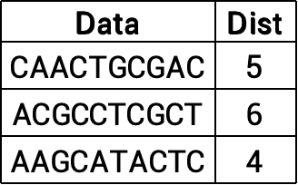
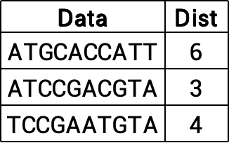
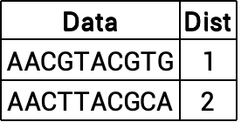
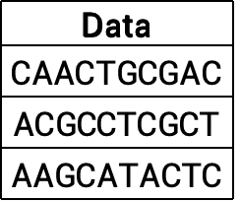
Baseline Solution
Each data provider computes local top-k
Data Federation
Data
$$ATGCACCATT$$
$$ATCCGACGTA$$
$$TCCGAATGTA$$
Data | Dist
$$ATGCACCATT$$ | 6
$$ATCCGACGTA$$ | 3
$$TCCGAATGTA$$ | 4
Data | Dist
$$AACGTACGTG$$ | 1
$$AACTTACGCA$$ | 2
$$Q$$
Local Top-2
Data
$$CAACTGCGAC$$
$$ACGCCTCGCT$$
$$AAGCATACTC$$
$$Q= <2,AACGTACGTA>$$
Data | Dist
$$CAACTGCGAC$$ | 5
$$ACGCCTCGCT$$ | 6
$$AAGCATACTC$$ | 4
$$Q$$
R $=$ {
$<1,AACGTACGTG>$,
$<2,AACTTACGCA>$,
}
Local Top-2
User
Broker
$$Q$$
Data
$$TAGTCAAGTC$$
$$AACGTACGTG$$
$$AACTTACGCA$$
Data | Dist
$$TAGTCAAGTC$$ | 5
$$AACGTACGTG$$ | 1
$$AACTTACGCA$$ | 2
Local Top-2
ZHANG Xinyi
csxyzhang@comp.hkbu.edu.hk
ZHANG Xinyi
ZHANG Xinyi
SIGMOD’24
SIGMOD’24
SIGMOD’24
Notes:
[Click 1 time]
With TEE, a baseline solution is to let each data provider compute local top-k results based on the query. The broker then uses TEE to sort the global top-k results and sends them to the user.

Slide 6
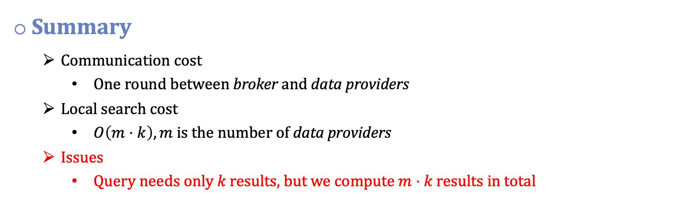
Baseline Solution
Summary
Communication cost
One round between broker and data providers
Local search cost
$O\left(m⋅k\right), m$ is the number of data providers
Issues
$\text{Query} \text{needs} \text{only} k \text{results}\text{,} \text{but} \text{we} \text{compute} m⋅k \text{results} \text{in} \text{total}$
ZHANG Xinyi
csxyzhang@comp.hkbu.edu.hk
ZHANG Xinyi
ZHANG Xinyi
SIGMOD’24
SIGMOD’24
SIGMOD’24
Notes:
It is easy to find that the baseline solution requires only one round of communication. The total local search cost is O(mk), where m is the number of data providers. However, since the user needs only k results, we compute m⋅k results in total.

Slide 7
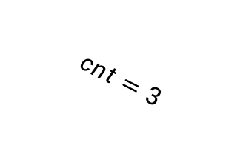
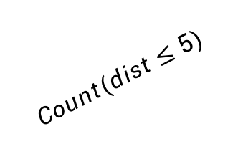

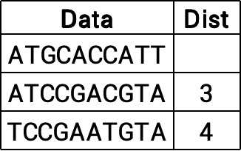
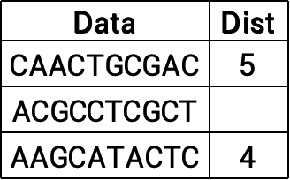
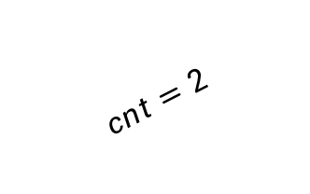

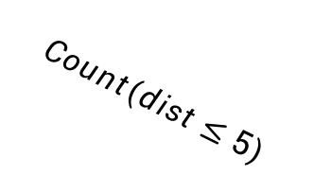


Prior Work
State-of-the-art solution: HuFu-Ext
Upper bound: 10
Lower bound: 0
Search Dist: 5
Data Federation
Data
$$ATGCACCATT$$
$$ATCCGACGTA$$
$$TCCGAATGTA$$
Data | Dist
$$ATGCACCATT$$
$$ATCCGACGTA$$ | 3
$$TCCGAATGTA$$ | 4
$$Count(dist≤5)$$
$$Σcnt>2$$
$$cnt=2$$
Data
$$CAACTGCGAC$$
$$ACGCCTCGCT$$
$$AAGCATACTC$$
$$Q= <2,AACGTACGTA>$$
Data | Dist
$$CAACTGCGAC$$ | 5
$$ACGCCTCGCT$$
$$AAGCATACTC$$ | 4
$$Count(dist≤5)$$
$$cnt=2$$
User
Broker
$$Count(dist≤5)$$
Data
$$TAGTCAAGTC$$
$$AACGTACGTG$$
$$AACTTACGCA$$
$$cnt=3$$
Data | Dist
$$TAGTCAAGTC$$ | 5
$$AACGTACGTG$$ | 1
$$AACTTACGCA$$ | 2
Yongxin Tong, et al. 2022. Hu-Fu: efficient and secure spatial queries over data federation. PVLDB (2022), 1159–1172.
csxyzhang@comp.hkbu.edu.hk
ZHANG Xinyi
csxyzhang@comp.hkbu.edu.hk
ZHANG Xinyi
csxyzhang@comp.hkbu.edu.hk
ZHANG Xinyi
SIGMOD’24
SIGMOD’24
SIGMOD’24
Notes:
The state-of-the-art HuFu enhances the Top-k search algorithm by transforming it into a series of range counts to find an appropriate search range. Although it is designed for spatial data, this approach can be extended to any Top-k search based on distance metrics. Our paper extends HuFu's Top-k algorithm to arbitrary data using TEE for security, which we call HuFu-Ext.
Here is an example of HuFu’s top-k search. We first need to set an initial search upper and lower bound for the search. HuFu will use a binary search to find the appropriate search.

Slide 8
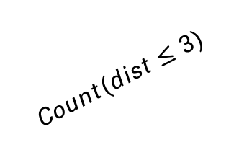
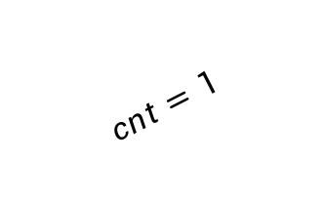
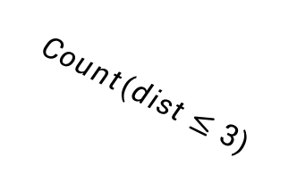

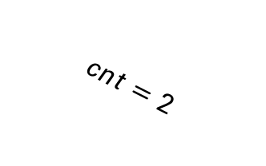


Prior Work
State-of-the-art solution: HuFu-Ext
Upper bound: 5
Lower bound: 0
Search Dist: 3
Data Federation
Data | Dist
$$ATGCACCATT$$
$$ATCCGACGTA$$ | 3
$$TCCGAATGTA$$ | 4
$$Count(dist≤3)$$
$$Σcnt>2$$
$$cnt=1$$
$$Q= <2,AACGTACGTA>$$
Data | Dist
$$CAACTGCGAC$$ | 5
$$ACGCCTCGCT$$
$$AAGCATACTC$$ | 4
$$Count(dist≤3)$$
$$cnt=0$$
User
Broker
$$Count(dist≤3)$$
$$cnt=2$$
Data | Dist
$$TAGTCAAGTC$$ | 5
$$AACGTACGTG$$ | 1
$$AACTTACGCA$$ | 2
Yongxin Tong, et al. 2022. Hu-Fu: efficient and secure spatial queries over data federation. PVLDB (2022), 1159–1172.
csxyzhang@comp.hkbu.edu.hk
ZHANG Xinyi
csxyzhang@comp.hkbu.edu.hk
ZHANG Xinyi
csxyzhang@comp.hkbu.edu.hk
ZHANG Xinyi
SIGMOD’24
SIGMOD’24
SIGMOD’24
Notes:
Again, with 3, the total count is still greater than 2. So still tight the bound.

Slide 9
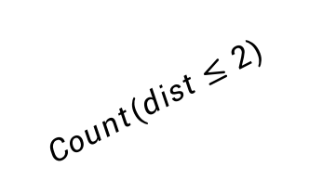
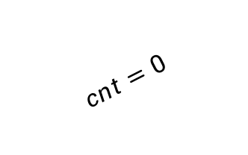
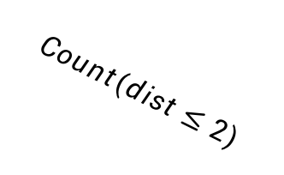



Prior Work
State-of-the-art solution: HuFu-Ext
Upper bound: 3
Lower bound: 0
Search Dist: 2
Data Federation
Data | Dist
$$ATGCACCATT$$
$$ATCCGACGTA$$ | 3
$$TCCGAATGTA$$ | 4
$$Count(dist≤2)$$
$$Σcnt=2$$
$$cnt=0$$
$$Q= <2,AACGTACGTA>$$
Data | Dist
$$CAACTGCGAC$$ | 5
$$ACGCCTCGCT$$
$$AAGCATACTC$$ | 4
$$Count(dist≤2)$$
$$cnt=0$$
User
Broker
$$Count(dist≤2)$$
$$cnt=2$$
Data | Dist
$$TAGTCAAGTC$$ | 5
$$AACGTACGTG$$ | 1
$$AACTTACGCA$$ | 2
Yongxin Tong, et al. 2022. Hu-Fu: efficient and secure spatial queries over data federation. PVLDB (2022), 1159–1172.
ZHANG Xinyi
csxyzhang@comp.hkbu.edu.hk
ZHANG Xinyi
ZHANG Xinyi
SIGMOD’24
SIGMOD’24
SIGMOD’24
Notes:
With distance 2, we find the total count is equal to 2. So this is the distance range we want to find.

Slide 10
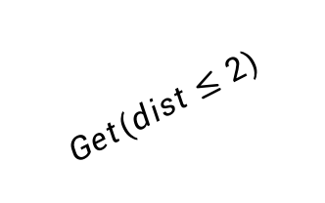
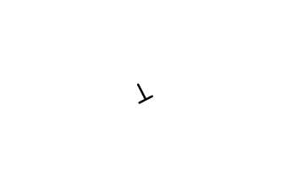
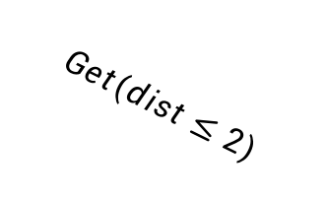

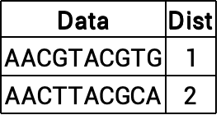


Prior Work
State-of-the-art solution: HuFu-Ext
Search range: 2
Data Federation
Data | Dist
$$ATGCACCATT$$
$$ATCCGACGTA$$ | 3
$$TCCGAATGTA$$ | 4
Data | Dist
$$AACGTACGTG$$ | 1
$$AACTTACGCA$$ | 2
$$Get(dist≤2)$$
$$⊥$$
$$Q= <2,AACGTACGTA>$$
Data | Dist
$$CAACTGCGAC$$ | 5
$$ACGCCTCGCT$$
$$AAGCATACTC$$ | 4
$$Get(dist≤2)$$
R $=$ {
$<1,AACGTACGTG>$,
$<2,AACTTACGCA>$,
}
$$⊥$$
User
Broker
$$Get(dist≤2)$$
2 results
Data | Dist
$$TAGTCAAGTC$$ | 5
$$AACGTACGTG$$ | 1
$$AACTTACGCA$$ | 2
Yongxin Tong, et al. 2022. Hu-Fu: efficient and secure spatial queries over data federation. PVLDB (2022), 1159–1172.
csxyzhang@comp.hkbu.edu.hk
ZHANG Xinyi
csxyzhang@comp.hkbu.edu.hk
ZHANG Xinyi
csxyzhang@comp.hkbu.edu.hk
ZHANG Xinyi
SIGMOD’24
SIGMOD’24
SIGMOD’24
Notes:
Therefore we use this distance to do the range search and get the final global top-k results.

Slide 11
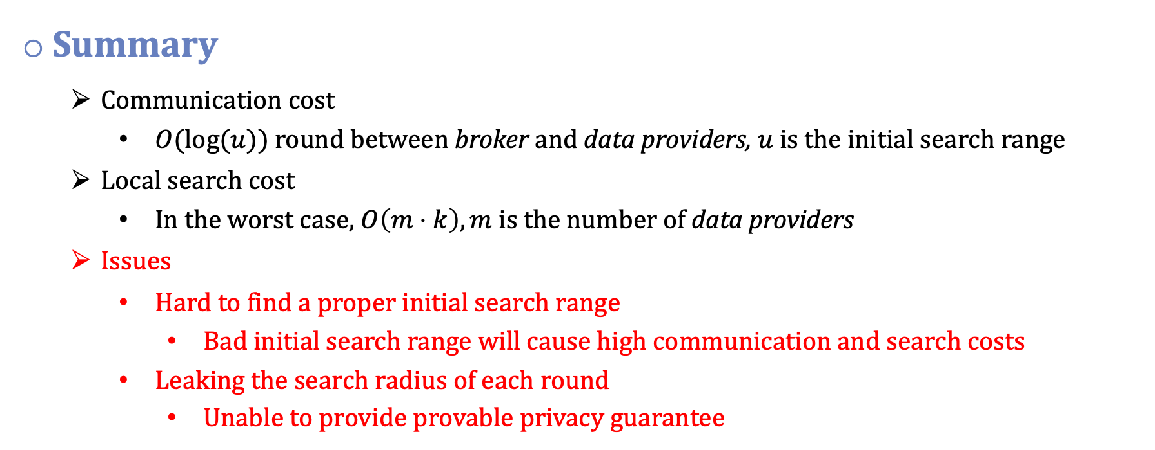
Prior Work
Summary
Communication cost
$O(log(u))$ round between broker and data providers, $u$ is the initial search range
Local search cost
In the worst case, $O\left(m⋅k\right), m$ is the number of data providers
Issues
Hard to find a proper initial search range
Bad initial search range will cause high communication and search costs
Leaking the search radius of each round
Unable to provide provable privacy guarantee
csxyzhang@comp.hkbu.edu.hk
ZHANG Xinyi
csxyzhang@comp.hkbu.edu.hk
ZHANG Xinyi
csxyzhang@comp.hkbu.edu.hk
ZHANG Xinyi
SIGMOD’24
SIGMOD’24
SIGMOD’24
Notes:
HuFu’s top-k search completes in O(log u) communication rounds, where u is the initial search range. In the worst case, HuFu still needs to compute O(mk) results if the initial range is too large.
This requires prior knowledge to set a proper initial range, as a poor choice increases costs.
Additionally, transforming Top-k searches into range counts leaks the search radius, weakening the privacy guarantees.

Slide 12
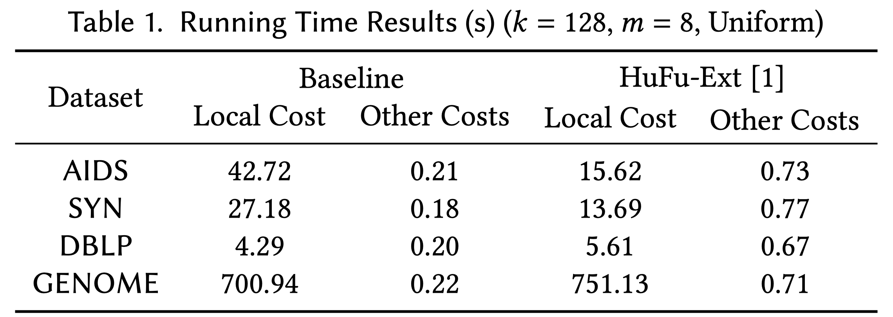
Observation
What if the local search cost is high?
E.g., edit distance of graph and sequence
Local search cost dominates the query cost
csxyzhang@comp.hkbu.edu.hk
ZHANG Xinyi
csxyzhang@comp.hkbu.edu.hk
ZHANG Xinyi
csxyzhang@comp.hkbu.edu.hk
ZHANG Xinyi
SIGMOD’24
SIGMOD’24
SIGMOD’24
Notes:
Previous works usually assume the local search cost will not dominate the total cost. What if the local search is high enough to dominate the total cost? For example, using edit distance as the similarity metric for graph and sequence.
Preliminary results in Table 1 show that local search costs account for at least 90% of query costs.

Slide 13

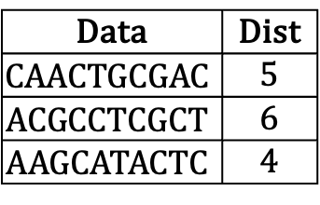
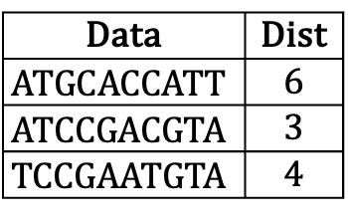
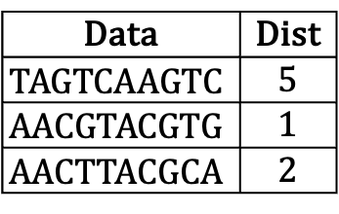
Observation
Can we reduce local computation?
Only let data providers compute the number of local results they need to provide
$$Q= <2,AACGTACGTA>$$
Data | Dist
$$ATGCACCATT$$ | 6
$$ATCCGACGTA$$ | 3
$$TCCGAATGTA$$ | 4
Data | Dist
$$TAGTCAAGTC$$ | 5
$$AACGTACGTG$$ | 1
$$AACTTACGCA$$ | 2
Data | Dist
$$CAACTGCGAC$$ | 5
$$ACGCCTCGCT$$ | 6
$$AAGCATACTC$$ | 4
csxyzhang@comp.hkbu.edu.hk
ZHANG Xinyi
csxyzhang@comp.hkbu.edu.hk
ZHANG Xinyi
csxyzhang@comp.hkbu.edu.hk
ZHANG Xinyi
SIGMOD’24
SIGMOD’24
SIGMOD’24
Notes:
Can we find a way to reduce the local search cost? In the ideal situation, we want data providers to compute only the number of local results they provide in the final Top-k results.
In our example, we only need the Green party to provide its local top-2 results to get the global top-2 results.

Slide 14
Observation
Obtain possible distribution of query results
Inspired by the filtering-and-verification paradigm
Lower-bound (LB) distance used for filtering can be considered as a rough distance
Find top-k LB distances of the query point is much faster than finding exact top-k
Graph (AIDS): 0.08s vs 40.47s
Sequence (GENOME): 0.15s vs 952.21s
csxyzhang@comp.hkbu.edu.hk
ZHANG Xinyi
csxyzhang@comp.hkbu.edu.hk
ZHANG Xinyi
csxyzhang@comp.hkbu.edu.hk
ZHANG Xinyi
SIGMOD’24
SIGMOD’24
SIGMOD’24
Notes:
To achieve this goal, one approach is to obtain the possible distribution of query results in advance. Inspired by the filtering-and-verification paradigm, we can use lower bound distances to quickly filter out unrelated results. Finding the Top-k based on these rough distances is much faster, allowing us to quickly estimate the distribution of query results.

Slide 15
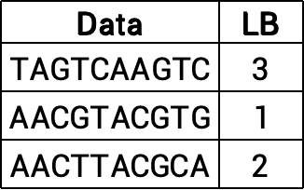

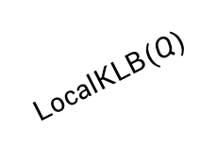
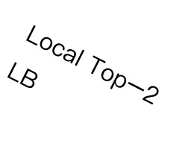
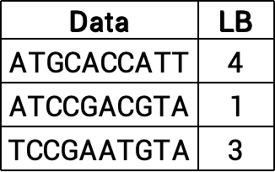
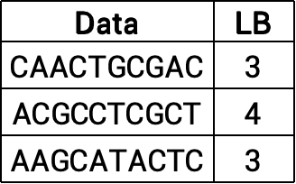
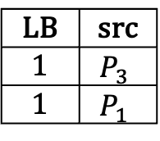
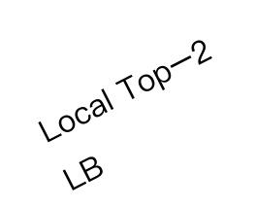






DANN
Distribution-Aware kNN Query
Reducing local computation by a fast lower-bound estimation round
Round 1: lower-bound estimation
Data
$$ATGCACCATT$$
$$ATCCGACGTA$$
$$TCCGAATGTA$$
Data | LB
$$ATGCACCATT$$ | 4
$$ATCCGACGTA$$ | 1
$$TCCGAATGTA$$ | 3
LB | src
1 | $$P_{3}$$
1 | $$P_{1}$$
$$LocalKLB(Q)$$
$$\text{Local} \text{Top}\text{−2} \text{LB}$$
$$P_{1}$$
Global Top-2 LB
Data
$$CAACTGCGAC$$
$$ACGCCTCGCT$$
$$AAGCATACTC$$
$$Q= <2,AACGTACGTA>$$
Data | LB
$$CAACTGCGAC$$ | 3
$$ACGCCTCGCT$$ | 4
$$AAGCATACTC$$ | 3
$$LocalKLB(Q)$$
Local Top-2 LB
User
Broker
$$P_{2}$$
$$LocalKLB(Q)$$
DP | $$k_{i}$$
$$P_{1}$$ | 1
$$P_{2}$$ | 1
$$P_{3}$$ | 1
Data
$$TAGTCAAGTC$$
$$AACGTACGTG$$
$$AACTTACGCA$$
$$\text{Local} \text{Top}\text{−2} \text{LB}$$
Data | LB
$$TAGTCAAGTC$$ | 3
$$AACGTACGTG$$ | 1
$$AACTTACGCA$$ | 2
$$P_{3}$$
kNN Map
csxyzhang@comp.hkbu.edu.hk
ZHANG Xinyi
csxyzhang@comp.hkbu.edu.hk
ZHANG Xinyi
csxyzhang@comp.hkbu.edu.hk
ZHANG Xinyi
SIGMOD’24
SIGMOD’24
SIGMOD’24
Notes:
Therefore, we proposed DANN, Distribution-Aware kNN Query algorithm. DANN reduces local computation cost by a fast lower-bound estimation round.
[Click 3 times]
In our example, after the broker receives and sends query Q to each data provider. The data providers first compute its local top-2 lower-bound distances and send results to the broker.
[Click 1 times]
The broker uses TEE to sort the global top-2 lower bound distances and find its source.
[Click 1 times]
Using global top-2 lower bound distances, the broker estimates the final results‘ distribution and records it in a kNN map. P3 and P1 will each have one result in the final results, but to ensure correctness, P2 needs to return at least its local top-1 result in the next round.

Slide 16











DANN
Distribution-Aware kNN Query
Reducing local computation by a fast lower-bound estimation round
Round 2: First round local computation & verification
Data | LB | Dist
$$ATGCACCATT$$ | 4 | 6
$$ATCCGACGTA$$ | 1 | 3
$$TCCGAATGTA$$ | 3 | 4
Data | LB
$$ATGCACCATT$$ | 4
$$ATCCGACGTA$$ | 1
$$TCCGAATGTA$$ | 3
Data | Dist | src
ATCC… | 1 | $$P_{3}$$
AACG… | 3 | $$P_{1}$$
$$LocalKNN(1)$$
$$\text{Local} \text{Top}\text{−1}$$
$$P_{1}$$
Candidates
Data | LB | Dist
$$CAACTGCGAC$$ | 3 | 5
$$ACGCCTCGCT$$ | 4 | 6
$$AAGCATACTC$$ | 3 | 4
$$Q= <2,AACGTACGTA>$$
Data | LB
$$CAACTGCGAC$$ | 3
$$ACGCCTCGCT$$ | 4
$$AAGCATACTC$$ | 3
$$LocalKNN(1)$$
Local Top-1
User
Broker
$$P_{2}$$
$$LocalKNN(1)$$
DP | $$k_{i}$$
$$P_{1}$$ | 1
$$P_{2}$$ | 1
$$P_{3}$$ | 2
DP | $$k_{i}$$
$$P_{1}$$ | 1
$$P_{2}$$ | 1
$$P_{3}$$ | 1
Data | LB | Dist
$$TAGTCAAGTC$$ | 3 | 5
$$AACGTACGTG$$ | 1 | 1
$$AACTTACGCA$$ | 2 | 2
$$\text{Local} \text{Top}\text{−1}$$
Data | LB
$$TAGTCAAGTC$$ | 3
$$AACGTACGTG$$ | 1
$$AACTTACGCA$$ | 2
$$P_{3}$$
kNN Map
csxyzhang@comp.hkbu.edu.hk
ZHANG Xinyi
csxyzhang@comp.hkbu.edu.hk
ZHANG Xinyi
csxyzhang@comp.hkbu.edu.hk
ZHANG Xinyi
SIGMOD’24
SIGMOD’24
SIGMOD’24
Notes:
[Click 3 times]
Based on the first round’s kNN map, each data provider returns its local top-1 result.
[Click 1 times]
The broker then receives and sorts these second-round local results to determine the current global top-2 candidates based on real distances. The nearest object is from P3, and the second closest is from P1. Since P2 does not contribute to the global candidates, it can be omitted in the next round. P1’s results are also last among the candidates, so it can be omitted as well. P3’s last result is at position 1, so it may still have another result in the global top-2,
[Click 1 times]
so we update P3’s record to 2 in the kNN map.

Slide 17




DANN
Distribution-Aware kNN Query
Reducing local computation by a fast lower-bound estimation round
Round 3: Second round local computation & return final results
Data | LB | Dist
$$ATGCACCATT$$ | 4 | 6
$$ATCCGACGTA$$ | 1 | 3
$$TCCGAATGTA$$ | 3 | 4
Data | Dist | src
ATCC… | 1 | $$P_{3}$$
AACG… | 3 | $$P_{1}$$
Data | Dist | src
ATCC… | 1 | $$P_{3}$$
AACT… | 2 | $$P_{3}$$
$$LocalKNN(1)$$
$$\text{Local} \text{Top}\text{−1}$$
$$P_{1}$$
Candidates
$$Q= <2,AACGTACGTA>$$
Data | LB | Dist
$$CAACTGCGAC$$ | 3 | 5
$$ACGCCTCGCT$$ | 4 | 6
$$AAGCATACTC$$ | 3 | 4
$$LocalKNN(1)$$
R $=$ {
$<1,AACGTACGTG>$,
$<2,AACTTACGCA>$,
}
Local Top-1
User
Broker
$$P_{2}$$
$$LocalKNN(2)$$
DP | $$k_{i}$$
$$P_{1}$$ | 1
$$P_{2}$$ | 1
$$P_{3}$$ | 2
$$\text{Local} \text{Top}\text{−2}$$
Data | LB | Dist
$$TAGTCAAGTC$$ | 3 | 5
$$AACGTACGTG$$ | 1 | 1
$$AACTTACGCA$$ | 2 | 2
$$P_{3}$$
kNN Map
csxyzhang@comp.hkbu.edu.hk
ZHANG Xinyi
csxyzhang@comp.hkbu.edu.hk
ZHANG Xinyi
csxyzhang@comp.hkbu.edu.hk
ZHANG Xinyi
SIGMOD’24
SIGMOD’24
SIGMOD’24
Notes:
We use the updated kNN map for the third round, allowing each data provider to return its new local kNN results. The broker then sorts these results to get the final global top-k results and returns them to the user.

Slide 18


DANN
Summary
Communication cost
Three rounds between broker and data providers
Local search cost
$O\left(k+m^{2}\right), m$ is the number of data providers
Third-round computation cost is usually less than $O\left(m^{2}\right)$ in practice
Issues
Access pattern during query processing is leaked
Network pattern (each round communication volume)
Memory access pattern (each round $k_{i}$, and update of top-k LB, candidates and kNN map)
csxyzhang@comp.hkbu.edu.hk
ZHANG Xinyi
csxyzhang@comp.hkbu.edu.hk
ZHANG Xinyi
csxyzhang@comp.hkbu.edu.hk
ZHANG Xinyi
SIGMOD’24
SIGMOD’24
SIGMOD’24
Notes:
In summary, there are three rounds of communication between the broker and data provider in DANN. Theoretically, the local computation amount in DANN is O(k+m^2), but in real scenarios, the additional computation is much less than m^2. However, DANN has an issue with leaking access patterns by observing the communication volume of each round and the computation number of each party in each round.

Slide 19
Security Basics
Trusted Execution Environment (TEE)
Hardware-enforced secure execution environment
Using the concept of enclaves
Encrypted enclave memory
Accessible only from the same enclave
Protect against the powerful attacker
Pros
Full functionality
Native CPU performance
Cons
No protection in the access pattern
Code
Secret data
Enclave
Untrusted OS
csxyzhang@comp.hkbu.edu.hk
csxyzhang@comp.hkbu.edu.hk
ZHANG Xinyi
csxyzhang@comp.hkbu.edu.hk
ZHANG Xinyi
ZHANG Xinyi
SIGMOD’24
SIGMOD’24
SIGMOD’24
Notes:
Why will the computation number of each party in each round be leaked? This is because TEE cannot protect access patterns, so the adversary can observe them for a side-channel attack.

Slide 20

Security Basics
Obliviousness
A security definition to protect access patterns
Access pattern can leak sensitive information:
Network: infer the source of the results via message lengths
How many data objects are provided by each data provider
Memory: infer the source and order of the results during aggregation by the broker
By observing the updates of top-k LB, candidates, and kNN map
Diﬀerential Obliviousness
An algorithm $𝒜$ is (𝜖,𝛿)-differentially oblivious if for any two neighboring databases $D_{1}$, $D_{2}$, and any subset of access patterns 𝑆:
$Pr \left[ℳ\left(𝒜,D_{1}\right)∈S\right]≤e^{ε}⋅Pr \left[ℳ\left(𝒜,D_{2}\right)∈S\right]+δ$
The access patterns satisfy differential privacy
Make it is possible to optimize query processing
Oded Goldreich. 1987. Towards a theory of software protection and simulation by oblivious RAMs. ACM symposium on Theory of computing. 182–194.
T-H. Hubert Chan, et al. 2019. Foundations of Differentially Oblivious Algorithms. ACM-SIAM Symposium on Discrete Algorithms.
csxyzhang@comp.hkbu.edu.hk
csxyzhang@comp.hkbu.edu.hk
ZHANG Xinyi
csxyzhang@comp.hkbu.edu.hk
ZHANG Xinyi
ZHANG Xinyi
SIGMOD’24
SIGMOD’24
SIGMOD’24
Notes:
Therefore, obliviousness is introduced to protect access patterns. In DANN, access patterns can reveal the number of data objects each data provider provides and allow the broker to infer the source and order of results during aggregation. In our work, we adopt a relaxed definition, differential obliviousness, which only requires query access patterns for any two neighboring databases to satisfy differential privacy, allowing us to optimize query processing.

Slide 21


DANN*
Secure DANN
DANN* provide provable (𝛆, 𝛅)-differential obliviousness
Using oblivious data processing
DP | $$k_{i}$$
$$P_{1}$$ | 1
$$P_{2}$$ | 1
$$P_{3}$$ | 2
LB | src
1 | $$P_{2}$$
1 | $$P_{1}$$
Data | Dist | src
ATCC… | 1 | $$P_{3}$$
AACG… | 3 | $$P_{1}$$
Broker
Global Top-2 LB
kNN Map
Candidates
Use the oblivious map and sorting
csxyzhang@comp.hkbu.edu.hk
ZHANG Xinyi
csxyzhang@comp.hkbu.edu.hk
ZHANG Xinyi
csxyzhang@comp.hkbu.edu.hk
ZHANG Xinyi
SIGMOD’24
SIGMOD’24
SIGMOD’24
Notes:
Therefore, we proposed a secure version of DANN in our paper that satisfies the differential obliviousness. We name it as DANN*. In DANN*, We use the oblivious map and sorting to hide the access pattern when the broker aggregates local results and updates relevant data records.

Slide 22



DANN*
Secure DANN
DANN* provide provable (𝛆, 𝛅)-differential obliviousness
Each round’s $k_{i}$ satisfies (𝛆, 𝛅)-differential privacy
$k_{i}← k_{i}−\frac{2}{ε}ln(2⋅ λ) +Lap(\frac{2}{ε})$
DP | $$k_{i}$$
$$P_{1}$$ | $$1−\frac{2}{ε}ln(2⋅ λ) +Lap(\frac{2}{ε})$$
$$P_{2}$$ | $$1−\frac{2}{ε}ln(2⋅ λ) +Lap(\frac{2}{ε})$$
$$P_{3}$$ | $$2−\frac{2}{ε}ln(2⋅ λ) +Lap(\frac{2}{ε})$$
Broker
kNN Map
Make $k_{i}$ satisfies differential privacy
ZHANG Xinyi
SIGMOD’24
csxyzhang@comp.hkbu.edu.hk
Notes:
For the round’s $k_{i}$ value, we add positive DP noise to the $k_{i}$ to make it satisfy differential private.

Slide 23


DANN*
Secure DANN
DANN* provide provable (𝛆, 𝛅)-differential obliviousness
Padding local results to upper bound size
Padding with ${k−k}_{i}$ dummy results
Data | LB | Dist
$$CAACTGCGAC$$ | 3 | 5
$$ACGCCTCGCT$$ | 4 | 6
$$AAGCATACTC$$ | 3 | 4
$$LocalKNN(1+ξ)$$
Local Top-1 + 1 dummy
Broker
Padding return results to size k
csxyzhang@comp.hkbu.edu.hk
ZHANG Xinyi
csxyzhang@comp.hkbu.edu.hk
ZHANG Xinyi
csxyzhang@comp.hkbu.edu.hk
ZHANG Xinyi
SIGMOD’24
SIGMOD’24
SIGMOD’24
Notes:
For the network access patterns, we pad the communication volume to the public upper bound to make it indistinguishable to the adversary.

Slide 24

FedKNN
Architecture
Query interface
For users to submit queries
Query optimizer
Cost estimation
Federated kNN search algorithms
Security primitives
Oblivious data processing
Differential privacy mechanism
Local search driver
Interaction with local database
csxyzhang@comp.hkbu.edu.hk
csxyzhang@comp.hkbu.edu.hk
ZHANG Xinyi
csxyzhang@comp.hkbu.edu.hk
ZHANG Xinyi
ZHANG Xinyi
SIGMOD’24
SIGMOD’24
SIGMOD’24
Notes:
Here is an overview of our FedKNN system architecture. The core component is our query optimizer, which determines the appropriate federated kNN search algorithm based on the query property.

Slide 25

Evaluation
Setup
Five datasets (AIDS, SYN, DBLP, GENOME, and OSM)
One broker with Intel SGX support
Data providers and the broker are deployed in Azure
Compared with the state-of-the-art solution (HuFu-Ext)
csxyzhang@comp.hkbu.edu.hk
csxyzhang@comp.hkbu.edu.hk
ZHANG Xinyi
csxyzhang@comp.hkbu.edu.hk
ZHANG Xinyi
ZHANG Xinyi
SIGMOD’24
SIGMOD’24
SIGMOD’24
Notes:
In the experiments. We deployed the system in a real-world network and did the evaluation in multiple data types. And we compared it with the SOTA solution HuFu.

Slide 26





Evaluation
Performance of kNN Algorithms
Experiments on varying 𝑘
DANN has the best performance compared to baselines in both graph and sequence data
DANN* is up to 8.6x and 4.8x faster than the baseline and HuFu-Ext
For the communication-dominated data (OSM), baseline has the best performance
csxyzhang@comp.hkbu.edu.hk
csxyzhang@comp.hkbu.edu.hk
ZHANG Xinyi
csxyzhang@comp.hkbu.edu.hk
ZHANG Xinyi
ZHANG Xinyi
SIGMOD’24
SIGMOD’24
SIGMOD’24
Notes:
The results show that DANN has the best performance compared to baselines in both graph and sequence data, and DANN* can maintain a high efficiency of DANN.
The baseline has the best performance for communication-dominated data like spatial data as it only involves one round of communication.

Slide 27


Evaluation
Performance of kNN Algorithms
Experiments on varying 𝜺
With a low privacy budget ($ε≥0.1$), DANN* can still maintain high efficiency compared to the baseline and HuFu-Ext
More experiments in our paper.
csxyzhang@comp.hkbu.edu.hk
csxyzhang@comp.hkbu.edu.hk
ZHANG Xinyi
csxyzhang@comp.hkbu.edu.hk
ZHANG Xinyi
ZHANG Xinyi
SIGMOD’24
SIGMOD’24
SIGMOD’24
Notes:
We also evaluate the performance of DANN* in different private settings. With a low privacy budget, DANN* can still maintain high efficiency compared to the baseline and HuFu-Ext. More experiments can be found in our paper.

Slide 28
Thank You
Notes:
That’s all. Thanks for your listening.

Slide 29

Evaluation
Performance of kNN Algorithms
Experiments on scalability
DANN* is not sensitive to the data size and maintains high efficiency when data size grows
ZHANG Xinyi
SIGMOD’24
csxyzhang@comp.hkbu.edu.hk

Slide 30

Evaluation
Ablation Studies
Ablation Studies of FedKNN
Lower-bound estimation can reduce the query time of DANN and DANN* up to 81% and 78% on the graph, and up to 42% and 40% on the sequence.
csxyzhang@comp.hkbu.edu.hk
ZHANG Xinyi
csxyzhang@comp.hkbu.edu.hk
ZHANG Xinyi
SIGMOD’24
SIGMOD’24
SIGMOD’24

