Slide 1

HIRE: A Hybrid Learned Index for Robustness and Efficiency
Xinyi Zhang¹, Liang Liang², Anastasia Ailamaki², and Jianliang Xu¹
¹Hong Kong Baptist University, ²EPFL

Slide 2
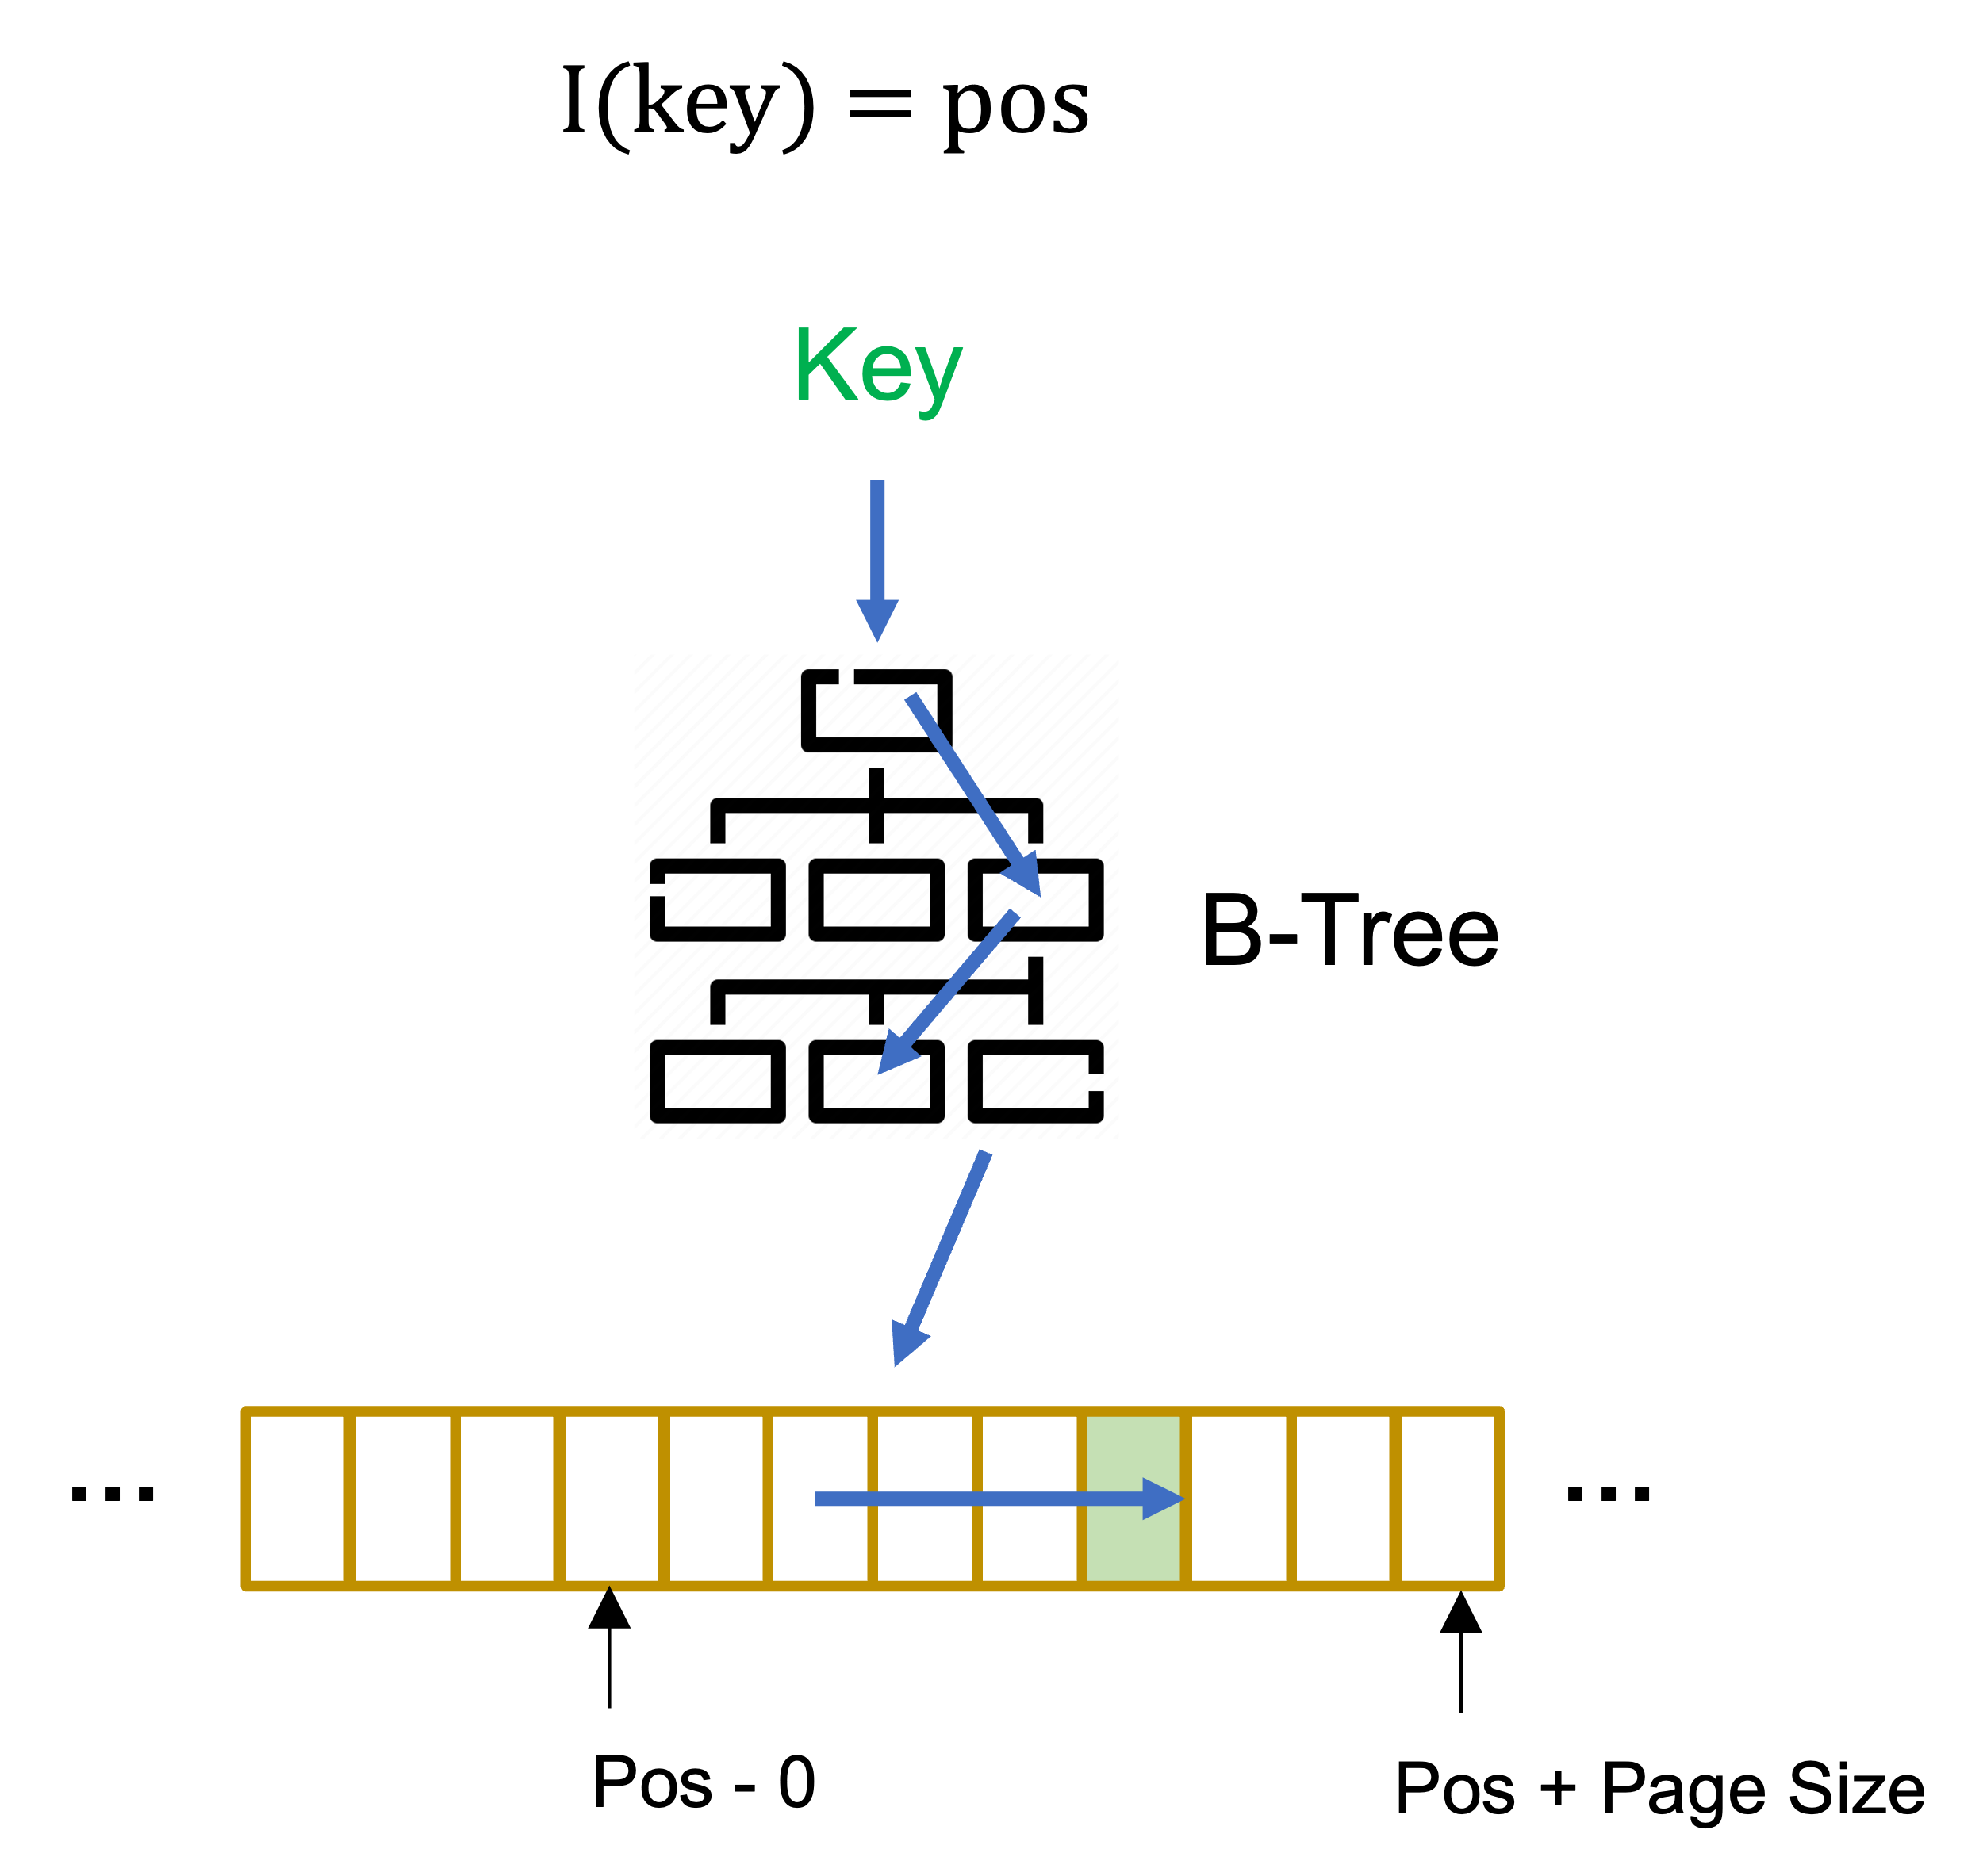
Learned Index
Index improves the speed of data retrieval operation on a database table
ZHANG Xinyi
csxyzhang@comp.hkbu.edu.hk
ZHANG Xinyi
ZHANG Xinyi
SIGMOD’24
SIGMOD’24
PG Day

Slide 3
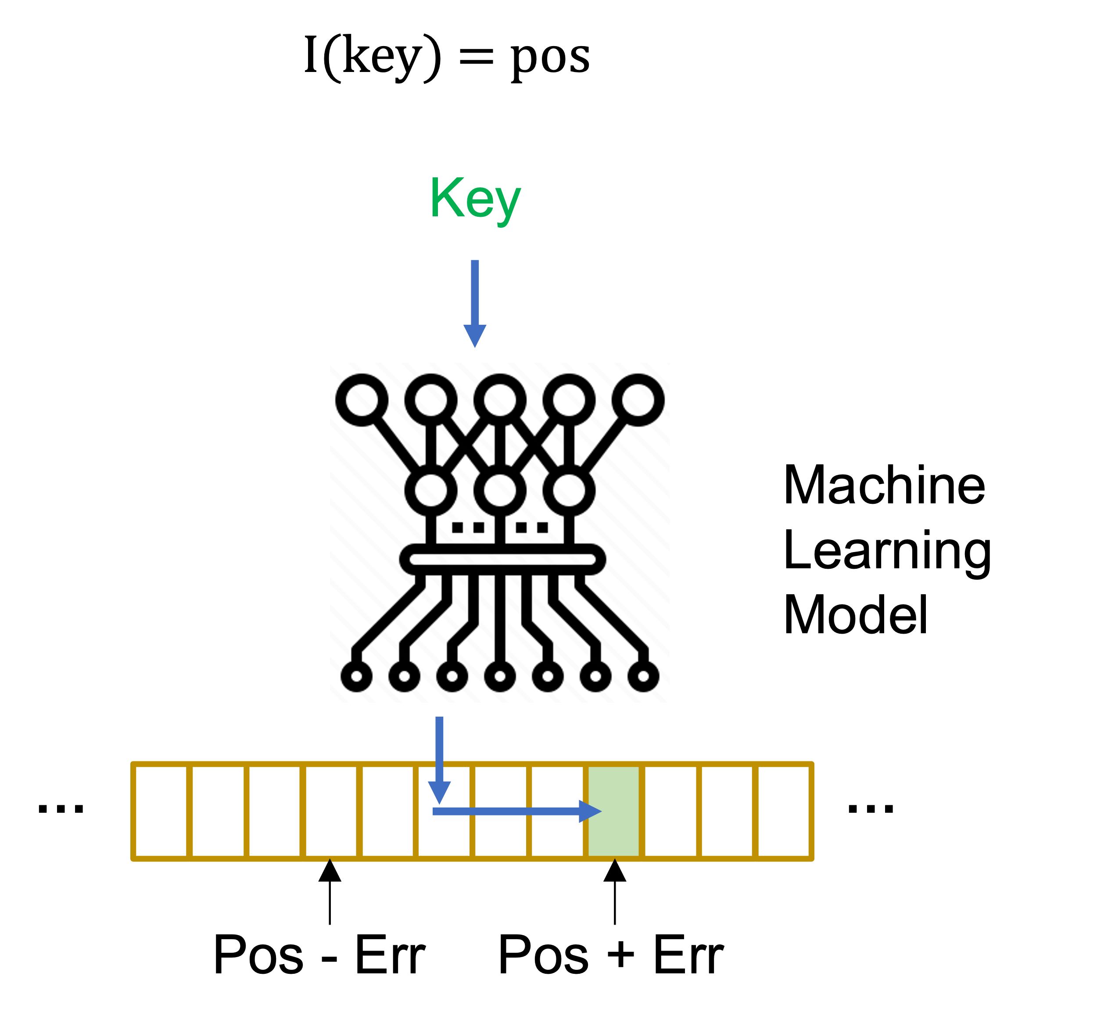
Learned Index
Index improves the speed of data retrieval operation on a database table
Learned index replaces algorithmic component of classic index structure with a machine learning model
The model accuracy matters
ZHANG Xinyi
csxyzhang@comp.hkbu.edu.hk
ZHANG Xinyi
ZHANG Xinyi
SIGMOD’24
SIGMOD’24
PG Day

Slide 4
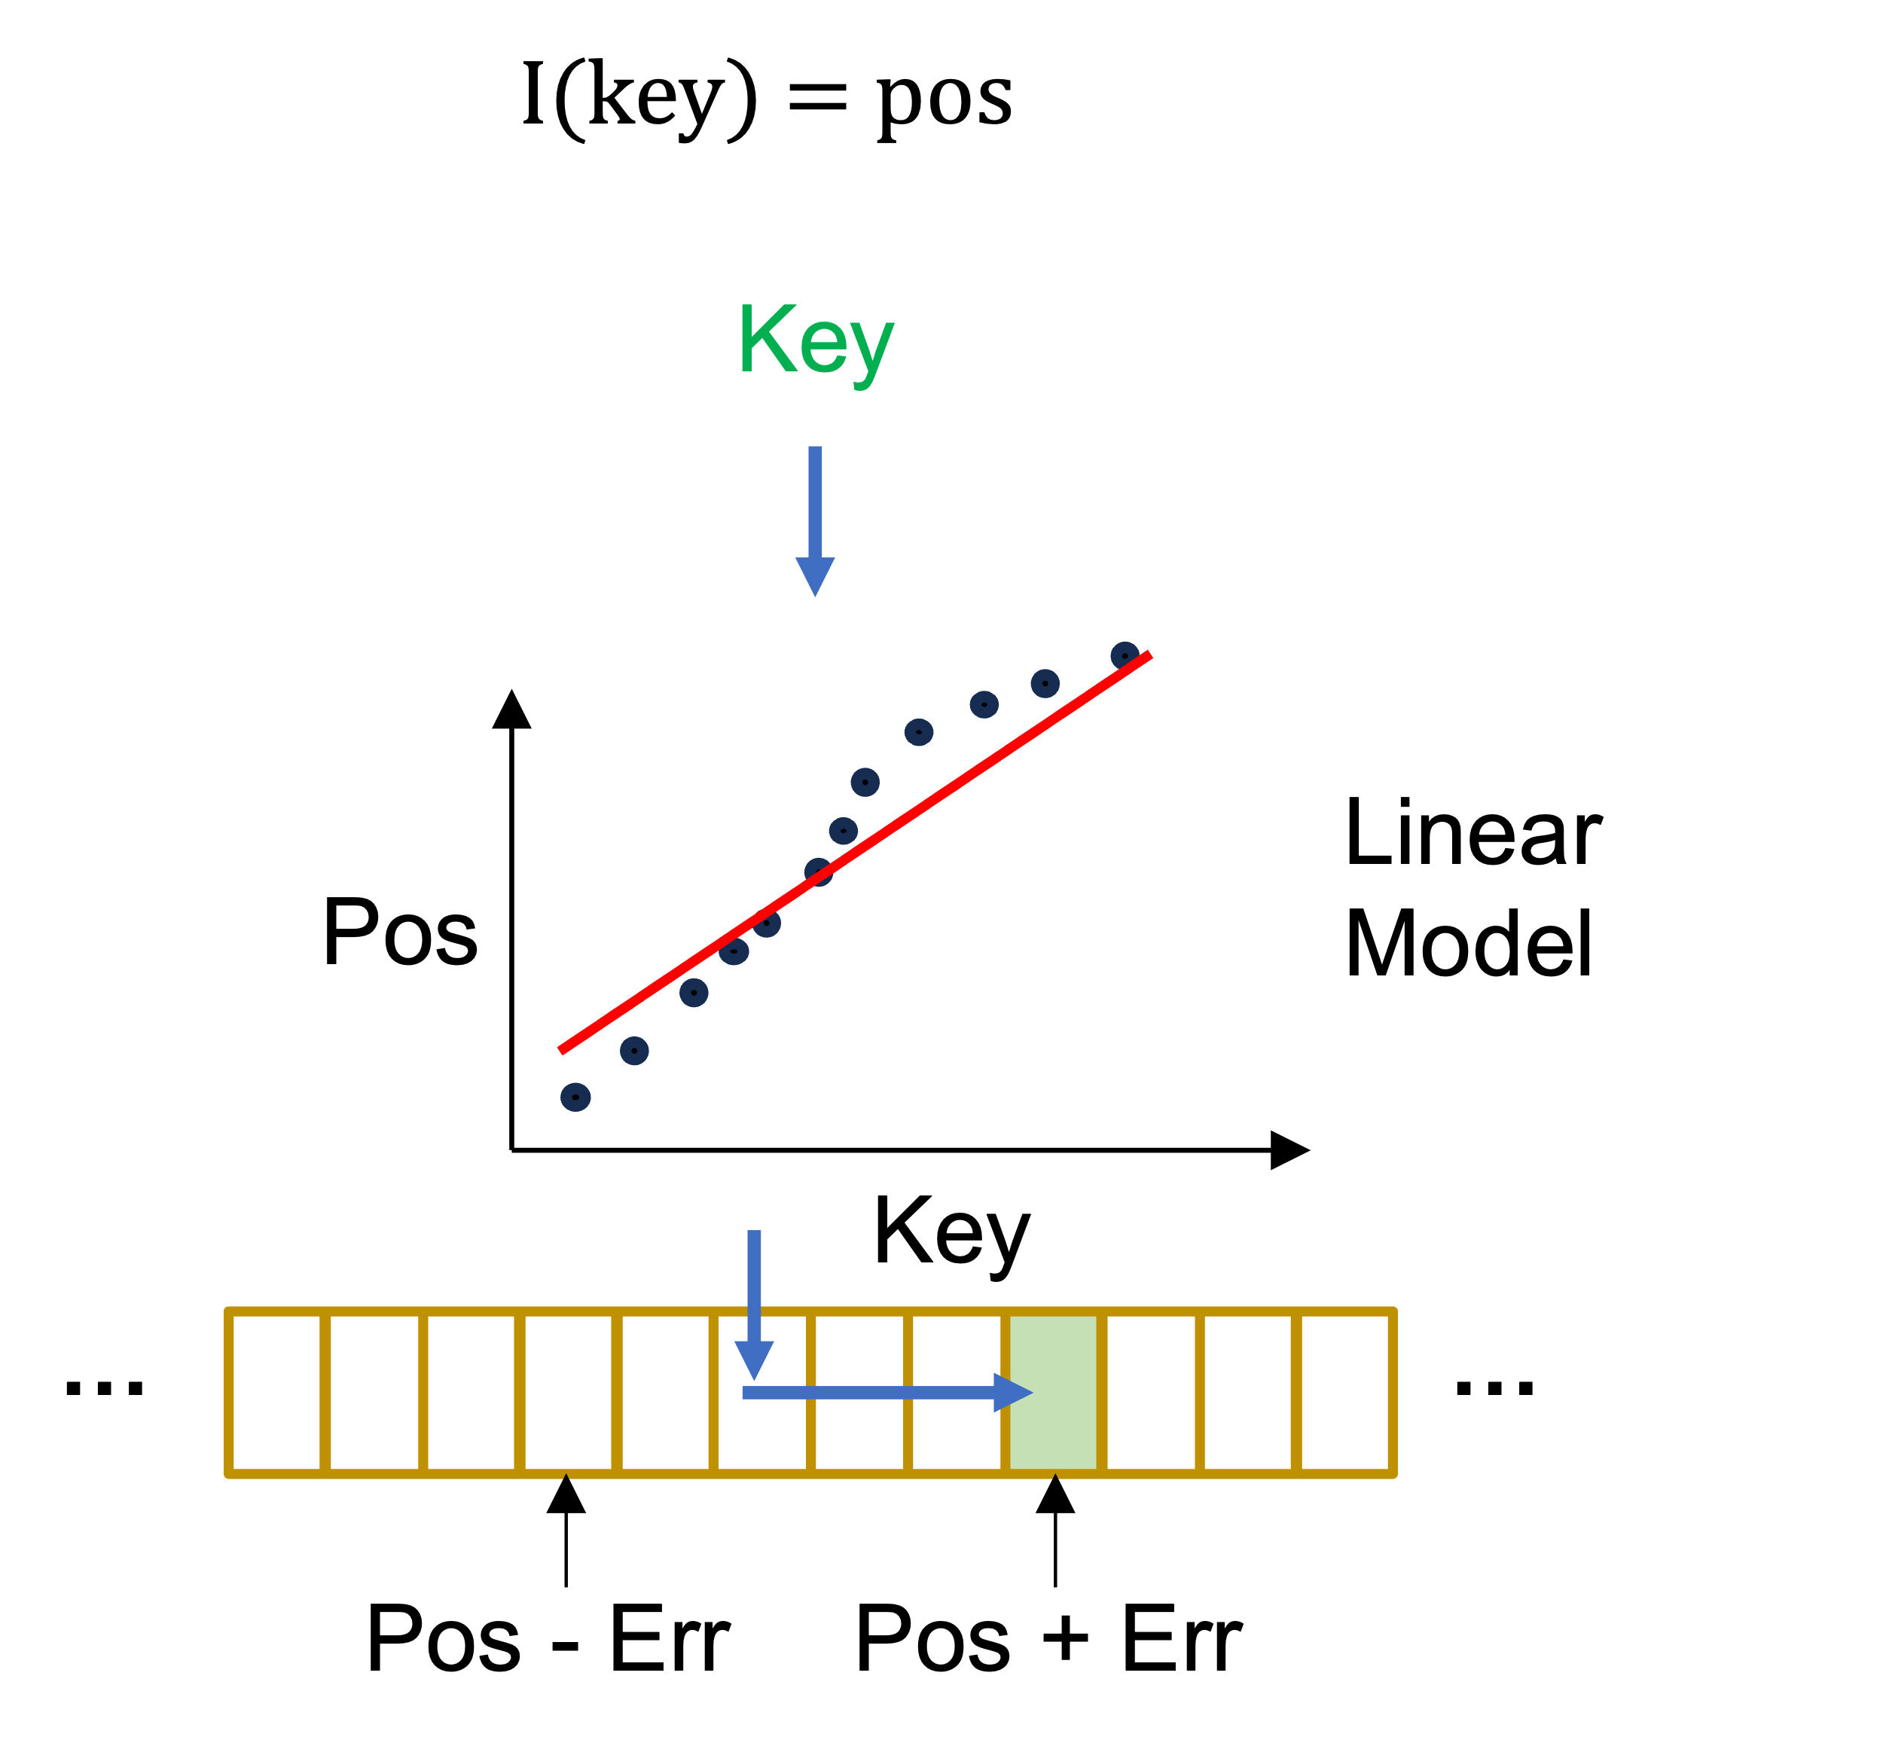
Learned Index
Index improves the speed of data retrieval operation on a database table
Learned index replaces algorithmic component of classic index structure with a machine learning model
For update efficiency, linear regression is the mainstream model
How to reduce the error
ZHANG Xinyi
csxyzhang@comp.hkbu.edu.hk
ZHANG Xinyi
ZHANG Xinyi
SIGMOD’24
SIGMOD’24
PG Day

Slide 5
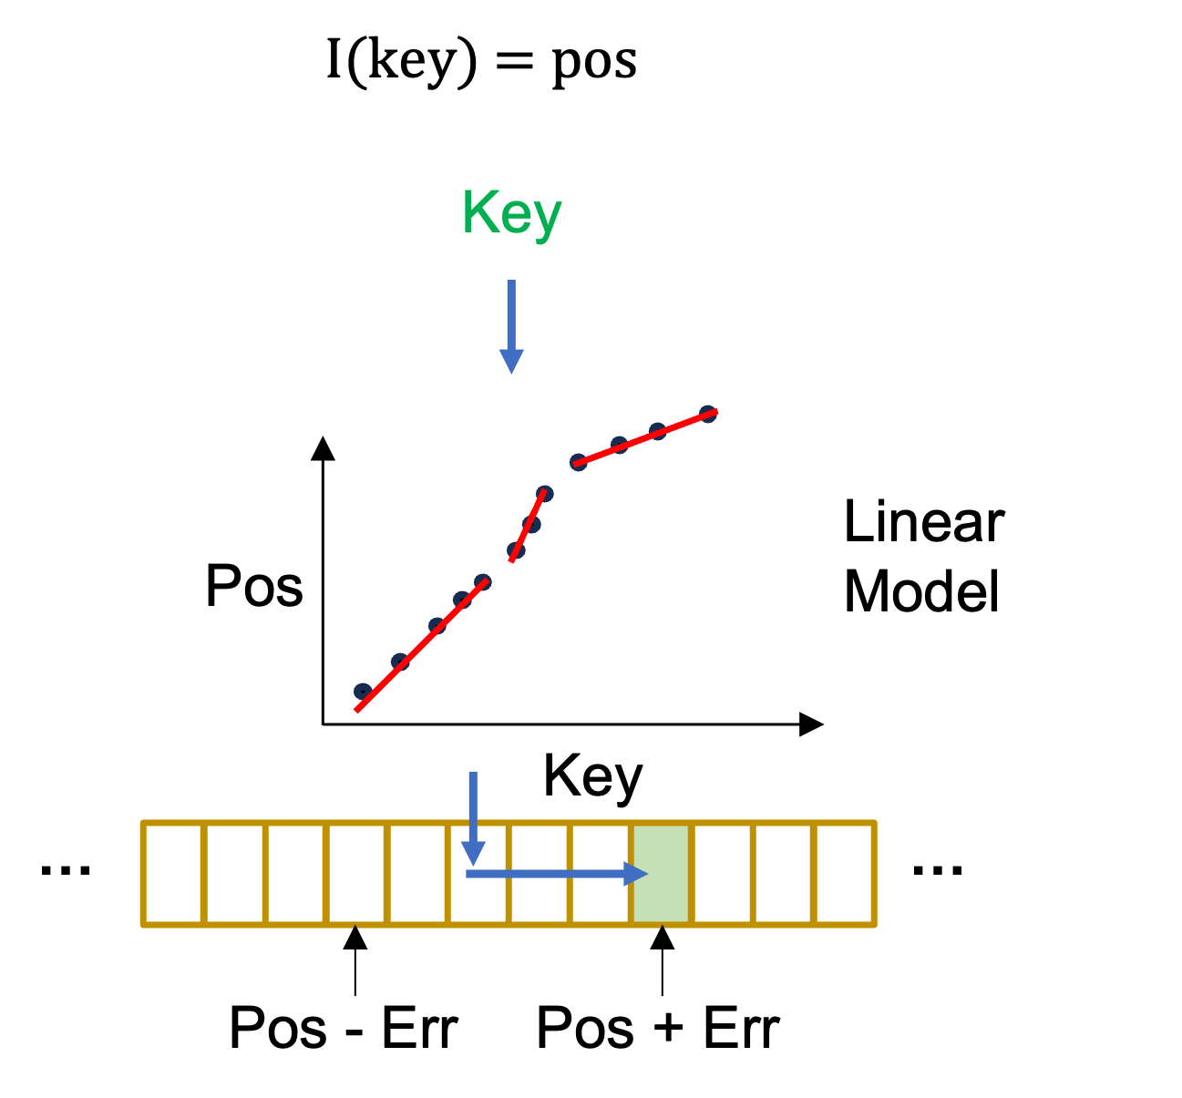
Learned Index
Index improves the speed of data retrieval operation on a database table
Learned index replaces algorithmic component of classic index structure with a machine learning model
For update efficiency, linear regression is the mainstream model
Updatable learned index focus on how to manage the linear segments
And how about their design?
ZHANG Xinyi
csxyzhang@comp.hkbu.edu.hk
ZHANG Xinyi
ZHANG Xinyi
SIGMOD’24
SIGMOD’24
PG Day

Slide 6
Limitation of Existing Updatable Learned Index
Three Key Limitations:
Inconsistent performance across different workloads
Limited optimization for range quires
The learned indexes are initially designed for range quires
Many proposals prioritized point query optimizations
High operational tail latency
ZHANG Xinyi
csxyzhang@comp.hkbu.edu.hk
ZHANG Xinyi
ZHANG Xinyi
SIGMOD’24
SIGMOD’24
PG Day

Slide 7
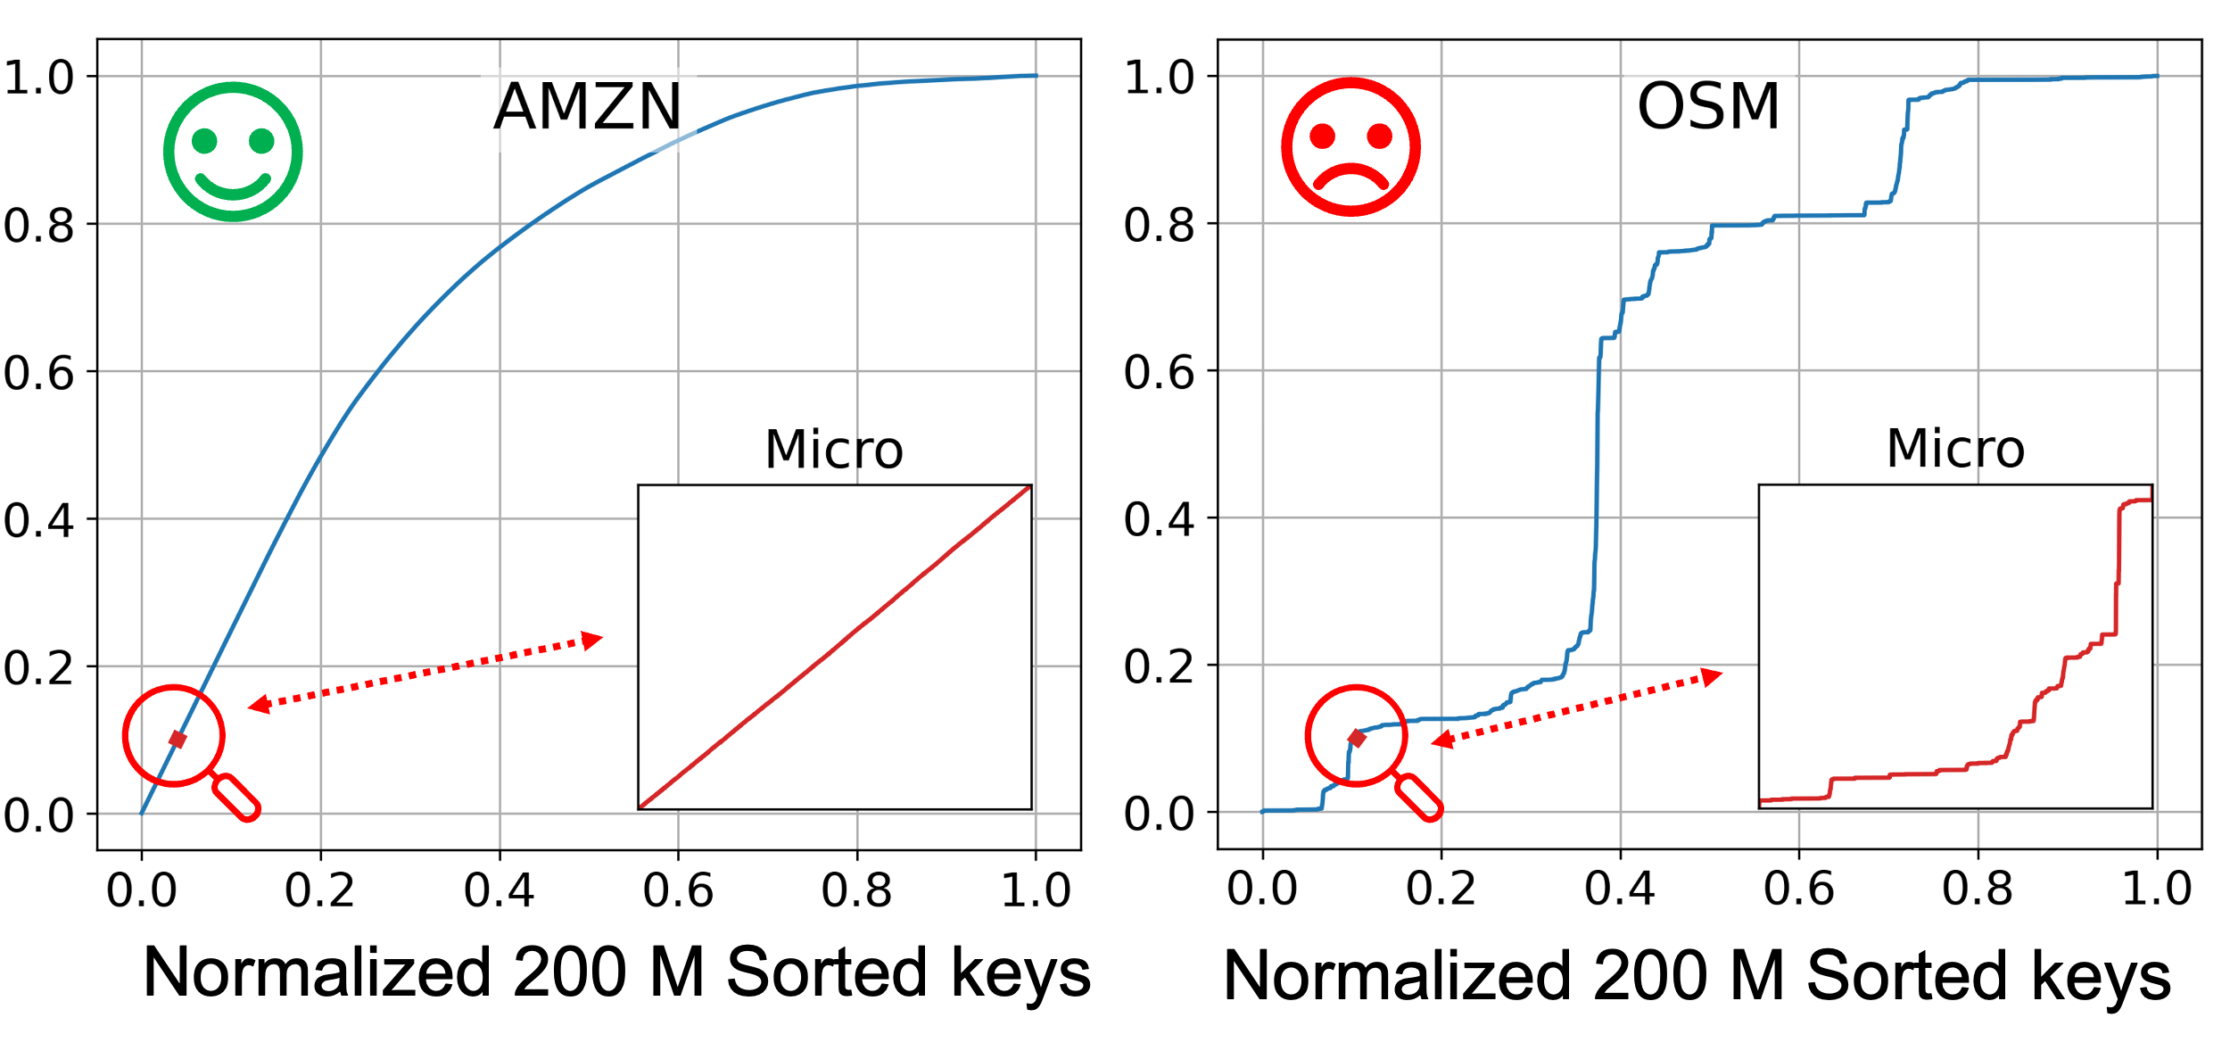
SOSD Dataset
ZHANG Xinyi
csxyzhang@comp.hkbu.edu.hk
ZHANG Xinyi
ZHANG Xinyi
SIGMOD’24
SIGMOD’24
PG Day

Slide 8
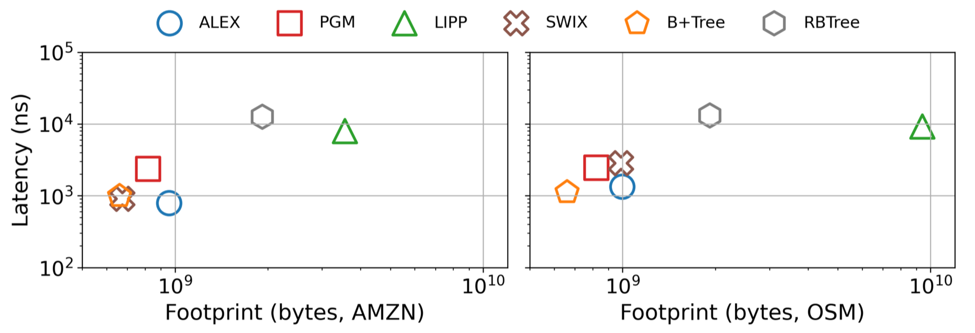


Performance Comparisons
Learned indexes baselines
Traditional Indexes
(7957, 3.5 x 10ˆ9)
(9214, 9.4 x 10ˆ9)
(1332, 1.0 x 10ˆ9)
(787, 9 x 10ˆ8)
(990, 6.6 x 10ˆ8)
(1018, 6.6 x 10ˆ8)
Learned indexes fail to always outperform B+Tree
ZHANG Xinyi
csxyzhang@comp.hkbu.edu.hk
ZHANG Xinyi
ZHANG Xinyi
SIGMOD’24
SIGMOD’24
PG Day

Slide 9
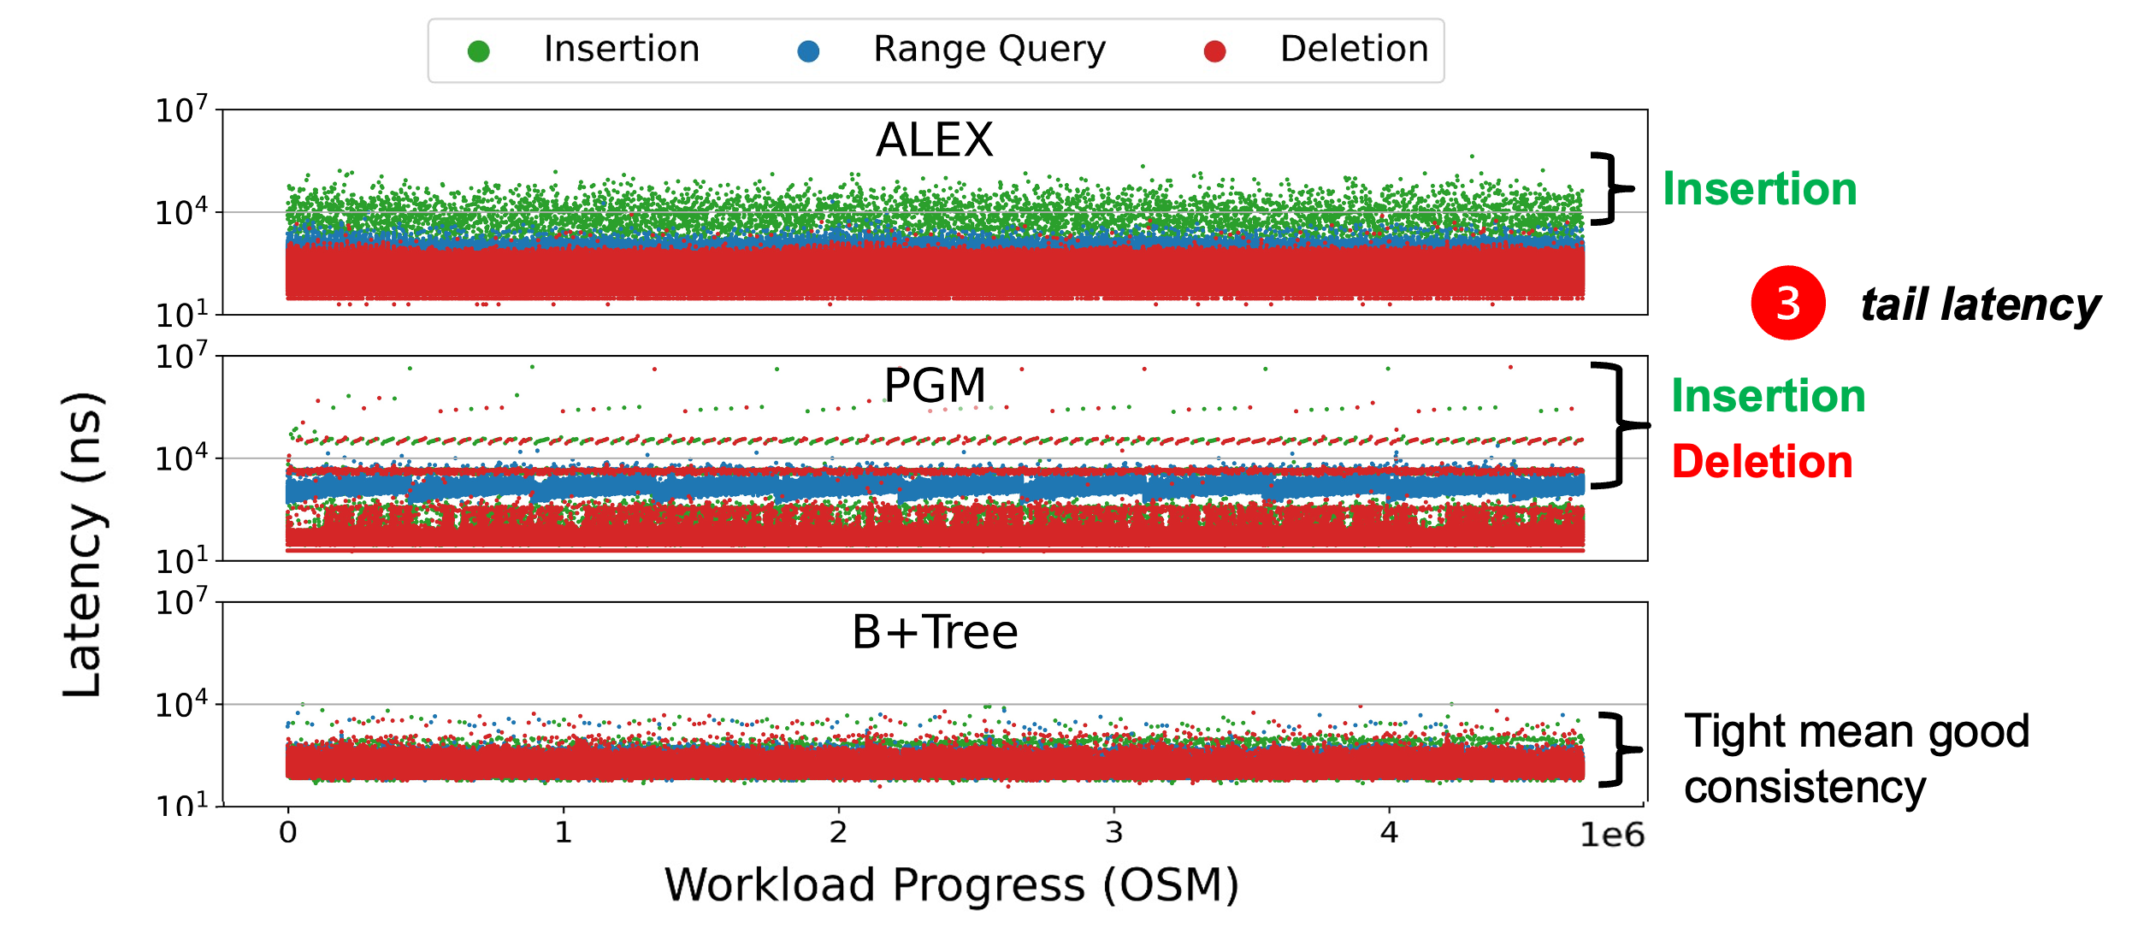
Operational Latency
High tail latency for learned index due to update
ZHANG Xinyi
csxyzhang@comp.hkbu.edu.hk
ZHANG Xinyi
ZHANG Xinyi
SIGMOD’24
SIGMOD’24
PG Day

Slide 10
Reasons for Limitations
Why learned index demonstrate following drawbacks?
Inconsistent performance across different workloads
Limited optimization for range quires
The learned indexes are initially designed for range quires
Many proposals prioritized point query optimizations
High operational tail latency
They are designed to do so
Updatable learned index designs often prioritize optimal performance under specific conditions, particularly for point queries, at the cost of worst-case stability and consistency.
ZHANG Xinyi
csxyzhang@comp.hkbu.edu.hk
ZHANG Xinyi
ZHANG Xinyi
SIGMOD’24
SIGMOD’24
PG Day

Slide 11
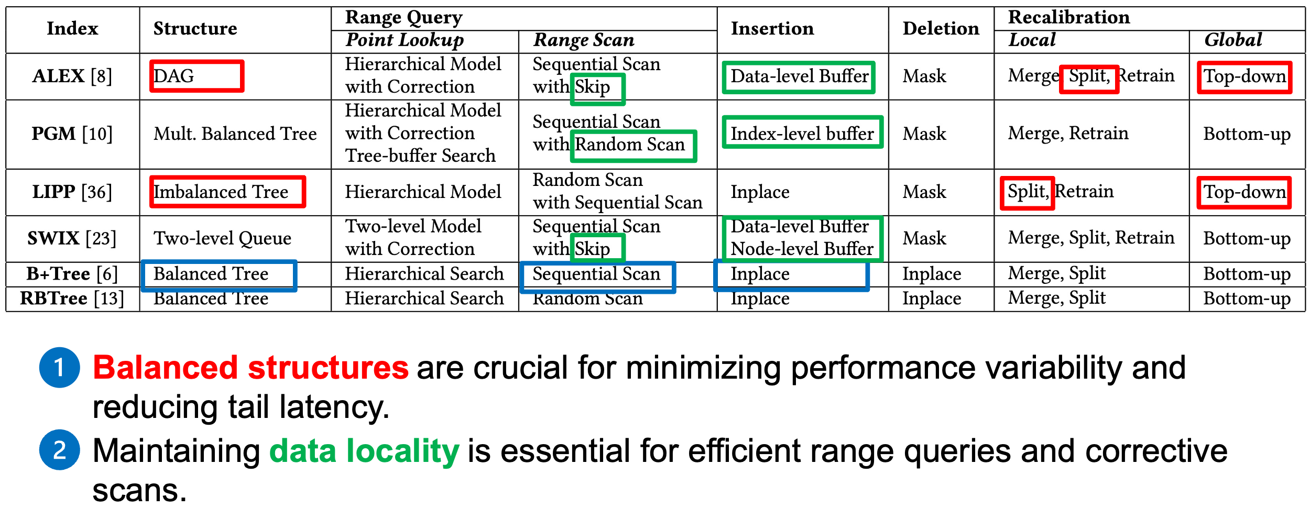
Index Design
How to design balanced structure
while maintaining the data locality?
ZHANG Xinyi
csxyzhang@comp.hkbu.edu.hk
ZHANG Xinyi
ZHANG Xinyi
SIGMOD’24
SIGMOD’24
PG Day

Slide 12
Design Goals
Overcome the three common limitations
Inconsistent performance across different workloads
Limited optimization for range quires
High operational tail latency
By ensuring
Balanced structure
Data locality
ZHANG Xinyi
csxyzhang@comp.hkbu.edu.hk
ZHANG Xinyi
ZHANG Xinyi
SIGMOD’24
SIGMOD’24
PG Day

Slide 13
HIRE
HIRE is hybrid in-memory model-accelerated index that provide stable and efficient query/update performance across diverse workload.
Four key components
Hybrid leaf node structure
Model-accelerated, log-based internal node
Novel bulk-loading algorithm for inter-level error optimization
Cost-driven, non-blocking retraining mechanism
ZHANG Xinyi
csxyzhang@comp.hkbu.edu.hk
ZHANG Xinyi
ZHANG Xinyi
SIGMOD’24
SIGMOD’24
PG Day

Slide 14
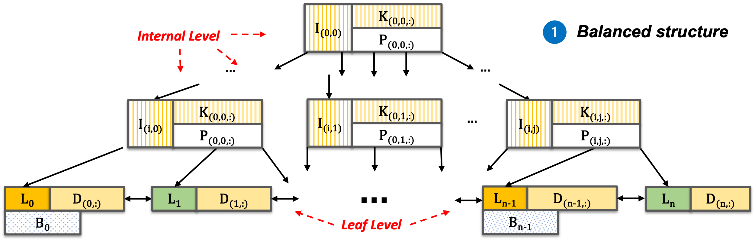
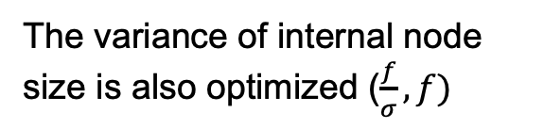
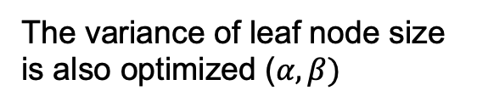
HIRE Structure
The variance of internal node size is also optimized ($\frac{f}{σ},f)$
The variance of leaf node size is also optimized ($α, β)$
ZHANG Xinyi
csxyzhang@comp.hkbu.edu.hk
ZHANG Xinyi
ZHANG Xinyi
SIGMOD’24
SIGMOD’24
PG Day

Slide 15
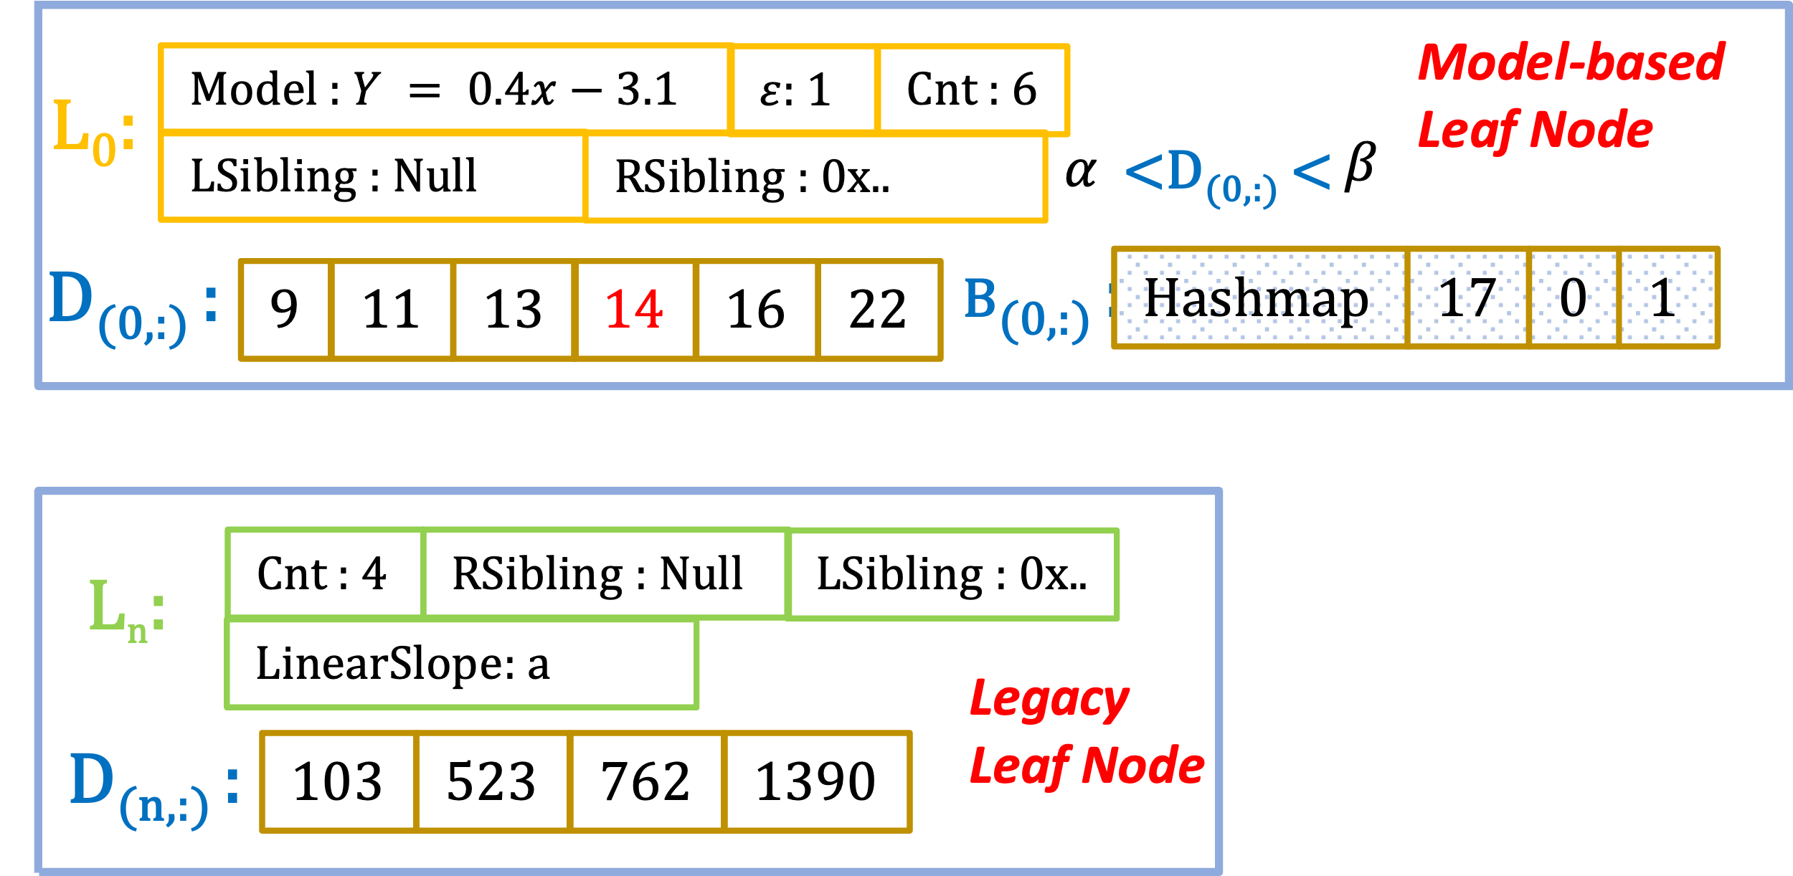


Hybrid Leaf Node Structure
Hybrid node structure
1
Interchangeable
M $→$L: size or accuracy decay
L $→$ M: if siblings show a similar linear slope
2
Data locality
ZHANG Xinyi
csxyzhang@comp.hkbu.edu.hk
ZHANG Xinyi
ZHANG Xinyi
SIGMOD’24
SIGMOD’24
PG Day

Slide 16
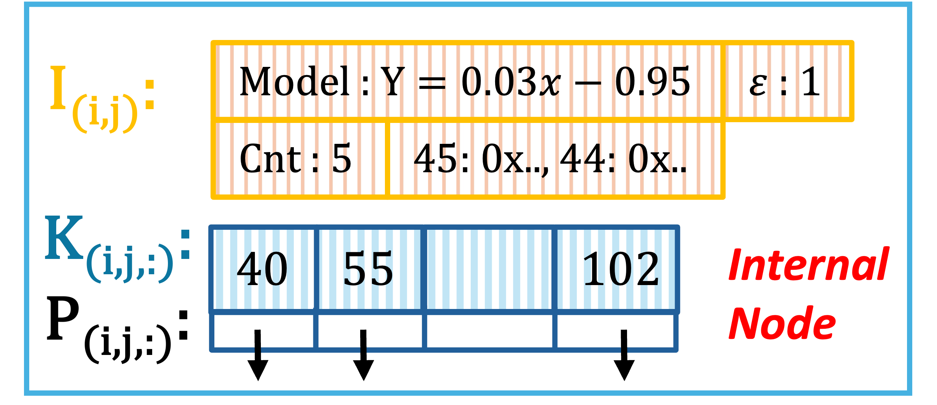
Model-accelerated Internal Node
Model-accelerated, log-based internal node
2
Model
Metadata
Logs
Key-pointer pairs
ZHANG Xinyi
csxyzhang@comp.hkbu.edu.hk
ZHANG Xinyi
ZHANG Xinyi
SIGMOD’24
SIGMOD’24
PG Day

Slide 17
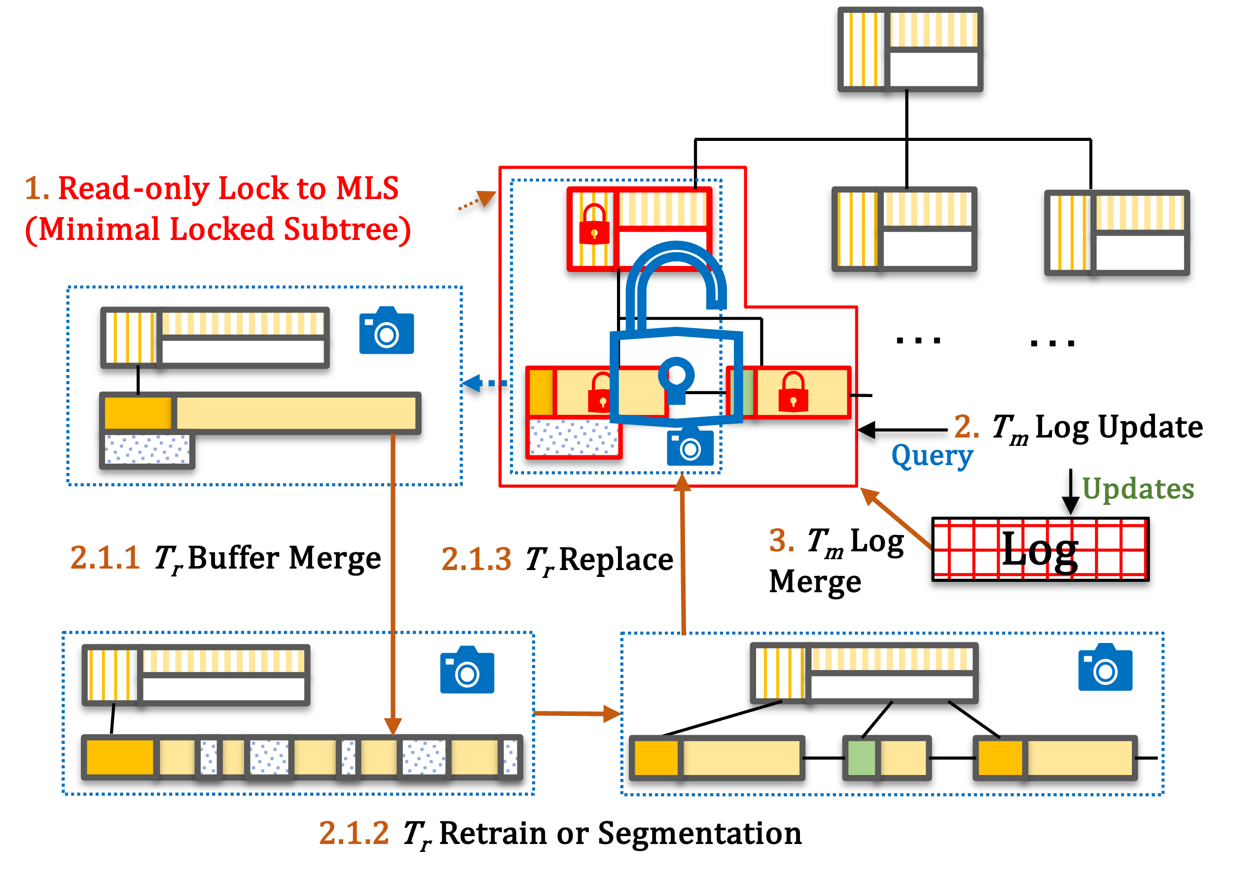
Non-blocking Recalibration
Non-blocking, cost-driven recalibration
3
3
Low Tail Latency
ZHANG Xinyi
csxyzhang@comp.hkbu.edu.hk
ZHANG Xinyi
ZHANG Xinyi
SIGMOD’24
SIGMOD’24
PG Day

Slide 18
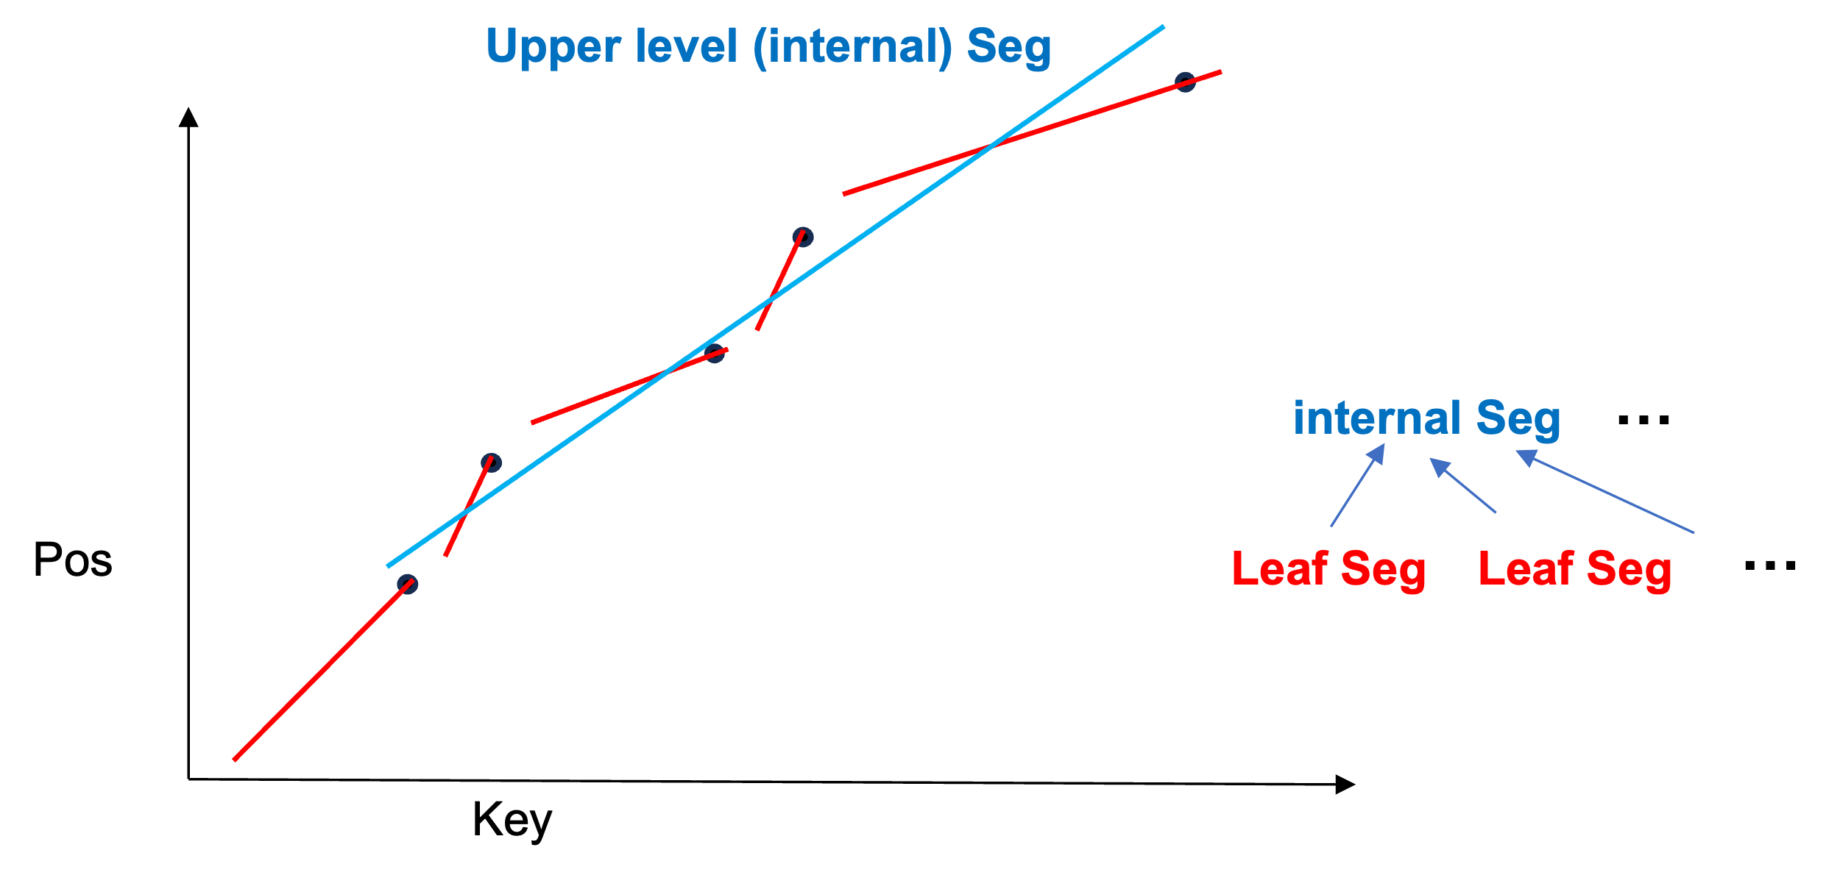
Inter-level Optimized Bulk-loading
Only focus on the current level accuracy, which leads to a non-optimized overall structure
However, internal nodes of HIRE prioritize load balance over accuracy.
In this case, we need new algorithm
which can maximize linearity across multi levels
ZHANG Xinyi
csxyzhang@comp.hkbu.edu.hk
ZHANG Xinyi
ZHANG Xinyi
SIGMOD’24
SIGMOD’24
PG Day

Slide 19
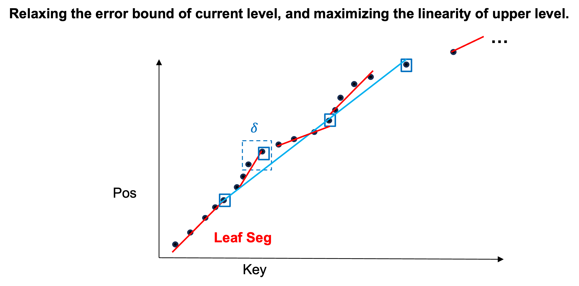
Inter-level Error Optimized Bulk-loading
ZHANG Xinyi
csxyzhang@comp.hkbu.edu.hk
ZHANG Xinyi
ZHANG Xinyi
SIGMOD’24
SIGMOD’24
PG Day

Slide 20
Evaluation
Setup
Six datasets from SOSD and GRE (OSM, FACE, AMZN, COVID, GENOME, and PLANET)
200 millions u64 keys
Evaluated on a Linux workstation
AMD Ryzen 9950X
64GB RAM
Four SOTA baselines
B+-Tree with SIMD optimization
ALEX
PGM
LIPP
20
csxyzhang@comp.hkbu.edu.hk
csxyzhang@comp.hkbu.edu.hk
ZHANG Xinyi
csxyzhang@comp.hkbu.edu.hk
ZHANG Xinyi
ZHANG Xinyi
SIGMOD’24
SIGMOD’24
PG Day

Slide 21
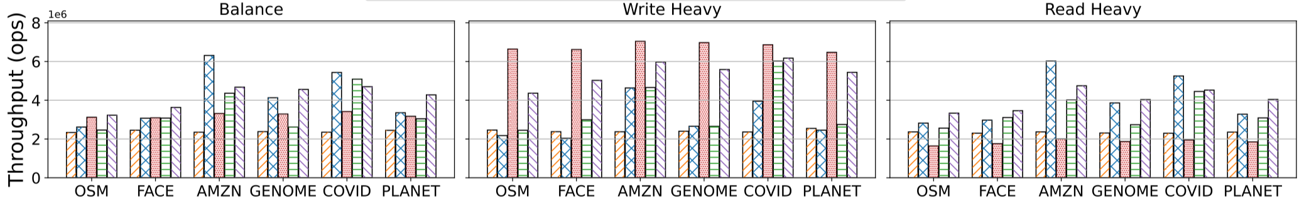
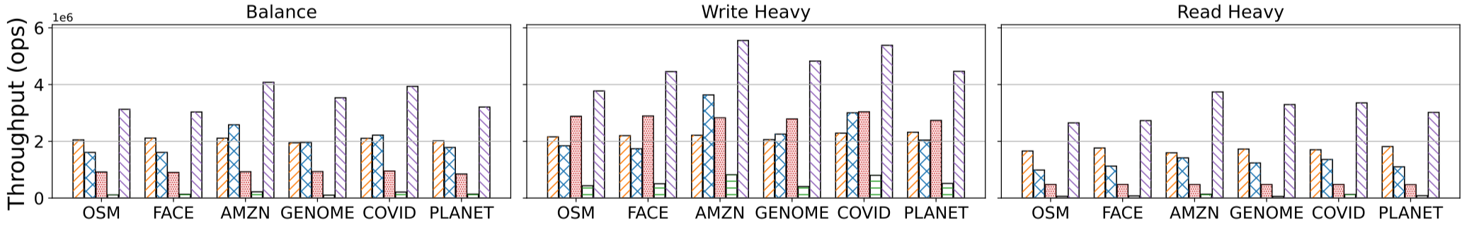
Query Performance
Point Query
Range Query
HIRE achieves at least a 1.5× improvement in throughput over all baselines
21
csxyzhang@comp.hkbu.edu.hk
csxyzhang@comp.hkbu.edu.hk
ZHANG Xinyi
csxyzhang@comp.hkbu.edu.hk
ZHANG Xinyi
ZHANG Xinyi
SIGMOD’24
SIGMOD’24
PG Day

Slide 22
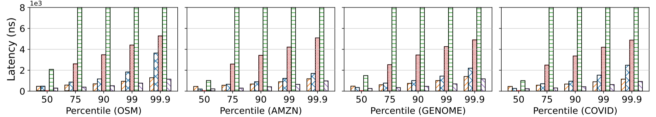
Tail Latency
HIRE achieves up to 98% reduction in tail latency compared to baselines
22
csxyzhang@comp.hkbu.edu.hk
csxyzhang@comp.hkbu.edu.hk
ZHANG Xinyi
csxyzhang@comp.hkbu.edu.hk
ZHANG Xinyi
ZHANG Xinyi
SIGMOD’24
SIGMOD’24
PG Day

Slide 23
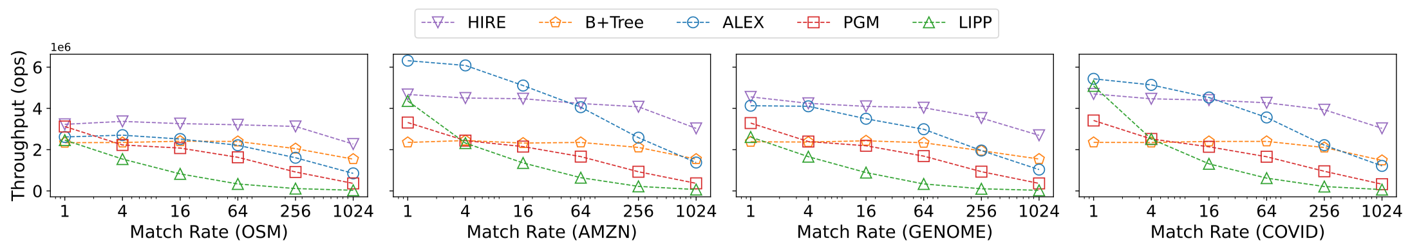
Match Rate
HIRE achieves up to 2.7× higher throughput than the best-performing learned index baseline
23
csxyzhang@comp.hkbu.edu.hk
csxyzhang@comp.hkbu.edu.hk
ZHANG Xinyi
csxyzhang@comp.hkbu.edu.hk
ZHANG Xinyi
ZHANG Xinyi
SIGMOD’24
SIGMOD’24
PG Day

Slide 24
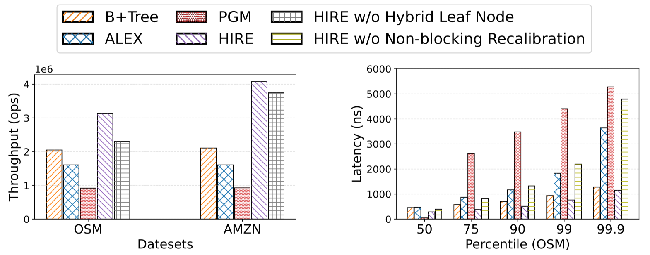
Ablation Studies
The Hybrid leaf layer and non-blocking recalibration are keys to ensure robust performance
24
csxyzhang@comp.hkbu.edu.hk
csxyzhang@comp.hkbu.edu.hk
ZHANG Xinyi
csxyzhang@comp.hkbu.edu.hk
ZHANG Xinyi
ZHANG Xinyi
SIGMOD’24
SIGMOD’24
PG Day

Slide 25
Thank You
Notes:
That’s all. Thanks for your listening.

