Slide 1

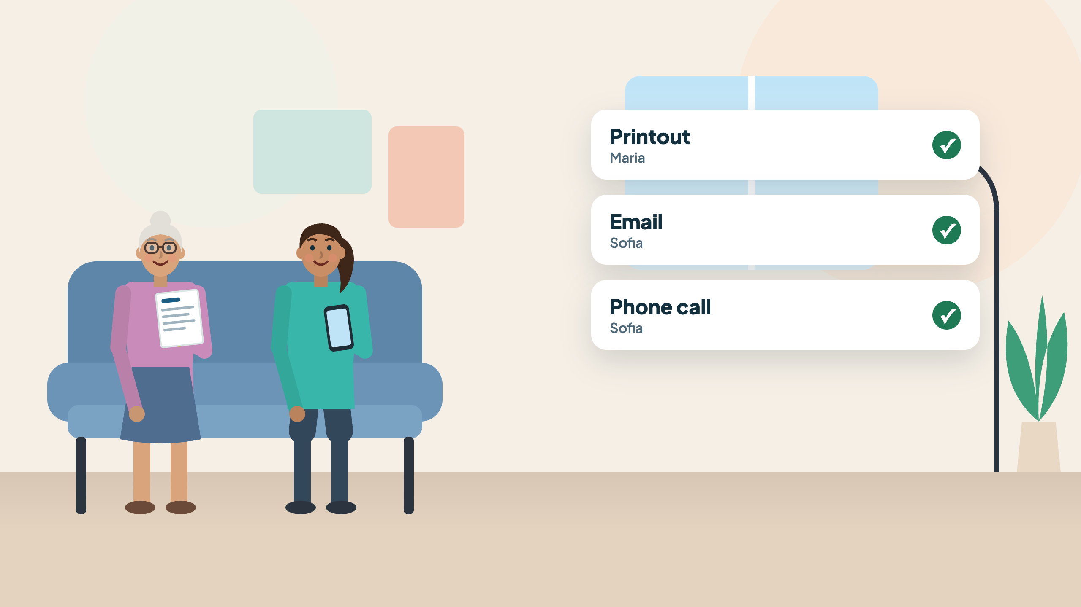
AI at 70
In our project, a person always stays in charge.
By Ethan · Jason · Max · Tanner
Notes:
AI at 70 turns a primary-care visit into a short, plain-language summary for older patients and the family members they choose: a printout, an email and a phone call, in five languages. In our project, a person always stays in charge.

Slide 2
1
Who are we building this for, and why do they need it?
Elderly patients who have difficulty retaining medical information and guidance.
✓
Visits move fast
✓
Details fade by the time they're home
✓
Families are left guessing
AI at 70 Health for all ages
Notes:
Our users are elderly patients who have difficulty retaining medical information and guidance, and the family members who help them. A visit is fast and full of jargon; by evening, the patient and family are unsure what changed.

Slide 3
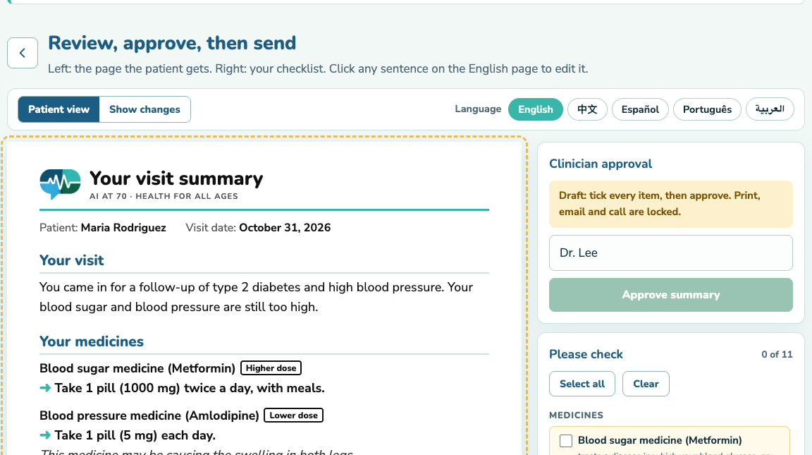
2
What could go wrong, and what would we do about it?
AI can make mistakes, so physicians always verify the final output.
✓
Every item on a checklist
✓
Nothing goes out until they approve
✓
Doubts are flagged, not guessed
AI at 70 Health for all ages
Notes:
AI can make mistakes, so the physician always verifies the final output. The review screen puts the patient's page next to a checklist; nothing can be printed, emailed or called until every item is ticked and the physician approves. Editing or changing the language removes the approval.

Slide 4
3
How does this help people rather than decide for them?
There is no change in medical guidance, only simplification.
THE PHYSICIAN'S NOTE
WHAT THE PATIENT READS
Decr. amlodipine to 5 mg daily
→
Blood pressure medicine (Amlodipine): Take 1 pill (5 mg) each day.
Metformin 1000 mg BID with meals
→
Blood sugar medicine (Metformin): Take 1 pill (1000 mg) twice a day, with meals.
AI at 70 Health for all ages
Notes:
AI at 70 changes no medical guidance; it only simplifies it. Every diagnosis, medicine, dose and instruction comes from the physician's own note and keeps its meaning; the tool rewrites it in everyday words and adds no advice of its own. We reinforce patients' control over their own health by breaking down what the visit actually means and what to actually do.

