Slide 1
Does gene expression change when nivolumab works?
Bulk RNA sequencing (RNA-seq) results
Ethan, RNA lead · with Krithika (TCR) and Kwaku (WES)
Reanalysis of Riaz et al., Cell 2017
Notes:
Hi, I'm Ethan, and I led the bulk RNA sequencing part of our project. Kwaku asked whether tumors lose their mutations when nivolumab works. I ask the matching question for gene expression: what changes in the biopsy, and is that change specific to patients who respond? [~20 s]

Slide 2
Nivolumab releases the brake; RNA shows what follows
T cells
Nivolumab
Immune genes
Tumor genes
Recognize the tumor, but PD-1 brakes them
→
Blocks PD-1 and releases the brake
→
Active T cells switch on IFN-γ and killing genes
→
As cancer cells die, melanoma genes fade
RNA measures these two, before and during treatment
Why RNA? DNA shows which targets exist. RNA shows what the cells are doing. If T cells attack, immune genes should rise and melanoma genes should fall in patients who respond.
Notes:
Kwaku covered how mutations create targets. RNA picks up the story from there. T cells recognize the tumor, but PD-1 acts as a brake. Nivolumab blocks PD-1. If that works, active T cells should switch on interferon-gamma and killing genes, and cancer cells should die, so melanoma genes should fade from the biopsy. DNA tells us which targets exist. RNA tells us what the cells in the biopsy are doing. So RNA can measure both the immune response and its effect on the tumor. [~35 s]

Slide 3
The study sampled each tumor twice
1
2
3
4
Biopsy 1
Nivolumab
Biopsy 2
Response
Taken before the first dose
Anti-PD-1 antibody that releases the brake on T cells
Taken about 4 weeks into treatment
Scans sort patients: PR/CR shrank, SD stable, PD grew
49
patients with RNA before treatment
42
with RNA at both biopsies: my main comparison
26
with WES, RNA and TCR at both biopsies (team's shared set)
Notes:
This is the same study design Kwaku showed: one biopsy before the first dose, a second about four weeks in, and scans that later sort patients into responders, stable disease and progressive disease. For RNA, 49 patients with a response call have a pre-treatment biopsy and 42 have both biopsies. Those 42 are my main comparison. Having both biopsies lets every patient act as their own control, which matters because tumors differ so much between people. [~30 s]

Slide 4
RNA-seq turns each biopsy into gene and program scores
1
2
3
4
Count genes
Normalize
Score programs
Change on treatment
Count RNA reads per gene. 19,578 genes pass the filter.
Adjust for sequencing depth so that samples are comparable (DESeq2, VST).
Average marker genes into 12 scores: T cells, IFN-γ, melanoma and more.
Compare biopsies per patient: DESeq2 for genes, fgsea for pathways.
Example: patient 30, a responder
19,578
→
39%
→
+2.5
→
−1.5
genes measured in both biopsies
of genes changed 2-fold or more
CD8 score (−0.8 to +1.7)
melanoma score (+0.1 to −1.4)
Notes:
Here is the workflow. We start from the authors' table of read counts: how many RNA reads came from each gene in each biopsy. After removing rarely detected genes, 19,578 remain. Second, we normalize, because some samples were simply sequenced more deeply. Third, we average marker genes into scores for programs such as CD8 T cells, interferon-gamma and melanoma identity. Fourth, we compare the two biopsies, using DESeq2 for single genes and pathway analysis for groups of genes. Take patient 30, a responder: 39 percent of genes changed at least two-fold, the CD8 score rose by 2.5, and the melanoma score fell by 1.5. [~40 s]

Slide 5
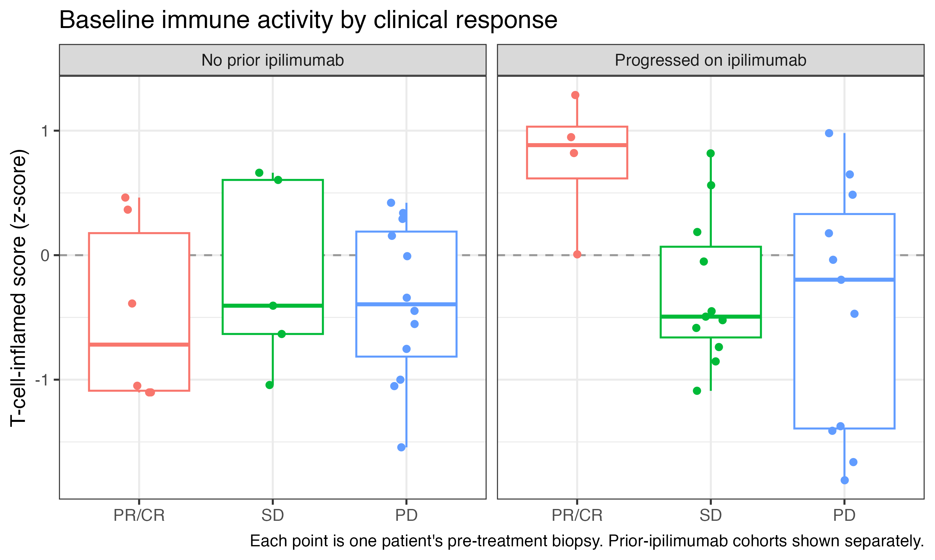
Baseline immune activity is a weak predictor
Median T-cell-inflamed score
Both cohorts combined
0.19
PR/CR (n = 10)
95% CI −1.05 to 0.82
−0.47
Stable (n = 16)
95% CI −0.63 to 0.19
−0.34
Progressive (n = 23)
95% CI −0.75 to 0.16
PR/CR − PD: +0.53 (95% CI −0.73 to +1.33). The interval crosses zero.
Notes:
First: does immune activity before treatment predict response? This is the RNA version of Kwaku's mutation-burden question. Each dot is a patient's T-cell-inflamed score, a published 18-gene measure of how immune-active a tumor is. Medians are 0.19 for responders, −0.47 for stable disease and −0.34 for progressors. The difference between responders and progressors is 0.53, with a 95 percent bootstrap interval from −0.73 to 1.33, so it crosses zero. One cohort detail matches the paper: the four responders who had already progressed on ipilimumab all sit at or above average, the 'hot tumor' pattern the authors describe, but responders without prior ipilimumab do not. The authors also called baseline expression only marginally predictive. [~40 s]

Slide 6
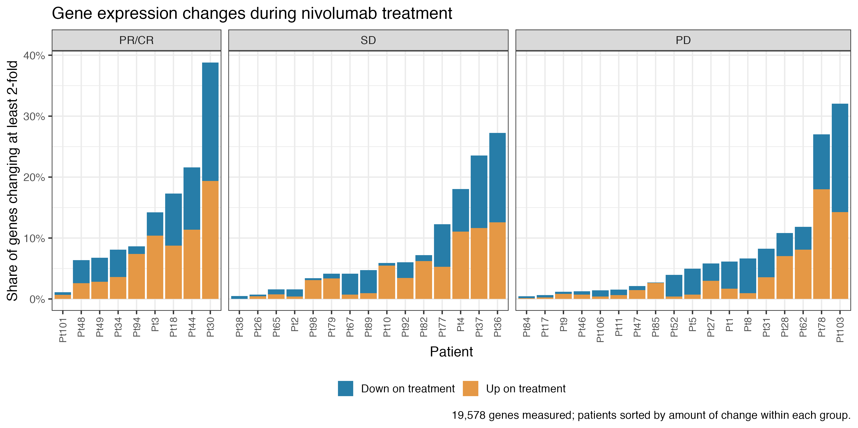
Each gene is tracked between the two biopsies
Genes shifting together
DESeq2 On vs Pre within group, FDR < 0.1
3,582
PR/CR
9 patients
28
Stable
15 patients
0
Progressive
18 patients
Median share changing 2-fold: 8.6%, 4.7% and 4.5%. Repeat libraries differ by about 3%, so consistency matters more than size.
Notes:
Next, the two biopsies. Each bar is one patient, and its height is the share of genes that changed at least two-fold: orange went up, blue went down. Responders change most, with a median of 8.6%, against 4.7% in stable disease and 4.5% in progressors. That gap is modest, and repeat libraries of the same biopsy already differ by about 3 percent. Some progressors, like patients 78 and 103, change a lot. The bigger difference is consistency. When DESeq2 asks which genes shift together across a group, it finds 3,582 in responders, 28 in stable disease and 0 in progressors. A formal test finds 1,721 genes whose change differs between responders and progressors. Responders move in a shared direction; progressors move, if at all, in their own directions. [~45 s]

Slide 7
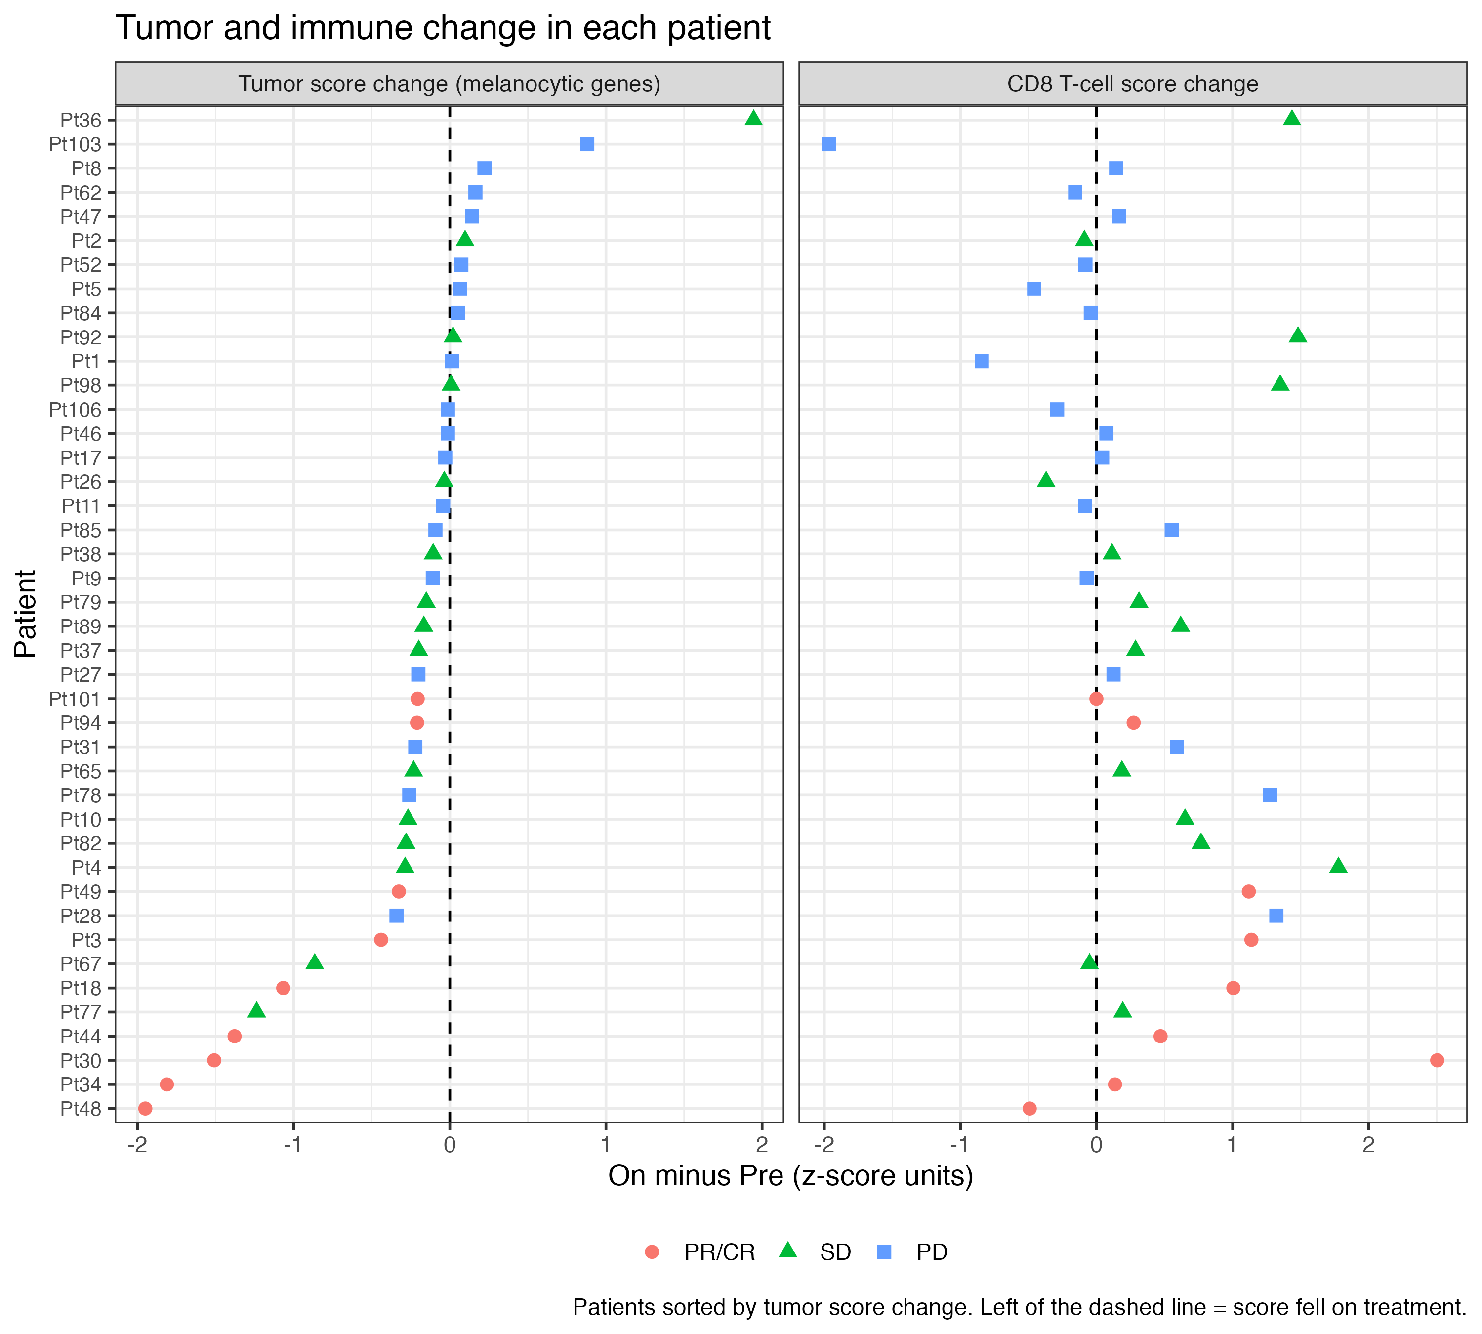
Responders lose tumor signal; immune gains are less specific
Change in tumor score on treatment (median)
−1.07
−0.01
PR/CR
95% CI −1.81 to −0.21
Progressive
95% CI −0.10 to 0.07
PR/CR − PD: −1.05 (95% CI −1.77 to −0.23); Wilcoxon p ≈ 0.0002 (n = 9 vs 18)
CD8 change: PR/CR +0.47, SD +0.31, PD 0.00; Wilcoxon p ≈ 0.07
Not universal: Pt94 and Pt101 respond with little tumor score change
Notes:
So which genes? Here each row is a patient, sorted by the change in a score built from five melanoma identity genes. Responders pile up at the bottom left: median change −1.07 against −0.01 in progressors. The difference is −1.05, with an interval of −1.77 to −0.23 and a rank-sum p of about 0.0002. The top single genes in responders tell the same story: SOX10, MLANA, PRAME and PAX3 all fall. On the right is the CD8 T-cell score. It rises in responders, median +0.47, but also in stable disease, +0.31, and the responder-versus-progressor test gives p of only about 0.07. Immune activation is clearly happening, but tumor loss is what marks a response. It isn't universal: patients 94 and 101 respond with little change in the tumor score. [~45 s]

Slide 8
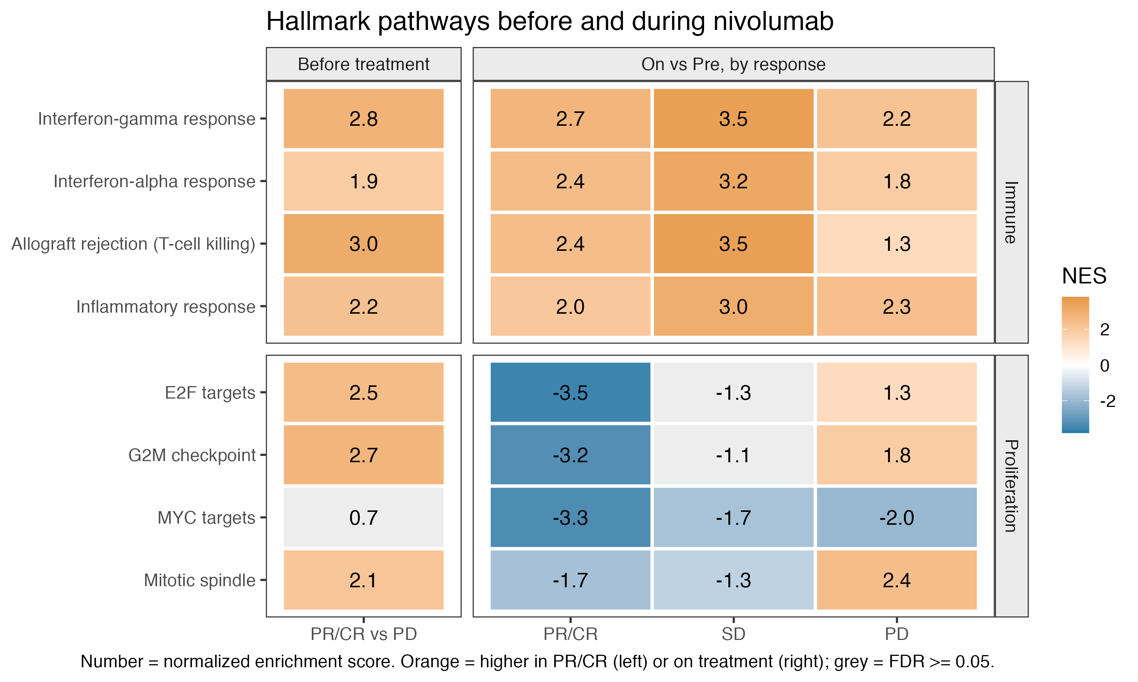
Immune pathways rise broadly; proliferation falls in responders
Reading the pattern
Immune: up in all groups
IFN-γ NES +2.7 PR/CR, +3.5 SD, +2.2 PD
Proliferation: splits groups
E2F NES −3.5 PR/CR, −1.3 SD (n.s.), +1.3 PD
Before treatment
Immune pathways lean higher in PR/CR, but scores overlap (slide 5)
Notes:
Pathways make the same point across thousands of genes. Orange means higher, blue lower, and grey is not significant. In the top block, immune pathways rise on treatment in every group, and stable disease is strongest, with interferon-gamma at +3.5. In the bottom block, proliferation falls hard in responders, with E2F targets at −3.5, while most of those programs rise in progressors, at +1.3. That matches the paper, which reported immune genes up and cell-cycle and melanin genes down in responders. The left column shows immune pathways already lean higher in responders before treatment, again as the paper describes. Enrichment p-values run small because genes in a pathway move together, so I read the direction and pattern here more than the exact significance. [~40 s]

Slide 9
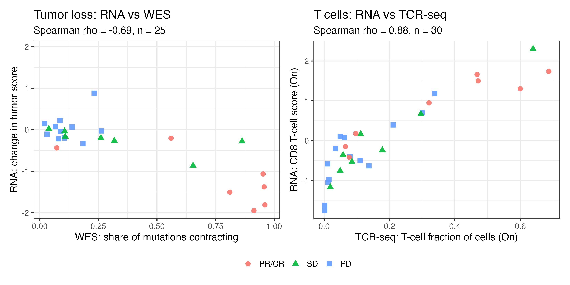
RNA agrees with WES and TCR sequencing
Spearman correlation
Same patients, independent assays
−0.69
Tumor loss vs WES contraction
n = 25
0.88
CD8 vs TCR T-cell fraction
n = 30
Baseline immune score vs mutation burden: rho 0.14. They carry different information.
Notes:
Do the RNA results agree with data measured a completely different way? On the left, each point is a patient with both RNA and exome data. The more a patient's mutations contract in Kwaku's analysis, the more the RNA tumor score falls: rho of −0.69 across 25 patients, and still −0.50 with responders removed. On the right, the RNA CD8 score tracks the T-cell fraction measured directly by TCR sequencing in Krithika's data: rho of 0.88. That validates the score. Both left-panel measures partly reflect how much tumor is in the biopsy, so they aren't fully independent. Baseline immune score and mutation burden barely correlate, rho of 0.14, so RNA and WES carry different information for a combined model. [~40 s]

Slide 10
What could make genes look changed?
Tumor loss dilutes other signals
Tumor score is close to the outcome
Fewer cancer cells inflate other cell types' share. Adjusting for tumor loss cuts the CD8 rise from +0.67 to +0.21. On-treatment CD8 holds (+1.30 to +1.21).
Response is defined by tumor shrinkage, so falling melanoma genes partly restate it. The score describes response; it is not yet a predictor.
Paper's gene counts not reproduced
Small groups, one snapshot
Authors' designs in current DESeq2: 397 vs 189 genes (Pre), 157 vs 475 (On vs Pre). Direction agrees. No public script for their 2,670.
9 responders and 18 progressors with paired RNA, sampled once at about week 4. Main results hold without Pt3, whom the paper excluded.
Notes:
Before the takeaways, what could fool this? First and most important is dilution. Bulk RNA is a mixture, so when tumor cells die, every other cell type becomes a bigger share. When I adjust the responder CD8 rise for tumor loss, it drops from +0.67 to +0.21 and the interval crosses zero, so that rise can't be separated from dilution. The on-treatment CD8 level holds up, at +1.30 before and +1.21 after adjustment. Second, response is defined by tumor shrinkage, so falling melanoma genes partly restate the outcome rather than predict it. Third, I couldn't reproduce the paper's gene counts. With their designs and a current DESeq2, I get 397 versus their 189 before treatment and 157 versus 475 on treatment. Their responder comparison, 2,670 genes, has no public script, and grouping stable disease with responders gives me only 7; responders versus progressors gives 3,479. The biological direction agrees. The paper also removed patient 3 as an outlier; I kept that patient, and the main results hold either way. Finally, groups are small, 9 responders and 18 progressors, at one time point. [~60 s]

Slide 11
Takeaways and next steps
1
2
3
Tumor loss stands out
Immunity is not enough
Next steps
Melanoma and proliferation programs fall in responders, in step with Kwaku's mutation contraction.
Immune pathways rise in all groups. Baseline scores overlap, but on-treatment CD8 separates PR/CR from PD (+1.66).
Deconvolve cell types, repeat on the 26 patients our team shares, and combine RNA, WES and TCR in a cross-validated model.
Thank you
Notes:
Three takeaways. First, what tracks response on RNA is tumor loss: melanoma and proliferation programs fall in responders, and that agrees with Kwaku's mutation contraction. Second, immune activation alone isn't enough. Immune pathways rise in every group, including patients whose tumors don't shrink, and the baseline score doesn't separate responders. The on-treatment CD8 level does, with a difference of +1.66, and it survives the tumor-content adjustment. Next, I'd use a proper deconvolution method to estimate cell types directly, repeat this on the 26 patients our team shares, and combine RNA, WES and TCR in a cross-validated model. Thank you. [~35 s]

