Slide 1
IMMUNOLOGY FINAL PROJECT · RNA-SEQ ARM
What changes in the tumor when nivolumab works?
Bulk RNA-seq re-analysis of Riaz et al., Cell 2017 (CheckMate 038): pre- vs on-treatment biopsies in advanced melanoma
Ethan (RNA-seq) · Krithika (TCR-seq) · Kwaku (WES + integration)

Slide 2
Why biopsy patients during treatment?
Baseline biomarkers for anti-PD-1 are weak; the on-treatment tumor may show the response as it happens
Nivolumab blocks PD-1 on T cells, releasing a brake on anti-tumor T-cell killing.
CheckMate 038 took biopsies before treatment (Pre) and at ~week 4 (On), with RNA-seq, TCR-seq and exome sequencing.
Response (RECIST): PRCR = partial/complete response, SD = stable disease, PD = progression.
Our question: do responders show immune activation and tumor loss in the same patients, and can RNA help predict response?
103
42
RNA-seq samples
after QC filter
patients with paired
Pre + On biopsies
25
19,578
tri-modal patients
with a response call
genes kept
(≥10 counts in ≥5 samples)
2

Slide 3
Three project aims, and what RNA-seq contributes
RNA-seq supplies the immune and tumor-state readout for every patient
1
2
3
Characterize each modality
Integrate per patient
Predict response
Which genes and pathways differ between responders and progressors, before and during treatment?
Do immune activation (RNA), clonal expansion (TCR) and neoantigen loss (WES) happen in the same patients?
Which features best separate responders, with honest small-n uncertainty?
RNA: DE genes, pathways, signature scores
RNA: per-patient Pre / On / delta table
RNA: AUCs of every score, ready for the model
3

Slide 4
01
Workflow and code
Five R scripts, run in order with scripts/rna_00_run_all.R

Slide 5
The RNA-seq pipeline
Each script reads the previous step's output; tables go to output/rna/, figures to figures/rna/
rna_01
rna_02
rna_03
rna_04
rna_05
Preprocess + QC
Differential
expression
Pathways
Immune
signatures
Clinical +
cross-modal
Counts → filter → VST
Library size, PCA
DESeq2: Pre PRCR vs PD;
paired On vs Pre;
per-group change
fgsea on 50 MSigDB
Hallmark sets
12 marker scores per
sample → per-patient
Pre / On / delta
AUC, survival,
RNA vs TCR / WES
Hand-off to the team: output/rna/rna_scores_per_patient.csv
One row per patient: Pre, On and On − Pre values for every signature, plus response, cohort and a tri-modal flag. This joins directly to Kwaku's integration table.
5

Slide 6
Key statistical design choices
Each choice protects against a specific failure mode of small, paired data
Paired design
Response-specific change
~ patient + time
~ response + response:patient + response:time
Each patient is their own control, which removes between-patient baseline differences.
Estimates the On vs Pre change separately in PRCR, SD and PD, then tests PRCR − PD (an interaction).
Signature scores
Effect sizes, not just p
mean z-score of VST genes
Hodges–Lehmann shift + 95% CI; AUC (DeLong CI)
Robust, interpretable per-sample scores for cell types and programs (CD8, cytotoxic, IFN-γ, melanocytic).
With n ≈ 9–24 per group, CIs show how much is uncertain; nothing is tuned on the outcome.
6

Slide 7
02
Results
QC → differential expression → pathways → signatures → outcome

Slide 8
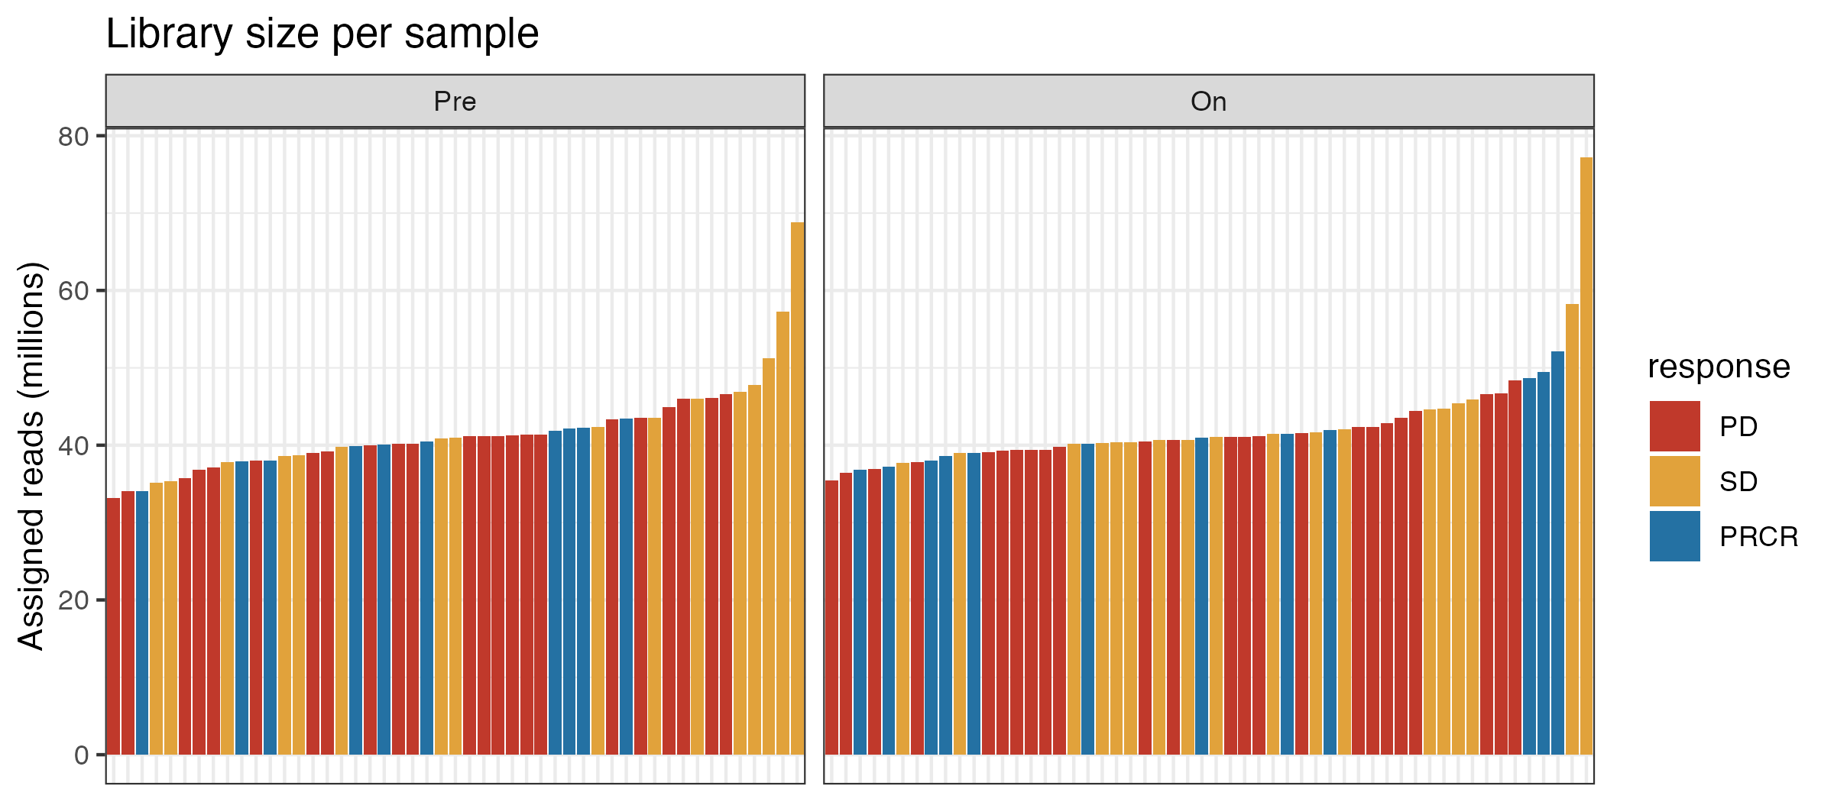
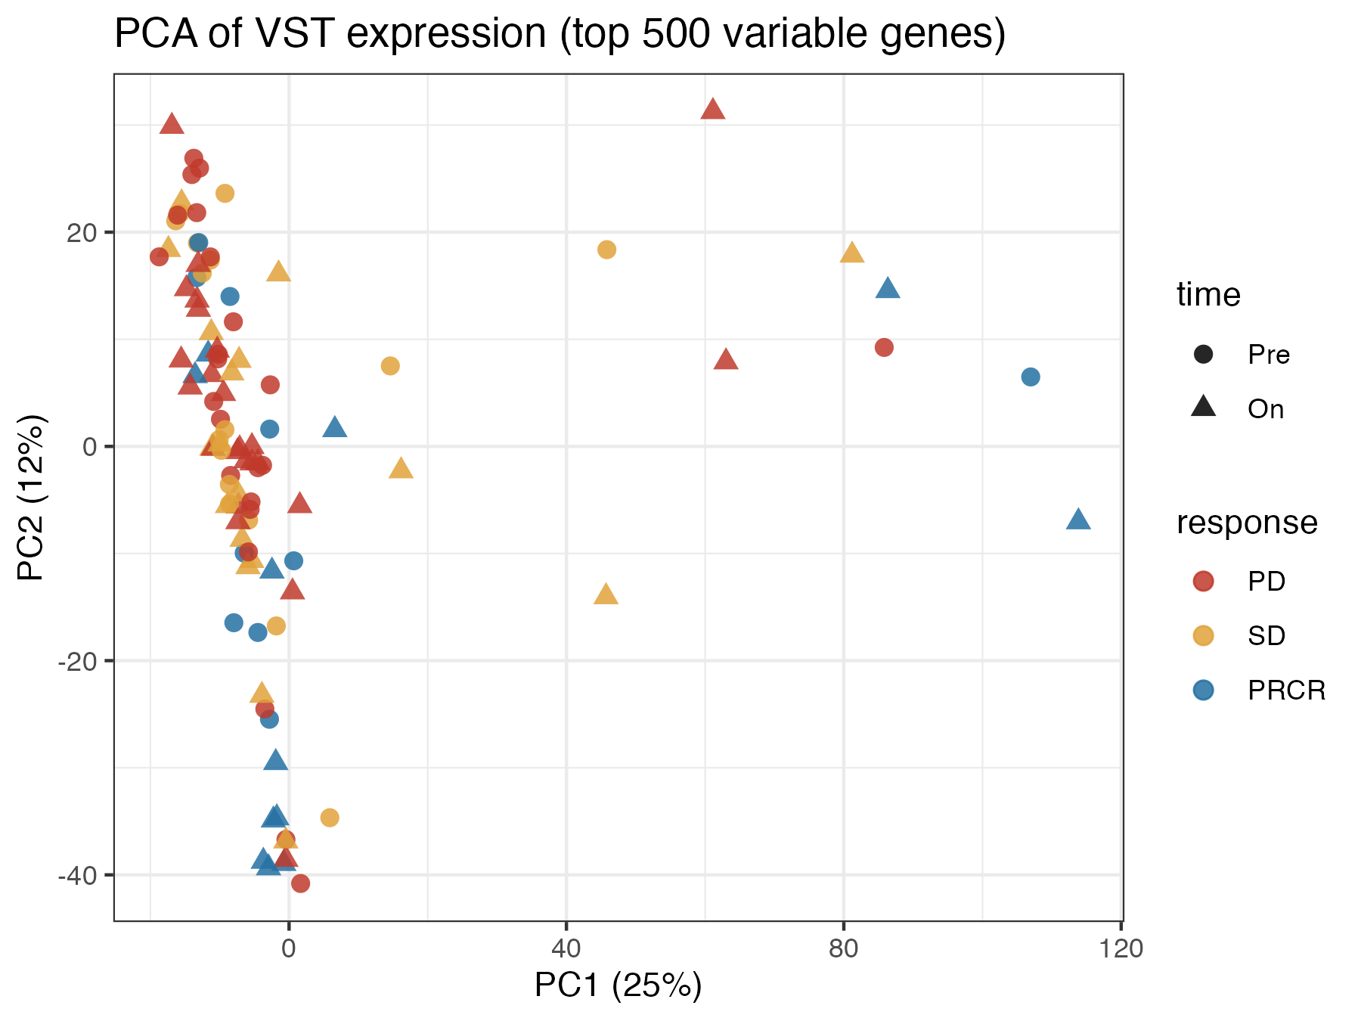
Data quality is consistent across groups
No batch structure by response or timepoint, so the downstream comparisons are fair
What to notice
Library sizes are comparable in PD, SD and PRCR at both timepoints.
The PCA shows no separation by response, so the main variation is tumor/immune composition, not artifacts.
8

Slide 9
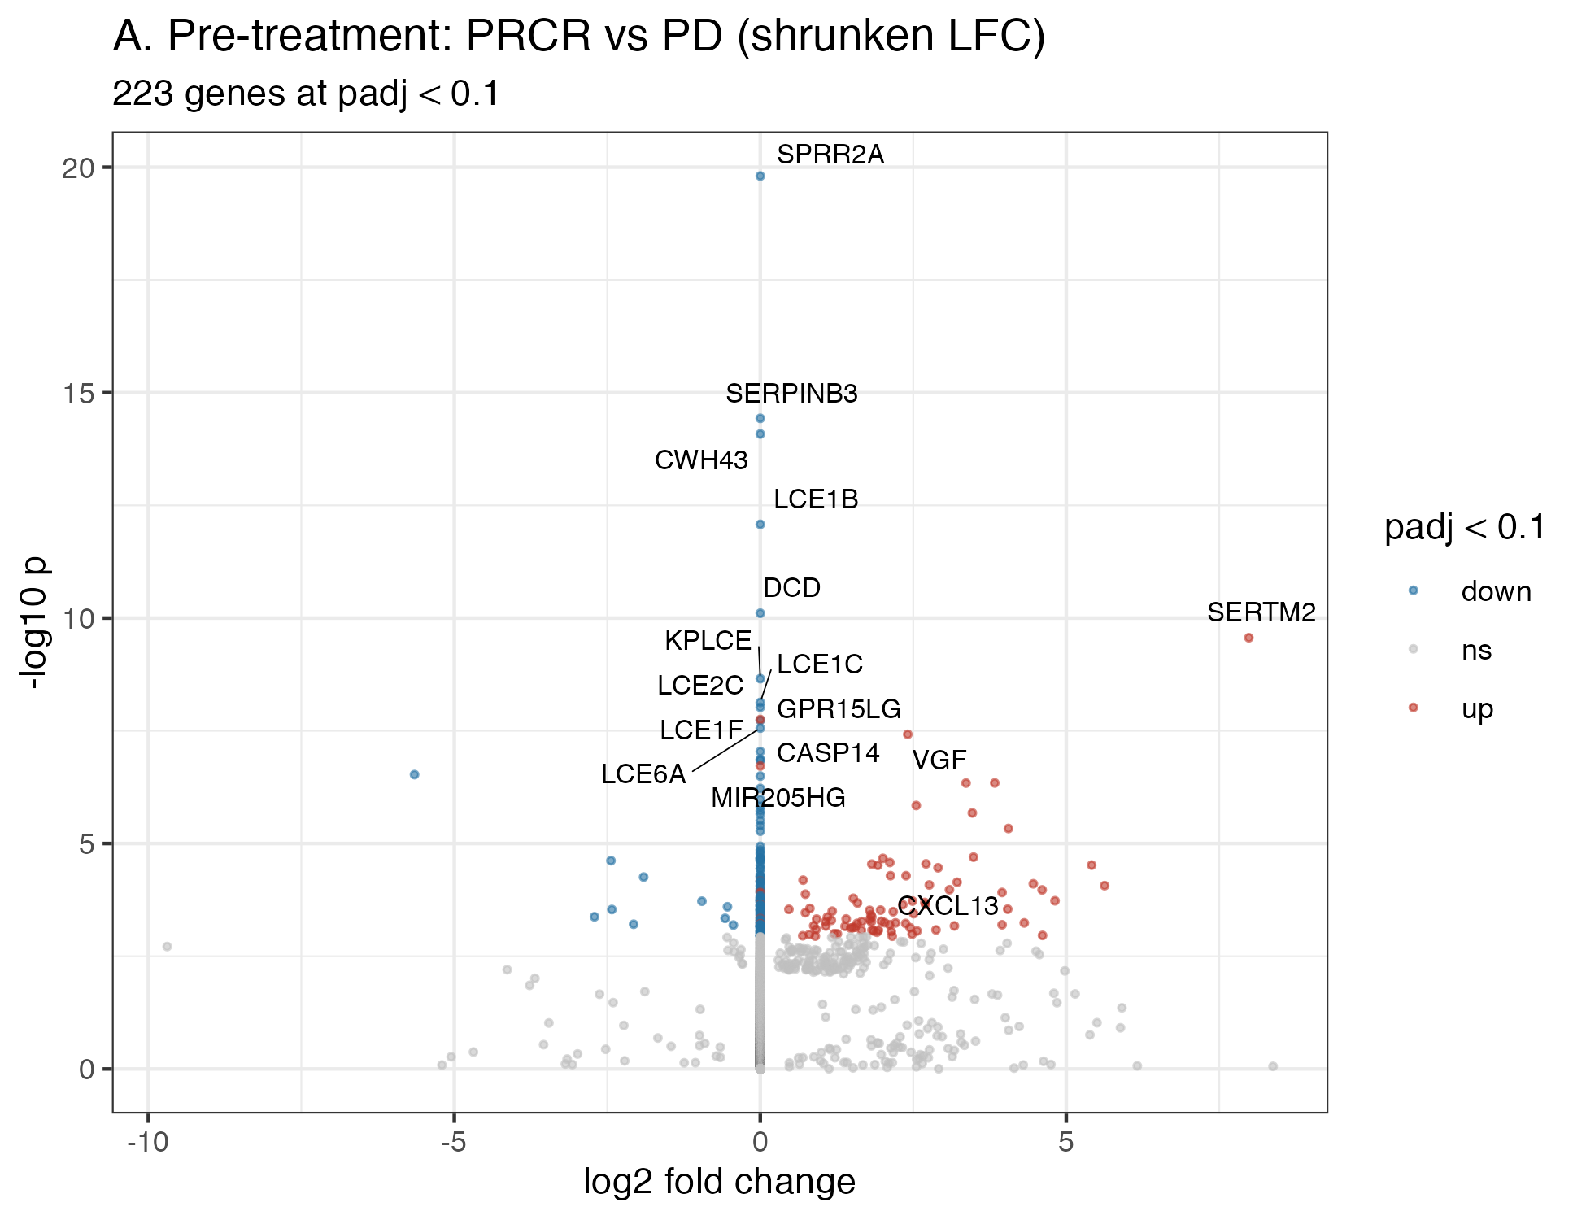
Before treatment, responders look only modestly different
Aim 1: pre-treatment PRCR vs PD (paper exclusions applied)
What to notice
223 genes at FDR < 0.1, mostly with small shrunken effects.
The top hits are epidermal/keratinocyte genes (SPRR2A, SERPINB3, LCE), which likely reflect skin in some biopsies rather than tumor biology.
Immune genes (e.g. CXCL13) lean higher in responders, but there is no clean baseline biomarker, consistent with the paper.
Motivates looking at the on-treatment biopsy.
9

Slide 10
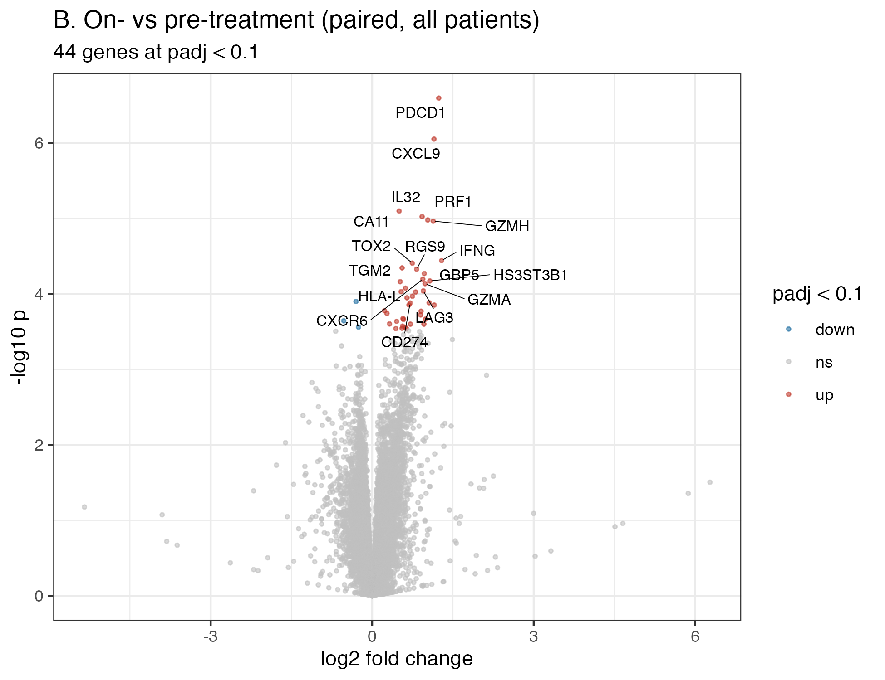
Nivolumab switches on T-cell and interferon genes
Aim 1: paired On vs Pre across all 42 patients with both biopsies
What to notice
44 genes change at FDR < 0.1.
The top hits are the PD-1 axis and T-cell effector genes: PDCD1, CXCL9, GZMH, PRF1, IFNG, LAG3, GBP5.
This is the expected immune response to PD-1 blockade, averaged over everyone.
10

Slide 11
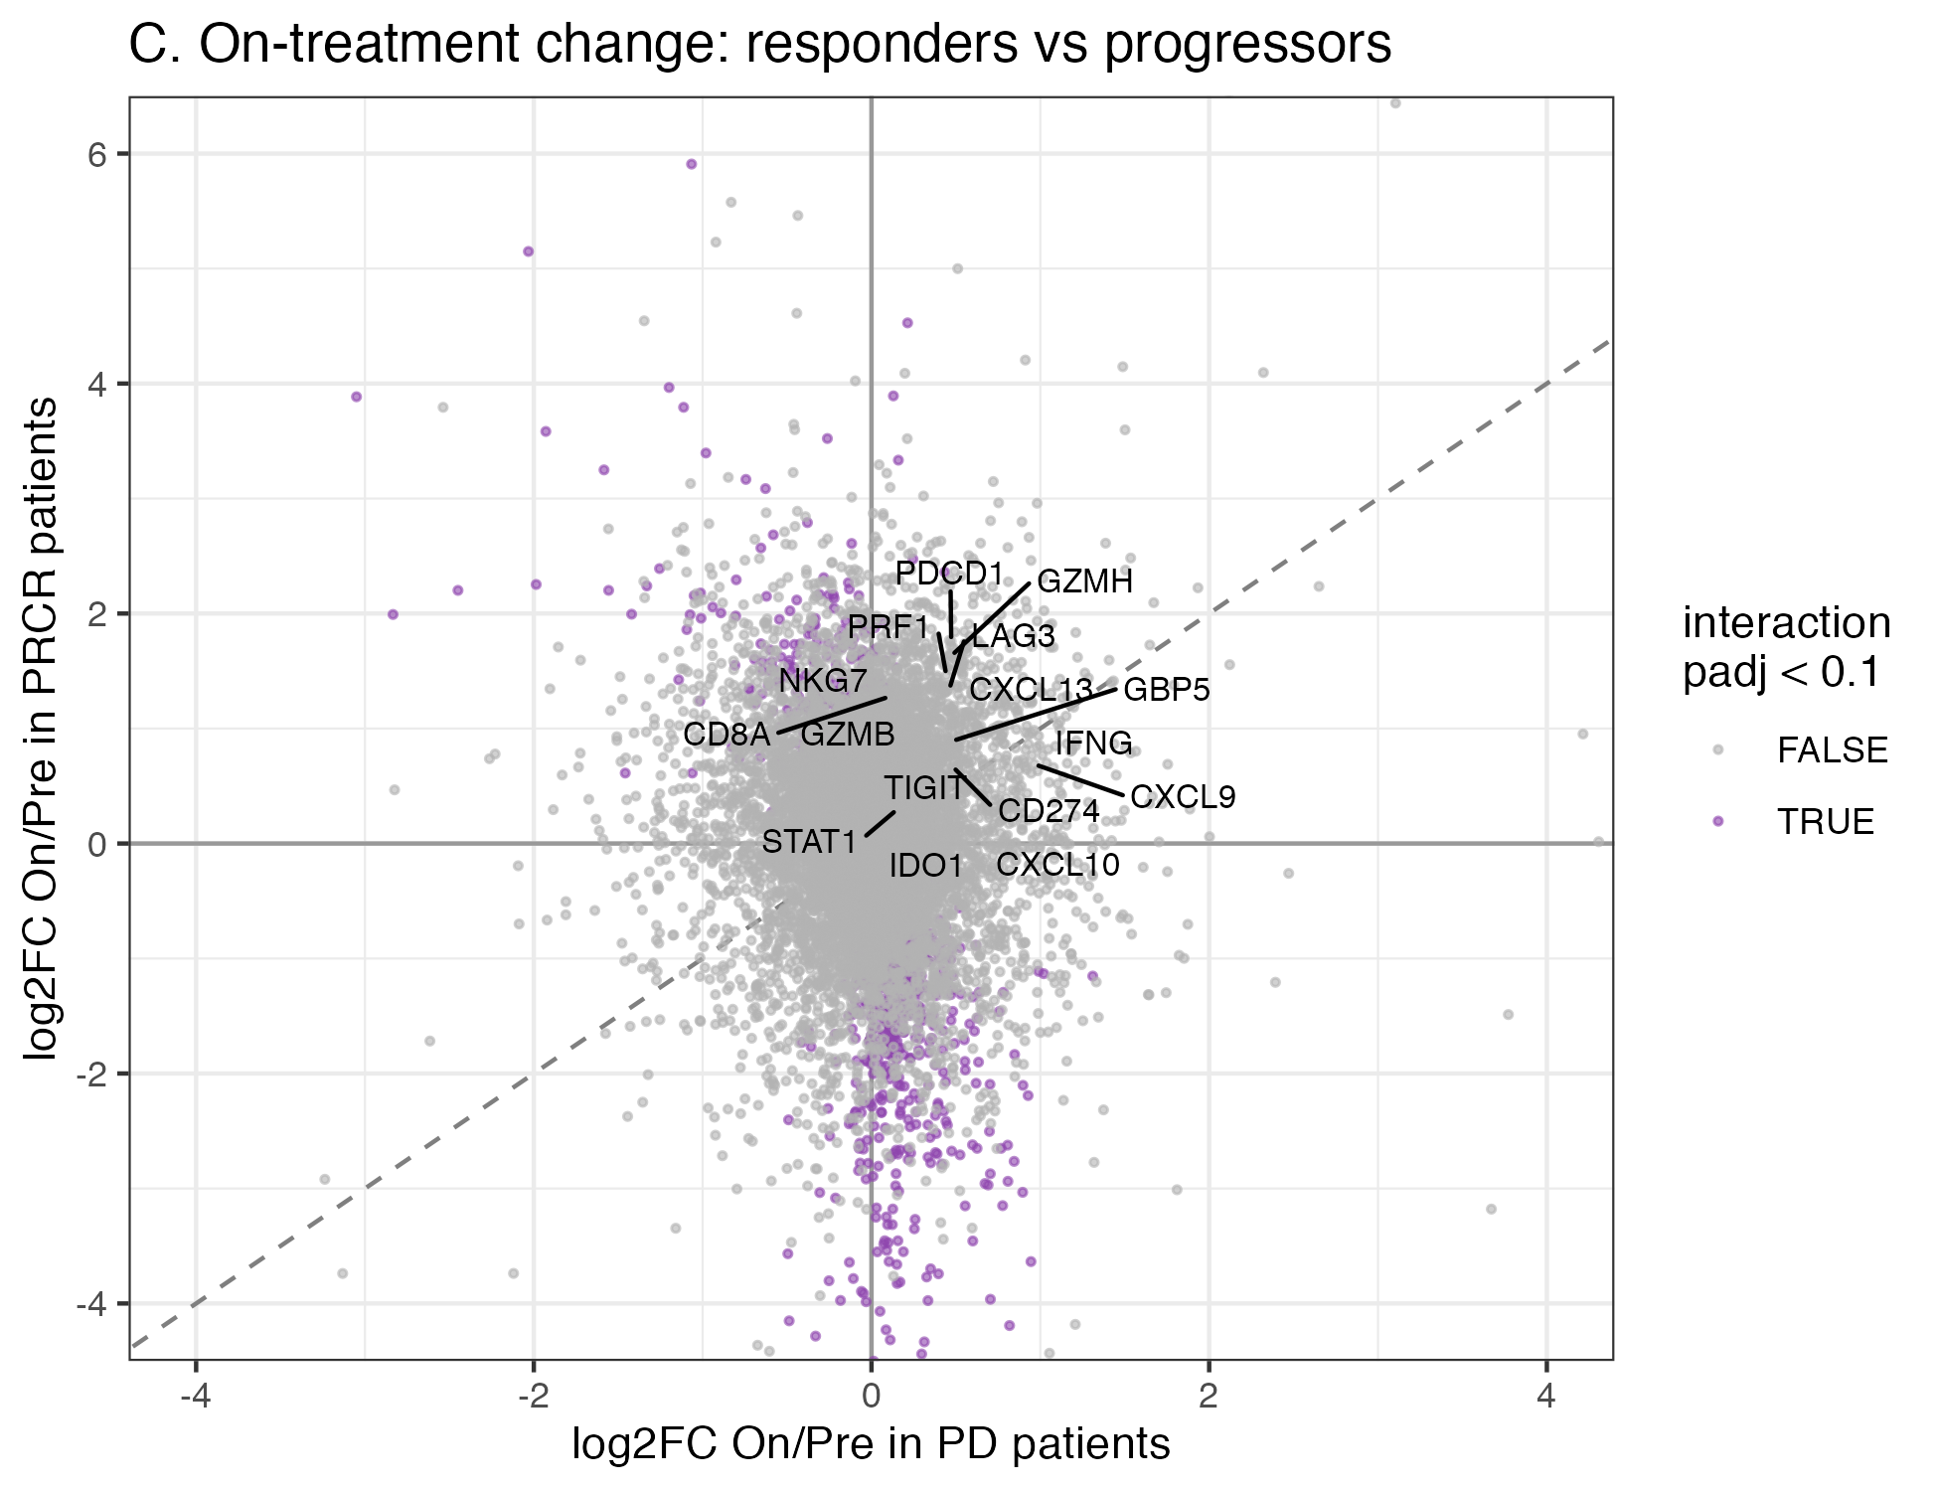
The on-treatment change is driven by responders
Aim 1: per-gene On/Pre change in PRCR (y) vs PD (x); purple = interaction FDR < 0.1
What to notice
PRCR: 3,582 genes change. PD: 0. SD: 28.
Immune genes rise mainly in responders (points above the diagonal).
The strongest drops in responders are melanoma lineage genes (SOX10, MLANA, PRAME, PAX3): the tumor is being cleared.
1,721 genes differ in PRCR vs PD change.
11

Slide 12
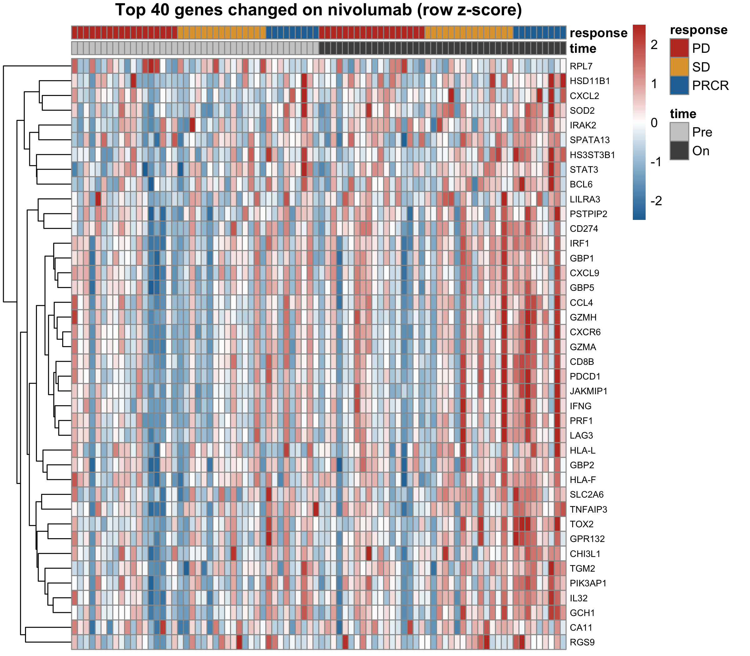
Top on-treatment genes, sample by sample
Top 40 On vs Pre genes, row z-scores; samples ordered by timepoint then response
What to notice
The On block is redder, especially for PRCR samples.
Some PD patients also gain immune genes, so activation alone is not enough.
The genes form a coherent T-cell/IFN-γ program, not scattered hits.
12

Slide 13
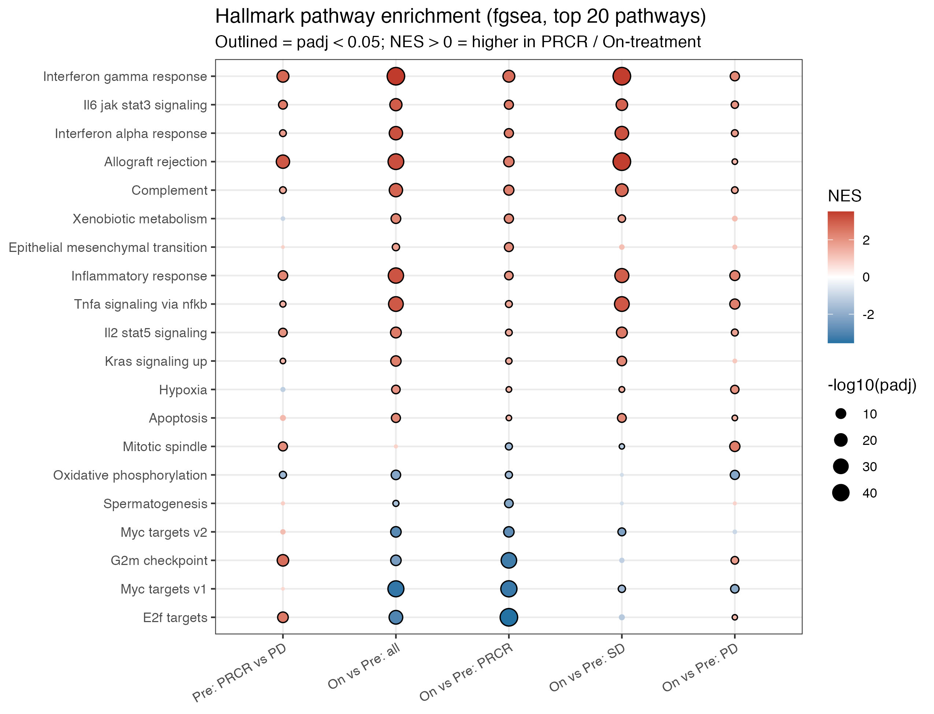
Pathways: interferon up, proliferation down in responders
fgsea on Hallmark sets; colour = direction (NES), size = significance
What to notice
IFN-γ / IFN-α, allograft rejection and inflammatory pathways rise On-treatment (IFN-γ NES 2.7 in PRCR).
E2F, MYC and G2M (tumor proliferation) fall sharply only in PRCR.
PD patients show weaker immune gains and no proliferation loss.
SD patients show strong interferon induction: an intermediate group.
13

Slide 14
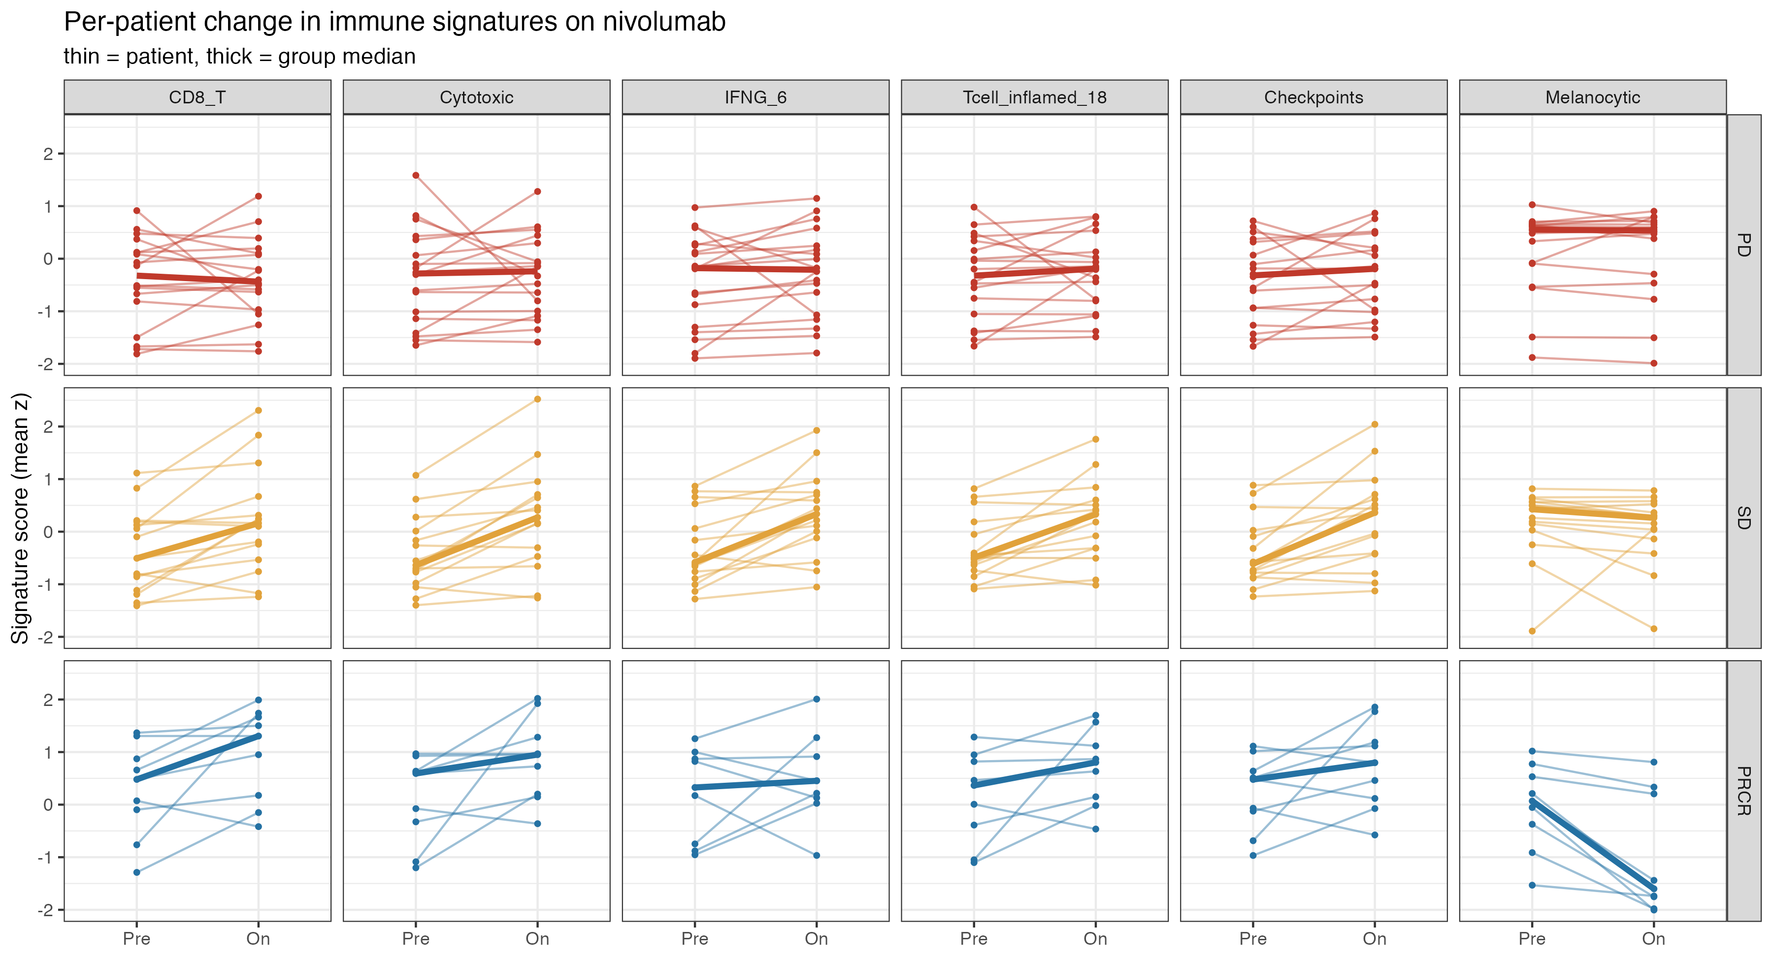
Every patient's trajectory, Pre → On
Signature scores per patient (thin lines) with group medians (thick); rows = response group
What to notice
PRCR: immune scores rise; tumor score collapses.
SD: immune scores rise; tumor barely moves.
PD: flat on every axis.
Immune activation is necessary but not sufficient.
14

Slide 15
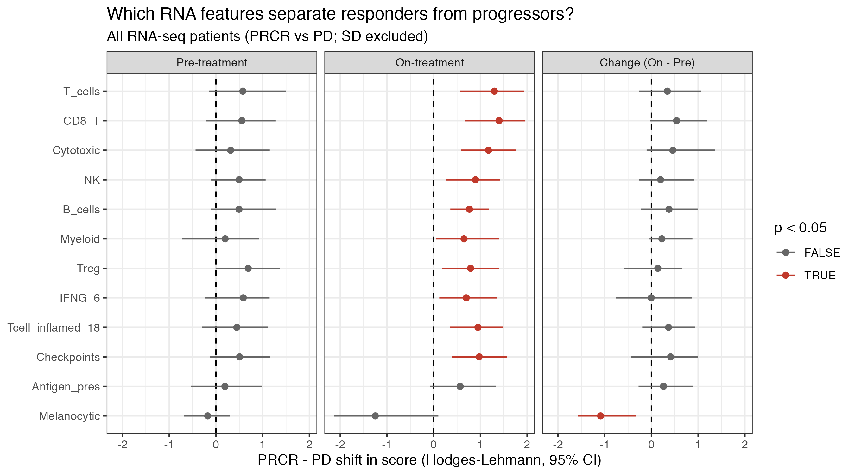
On-treatment RNA separates responders; baseline does not
PRCR − PD shift in each score with 95% CI (Hodges–Lehmann); red = p < 0.05
What to notice
Pre: every CI crosses 0.
On: 10 of 12 scores higher in PRCR (CD8 shift +1.4, FDR 0.006).
Change: the clearest signal is loss of melanocytic genes (FDR 0.006).
15

Slide 16
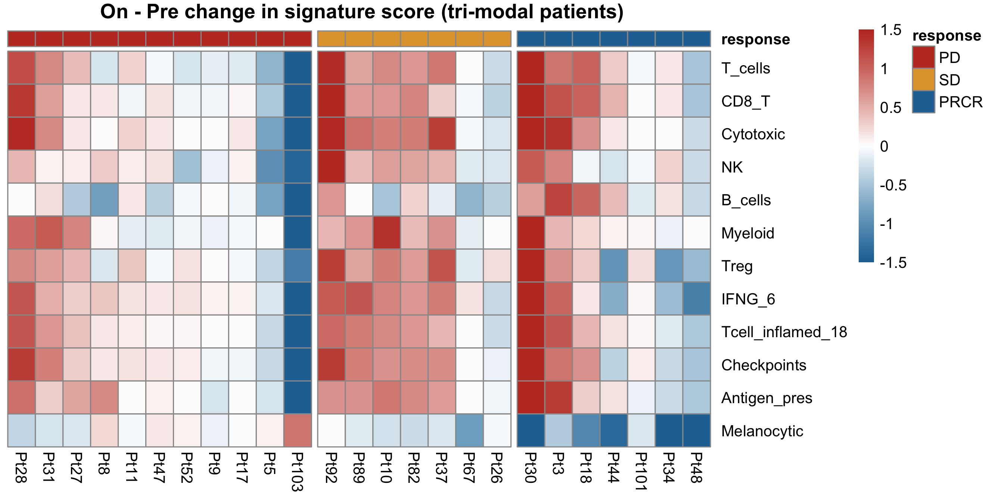
Patient-level view for integration (Aim 2)
On − Pre change in each score for the 25 tri-modal patients; these values feed the merged table
Read across a column: responders such as Pt30 and Pt3 gain every immune program and lose the tumor signature. Some PD patients (Pt28, Pt31) gain immune signal without tumor loss. These are the cases where TCR and neoantigen data should explain the difference.
16

Slide 17
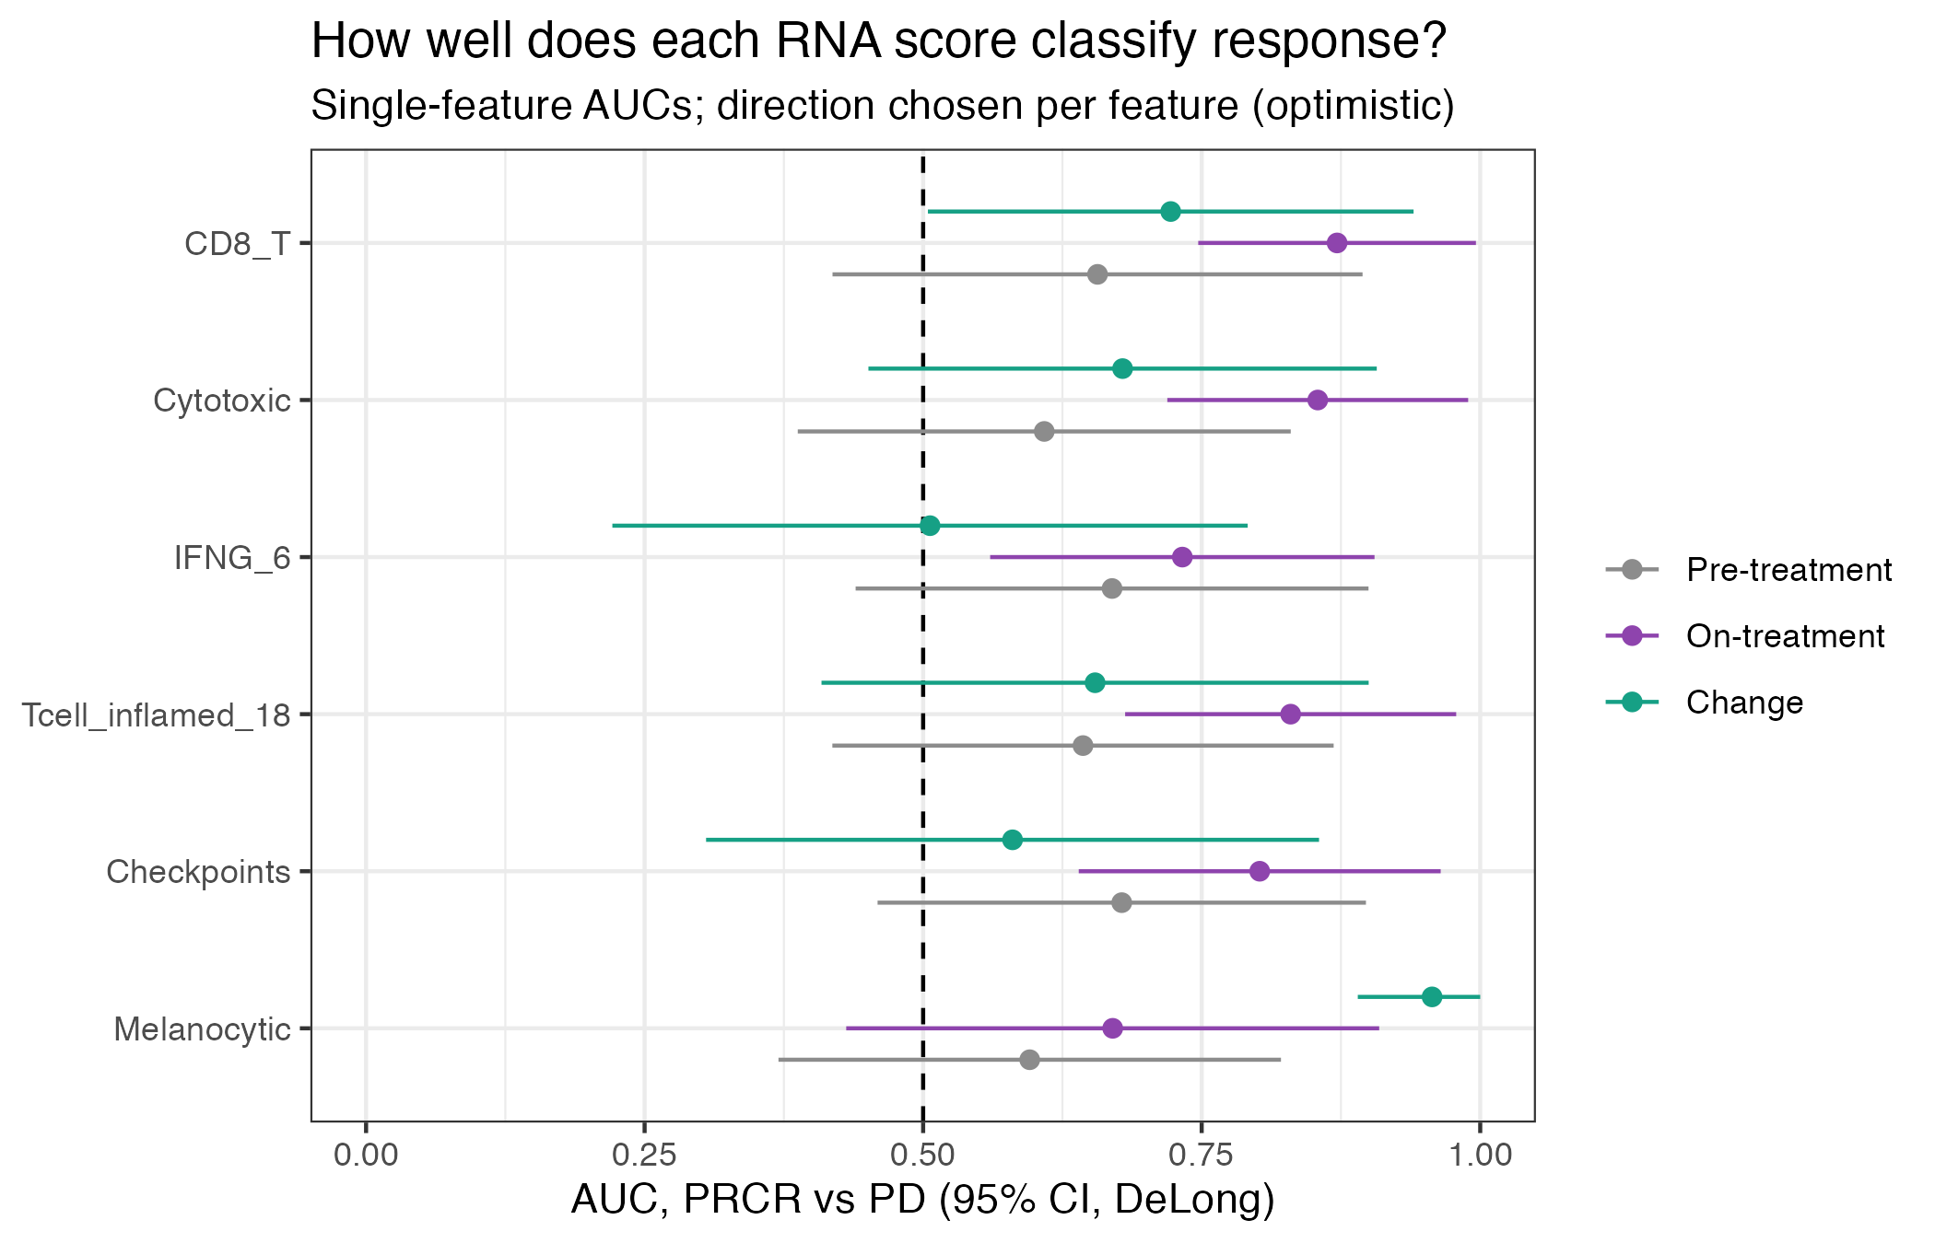
Which RNA feature best classifies response? (Aim 3)
Single-feature AUC, PRCR vs PD, with DeLong 95% CI
What to notice
Pre-treatment scores: AUC 0.60 to 0.68, with CIs touching 0.5.
On-treatment CD8: AUC 0.87 (0.75 to 1.00).
Melanocytic change: AUC 0.96, but partly circular, since tumor shrinkage is the response.
Next: combine with TCR and WES features in a cross-validated model.
17

Slide 18
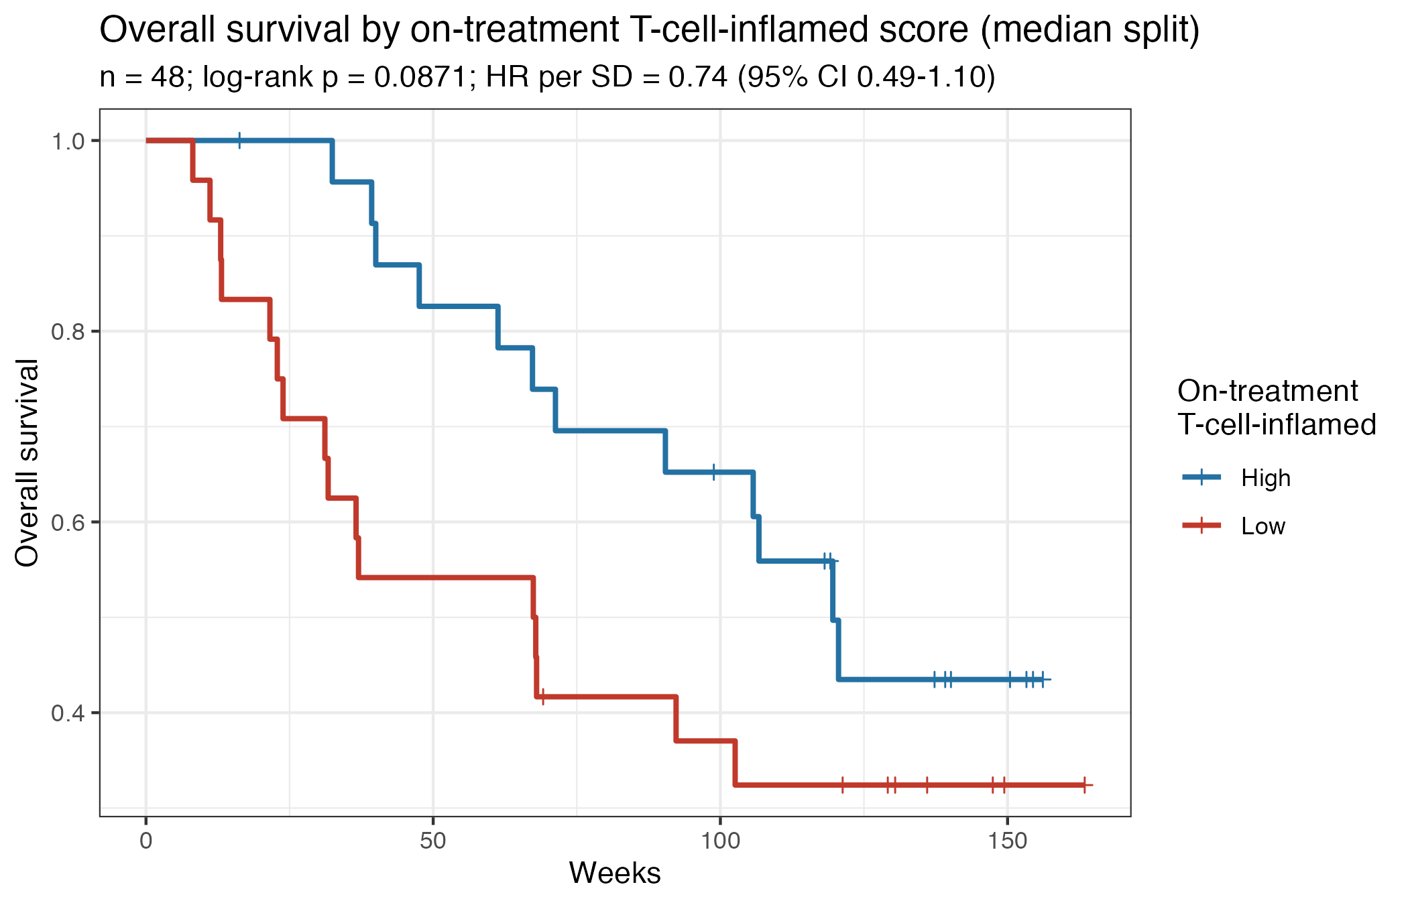
A higher on-treatment inflamed score trends toward longer survival
Overall survival, median split on the 18-gene T-cell-inflamed score (On biopsy)
What to notice
The curves separate early and stay apart.
HR per SD = 0.74 (0.49 to 1.10); log-rank p = 0.09, which is not significant with n = 48.
Caveat: the score is measured at week 4, so patients must survive to the biopsy (landmark bias).
18

Slide 19
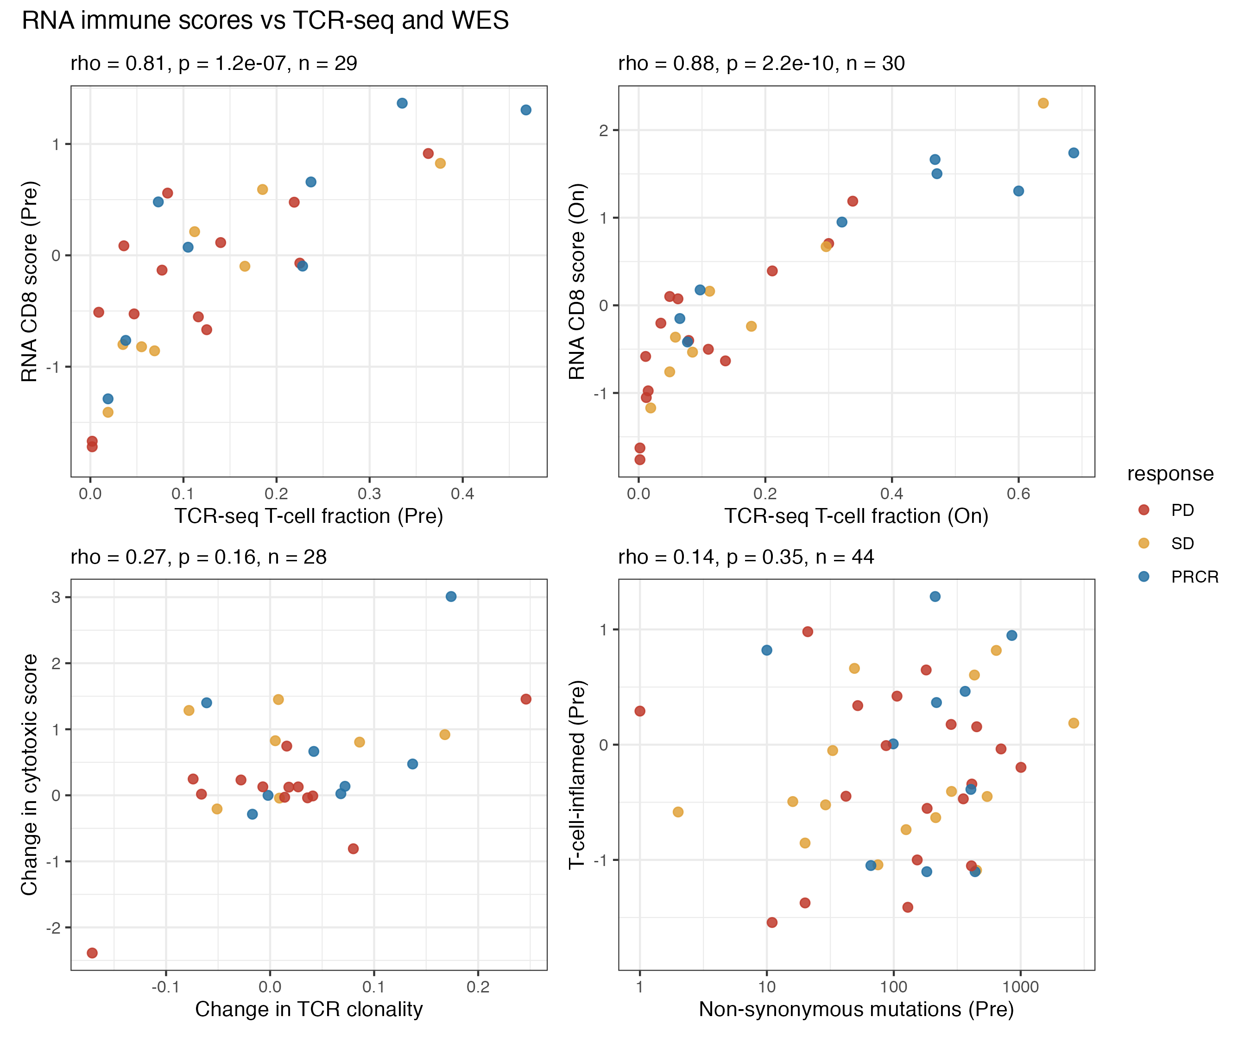
RNA agrees with TCR-seq; mutation burden is a separate axis
Preview of Aim 2: RNA scores vs Krithika's TCR metrics and Kwaku's mutation counts
What to notice
Validation: the RNA CD8 score tracks the TCR-seq T-cell fraction (ρ = 0.81 Pre, 0.88 On).
Change in TCR clonality vs change in cytotoxic score: a weak trend (ρ = 0.27).
Mutation burden does not predict baseline inflammation (ρ = 0.14), so it adds independent information.
19

Slide 20
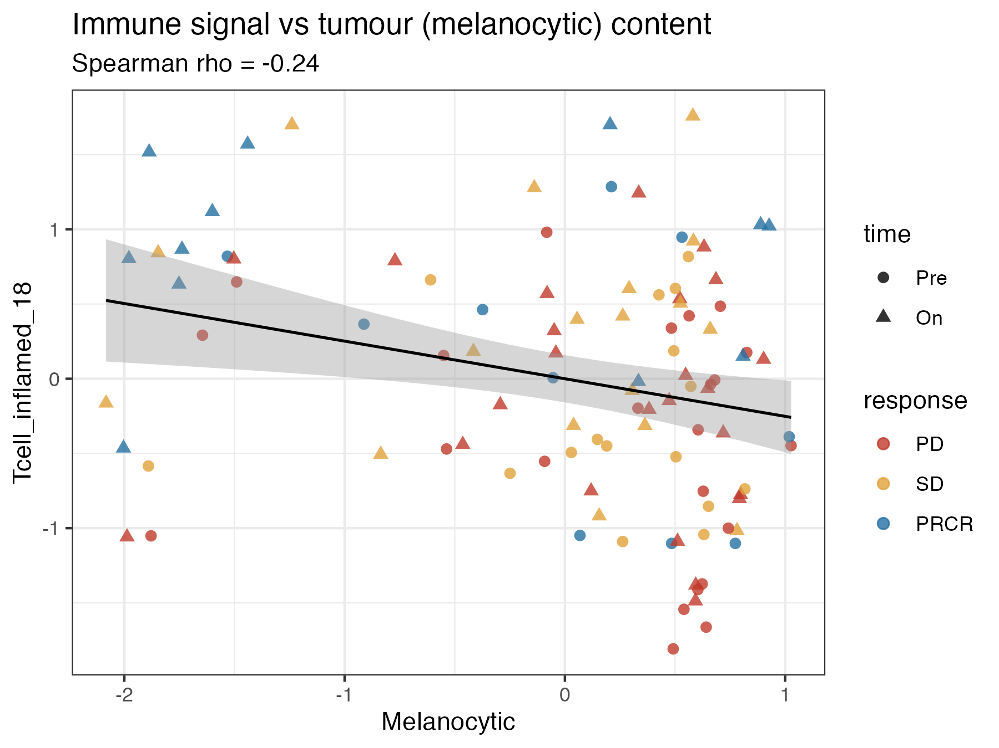
Caveat: tumor content confounds immune scores
Bulk RNA mixes tumor and immune cells; more tumor means less room for immune signal
Why it matters
Immune and melanocytic scores are weakly anti-correlated across samples (ρ = −0.24).
Part of the On-treatment immune 'gain' in responders reflects tumor loss.
Fix: adjust for tumor purity (e.g. ESTIMATE or deconvolution) before integration.
20

Slide 21
Conclusions and next steps
What RNA-seq shows
Baseline expression barely separates responders.
In responders, nivolumab drives an IFN-γ / CD8 / cytotoxic program while tumor and proliferation genes collapse.
PD tumors stay flat; SD tumors activate immunity without clearing the tumor.
On-treatment CD8 score reaches AUC 0.87 and tracks the TCR-seq T-cell fraction.
Next steps
Purity-adjust scores; proper deconvolution (CIBERSORTx / quanTIseq).
Merge RNA deltas with TCR expansion and neoantigen loss (Aim 2).
Cross-validated multi-modal classifier with nested CV (Aim 3).
Settle the response definitions: Pt23 (NE) and SD as responder or not.

