Slide 1
TCR Clonotype Tracking in
Anti-PD-1 Immunotherapy
Reanalysis and Extension of Riaz et al. 2017 (Cell)
CA209-038 Trial · Nivolumab · Melanoma · immunoSEQ TCRβ
Notes:
STATUS: INTRODUCTION. This is a presentation-first final project analyzing the TCR-seq data from Riaz et al. 2017 (Cell). The CA209-038 trial tested nivolumab (anti-PD-1) in advanced melanoma patients, split into two cohorts: Ipi-Progressed (prior ipilimumab) and Ipi-Naive (no prior ipilimumab). 29 patients have paired pre- and on-treatment immunoSEQ TCR-beta repertoires. We reproduce the paper's published metrics and extend the analysis with clonotype tracking, expansion composition, depth context, TIL mediation, and a novel TCR-WES cross-modality connection.

Slide 2
Riaz et al. biopsied melanomas before and during nivolumab to see what changes when PD-1 blockade works
1
2
3
4
Biopsy 1
Nivolumab
Biopsy 2
Response
Before the first dose
Anti-PD-1: releases the T-cell brake
About 4 weeks in
PR/CR shrank · SD stable · PD grew
CheckMate 038 · advanced melanoma · ipilimumab-naive and ipilimumab-progressed cohorts
Tumor DNA
T-cell receptors
RNA
Responders' tumors lose mutations and neoantigens
T-cell clones expand in responders
Immune genes rise; cell-cycle and melanin genes fall
Notes:
Nivolumab is an antibody that blocks PD-1, the brake on T cells. In the CheckMate 038 trial, Riaz and colleagues took a biopsy from patients with advanced melanoma before the first dose and again about four weeks in, and sequenced the tumor DNA, the T-cell receptors and the RNA. Half the cohort had never had ipilimumab; the other half had already progressed on it. Their headline: in responders the tumor loses mutations, T-cell clones expand, and immune genes switch on. We re-analyzed their public data to test each of those claims. [~40 s]

Slide 3
We follow the biology in order: the targets, the T cells that respond, then what the tissue is doing
1
WES
Kwaku
2
TCR-seq
Krithika
3
RNA-seq
Ethan
Which mutations and neoantigens exist, and are they lost on treatment?
Which T-cell clones respond and expand?
What is the biopsy doing: immune activity and remaining tumor?
→
→
Why this order? DNA sets the targets, TCR shows who attacks them, and RNA shows the outcome in the tissue, linking both.
Notes:
We present three data types in this order. Kwaku starts with whole-exome sequencing: which mutations, and so which targets, the tumor has, and whether they disappear. Krithika follows with T-cell receptor sequencing: which T-cell clones respond and expand. I finish with RNA, which reads out the whole biopsy at once, both the immune activity and the tumor that is left, so it ties the other two together and leads into our comparison. [~30 s]

Slide 4
Nivolumab releases the brake; WES shows the targets
Mutations
Neoantigens
T cells
Nivolumab
Tumor DNA changes alter its proteins
→
Mutated protein pieces shown on the cell surface
→
Recognise neoantigens as foreign, but PD-1 brakes them
→
Blocks PD-1, so T cells can kill the cancer
WES measures these two, before and during treatment
Why WES? Nivolumab helps only some melanoma patients. If T cells kill the cells carrying neoantigens, those mutations should disappear between biopsies in patients who respond. WES lets us check.
Notes:
First, the biology. Tumors carry DNA mutations that change their proteins. Pieces of those mutated proteins, called neoantigens, get displayed on the cell surface, and T cells can recognise them as foreign. But tumors press a brake on T cells called PD-1. Nivolumab blocks PD-1 and releases that brake, so T cells can kill the cancer. It only works in some patients, so why? WES reads the first two steps: the mutations and the neoantigens. If T cells really kill the cells carrying neoantigens, those mutations should disappear between the two biopsies in the patients who respond. [~35 s]

Slide 5
The study sampled each tumor twice
1
2
3
4
Biopsy 1
Nivolumab
Biopsy 2
Response
Taken before the first dose
Anti-PD-1 antibody that releases the brake on T cells
Taken about 4 weeks into treatment
Scans sort patients: PR/CR shrank, SD stable, PD grew
68
patients with WES before treatment
41
with WES at both biopsies: my main comparison
26
with WES, RNA and TCR at both biopsies (team's shared set)
Notes:
Here's how the study worked. Each patient had a tumor biopsy before their first dose of nivolumab. Nivolumab blocks PD-1, a brake on T cells, so the immune system can attack the tumor. About four weeks in, they took a second biopsy. Later, scans sorted patients into responders, meaning partial or complete response, stable disease, or progressive disease. Sixty-eight patients had exome sequencing before treatment, and 41 had it at both biopsies. Those 41 are my main comparison. [~35 s]

Slide 6
WES turns each biopsy into three numbers
1
2
3
4
Tumor vs normal
Mutation burden
Neoantigens
Loss on treatment
Read the protein-coding exome (~1–2% of DNA). Tumor-only variants are somatic.
Count nonsynonymous mutations: those that change a protein.
Using each patient's HLA type, predict which mutated peptides T cells could see.
Compare the pre-treatment biopsy with the one ~4 weeks into nivolumab.
Example: patient 7, a responder
1,363
→
834
→
≈12
→
2
protein-changing mutations before
predicted neoantigens before
neoantigens expected on treatment
neoantigens actually seen
Notes:
WES reads the protein-coding part of the DNA, about one to two percent of the genome. We sequence the tumor and normal blood; mutations found only in the tumor are somatic. Counting the protein-changing ones gives mutation burden. Using each patient's HLA type, we predict which mutated peptides can be shown to T cells; those are neoantigens. Then we compare the two biopsies. Take patient 7, a responder: 1,363 mutations and 834 predicted neoantigens before treatment. Based on how many silent mutations survived, we'd expect about 12 neoantigens on treatment, but only 2 were left. [~40 s]

Slide 7
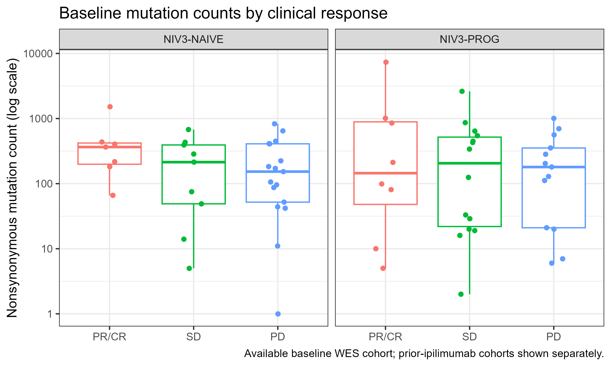
Baseline mutation burden is a weak predictor
Median nonsynonymous mutations
Both cohorts combined
217
PR/CR (n = 15)
95% CI 99–852
214
Stable (n = 23)
95% CI 29–428
162
Progressive (n = 30)
95% CI 92–254
PR/CR − PD: +55 mutations (95% CI −95 to +393). The interval crosses zero.
Notes:
First: does the number of mutations before treatment predict response? Not cleanly. Each dot is a patient, on a log scale, split by whether they had prior ipilimumab; the medians on the right combine both cohorts. They are 217 for responders, 214 for stable disease and 162 for progressors, but the ranges overlap almost completely. The difference between responders and progressors is 55 mutations, with a 95 percent bootstrap confidence interval from minus 95 to plus 393, so it crosses zero. Baseline burden alone is a weak predictor here. [~35 s]

Slide 8
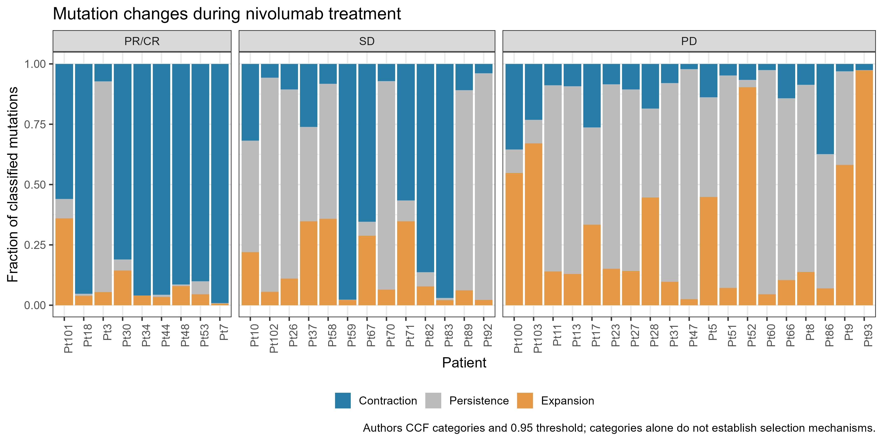
Each mutation is tracked between the two biopsies
Three categories
Contraction
Lost, or now in fewer cancer cells
Persistence
About the same share of cancer cells
Expansion
Now in more cancer cells
Share of cells is the cancer cell fraction, adjusted for tumor purity. A change only counts at 95% confidence.
Notes:
To see what changed, the authors tracked every mutation from the first biopsy to the second. For each one they estimate the cancer cell fraction: the share of cancer cells carrying it, adjusted for how much of the sample is tumor. Each bar is one patient. Blue means the mutation contracted: it disappeared or is now in fewer cancer cells. Gray means it persisted, and orange means it expanded. Look at the left panel: almost every responder is mostly blue. Progressors on the right are mostly gray and orange. [~35 s]

Slide 9
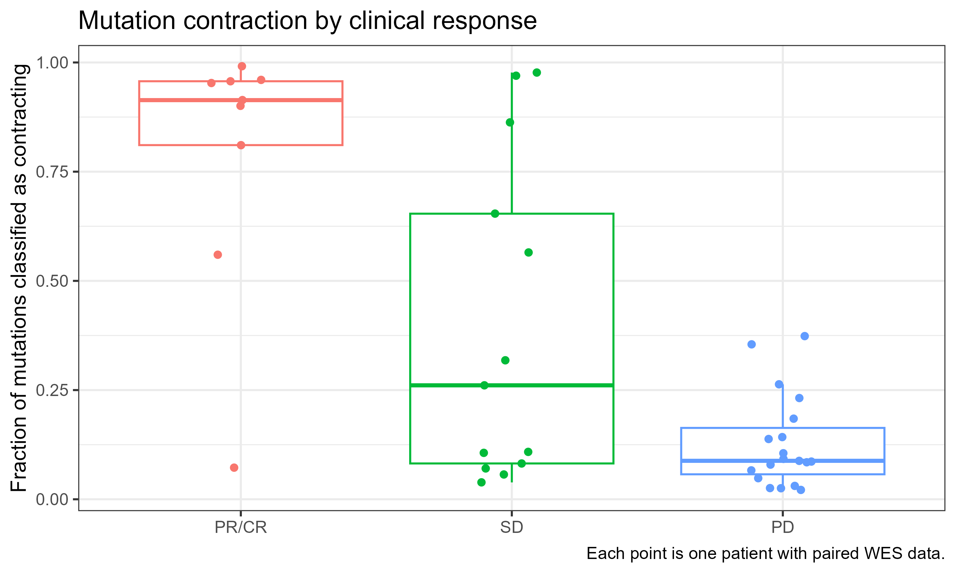
Most mutations contract in responders
Median share of mutations contracting
Contracting = lost, or now in fewer cancer cells
91%
PR/CR (n = 9)
95% CI 56–96%
26%
Stable (n = 13)
95% CI 8–65%
9%
Progressive (n = 19)
95% CI 7–14%
PR/CR − PD: 83 points (95% CI 48–88); Wilcoxon p ≈ 0.0001. Two responders sit low.
Notes:
The change over time looks very different. This shows the fraction of each patient's mutations classified as contracting between the two biopsies, using the authors' cancer-cell-fraction categories. Contracting means the mutation disappeared or is now found in fewer of the cancer cells. In responders the median is 91 percent; in progressors it's 9 percent; stable disease sits in between with a wide spread. The difference is 83 percentage points, with a 95 percent bootstrap confidence interval of 48 to 88, and a rank-sum p of about 0.0001 comparing responders with progressors. Two responders are low, so it's a strong trend, not a rule. [~45 s]

Slide 10
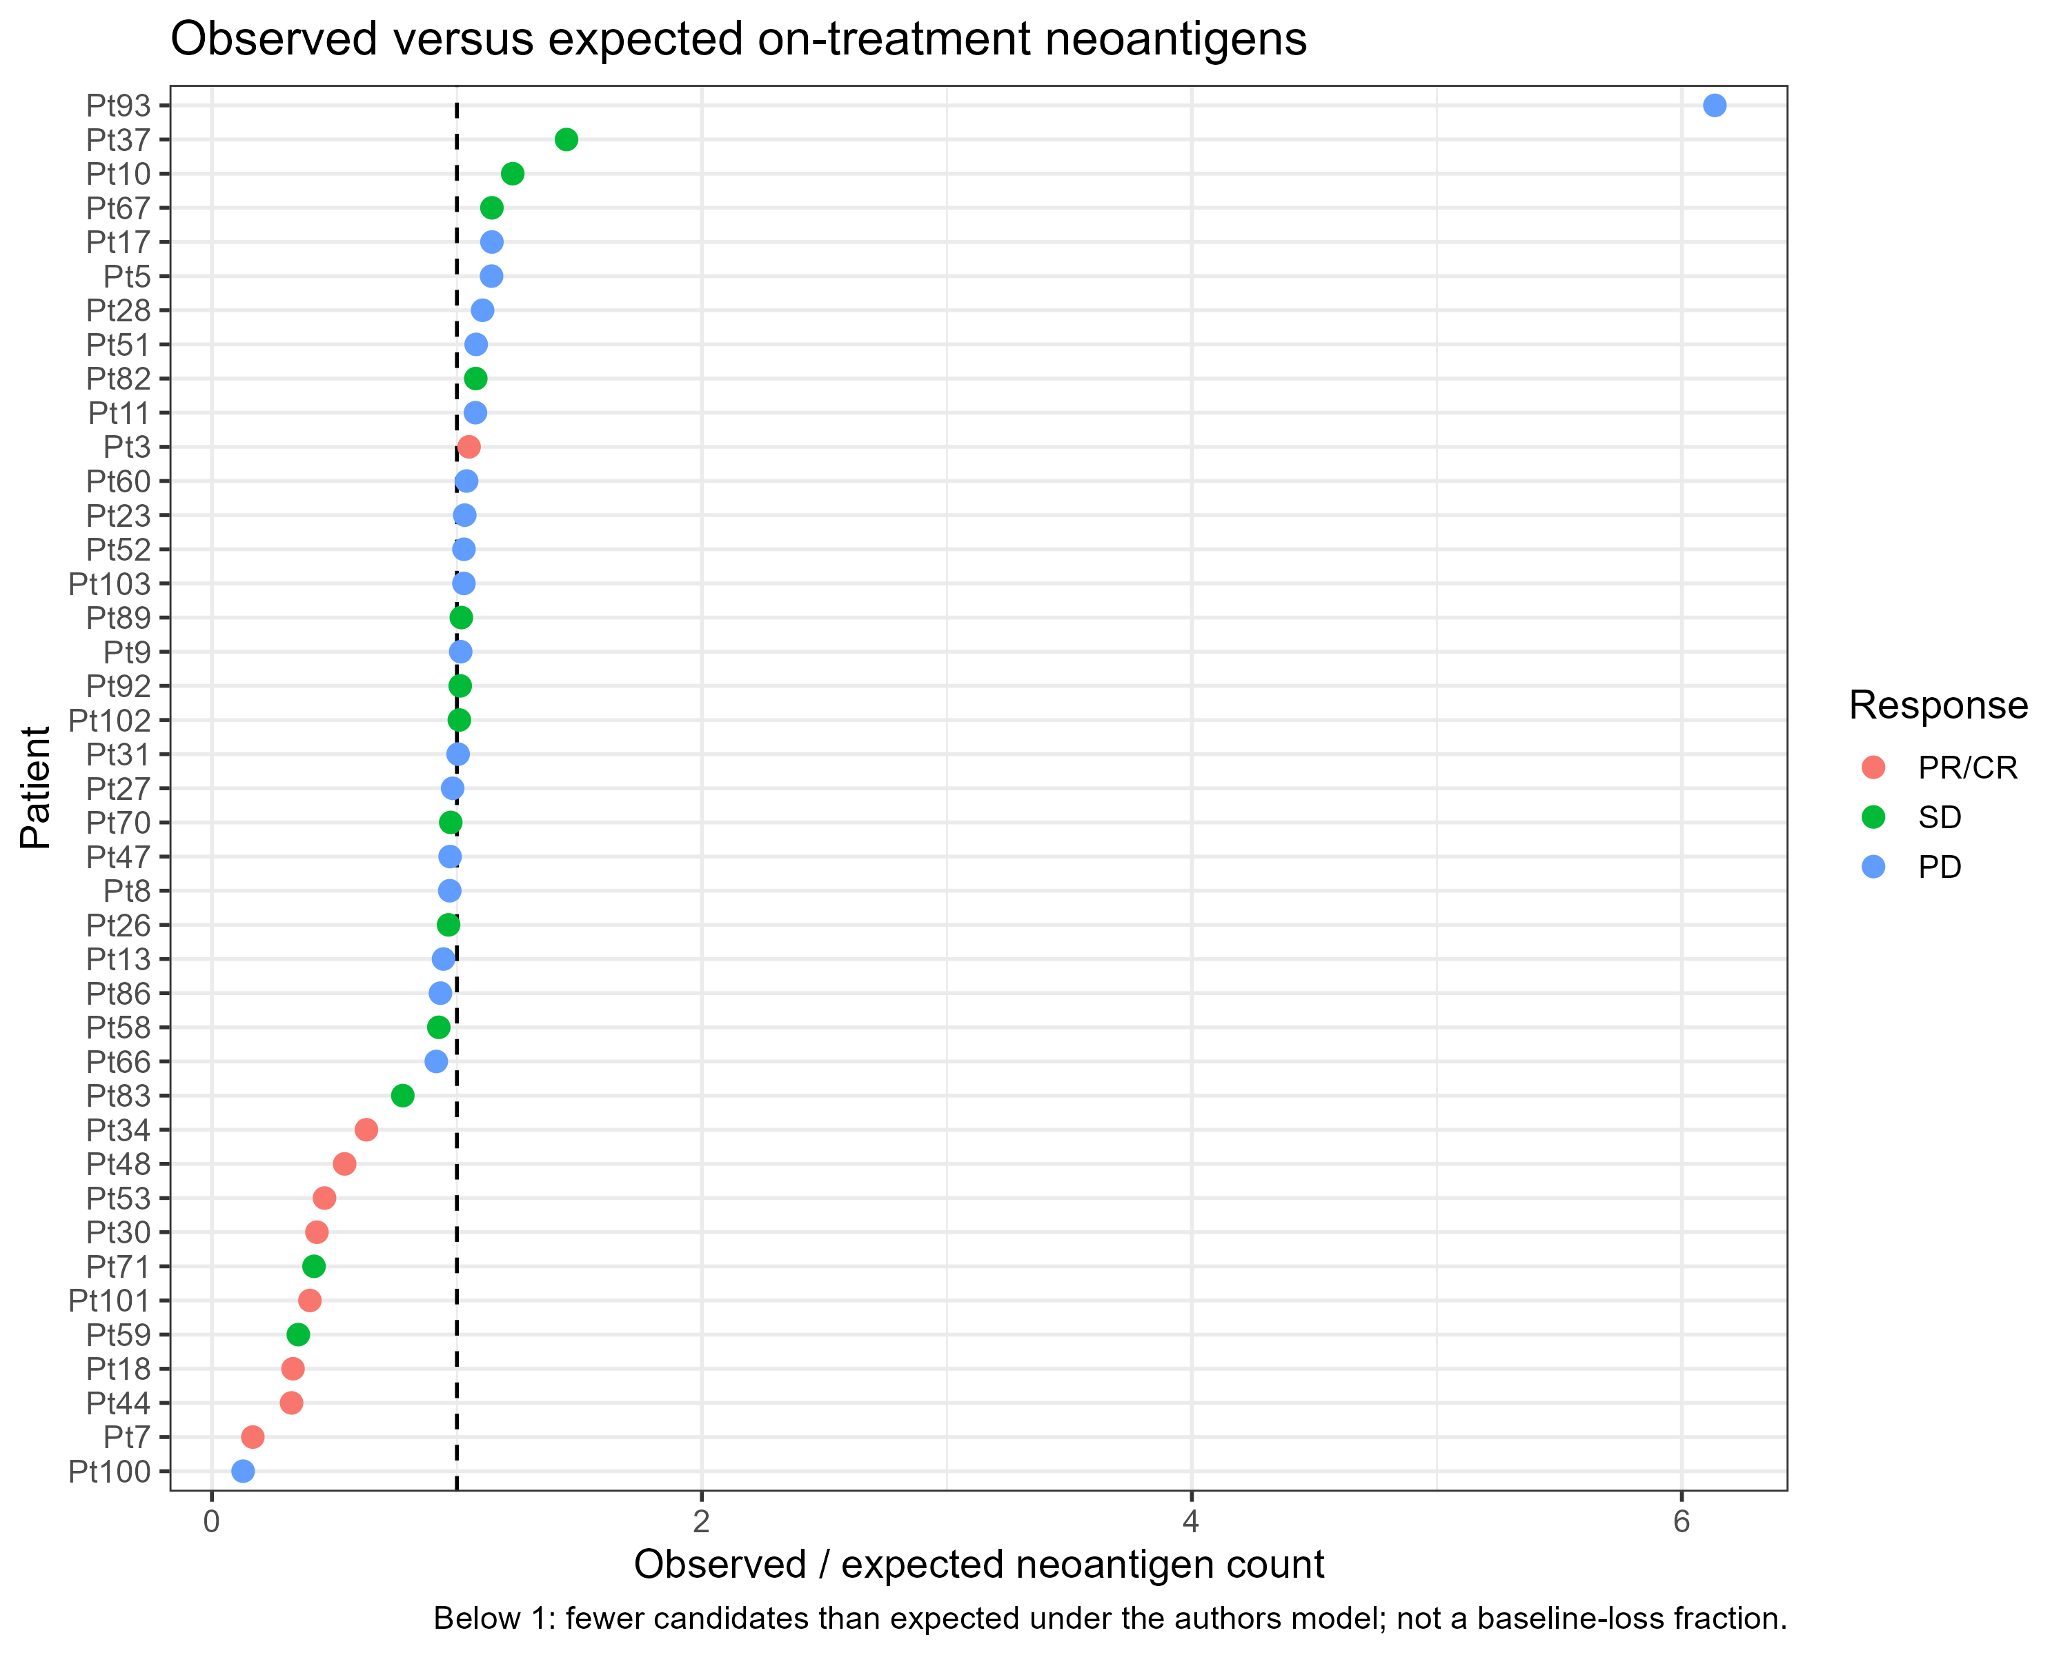
Responders keep fewer neoantigens than expected
Observed ÷ expected neoantigens on treatment (median)
0.43
1.03
PR/CR
95% CI 0.32–0.63
Progressive
95% CI 0.97–1.08
Below the dashed line = fewer candidates than the authors' model expects
PR/CR − PD: −0.60 (95% CI −0.70 to −0.40); Wilcoxon p ≈ 0.0008 (n = 9 vs 19)
Not universal: one responder (Pt3) is above 1
Notes:
Neoantigens follow the same pattern. For each patient, we compare the neoantigens observed on treatment with the number expected from the authors' model; below the dashed line means fewer than expected. The yardstick is silent mutations, which T cells can't see: expected means how many neoantigens would remain if they survived at the same rate as silent mutations. Responders have a median ratio of 0.43, while progressors are at 1.03, essentially no change. The difference is minus 0.60, with a 95 percent confidence interval of minus 0.70 to minus 0.40, and p of about 0.0008 comparing responders with progressors. One responder, Pt3, is above 1, so again it's not universal. This fits the idea that T cells remove the cancer cells carrying visible mutations. [~45 s]

Slide 11
What could make mutations look lost?
Immune cells dilute the tumor
Contraction is not only loss
A responding biopsy fills with T cells, so tumor DNA is scarcer and mutations are harder to detect. Cancer cell fractions adjust for purity, but low purity remains a risk.
The category also counts mutations that went from all cancer cells to some. Fewer cells, not necessarily zero.
Processed data, not raw reads
Small groups, one snapshot
I reran the authors' code on their processed tables. Mutations and neoantigens were not re-called from sequencing reads.
9 responders and 19 progressors with paired WES, sampled once at about week 4. Bootstrap intervals show the uncertainty.
Notes:
Before the takeaways, what could fool this result? First, when nivolumab works, the biopsy fills with immune cells, so there's less tumor DNA and mutations get harder to detect. The cancer cell fractions adjust for purity, but it's still a risk. Second, contraction doesn't always mean a mutation vanished; it also counts mutations that went from being in every cancer cell to only some. Third, I reran the authors' code on their processed tables; I didn't re-call mutations from raw reads. And finally, the groups are small, 9 responders and 19 progressors, with one snapshot at week 4. That's why I report confidence intervals. [~40 s]

Slide 12
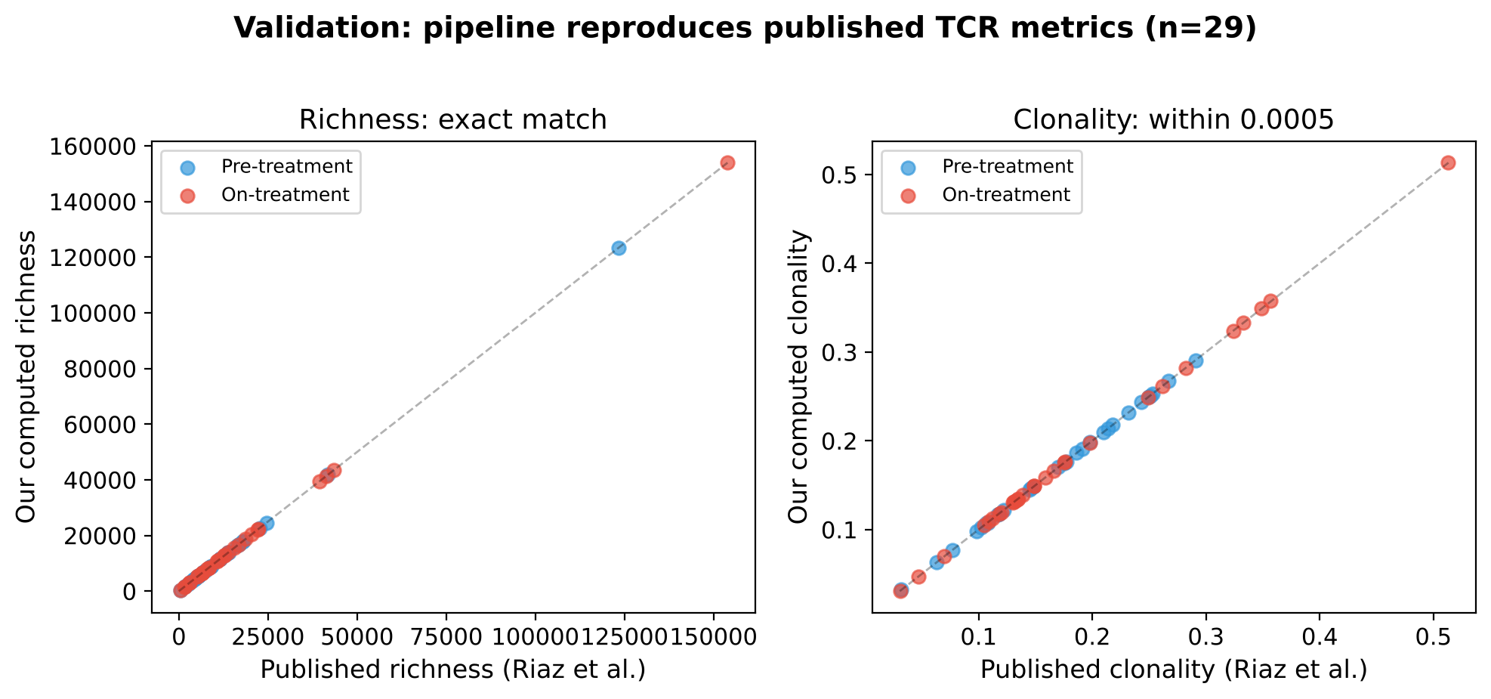
REPRODUCED
Pipeline Validation: Exact Match with Published Metrics
Richness: exact integer match for all 58 samples
Clonality: within 0.0005 (floating-point rounding)
Fig 5B p-values reproduced within sample-subset differences
29 patients with paired pre- and on-treatment TCRβ repertoires · Productive filter: CDR3 non-empty, starts with C, no stop codon
Notes:
STATUS: REPRODUCED. This validates that our pipeline exactly reproduces the published TCR metrics from Riaz et al.
WHAT WAS DONE: We built a Python pipeline that reads the raw immunoSEQ TSV files, applies the productive filter (CDR3 non-empty, starts with C, no stop codon), collapses to CDR3 amino acid clonotypes, and computes richness, Shannon entropy, evenness, and clonality. We compared every metric against the paper's published TCRmetrics.csv.
RESULTS: Richness: exact integer match for all 58 samples. Clonality: max difference 0.0005 (floating-point rounding in Shannon entropy computation). Fig 5B Mann-Whitney p-values: Ipi-Prog p=0.029 (paper: 0.016 with 34 patients, we have 29), Ipi-Naive p=0.94 (paper: 0.72).
METHODS: Productive filter matching immunoSEQ Analyzer. Clonotype = unique CDR3 amino acid sequence. Shannon entropy in bits (log2). Evenness = H/log2(N). Clonality = 1 - evenness. Script: scripts/validate_metrics.py, scripts/reproduce_fig5b_stats.py.

Slide 13
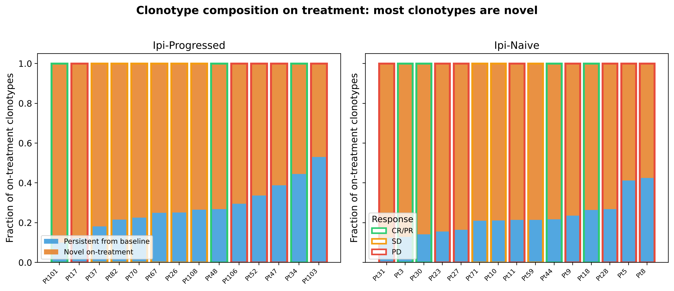
NEW ANALYSIS
75–99% of On-Treatment Clonotypes Are Novel
The paper never tracked individual clonotypes across timepoints
Most on-treatment repertoire is newly detected, not persistent from baseline
Novel clonotypes may include unsampled baseline clones (sampling caveat)
Clonotype = CDR3aa + V gene + J gene · Paired pre/on-treatment repertoires
Notes:
STATUS: NEW ANALYSIS. The paper analyzed diversity metrics (richness, clonality) but never tracked individual clonotypes across timepoints to see which ones persisted and which were new.
WHAT WAS DONE: We aligned pre-treatment and on-treatment repertoires at the CDR3aa+V+J clonotype level. For each patient, we classified every on-treatment clonotype as "persistent" (also detected at baseline) or "novel" (not detected at baseline).
RESULTS: 75-99% of on-treatment clonotypes are novel — they were not detected in the pre-treatment sample. This means the vast majority of the on-treatment repertoire is newly detected T cells.
BIOLOGICAL SIGNIFICANCE: This reveals massive T cell turnover during anti-PD-1 therapy. The treatment doesn't just reinvigorate existing tumor-infiltrating T cells — it recruits an entirely new repertoire. This has implications for understanding the mechanism of checkpoint blockade.
CAVEATS: "Novel" clonotypes may include T cells that were present at baseline but below the detection limit of immunoSEQ. This is a sampling limitation, not a biological certainty.
METHODS: Clonotype = CDR3 amino acid + V gene + J gene. Pre/on alignment by exact match. Script: scripts/run_tracking.py. Output: outputs/tracking_aa_vj.csv.

Slide 14
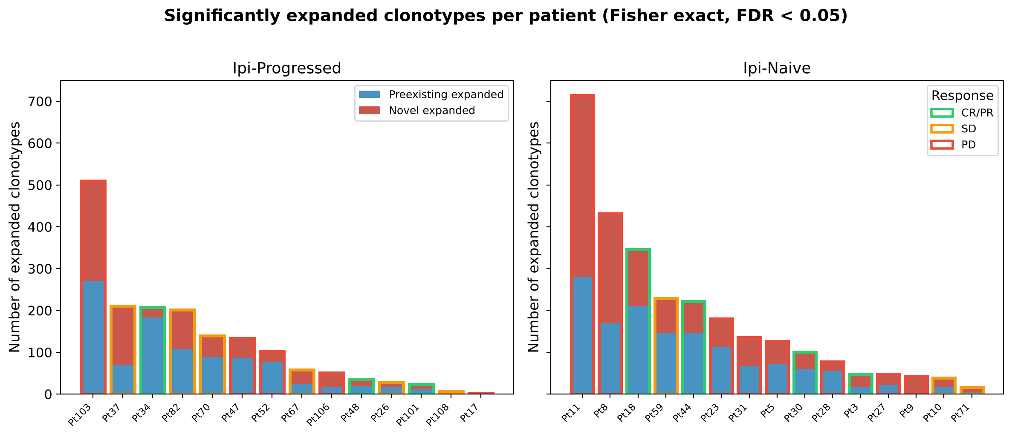
NEW ANALYSIS
Clonotype Expansion: Novel Clones Drive the Response
~47% of expanded clonotypes are novel (not detected at baseline)
Expansion counts are depth-dependent (ρ = 0.51 with min depth)
Fisher exact test per clonotype, BH FDR < 0.05 (standard method)
Expansion: one-sided Fisher exact · Same method as immunoSEQ Analyzer (DeWitt et al. 2015)
Notes:
STATUS: NEW ANALYSIS. The paper used the immunoSEQ Analyzer's expansion calls (Fig 6B) but did not break down expanded clonotypes by novel vs preexisting origin.
WHAT WAS DONE: For every clonotype in the union of pre and on repertoires, we performed a one-sided Fisher exact test comparing its share of the on-treatment repertoire with its share at baseline. BH FDR correction within each patient and direction. We then classified each expanded clonotype as "preexisting" (detected at baseline) or "novel" (count=0 pre-treatment).
RESULTS: ~47% of significantly expanded clonotypes are novel. Preexisting expanded clones had median 6.5x fold change. IMPORTANT: raw expansion counts are depth-dependent (Spearman rho=0.51 with minimum sample depth).
BIOLOGICAL SIGNIFICANCE: Nearly half of expanding T cells are newly recruited, not reinvigorated. This suggests recruitment is as important as reinvigoration in the anti-PD-1 response.
METHODS: One-sided Fisher exact (hypergeometric) per clonotype. BH FDR at 0.05. Minimum 2 templates. Clonotype = CDR3aa + V + J. Split-half null calibration: 0 false calls in 58 samples. Script: scripts/run_expansion.py, scripts/check_expansion_null.py.

Slide 15
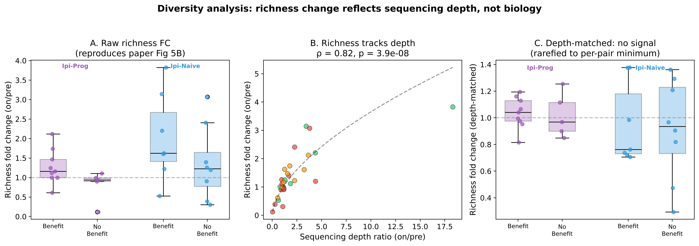
REPRODUCED + EXPANDED
Diversity Analysis: Richness Change Reflects Depth, Not Biology
Panel A: reproduces the paper's richness finding (raw data)
Panel B: richness FC tracks depth ratio at ρ = 0.82 (p = 3.9 × 10⁻⁸)
Panel C: after depth matching, the richness–response signal disappears
Rarefaction: multivariate hypergeometric downsampling without replacement · 20 draws, seed 1
Notes:
STATUS: REPRODUCED + EXPANDED. Panel A reproduces the paper's Fig 5B richness finding. Panels B and C add new depth context the paper did not address.
WHAT WAS DONE: Panel A — raw richness FC compared by benefit group, reproducing the paper. Panel B — correlated richness FC with depth ratio across all 29 patients. Panel C — repeated after rarefaction to per-pair minimum depth.
RESULTS: Panel A: Raw richness FC higher in benefit (p=0.029, paper: 0.016 with 34 patients). Panel B: rho=0.82, p=3.9e-8 — nearly all variance explained by depth. Panel C: Depth-matched, benefit vs no-benefit p=0.70 (Ipi-Prog), p=0.94 (Ipi-Naive). All other depth-matched metrics also null.
BIOLOGICAL SIGNIFICANCE: This reframes the paper's finding. The richness "signal" measures T cell infiltration change (more T cells = more templates = more clonotypes), not repertoire diversity per se. Additive, not a refutation.
METHODS: Rarefaction: multivariate hypergeometric, 20 draws, seed 1. Fixed depth 3500 (keeps 28/29). Mann-Whitney: exact when no ties. Scripts: scripts/run_diversity.py, scripts/reproduce_fig5b_stats.py.

Slide 16
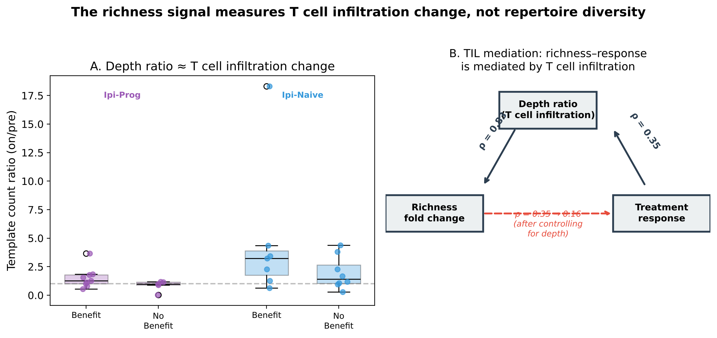
KEY INSIGHT
The Richness Signal Measures T Cell Infiltration, Not Diversity
Depth ratio ≈ TIL change: template counts reflect T cell content in the biopsy
Partial correlation: ρ drops from 0.35 to 0.16 (p = 0.41) controlling for depth
Additive to the paper: the richness signal is real — it measures infiltration change
This reframes the paper's finding: responders have more T cells on treatment, which drives the richness increase
Notes:
STATUS: NEW ANALYSIS. This is our strongest original analytical finding — a mediation analysis the paper did not perform.
WHAT WAS DONE: Spearman partial correlation between richness FC and response, controlling for template count ratio (depth ratio). The depth ratio serves as a proxy for TIL change because immunoSEQ captures T cell DNA.
RESULTS: Raw correlation: rho=0.348, p=0.064. After controlling for depth ratio: rho=0.162, p=0.411. The depth ratio mediates the richness-response relationship. Depth ratio correlates with richness FC at rho=0.82 and with TIL change at rho=0.827.
BIOLOGICAL SIGNIFICANCE: The paper's richness finding is not about repertoire diversity — it's about T cell infiltration. Anti-PD-1 works partly by increasing TILs, and patients who respond have a bigger increase. The richness metric was measuring this infiltration change all along. This reframes it as an infiltration biomarker rather than a diversity biomarker — additive, not a refutation.
METHODS: Spearman partial correlation (residual method). Response coded as binary. All 29 patients. Script: scripts/make_all_figures.py (figure), ad hoc session analysis (statistics).

Slide 17
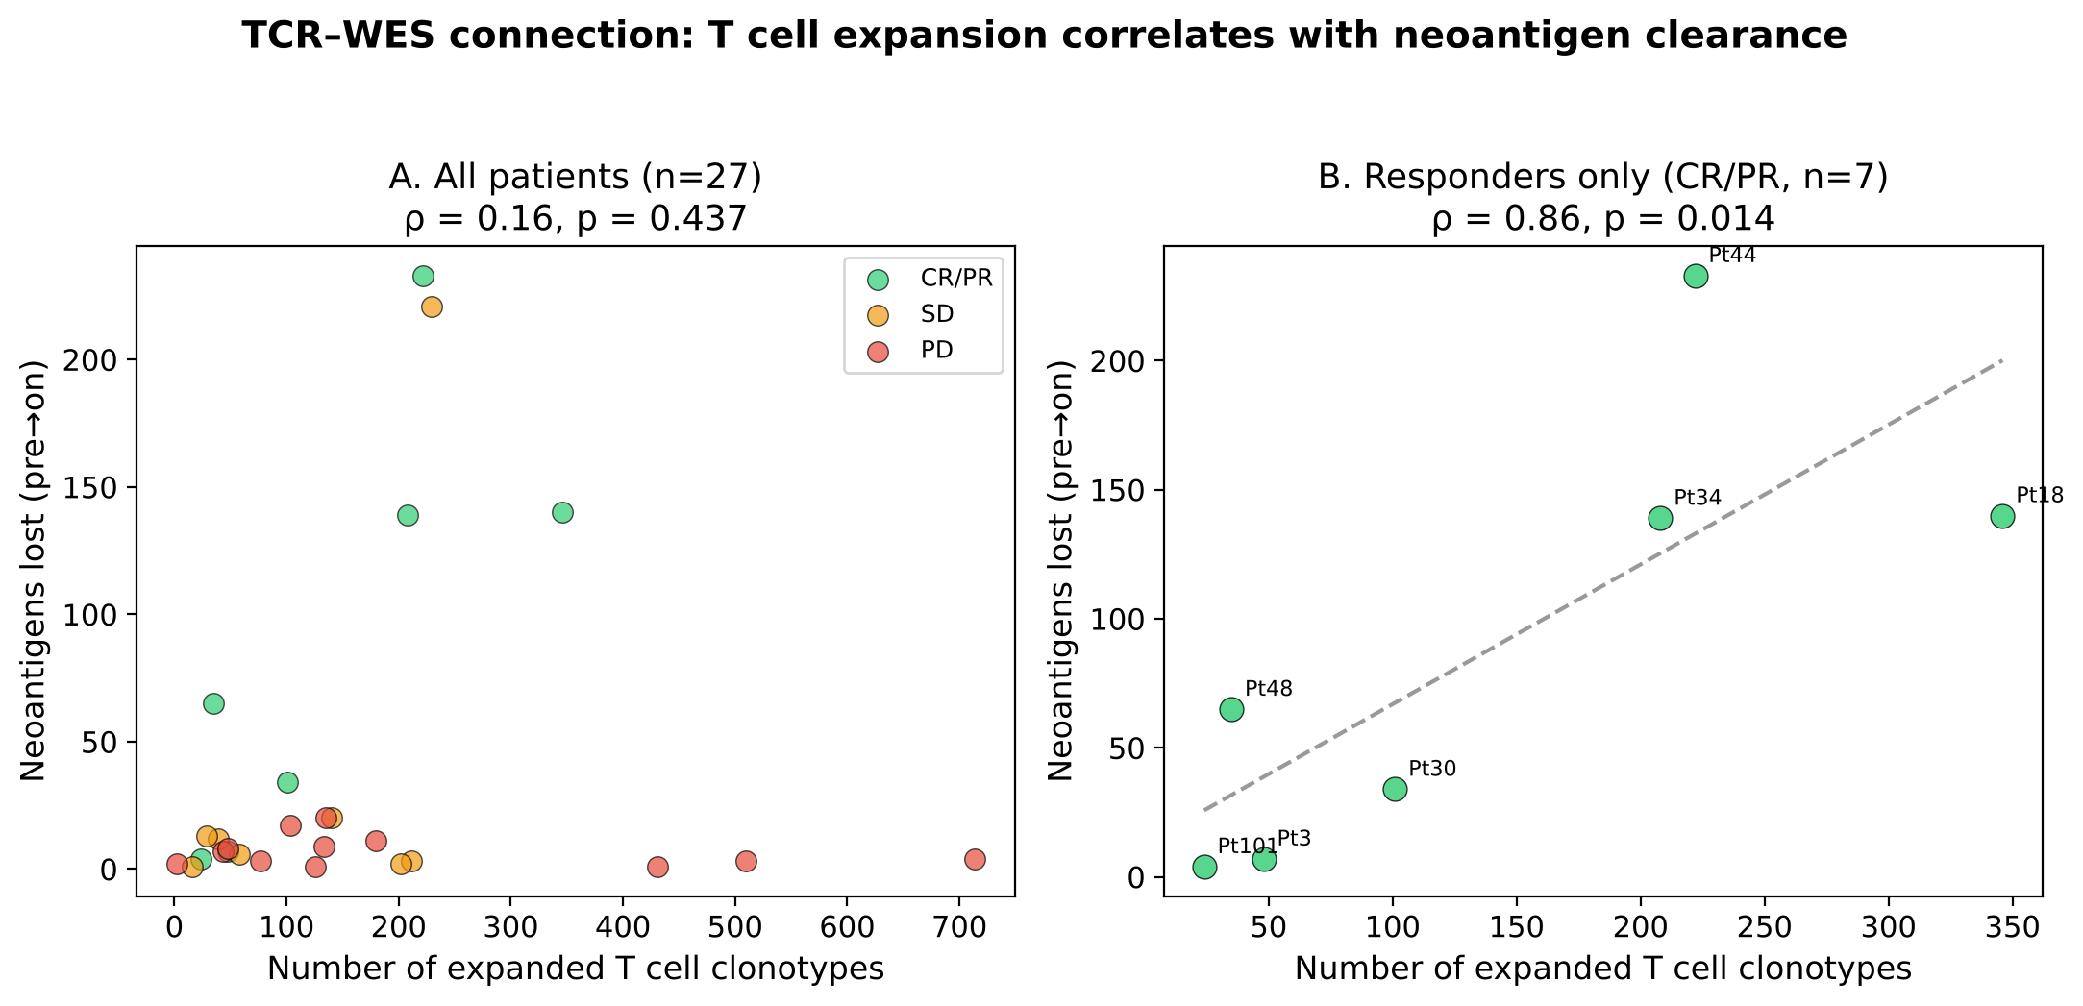
NEW ANALYSIS — TCR × WES
T Cell Expansion Correlates with Neoantigen Clearance
Responders (CR/PR): ρ = 0.86, p = 0.014 — strong link between expansion and neoantigen loss
Hypothesis-generating: n = 7 responders with both TCR and WES data; needs validation
The paper didn't test this: a connection between TCR dynamics and genomic tumor evolution
27 patients with paired TCR-seq and WES clonality data · Neoantigen loss from PyClone subclonal analysis
Notes:
STATUS: NEW ANALYSIS. The paper analyzed TCR and WES data separately but never connected them. This is a novel cross-modality analysis.
WHAT WAS DONE: Linked TCR expansion results to WES neoantigen depletion data from the paper's clonality table (PyClone subclonal analysis, 21,696 mutations). For each patient, counted neoantigens lost (pre.is.neo=True and on.is.neo=False). Correlated with number of expanded clonotypes.
RESULTS: Overall (n=27): weak (rho=0.16, p=0.437). Responders only (CR/PR, n=7): rho=0.857, p=0.014 — strong, significant correlation. Non-responders (PD, n=12): novel clonotype count correlates with neo_lost (rho=0.744, p=0.006), likely a size/depth confound.
BIOLOGICAL SIGNIFICANCE: The most biologically compelling new finding. In responders, more expanding T cells = more neoantigens cleared. Interpretation: expanded T cells target neoantigen-bearing tumor clones (immunoediting). This connects two hallmarks of successful immunotherapy.
CAVEATS: n=7 is strictly hypothesis-generating. Correlation does not prove causation. Neoantigen annotations from the paper's PyClone analysis, not recomputed.
METHODS: Fisher exact expansion + BH FDR. Neoantigen loss from clonality.data.table.pyclone.95.ci.txt. Spearman correlation. Script: scripts/make_all_figures.py.

Slide 18
Summary
Validated
New: Clonotype Tracking
New: TCR × WES
Pipeline reproduces all published TCR metrics and group-level statistics from Riaz et al.
75–99% of on-treatment clonotypes are novel. ~47% of expanded clones were not detected at baseline.
In responders, T cell expansion correlates with neoantigen clearance (ρ = 0.86, p = 0.014, n = 7).
Depth Context
Methods
Limitations
The paper's richness signal is mediated by T cell infiltration change (ρ drops 0.35 → 0.16). Additive, not a refutation.
All standard: Fisher exact, hypergeometric rarefaction, exact Mann-Whitney, Spearman correlations, BH FDR.
Small cohorts (n = 7–16 per group). Per-cohort AUC 0.70 has only 25% power. All depth-matched response metrics are null.
Notes:
SUMMARY OF WHAT IS REPRODUCED vs NEW:
REPRODUCED: (1) Pipeline validation — richness exact match, clonality within 0.0005, Fig 5B p-values match. (2) Raw diversity analysis — reproduces the paper's richness fold change result.
NEW ANALYSIS: (1) Clonotype tracking — 75-99% novel on-treatment. (2) Expansion composition — ~47% of expanded clones are novel. (3) TCR-WES connection — rho=0.86, p=0.014 in responders (n=7).
EXPANDED: (1) Depth context — richness FC tracks depth ratio at rho=0.82; depth-matched metrics all null. (2) TIL mediation — partial correlation drops from 0.35 to 0.16.
COMPLETE METHODS: Productive filter. Clonotype levels: CDR3aa (diversity), CDR3aa+V+J (tracking/expansion). Rarefaction: multivariate hypergeometric, 20 draws, seed 1. Expansion: one-sided Fisher exact, BH FDR 0.05. Mann-Whitney: exact when no ties. AUC = P(responder > non-responder), percentile bootstrap CI. Spearman correlations. Partial correlation: residual method.
LIMITATIONS: (1) 7-16 patients per group. Min detectable AUC 0.93 at 80% power. (2) All depth-matched metrics null. (3) TCR-WES n=7, hypothesis-generating. (4) Novel clonotypes may include unsampled baseline clones.
SCRIPTS: validate_metrics.py, run_tracking.py, run_expansion.py, run_diversity.py, run_response.py, make_all_figures.py.

Slide 19
RNA-seq turns each biopsy into gene and program scores, compared within each patient
1
2
3
4
Count genes
Normalize
Score programs
Compare biopsies
Authors' read counts; 19,578 genes pass the filter
Correct for sequencing depth (DESeq2 VST)
Average marker genes: CD8, IFN-γ, tumor (melanocytic)…
On vs Pre per patient: DESeq2 genes, fgsea pathways
49
patients with a pre-treatment biopsy
42
with both biopsies (main comparison)
9 · 15 · 18
paired PR/CR · SD · PD
Notes:
My part is the RNA. We start from the authors' read counts, 19,578 genes after filtering. We normalize for sequencing depth, then average marker genes into scores, for example CD8 T cells, interferon-gamma, and a tumor score built from melanoma identity genes. Then we compare each patient's two biopsies, so every patient is their own control. That matters because melanomas differ so much from person to person that a between-patient comparison would mostly measure those differences. 49 patients have a pre-treatment biopsy, and 42 have both. [~30 s]

Slide 20
Nivolumab releases the brake; WES shows the targets
Mutations
Neoantigens
T cells
Nivolumab
Tumor DNA changes alter its proteins
→
Mutated protein pieces shown on the cell surface
→
Recognise neoantigens as foreign, but PD-1 brakes them
→
Blocks PD-1, so T cells can kill the cancer
WES measures these two, before and during treatment
Why WES? Nivolumab helps only some melanoma patients. If T cells kill the cells carrying neoantigens, those mutations should disappear between biopsies in patients who respond. WES lets us check.
Notes:
First, the biology. Tumors carry DNA mutations that change their proteins. Pieces of those mutated proteins, called neoantigens, get displayed on the cell surface, and T cells can recognise them as foreign. But tumors press a brake on T cells called PD-1. Nivolumab blocks PD-1 and releases that brake, so T cells can kill the cancer. It only works in some patients, so why? WES reads the first two steps: the mutations and the neoantigens. If T cells really kill the cells carrying neoantigens, those mutations should disappear between the two biopsies in the patients who respond. [~35 s]

Slide 21
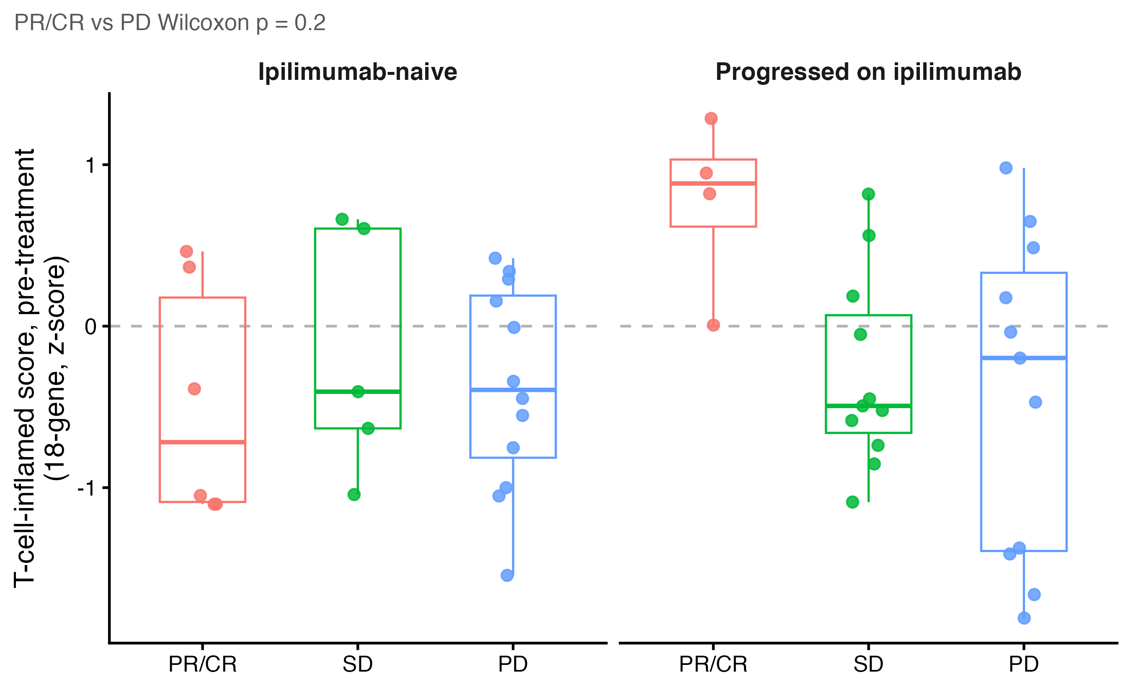
Before treatment, immune activity only weakly predicts who will respond
Medians: PR/CR 0.19, SD −0.47, PD −0.34
PR/CR − PD +0.53; 95% CI −0.73 to +1.33 crosses zero
Ipilimumab-progressed responders start 'hot'
Recreates the paper
Paper: baseline expression only marginally predictive, split by ipilimumab cohort. Our change: one fixed 18-gene score (Ayers 2017) instead of genome-wide testing.
Notes:
First question: does immune activity before treatment predict response? Each dot is one patient's T-cell-inflamed score, a published 18-gene measure of how immune-active a tumor is. Responders sit a little higher, but the difference from progressors, 0.53, has a confidence interval that crosses zero. The one clear pattern is on the right: responders who had already failed ipilimumab all start with 'hot' tumors. That matches the paper, which also called baseline expression only marginally predictive. In the patients who had never had ipilimumab, responders and progressors overlap almost completely. So a single snapshot before treatment is not enough; to understand response, we need to look at what changes during treatment. [~50 s]

Slide 22
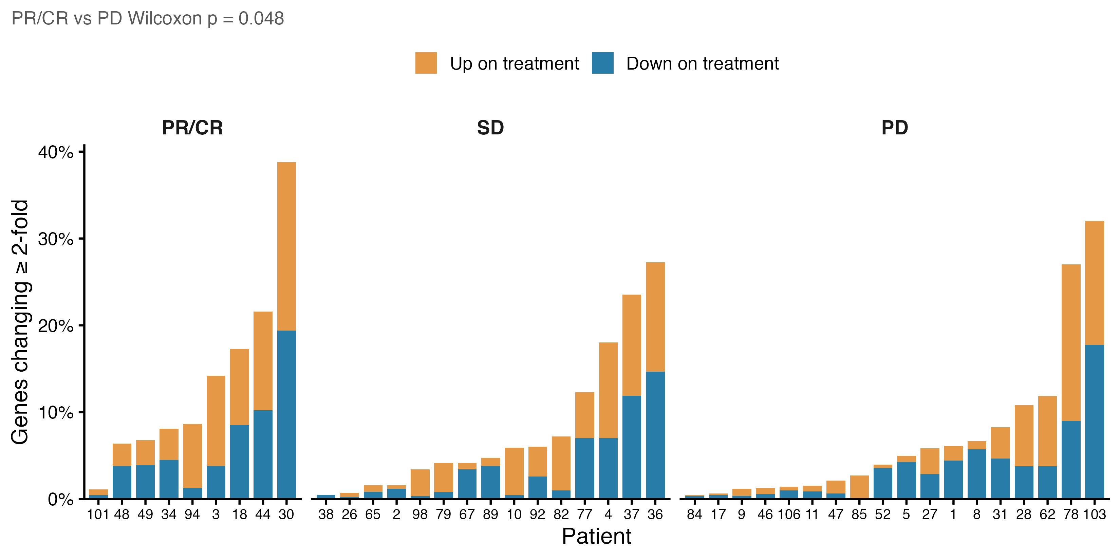
On treatment, responders' genes shift more, and far more consistently, than progressors'
Median genes changing 2-fold: 8.6% PR/CR vs 4.5% PD
Genes shifting together (DESeq2, FDR < 0.1): 3,582 PR/CR, 28 SD, 0 PD
Builds on the paper
Paper counted On vs Pre DE genes; we could not reproduce its exact counts (before treatment: 397 ours vs 189 paper). New: per-patient view and a repeat-library noise floor (~3%).
Notes:
Next, the two biopsies. Each bar is a patient: the share of genes that went up, in orange, or down, in blue, at least two-fold. Responders change more, a median of 8.6% of genes against 4.5% in progressors. But the bigger difference is consistency. When we ask which genes shift together across a group, we find 3,582 in responders, 28 in stable disease and 0 in progressors. For scale, two sequencing runs of the same biopsy already differ by about 3 percent of genes, so the raw amount of change is modest. Responders move in a shared direction; progressors, when they change, change in their own way. [~50 s]

Slide 23
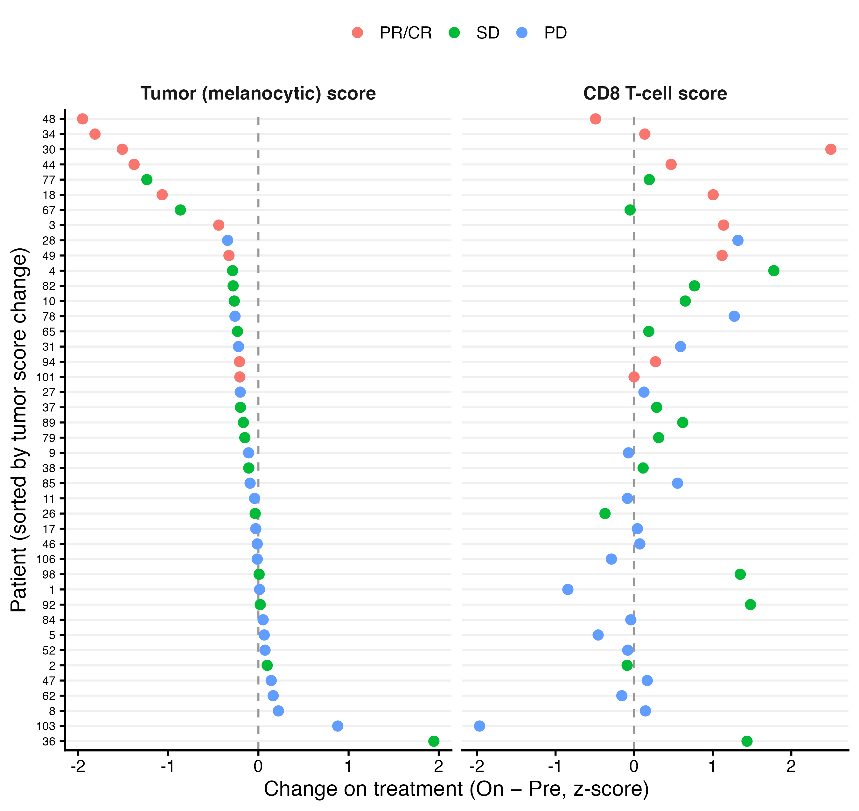
Tumor loss, more than immune gain, marks a response
Tumor score: PR/CR −1.07 vs PD −0.01 (p ≈ 0.0002)
CD8 score: PR/CR +0.47, SD +0.31, PD 0.00 (p ≈ 0.07)
Exceptions: Pt94 and Pt101
New beyond the paper
Paper showed melanin pathway genes falling in responders. We turn this into a per-patient tumor score and line it up against CD8 change.
Notes:
So which genes are changing? Each row is a patient, sorted by the change in a tumor score made from five melanoma identity genes, like MLANA and tyrosinase. Responders, in red, cluster at the top with the biggest drops: a median of −1.07 against −0.01 in progressors, p about 0.0002. On the right, the CD8 T-cell score rises in responders, but it also rises in stable disease, and the responder-versus-progressor test is only p about 0.07. It isn't universal: patients 94 and 101 respond with almost no change in the tumor score. But overall, the clearest RNA sign of response is the tumor disappearing from the biopsy. [~50 s]

Slide 24
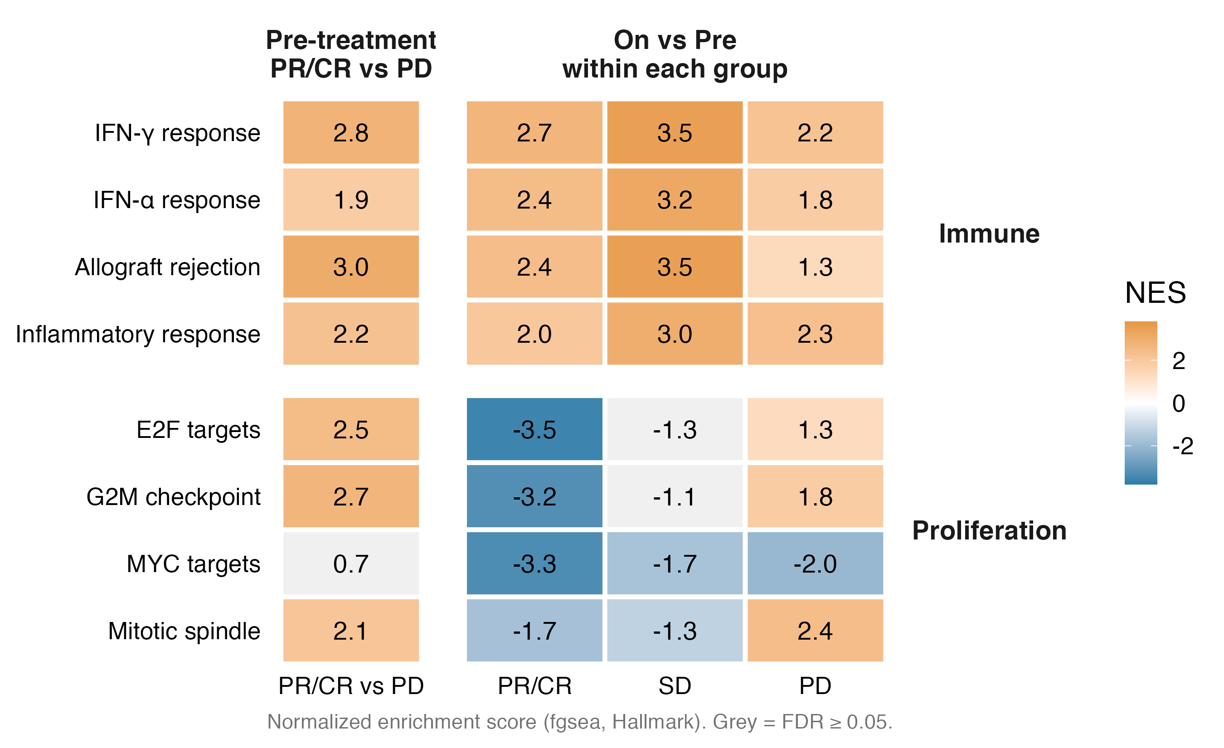
Immune pathways rise in every group; only responders shut down proliferation
IFN-γ: +2.7 PR/CR, +3.5 SD, +2.2 PD
E2F targets: −3.5 PR/CR vs +1.3 PD
Recreates the paper
Paper: immune genes up and cell-cycle genes down in responders (GSEA). Our change: Hallmark sets with fgsea, plus SD and PD columns so the contrast between groups is visible.
Notes:
Pathways show the same thing across thousands of genes. Orange means up on treatment, blue down, grey not significant. The top block is immune pathways: interferon-gamma rises in every group, even progressors at +2.2. The bottom block is proliferation: it collapses only in responders, E2F targets at −3.5, while progressors' tumors keep dividing. This recreates the paper's result, immune up and cell cycle down in responders, and adding the other groups shows that immune activation alone is not enough. [~45 s]

Slide 25
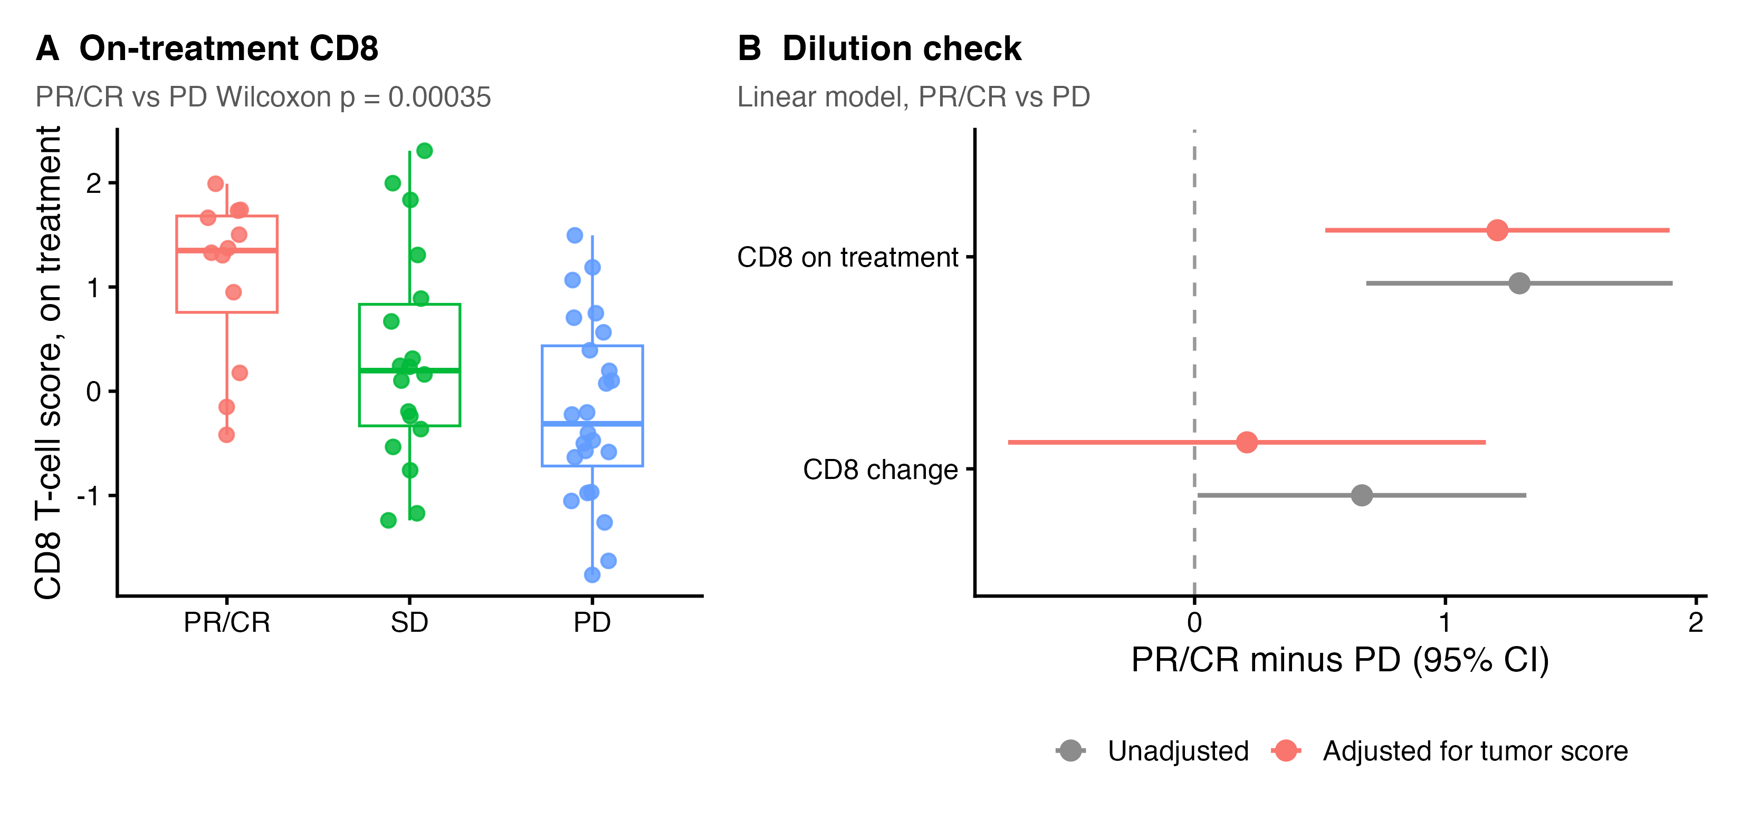
The on-treatment CD8 level is the immune signal that survives the tumor-dilution check
CD8 rise: +0.67 → +0.21 after adjustment
On-treatment CD8: +1.30 → +1.21, still clear of zero
New beyond the paper
Bulk RNA is a mixture: when tumor cells die, other cells' share grows. We add an adjustment for tumor content.
Notes:
One catch with bulk RNA: it is a mixture. When tumor cells die, immune cells become a bigger share of what's left, even if no new T cells arrive. So we adjusted for the tumor score. The responder CD8 rise drops from +0.67 to +0.21, so it can't be separated from dilution. But the on-treatment CD8 level holds, +1.30 before and +1.21 after. So by week four, responders' tumors are gone and what remains is full of CD8 T cells. That's the RNA story, and it leads into how RNA compares with the TCR data. [~45 s]

Slide 26
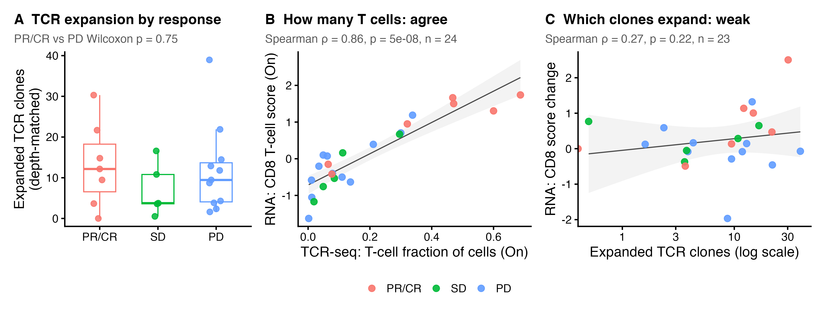
RNA and TCR agree on how many T cells are present, but only TCR-seq sees which clones expand
Modality comparisons
WES vs TCR
Kwaku & Krithika
WES vs RNA
Kwaku
TCR vs RNA
T-cell amount ρ 0.86; expansion vs CD8 change ρ 0.27
Expanded clones by response (depth-matched median): PR/CR 12, SD 4, PD 9; PR/CR vs PD p = 0.75 (n = 7 vs 12)
Panel A recreates the paper's expansion-by-response comparison; B and C are new links between modalities
Notes:
To compare modalities: RNA and TCR sequencing agree almost perfectly on how many T cells are in a biopsy, rho 0.86. But Krithika's count of expanding clones barely tracks any RNA score, for example rho 0.27 with CD8 change, and no expansion or clonality measure survives multiple-testing correction against any RNA score. So RNA measures the size of the immune response, and TCR-seq measures its clonal makeup: complementary, not redundant. [~35 s]

Slide 27
Takeaways and next steps
1
2
3
Loss tracks response
Visible targets are lost
Next steps
Mutation loss during treatment separates responders far better than baseline mutation burden.
Responders keep 0.43 of the neoantigens expected, consistent with T cells removing the cells they can see.
Repeat on the 26 patients our team shares, apply stricter purity filters, and link with the TCR and RNA results.
Thank you
Notes:
Three takeaways. First, losing mutations during treatment, not the starting number, is what tracks response. Second, the targets T cells can see are the ones that disappear: responders keep less than half of the neoantigens we'd expect, which fits T cells removing the cancer cells they can see. Next, I'll repeat this on the 26 patients our team shares, apply stricter purity filters, and link it with Krithika's TCR and Ethan's RNA results. Thank you. [~30 s]

