Slide 1
Do melanomas lose their mutations when nivolumab works?
Whole exome sequencing (WES) results
Kwaku Darkwah, WES and integration lead · with Krithika (TCR) and Ethan (RNA)
Reanalysis of Riaz et al., Cell 2017
Notes:
Hi, I'm Kwaku, and I led the whole exome sequencing part of our project. My question is simple: when nivolumab works, do tumors actually lose mutations? To answer it, I reran the authors' public code from Riaz et al. 2017. [~20 s]

Slide 2
Nivolumab releases the brake; WES shows the targets
Mutations
Neoantigens
T cells
Nivolumab
Tumor DNA changes alter its proteins
→
Mutated protein pieces shown on the cell surface
→
Recognise neoantigens as foreign, but PD-1 brakes them
→
Blocks PD-1, so T cells can kill the cancer
WES measures these two, before and during treatment
Why WES? Nivolumab helps only some melanoma patients. If T cells kill the cells carrying neoantigens, those mutations should disappear between biopsies in patients who respond. WES lets us check.
Notes:
First, the biology. Tumors carry DNA mutations that change their proteins. Pieces of those mutated proteins, called neoantigens, get displayed on the cell surface, and T cells can recognise them as foreign. But tumors press a brake on T cells called PD-1. Nivolumab blocks PD-1 and releases that brake, so T cells can kill the cancer. It only works in some patients, so why? WES reads the first two steps: the mutations and the neoantigens. If T cells really kill the cells carrying neoantigens, those mutations should disappear between the two biopsies in the patients who respond. [~35 s]

Slide 3
The study sampled each tumor twice
1
2
3
4
Biopsy 1
Nivolumab
Biopsy 2
Response
Taken before the first dose
Anti-PD-1 antibody that releases the brake on T cells
Taken about 4 weeks into treatment
Scans sort patients: PR/CR shrank, SD stable, PD grew
68
patients with WES before treatment
41
with WES at both biopsies: my main comparison
26
with WES, RNA and TCR at both biopsies (team's shared set)
Notes:
Here's how the study worked. Each patient had a tumor biopsy before their first dose of nivolumab. Nivolumab blocks PD-1, a brake on T cells, so the immune system can attack the tumor. About four weeks in, they took a second biopsy. Later, scans sorted patients into responders, meaning partial or complete response, stable disease, or progressive disease. Sixty-eight patients had exome sequencing before treatment, and 41 had it at both biopsies. Those 41 are my main comparison. [~35 s]

Slide 4
WES turns each biopsy into three numbers
1
2
3
4
Tumor vs normal
Mutation burden
Neoantigens
Loss on treatment
Read the protein-coding exome (~1–2% of DNA). Tumor-only variants are somatic.
Count nonsynonymous mutations: those that change a protein.
Using each patient's HLA type, predict which mutated peptides T cells could see.
Compare the pre-treatment biopsy with the one ~4 weeks into nivolumab.
Example: patient 7, a responder
1,363
→
834
→
≈12
→
2
protein-changing mutations before
predicted neoantigens before
neoantigens expected on treatment
neoantigens actually seen
Notes:
WES reads the protein-coding part of the DNA, about one to two percent of the genome. We sequence the tumor and normal blood; mutations found only in the tumor are somatic. Counting the protein-changing ones gives mutation burden. Using each patient's HLA type, we predict which mutated peptides can be shown to T cells; those are neoantigens. Then we compare the two biopsies. Take patient 7, a responder: 1,363 mutations and 834 predicted neoantigens before treatment. Based on how many silent mutations survived, we'd expect about 12 neoantigens on treatment, but only 2 were left. [~40 s]

Slide 5
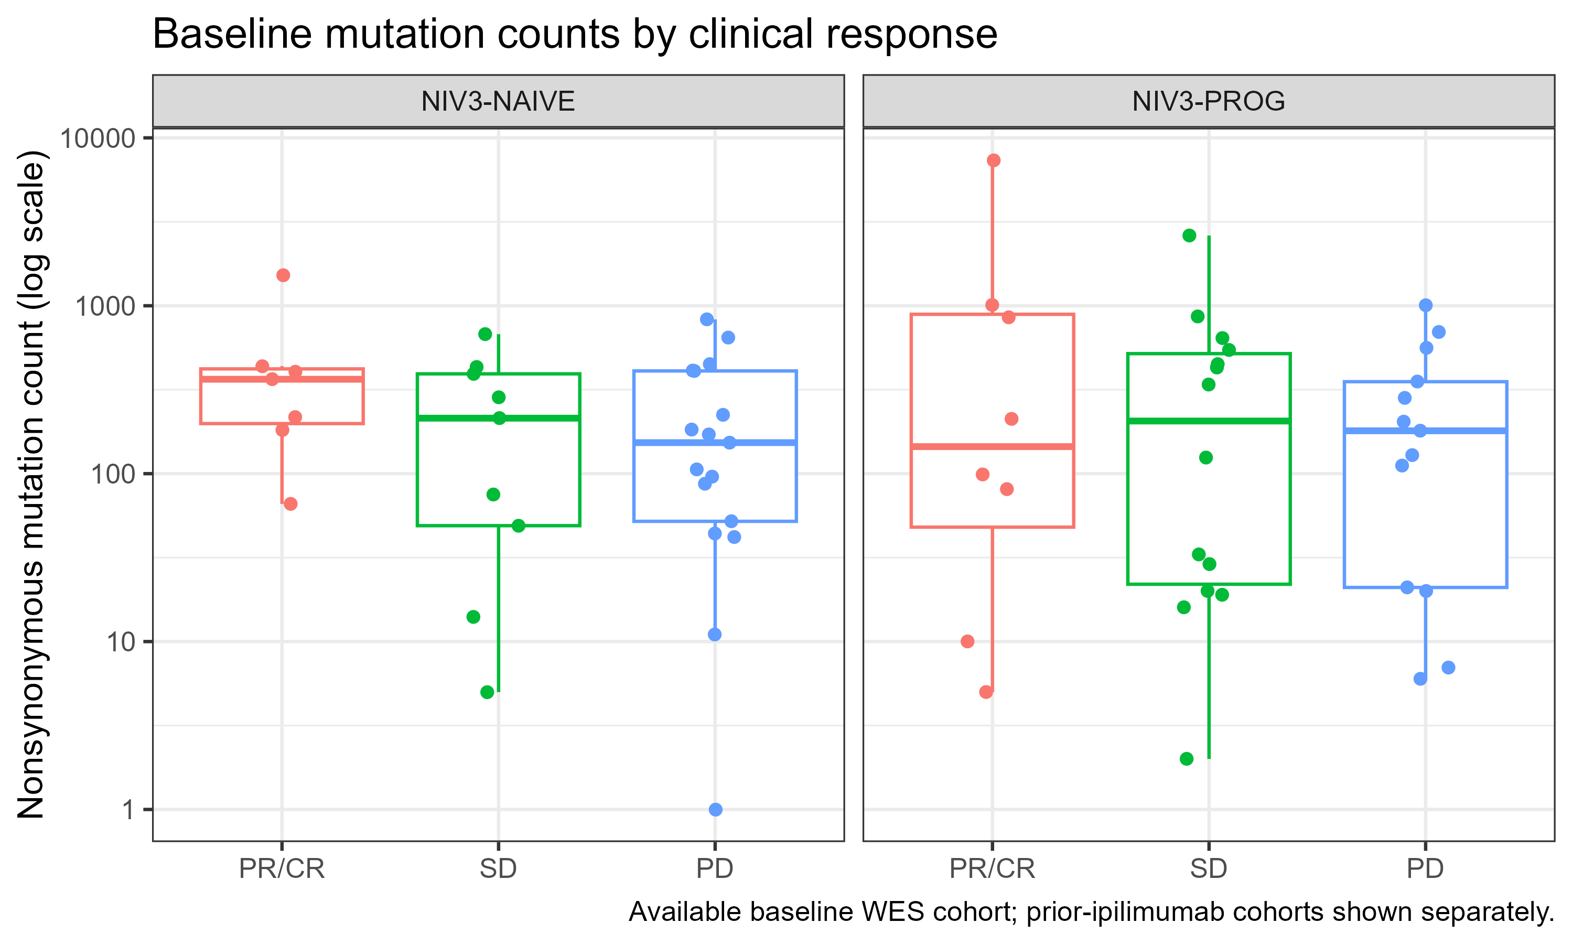
Baseline mutation burden is a weak predictor
Median nonsynonymous mutations
Both cohorts combined
217
PR/CR (n = 15)
95% CI 99–852
214
Stable (n = 23)
95% CI 29–428
162
Progressive (n = 30)
95% CI 92–254
PR/CR − PD: +55 mutations (95% CI −95 to +393). The interval crosses zero.
Notes:
First: does the number of mutations before treatment predict response? Not cleanly. Each dot is a patient, on a log scale, split by whether they had prior ipilimumab; the medians on the right combine both cohorts. They are 217 for responders, 214 for stable disease and 162 for progressors, but the ranges overlap almost completely. The difference between responders and progressors is 55 mutations, with a 95 percent bootstrap confidence interval from minus 95 to plus 393, so it crosses zero. Baseline burden alone is a weak predictor here. [~35 s]

Slide 6
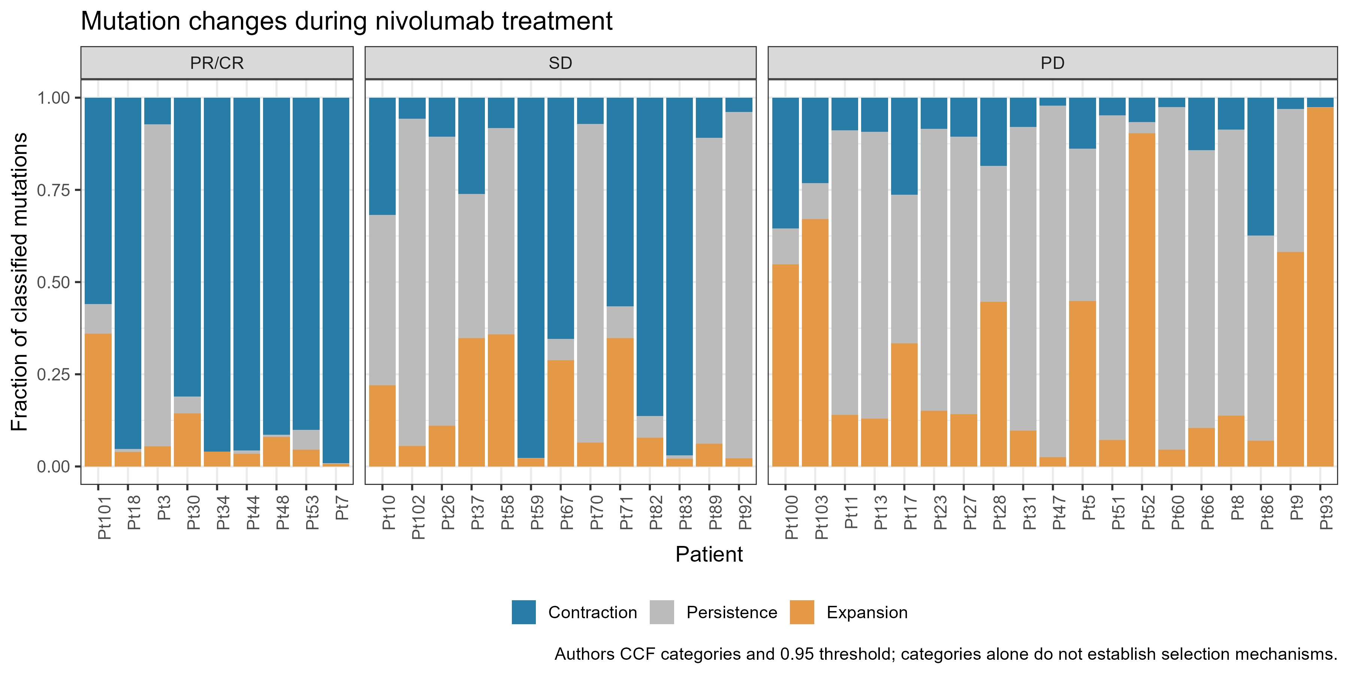
Each mutation is tracked between the two biopsies
Three categories
Contraction
Lost, or now in fewer cancer cells
Persistence
About the same share of cancer cells
Expansion
Now in more cancer cells
Share of cells is the cancer cell fraction, adjusted for tumor purity. A change only counts at 95% confidence.
Notes:
To see what changed, the authors tracked every mutation from the first biopsy to the second. For each one they estimate the cancer cell fraction: the share of cancer cells carrying it, adjusted for how much of the sample is tumor. Each bar is one patient. Blue means the mutation contracted: it disappeared or is now in fewer cancer cells. Gray means it persisted, and orange means it expanded. Look at the left panel: almost every responder is mostly blue. Progressors on the right are mostly gray and orange. [~35 s]

Slide 7
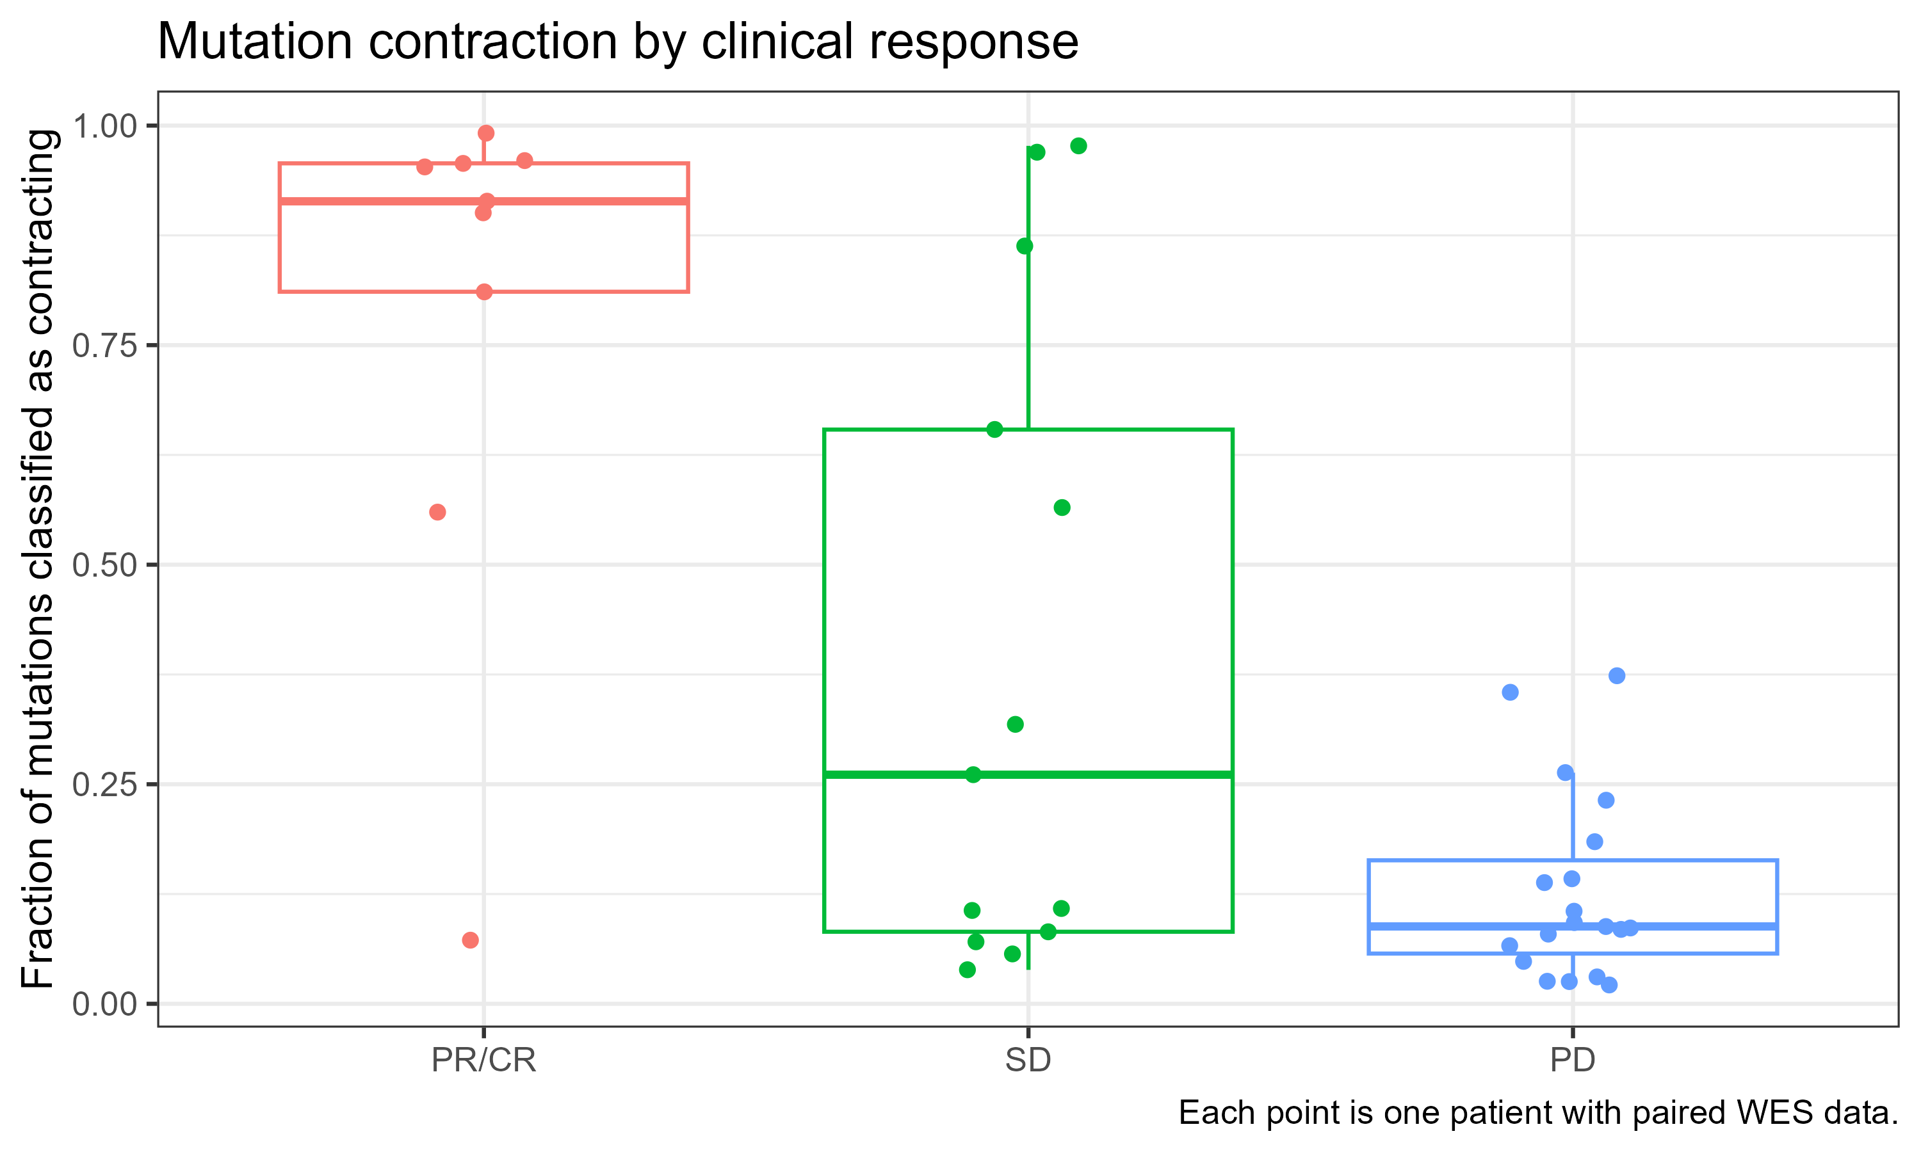
Most mutations contract in responders
Median share of mutations contracting
Contracting = lost, or now in fewer cancer cells
91%
PR/CR (n = 9)
95% CI 56–96%
26%
Stable (n = 13)
95% CI 8–65%
9%
Progressive (n = 19)
95% CI 7–14%
PR/CR − PD: 83 points (95% CI 48–88); Wilcoxon p ≈ 0.0001. Two responders sit low.
Notes:
The change over time looks very different. This shows the fraction of each patient's mutations classified as contracting between the two biopsies, using the authors' cancer-cell-fraction categories. Contracting means the mutation disappeared or is now found in fewer of the cancer cells. In responders the median is 91 percent; in progressors it's 9 percent; stable disease sits in between with a wide spread. The difference is 83 percentage points, with a 95 percent bootstrap confidence interval of 48 to 88, and a rank-sum p of about 0.0001 comparing responders with progressors. Two responders are low, so it's a strong trend, not a rule. [~45 s]

Slide 8
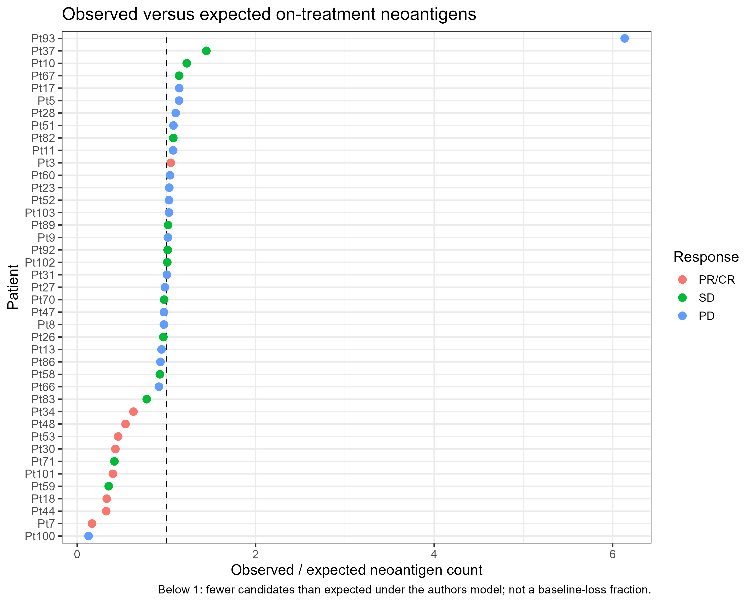
Responders keep fewer neoantigens than expected
Observed ÷ expected neoantigens on treatment (median)
0.43
1.03
PR/CR
95% CI 0.32–0.63
Progressive
95% CI 0.97–1.08
Below the dashed line = fewer candidates than the authors' model expects
PR/CR − PD: −0.60 (95% CI −0.70 to −0.40); Wilcoxon p ≈ 0.0008 (n = 9 vs 19)
Not universal: one responder (Pt3) is above 1
Notes:
Neoantigens follow the same pattern. For each patient, we compare the neoantigens observed on treatment with the number expected from the authors' model; below the dashed line means fewer than expected. The yardstick is silent mutations, which T cells can't see: expected means how many neoantigens would remain if they survived at the same rate as silent mutations. Responders have a median ratio of 0.43, while progressors are at 1.03, essentially no change. The difference is minus 0.60, with a 95 percent confidence interval of minus 0.70 to minus 0.40, and p of about 0.0008 comparing responders with progressors. One responder, Pt3, is above 1, so again it's not universal. This fits the idea that T cells remove the cancer cells carrying visible mutations. [~45 s]

Slide 9
What could make mutations look lost?
Immune cells dilute the tumor
Contraction is not only loss
A responding biopsy fills with T cells, so tumor DNA is scarcer and mutations are harder to detect. Cancer cell fractions adjust for purity, but low purity remains a risk.
The category also counts mutations that went from all cancer cells to some. Fewer cells, not necessarily zero.
Processed data, not raw reads
Small groups, one snapshot
I reran the authors' code on their processed tables. Mutations and neoantigens were not re-called from sequencing reads.
9 responders and 19 progressors with paired WES, sampled once at about week 4. Bootstrap intervals show the uncertainty.
Notes:
Before the takeaways, what could fool this result? First, when nivolumab works, the biopsy fills with immune cells, so there's less tumor DNA and mutations get harder to detect. The cancer cell fractions adjust for purity, but it's still a risk. Second, contraction doesn't always mean a mutation vanished; it also counts mutations that went from being in every cancer cell to only some. Third, I reran the authors' code on their processed tables; I didn't re-call mutations from raw reads. And finally, the groups are small, 9 responders and 19 progressors, with one snapshot at week 4. That's why I report confidence intervals. [~40 s]

Slide 10
Takeaways and next steps
1
2
3
Loss tracks response
Visible targets are lost
Next steps
Mutation loss during treatment separates responders far better than baseline mutation burden.
Responders keep 0.43 of the neoantigens expected, consistent with T cells removing the cells they can see.
Repeat on the 26 patients our team shares, apply stricter purity filters, and link with the TCR and RNA results.
Thank you
Notes:
Three takeaways. First, losing mutations during treatment, not the starting number, is what tracks response. Second, the targets T cells can see are the ones that disappear: responders keep less than half of the neoantigens we'd expect, which fits T cells removing the cancer cells they can see. Next, I'll repeat this on the 26 patients our team shares, apply stricter purity filters, and link it with Krithika's TCR and Ethan's RNA results. Thank you. [~30 s]

