Slide 1
TCR Clonotype Tracking in
Anti-PD-1 Immunotherapy
Reanalysis and Extension of Riaz et al. 2017 (Cell)
CA209-038 Trial · Nivolumab · Melanoma · immunoSEQ TCRβ
Notes:
STATUS: INTRODUCTION. This is a presentation-first final project analyzing the TCR-seq data from Riaz et al. 2017 (Cell). The CA209-038 trial tested nivolumab (anti-PD-1) in advanced melanoma patients, split into two cohorts: Ipi-Progressed (prior ipilimumab) and Ipi-Naive (no prior ipilimumab). 29 patients have paired pre- and on-treatment immunoSEQ TCR-beta repertoires. We reproduce the paper's published metrics and extend the analysis with clonotype tracking, expansion composition, depth context, TIL mediation, and a novel TCR-WES cross-modality connection.

Slide 2
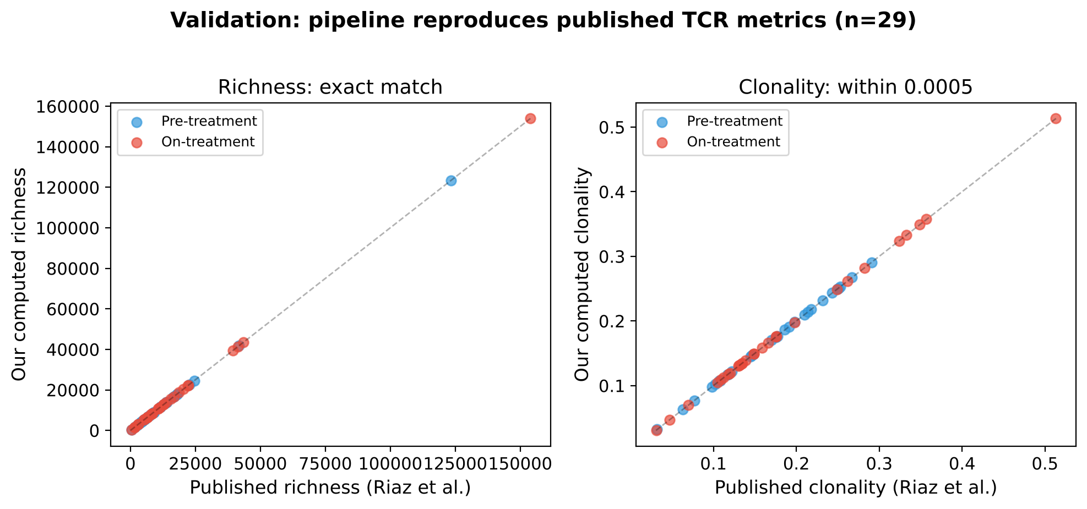
REPRODUCED
Pipeline Validation: Exact Match with Published Metrics
Richness: exact integer match for all 58 samples
Clonality: within 0.0005 (floating-point rounding)
Fig 5B p-values reproduced within sample-subset differences
29 patients with paired pre- and on-treatment TCRβ repertoires · Productive filter: CDR3 non-empty, starts with C, no stop codon
Notes:
STATUS: REPRODUCED. This validates that our pipeline exactly reproduces the published TCR metrics from Riaz et al.
WHAT WAS DONE: We built a Python pipeline that reads the raw immunoSEQ TSV files, applies the productive filter (CDR3 non-empty, starts with C, no stop codon), collapses to CDR3 amino acid clonotypes, and computes richness, Shannon entropy, evenness, and clonality. We compared every metric against the paper's published TCRmetrics.csv.
RESULTS: Richness: exact integer match for all 58 samples. Clonality: max difference 0.0005 (floating-point rounding in Shannon entropy computation). Fig 5B Mann-Whitney p-values: Ipi-Prog p=0.029 (paper: 0.016 with 34 patients, we have 29), Ipi-Naive p=0.94 (paper: 0.72).
METHODS: Productive filter matching immunoSEQ Analyzer. Clonotype = unique CDR3 amino acid sequence. Shannon entropy in bits (log2). Evenness = H/log2(N). Clonality = 1 - evenness. Script: scripts/validate_metrics.py, scripts/reproduce_fig5b_stats.py.

Slide 3
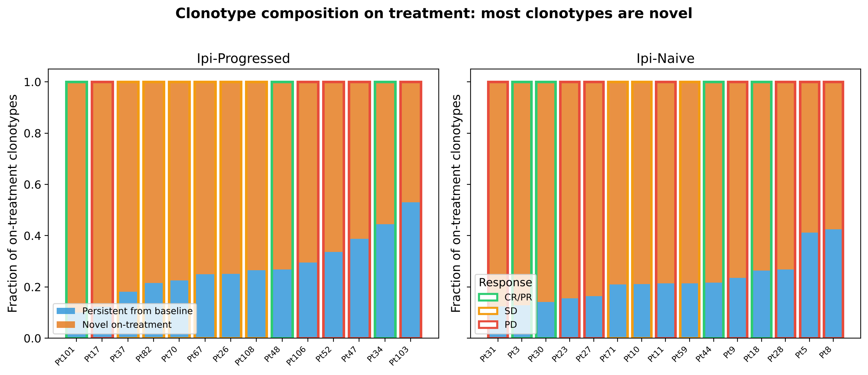
NEW ANALYSIS
75–99% of On-Treatment Clonotypes Are Novel
The paper never tracked individual clonotypes across timepoints
Most on-treatment repertoire is newly detected, not persistent from baseline
Novel clonotypes may include unsampled baseline clones (sampling caveat)
Clonotype = CDR3aa + V gene + J gene · Paired pre/on-treatment repertoires
Notes:
STATUS: NEW ANALYSIS. The paper analyzed diversity metrics (richness, clonality) but never tracked individual clonotypes across timepoints to see which ones persisted and which were new.
WHAT WAS DONE: We aligned pre-treatment and on-treatment repertoires at the CDR3aa+V+J clonotype level. For each patient, we classified every on-treatment clonotype as "persistent" (also detected at baseline) or "novel" (not detected at baseline).
RESULTS: 75-99% of on-treatment clonotypes are novel — they were not detected in the pre-treatment sample. This means the vast majority of the on-treatment repertoire is newly detected T cells.
BIOLOGICAL SIGNIFICANCE: This reveals massive T cell turnover during anti-PD-1 therapy. The treatment doesn't just reinvigorate existing tumor-infiltrating T cells — it recruits an entirely new repertoire. This has implications for understanding the mechanism of checkpoint blockade.
CAVEATS: "Novel" clonotypes may include T cells that were present at baseline but below the detection limit of immunoSEQ. This is a sampling limitation, not a biological certainty.
METHODS: Clonotype = CDR3 amino acid + V gene + J gene. Pre/on alignment by exact match. Script: scripts/run_tracking.py. Output: outputs/tracking_aa_vj.csv.

Slide 4
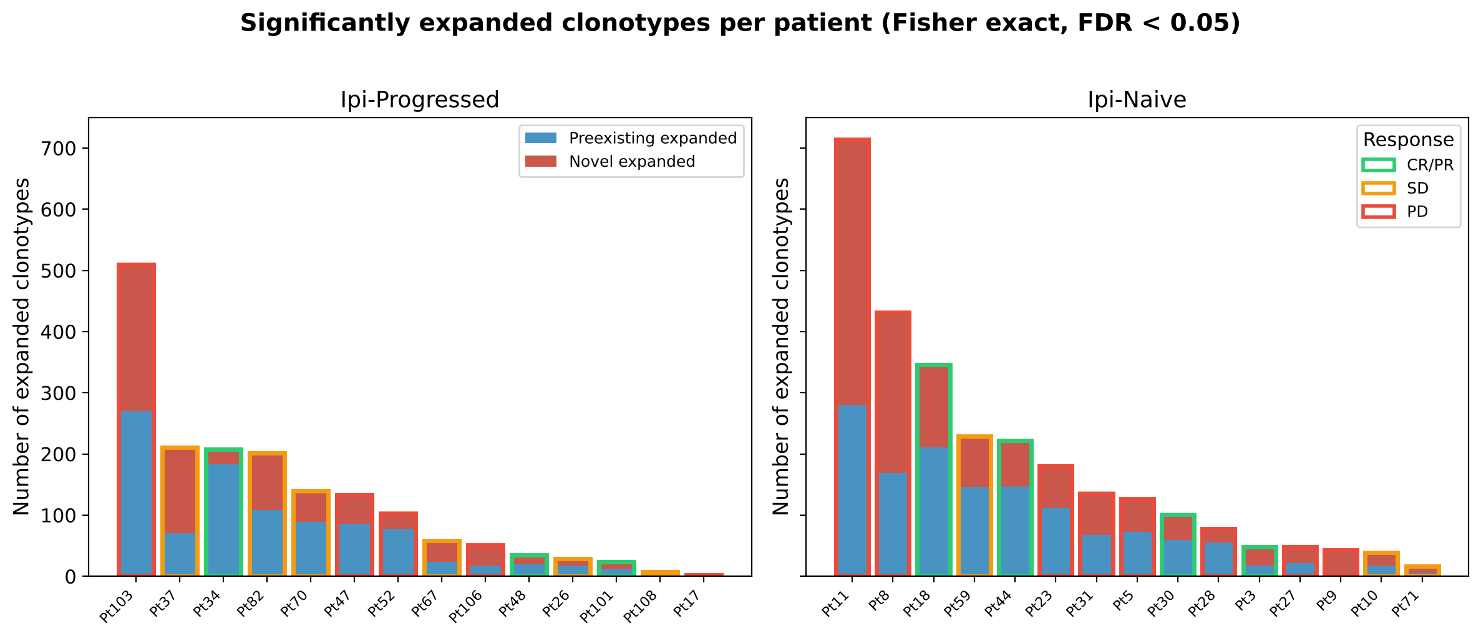
NEW ANALYSIS
Clonotype Expansion: Novel Clones Drive the Response
~47% of expanded clonotypes are novel (not detected at baseline)
Expansion counts are depth-dependent (ρ = 0.51 with min depth)
Fisher exact test per clonotype, BH FDR < 0.05 (standard method)
Expansion: one-sided Fisher exact · Same method as immunoSEQ Analyzer (DeWitt et al. 2015)
Notes:
STATUS: NEW ANALYSIS. The paper used the immunoSEQ Analyzer's expansion calls (Fig 6B) but did not break down expanded clonotypes by novel vs preexisting origin.
WHAT WAS DONE: For every clonotype in the union of pre and on repertoires, we performed a one-sided Fisher exact test comparing its share of the on-treatment repertoire with its share at baseline. BH FDR correction within each patient and direction. We then classified each expanded clonotype as "preexisting" (detected at baseline) or "novel" (count=0 pre-treatment).
RESULTS: ~47% of significantly expanded clonotypes are novel. Preexisting expanded clones had median 6.5x fold change. IMPORTANT: raw expansion counts are depth-dependent (Spearman rho=0.51 with minimum sample depth).
BIOLOGICAL SIGNIFICANCE: Nearly half of expanding T cells are newly recruited, not reinvigorated. This suggests recruitment is as important as reinvigoration in the anti-PD-1 response.
METHODS: One-sided Fisher exact (hypergeometric) per clonotype. BH FDR at 0.05. Minimum 2 templates. Clonotype = CDR3aa + V + J. Split-half null calibration: 0 false calls in 58 samples. Script: scripts/run_expansion.py, scripts/check_expansion_null.py.

Slide 5
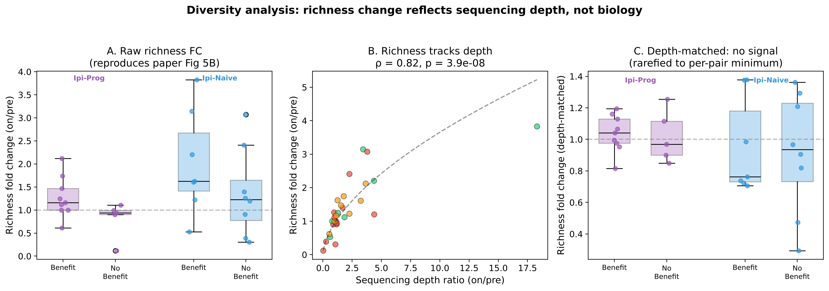
REPRODUCED + EXPANDED
Diversity Analysis: Richness Change Reflects Depth, Not Biology
Panel A: reproduces the paper's richness finding (raw data)
Panel B: richness FC tracks depth ratio at ρ = 0.82 (p = 3.9 × 10⁻⁸)
Panel C: after depth matching, the richness–response signal disappears
Rarefaction: multivariate hypergeometric downsampling without replacement · 20 draws, seed 1
Notes:
STATUS: REPRODUCED + EXPANDED. Panel A reproduces the paper's Fig 5B richness finding. Panels B and C add new depth context the paper did not address.
WHAT WAS DONE: Panel A — raw richness FC compared by benefit group, reproducing the paper. Panel B — correlated richness FC with depth ratio across all 29 patients. Panel C — repeated after rarefaction to per-pair minimum depth.
RESULTS: Panel A: Raw richness FC higher in benefit (p=0.029, paper: 0.016 with 34 patients). Panel B: rho=0.82, p=3.9e-8 — nearly all variance explained by depth. Panel C: Depth-matched, benefit vs no-benefit p=0.70 (Ipi-Prog), p=0.94 (Ipi-Naive). All other depth-matched metrics also null.
BIOLOGICAL SIGNIFICANCE: This reframes the paper's finding. The richness "signal" measures T cell infiltration change (more T cells = more templates = more clonotypes), not repertoire diversity per se. Additive, not a refutation.
METHODS: Rarefaction: multivariate hypergeometric, 20 draws, seed 1. Fixed depth 3500 (keeps 28/29). Mann-Whitney: exact when no ties. Scripts: scripts/run_diversity.py, scripts/reproduce_fig5b_stats.py.

Slide 6
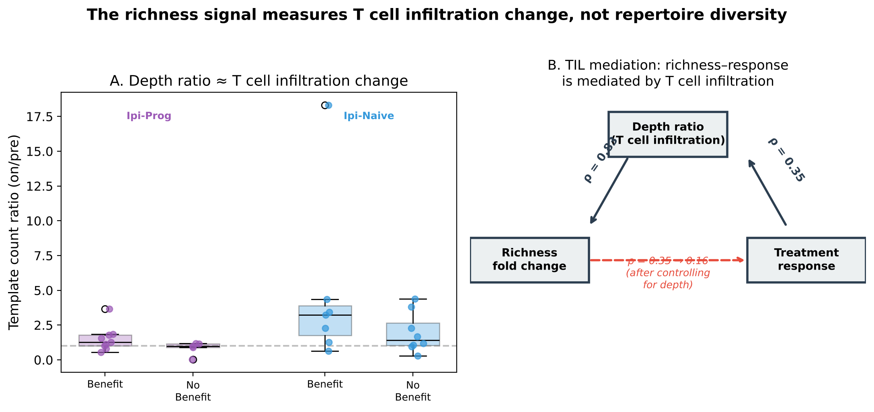
KEY INSIGHT
The Richness Signal Measures T Cell Infiltration, Not Diversity
Depth ratio ≈ TIL change: template counts reflect T cell content in the biopsy
Partial correlation: ρ drops from 0.35 to 0.16 (p = 0.41) controlling for depth
Additive to the paper: the richness signal is real — it measures infiltration change
This reframes the paper's finding: responders have more T cells on treatment, which drives the richness increase
Notes:
STATUS: NEW ANALYSIS. This is our strongest original analytical finding — a mediation analysis the paper did not perform.
WHAT WAS DONE: Spearman partial correlation between richness FC and response, controlling for template count ratio (depth ratio). The depth ratio serves as a proxy for TIL change because immunoSEQ captures T cell DNA.
RESULTS: Raw correlation: rho=0.348, p=0.064. After controlling for depth ratio: rho=0.162, p=0.411. The depth ratio mediates the richness-response relationship. Depth ratio correlates with richness FC at rho=0.82 and with TIL change at rho=0.827.
BIOLOGICAL SIGNIFICANCE: The paper's richness finding is not about repertoire diversity — it's about T cell infiltration. Anti-PD-1 works partly by increasing TILs, and patients who respond have a bigger increase. The richness metric was measuring this infiltration change all along. This reframes it as an infiltration biomarker rather than a diversity biomarker — additive, not a refutation.
METHODS: Spearman partial correlation (residual method). Response coded as binary. All 29 patients. Script: scripts/make_all_figures.py (figure), ad hoc session analysis (statistics).

Slide 7
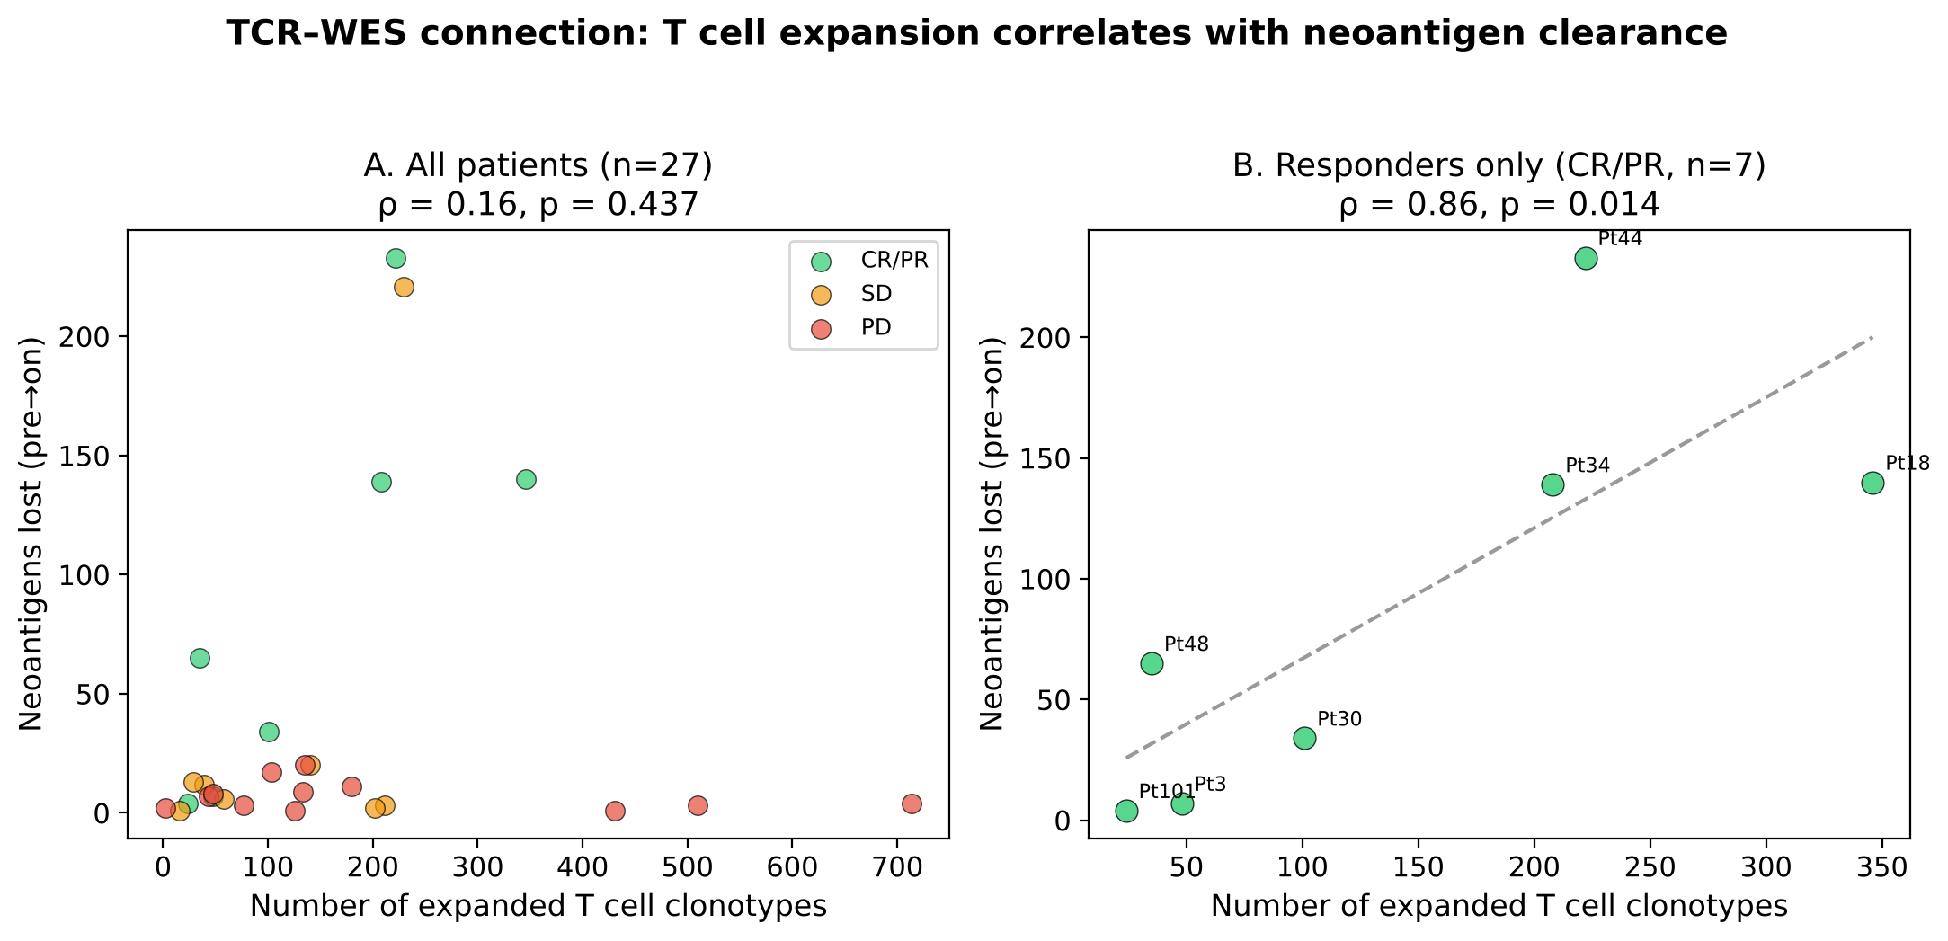
NEW ANALYSIS — TCR × WES
T Cell Expansion Correlates with Neoantigen Clearance
Responders (CR/PR): ρ = 0.86, p = 0.014 — strong link between expansion and neoantigen loss
Hypothesis-generating: n = 7 responders with both TCR and WES data; needs validation
The paper didn't test this: a connection between TCR dynamics and genomic tumor evolution
27 patients with paired TCR-seq and WES clonality data · Neoantigen loss from PyClone subclonal analysis
Notes:
STATUS: NEW ANALYSIS. The paper analyzed TCR and WES data separately but never connected them. This is a novel cross-modality analysis.
WHAT WAS DONE: Linked TCR expansion results to WES neoantigen depletion data from the paper's clonality table (PyClone subclonal analysis, 21,696 mutations). For each patient, counted neoantigens lost (pre.is.neo=True and on.is.neo=False). Correlated with number of expanded clonotypes.
RESULTS: Overall (n=27): weak (rho=0.16, p=0.437). Responders only (CR/PR, n=7): rho=0.857, p=0.014 — strong, significant correlation. Non-responders (PD, n=12): novel clonotype count correlates with neo_lost (rho=0.744, p=0.006), likely a size/depth confound.
BIOLOGICAL SIGNIFICANCE: The most biologically compelling new finding. In responders, more expanding T cells = more neoantigens cleared. Interpretation: expanded T cells target neoantigen-bearing tumor clones (immunoediting). This connects two hallmarks of successful immunotherapy.
CAVEATS: n=7 is strictly hypothesis-generating. Correlation does not prove causation. Neoantigen annotations from the paper's PyClone analysis, not recomputed.
METHODS: Fisher exact expansion + BH FDR. Neoantigen loss from clonality.data.table.pyclone.95.ci.txt. Spearman correlation. Script: scripts/make_all_figures.py.

Slide 8
Summary
Validated
New: Clonotype Tracking
New: TCR × WES
Pipeline reproduces all published TCR metrics and group-level statistics from Riaz et al.
75–99% of on-treatment clonotypes are novel. ~47% of expanded clones were not detected at baseline.
In responders, T cell expansion correlates with neoantigen clearance (ρ = 0.86, p = 0.014, n = 7).
Depth Context
Methods
Limitations
The paper's richness signal is mediated by T cell infiltration change (ρ drops 0.35 → 0.16). Additive, not a refutation.
All standard: Fisher exact, hypergeometric rarefaction, exact Mann-Whitney, Spearman correlations, BH FDR.
Small cohorts (n = 7–16 per group). Per-cohort AUC 0.70 has only 25% power. All depth-matched response metrics are null.
Notes:
SUMMARY OF WHAT IS REPRODUCED vs NEW:
REPRODUCED: (1) Pipeline validation — richness exact match, clonality within 0.0005, Fig 5B p-values match. (2) Raw diversity analysis — reproduces the paper's richness fold change result.
NEW ANALYSIS: (1) Clonotype tracking — 75-99% novel on-treatment. (2) Expansion composition — ~47% of expanded clones are novel. (3) TCR-WES connection — rho=0.86, p=0.014 in responders (n=7).
EXPANDED: (1) Depth context — richness FC tracks depth ratio at rho=0.82; depth-matched metrics all null. (2) TIL mediation — partial correlation drops from 0.35 to 0.16.
COMPLETE METHODS: Productive filter. Clonotype levels: CDR3aa (diversity), CDR3aa+V+J (tracking/expansion). Rarefaction: multivariate hypergeometric, 20 draws, seed 1. Expansion: one-sided Fisher exact, BH FDR 0.05. Mann-Whitney: exact when no ties. AUC = P(responder > non-responder), percentile bootstrap CI. Spearman correlations. Partial correlation: residual method.
LIMITATIONS: (1) 7-16 patients per group. Min detectable AUC 0.93 at 80% power. (2) All depth-matched metrics null. (3) TCR-WES n=7, hypothesis-generating. (4) Novel clonotypes may include unsampled baseline clones.
SCRIPTS: validate_metrics.py, run_tracking.py, run_expansion.py, run_diversity.py, run_response.py, make_all_figures.py.

