Slide 1
How tumors and T cells change when nivolumab works
A reanalysis of Riaz et al., Cell 2017: WES, TCR-seq and RNA-seq
Kwaku (WES) · Krithika (TCR) · Ethan (RNA)

Slide 2
Riaz et al. biopsied melanomas before and during nivolumab to see what changes when PD-1 blockade works
1
2
3
4
Biopsy 1
Nivolumab
Biopsy 2
Response
Before the first dose
Anti-PD-1: releases the T-cell brake
About 4 weeks in
PR/CR shrank · SD stable · PD grew
CheckMate 038 · advanced melanoma · ipilimumab-naive and ipilimumab-progressed cohorts
Tumor DNA
T-cell receptors
RNA
Responders' tumors lose mutations and neoantigens
T-cell clones expand in responders
Immune genes rise; cell-cycle and melanin genes fall
Notes:
Nivolumab is an antibody that blocks PD-1, the brake on T cells. In the CheckMate 038 trial, Riaz and colleagues took a biopsy from patients with advanced melanoma before the first dose and again about four weeks in, and sequenced the tumor DNA, the T-cell receptors and the RNA. Half the cohort had never had ipilimumab; the other half had already progressed on it. Their headline: in responders the tumor loses mutations, T-cell clones expand, and immune genes switch on. We re-analyzed their public data to test each of those claims. [~40 s]

Slide 3
We follow the biology in order: the targets, the T cells that respond, then what the tissue is doing
1
WES
Kwaku
2
TCR-seq
Krithika
3
RNA-seq
Ethan
Which mutations and neoantigens exist, and are they lost on treatment?
Which T-cell clones respond and expand?
What is the biopsy doing: immune activity and remaining tumor?
→
→
Why this order? DNA sets the targets, TCR shows who attacks them, and RNA shows the outcome in the tissue, linking both.
Notes:
We present three data types in this order. Kwaku starts with whole-exome sequencing: which mutations, and so which targets, the tumor has, and whether they disappear. Krithika follows with T-cell receptor sequencing: which T-cell clones respond and expand. I finish with RNA, which reads out the whole biopsy at once, both the immune activity and the tumor that is left, so it ties the other two together and leads into our comparison. [~30 s]

Slide 4
RNA-seq turns each biopsy into gene and program scores, compared within each patient
1
2
3
4
Count genes
Normalize
Score programs
Compare biopsies
Authors' read counts; 19,578 genes pass the filter
Correct for sequencing depth (DESeq2 VST)
Average marker genes: CD8, IFN-γ, tumor (melanocytic)…
On vs Pre per patient: DESeq2 genes, fgsea pathways
49
patients with a pre-treatment biopsy
42
with both biopsies (main comparison)
9 · 15 · 18
paired PR/CR · SD · PD
Notes:
My part is the RNA. We start from the authors' read counts, 19,578 genes after filtering. We normalize for sequencing depth, then average marker genes into scores, for example CD8 T cells, interferon-gamma, and a tumor score built from melanoma identity genes. Then we compare each patient's two biopsies, so every patient is their own control. That matters because melanomas differ so much from person to person that a between-patient comparison would mostly measure those differences. 49 patients have a pre-treatment biopsy, and 42 have both. [~30 s]

Slide 5
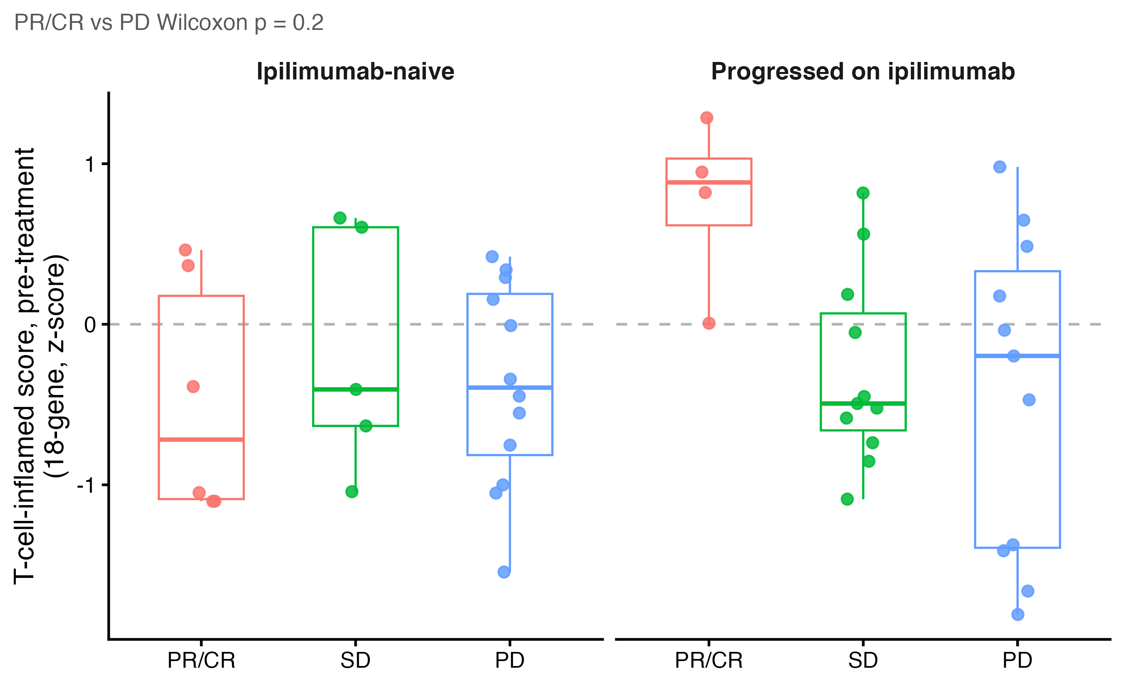
Before treatment, immune activity only weakly predicts who will respond
Medians: PR/CR 0.19, SD −0.47, PD −0.34
PR/CR − PD +0.53; 95% CI −0.73 to +1.33 crosses zero
Ipilimumab-progressed responders start 'hot'
Recreates the paper
Paper: baseline expression only marginally predictive, split by ipilimumab cohort. Our change: one fixed 18-gene score (Ayers 2017) instead of genome-wide testing.
Notes:
First question: does immune activity before treatment predict response? Each dot is one patient's T-cell-inflamed score, a published 18-gene measure of how immune-active a tumor is. Responders sit a little higher, but the difference from progressors, 0.53, has a confidence interval that crosses zero. The one clear pattern is on the right: responders who had already failed ipilimumab all start with 'hot' tumors. That matches the paper, which also called baseline expression only marginally predictive. In the patients who had never had ipilimumab, responders and progressors overlap almost completely. So a single snapshot before treatment is not enough; to understand response, we need to look at what changes during treatment. [~50 s]

Slide 6
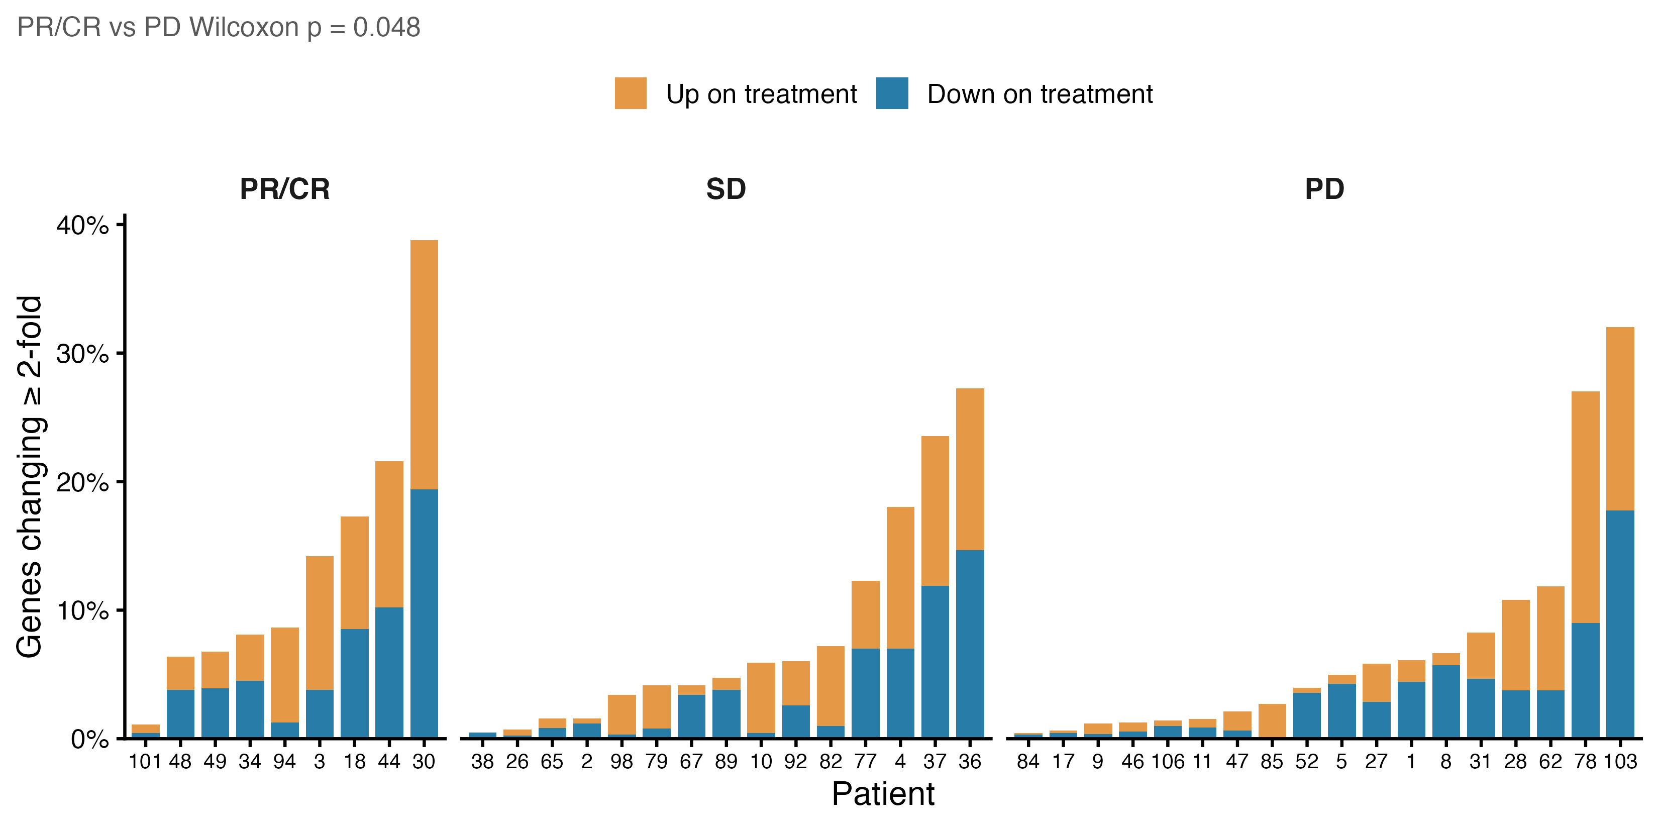
On treatment, responders' genes shift more, and far more consistently, than progressors'
Median genes changing 2-fold: 8.6% PR/CR vs 4.5% PD
Genes shifting together (DESeq2, FDR < 0.1): 3,582 PR/CR, 28 SD, 0 PD
Builds on the paper
Paper counted On vs Pre DE genes; we could not reproduce its exact counts (before treatment: 397 ours vs 189 paper). New: per-patient view and a repeat-library noise floor (~3%).
Notes:
Next, the two biopsies. Each bar is a patient: the share of genes that went up, in orange, or down, in blue, at least two-fold. Responders change more, a median of 8.6% of genes against 4.5% in progressors. But the bigger difference is consistency. When we ask which genes shift together across a group, we find 3,582 in responders, 28 in stable disease and 0 in progressors. For scale, two sequencing runs of the same biopsy already differ by about 3 percent of genes, so the raw amount of change is modest. Responders move in a shared direction; progressors, when they change, change in their own way. [~50 s]

Slide 7
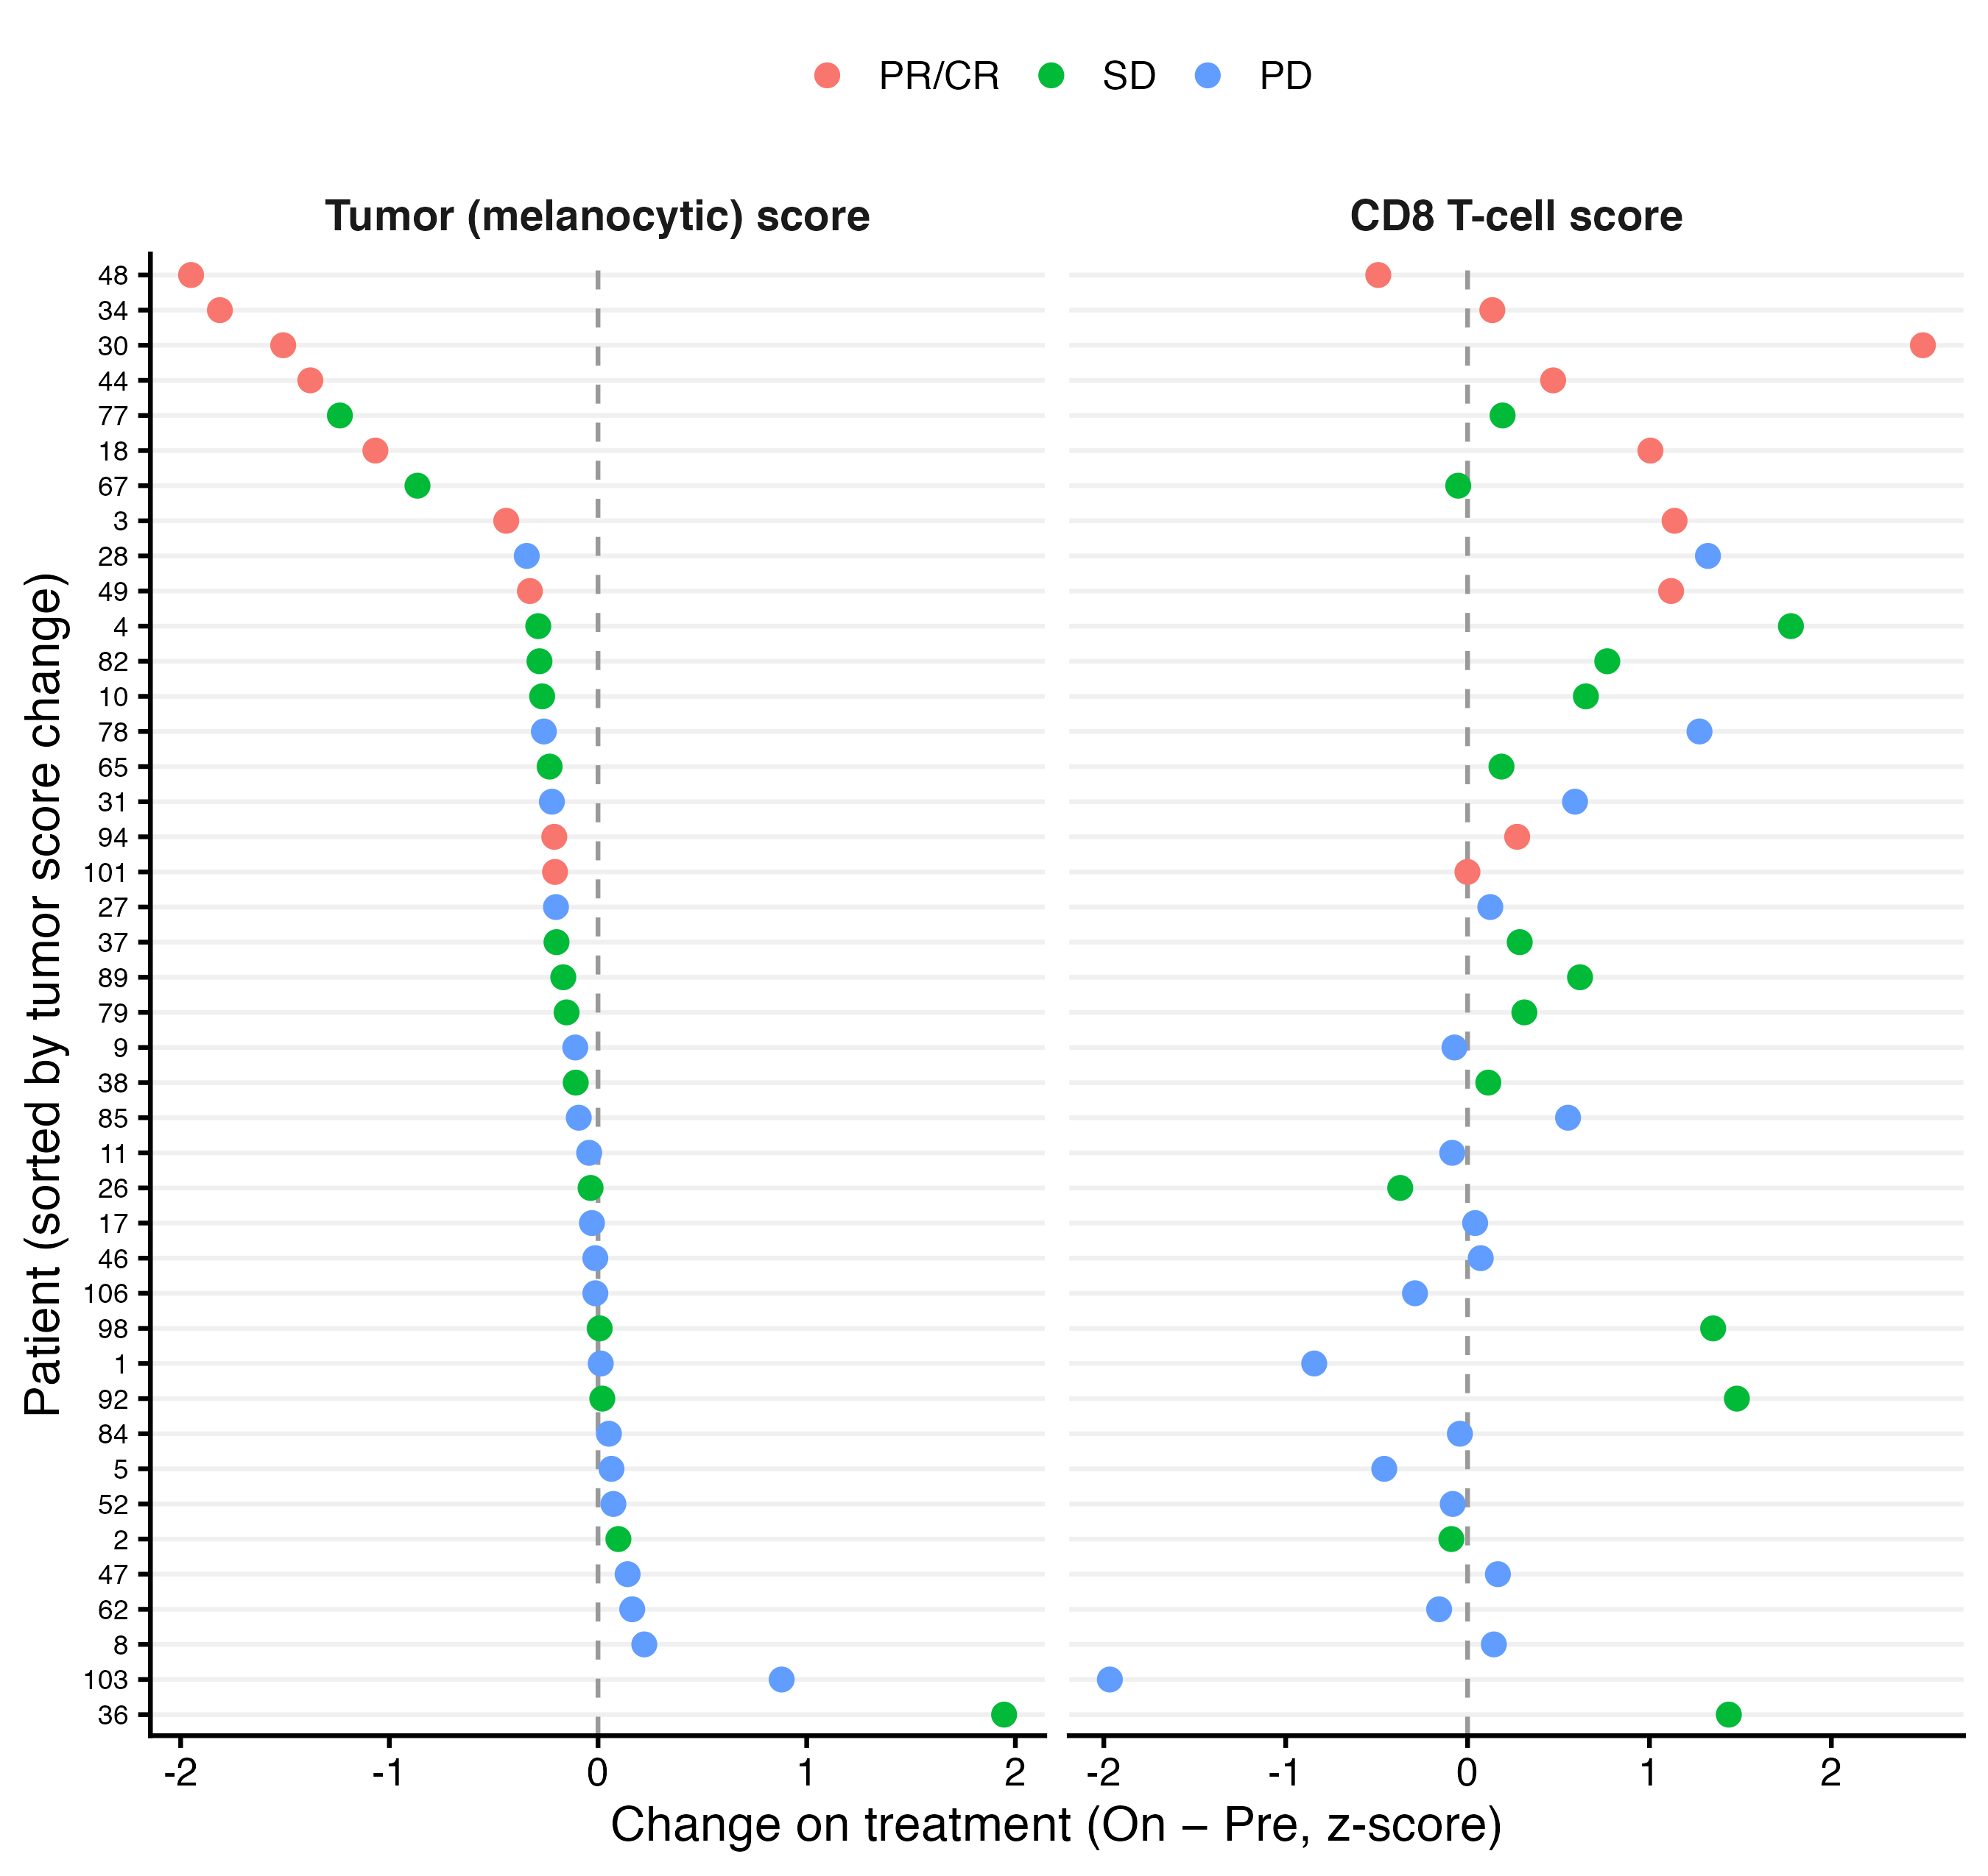
Tumor loss, more than immune gain, marks a response
Tumor score: PR/CR −1.07 vs PD −0.01 (p ≈ 0.0002)
CD8 score: PR/CR +0.47, SD +0.31, PD 0.00 (p ≈ 0.07)
Exceptions: Pt94 and Pt101
New beyond the paper
Paper showed melanin pathway genes falling in responders. We turn this into a per-patient tumor score and line it up against CD8 change.
Notes:
So which genes are changing? Each row is a patient, sorted by the change in a tumor score made from five melanoma identity genes, like MLANA and tyrosinase. Responders, in red, cluster at the top with the biggest drops: a median of −1.07 against −0.01 in progressors, p about 0.0002. On the right, the CD8 T-cell score rises in responders, but it also rises in stable disease, and the responder-versus-progressor test is only p about 0.07. It isn't universal: patients 94 and 101 respond with almost no change in the tumor score. But overall, the clearest RNA sign of response is the tumor disappearing from the biopsy. [~50 s]

Slide 8
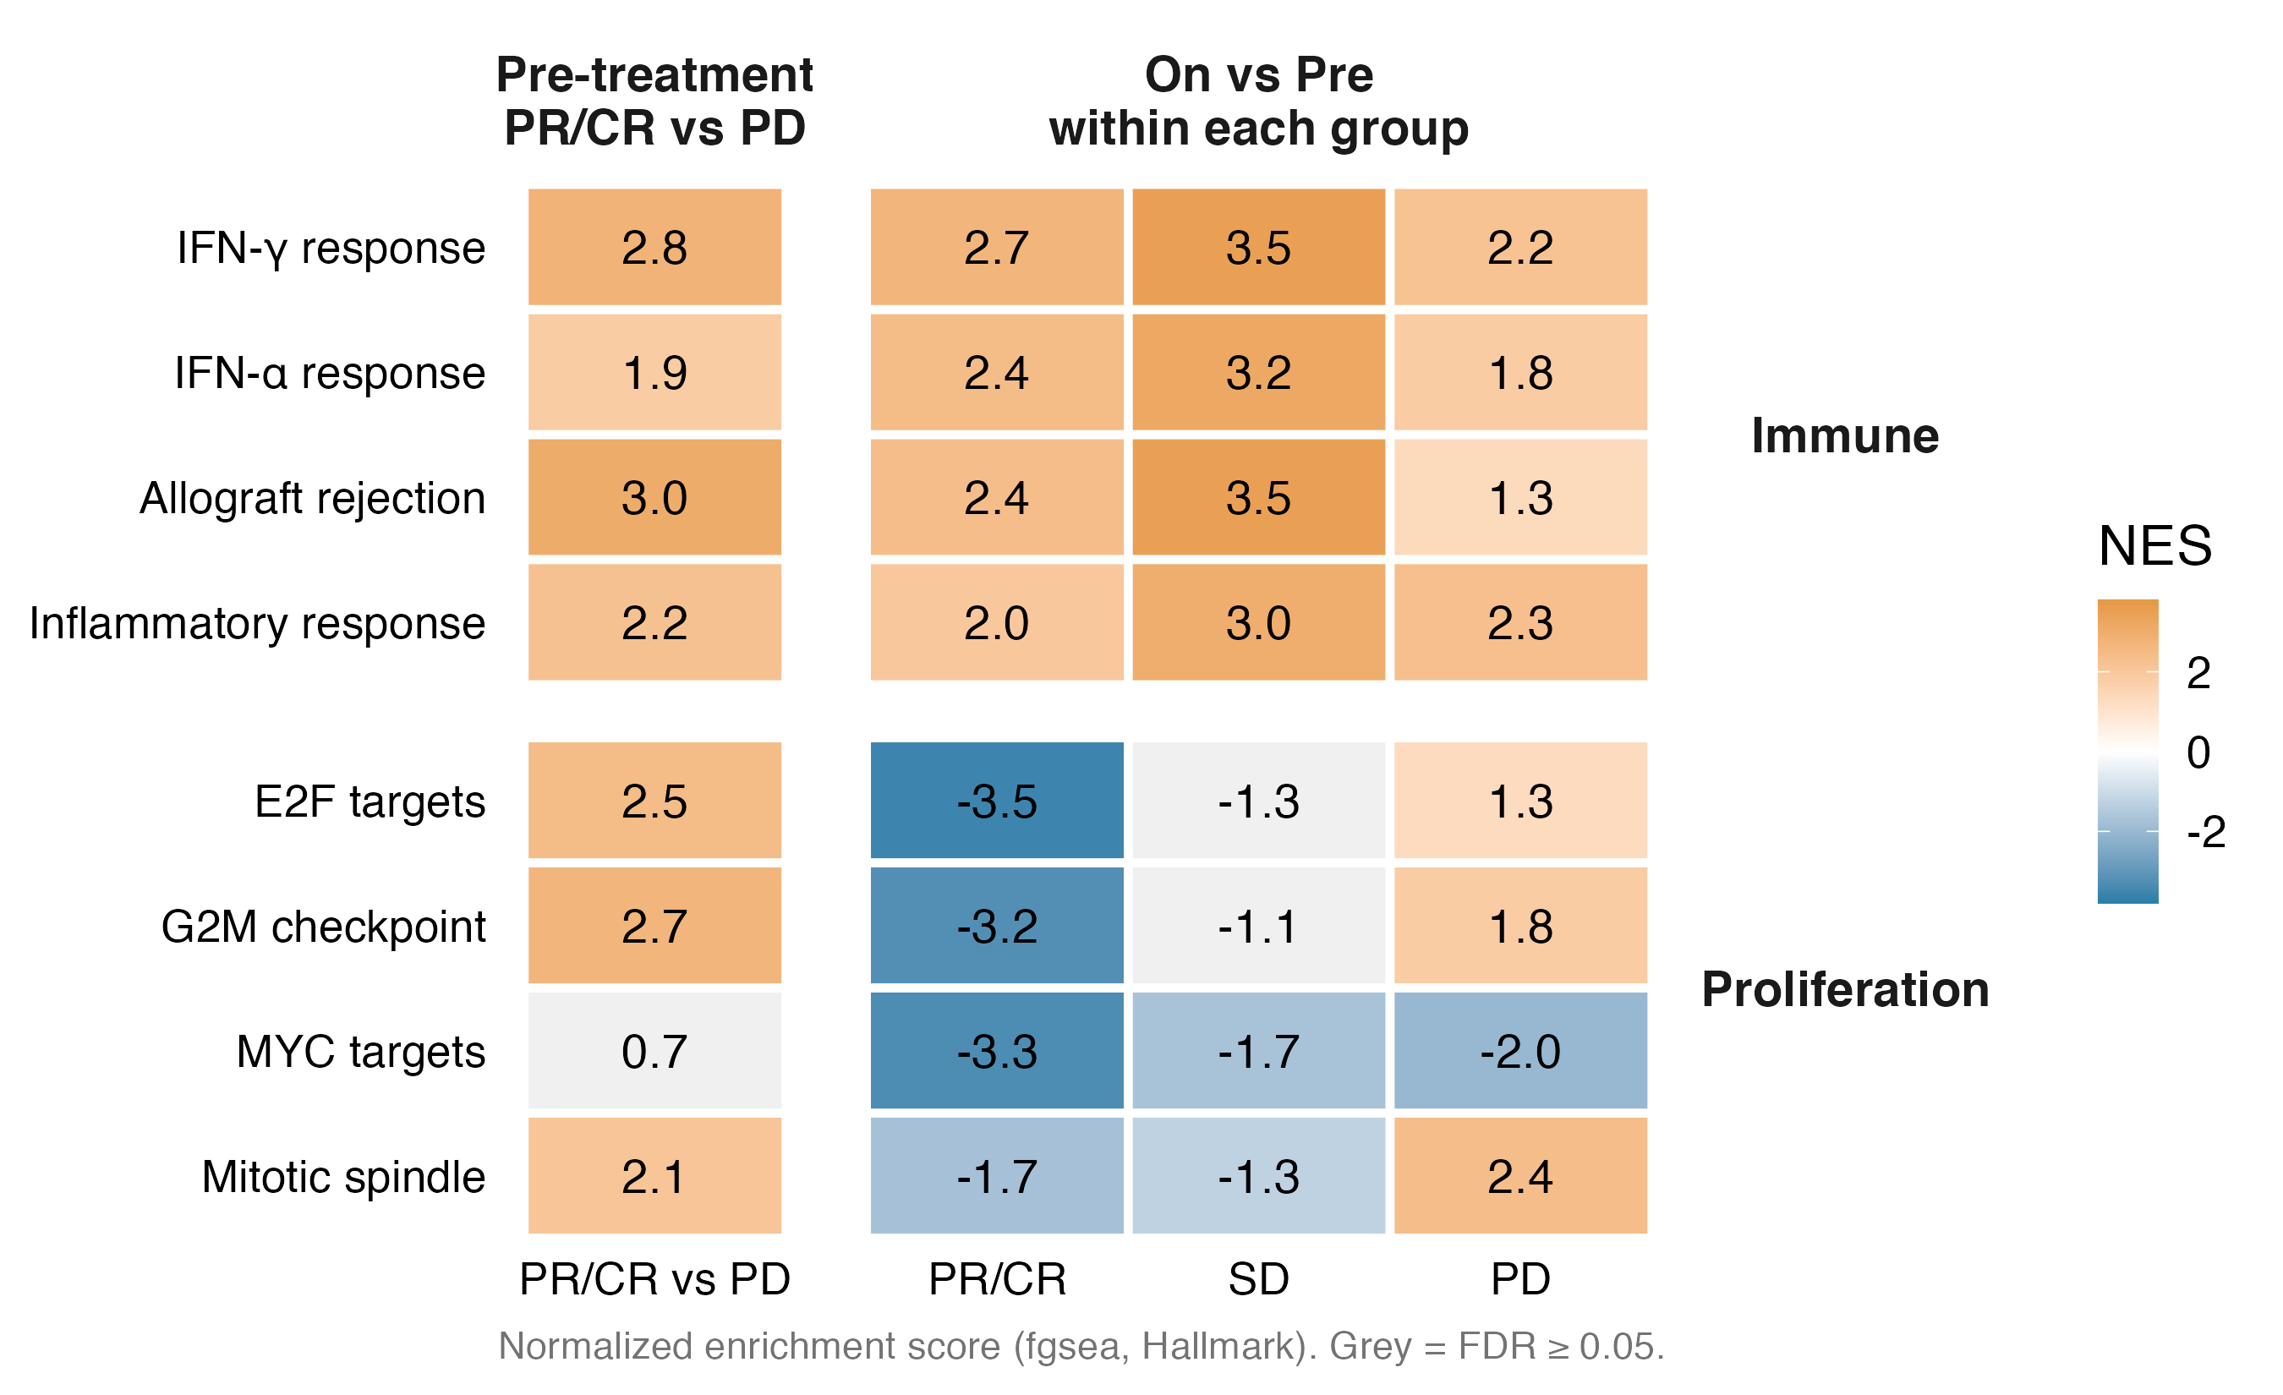
Immune pathways rise in every group; only responders shut down proliferation
IFN-γ: +2.7 PR/CR, +3.5 SD, +2.2 PD
E2F targets: −3.5 PR/CR vs +1.3 PD
Recreates the paper
Paper: immune genes up and cell-cycle genes down in responders (GSEA). Our change: Hallmark sets with fgsea, plus SD and PD columns so the contrast between groups is visible.
Notes:
Pathways show the same thing across thousands of genes. Orange means up on treatment, blue down, grey not significant. The top block is immune pathways: interferon-gamma rises in every group, even progressors at +2.2. The bottom block is proliferation: it collapses only in responders, E2F targets at −3.5, while progressors' tumors keep dividing. This recreates the paper's result, immune up and cell cycle down in responders, and adding the other groups shows that immune activation alone is not enough. [~45 s]

Slide 9
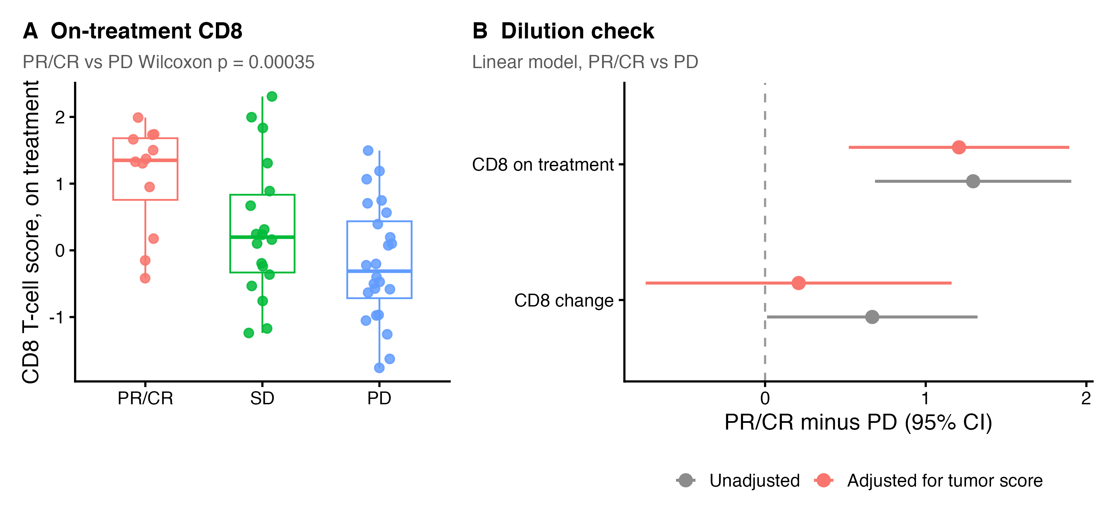
The on-treatment CD8 level is the immune signal that survives the tumor-dilution check
CD8 rise: +0.67 → +0.21 after adjustment
On-treatment CD8: +1.30 → +1.21, still clear of zero
New beyond the paper
Bulk RNA is a mixture: when tumor cells die, other cells' share grows. We add an adjustment for tumor content.
Notes:
One catch with bulk RNA: it is a mixture. When tumor cells die, immune cells become a bigger share of what's left, even if no new T cells arrive. So we adjusted for the tumor score. The responder CD8 rise drops from +0.67 to +0.21, so it can't be separated from dilution. But the on-treatment CD8 level holds, +1.30 before and +1.21 after. So by week four, responders' tumors are gone and what remains is full of CD8 T cells. That's the RNA story, and it leads into how RNA compares with the TCR data. [~45 s]

Slide 10
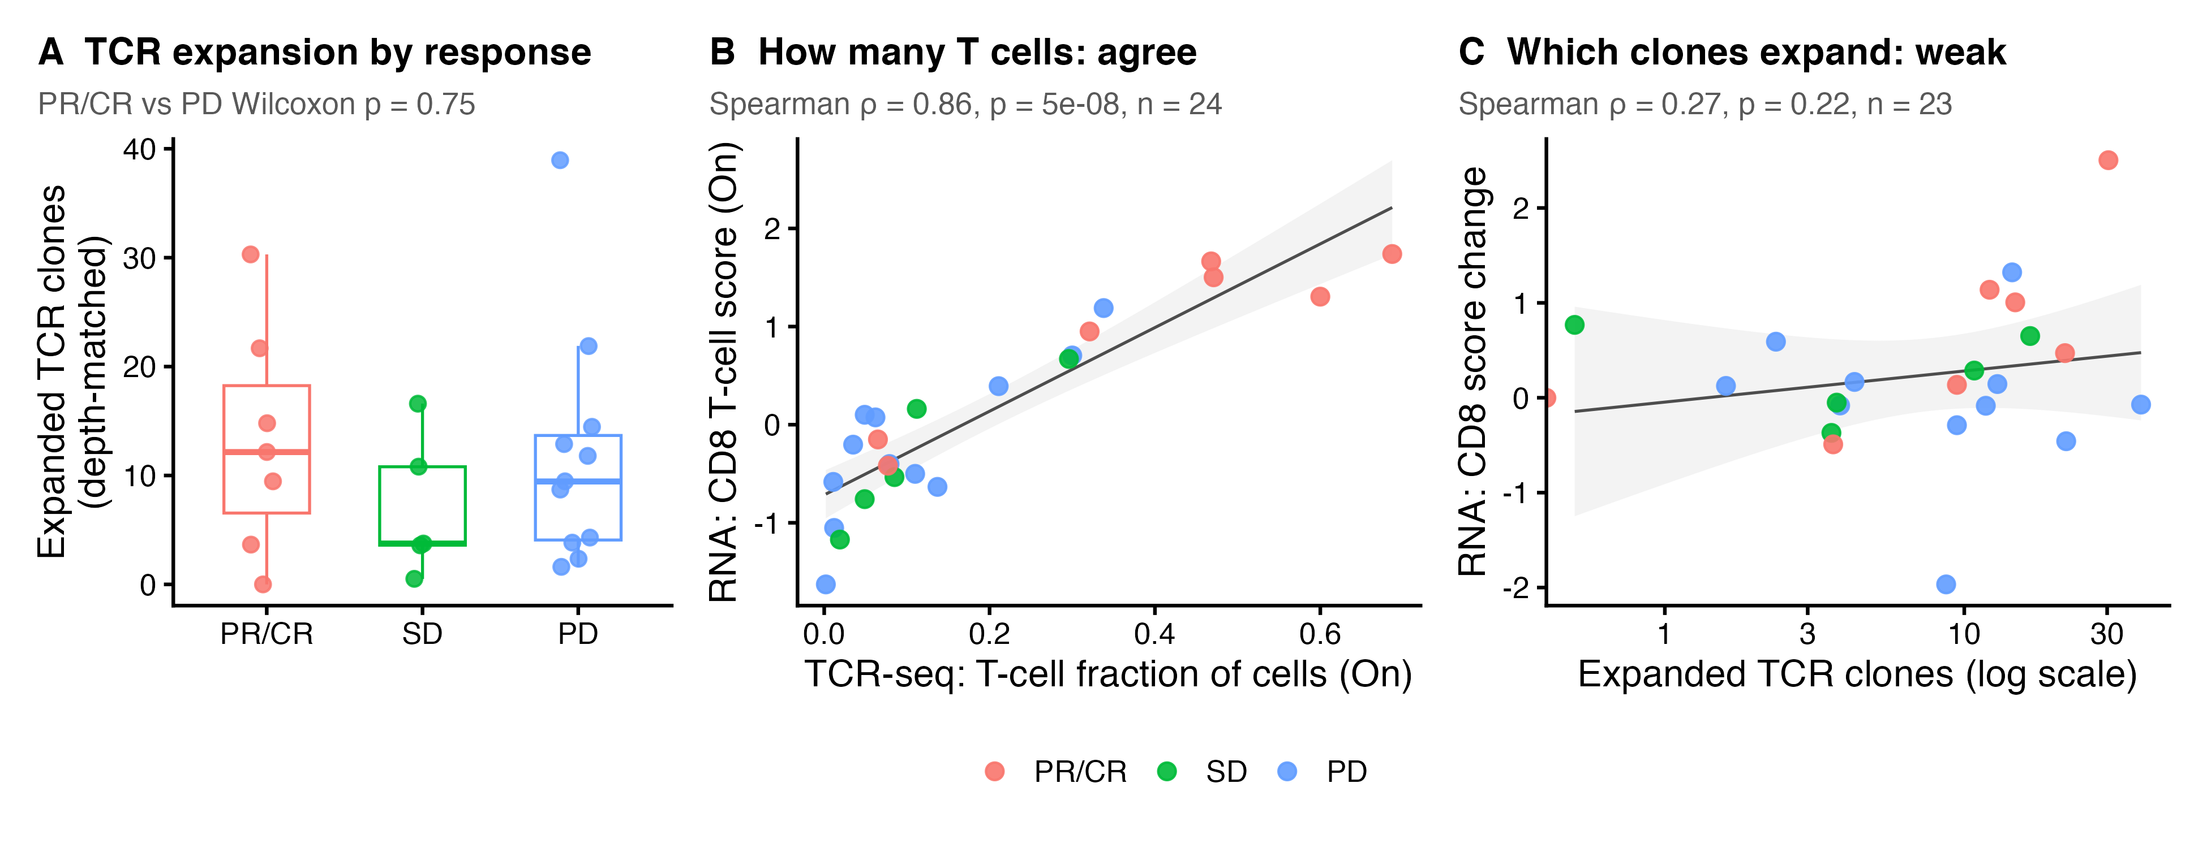
RNA and TCR agree on how many T cells are present, but only TCR-seq sees which clones expand
Modality comparisons
WES vs TCR
Kwaku & Krithika
WES vs RNA
Kwaku
TCR vs RNA
T-cell amount ρ 0.86; expansion vs CD8 change ρ 0.27
Expanded clones by response (depth-matched median): PR/CR 12, SD 4, PD 9; PR/CR vs PD p = 0.75 (n = 7 vs 12)
Panel A recreates the paper's expansion-by-response comparison; B and C are new links between modalities
Notes:
To compare modalities: RNA and TCR sequencing agree almost perfectly on how many T cells are in a biopsy, rho 0.86. But Krithika's count of expanding clones barely tracks any RNA score, for example rho 0.27 with CD8 change, and no expansion or clonality measure survives multiple-testing correction against any RNA score. So RNA measures the size of the immune response, and TCR-seq measures its clonal makeup: complementary, not redundant. [~35 s]

