Slide 1
Tracking tumor T-cell clonotypes
during anti-PD-1 therapy
A reanalysis and extension of the TCR processing in the Riaz et al paper

Slide 2
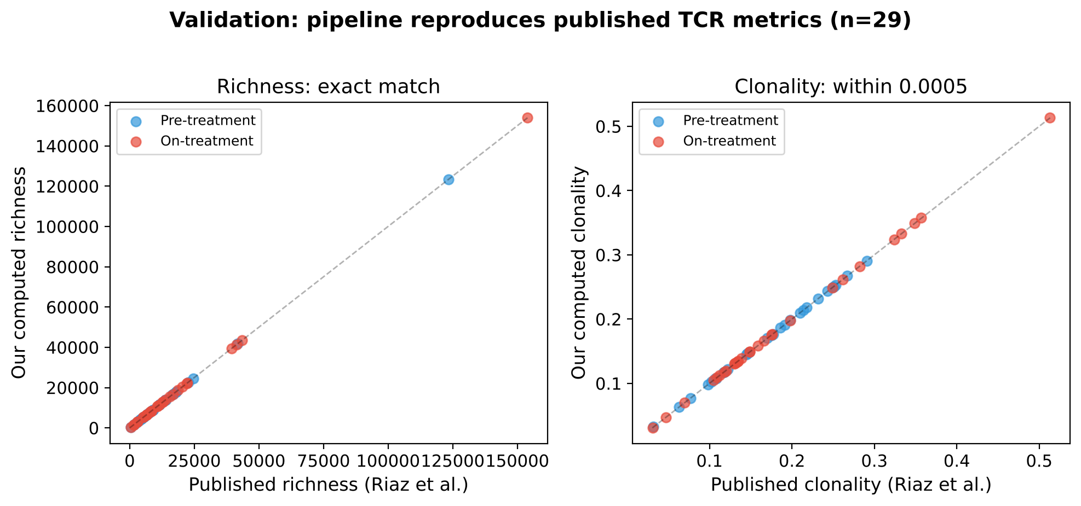
Published repertoire metrics are reproducible
58 paired samples
Richness matches; clonality differs by ≤ 0.0005.

Slide 3
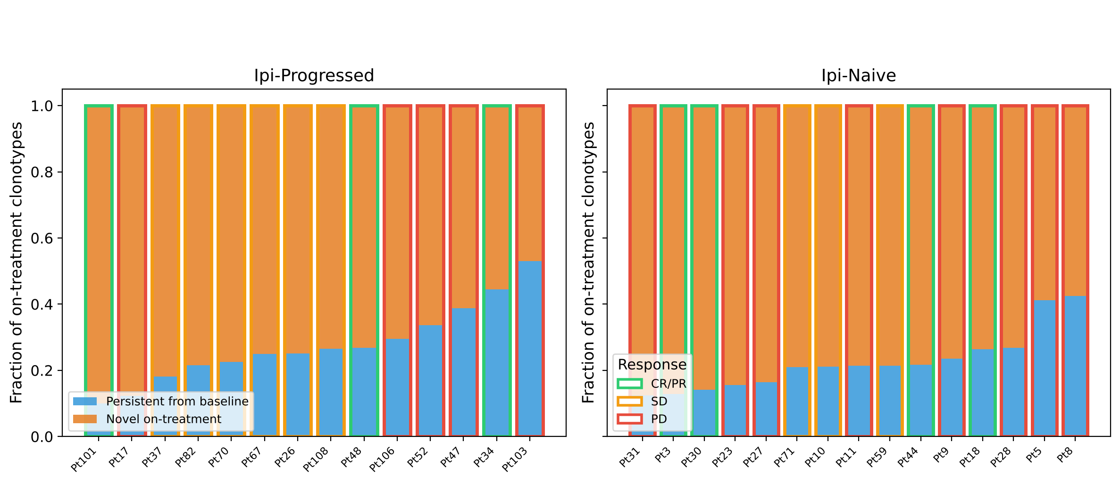
Most on-treatment clonotypes were baseline-undetected
75–99% of distinct on-treatment identities were not detected at baseline.
Identity = CDR3 amino acid sequence + V gene + J gene

Slide 4
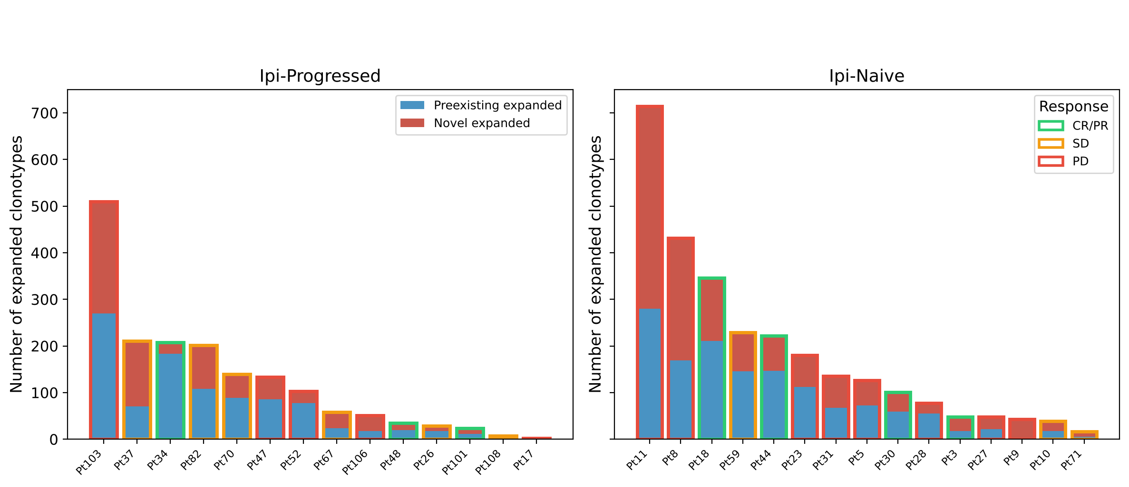
Expansion calls include baseline-undetected clonotypes
Significantly expanded clonotypes include both baseline-detected and newly detected sequences.
“Novel” in the figure are not baseline-undetected

Slide 5
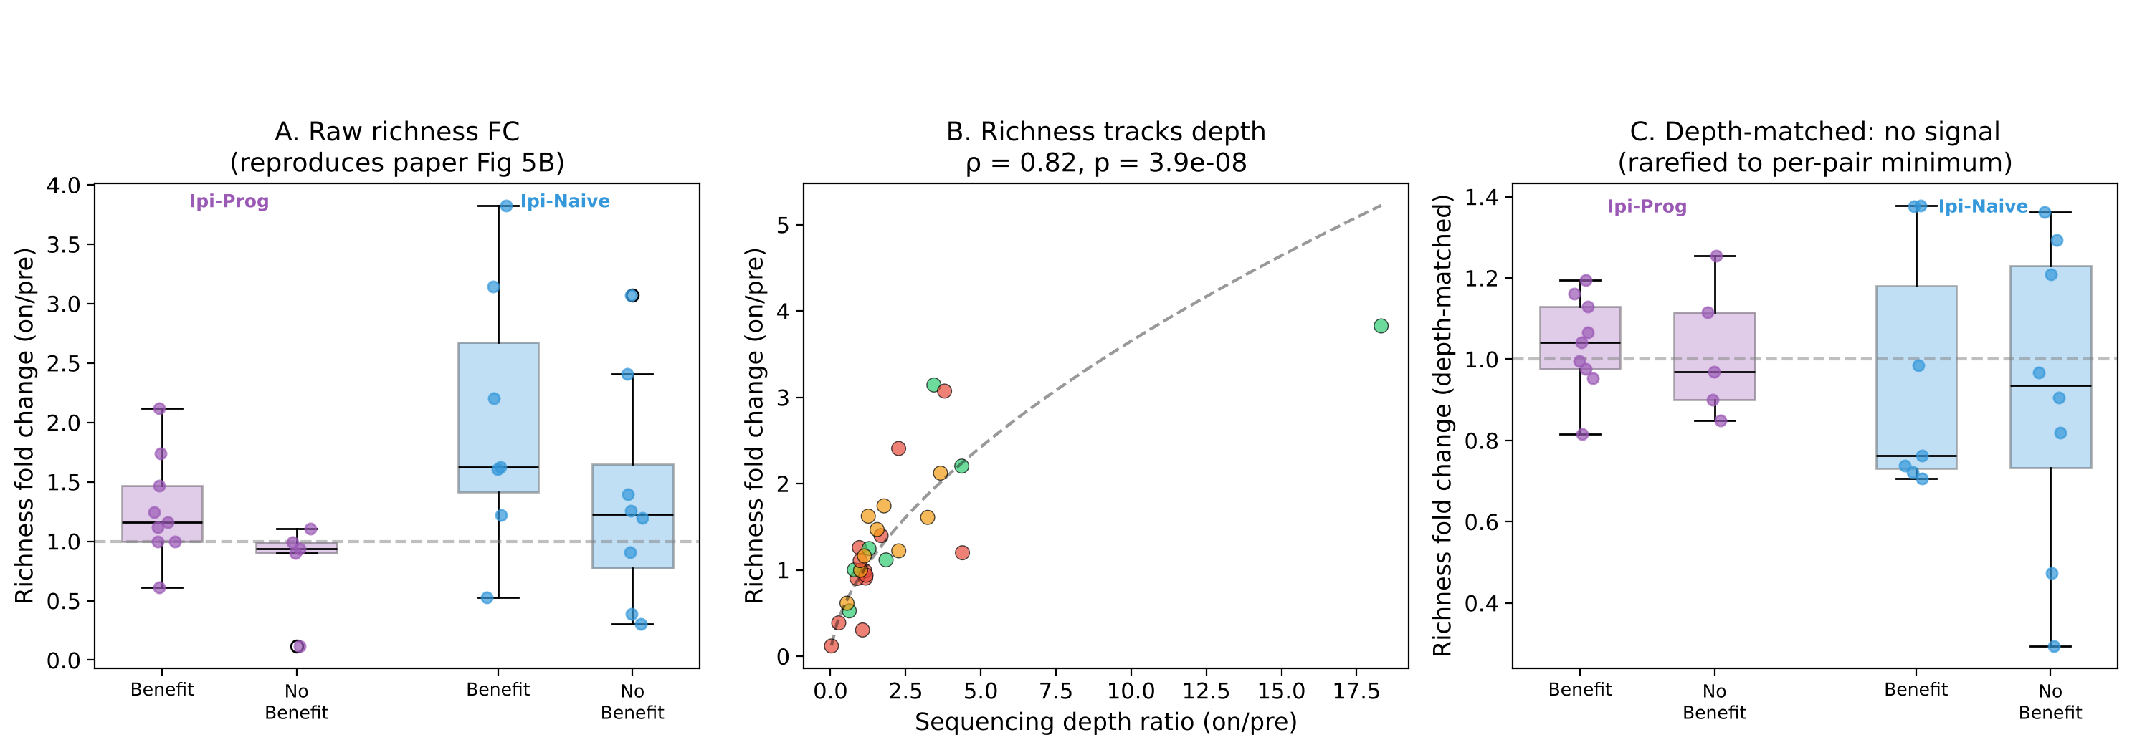
Richness–response patterns depend on sequencing depth
Raw Ipi-progressed comparison: p = 0.029 · Richness–depth: Spearman ρ = 0.82
Depth matching changes inference; whether the remaining signal reflects biology requires further study

Slide 6
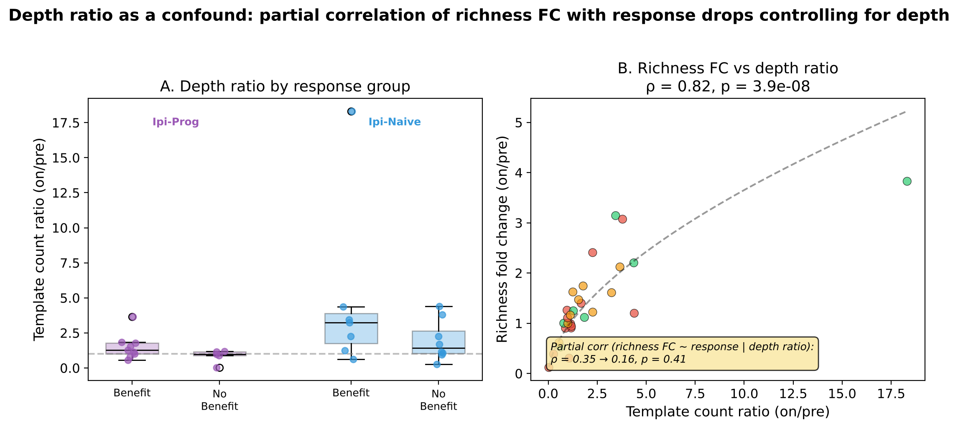
Depth ratio as a confound in richness–response
Partial correlation of richness FC with response drops after controlling for depth ratio
Formalizes the paper’s qualitative observation (Fig 5E) that diversity changes may reflect infiltration

Slide 7
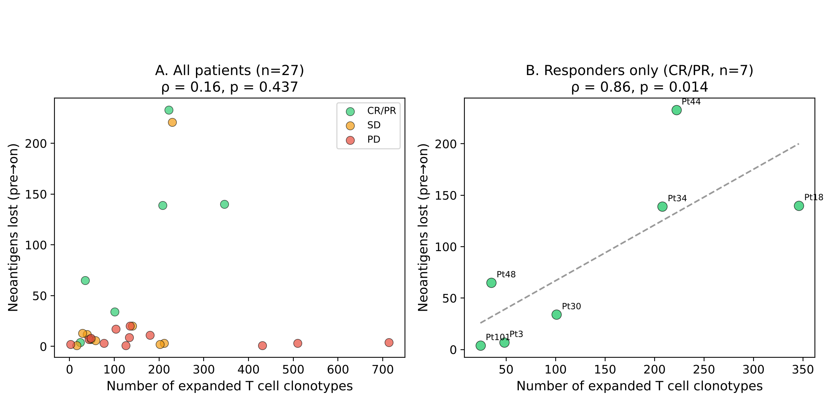
TCR expansion and predicted neoantigen loss
Reproduces paper Fig 6B · Responders (CR/PR): Spearman ρ = 0.86, p = 0.014 (n = 7)

Slide 8
What this reanalysis shows
Reproduction
Published richness and clonality metrics agree closely with our independent calculations.
Clonotype-level tracking
Most on-treatment identities were not detected at baseline; this does not prove recruitment.
Depth sensitivity and TCR–WES integration
Richness change is confounded by sequencing depth. TCR expansion correlates with predicted neoantigen loss in responders (n = 7), reproducing the paper’s Fig 6B finding.
LIMITATIONS 29 paired patients · depth and detection bias · 7 responders in TCR-WES analysis

