Slide 1
CA209-038 · RIAZ ET AL., CELL 2017
Tracking T cell clones through nivolumab
A depth-aware re-analysis of TCRβ clonotype replacement, expansion and diversity
29 patients with raw pre- and on-treatment tables · Python re-implementation validated against the authors’ metrics
Notes:
Overview of a re-implementation of the clonotype tracking, replacement, expansion and diversity analysis from Riaz et al. 2017. Everything here comes from the project outputs; 29 of the paper’s 34 TCR patients have raw tables in the authors’ repository.

Slide 2
Four analyses, one pipeline
1
2
3
4
Track
Replace
Expand
Diversify
Follow each CDR3 (amino acid plus V and J gene) from the baseline to the on-treatment sample.
Share of on-treatment templates and clonotypes that descend from baseline clones.
One-sided Fisher exact test per clone, with false discovery control inside each patient.
Richness, Shannon, evenness, Simpson and D90, raw and rarefied to a common depth.
Each step runs raw and depth-matched. Every non-standard processing choice is logged as a numbered assumption (A1 to A20).
Notes:
The pipeline is a Python re-implementation rather than the authors’ 2017 Python 2.7 code. Clonotype definitions: amino acid CDR3 for diversity, amino acid plus V and J for tracking and expansion. The assumptions table in the project README lists every processing choice.

Slide 3
The authors’ metrics reproduce from raw tables
Identical
0.0005
4 of 4
Richness, in all 29 patients with raw tables
Largest gap in clonality; D90 is within about 0.0002
Published Fig. 5B p-values, using the exact Mann-Whitney test as R does
Validated against the authors’ TCRmetrics.csv. The Fig. 5B evenness result depends on the authors’ exclusion of two patients (Pt28, Pt103); without it the Ipi-naive p-value is 0.136, not 0.036.
Notes:
The one earlier discrepancy (0.480 vs 0.489 for Ipi-naive richness) came from scipy defaulting to a normal approximation when both groups have more than 8 patients; R uses the exact test when there are no ties. With the exact test all four published p-values match.

Slide 4
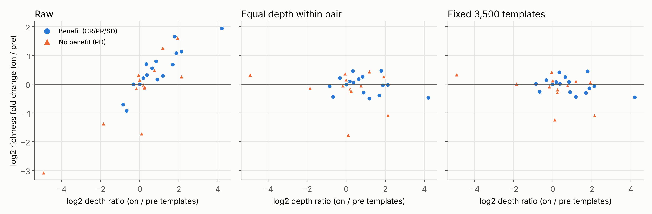
Raw richness change mostly reflects sequencing depth
Correlation with the on/pre depth ratio: ρ = +0.82 raw, −0.11 with equal depth in each pair, −0.30 at a fixed 3,500 templates.
Notes:
Each dot is one patient. Rarefaction downsamples without replacement and averages 20 draws. Fixed-depth results use 28 patients (one pair has fewer than 3,500 templates).

Slide 5
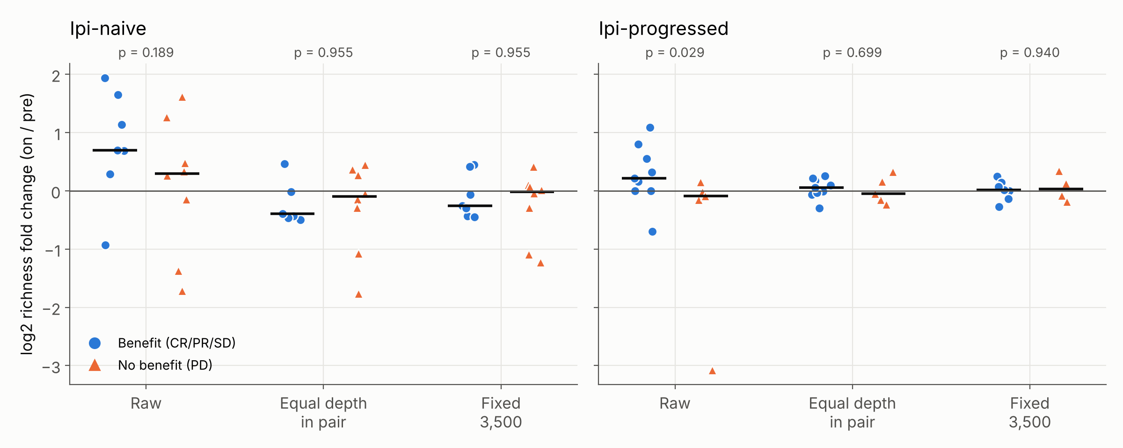
The Ipi-progressed richness association does not survive depth matching
Raw Ipi-progressed p = 0.029 (q = 0.29) becomes 0.70 and 0.94 after depth matching. Groups have 4 to 9 patients, so these tests are exploratory.
Notes:
Two-sided Mann-Whitney, benefit (CR/PR/SD) vs no benefit (PD), per cohort, on 29 of the paper’s 34 patients. The paper’s raw p of 0.016 uses all 34 patients. Q-values are Benjamini-Hochberg within each depth treatment.

Slide 6
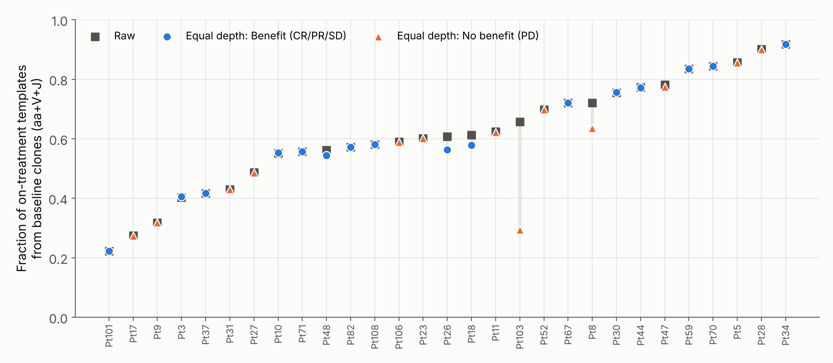
On-treatment repertoires are largely built from baseline clones
Median 61% of on-treatment templates, but only about 22% of clonotypes, descend from baseline clones. Pt103 changes most when depth is matched.
Notes:
Clonotype = CDR3 amino acid plus V and J gene. Raw medians: 0.608 of templates, 0.225 of clonotypes. Grey squares are raw values; coloured markers are the equal-depth values (blue circle benefit, orange triangle no benefit). The tracking definition (amino acid plus V and J) is not validated against the authors’ code.

Slide 7
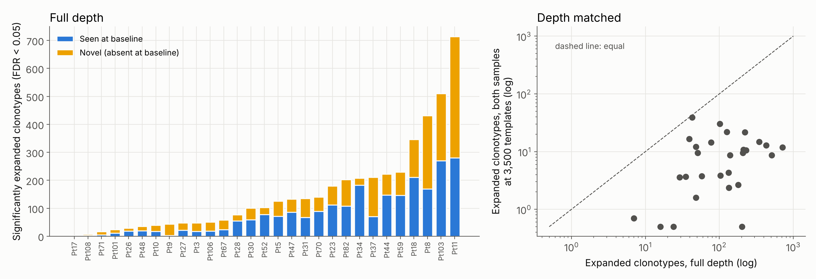
Expanded-clone counts depend heavily on depth
Median 103 expanded clonotypes at full depth versus about 9 with both samples cut to 3,500 templates. 47% of expansions are clones absent at baseline. A split-half null gave 0 significant calls in 58 samples.
Notes:
Expansion test: one-sided Fisher exact per clone, Benjamini-Hochberg FDR 0.05 within each patient, tested set = clones with at least 2 templates across both samples. In the right panel, zero counts are plotted at 0.5 on the log axes. The authors’ expanded-clone counts are not in the repository, so this analysis is not validated against theirs. The split-half null assumes sampling noise only, so it is a best case.

Slide 8
What the data support, and what they do not
Supported
Not supported yet
The authors’ diversity metrics and Fig. 5B statistics reproduce from raw tables.
Raw richness change tracks sequencing depth; depth matching removes that trend.
No overall pre-to-on shift in diversity is significant once depth is matched.
A response signal in richness or evenness change: groups have 4 to 9 patients.
Agreement with the authors on expansion: their expanded-clone counts are not public.
All 34 patients: 5 have no raw tables. Noise beyond sampling is unmeasured, with no replicates.
Notes:
The full list of processing choices is the assumptions table (A1 to A20) in the project README. Diversity group tests use no outlier exclusions and 29 patients.

Slide 9
Potential Next Steps
1
Link expanded clones to neoantigen data
Connect expansion calls to the repository’s neoantigen and clonal-structure data, in the spirit of the paper’s Fig. 6B.
2
Test sensitivity to processing choices
Drop singleton clonotypes (about 65% of clonotypes) and vary the clonotype definition, then recheck replacement and expansion.
3
Cross-check with an independent tool
Compare the diversity and overlap numbers against immunarch in R before relying on them.
Notes:
These are options, not commitments. Reconstructing TCRs from RNA-seq (TRUST4 or MiXCR) is a possible later phase but was left out of the planned scope.

