Slide 1
Team 4 Presentation
Ling Fang
Weigang Lin
Zhongai Shi
Runhao Yang

Slide 2
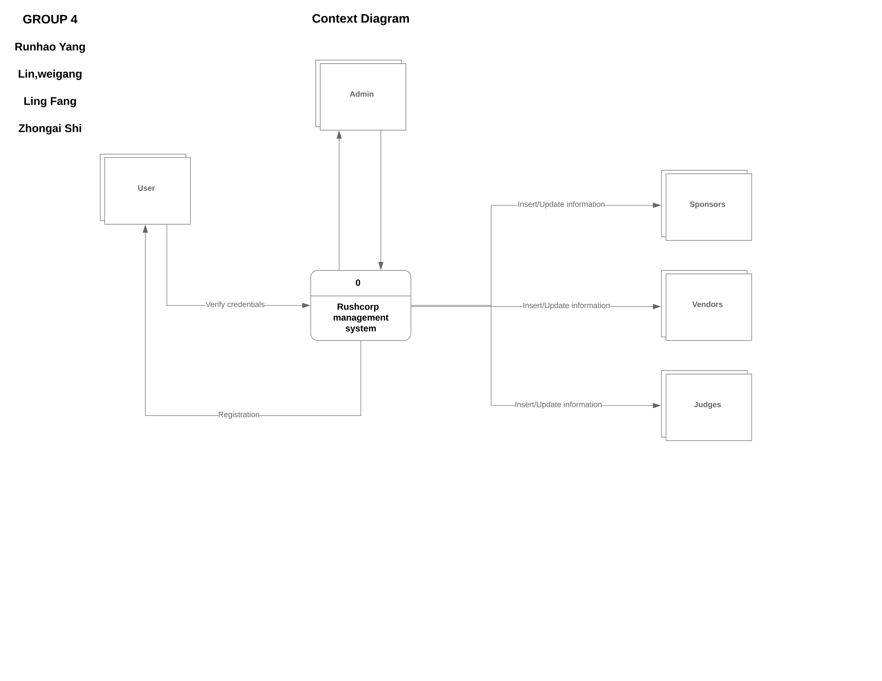
Project analysis slide 2
Context Diagram

Slide 3
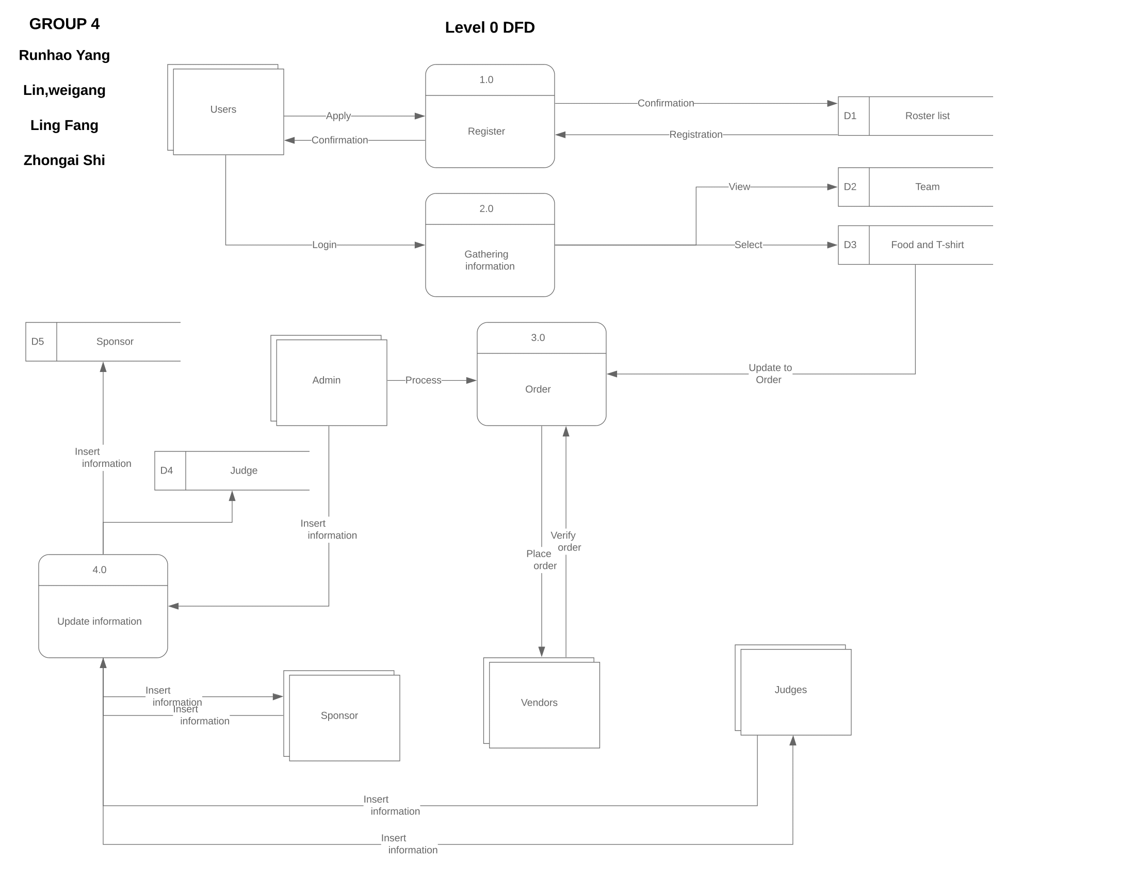
Project analysis slide 3
DFD-0

Slide 4
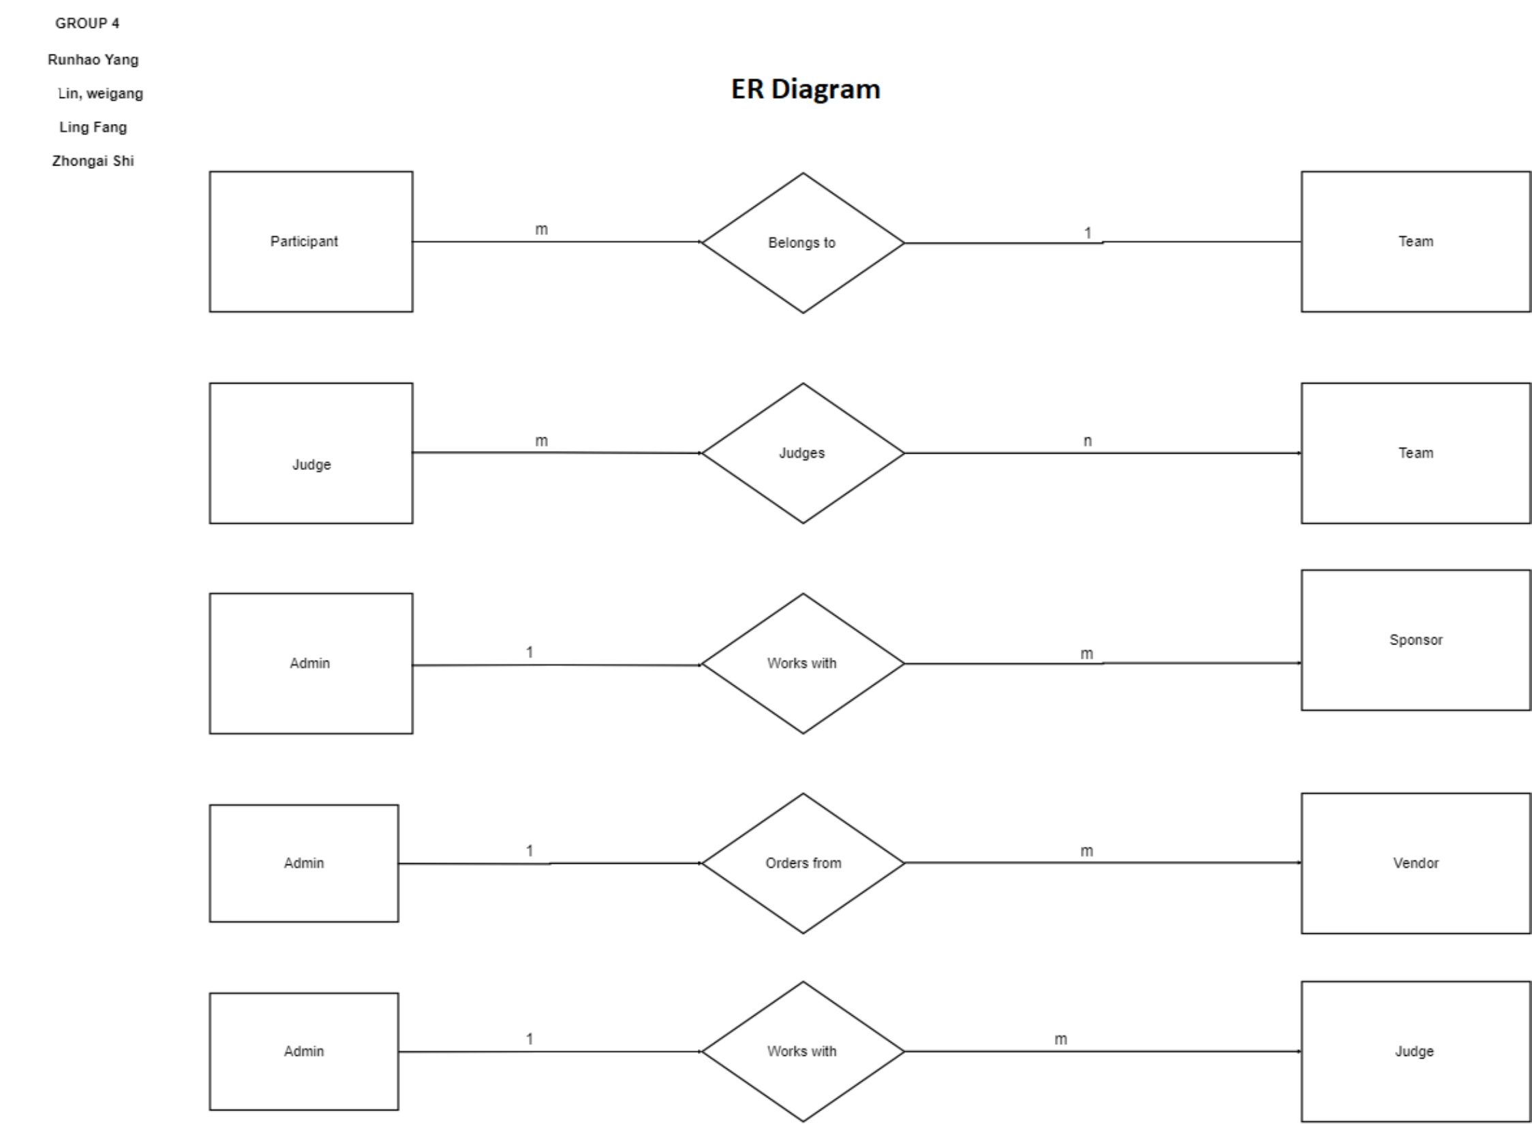
Project analysis slide 4
ER-Diagram

Slide 5
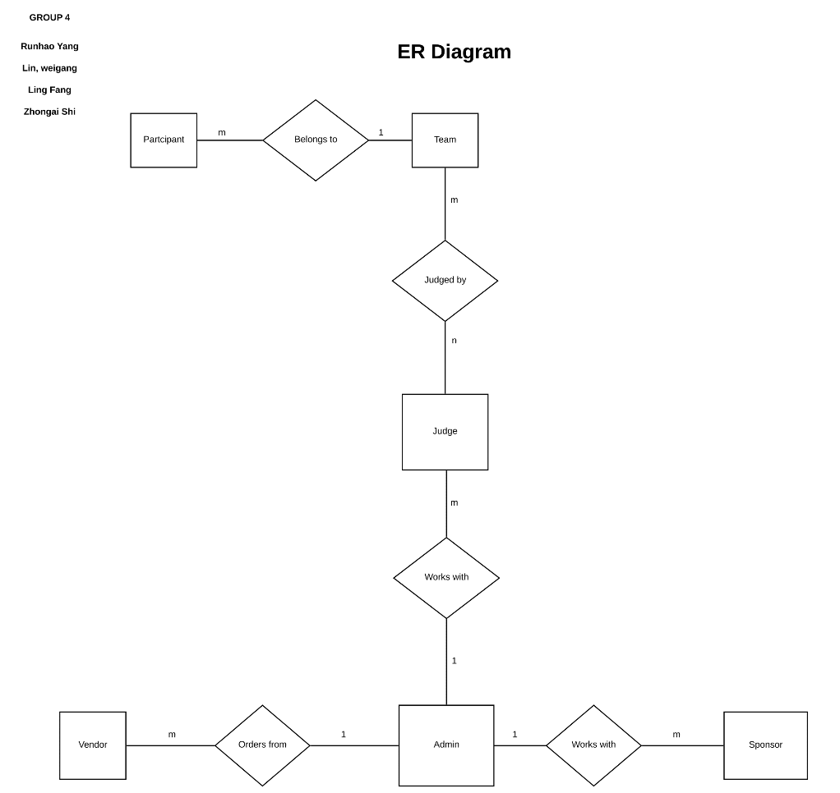
Project analysis slide 5
ER-Diagram continued

Slide 6
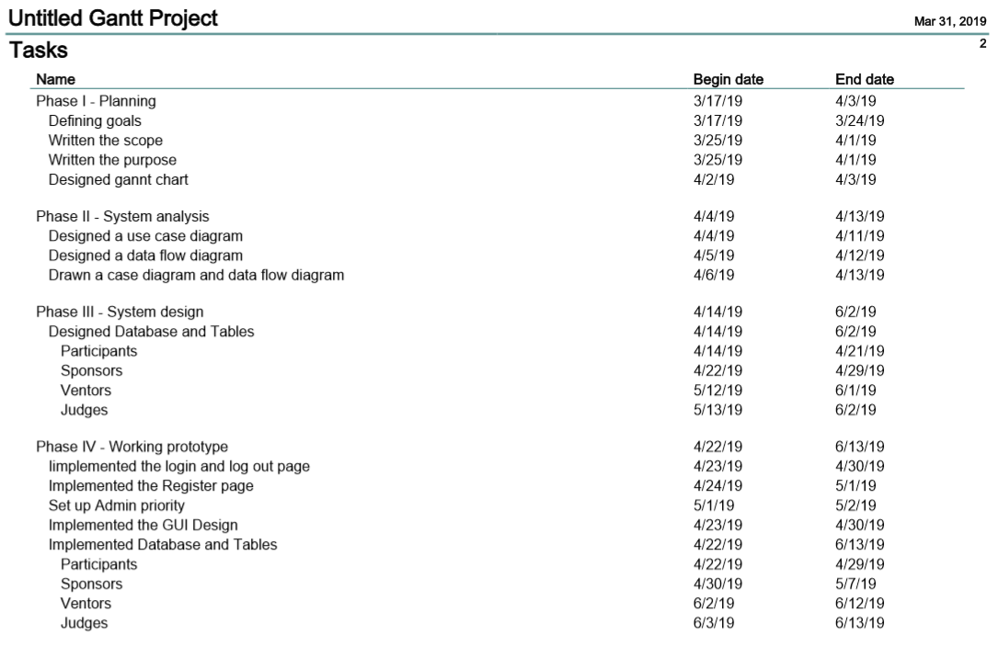
Project analysis slide 6
Gantt Chart

Slide 7
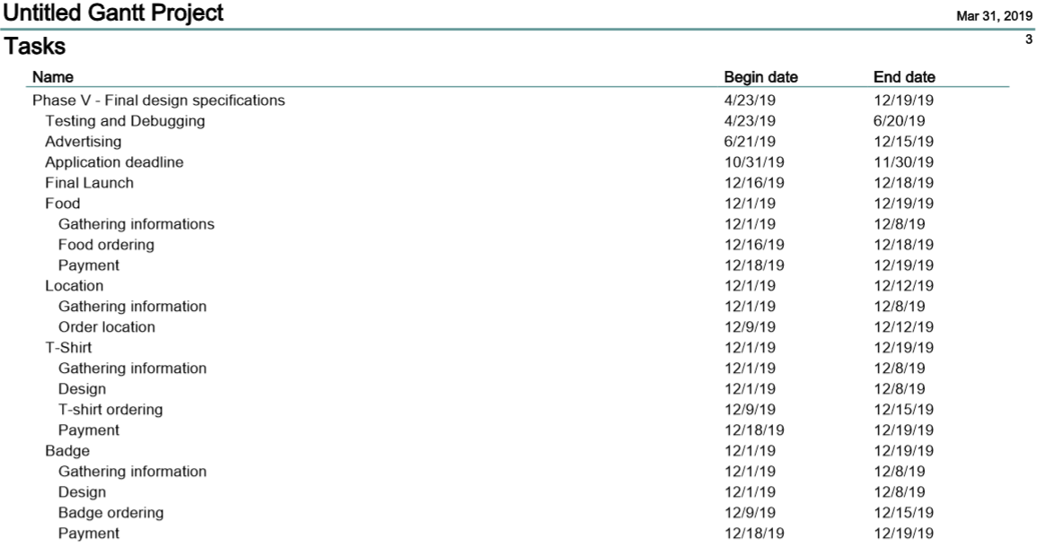
Project analysis slide 6
Gantt Chart

Slide 8
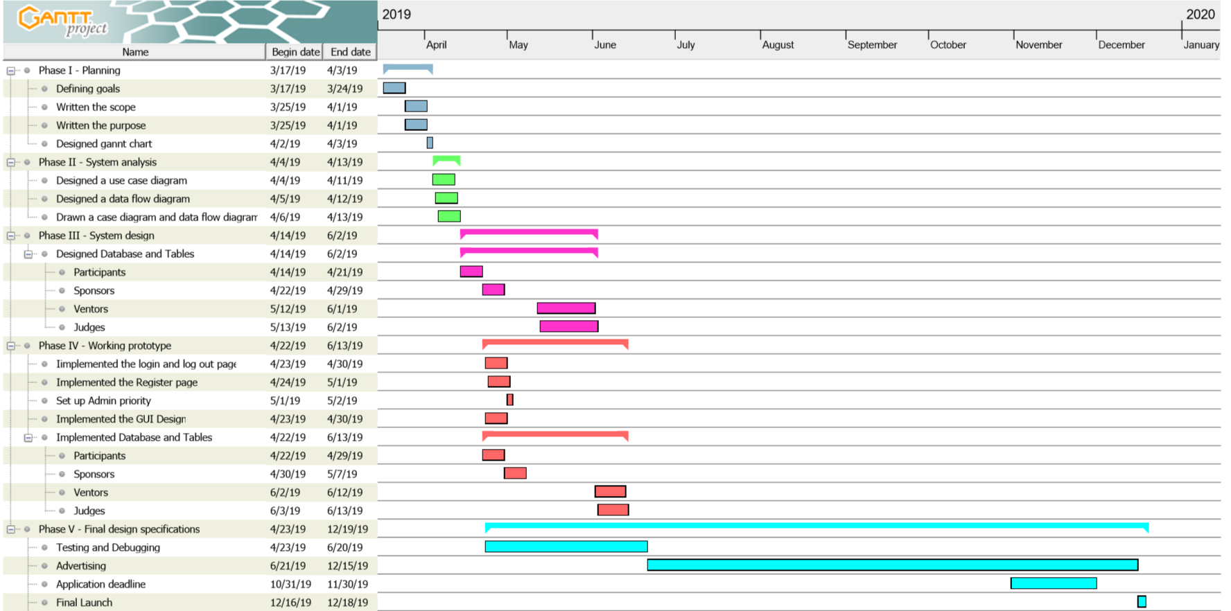
Project analysis slide 6
Gantt Chart

Slide 9
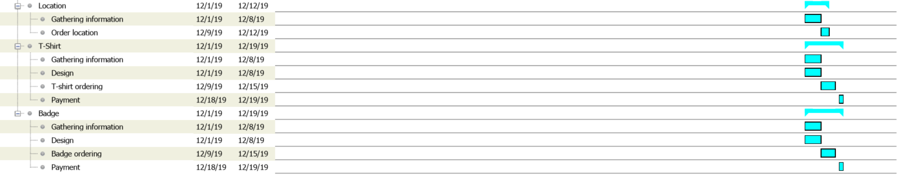
Project analysis slide 6
Gantt Chart

Slide 10
Thank You

