Slide 1

FMCG DISTRIBUTION

Slide 2


FMCG DISTRIBUTION
The distribution process includes the entire Supply Chain Management process, which begins from Raw Materials Suppliers, down to End-users
Involves the sale of items with generally low costs and quick inventory turnover, usually falling under the categories Food and Beverage, Personal and Household Care, and Non-Food Products (Furniture, Appliances, etc.)
Notes:
http://www.payscale.com/research/PH/Industry=Business_Process_Outsourcing/Salary

Slide 3




57%
36%
1%
FMCGs
Traditional Channels
(sari-sari, groceries, market stalls)
Modern Trade Channels (supermarkets, drug stores, dept stores)
6%
Promotional Gifting
Direct Sales

Slide 4





59.5%
20.4%
11.6%
FMCGs
Food
Personal Care
8.5%
Beverages
Household Care

Slide 5
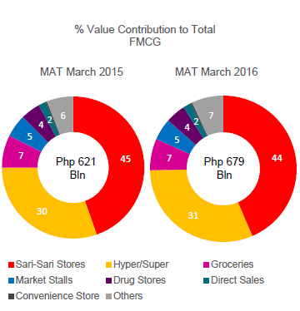
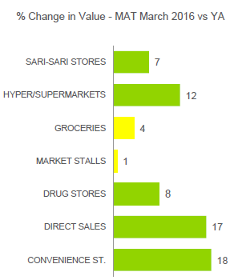
FMCG PERFORMANCE BY CHANNEL
Notes:
Source: Kantar Worldpanel – Household Panel – National Philippines – Total FMCG

Slide 6
TOP 10 RETAILERS IN THE PHILIPPINES
Ranking | Establishment
1 | Puregold
2 | SM
3 | Gaisano
4 | Mercury Drug
5 | Robinsons
Ranking | Establishment
6 | CSI
7 | Waltermart
8 | LCC
9 | Super 8 Grocery Warehouse
10 | Ever Supermarket
Of the Big 10 retailers in the Modern Trade channel, the top five (5) retailers enjoy 13% of total FMCG sales in the market, with 61% penetration and P6,000 spent on average.

Slide 7
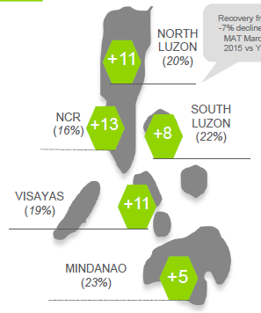
Retail Sales Growth, (% Change in Value)
Notes:
Source: Kantar Worldpanel – Household Panel – National Philippines – Total FMCG

Slide 8
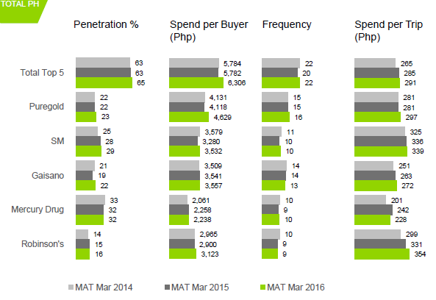
FMCG PERFORMANCE BY CHANNEL
Notes:
Source: Kantar Worldpanel – Household Panel – National Philippines – Total FMCG

Slide 9
GROWTH TRENDS
Towards outsourcing warehouse and logistics service providers
Internet as a distribution channel
Challenges:
Poor infrastructure, heavy traffic
Port congestion
Lack of government support
Inventory management - finding the right quantities to order

Slide 10



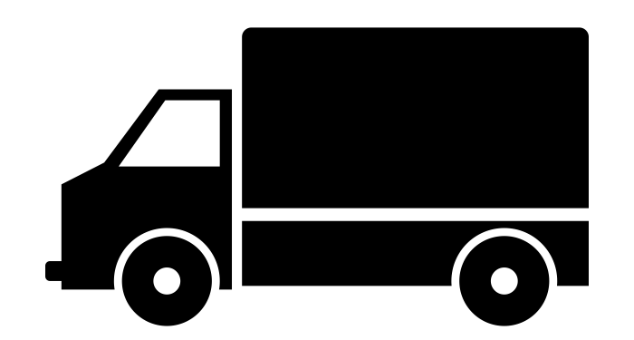










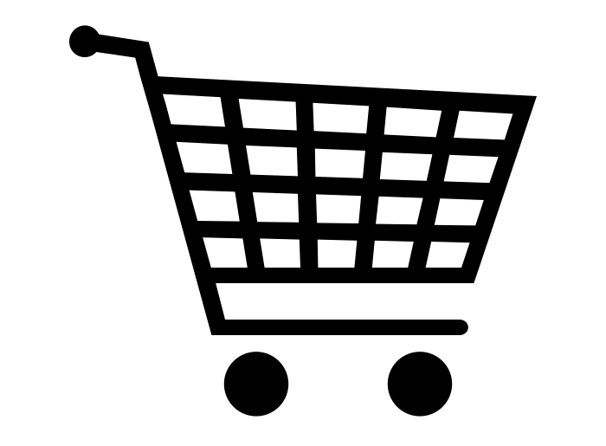


Supplies
Warehousing Fees
Raw Materials Suppliers
Inventory Safekeeping
Warehousing
Payments
Freight Services
Logistics Service Provider
Manufacturer
Bills Payment
Manpower Agencies
Wages
Freight Forwarding
(Shipping / Air)
Labor
Loan Repayment
Loan
Exporters
Government
Payments
Procurement Payment
Procurement of Goods
Global Retailers
Procurement Payment
Banks
Freight Services
Procurement of Goods
Bills Payment
Loan Repayment
Employees
Loan
Wholesalers / Distributors
Utilities
Consumers
Services / Employment / Leasing
Retailers
Key accounts / Organizational end-users
Equipment
Bills Payments / Salaries
Payments
Sales
Notes:
Retailers -> Modern and Traditional Channels
Modern = hypermarkets, department stores, drug stores
Traditional = sari-sari stores, market stalls

Slide 11
PERSONS TO TARGET
Human Resources - Will focus the discussions on Payroll and Employee related services
Finance and Treasury - Will focus the discussions on ADB requirements, FX Conversions
Key Accounts – May be able to refer you to their suppliers
Suppliers – May have a need for Manufacturer-Supplier Financing

Slide 12
Thank you! Customer Segments Management 21st Flr, UnionBank Plaza

