Slide 1
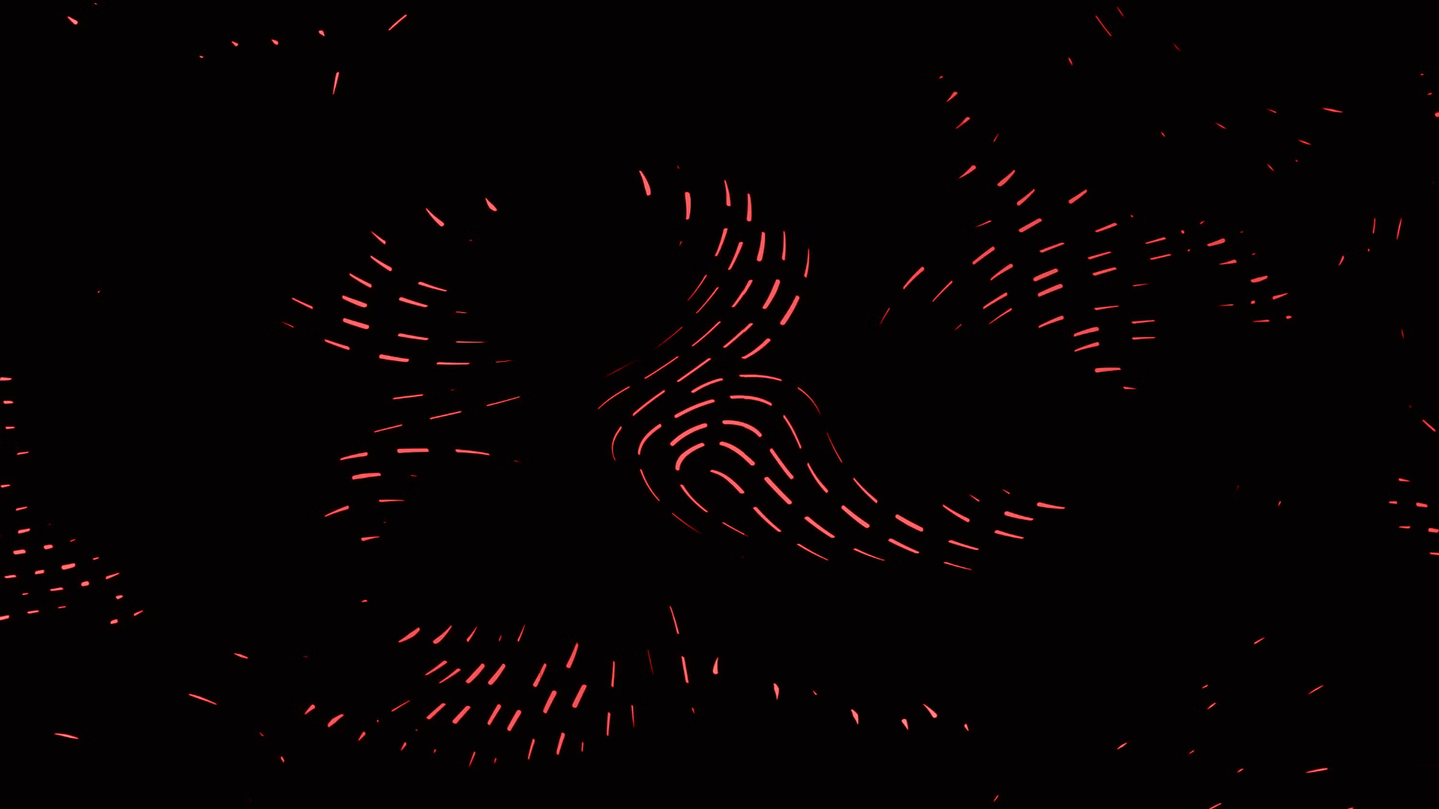

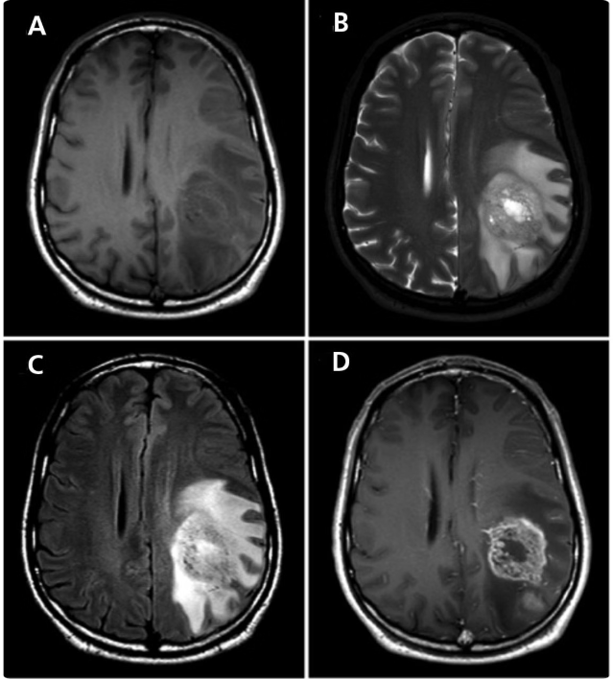
Brain Tumor Detection
The purpose of developing a web application for brain tumor detection and segmentation using LLMs and Deep Learning models is multifaceted:
Early Diagnosis and Treatment Planning
Accuracy and Efficiency
Patient Care and Monitoring
Accessible and User-Friendly Interface
By Generative Neurology
G31
Notes:
By

Slide 2
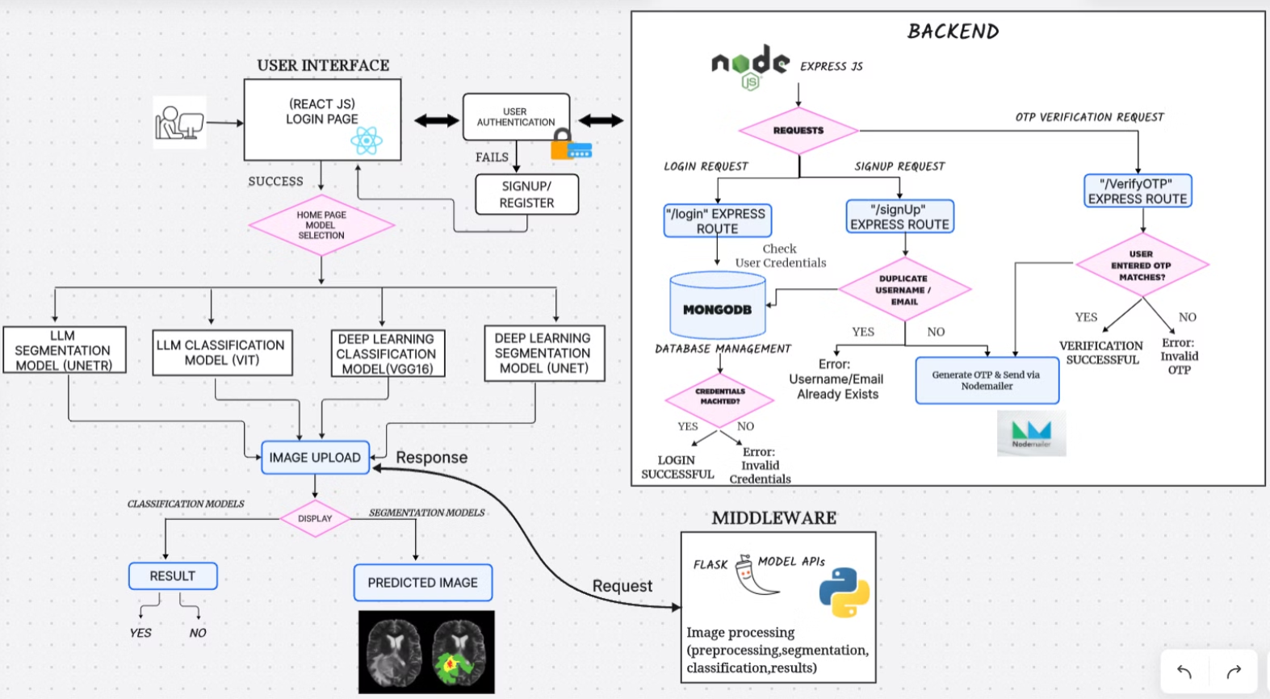

Slide 3
Project Workflow
Requirement Gathering
1
Understand project goals and user needs
2
Architecture Design
Determine MERN stack components
Development
3
Implement frontend, backend, and model APIs
4
Integration
Connect all components and ensure smooth data flow
Testing
5
Perform functional, integration, and user testing
6
Deployment
Release the application to the production environment

Slide 4
Challenges Faced
1
Data Preprocessing
2
Accurate Tumor Detection
3
Seamless Integration
Normalizing diverse medical imaging data
Connecting model APIs with frontend and backend components
Leveraging deep learning models for segmentation and classification
4
Performance and Scalability
Optimizing the application for increasing user traffic

Slide 5
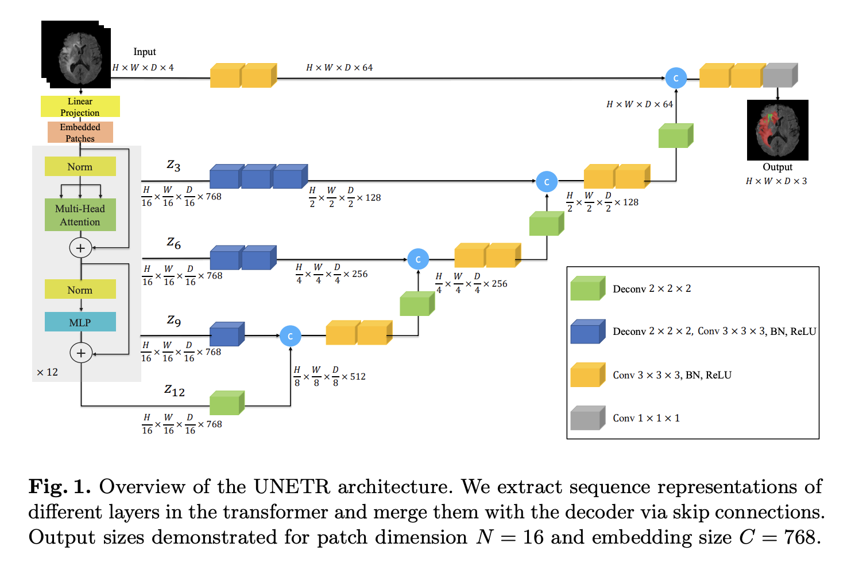
UNETR
UNETR (UNet Transformer) is a novel deep learning model that combines the strengths of the U-Net architecture with Transformer-based encoders.
It is designed for 3D medical image segmentation but it

Slide 6
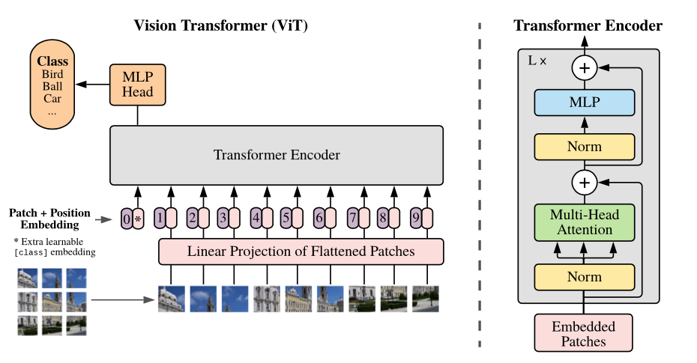
ViT

Slide 7
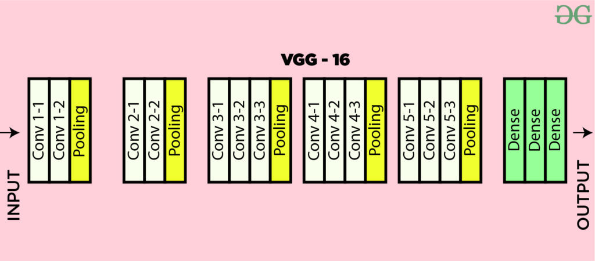
VGG16

Slide 8
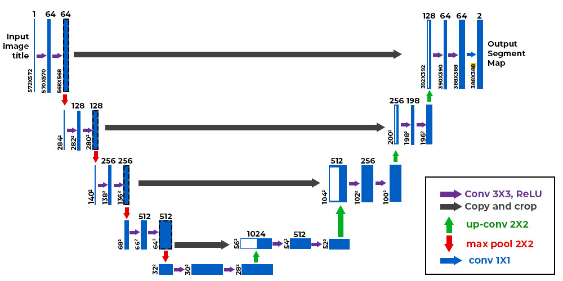
UNET

Slide 9

Thank You
We appreciate your time and attention. It was a pleasure presenting this project to you.

