Slide 1

Design and Implementation of an ESP32-Based Wireless Intrusion Detection System with Tamper and Link Supervision
25ES604 EMBEDDED SYSTEM DESIGN · TERM PROJECT
HomeGuard: a two-node wireless home alarm, built stage by stage through the embedded system design flow
Jothi Prabha R · EBS26014
Linganiveth S G · EBS26016
Guide: Dr. Anju S Pillai · 6 November 2026
Notes:
Introduce the project in one line: a wireless intrusion alarm with one detector node and one hub. Emphasise that the focus is the embedded system design flow, not application complexity. Review 1 and Review 2 are covered in this single presentation.

Slide 2






The problem and our idea
PROJECT IDEA
Problem
Detector node (ESP32)
PIR motion · door reed switch · tamper switch
Wired alarm sensors are costly to install, and a cut wire can silently disable them
An intruder can open or smash a sensor; a basic alarm never notices
If a wireless sensor dies or goes out of range, simple systems keep showing "all OK"
ESP-NOW wireless link
Hub (ESP32)
decides: arm, delay, alarm, fault
Objective
Design a two-node wireless alarm (detector + hub) that detects intrusion, resists tampering and reports a lost sensor, following every stage of the embedded system design flow.
Keypad
OLED
Siren
Phone
Notes:
Problem first, then the idea. Similar to commercial wireless alarm kits, but the point is to apply the ESD design flow to a realistic product.

Slide 3
Methodology: the design flow we followed
METHODOLOGY
1 Requirements
8 functional + 5 non-functional
2 Specification
timings, packet, pins, limits
3 System architecture
2 nodes, HW/SW partition
4 Hardware track
5 Software track
Design
schematics, calculations
Build
breadboard per block
Test
HT1–HT6
Design
protocol, FSM
Code
Arduino C++
Test
ST1–ST11
6 System integration
mount, latency, range
7 System validation
requirement → test traceability
8 Operation & maintenance
user guide, limitations
Every stage left a document in the project repository; the tracker at the bottom of each slide shows where we are.
Req
Spec
Arch
HW
SW
Integ
Valid
O&M
Notes:
This is the backbone of the talk. Hardware and software were designed in parallel after the architecture was fixed, unit-tested separately, then integrated and validated against the requirements. Each following slide is one stage.

Slide 4
What the system must do
STAGE 1 · REQUIREMENTS
Functional requirements
Non-functional
FR1 Detect motion in the protected room (PIR)
FR2 Detect the door opening and closing
FR3 Detect tampering with the detector, in any state
FR4 Arm / disarm with a 4-digit PIN (keypad and phone)
FR5 Exit delay 30 s on arming, entry delay 15 s on the door
FR6 Sound a siren; show status on LEDs, OLED and phone
FR7 Report a lost or offline detector
FR8 Lock the keypad after 3 wrong PINs
NFR1 Event → siren in under 1 s
NFR2 No lost events: every event acknowledged
NFR3 Fail-safe: a cut wire or dead sensor never fails silently
NFR4 Indoor range of at least 10 m
NFR5 Works without internet or a router
Req
Spec
Arch
HW
SW
Integ
Valid
O&M
Notes:
Requirements are written as what, not how. The non-functional ones are what make it a dependable embedded system rather than a hobby demo: latency, no lost events, fail-safe behaviour.

Slide 5
Requirements turned into measurable numbers
STAGE 2 · SPECIFICATION
Parameter | Specification | Traces to
Radio link | ESP-NOW, 2.4 GHz, channel 1, peer-to-peer by MAC address (no router) | NFR4, NFR5
Packet | 12 bytes: node ID, type, sequence no., battery, uptime, CRC-16/CCITT | NFR2
Reliability | ACK within 100 ms, up to 3 retries, duplicates filtered by sequence no. | NFR2
Supervision | Heartbeat every 5 s; detector marked OFFLINE after 15 s of silence | FR7, NFR3
Inputs | Switch to GND + 10 kΩ pull-up + 100 nF (τ = 1 ms); 50 ms firmware debounce | FR2, FR3, NFR3
Alarm timing | Exit delay 30 s · entry delay 15 s · siren limited to 3 min | FR5, FR6
Security | 4-digit PIN; 3 wrong attempts → 60 s lockout | FR4, FR8
Response time | Sensor event → siren on in < 1 s | NFR1
Req
Spec
Arch
HW
SW
Integ
Valid
O&M
Notes:
Each requirement became a number we can test. The 'Traces to' column is the link back to the requirements; the same IDs come back in the validation slide.

Slide 6





Two nodes, one wireless link
STAGE 3 · SYSTEM ARCHITECTURE
Detector node · ESP32 (Board 2)
Hub · ESP32 (Board 1)
PIR HC-SR501 → GPIO27
Firmware: alarm state machine, supervision, PIN lockout, web server
Door reed switch → GPIO26
ESP-NOW · ch 1
4×4 keypad (input)
Tamper switch → GPIO25
event packet (12 B)
SSD1306 OLED, I2C
Firmware: debounce, event queue, ACK/retry, 5 s heartbeat
ACK (same seq. no.)
Siren via BC547 driver
heartbeat every 5 s
4 status LEDs
Powered by USB power bank
Phone page on Wi-Fi AP
Why two microcontrollers? Sensors sit at the door, the control panel sits inside. The detector only senses and reports; the hub owns every decision. The wireless link, its reliability and its supervision are the core design problem.
Req
Spec
Arch
HW
SW
Integ
Valid
O&M
Notes:
HW/SW partition: sensing and debouncing on the detector, all decisions on the hub. The detector never decides to sound the alarm, so it stays simple. Replace this slide's diagram with the ChatGPT architecture image if you prefer.

Slide 7
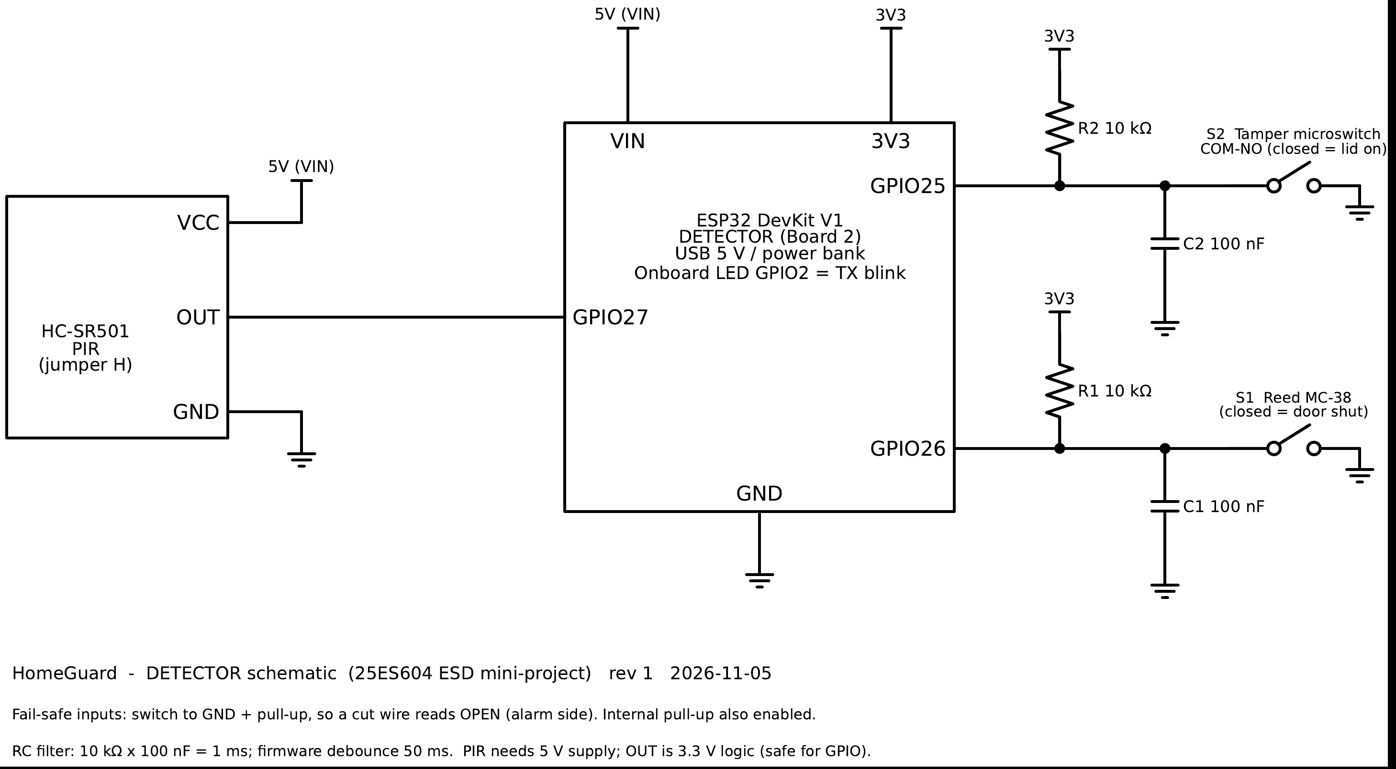
Detector node: sensing with fail-safe inputs
STAGE 4 · HARDWARE DESIGN
Fail-safe wiring
Switch to GND with a pull-up: a cut wire reads OPEN, which raises an event instead of silence.
Two-layer debounce
10 kΩ × 100 nF = 1 ms RC filter, plus 50 ms in firmware. The tamper switch bounced up to 31 times; we still get one event.
PIR interface
5 V supply from VIN, 3.3 V output straight into GPIO27; 30 s warm-up handled in firmware.
Detector schematic (full PDF in hardware/schematics)
Req
Spec
Arch
HW
SW
Integ
Valid
O&M
Notes:
Explain why the switches go to ground: in an alarm, the failure mode must be the alarm side. Mention the measured bounce of the tamper switch from the L03 test log.

Slide 8
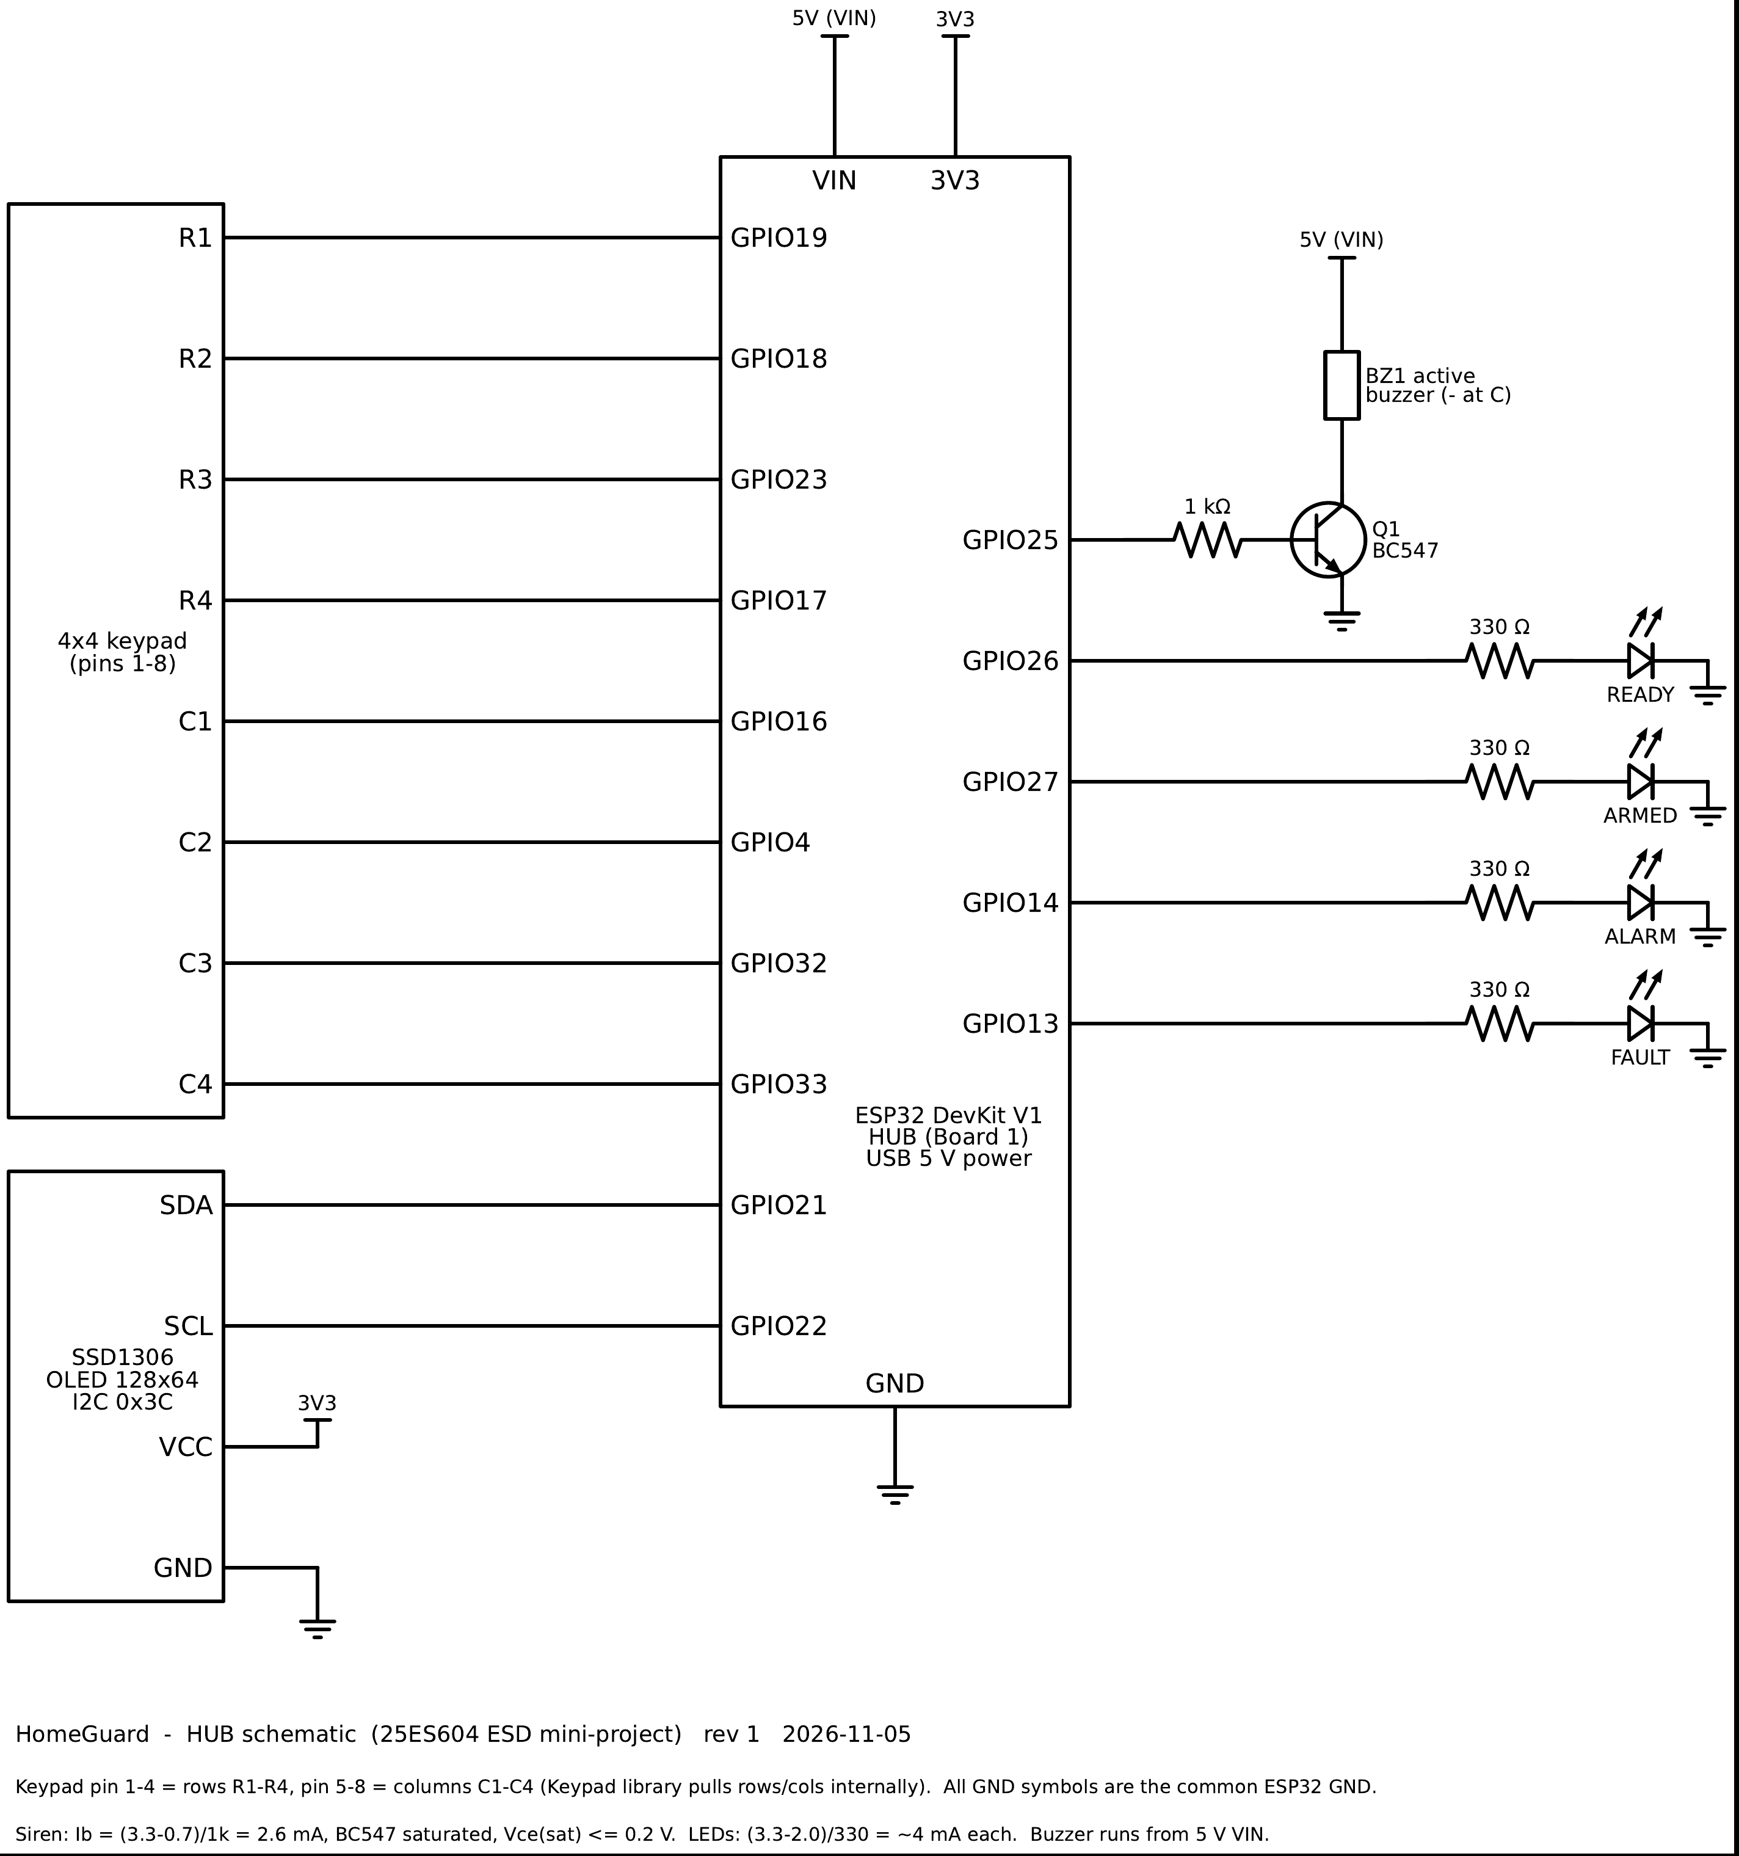
Hub: user interface and siren driver
STAGE 4 · HARDWARE DESIGN
Siren driver
BC547 low-side switch. Ib = (3.3 − 0.7) / 1 kΩ = 2.6 mA → saturated, Vce ≤ 0.2 V. Buzzer runs from 5 V, not from the GPIO.
Status LEDs
(3.3 − 2.0) / 330 Ω ≈ 4 mA each: bright enough, well inside the GPIO limit.
Keypad
4×4 matrix scanned row by row: 16 keys need only 8 GPIOs.
OLED display
SSD1306 on I2C (SDA 21, SCL 22), address 0x3C, 3.3 V.
Req
Spec
Arch
HW
SW
Integ
Valid
O&M
Notes:
Show the calculations: these are the design decisions the faculty wants to see. The transistor is needed because a GPIO can only source a few mA and the buzzer needs 5 V.

Slide 9
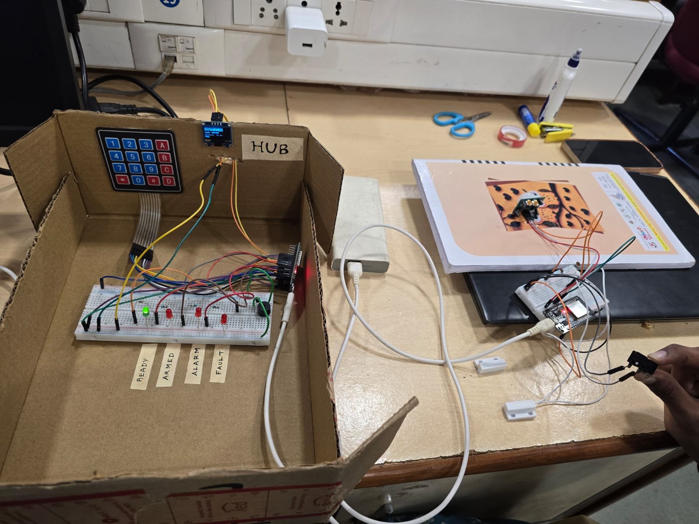
Hardware built and tested block by block
STAGE 4 · HW IMPLEMENTATION & TESTING
ID | Block | Pass criterion | Result
HT1 | Power rails | 5.0 ± 0.25 V, 3.3 ± 0.1 V | Pass
HT2 | PIR sensor | Detects a walk-past; OUT 3.3 V | 5/5 detected
HT3 | Door + tamper inputs | One event per action | Pass (debounced)
HT4 | Siren driver | Buzzer sounds; Vce ≤ 0.2 V | Pass
HT5 | LEDs, keypad, OLED | 4 LEDs, 16 keys, OLED at 0x3C | LEDs pass; keys/OLED: fill in
HT6 | Radio link | ≥ 99 of 100 pings answered | 452/452, RTT 2.4–3.0 ms
Each block had its own test sketch (L01–L05) before the final firmware was loaded.
Req
Spec
Arch
HW
SW
Integ
Valid
O&M
Notes:
Hardware was brought up one block at a time with dedicated test sketches, so a fault could only be in the block just added. Fill in the shaded cells after the morning bench check.

Slide 10
Firmware structure and wireless protocol
STAGE 5 · SOFTWARE DESIGN
Non-blocking super-loop (no RTOS, no delay())
12-byte packet
Interrupt / radio callback: copy data into a queue, set a flag, return
node
1 B
type
1 B
seq
2 B
batt
2 B
uptime
4 B
CRC
2 B
loop() runs every task in turn:
Reliable delivery
Drain received packets → handle events
Scan keypad → PIN entry
Timers: exit / entry delay, supervision
Drive siren and LEDs
Refresh OLED every 250 ms
Serve the phone web page
Hub acts first, then ACKs with the same seq. no.
No ACK in 100 ms → resend, up to 3 tries
Same seq. no. again → re-ACK but do not act twice
CRC-16 rejects corrupted packets
Heartbeat every 5 s; 15 s of silence → detector OFFLINE
Req
Spec
Arch
HW
SW
Integ
Valid
O&M
Notes:
Why no RTOS: few tasks, millisecond deadlines, and a non-blocking loop is simpler to verify. Interrupts only copy data and set a flag; all decisions happen in the loop. The sequence number plus ACK gives exactly-once handling.

Slide 11



Alarm logic as a finite state machine
STAGE 5 · SOFTWARE DESIGN
PIN + A
30 s elapsed
door opens
15 s elapsed
DISARMED
EXIT DELAY
ARMED
ENTRY DELAY
ALARM
motion while armed → instant alarm
Tamper, any state
Valid PIN + #
Safety limits
Opening the detector lid sounds the alarm even when disarmed (24-hour zone). Closing the lid does not silence it.
From any armed, delay or alarm state → DISARMED. This is the only way out of ALARM.
Siren stops after 3 min · 3 wrong PINs → 60 s lockout · detector silent 15 s → FAULT.
Req
Spec
Arch
HW
SW
Integ
Valid
O&M
Notes:
Walk the happy path left to right, then the two shortcuts: motion goes straight to alarm, and tamper reaches alarm from any state. Alarms latch: only a valid PIN clears them, so an intruder cannot silence the system.

Slide 12
Firmware implemented and unit-tested
STAGE 5 · SW IMPLEMENTATION & TESTING
Toolchain
Arduino IDE 2.x, ESP32 Arduino core 3.x
ID | Test | Pass criterion | Result
ST1 | Event delivery | 10/10 events ACKed, first try | Pass
ST2 | Arm + exit delay | 30 s countdown, then ARMED | Pass
ST3 | Entry + disarm | PIN within 15 s, no siren | Pass
ST4 | Entry timeout | ALARM after 15 s | Pass
ST5 | Motion while armed | Instant ALARM | Pass
ST6 | Tamper while disarmed | ALARM; PIN clears it | Pass
ST7 | Detector unplugged | OFFLINE within 15 s | Pass
ST8 | 3 wrong PINs | Locked for 60 s | Pass
ST9 | Arm with lid open | Arming refused | Pass
ST10 | Phone page | Status + arm/disarm work | Pass
ST11 | Retry / duplicate | Event handled once | Pass
Code
detector_node.ino, hub.ino and a shared packet.h
Libraries
ESP-NOW, WebServer, Adafruit SSD1306, Keypad
Approach
Test sketches L01–L05 per block, then the full firmware
Req
Spec
Arch
HW
SW
Integ
Valid
O&M
Notes:
Unit tests run on the real boards with both serial monitors open. Fill in the shaded results after the morning run; the serial logs are saved in docs/06_testing/logs.

Slide 13
Every requirement traced to a test
STAGE 7 · SYSTEM VALIDATION
Requirement | Verified by | Result
FR1 Motion detection | ST5, HT2 | Pass
FR2 Door open / close | ST1, ST3 | Pass
FR3 Tamper in any state | ST6 | Pass
FR4 PIN arm / disarm (keypad + phone) | ST2, ST10 | Pass
FR5 Exit and entry delays | ST2, ST3, ST4 | Pass
FR6 Siren and status display | ST4, HT4, HT5 | Pass
FR7 Offline detector reported | ST7 | Pass
FR8 PIN lockout | ST8 | Pass
NFR1 Event → siren < 1 s | Latency, 20 samples | Pass
NFR2 No lost events | ST1, ST11, HT6 | Pass
NFR3 Fail-safe | ST7 + switch-to-GND wiring | Pass
NFR4 Range ≥ 10 m | HT6 range test | Pass
NFR5 No internet needed | ST10 (hub's own Wi-Fi) | Pass
Req
Spec
Arch
HW
SW
Integ
Valid
O&M
Notes:
Validation asks: did we build the right system? Every requirement from Stage 1 maps to at least one test. Fill in Pass for each after the morning run.

Slide 14
Live demonstration
IMPLEMENTATION · LIVE DEMO
1
Status at a glance
2
Arm with exit delay
3
Authorised entry
OLED and phone page show DISARMED, detector online
PIN + A → 30 s countdown with chirps → ARMED
Door opens → 15 s → PIN + # → disarmed, no siren
4
Intruder
5
Tamper
6
Sensor lost
Motion while armed → instant alarm; disarm from the phone
Lid opened while disarmed → alarm (24-hour zone)
Detector unplugged → OFFLINE fault within 15 s
Req
Spec
Arch
HW
SW
Integ
Valid
O&M
Notes:
Use the 30 s exit delay to point at the state machine slide. Keep the PIR facing a wall until scenario 4. Backup: the demo video recorded in the morning.

Slide 15
Using and maintaining the system
STAGE 8 · OPERATION & MAINTENANCE
Operate
Maintain
Known limitations
Arm: PIN + A
Disarm or silence: PIN + #
Clear a typo: *
Phone: join HomeGuard-Hub, open http://192.168.4.1
Tamper alarm latches: enter PIN, then close the lid
Detector offline: check power and distance
Change PIN or timings: edit constants in hub.ino, re-flash
Replace a board: update its MAC, re-flash both
One detector only
ESP-NOW link not encrypted
PIN fixed in firmware
No battery level reporting
No SMS / cloud notification
Req
Spec
Arch
HW
SW
Integ
Valid
O&M
Notes:
Operation and maintenance is the last stage of the flow: how a user runs it, how a technician services it, and what it honestly cannot do yet.

Slide 16
Outcome and what we hand in
CONCLUSION
Outcome
Report and repository
A working two-node wireless alarm meeting FR1–FR8
The full design flow followed, with a document for every stage
Dependability by design: ACK/retry, CRC, supervision, fail-safe wiring, PIN lockout
docs/01_requirements … 08_operation_maintenance
hardware/schematics: hub + detector PDFs
firmware/: detector_node, hub, test sketches
docs/06_testing: HT/ST sheets + serial logs
docs/learning: one note per build step
docs/report: final project report
Future work
Multiple detectors and ESP-NOW encryption
Battery operation with voltage reporting
PIN change from the keypad; GSM or app alerts
Custom PCB and enclosure
Req
Spec
Arch
HW
SW
Integ
Valid
O&M
Notes:
Close by tying back to the design flow: every stage produced an artefact, and the report follows the same chapter order.

Slide 17
Thank you. Questions?
HomeGuard · ESP32 wireless intrusion detection with tamper and link supervision
Jothi Prabha R · EBS26014
Linganiveth S G · EBS26016
Notes:
Likely questions: why two MCUs, why ESP-NOW, what if a packet is lost, why no RTOS, fail-safe wiring, limitations. Short answers are in docs/slides/demo_day_plan.md.

