Slide 1
A PIR-Based Intrusion Detection System with Real-time Alerts
Introduction
Need For Smart security
Project overview
Working Principle
Wireless Communication
Future Enhancements
Future Enhancements
Conclusion
Conclusion
A Smart Sentinel for Instant Security Alerts

Slide 2
ABSTRACT
This project presents the development of a smart home security system leveraging ESP NodeMCU, PIR motion sensors, and Telegram integration. The system detects motion using PIR sensors and triggers alerts via Telegram messages and audible alarms, enhancing real-time notification capabilities. Through the integration of these technologies, the project aims to provide an effective, affordable, and accessible solution for home security. Future enhancements such as advanced security measures, cloud integration are envisioned to further elevate the system's capabilities. Overall, this project demonstrates the potential of IoT technologies to revolutionize home security and automation, paving the way for safer and smarter living spaces.

Slide 3
Table of contents
01
02
03
04
05
06
Introduction
Need For Smart security
Project overview
Working Principle
Wireless Communication
Future Enhancements
Conclusion
Introduction
Introduction
Need For Smart Light
Project Overview
Working Principle
Wireless Communication
Future Enhancements

Slide 4

Enhancing Security with SmartMotion
Introduction
Need For Smart security
Project overview
Working Principle
Wireless Communication
Future Enhancements
Conclusion
In our increasingly connected world, ensuring the security of our homes and workplaces is vital. Traditional security systems often come with limitations, like high costs and complex installations. That's why we've developed "SmartMotion" – a PIR-based Intrusion Detection System with Real-time Alerts
SmartMotion utilizes ESP NodeMCU and PIR motion sensors to detect intrusions. When motion is detected, it triggers a buzzer alert and sends a real-time notification via WhatsApp to the user's smartphone.

Slide 5

Introduction
Need For Smart security
Project overview
Working Principle
Wireless Communication
Future Enhancements
Conclusion
As urbanization accelerates, so does the demand for smarter infrastructure. Traditional street lighting systems, plagued by inefficiencies and maintenance challenges, fall short in meeting the evolving needs of modern cities. Enter smart street lighting solutions, designed to address these shortcomings and usher in an era of intelligent, responsive urban lighting networks
Rising Environmental Concerns: With growing awareness of environmental issues such as climate change and light pollution, there is a pressing need to adopt sustainable practices in urban infrastructure. Traditional street lighting often contributes to light pollution, disrupting ecosystems and impacting human health. Smart street lighting, with its ability to dynamically adjust illumination levels and minimize unnecessary light emissions, offers a compelling solution to mitigate these environmental concerns and foster a harmonious coexistence between urban development and natural ecosystems.

Slide 6
Introduction
Need For Smart Light
Project Overview
Working Principle
Wireless Communication
Future Enhancements
Conclusion
Our security system combines key components: the ESP NodeMCU for central control, PIR motion sensor for detecting movement, and a buzzer for immediate alerts. Real-time notifications are sent via Telegram, ensuring swift response to any detected intrusion.
Main Components
NODE MCU
ESP8266
Buzzer
PIR SENSOR
LIGHTS

Slide 7
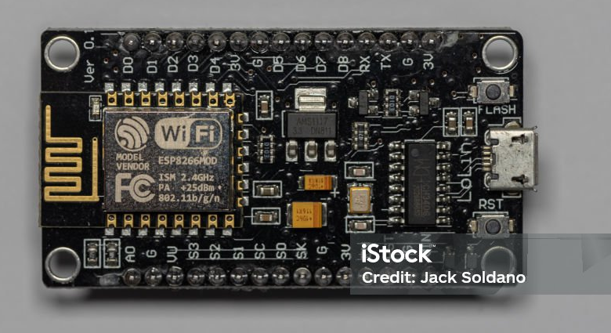
Node MCU ESP 8266
At the heart of our system lies the ESP8266, a miniature powerhouse renowned for its WiFi connectivity and computational prowess. Empowered by this compact yet capable microcontroller, our smart street lighting solution transcends the limitations of conventional lighting systems, offering unparalleled flexibility and intelligence.
Overall, the ESP8266 microcontroller plays a pivotal role in realizing the objectives of the smart street lighting project by providing connectivity, intelligence, and control capabilities essential for building a modern, efficient, and sustainable urban lighting infrastructure..

Slide 8
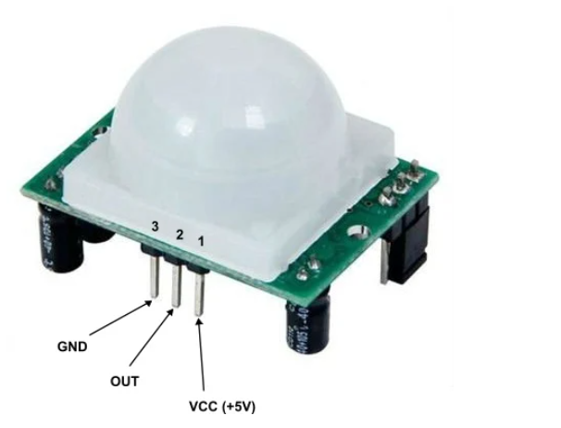
PIR SENSOR
The PIR sensor detects infrared radiation emitted by objects within its field of view. When a change in infrared radiation is detected, indicating movement, the sensor triggers an electrical signal, which is then interpreted by the microcontroller to initiate the desired action, such as activating an alarm or sending a notification.
The PIR sensor serves as the primary motion detector in our project, detecting any movement within its range and triggering the alarm or notification system accordingly."

Slide 9
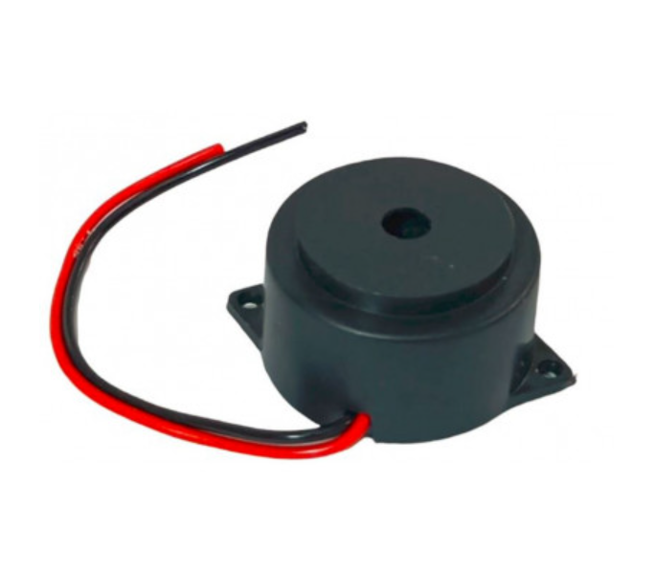
BUZZER
The buzzer emits a distinct sound upon activation, serving as an effective deterrent to intruders and drawing immediate attention to the detected motion. Its integration adds an extra layer of security to our system, enhancing its overall effectiveness in safeguarding the premises.
In our project, the buzzer plays a crucial role in alerting users to potential intrusions detected by the PIR sensor. When motion is sensed, the buzzer emits a loud sound, serving as an immediate deterrent to intruders and notifying occupants of the premises about the detected motion. This audible alert ensures that any unauthorized activity is promptly addressed, enhancing the security measures of the system.

Slide 10

LIGHTS
In our project, lights serve as visual indicators triggered by the PIR sensor's detection of motion. They provide immediate illumination upon detecting movement, enhancing security and visibility in the monitored area."
Lights serve as visual indicators activated by the PIR sensor's detection of motion. They illuminate the surrounding area, providing enhanced visibility and security upon detecting movement

Slide 11
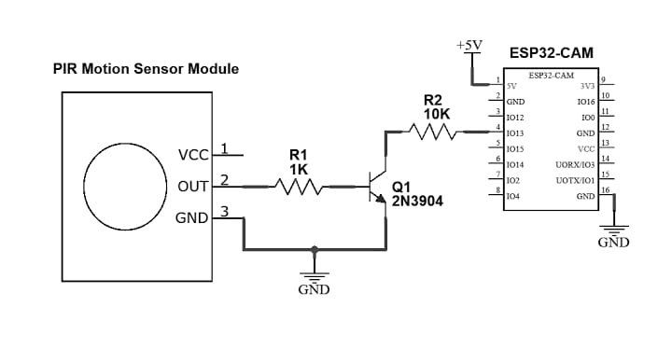
Introduction
Need For Smart security
Project Overview
Working principle
Wireless Communication
Future Enhancements
Conclusion
The working principle of lights in our project is straightforward: they are activated by the PIR sensor's detection of motion. When the sensor detects movement within its range, it sends a signal to the lights, triggering them to turn on. This immediate illumination enhances visibility and security in the monitored area, providing a visual indication of detected motion

Slide 12
Introduction
Need For Smart security
Project Overview
Working Principle
Wireless Communication
Future Enhancements
Conclusion
The Telegram bot receives messages from users, processes them to understand their intent, generates appropriate responses based on predefined logic or AI, and sends the responses back to users on Telegram. It may also integrate with other systems, such as sending notifications based on triggers like motion detection.
APIs can connect with the Arduino IDE through libraries or by making HTTP requests. Arduino boards with networking capabilities can send HTTP requests to interact with RESTful APIs. Serial communication can be used for APIs requiring serial ports. WebSocket communication is an option for real-time APIs. Custom communication protocols may be needed for unique cases. Overall, integration involves writing code in the Arduino sketch to communicate with API endpoints, process data, and perform actions based on responses, enabling Arduino projects to interact with external services.

Slide 13
Introduction
Need For Smart security
Project Overview
Working Principle
Wireless Communication
Future Enhancement
Conclusion
Future enhancements for this project could include:
Advanced Security Measures
Mobile Application Integration
Cloud Integration
Machine Learning Algorithms
Multi-Sensor Integration
Voice Control Integration
Geofencing
Energy Efficiency Optimization
Community and User Interaction

Slide 14
Introduction
Need For Smart security
Project Overview
Working Principle
Wireless Communication
Future Enhancement
Conclusion
In conclusion, our project stands as a testament to the potential of merging cutting-edge technology with practical applications. By seamlessly integrating hardware and software components, we've created a reliable and efficient system that addresses the fundamental need for enhanced home security. As we envision the future, we see boundless opportunities for refinement and expansion. Through ongoing collaboration and innovation, we're poised to shape the landscape of home automation and security, making meaningful strides towards safer and smarter living environments for all.

Slide 15
Thanks!
Introduction
Need For Smart security
Project Overview
Working Principle
Wireless Communication
Future Enhancement
Conclusion

