Slide 1

Ling Chen, Laura Colbran, and Ying Ji
Vanderbilt University

Slide 2
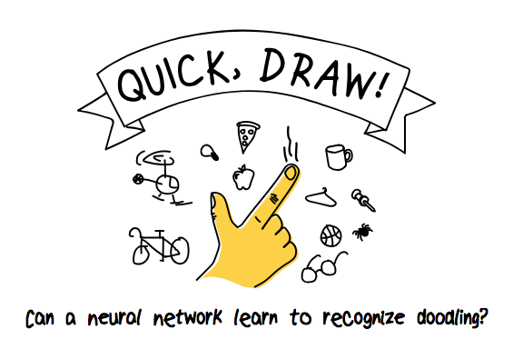
Ling Chen, Laura Colbran, and Ying Ji
Vanderbilt University
Doodles are labeled and filtered for quality using a CNN.

Slide 3
Data
https://quickdraw.withgoogle.com/

Slide 4
Organization
Frontend
React.js
Backend
Django

