Slide 1
MLOps - Why and How?
Efraim Berkovič, Lingea s.r.o., Brno, Czech Republic
https://github.com/lingea-research/MLOps_Workshop

Slide 2
Why MLOps
Andrew NG (deeplearning.ai) estimates, that developing an ML models is only 25% of the ML work
According to a recent study by NewVantage Partners, of 70 leading enterprise companies, only 15% have deployed AI capabilities into widespread production. AI that is not deployed to generate value is only a very costly experiment. These experiments are complex technical accomplishments, but they don’t translate into ROI.
MLOps allows companies to easily deploy, monitor, and update models in production, paving the way to AI with ROI.

Slide 3
Why MLOps
MLOps allows organizations to automate and scale the deployment and management of trusted machine learning in production

Slide 4
Why MLOps
Issues with Deployment
Businesses don’t realize the full benefits of AI because models are not deployed. Or if they are deployed, it’s not at the speed or scale to meet the needs of the business.
Issues with Monitoring
Evaluating machine learning model health manually is very time-consuming and distracts resources from model development
Issues with Lifecycle Management
Even if they can identify model decay, organizations cannot regularly update models in production because the process is resource intensive. There are also concerns that manual code is brittle, and the potential for outages is high
Issues with Model Governance
Businesses need time-consuming and costly audit processes in order to ensure compliance as a result of varied deployment processes, modeling languages, and the lack of a centralized view of AI in production across an organization
Notes:
MLOps Deployment Helps You With:
Multiple languages and multiple teams are used to build models.
Models are sent to IT but are not making it into production.
Models must be rewritten in different languages for deployment.
There is a large backlog of models waiting to be deployed.
Data scientists spend a lot of time troubleshooting models during the deployment process.
A standardized process for elevating models from development to production is missing or flawed.
There is a complex process for putting models into production that requires updating multiple systems.
monitor search find detect risk error fraud dark
2. Issues with Monitoring
Evaluating machine learning model health manually is very time-consuming and distracts resources from model development.
MLOps Monitoring Helps You With:
Models are in production, but no monitoring has ever been performed.
Models are deployed across the organization and in various systems without a consistent way to monitor them.
Models have been in production for a long time and never refreshed.
Model performance must be determined with a manual process performed by a data scientist.
There is no centralized way to view model performance across the entire organization or to offload accountability to Ops teams.

Slide 5
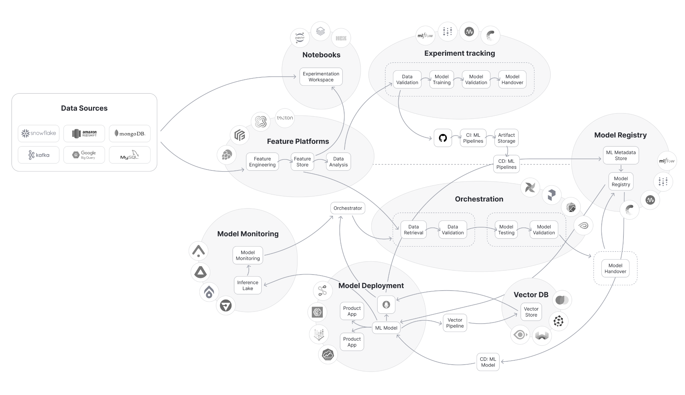

The “Usual” way to manage ML Pipelines
Notes:
In reality, building an ML environment that can actually be in production and scale, looks like that:
Bunch of different vendors and open source tools wired down into a workflow, with lots of stitching required and multiple teams need to be involved, and in some cases it even requires to build new teams just for that.
Although it looks complex and expansive, up until now that was the only way to make it happen.

Slide 6
Agenda
Problem – language detection
Selected algorithm – fasttext – supervised text classification
Bringing to production
MLFlow – for tracking and monitoring
DataBricks – for hosting MLFlow and Jupyter Notebooks
HuggingFace – for Model Registry
Commercial tools and libraries
WandB
Qwak
Snowflake and Snowpark
Arize

Slide 7
Language Detection
Determining the language in which a given text, document, or spoken utterance is composed
Methods
Rule-based – esp. for different script systems (č, ř, א, ײַ, ز, ژ)
Statistical – n-grams pattern recognition
Machine learning – supervised learning given labeled data
Deep learning – convolutional and recurrent neural networks
Existing solutions
Spacy
NLTK

Slide 8
Data Collection and Preparation
Web scraping
Selenium
https://tatoeba.org/en/
Pre-processing
Text cleaning
Tokenization
Lowercasing
Stopword removal (?)
Normalization – remove diacritics (?)

Slide 9
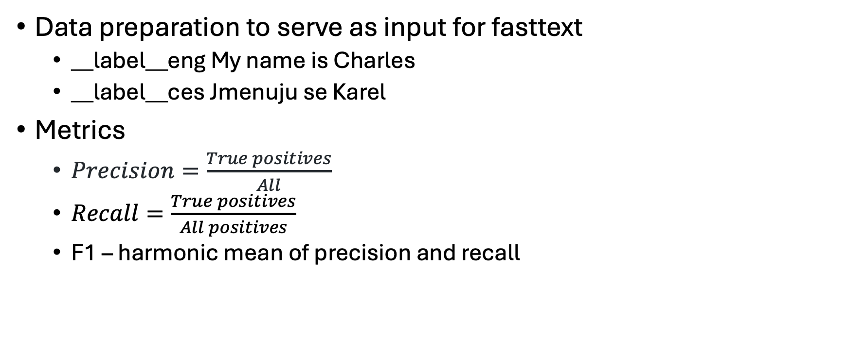
fasttext
Data preparation to serve as input for fasttext
__label__eng My name is Charles
__label__ces Jmenuju se Karel
Metrics
$Precision=\frac{True positives}{All}$
$Recall=\frac{True positives}{All positives}$
F1 – harmonic mean of precision and recall

Slide 10
Manual Run
DEMO
~/tools/fastText-0.9.2/fasttext supervised -input all_train.txt -output model_ver1
~/tools/fastText-0.9.2/fasttext predict model_ver1.bin -
~/tools/fastText-0.9.2/fasttext test model_ver1.bin.bin all_valid.txt
-epoch 25 -lr 0.1 -wordNgrams 2

Slide 11
fasttext – fine-tuning
For accuracy
More epochs - number of times each example is seen
Smaller learning rate – 0.1 .. 1.0
N-grams - where word order is important, such as sentiment analysis
For training speed
Another loss function – hierarchical softmax instead of regular one
Multi-label classification

Slide 12
MLFlow
Programmatic run - DEMO
Concepts
Runs – executions of some piece of data science code
records
metadata - metrics, parameters, start and end times OR mlflow.autlog()
artifacts - output files from the run such as model weights, images
Experiments - groups together runs for a specific task
You can create an experiment using the CLI, API, or UI

Slide 13
MLFlow Components
MLflow Tracking - Logs key metrics, parameters, models, and other artifacts when running ML code to monitor experiments
log_param, log_metric, log_artifact
autolog - https://mlflow.org/docs/latest/tracking/autolog.html
detecting data drifts (distribution of features, unseen values) and concept drifts
automated retraining
integration with alerting systems (PagerDuty / Prometheus)
MLflow Projects - Configurable standard format for organizing ML training code to ensure consistency and reproducibility
https://github.com/alfredodeza/mlflow-demo/blob/main/exploratory/MLproject
https://github.com/mlflow/mlflow-example/blob/master/MLproject
MLflow Models - Package ML model files with their dependencies so they can be deployed on diverse platforms
https://github.com/MicrosoftDocs/azure-docs/blob/main/articles/machine-learning/how-to-log-mlflow-models.md

Slide 14
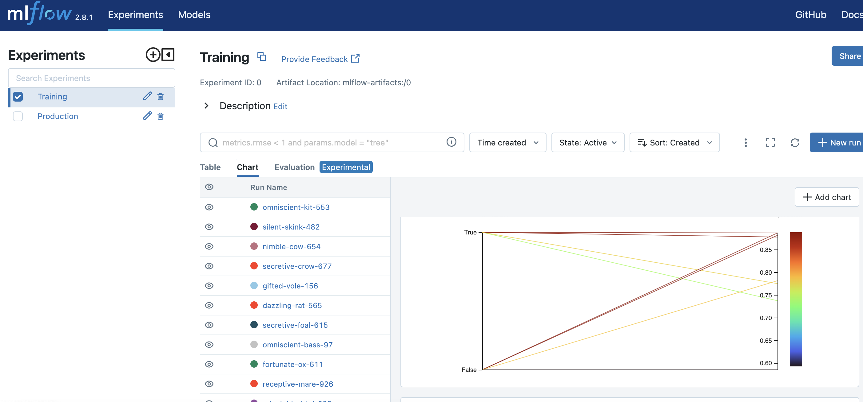
MLFlow Experiment Tracking

Slide 15
MLFlow Projects
Conda Environment - Specifies the dependencies and software required to recreate the runtime environment
OR: virtual environment, can be exported from Poetry spec file
Entry Points - Define the scripts that can be executed within the project workflow
Git Repository - Remote repository that contains an MLflow project enabling portability
mlflow run - Executes an MLflow project locally or from a Git repo with given parameters
https://github.com/alfredodeza/mlflow-demo

Slide 16
MLFlow Models
Model Registry – Centralized model storage to manage versions and lifecycle - https://www.mlflow.org/docs/latest/model-registry.html
Staging
Production
Archived
MLflow Artifacts – Files including model, Conda YAML that detail software environment
MLflow Serve – Expose packaged model via real-time inference REST API
V2 inference protocol used by KServe and Seldon Core, BentoML
https://getindata.com/blog/machine-learning-model-serving-tools-comaprison-kserve-seldon-core-bentoml/
can be exported as Spark UDFs

Slide 17
Hugging Face
Model Hub - Repository of thousands of reusable trained ML models
Datasets - Collection of curated datasets for model tuning
Spaces - Hosted apps to demonstrate ML projects
Streamlit vs Gradio
CLI - Command line tool to access Hugging Face capabilities
Model Hub - Explore and download models from the repository
Fine-tuning - Customize model accuracy by retraining on new data
Dataset Hub - Access text, image, audio and tabular datasets

Slide 18
Hugging Face
import fasttext from huggingface_hub import hf_hub_download model_path = hf_hub_download(repo_id="lingea/small_fasttext_model_for_language_detection", filename="model4.bin") model = fasttext.load_model(model_path) print(model.labels) ds_file = hf_hub_download(repo_id='lingea/small_raw_dataset_for_language_detection', filename='all.txt', repo_type="dataset") with open(ds_file) as f: text = f.read() print(text) # OR: git lfs install && git clone git@hf.co:datasets/<dataset ID>

Slide 19
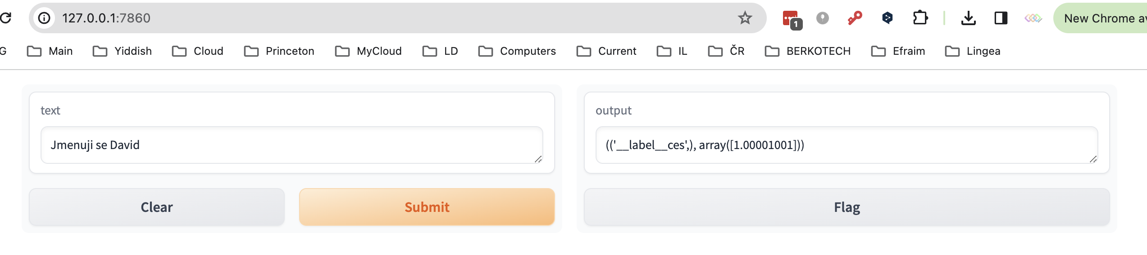
Gradio

Slide 20
Datasets in Hugging Face
for NLP, vision, and audio tasks.
Key features include:
- Simple APIs to load datasets with a single line of code
- Integrates directly with the Hugging Face Hub to access shared datasets
- Efficient data processing using Apache Arrow to handle large datasets
- Methods for common data tasks like tokenization, padding, etc
- Support for working with audio, tabular, image, and text data
- Building and versioning your own datasets to share
The library aims to save time prepping datasets so you can focus on building models. Backed by a standardized format, datasets can be shared and reused easily.

Slide 21
Hugging Face Hub Contents
Over 120k ML models for tasks like NLP, vision, and audio
Over 20k datasets in 100+ languages
Over 50k Spaces, which are apps to demonstrate models interactively
Support for organizing content into user and organization accounts
Security features like access control and malware scanning

Slide 22
Hugging Face Hub Capabilities
Discover state of the art models and datasets
Integrate them into your projects with library support
Build interactive demo apps with SDKs like Gradio and Streamlit
Manage public and private content through organizations

Slide 23
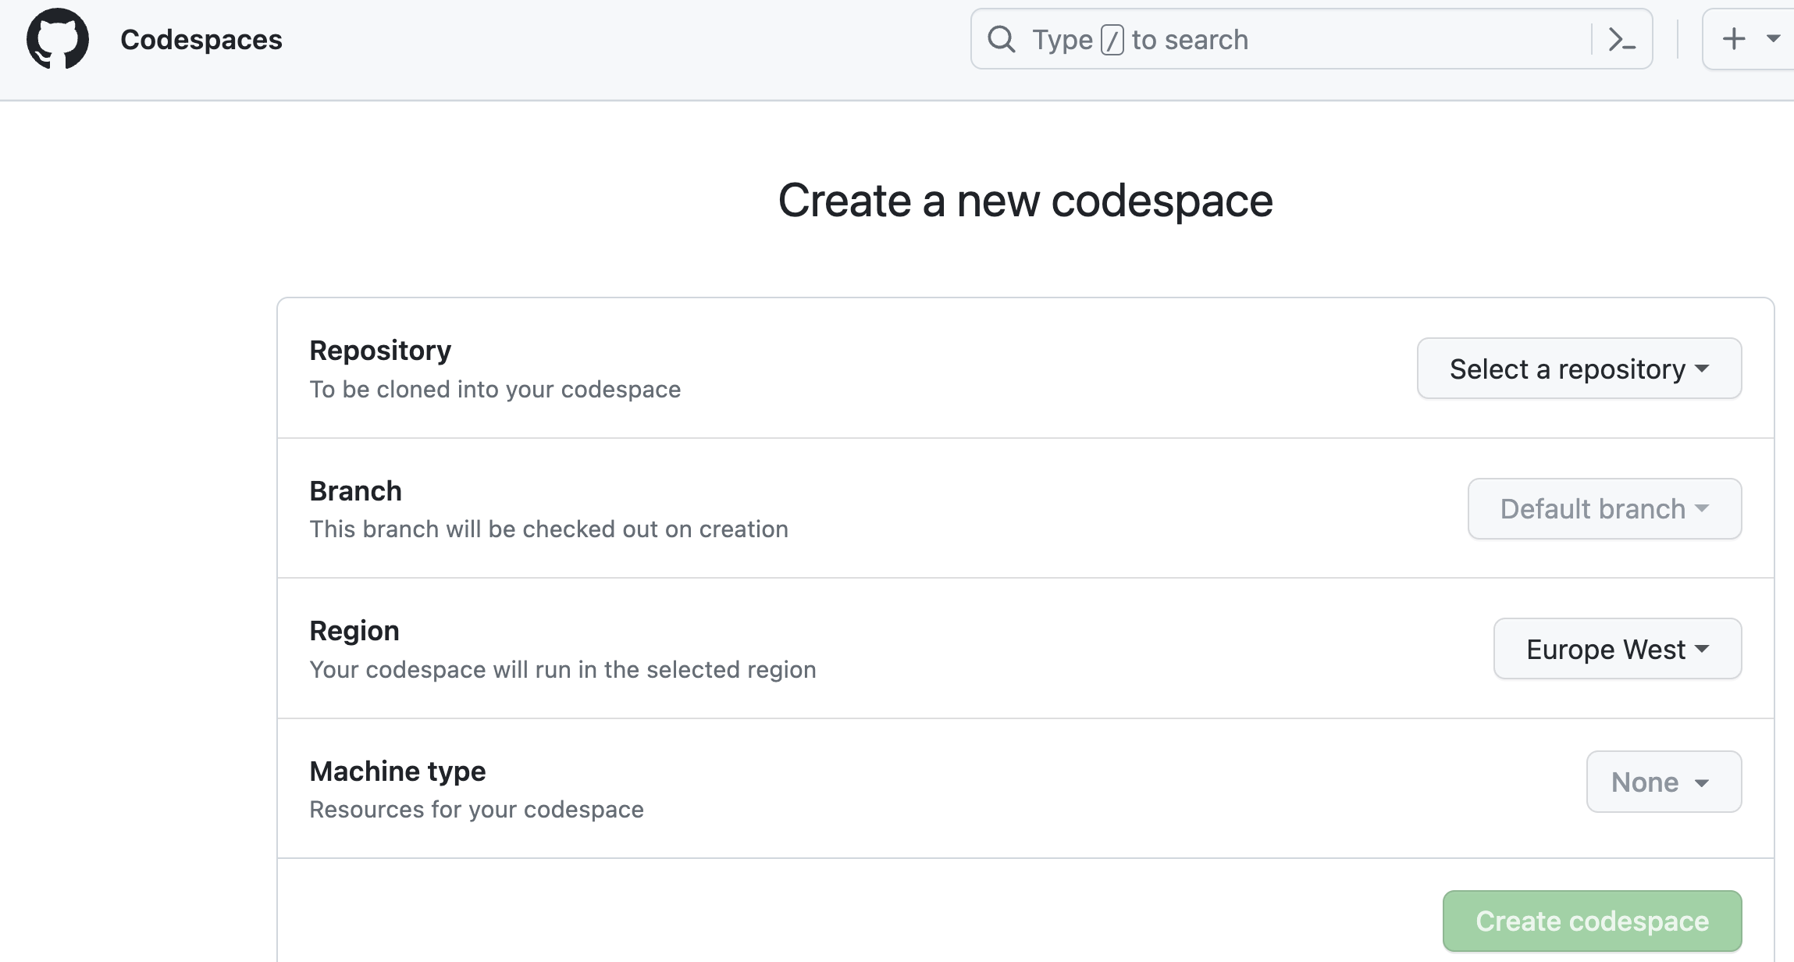
Applied Hugging Face
Codespaces - Browser-based dev environment with GPU access
CLI - Command line tool for tasks like authentication and caching
Inference API - Hosted API to get predictions from latest models

Slide 24
Packaging Hugging Face
FastAPI - Python web framework for building APIs
Container Registry - Docker image storage like DockerHub or Azure Container Registry
CI/CD Pipeline - Automate building, testing and deployment processes

Slide 25
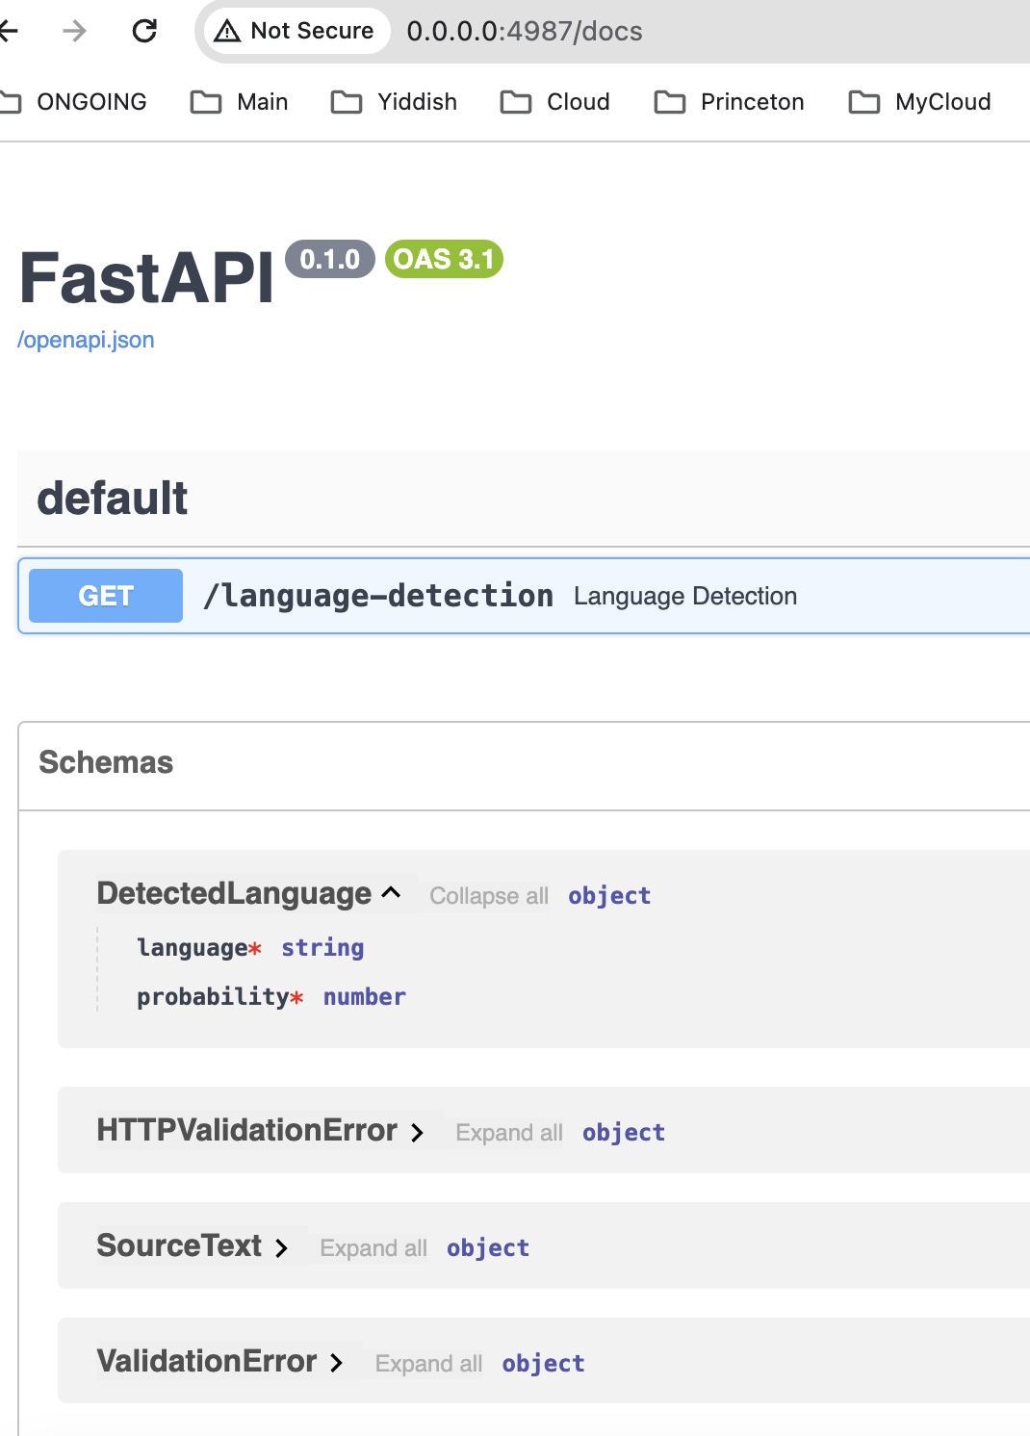
FastAPI

Slide 26
Fine-tuning
Fine-tuning - Specialize models by retraining on new data
https://medium.com/@tskumar1320/how-to-fine-tune-pre-trained-language-translation-model-3e8a6aace9f
ONNX - Open standard for interoperability between frameworks
Quantization - Model compression technique to optimize speed

Slide 27
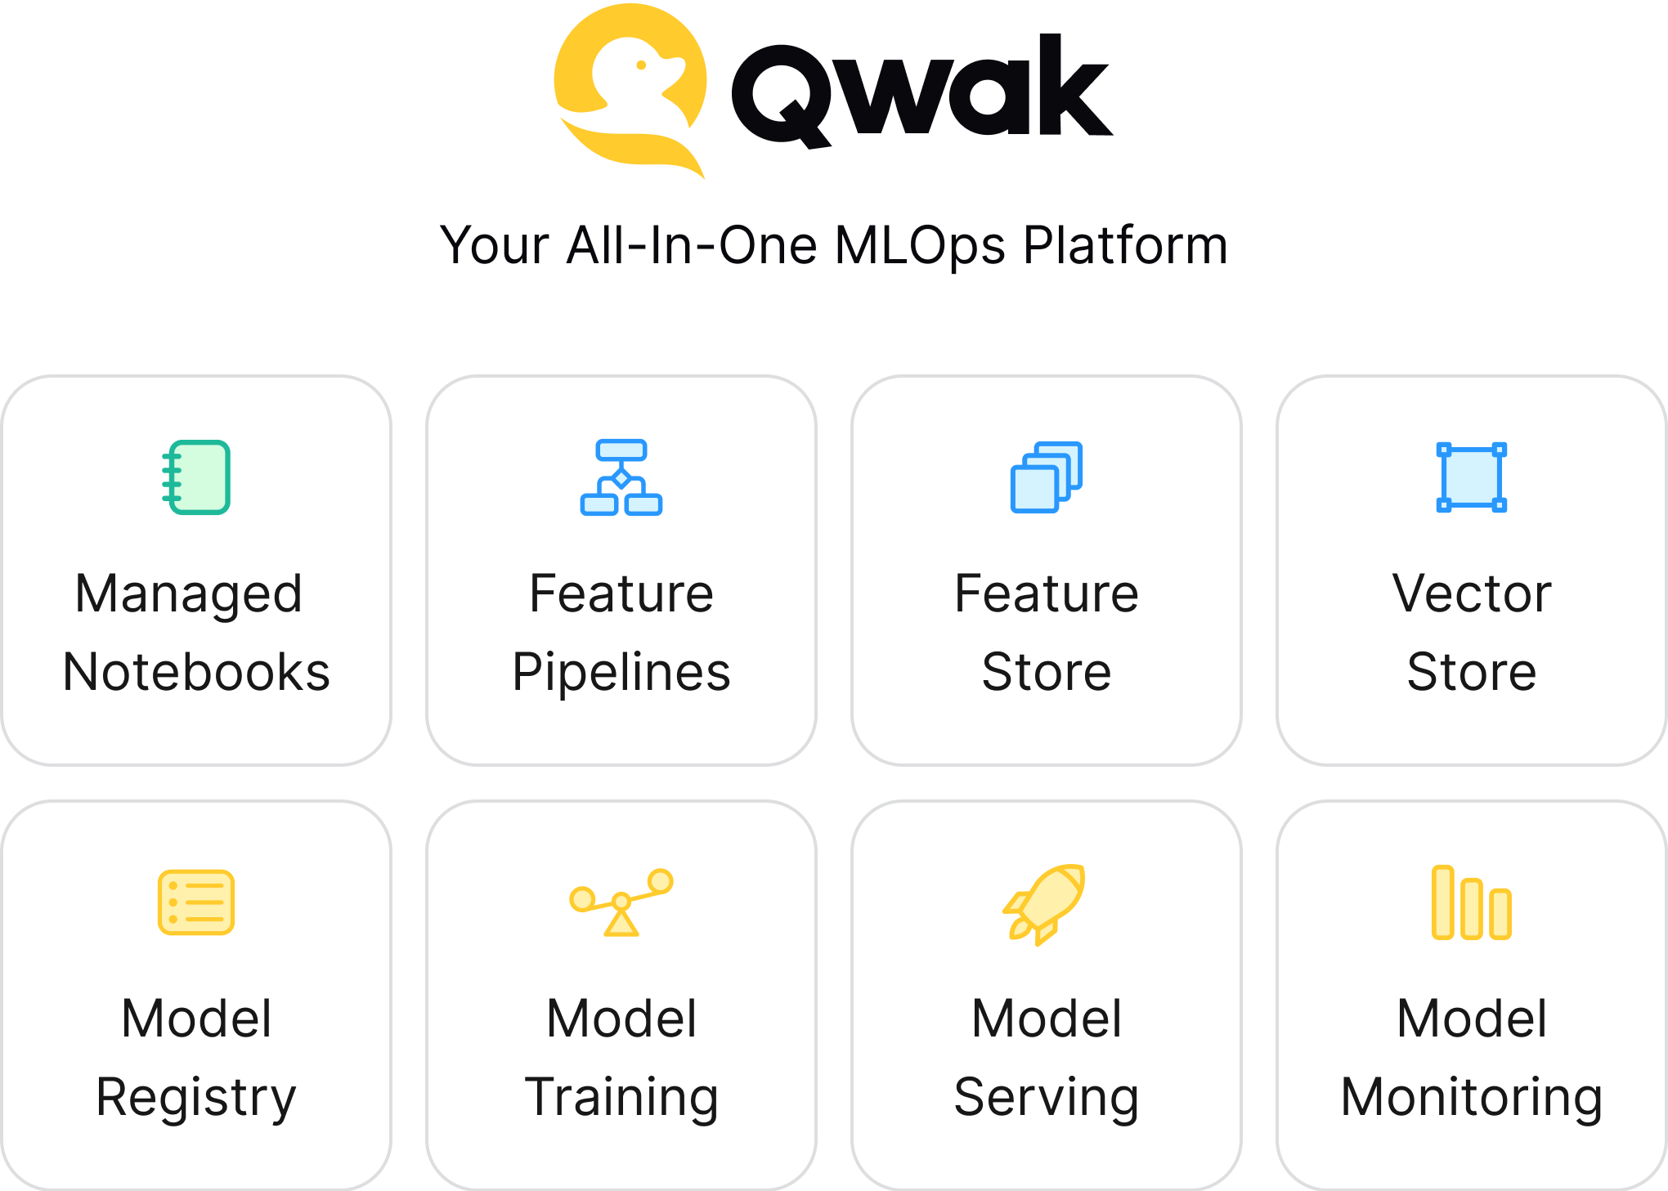
The Qwak Platform
Notes:
We are here to change that.
Qwak contains everything that an ML builder needs in order to create ML applications.
From research environment, to feature and vector pipeline and stores, all the way to model experiment tracking, training, serving and monitoring.
All in one place, fully managed, with no frictions, and ready to scale.

Slide 28
More commercial Platforms
Databricks
Snowflake
Tools
AWS SageMaker
Azure ML

Slide 29
References
https://spotintelligence.com/2023/09/20/language-identification/#Building_and_Training_Language_Identification_Models
https://fasttext.cc/docs/en/supervised-tutorial.html
https://mlflow.org/docs/latest/tracking.html
https://www.qwak.com/
https://neptune.ai/blog/mlops-tools-platforms-landscape
https://huggingface.co/blog/convert-transformers-to-onnx

Slide 30
Links
https://github.com/alfredodeza/mlflow-demo
https://github.com/mlflow/mlflow-example
https://huggingface.co/blog/fasttext
https://tech.bakkenbaeck.com/post/fasttext-with-mlflow

Slide 31
Summary
Manual training and prediction
MLFlow + metrics + parameters. Data drift
FastAPI for serving
Gradio for demonstrators
MLFlow for model and dataset storage
MLFlow for model serving
HuggingFace for model and dataset storage
HuggingFace for model demonstration

