Slide 1
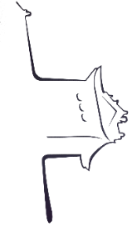


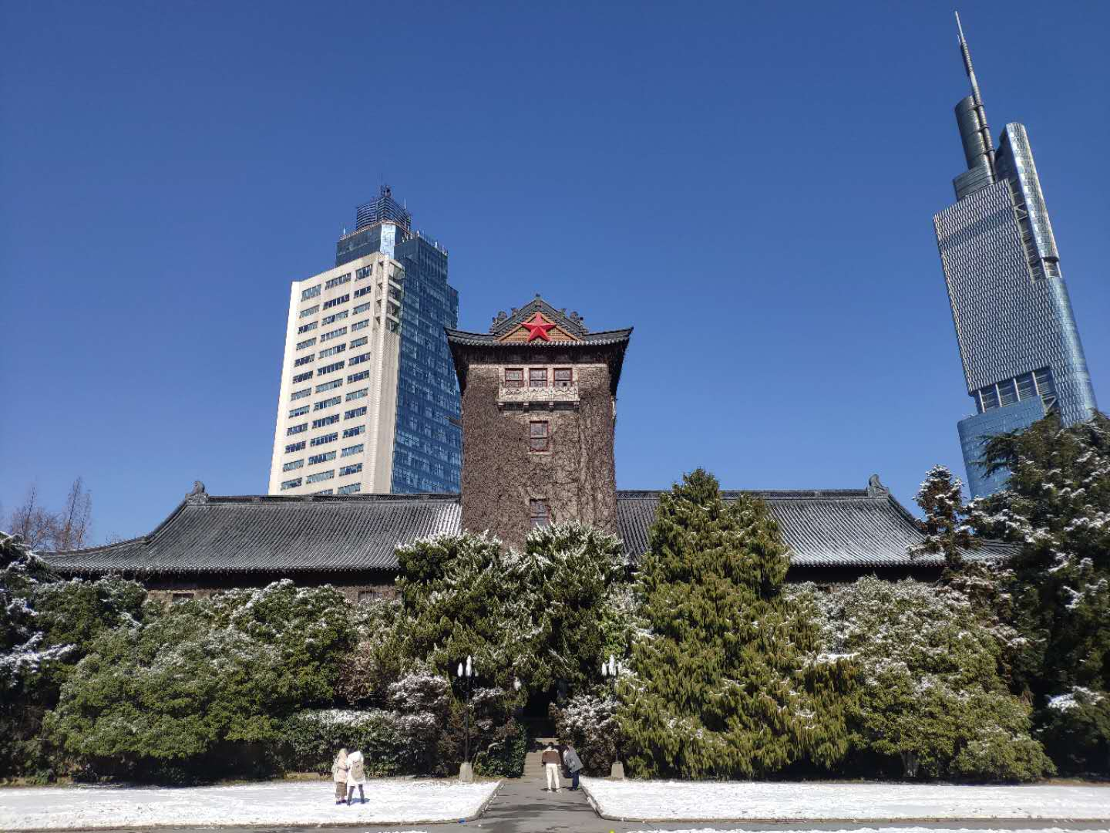


Title
Haifeng Lin

Slide 2
Backgroud & Related work
Challenges & Opportunity
Approach
Setup
Results

Slide 3

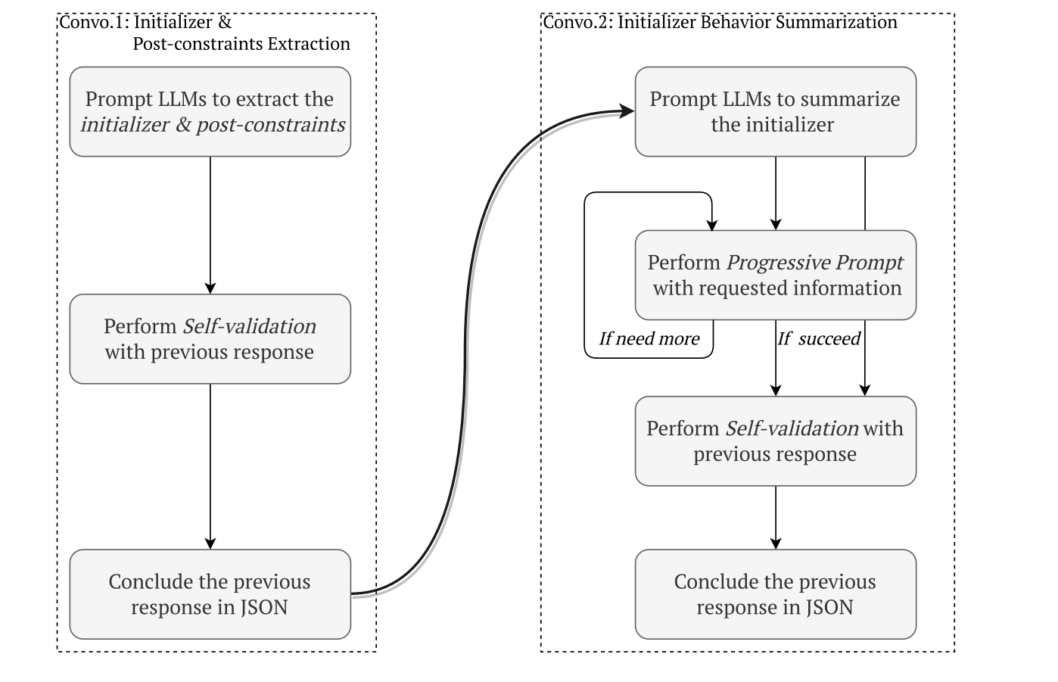
Background & Related work: LLM for static analysis
Llift[1]xxxx
[1] Li H, Hao Y, Zhai Y, et al. Enhancing static analysis for practical bug detection: An llm-integrated approach[J]. Proceedings of the ACM on Programming Languages, 2024, 8(OOPSLA1): 474-499.

Slide 4
Thanks

