Slide 1


ERA: Expert Retrieval and Assembly for Early Action Prediction
Lin Geng Foo¹*, Tianjiao Li¹*, Hossein Rahmani², Qiuhong Ke³, and Jun Liu¹
¹ ISTD Pillar, Singapore University of Technology and Design
² School of Computing and Communications, Lancaster University
³ Department of Data Science & AI, Monash University
^{* Equal Contribution}
Notes:
Hello everyone, I am Lin Geng from Singapore University of Technology and Design, and today I will be presenting about our paper titled ERA: Expert Retrieval and Assembly for Early Action Prediction.

Slide 2
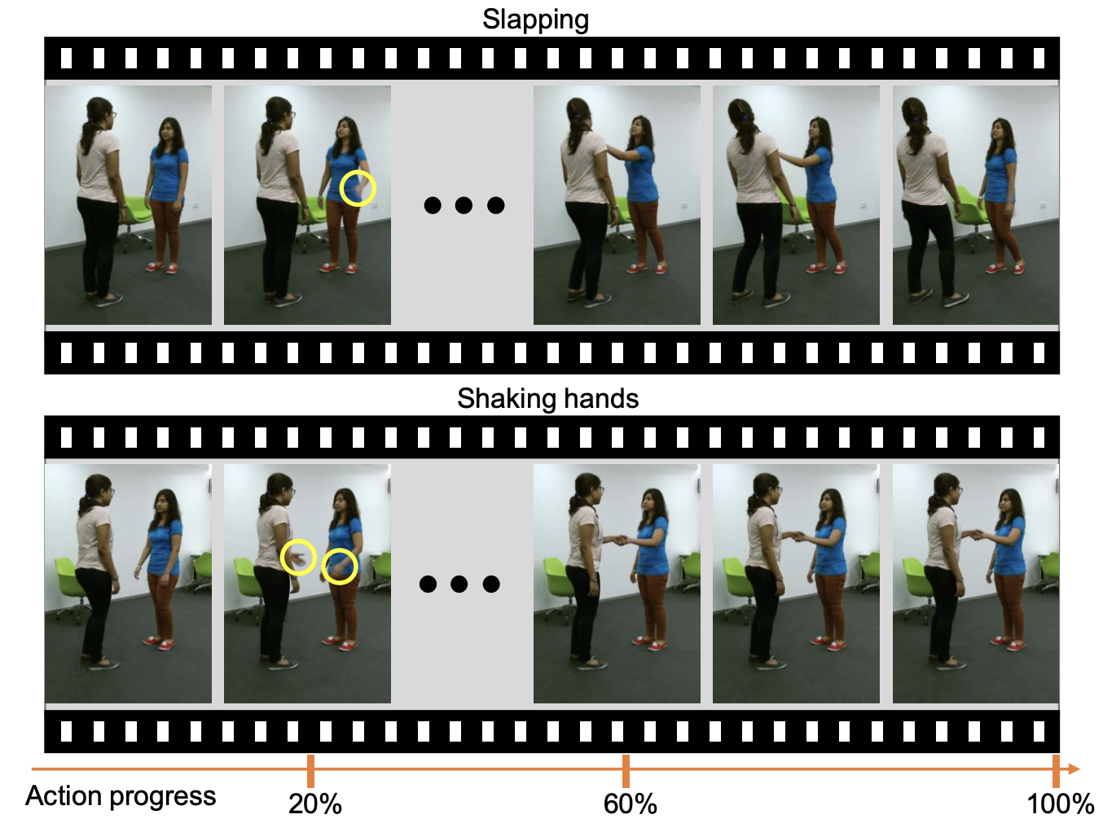
Early Action Prediction
Early Action Prediction is where we try to recognize the human action at the very early stage.
At the beginning stages of actions, there are often only subtle cues for action recognition.
Notes:
(Read off the slides)
For example, in the two actions shown here, Slapping and Shaking hands, if we were to only use the first few frames to discriminate between them, it can be a very challenging task.
This is because we have to rely on some specific and minor discriminative cues in order to tell them apart.

Slide 3
Dynamic Networks for Expert Specialization
Non-Expert
Expert 1
Expert 2
Expert 3
Slapping
Punching
Jumping
Eat meal
Shaking Hands
Hopping
Drink water
Pointing
Squatting
Notes:
Here we tackle this problem with a novel insight on this issue.
We observe that, during training of traditional neural networks, we update all parameters using loss gradients from all samples. Thus, they can be encouraged to learn general patterns that apply to more samples, as opposed to learning specific subtle cues that may only apply to a small subset of the data. In other words, it can be difficult to learn specialized knowledge to distinguish between certain highly similar samples, because what is useful for a subset of similar samples, might not be useful for the other samples.
Instead, we propose a dynamic expert-retrieval based architecture, where experts are exclusively retrieved to handle samples that are highly similar, and thus specializes better in handling them.
Let’s say that there are some subsets of similar actions that are difficult to handle.
In order to discriminate between all action classes, neural networks might tend to learn general patterns.
It is difficult to learn specialized knowledge, because what is useful for one subset of samples, might not be useful for the other subset
General patterns vs subtle cues
Non experts learn general patterns, because they need to learn to discriminate between all action classes.
They cannot learn specialized knowledge, because what is useful for one subset of samples, might not be useful for the other subset
As such, we can introduce experts to learn the specialized knowledge

Slide 4
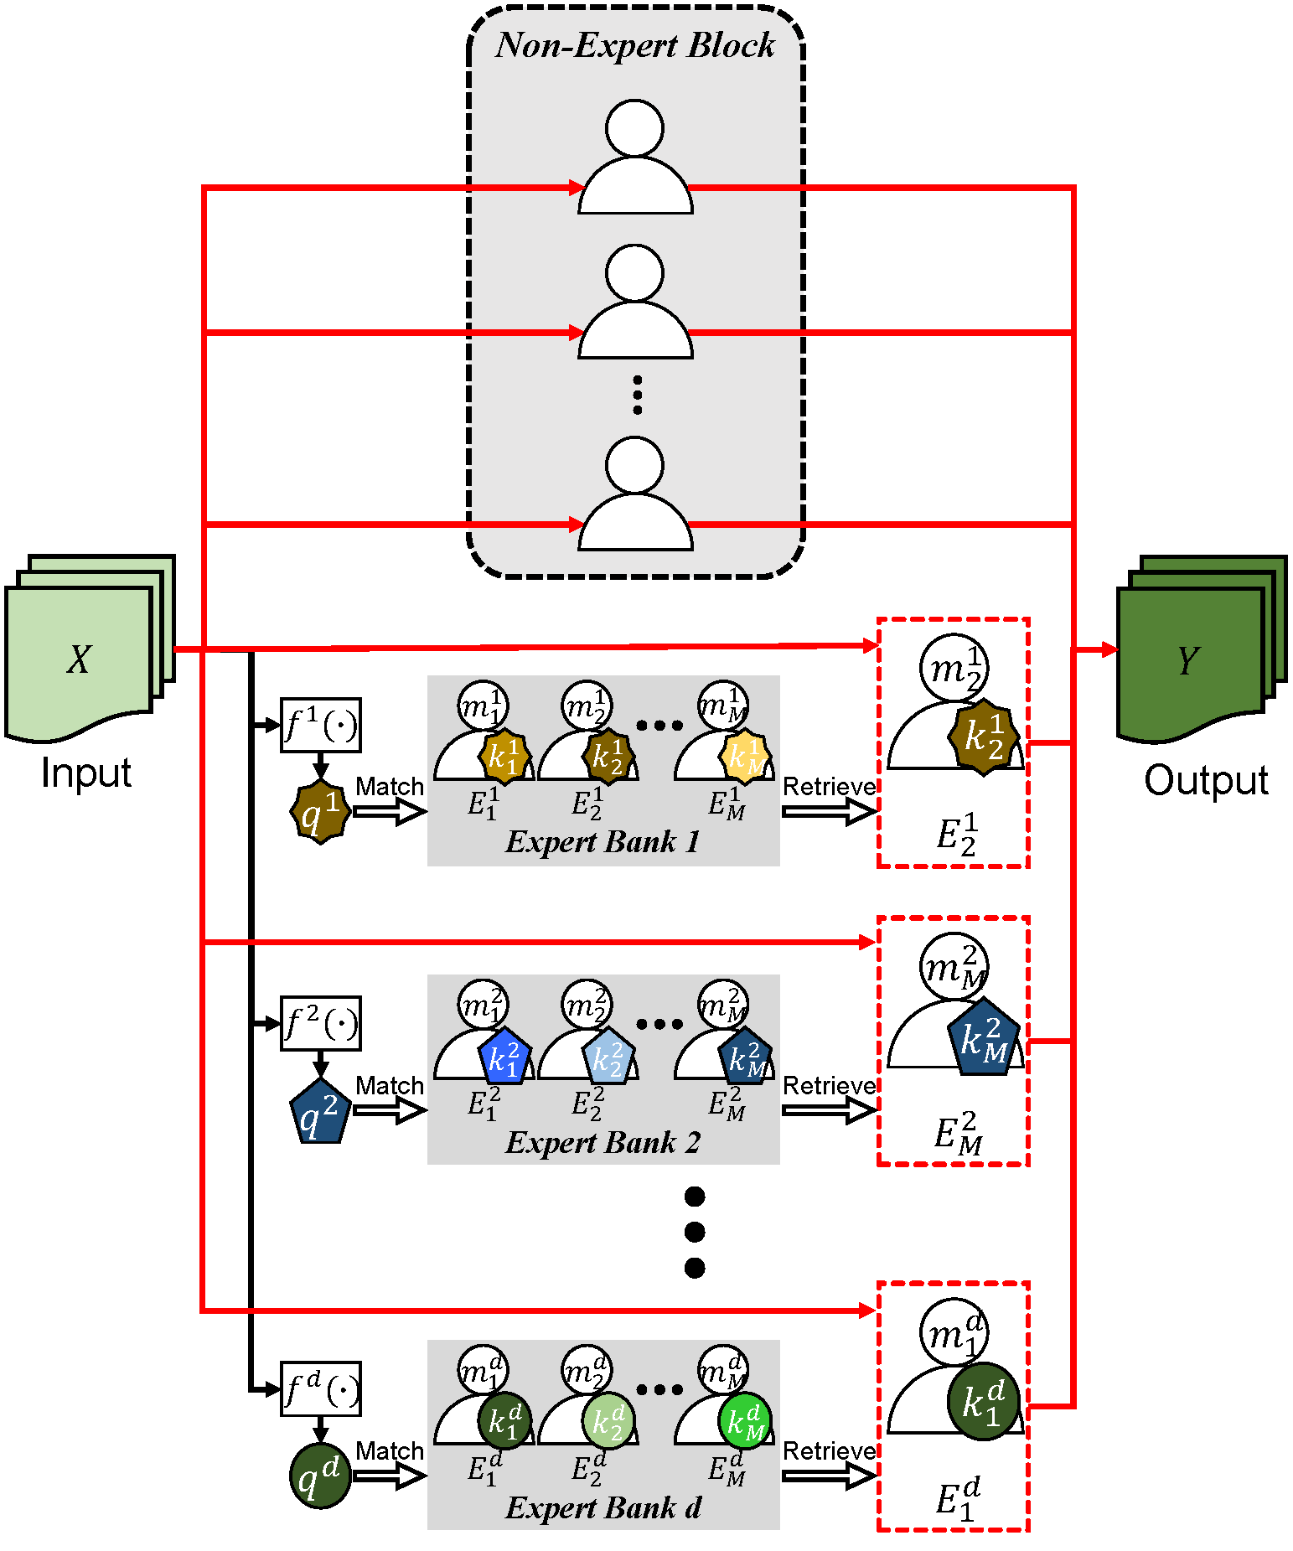
Expert Retrieval and Assembly (ERA)
We design a new module that can replace convolutional layers in Convolutional Neural Networks (CNNs).
Our module retrieves and assembles a set of experts most specialized at using discriminative subtle differences, to distinguish an input sample from other highly similar samples.
Notes:
To this end, we….. Design our ERA module
The design can be seen on the right.
design the ERA module with a set of experts to learn different subtle
cues that exist across different actions
module that retrieves and assembles a set of experts most specialized at using dis- criminative subtle differences, to distinguish an input sample from other highly similar samples. To encourage our model to effectively use subtle differences for early action prediction, we push experts to discriminate exclusively between samples that are highly similar, forcing these ex- perts to learn to use subtle differences that exist between those samples.

Slide 5
ERA Module Design
Highlights of the Design
Both non-experts and experts are used. Each expert/non-expert outputs a channel
Conditioned on the input, an expert is retrieved from each Expert Bank, while other experts are not used
Retrieval is done using Key-Query Mechanism to select similar experts for similar inputs, such that experts specialize in distinguishing using subtle cues
Notes:
Our ERA module contains both non-experts and experts.
Our non-expert block contains weights in a similar manner to the traditional convolutional layer.
Below, we have expert channels, where each expert channel has an expert bank.
The expert bank contains multiple experts.
In the forward pass, conditioned on the….. (read off the slides)
Note that this module can be trained in an end-to-end manner similar to traditional CNN layers, and thatt we do not need any additional labels during training.
design the ERA module with a set of experts to learn different subtle
cues that exist across different actions
module that retrieves and assembles a set of experts most specialized at using dis- criminative subtle differences, to distinguish an input sample from other highly similar samples. To encourage our model to effectively use subtle differences for early action prediction, we push experts to discriminate exclusively between samples that are highly similar, forcing these ex- perts to learn to use subtle differences that exist between those samples.
Can replace the traditional convolutional layer

Slide 6
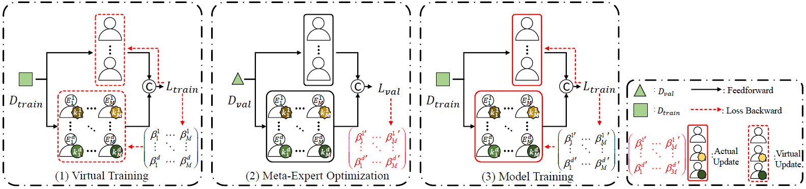
Expert Learning Rate Optimization (ELRO)
Motivation for New Training Scheme
Moreover, it is non-trivial to balance the training among the many different experts in the module.
For instance, as some subtle cues may be more common, a few experts are selected more often and might be better trained.
Notes:
(Read off the slides)
However, different experts may witness different samples, which leads to the uneven distribution for experts. To mitigate this issue, an effective Expert Learning Rate
Optimization (ELRO) is implemented during the training of the experts, which tunes their individual learning rates, resulting in a more effective training of experts and improved performance. The proposed method is shown in Fig.2.
However, it is non-trivial to balance the training among different experts in the ERA module, especially when the experts might be selected by vastly different numbers of samples. For instance, as some subtle cues may be more common, a few experts are selected more often and might be better trained.

Slide 7
Expert Learning Rate Optimization (ELRO)
Thus, we introduce individual expert learning rates for more balanced training of our experts. ELRO is implemented during the training of the experts, which tunes their individual learning rates together with the rest of the model parameters.
Overall, ELRO is a 3-step procedure shown below:
Notes:
Thus, we introduce individual expert learning rates for more balanced training of our experts.
An Expert Learning Rate Optimization training algorithm is also designed in order to optimize these experts’ individual learning rates together with the rest of our model parameters.
Overall, ELRO is a a 3-step procedure involving the use of meta-learning
In order to balance the training
However, different experts may witness different samples, which leads to the uneven distribution for experts. To mitigate this issue, an effective Expert Learning Rate
Optimization (ELRO) is implemented during the training of the experts, which tunes their individual learning rates, resulting in a more effective training of experts and improved performance. The proposed method is shown in Fig.2.
And here, meta-learning is used to optimize the expert’s individual learning rates.

Slide 8
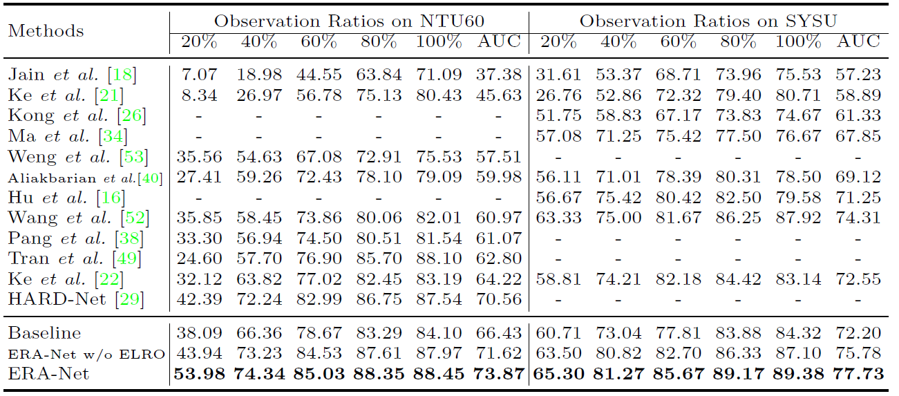
Experiments
Table 1: Results on NTU60 and SYSU
Notes:
Overall, we experiment on 4 popular and challenging datasets.
Here, we show our results on NTU60 and SYSU, where we achieve state-of-the-art results, and obtain a significant improvement over our baselines.

Slide 9
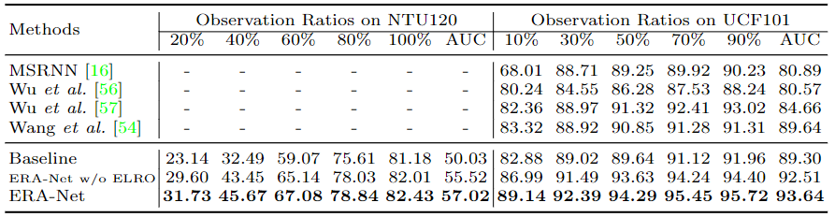
Experiments
Table 2: Results on NTU120 and UCF101
Notes:
Here, we show our results on NTU120 and UCF101, where we also obtain a significant improvement over our baselines.

Slide 10
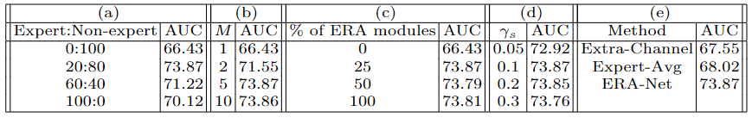
Experiments
Table 3: Ablation Studies conducted on NTU60
Notes:
Replace about 25% of the modules in the backbone. Achieve good results.

Slide 11
Qualitative Validation
Supplementary Figure 1: Visualization of experts selection.
Notes:
Here, we provide some qualitative validation of our module.
We observe that, when samples from similar actions are input into the module, our module tends to select the same experts for them.
On the other hand, when the samples are from actions that are very different, for example kicking and point finger, our module tends to select different experts.

Slide 12
Summary
We propose a novel ERA module that effectively utilizes subtle discriminative differences between similar actions through retrieval and assembly of the most suitable experts for action prediction. Our ERA module is a flexible plug-and-play module that can replace the traditional convolutional layer.
To balance the training among experts and further improve performance of the ERA module on early action prediction, we design an effective ELRO method.
We obtain state-of-the-art-performance on early action prediction on four widely used datasets by replacing convolutional layers of the baseline architectures with our ERA modules.

Slide 13
Thank You!
Notes:
This is the end of the presentation.
Thank you very much for your kind attention.

