Slide 1
Detailed Steps for Granger Causality calculation for categorical datasets
Tian Linger Xu
May 4th, 2017

Slide 2
Outline
What is Granger Causality?
Theories and equations
How is Granger Causality calculated?
Fit GLM for modelling each variable as autoregressive model and pick the best history order with AIC
Calculate LLK of excluding each neuron using a new GLM model and parameters
Use simulated data to testify the magnitude of Granger Causality values
Preprocessing for our multimodal datasets
Notes:
Which we know the ground truth temporal relations

Slide 3
Granger causality
Wiener-Granger causality is a statistical notion of causality applicable to time series data, originally developed in the context of econometric theory.
In 2003, Clive Granger was awarded the Nobel Memorial Prize in Economic Sciences, in recognition that he and his co-winner, Robert F. Engle, had made contributions to the analysis of time series data that had changed fundamentally the way in which economists analyze financial and macroeconomic data.
Notes:
, then achieved broad application in the neuroscience field and beyond.

Slide 4
Granger causality
Granger (1969) formalized the basic idea of causality between signals introduced by Wiener (1956) based on multivariate autoregressive (MVAR) models of stochastic processes:
If past values of Y contains information that helps predict X above and beyond the information contained in the past values of X alone, then Y is said to Granger-cause X.

Slide 5
Granger causality
The cause occurs before the effect;
The cause contains information about the effect that that is unique, and is in no other variable.
A consequence of these statements is that the causal variable can help forecast the effect variable, beyond or incorporating all other variables’ predictabilities.
Notes:
1. So there is a notion of temporal precedence embedded in computing granger causality;
2.
A consequence of these statements is that the causal variable can help forecast the effect variable after other data has first been used. Unfortunately, many users concentrated on this forecasting implication rather than on the original definition. At that time, I had little idea that so many people had very fixed ideas about causation, but they did agree that my definition was not “true causation” in their eyes, it was only “Granger causation.” I would ask for a definition of true causation, but no one would reply.

Slide 6
Granger causality
What is multivariate autoregressive (MVAR) models?
How Granger causality is calculated based on MVAR?

Slide 7
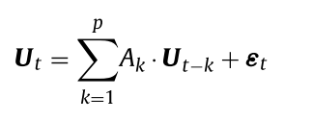
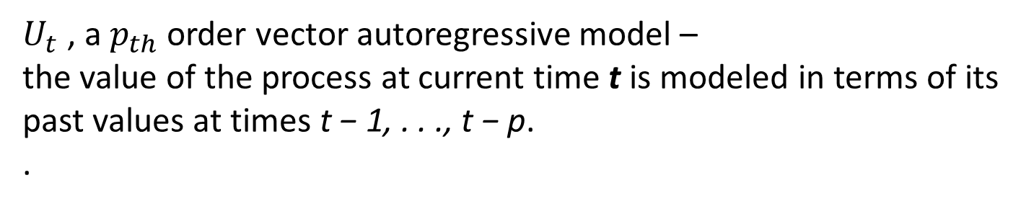
$U_{t}$ , a $p_{th}$ order vector autoregressive model –
the value of the process at current time t is modeled in terms of its
past values at times t − 1, . . ., t − p.
.
Notes:
Here p is the model order, which may be infinite.
The regression coefficients represent the predictable structure of the data, the residuals the unpredictable

Slide 8
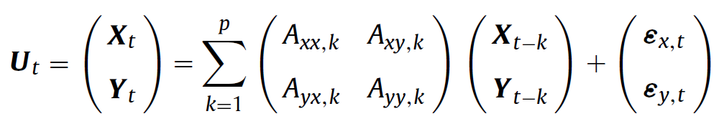
$U_{t}$ , a $p_{th}$ order vector autoregressive model,
is split into two jointly distributed (inter-dependent)
multivariate processes:
Notes:
Here p is the model order, which may be infinite. The

Slide 9
$U_{t}$ , a $p_{th}$ order vector autoregressive model,
is split into two jointly distributed (inter-dependent)
multivariate processes:

Slide 10
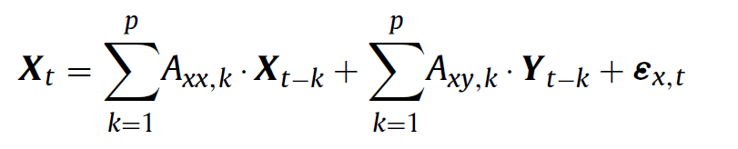
The $x$ component of the regression, dependent on the past of $X$ and $Y$
Notes:
And in order to evaluate whether Y contains information that is beyond X’s own history

Slide 11
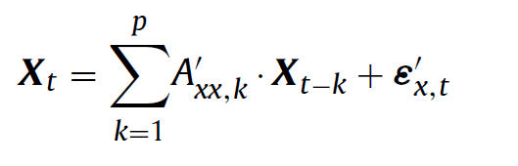
The $x$ component of the regression, dependent on the past of $X$ and $Y$
Above full regression vs reduced regression (by omitting $Y$’s history)

Slide 12
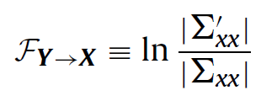
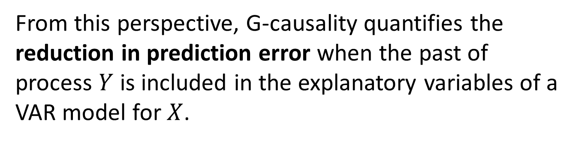
G-causality from $Y$ to $X$ is defined to be the log-likelihood ratio
From this perspective, G-causality quantifies the reduction in prediction error when the past of process $Y$ is included in the explanatory variables of a VAR model for $X$.

Slide 13
Likelihood with history of the entire system that have lead to a
specific sequence of X
Y
History of
X
A sequence of
w
z
X

Slide 14
Likelihood with history of the entire system that have lead to a
specific sequence of X
Y
History of
X
A sequence of
w
z
X
Likelihood with history of the entire system excluding Y
w
X
z
X
History of
A sequence of

Slide 15
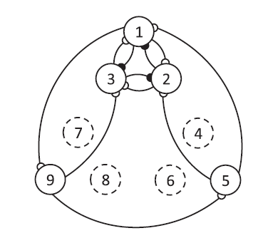
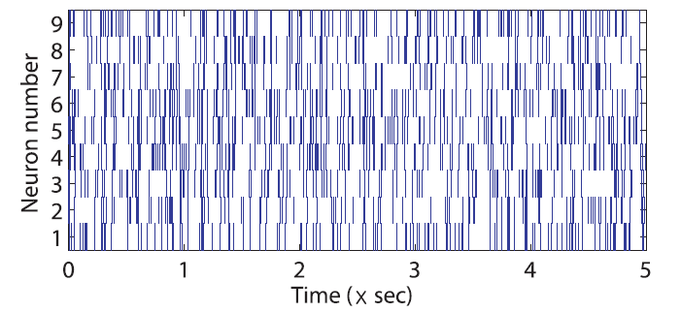
Kim et al. (2011) proposed a point process framework to enable Granger causality to be applied to point process data with discrete nature.
Notes:
A temporal point process is a stochastic time-series of binary events that occurs in continuous time. It can only take on two values at each point in time, indicating whether or not an event has actually occurred.

Slide 16
This framework models the conditional intensity function (CIF) of the point process with generalized linear model (GLM).

Slide 17
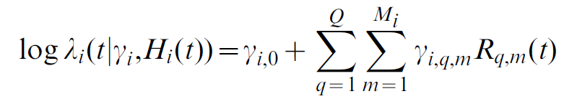
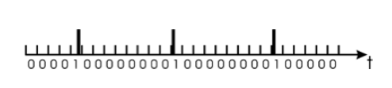

The log likelihood of neuron $i$’s activity in the time interval (0, t] is modeled as a linear combination of the dependency of neuron $i$’s firing probability to the history of each individual neuron in the ensemble.
Spike count of neuron $q$
in $m_{th}$ time window
Kim et al., 2011

Slide 18
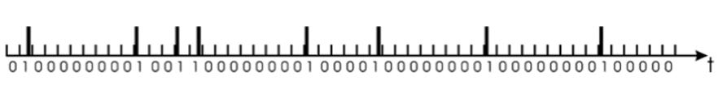
History data to make inferences
Prediction target

Slide 22
In the next round, increase history window by 1

Slide 25
Iterate through all possible history windows

Slide 26
After obtaining general linear models (GLM) with all possible history window sizes, select best approximating model using Akaike’s information criterion (Akaike, 1974) or Bayesian information criterion (Schwartz, 1978).
Choose the best fitting model order p for each variable.

Slide 27
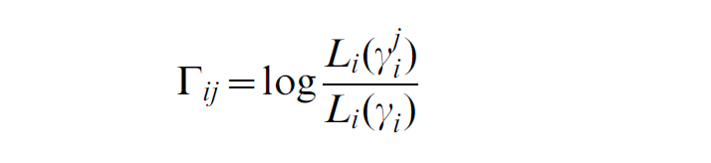
The causal relationships between $Y$ to $X$ is assessed by calculating the relative reduction in the likelihood of producing a particular section of time series of $X$ if the history of $Y$ is excluded, compared with the likelihood if all the available covariates are used.
If LLK = 0, there is no causal influence
If LLK < 0, history of $j$ has a causal influence on $i$

Slide 28
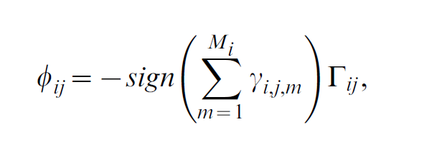
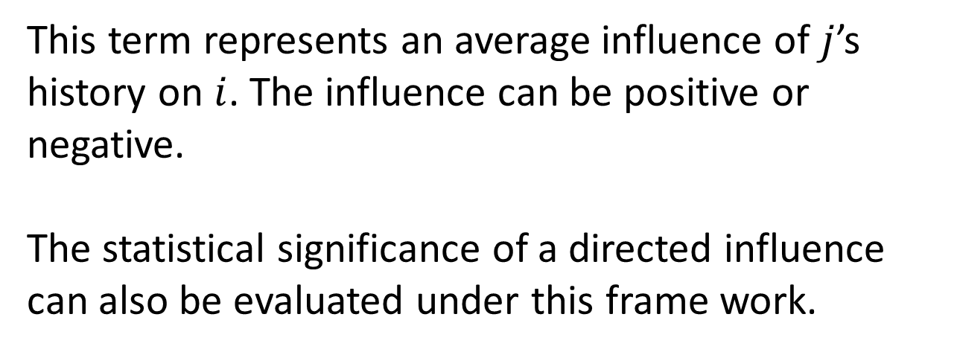
The granger causality measure from $j$ to $i$:
This term represents an average influence of $j$’s history on $i$. The influence can be positive or negative.
The statistical significance of a directed influence can also be evaluated under this frame work.

Slide 29
Significance test
The deviance is obtained by comparing the estimated model with a more general model that has a parameter for every observation so that the data fits exactly, which is called a full model.
In the GLM framework the deviance is used to compare two models.
Thus, the deviance difference between two models is equivalent to -2 times log-likelihood ratio, LLK.

Slide 30
What types of temporal inferences we can make from applying G-causality to time series?
What factors in temporal relations will influence the magnitude of G-causality?

Slide 31
Demo cases for extracting G-causality with simulated data
Github link:
https://github.com/lingerxu/Granger_demo

Slide 32

onset step size = 200
Total data length 3000
$$stream1$$

Slide 33
onset step size = 200
Total data length 3000
$$stream1$$
Create a streams whose onset always precedes stream1
The onset stream2 happens before the onset of stream1 randomly within a certain window size

Slide 34
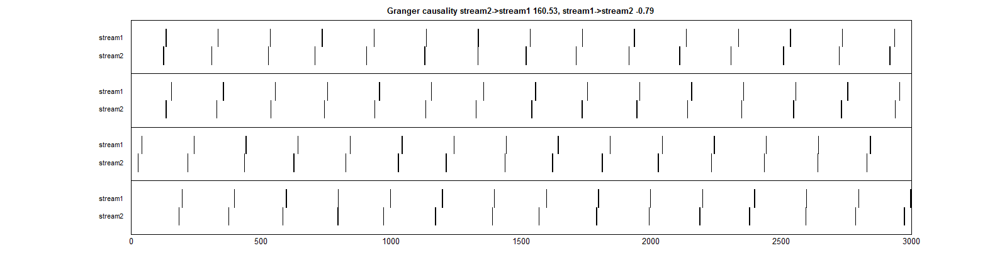


onset step size = 200
Total data length 3000
$$stream1$$
$$stream2$$
window_size = 30 data points

Slide 35
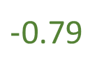

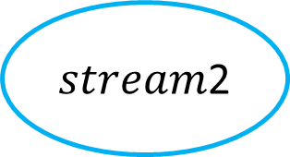
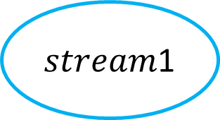
$$160.55$$
$stream$1
$stream$2
Total data length 3000
$−$0.79
Onset step size = 200
Window size = 30

Slide 36


Three factors in temporal relations
The response time between a leading stream event onset and a following event onset
The shorter the window, the higher gcause value
$$stream2$$
$$stream1$$
Notes:
Of course with regard to the entire network

Slide 37
Three factors in temporal relations
The response time between a leading stream event onset and a following event onset
The shorter the window, the higher gcause value
The frequency of the temporal causal relationship
The higher the frequency, the higher gcause value
Notes:
Of course with regard to the entire network

Slide 38
Three factors in temporal relations
The response time between a leading stream event onset and a following event onset
The shorter the window, the higher gcause value
The frequency of the temporal causal relationship
The higher the frequency, the higher gcause value
The rate of successful leading relationships given same event frequency
The higher probability, the higher gcause value
Notes:
Of course with regard to the entire network

Slide 39
$$160.55$$
$stream$1
$stream$2
Total data length 3000
$−$0.79
Onset step size = 200
Window size = 30

Slide 40
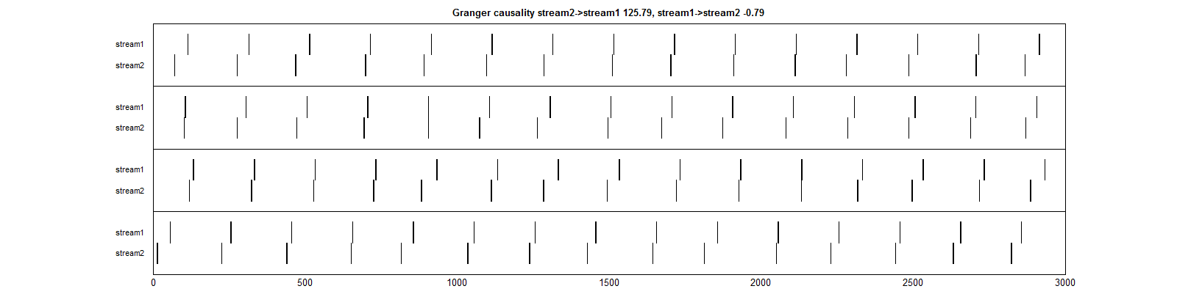


$$125.79$$
$stream$1
$stream$2
Total data length 3000
$$−0.79$$
Onset step size = 200
Window size = 50

Slide 41
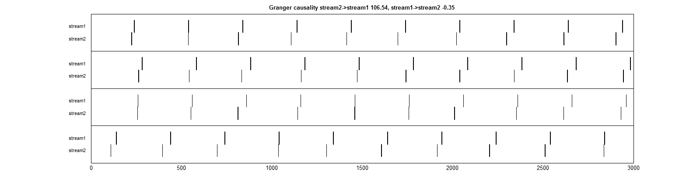


$$106.54$$
$stream$1
$stream$2
Total data length 3000
$$−0.35$$
Onset step size = 300
Window size = 50

Slide 42


onset step size = 200
Total data length 3000
$$stream1$$
$$stream2$$
$$stream3$$
Multiple leading relations with different parameters

Slide 43
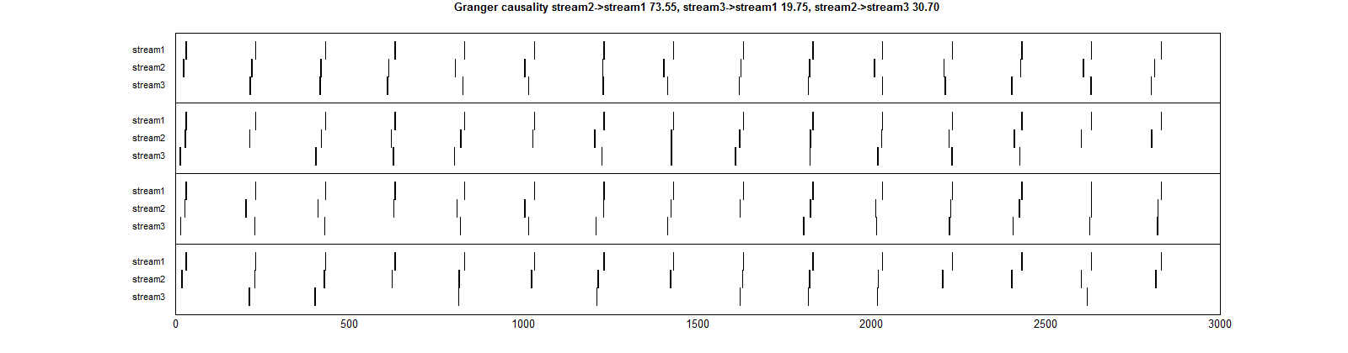


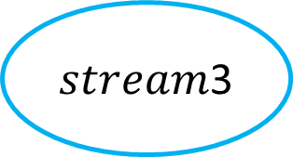
$$73.55$$
$stream$1
$stream$2
Among all the occurrences of
stream1, stream2 occurs 90%
of the time; stream3 occurs
50% of the time
$$19.75$$
$stream$3

Slide 44
Interpreting G-cause with simulated temporal streams
Granger causality indeed can detect relationships among correlated temporal variables reliably, even with multiple leading relationships/causes.
Magnitude of G-cause is sensitive to:
a) the response time between a leading stream and a following stream with regard to the entire network;
b) the frequency of the temporal causal relationship;
c) the rate of the leading event successfully triggered the onset of the following event.
Notes:
With simulated data, we found out that granger causality indeed can detect relationships among correlated temporal variables reliably in various contexts. It can even extract multiple confounding leading relationships that have directional influence towards the same variable/node, with regard to their level of casual influence. Several factors that influence the magnitude of granger causality in temporal data streams are: a) the response time between a leading stream and a following stream with regard to the entire network; b) the frequency of the temporal causal relationship; c) the rate of the leading event successfully triggered the onset of the following event.

Slide 45
Interpreting G-cause with simulated temporal streams
What would be the baseline? How about randomly distributed time series?

Slide 46
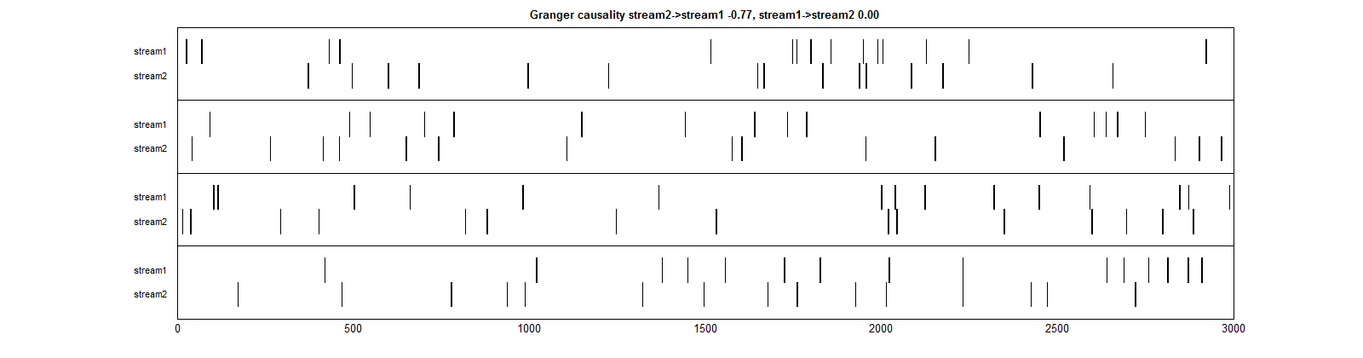
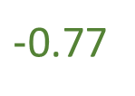

$−$0.77
$stream$1
$stream$2
Totally randomly distributed
temporal streams
$$0.00$$

Slide 47
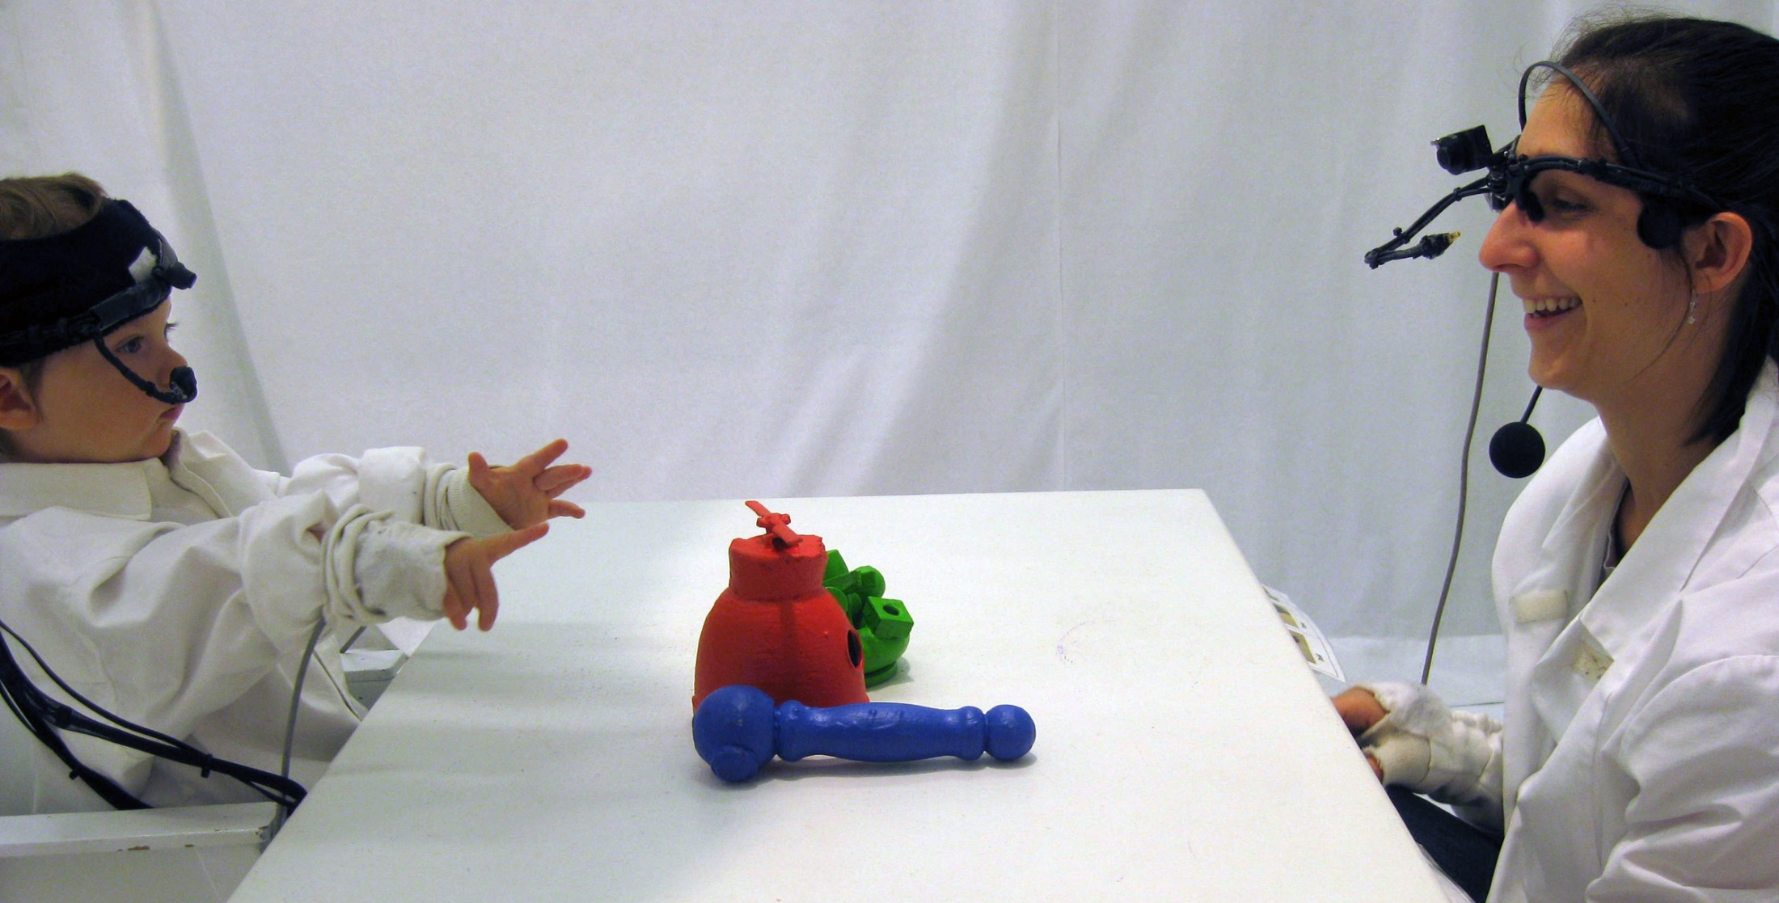
Mining directional Granger Causality in multimodal child-parent interaction data set
Notes:
We will first introduce our child parent interaction data set,
Explain the construction process of CRP with our collected multimodal behavioral streams

Slide 48
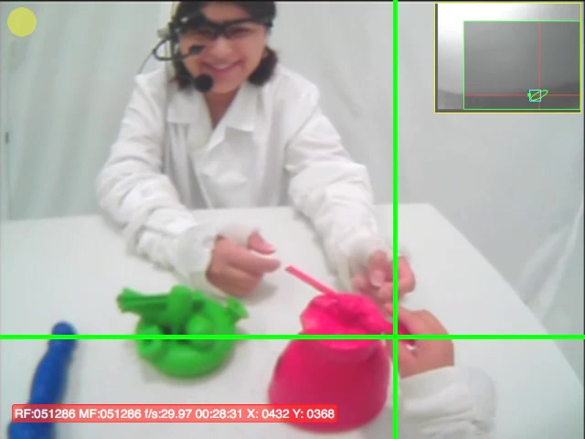
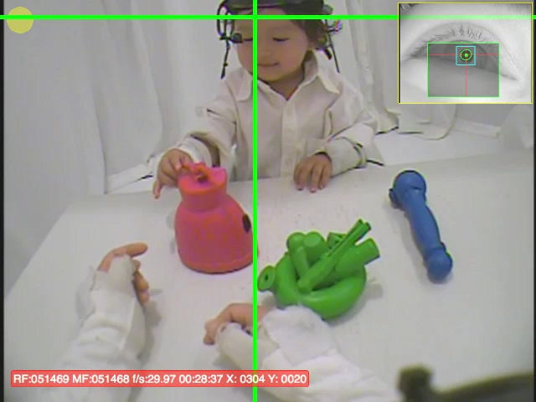
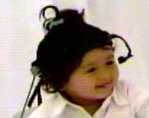
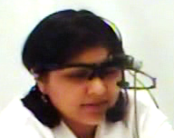
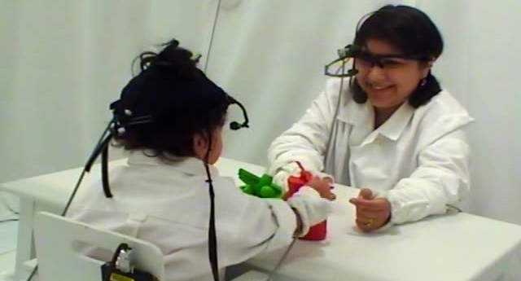
The child’s first person view
The parent’s first person view
From eye camera
From eye camera
Child’s eye tracker
Eye gaze tracking and Region-Of-Interest (ROI) coding
Manual coding of hand action: child right hand holding red object
Speech recording
Notes:
We invited children at different age groups with their caregivers to our lab. During the experiment, they will engage in free-following interaction by playing with three colorful objects.
Light weight cameras and eye trackers were placed on their forehead to track their gaze and first person visual input in real-time. (Emphasize this??)
We also record their hand and body movements, as well as their speech.

Slide 49


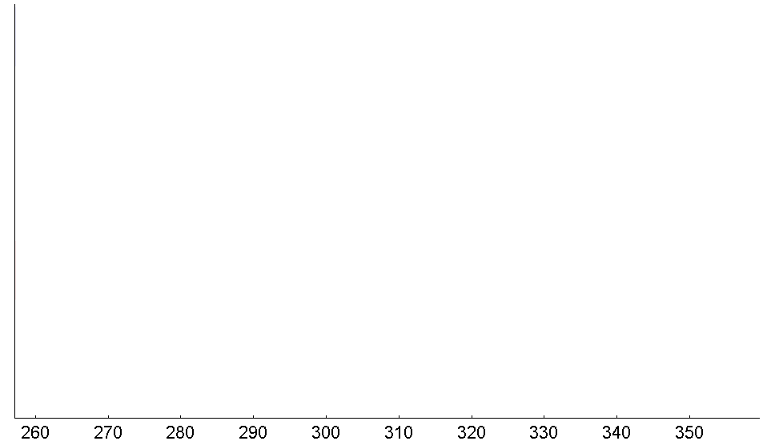
Child gaze
Parent gaze
Child left hand
Child right hand
Parent left hand
Data collection sample rate:
30 data points / second
Parent right hand
Time (in seconds)
Notes:
Each trial lasted 90 seconds long, and our recording sampling rate is 30 data points per second.
After data collection, we coded data from each behavioral module into categorical time series.
With gaze data,
and speech data

Slide 50
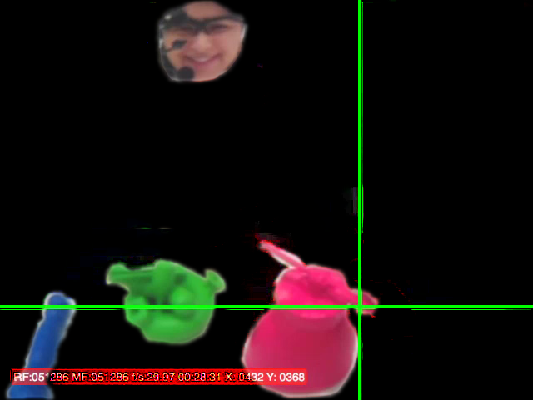
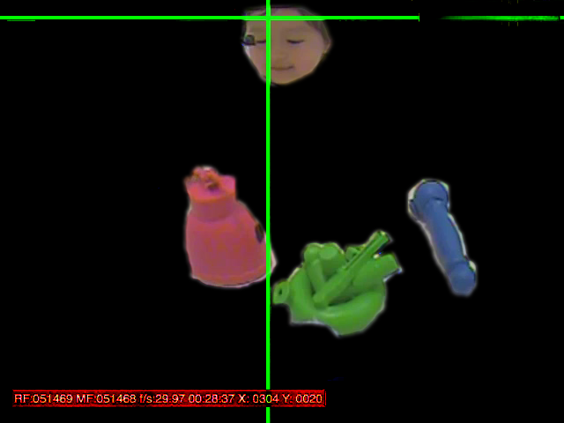
Child gaze
Parent gaze
Child left hand
Child right hand
Parent left hand
Parent right hand
Time (in seconds)
Notes:
With gaze data, there are four possible ROI values, the child could…
And the other partner’s face

Slide 51
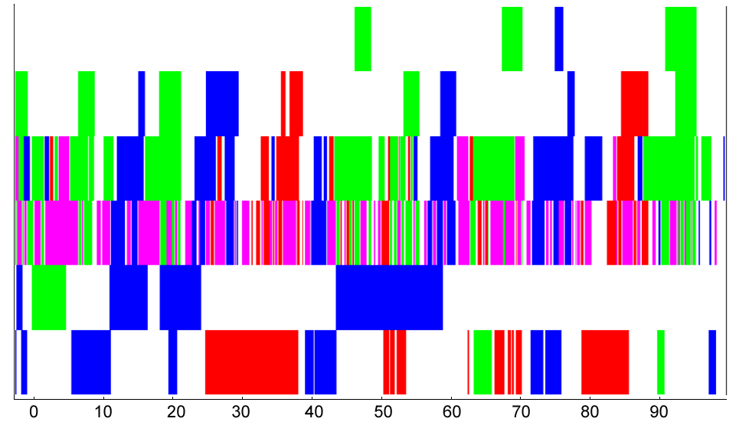
Child left hand
Child right hand
Child eye
Parent eye
Parent left hand
Parent right hand
Time (in seconds)
Notes:
The same with inhand holding streams
Different color representing where the child or the parent was looking at and holding the experiment throughout time

Slide 52
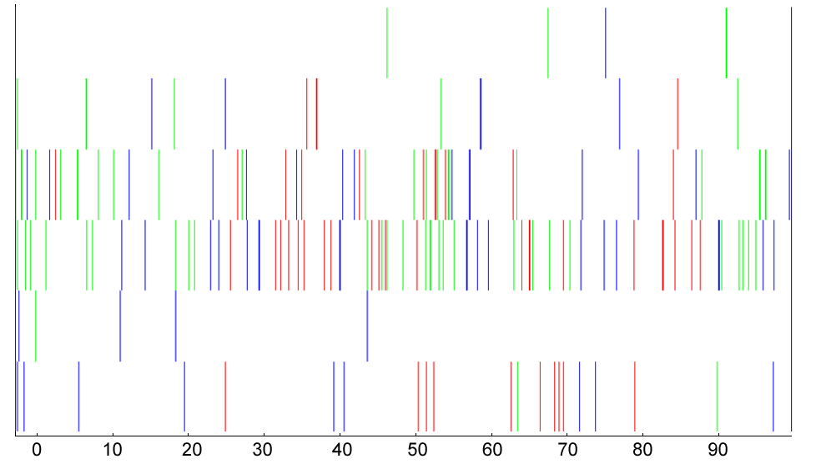
Child left hand
Child right hand
Child eye
Parent eye
Parent left hand
Parent right hand
Time (in seconds)
Notes:
The same with inhand holding streams
Different color representing where the child or the parent was looking at and holding the experiment throughout time

Slide 53
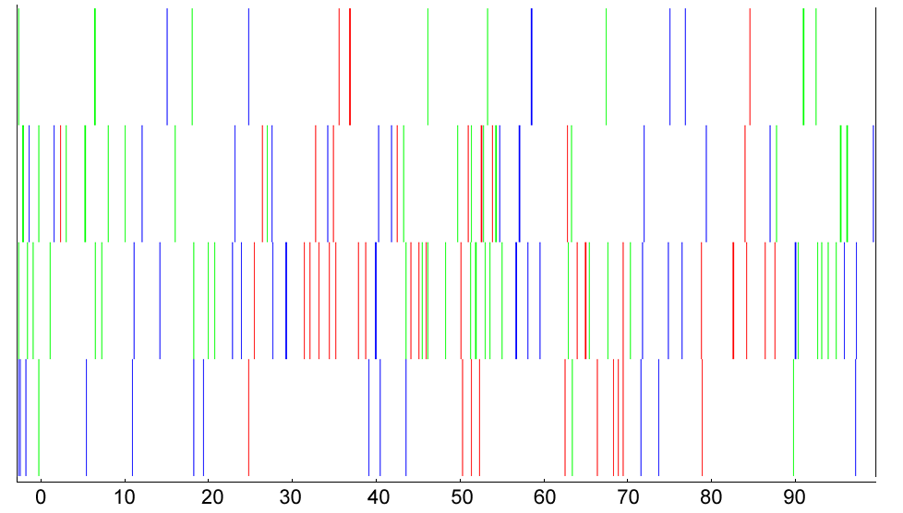
Child hand
Child eye
Parent eye
Parent hand
Time (in seconds)
Notes:
The same with inhand holding streams
Different color representing where the child or the parent was looking at and holding the experiment throughout time

Slide 54
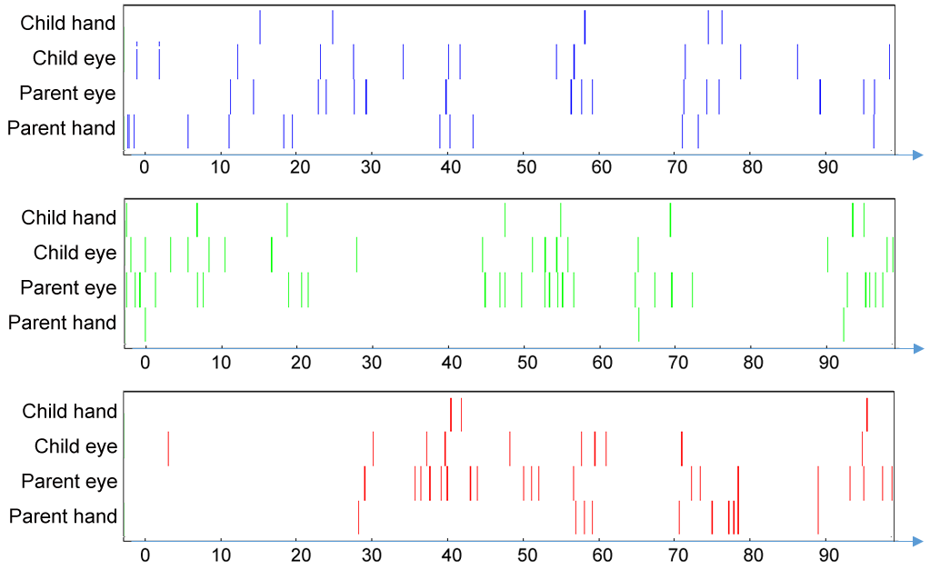
Notes:
The same with inhand holding streams
Different color representing where the child or the parent was looking at and holding the experiment throughout time

Slide 55
???
Child Eye
Parent Eye
Child Hand
Parent Hand
Notes:
And to get a better sense of granger causality value, we also tested the algorithm with simulated datasets in which we know the ground truth of certain event onsets precedes or follows other types of events.

Slide 56
Baseline calculation

Slide 57
Notes:
The same with inhand holding streams
Different color representing where the child or the parent was looking at and holding the experiment throughout time

Slide 58
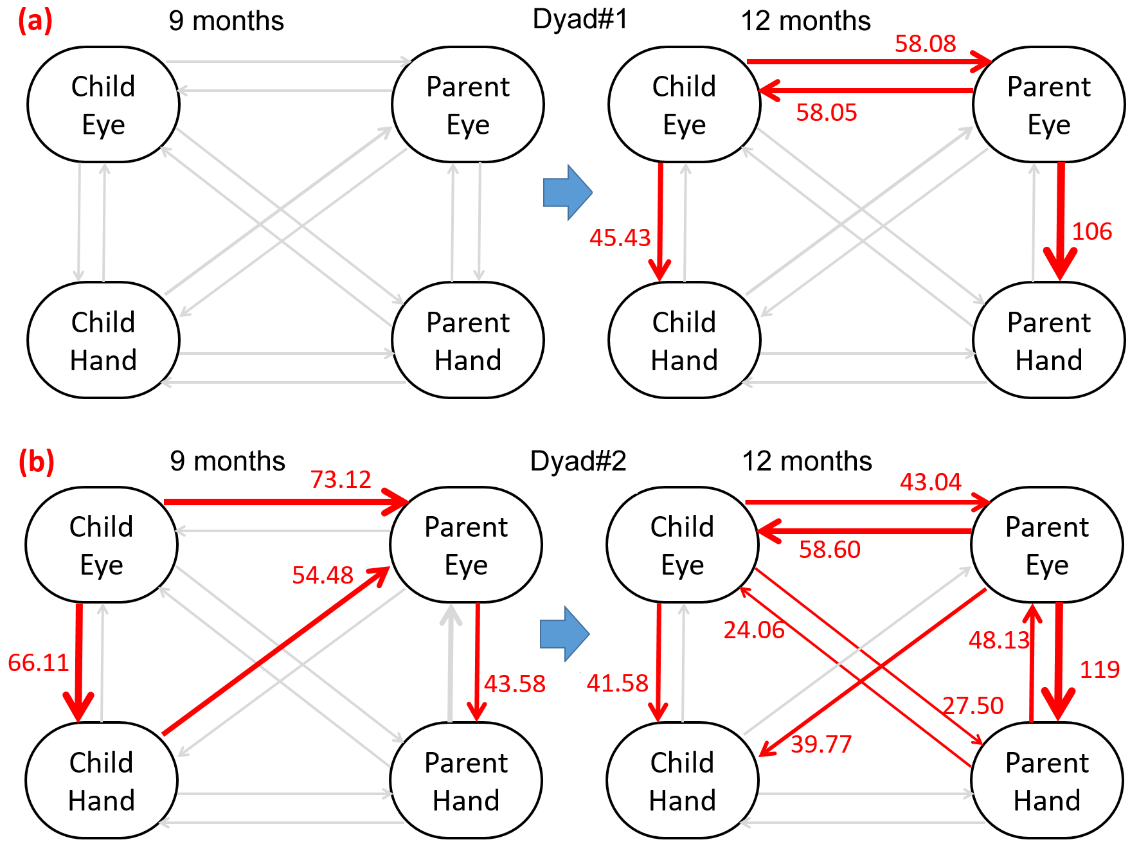
Directional influences in Infant Parent Interaction

Slide 59
Research questions
At a certain age group, what are the significant directional influences in child-parent coordinated behaviors, both intra-personally and inter-personally?
Do these relations change developmentally? Are there distinct individual differences?
Many other potential applications.

Slide 60
Thank you!
Questions?

