Slide 1
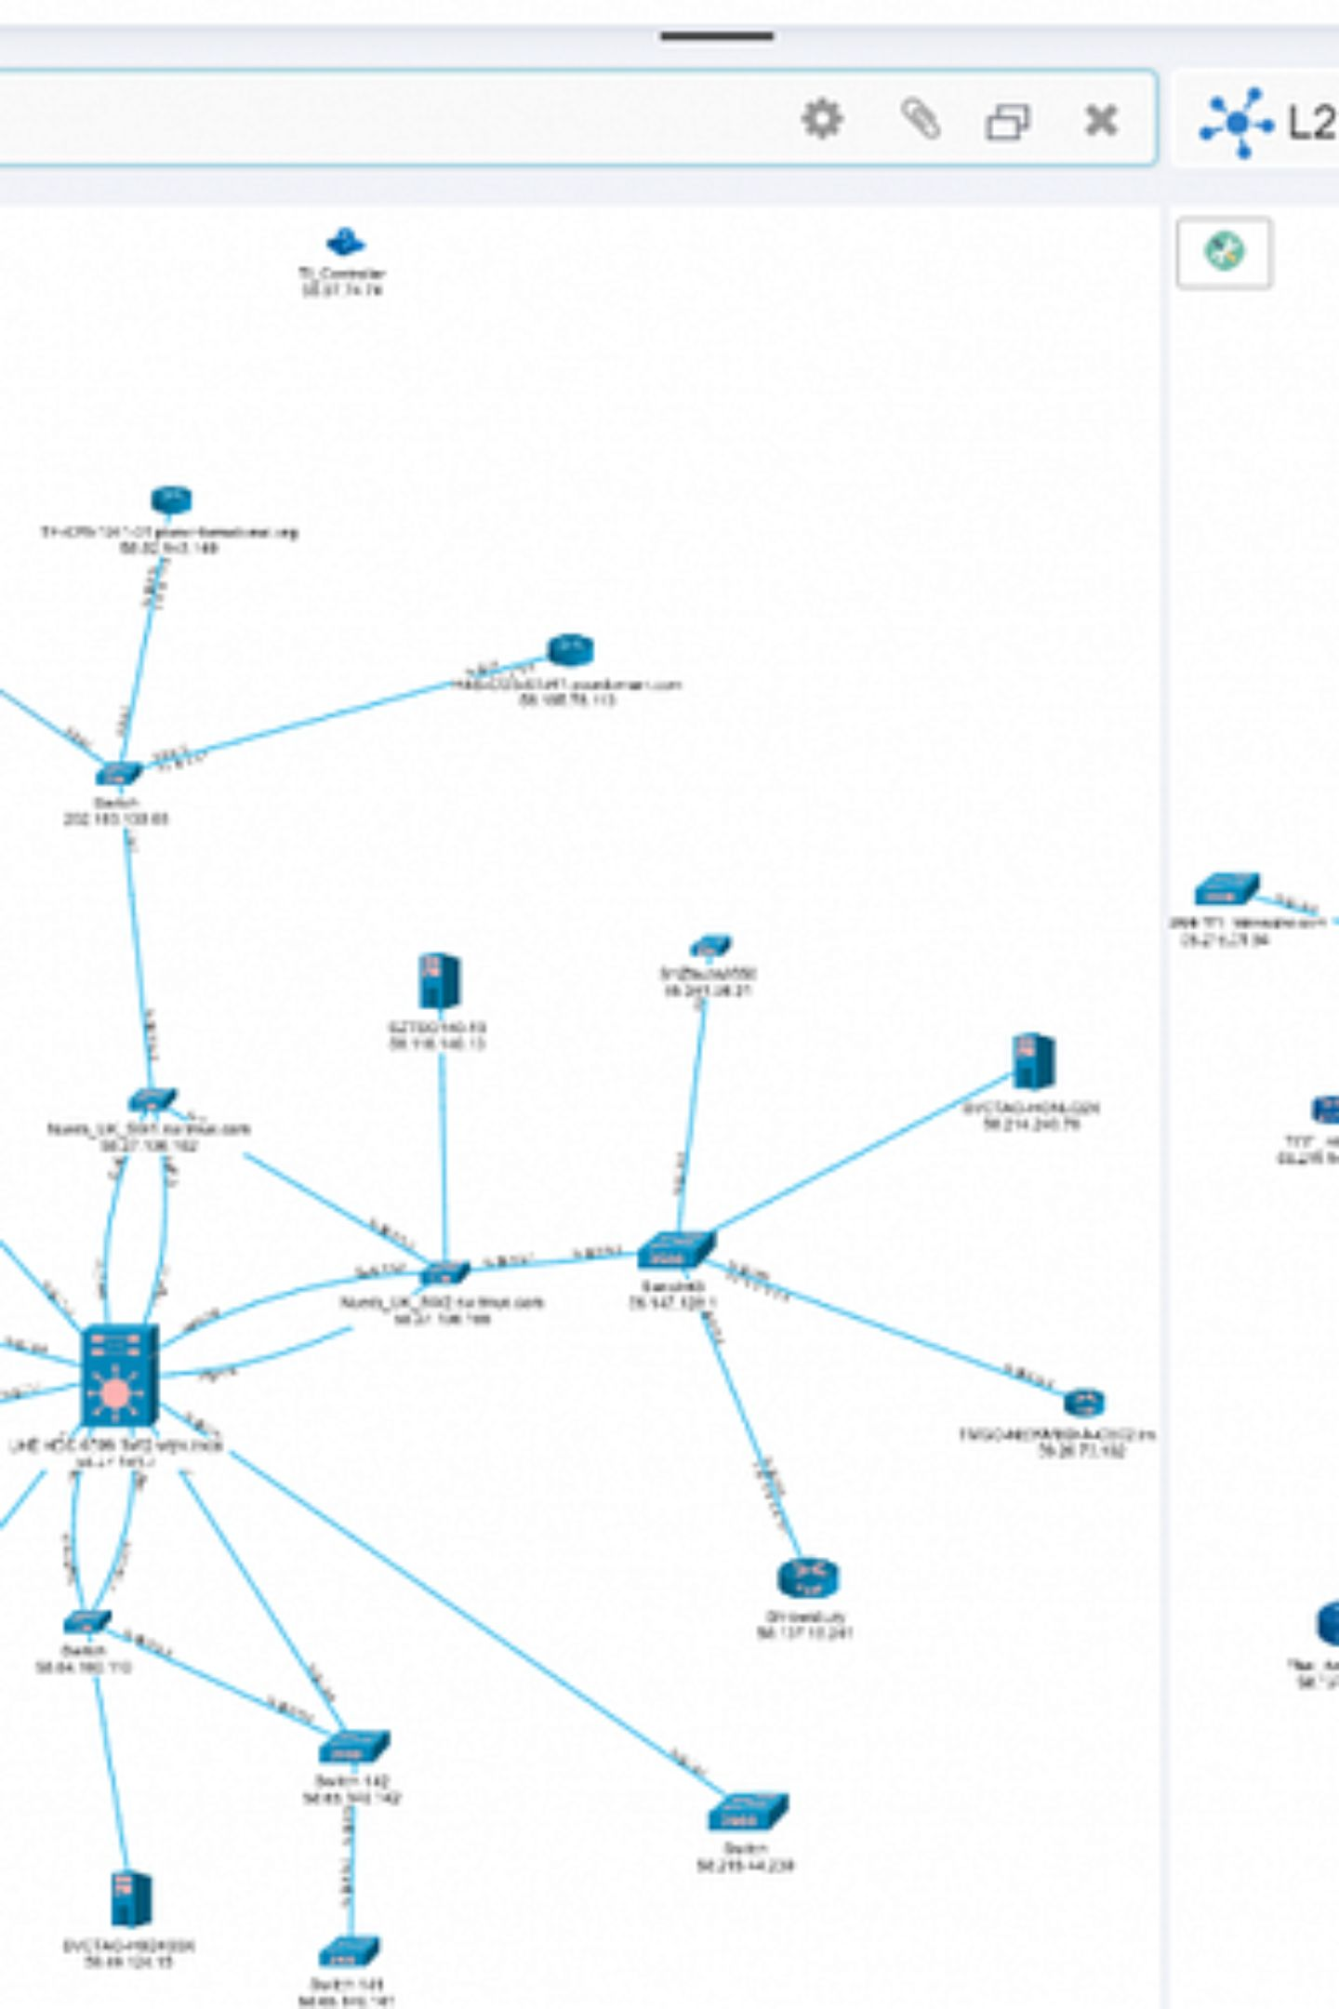
TDMA Scheduler — Executive Summary
Topology-aware TDMA scheduler produced a conflict-free 9-slot frame for a 16-node 4×4 grid using a 500 m configured radio range. Integrated with EMANE 1.5.3 (16 NEMs), published TDMA events, created emane1–emane16 (172.30.1.1–.16), and validated packet-level connectivity: 5 transmitted, 5 received, 0% loss.

Slide 2

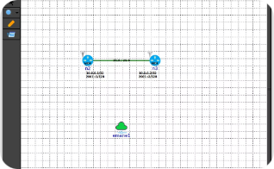
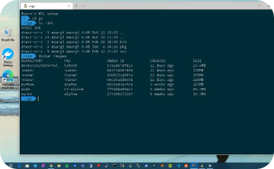
Project Overview
Implementation
Simulation Platform
Environment
Python with NetworkX drives scheduling logic and exports EMANE XML.
WSL2 / Ubuntu 22.04 for emulation and testing (TUN device considerations noted).
EMANE 1.5.3 used for event publication and virtual NEM validation.

Slide 3
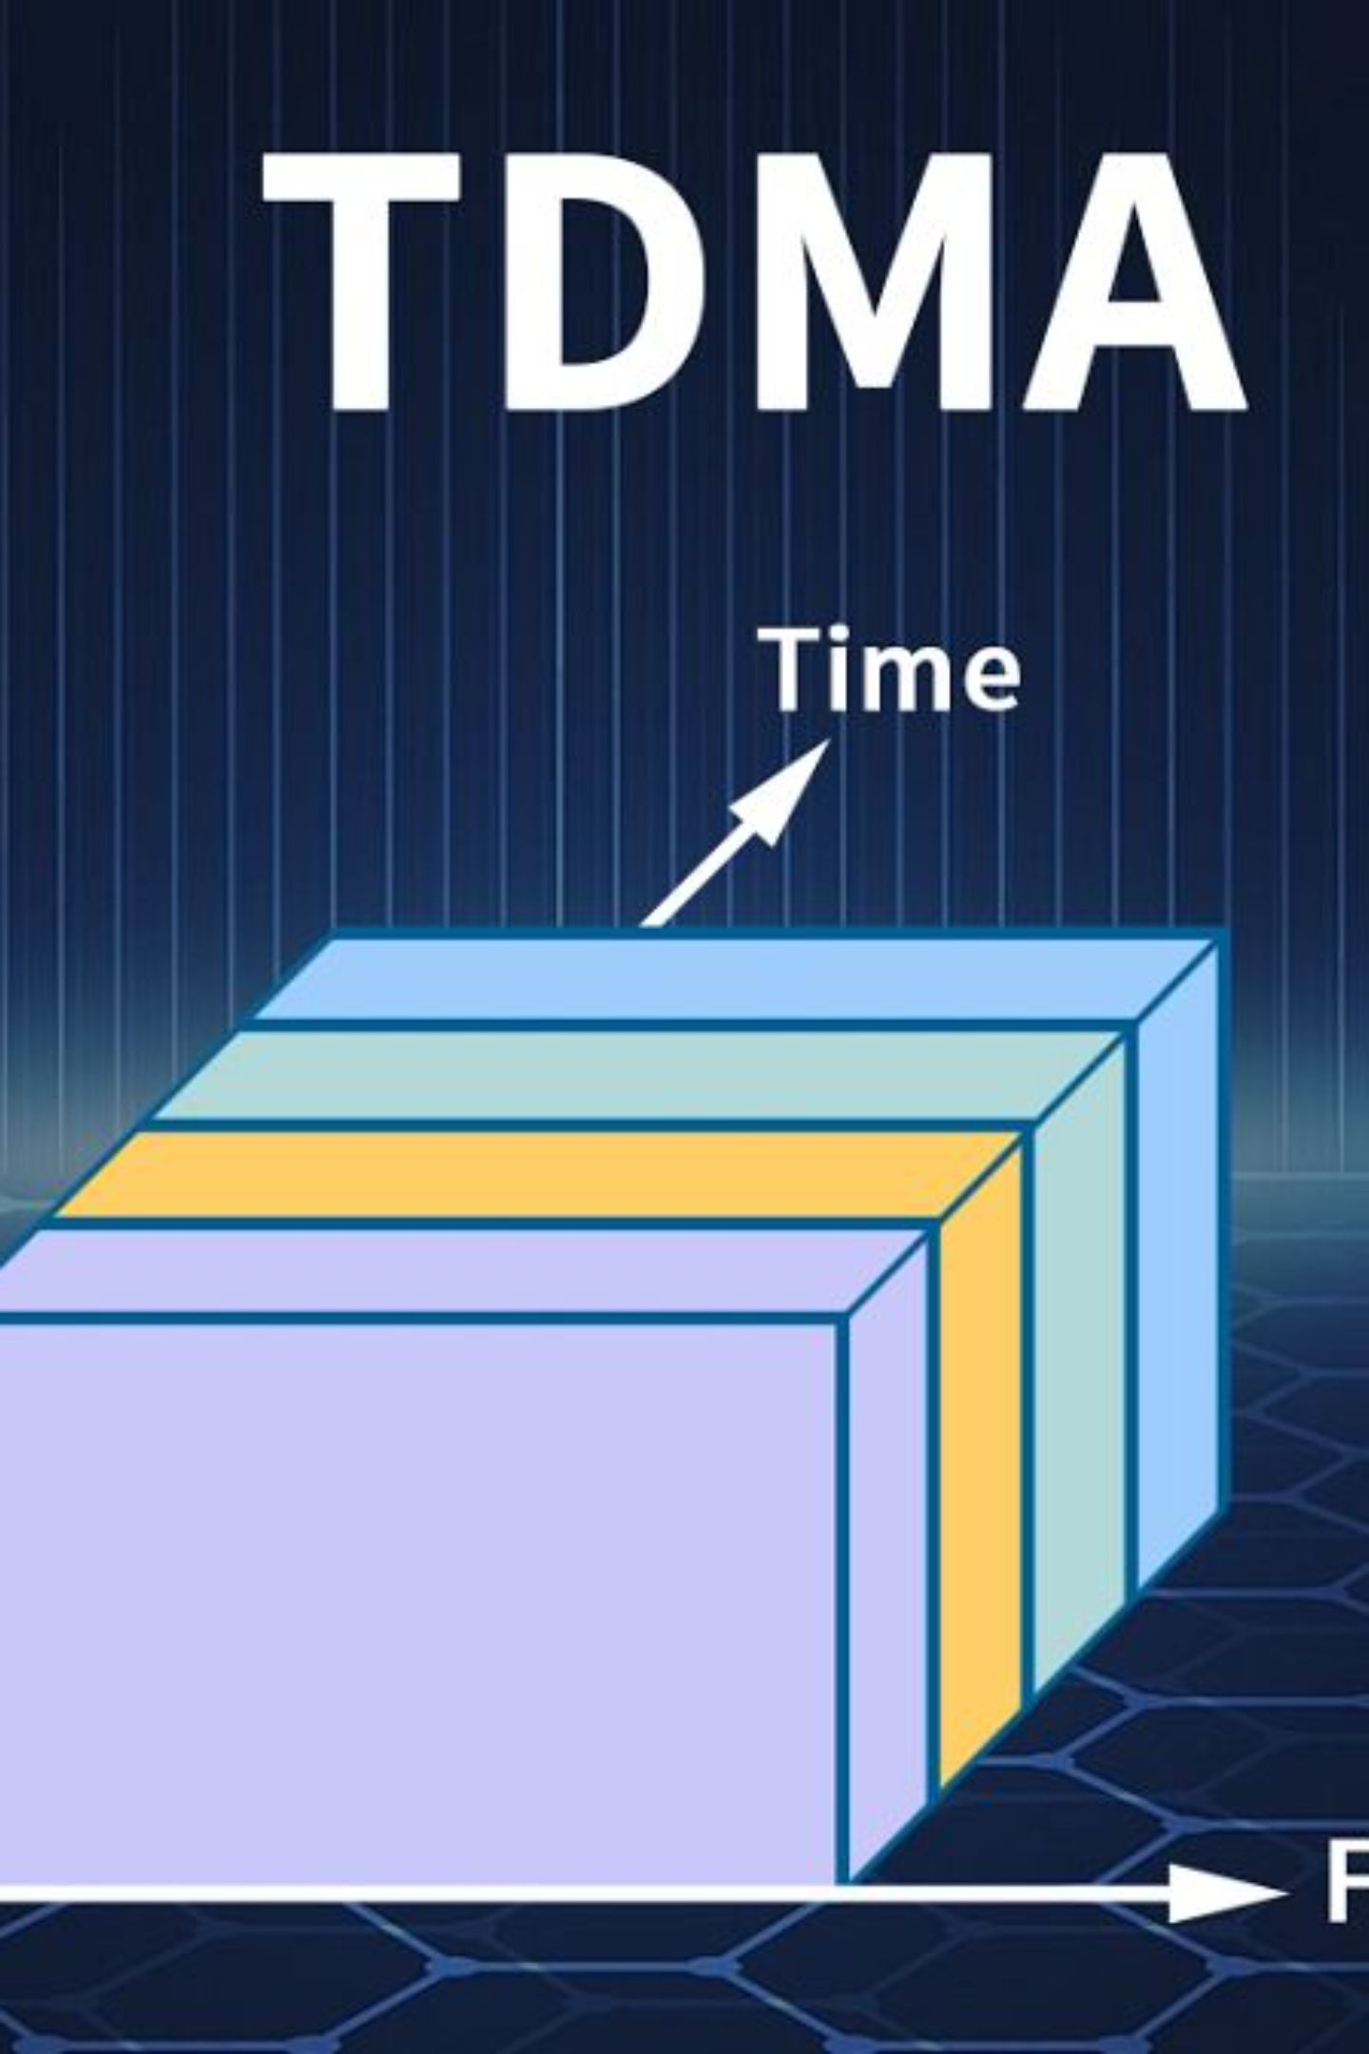

Schedule Summary
Single frame with 9 unique timeslots, 1000 µs slot duration, 1 MHz bandwidth, 2.4 GHz frequency, and reported conflict-free assignment across 16 nodes.
Optimized spatial reuse groups multiple transmitters per slot where constraints allow.

Slide 4
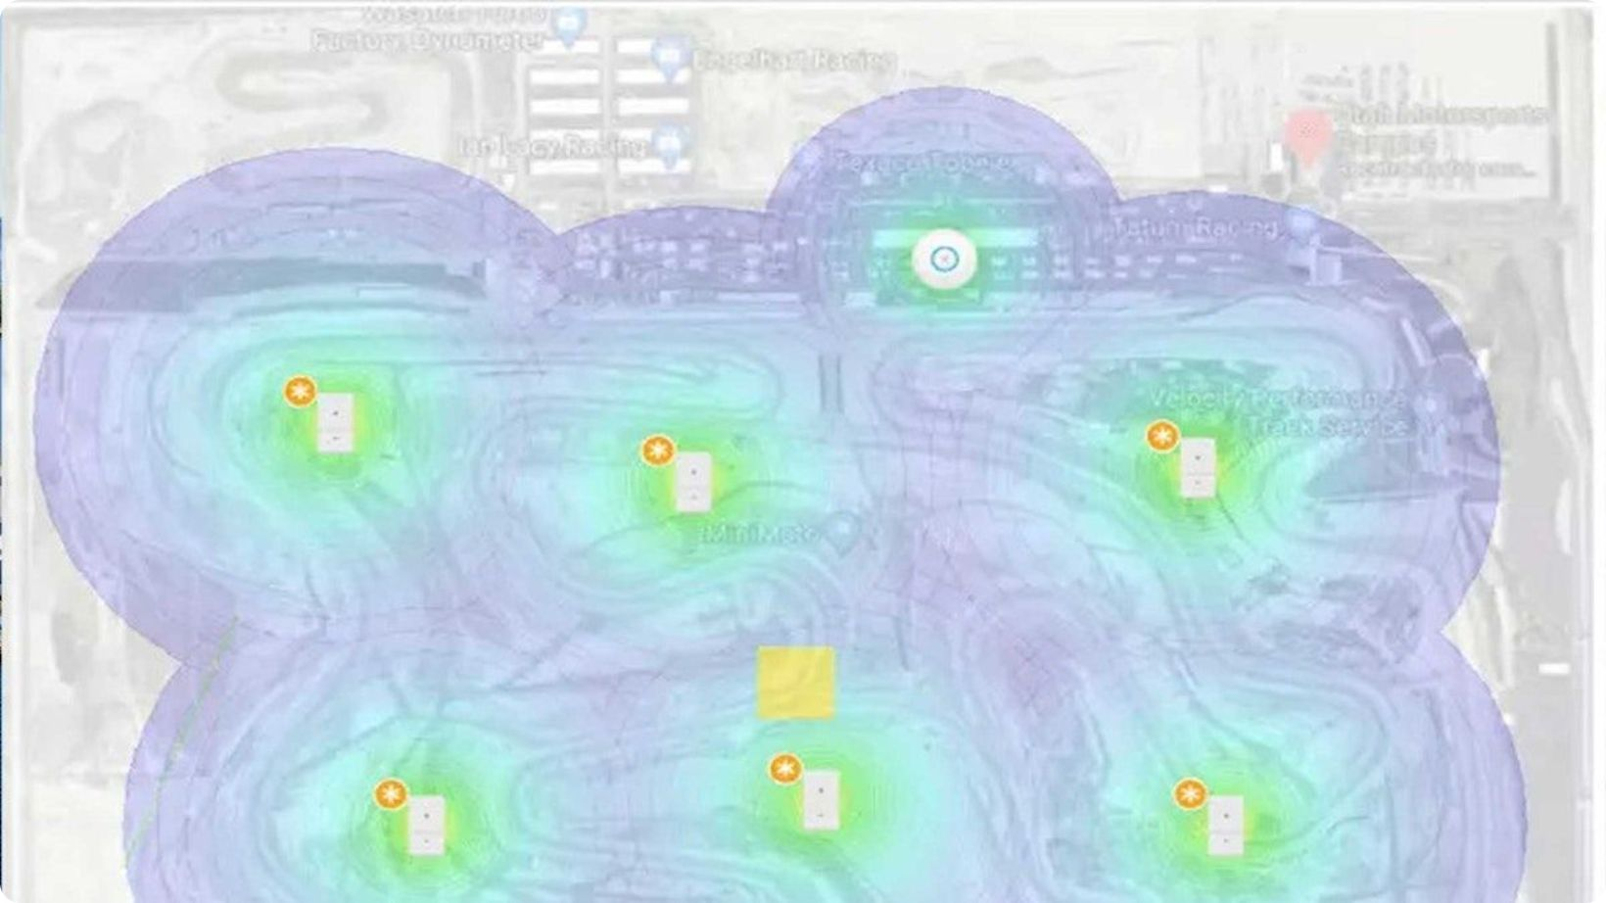
Topology & Conflict Model
Key Parameters
Nodes: 16 (4×4 grid)
Configured radio range: 500 m
Frame: 1 frame, 9 slots
Slot duration: 1000 μs
The conflict model uses topology + range to determine compatible transmitters that may share slots, enabling spatial reuse vs one-node-per-slot.

Slide 5
Generated Schedule (Node → Slot)
Node | Slot
Node_01 | 8
Node_02 | 4
Node_03 | 5
Node_04 | 8
Node_05 | 6
Node_06 | 0
Node_07 | 1
Node_08 | 6
Node | Slot
Node_09 | 7
Node_10 | 2
Node_11 | 3
Node_12 | 7
Node_13 | 8
Node_14 | 4
Node_15 | 5
Node_16 | 8
Slot 8 includes nodes 1,4,13,16 — an example of spatial reuse enabled by the conflict model.

Slide 6

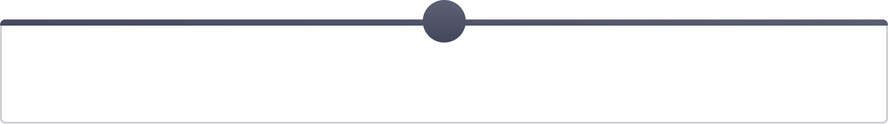
Slot-wise Transmitters
1
2
3
4
0
1
2
3
6
7
10
11
5
6
7
8
4
5
6
7
2, 14
3, 15
5, 8
9, 12
9
8
1, 4, 13, 16

Slide 7

EMANE Integration & NEM Configuration
Platform & NEMs
Platform XML defines 16 NEMs, TDMA radio-model, virtual transport (transvirtual), and event multicast settings. Each NEM has an interface emane1–emane16 with addresses 172.30.1.1–172.30.1.16 and subid 7.
There was an error generating this image
TDMA radio model: tdmaeventschedulerradiomodel with PHY/MAC parameters configured in XML.

Slide 8
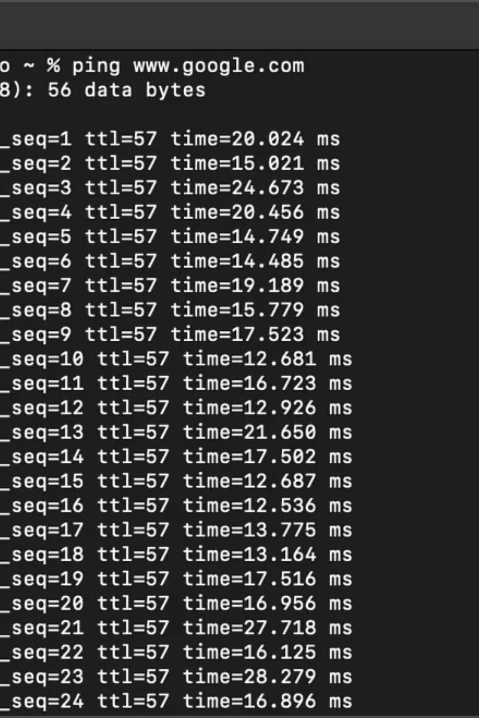
Validation & Test Results
Scheduler
Processed 16 nodes; produced 9-slot conflict-free frame.
EMANE
emane --version verified 1.5.3; platform launched successfully.
Interfaces & IPs
emane1–emane16 present with 172.30.1.1–.16 addresses in WSL2.
Packet Test
Ping 172.30.1.2: 5 TX, 5 RX, 0% loss, avg RTT 0.093 ms.

Slide 9
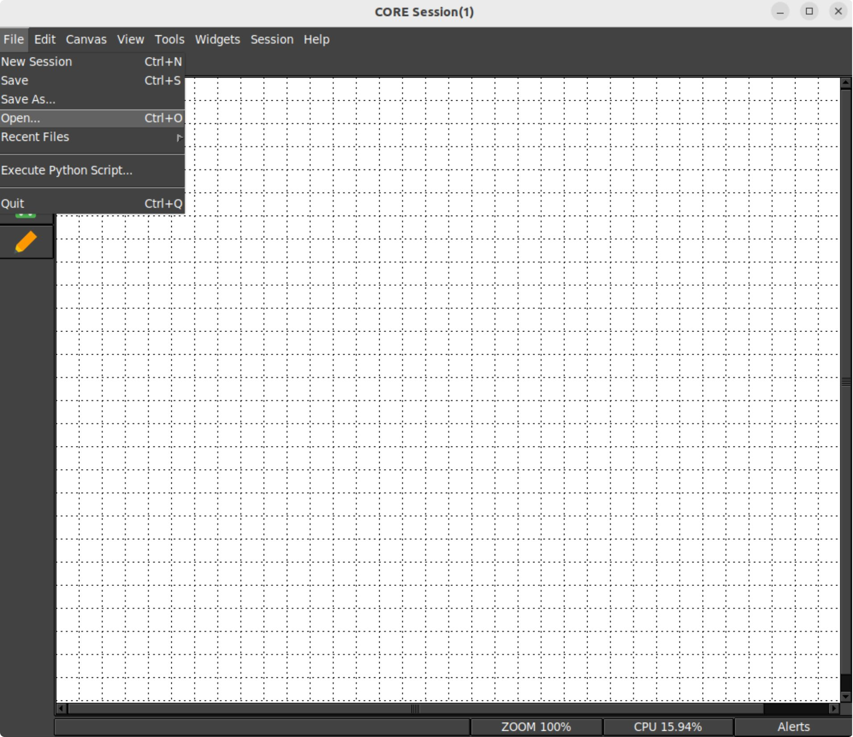
Installation & Execution
Key commands to reproduce the demo:
Verify EMANE: emane --version
Run scheduler: python3 run_from_file.py sample_input.json --range 500
Start EMANE: sudo emane emane/platform-16nem.xml
Publish schedule: emaneevent-tdmaschedule emane/tdma-schedule.xml
Verify interfaces: ip -br link | grep emane

Slide 10


Limitations & Future Scope
Limitations
Future Work
Validation performed under WSL2 (not hardware). Real-time priority warnings and TUN device issues observed. 500 m is a configured model parameter; ping validation is virtual, not RF measurement.
Add graphical topology/schedule visualization, support larger topologies, automated EMANE XML generation, configurable conflict parameters, regression tests, and native Linux real-time evaluation.
Within stated constraints, the project demonstrates an end-to-end prototype of scheduling → EMANE integration → virtual validation.

