Slide 1

SWE3004 · SOFTWARE DESIGN AND DEVELOPMENT
EdgeRetina
Privacy-Aware Diabetic Retinopathy Classification
Simulated federated learning and explainable deep learning
Lingeshwar G · 22MIS0558
M.Tech Software Engineering | VIT, Vellore
Guide: Dr. Asha N · October 2026
APTOS 2019 training sample · No DR
Notes:
Introduce the project as a research prototype that brings classification, a simulated federated workflow and visual explanations into one application. The photograph is a real example from the project training split.
Sources: Supplied final project report, title page and executive summary, pp. i and vi; project dataset data/raw/train_images/38f1901f214a.png.

Slide 2
CONTEXT
Why EdgeRetina?
Retinal photographs can support earlier review of diabetic retinopathy.
3,662
But a central training pool can require sensitive images to be collected in one place. A practical prototype should also explain what the model attends to and show where its results are weak.
labelled retinal fundus images
5
DR severity grades
PROJECT AIM
Build a five-grade classifier and demonstrate local training, processed model updates and Grad-CAM explanations in a web application.
Research prototype · not a clinical diagnostic device
EDGERETINA · PROJECT DEFENSE
02
Notes:
Frame the need: retinal images are useful for screening research, while data sharing and trust matter. State that EdgeRetina is a research prototype and does not claim clinical readiness.
Sources: Supplied final project report, Executive Summary and Chapters 1–2, pp. vi and 1–11.

Slide 3
DATA
APTOS 2019: five grades, uneven counts
Class imbalance makes accuracy alone an incomplete measure.
Image count by diagnosis grade
TRAIN / VALIDATION / TEST
2,563
train
549
validation
550
held-out test images
No DR : Severe DR = 9.35 : 1
EDGERETINA · PROJECT DEFENSE
03
Notes:
APTOS 2019 contains 3,662 labelled images. The No DR class is the largest; Severe DR is the smallest. The split used here is 2,563 train, 549 validation and 550 test. Emphasize the 9.35-to-1 imbalance and why macro-F1 and per-class recall matter.
Sources: Supplied final project report, Chapter 5.1 and 5.4, pp. 26–29; reports/validation/dataset_analysis.json.

Slide 4
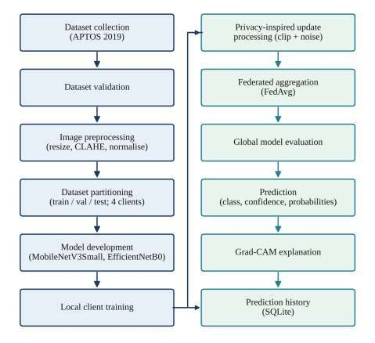
METHOD
From fundus image to prediction
A consistent input pipeline
Validate image and label files
Resize to the model input; apply CLAHE where configured; normalize pixel values.
Train in two stages
1 Train the five-class classification head
2 Fine-tune the pretrained backbone
Same preprocessing is used at training and prediction time.
EDGERETINA · PROJECT DEFENSE
04
Notes:
Walk through the project pipeline from validation and preprocessing to training, prediction and Grad-CAM. Input processing resizes images, applies CLAHE where configured, and normalizes values. Explain head training followed by fine-tuning.
Sources: Supplied final project report, Fig. 4.2 and Chapters 5.2–5.7, pp. 19 and 27–32.

Slide 5
MODELS
Two transfer-learning backbones
Both models produce five softmax outputs for the DR severity grades.
MobileNetV3Small
EfficientNetB0
Designed for efficient computation and a smaller memory footprint.
Balances model depth, width and input resolution through compound scaling.
Use case
Use case
A lightweight model suited to constrained devices.
A stronger accuracy result in this project’s centralized comparison.
Training strategy
Transfer learning → train head → fine-tune → evaluate on the held-out test set
EDGERETINA · PROJECT DEFENSE
05
Notes:
Both backbones use transfer learning and a five-output head. MobileNetV3Small prioritizes efficiency. EfficientNetB0 has higher reported accuracy in the centralized comparison, while MobileNetV3Small has slightly higher macro-F1. Save the comparison values for the results slide.
Sources: Supplied final project report, Chapter 5.5 and Table 5.4, pp. 29–30.

Slide 6

IMPLEMENTATION
One Flask application connects the workflow
Web interface
Upload an image, view prediction probabilities and confidence, review Grad-CAM, and browse prediction history.
Model and data services
MobileNetV3Small and EfficientNetB0 run with shared image preprocessing. Training results and prediction records are stored locally.
Technology
Flask · TensorFlow/Keras · SQLite
EDGERETINA · PROJECT DEFENSE
06
Notes:
Use the diagram to explain the main layers: Flask UI, backend services, deep-learning models, dataset/model artifacts and the local SQLite store. The project runs locally as a research prototype.
Sources: Supplied final project report, Fig. 4.1 and Chapter 4, pp. 18–24.

Slide 7
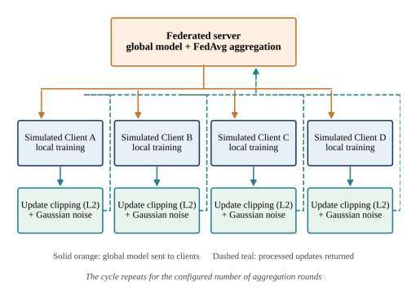
FEDERATED LEARNING
Four simulated clients, one global model
What the experiment simulates
Four client partitions train locally. Each produces a model update; the server processes updates and combines them with sample-weighted FedAvg.
What it does not simulate
The clients run on one machine and split one dataset. There is no real hospital network or cross-institution data heterogeneity.
The client model update is the difference between local weights and the global weights.
EDGERETINA · PROJECT DEFENSE
07
Notes:
Explain the single round: distribute the current global model; train locally; process each update; aggregate. State precisely that clients are software simulations on the same machine using partitions of one dataset.
Sources: Supplied final project report, Fig. 6.1 and Sections 6.2–6.4, pp. 34–36.

Slide 8
PRIVACY-INSPIRED PROCESSING
Clip large updates, then add Gaussian noise
These operations apply to model-weight updates, not to retinal pixels.
1 Measure the update
3 Add zero-mean Gaussian noise
Δ = w_local − w_global
‖Δ‖₂ summarizes the update’s overall size.
Δ_processed = Δ_clip + η, η ~ N(0, σ²I)
2 Clip to the norm limit
Current implementation: C = 1.0, noise multiplier = 0.10. Per-weight noise scale = C × 0.10 / √M, where M is the number of update parameters.
Δ_clip = Δ × min(1, C / ‖Δ‖₂)
Report example: [3, 4] has norm 5. With C = 1, scale by 0.2 → [0.6, 0.8].
4 Aggregate processed updates
FedAvg weights each client by its share of training samples.
Privacy caveat: no (ε, δ) privacy accountant or formal guarantee; secure aggregation and encryption are also absent.
EDGERETINA · PROJECT DEFENSE
08
Notes:
Use the exact [3,4] example from the report to make clipping tangible. Then explain that Gaussian noise perturbs each update entry. The current code scales per-weight noise as C times the configured multiplier divided by the square root of the parameter count. Be clear that this prototype does not compute a privacy budget, has no secure aggregation or encryption, and makes no formal differential privacy claim.
Sources: Supplied final project report, Sections 6.5.1–6.5.4, pp. 36–38; current backend/app/federated/differential_privacy.py and backend/app/federated/server.py.

Slide 9

EXPLAINABILITY
Grad-CAM highlights influential image regions
Prediction
Five-class output
The model returns a DR grade with confidence and class probabilities.
Visual explanation
Grad-CAM overlays a coarse heatmap to show regions that influenced the selected prediction.
A heatmap is not a lesion segmentation and was not validated against clinician annotations.
EDGERETINA · PROJECT DEFENSE
09
Notes:
Explain that Grad-CAM is used as a visual aid to understand regions that influenced a model output. It does not prove that the model is correct and does not mark lesions with pixel-level accuracy.
Sources: Supplied final project report, Fig. 8.10 and Section 6.7, pp. 39 and 54; Grad-CAM screenshot embedded from the report.

Slide 10

DEMONSTRATION
The web app connects prediction, training and evidence
Application features
Image upload with file validation
Prediction grade, confidence and class probabilities
Grad-CAM explanation and prediction history
Training control, federated status and saved evaluation artifacts
The dashboard reports metrics from saved artifacts, not live batch accuracy.
EDGERETINA · PROJECT DEFENSE
10
Notes:
Briefly demo the application: upload an image, review the grade and probabilities, inspect a Grad-CAM heatmap, and view saved records and metrics. The screenshot comes from the report’s evidence dashboard.
Sources: Supplied final project report, Chapter 8, pp. 49–56, including Fig. 8.13; screenshot embedded from the report.

Slide 11
EVALUATION
Accuracy and macro-F1 tell different stories
All three values below use the 550-image held-out test split.
71.1%
Best centralized accuracy
EfficientNetB0
42.0%
Best centralized macro-F1
MobileNetV3Small
Minority-grade performance remains weak. Interpret accuracy alongside macro-F1 and per-class recall.
FL result: saved 5-round dashboard evaluation (67.1% accuracy, 40.1% macro-F1, QWK 0.687). This later run was not in the report’s original results section.
EDGERETINA · PROJECT DEFENSE
11
Notes:
The centralized comparison in the final report has EfficientNetB0 at 71.1% accuracy and 40.9% macro-F1; MobileNetV3Small at 63.3% and 42.0%. The current project’s saved five-round federated evaluation file contains 67.09% accuracy, 40.08% macro-F1, QWK 0.687 and MAE 0.547 on the same 550-image test split. The report’s Chapter 9 says federated metrics were not available when it was written; present the federated metric as a later saved dashboard evaluation, not as a figure from the submitted report. Severe-class recall is zero in this saved federated run, so do not imply robust five-class performance.
Sources: Supplied final project report, Tables 9.3 and 9.7, pp. 59 and 66; current reports/federated/evaluation.json, run_id 68688c55a1864640ab728b6f2032341c (five rounds, 550 test samples).

Slide 12
CONCLUSION
A complete research workflow, with clear next steps
Demonstrated
Next steps
Five-grade DR classification on APTOS 2019
Improve Mild and Severe recall; evaluate across more splits and an external dataset.
Centralized model comparison and a saved five-round FL run
Use non-identical client data and test realistic multi-institution settings.
A working Flask application with prediction and Grad-CAM
Add privacy accounting and secure aggregation; validate explanations with clinicians.
Federated workflow with four simulated clients
Takeaway
EdgeRetina demonstrates the workflow; it is not a clinically validated system or a formal privacy guarantee.
EDGERETINA · PROJECT DEFENSE
12
Notes:
Close by describing EdgeRetina as a research prototype. The most important next steps are improving minority-grade recall, external testing, realistic client heterogeneity, formal privacy accounting and clinical validation. Invite questions.
Sources: Supplied final project report, Chapters 9–11, pp. 64–68; report’s limitations and future-work sections.

