Slide 1
Employee Leave Management System
Java Full-Stack Web Application
Presented by: LingesWaran J
Technologies: AngularJS | Spring Boot | MySQL

Slide 2
Project Overview
Purpose: Simplify and digitize leave application and approval process
Users: Employees and Admins
Statuses: Pending, Approved, Rejected

Slide 3
Tech Stack
Frontend: AngularJS (1.8.2)
Backend: Spring Boot (v3.5.x)
Database: MySQL
Tools: Eclipse IDE, Live Server, MySQL Workbench

Slide 4
System Architecture
1. AngularJS frontend calls REST APIs
2. Spring Boot REST API handles logic and database interaction
3. MySQL stores leave request data
Architecture: AngularJS → Spring Boot → MySQL

Slide 5
Key Features
✔ Employees can apply for leave
✔ Admin can view and manage requests
✔ Status updates: Approve / Reject
✔ Data stored and retrieved from MySQL
✔ Real-time UI updates

Slide 6
Database Schema
Table: leave_request
- id (Primary Key)
- employee_name (VARCHAR)
- start_date (DATE)
- end_date (DATE)
- reason (TEXT)
- status (VARCHAR)

Slide 7
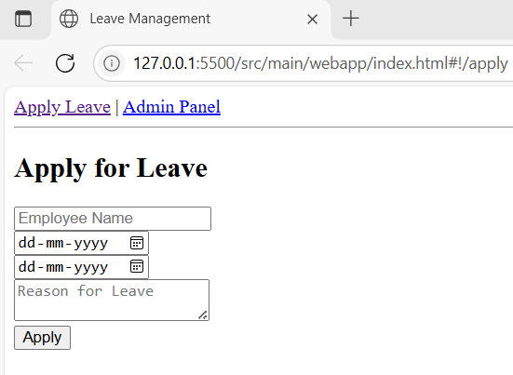
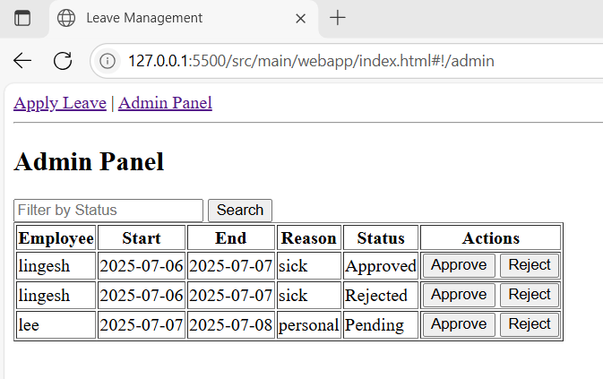
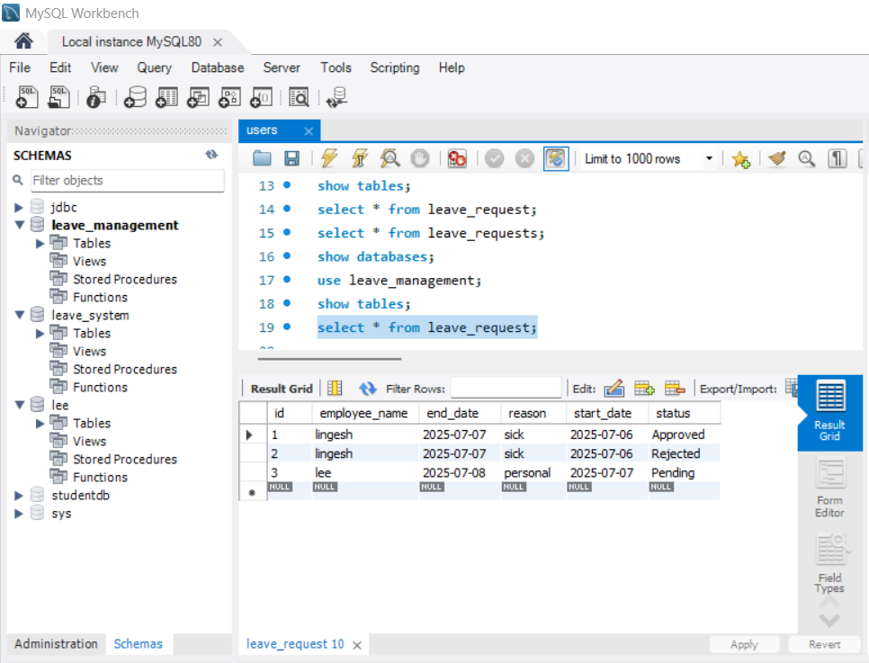
Application Screenshots
1. Apply Leave Page
2. Admin Panel
3. MySQL Table View

Slide 8
Live Demo
URL: http://127.0.0.1:5500/index.html
Show employee form submission
Show admin approval
Show MySQL table updates

Slide 9
Challenges Faced
CORS errors between frontend and backend
AngularJS routing issues
MySQL connectivity and table mapping
Error debugging in browser console

Slide 10
Conclusion
✔ Successfully built and deployed leave management system
✔ Integrated frontend, backend, and database
✔ Learned full-stack development hands-on
✔ Scalable and extendable for real-world use

