Slide 1
SURF: Detecting and Measuring Search Poisoning
Long Lu, Roberto Perdisci, and Wenke Lee
Georgia Tech and University of Georgia

Slide 2



Search engines

Slide 3



SEO
Optimizing website presentation to search crawlers
Emphasizing keyword relevance
Demonstrating popularity
Black-hat SEO
Artificially inflating relevance
Dishonest but typically non-malicious

Slide 4
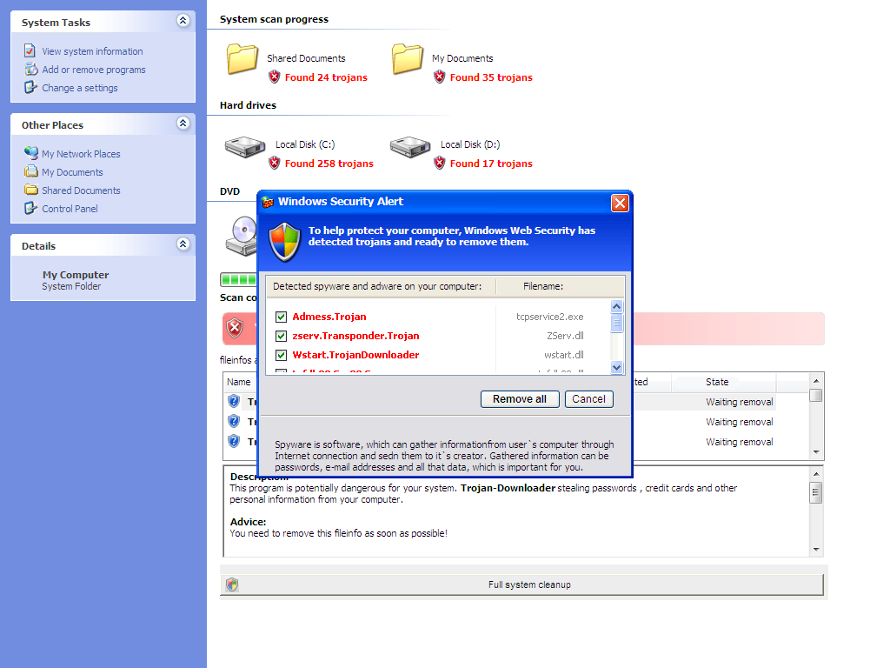
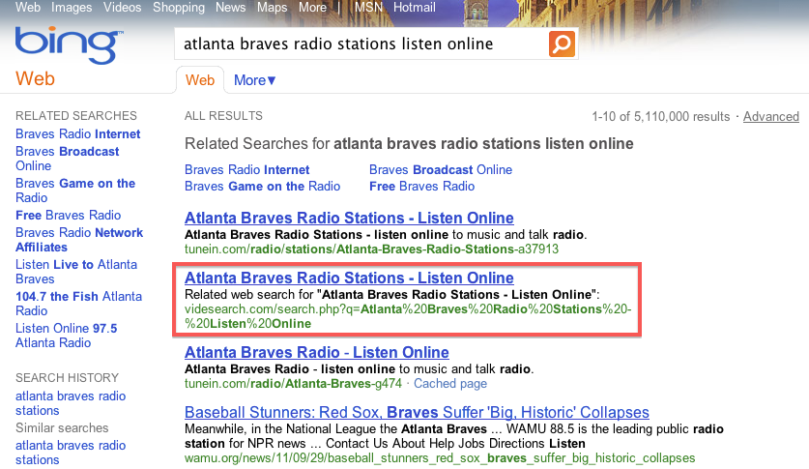
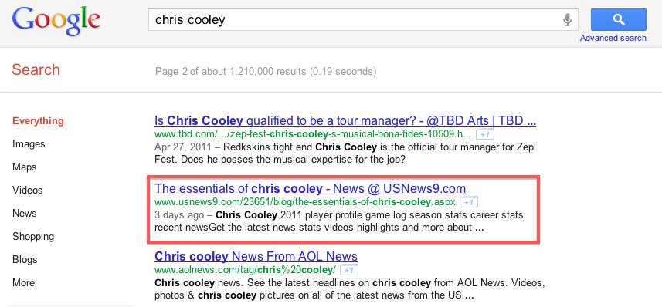
Search poisoning

Slide 5



Search poisoning
Aggressively abusing SEO
Forging relevance
Employing link farm
Redirecting visitors
Inadequate countermeasures
IR quality assurance
Designed for less adversarial scenarios
Robust solutions needed

Slide 6





Malicious search user redirection
Preserving poisoning infrastructure
Filtering out detection traffic
Enabling affiliate network

Slide 7
Observations
Analyzed 1,048 search poisoning cases
Ubiquitous cross-site redirections
Poisoning as a service
Variety in malicious applications
Persistence under transient appearances

Slide 8
Goals
Generality
Robustness
Wide deployability
Not specific to malicious content hosted on terminal page
Cannot be trivially evaded by attackers
Not dependent on proprietary data or special environment
SURF
(Search User Redirection Finder)

Slide 9


SURF overview
Instrumented Browser
Feature Sources
Browser events
Network info
Search result
Feature Extractor
SURF
Classifier

Slide 10
SURF prototype
Instrumented browser
Stripped IE with customizations (~1k SLOC in C#)
Listening and responding to rendering events
Feature extractor
Offline execution to facilitate experiments
SURF Classifier
Weka’s J48
Simple, efficient, and easily interpreted

Slide 11
Detection features
Redirection composition
Total redirection hops
Cross-site redirection hops
Chained webpages
Landing-to-terminal distance
Page rendering errors
Redirection consistency
IP-to-name ratio
Poisoning resistance
Keyword poisoning resistance
Search rank
Good rank confidence

Slide 12
Detection features (1/3)
Redirection composition
Regular Vs. Malicious search redirection
Covering all types of redirections
Total redirection hops
Cross-site redirection hops
Redirection consistency

Slide 13
Detection features (2/3)
Chained webpages
Webpages involved in redirections
Distance = min {geo_dist, org_dist}
Premature termination on errors
Unnamed malicious hosts
Landing-to-terminal distance
Page rendering errors
IP-to-name ratio

Slide 14
Detection features (3/3)
Poisoning resistance
Derived from search keyword and result
Poison resistance
Difficulty of poisoning a keyword
Avg {PageRank of top 10 results}
Good rank confidence
Poison resistance / search rank
Keyword poison resistance
Search rank
Good rank confidence

Slide 15
Evaluation
Semi-manually labeled datasets
2,344 samples collected on Oct 2010
Labeling methods does not overlap detection features

Slide 16
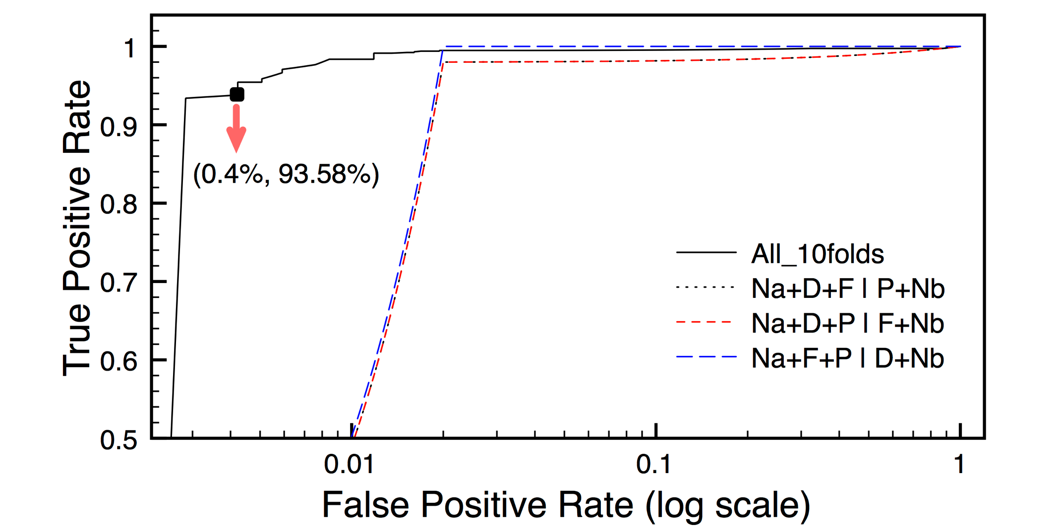
Evaluation
Accuracy
10-fold cross validation
On average, 99.1% TP, 0.9% FP
Generality
Cross-category validation
Oblivious to on-page malicious content
Robustness
Simulating compromised features
Evaluating accuracy degradation

Slide 17
Discussion
Unselected features
Evadable or dependent on search-internal data
Domain reputation
Deployment scenarios
Regular users, search engines, security vendors.
Enabling community efforts

Slide 18
Empirical measurements
7-month measurement study (2010-9 ~ 2011-4)
12 million search results analyzed
On a daily basis:
Retrieve trendy keywords
Dispatch search jobs to SURF bots
visits each search result and produces logs
Feature extraction and classification

Slide 19
Empirical measurements
7-day window
Poisoning lag and poisoned volume
Avg. landing page life time – 1.7 days

Slide 20
Empirical measurements
7-month window
More than 50% trendy keywords poisoned

Slide 21
Empirical measurements
7-month window
Unique landing domains observed per week

Slide 22
Empirical measurements
7-month window
Terminal page variety survey

Slide 23
Conclusion
In-depth study of search poisoning
Design and evaluation of SURF
Long-term measurement of search poisoning

