Slide 1
Simhash-Based Dynamic Cloaking Detection
Ruian Duan
Notes:
morning, dear professors, my name is Ruian Duan. I am a third year PhD advised by Prof. Wenke Lee.

Slide 2
Introduction

Slide 3
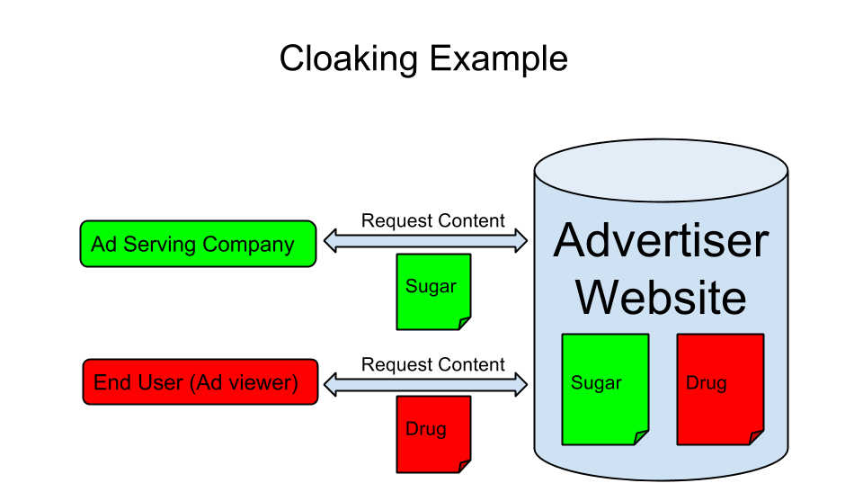
Notes:
Advertisements are important, because it is all about money. There are several parties included in advertisement campaign. Ad serving company, advertiser, end user.
Advertisers may abuse ad service provided by ad serving company. When ad serving company visit, good, when end user visit, bad.

Slide 4
Dynamic Cloaking
Cloaking is responsible for 35% ads policy violation (Google stats 2013)!
Dynamic Cloaking: The user and Ad Serving Company stay on the same domain, but are served entirely different content (usually non-compliant)
Redirect Cloaking: The user and Ad Serving Company are redirected to different websites through the same ad

Slide 5
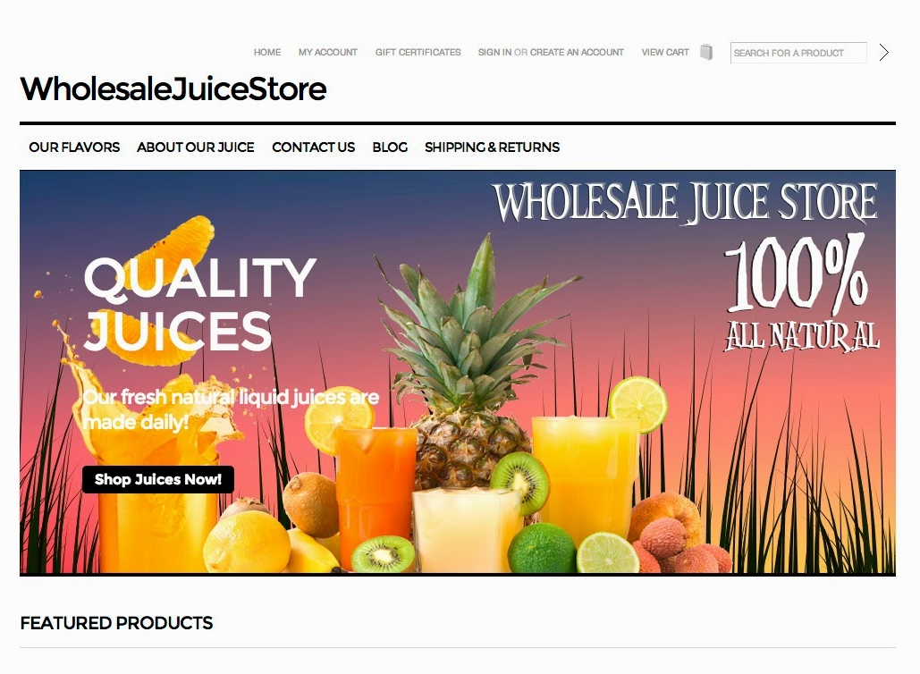
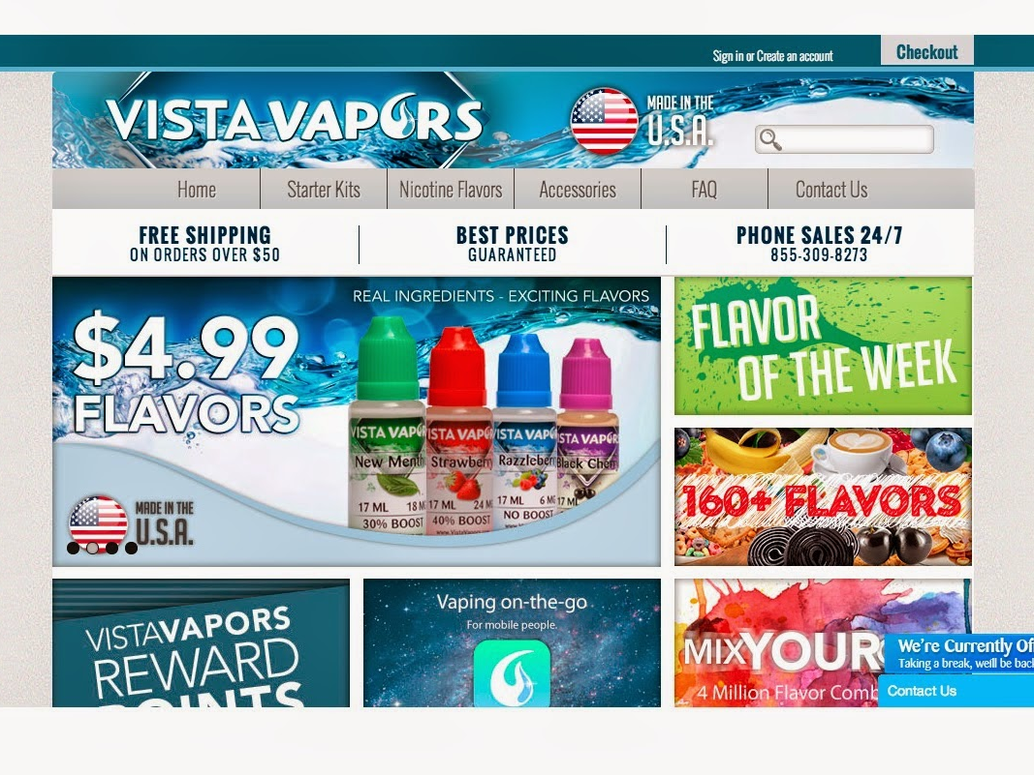
Dynamic Cloaking Example
Google View: Juice
User View: Tobacco
Policy Violation!

Slide 6
Two Major Challenges
Reveal the uncloaked content
Detect similarities between pages
IP cloaking, the hardest kind of cloaking to detect
Proxies are used now, but cloakers could detect and block proxy
Existing approaches pretend to be a normal user to reveal cloaking!
Why not collect information from user side directly?
Collect sufficient data for comparison as well as protecting privacy.

Slide 7
Simhash-Based Dynamic Cloaking Detection
Merits of simhash
Short representation of a web page
Good way to identify similarities/differences
Protect user privacy
Proposal
Collect simhash from user side (browser extension) and compare with what ad serving company sees!
Difficulties
“hash” which set of features
How do we define “similarity” between pages?

Slide 8
Background

Slide 9
Simhash
Properties of Charikar’s simhash (similarity hash)
“hash” of a set of features
Words, n-grams, dom relations
Similar sets of features have similar hash values
Implication: if simhashes are close then pages are similar
How does simhash work?
Page 1 = <“google”, “apple”> -> 0000,1111 = hash1
Page 2 = <“google”, “apple”, “twitter”> -> 0001,1111 = hash2
Hamming distance (hash1, hash2) = 1, page 1 and page 2 are similar!

Slide 10
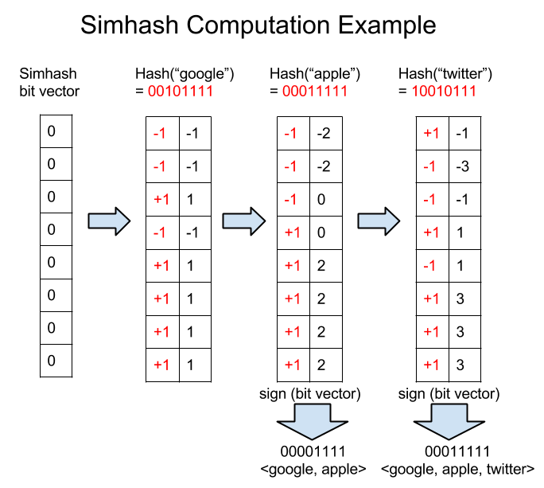
Notes:
Number vector, each element is a counter, its sign corresponds to each bit of simhash.
Take feature “google”, the hash can be any hash algorithm (MD5, SHA1). This hash is mapped to index of the vector. If 0, then -1, if 1 then +1. A hash is an update on each element of the vector. From the updated vector, we can get simhash for processed features. <google, apple> and <google, apple, twitter>

Slide 11
Feature Selection

Slide 12
Feature Requirements
The order of features is not captured in simhash
If the order of features matters, extract separate features representing order
A small feature set may not work well
Extract relatively a large set of features, so that one feature difference wouldn’t cause high hamming distance

Slide 13
Feature Selection
Text features
Word (term)
Two word set (bi-gram)
Three word set (tri-gram)
E.g. I like it.
Word is {I, like, it}
Bi-gram is {I like, like it}
Tri-gram is {I like it}

Slide 14
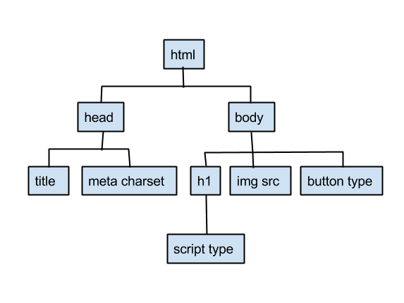
Feature Selection
Dom tree features
Tag and attribute names
E.g. <meta charset>
Strip values because
attributes may have
different values every visit
E.g. dynamic link address in ads
Parent node – child node pair
E.g. <head> - <title>, <body> - <img src>

Slide 15
Similarity Definition

Slide 16
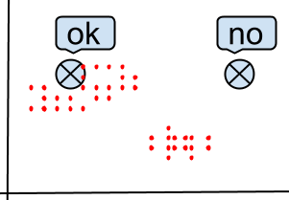
Intuitions
Distance among multiple observations of the same URL
Several clusters
Mobile, desktop have different layout
and content
Small distance within each cluster
URL serve similar content to users
Distance among different URLs
Large, supposed to serve different content
Large distance between user and ad serving company observation indicates high probability of cloaking for the same URL

Slide 17
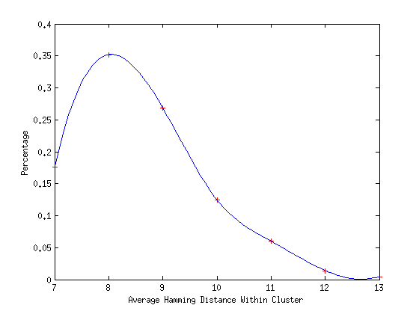
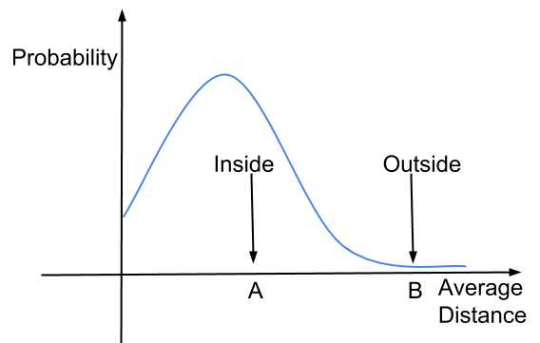
Multiple Observations of the Same URL
Within each cluster, average distance distribution is close to normal distribution
Average hamming distance (H) for S_{i} in cluster is
Normality test: One-sample Kolmogorov-Smirnov test

Slide 18
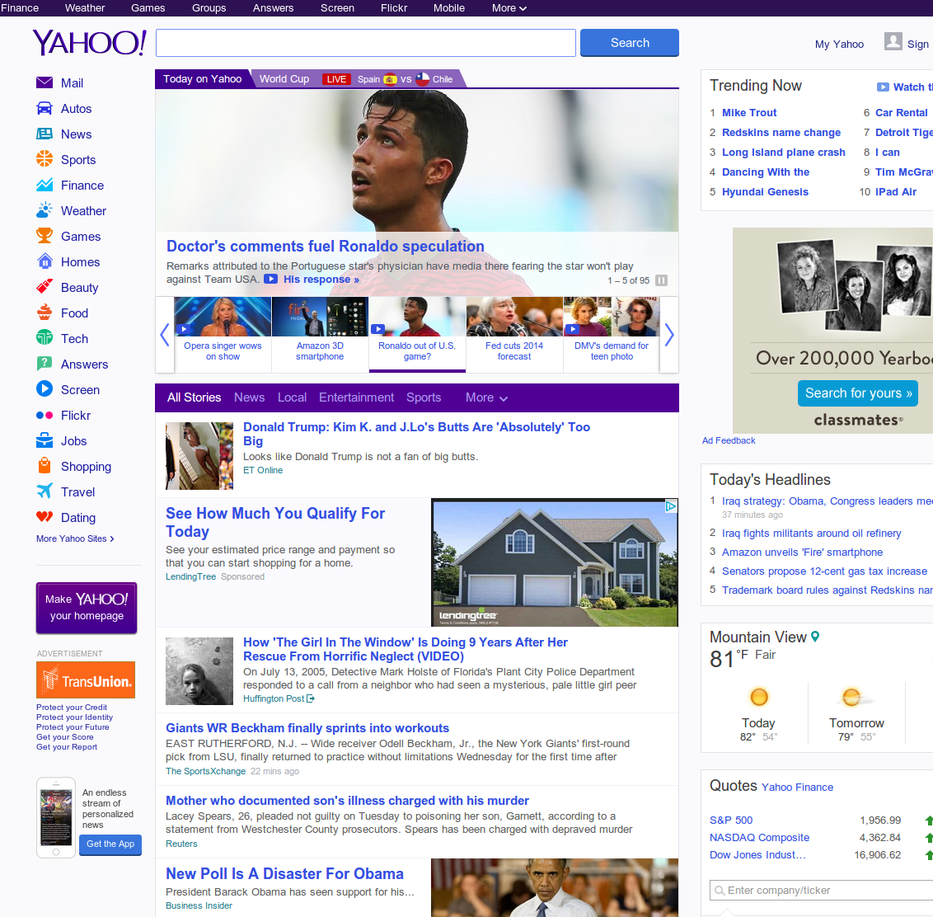
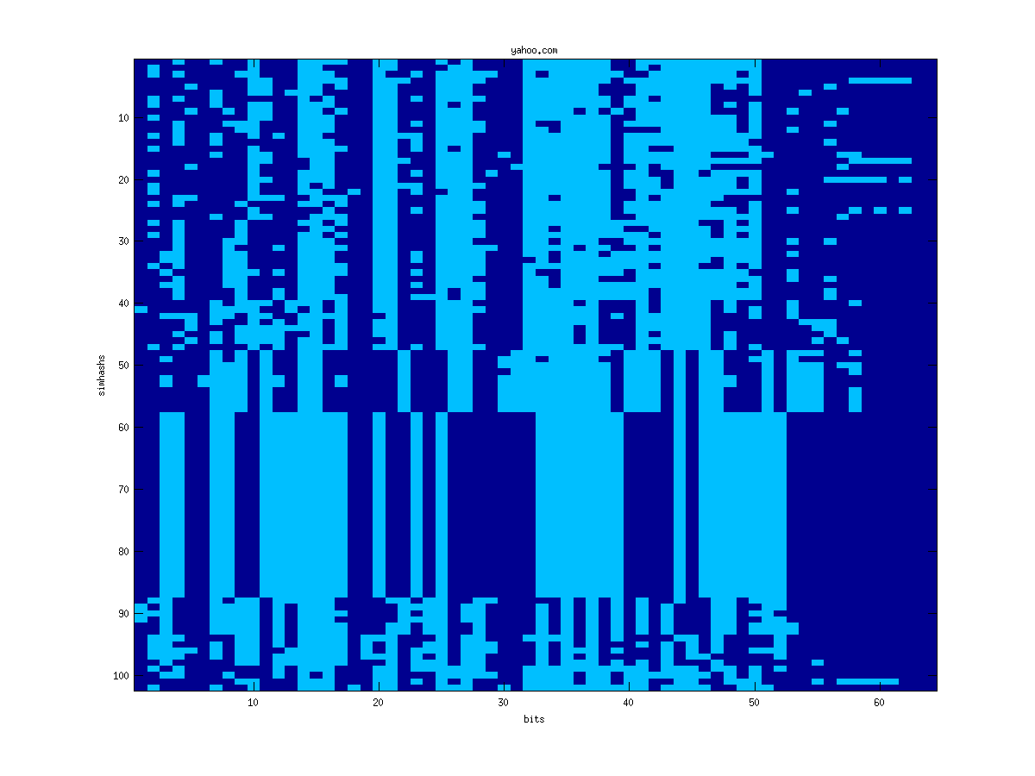
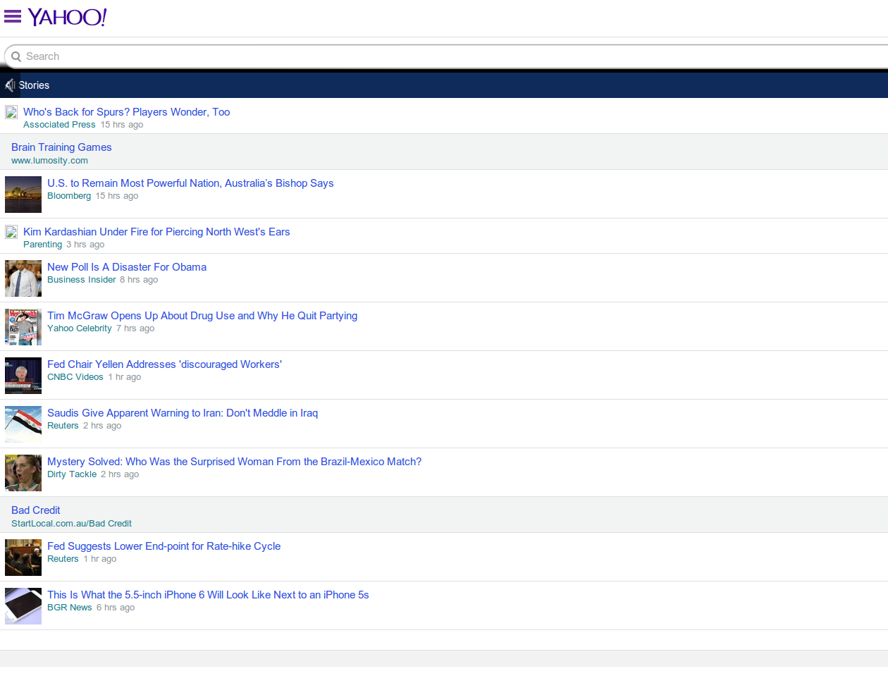
Observations of yahoo.com
Mobile version
Desktop version
Bits of simhash

Slide 19
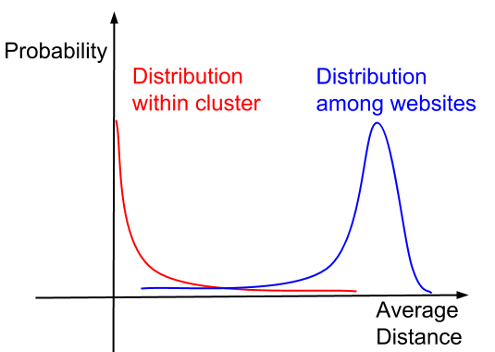
Distance Distribution Across Websites
Within cluster distribution
Most websites merely change, sharp drop from zero
Among websites distribution
Different websites serve different content, peak at high distance
Notes:
for 10 websites, each website has 10 simhash. 100x9 distance matrix. Histogram on these distance.

Slide 20
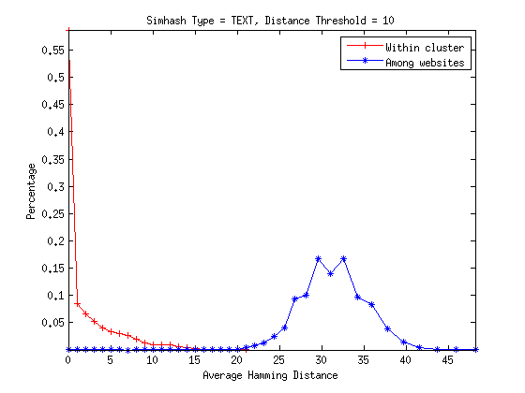

Distance Distribution Across Websites
Similarity Definition:
H_{T} cover website dynamics, but tell different pages apart
Hamming distance threshold
Notes:
The similarity notion is denoted by hamming distance.

Slide 21
Cloaking Detection Methodology
Use gap between website dynamics and different pages to learn patterns of websites from Ad Serving Company
Large distance between user observation (collected through browser extension) and learned patterns indicates high probability of cloaking

Slide 22
Cluster Learning Phase

Slide 23
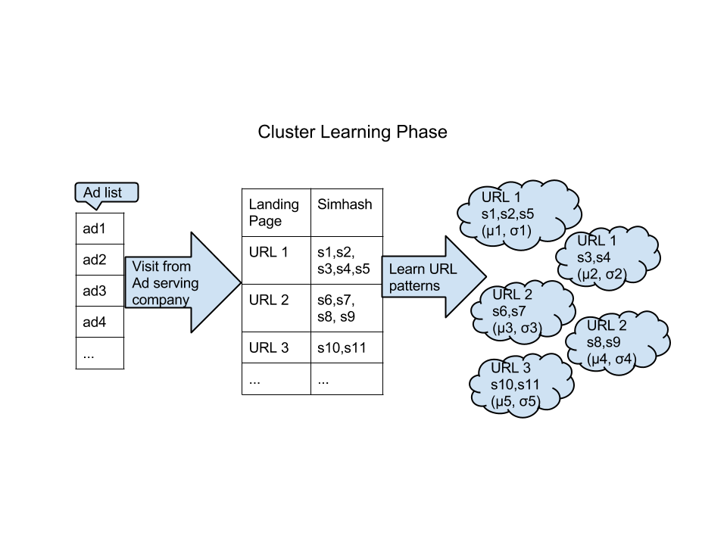

Slide 24
Cluster Learning Algorithm
Find neighbors for each simhash, if distance between two simhash is less than a threshold H, then they are neighbors
Build a graph, each simhash is a node, and neighborhood is an edge, use BFS to find connected components (patterns) in this graph
The system learn clusters (patterns) for each URL

Slide 25
Cloaking Detection Phase

Slide 26
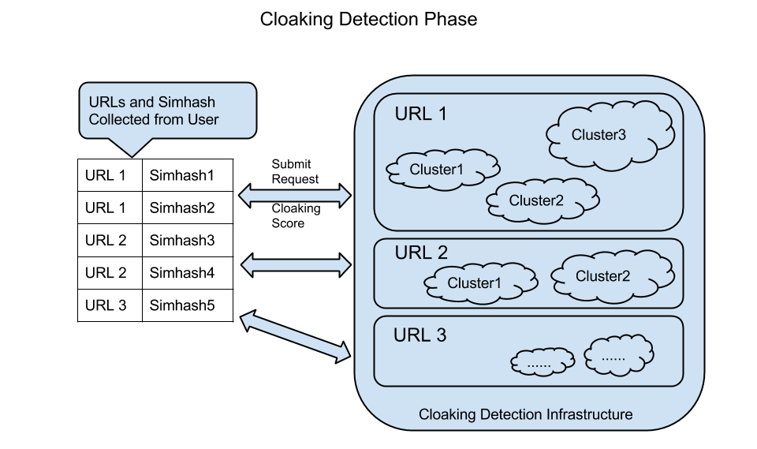

Slide 27
Cloaking Detection Algorithm
Empirical rule for normal distribution
Modified empirical rule
If average_distance > μ + Nσ, not in cluster (distribution)
Judge criteria
Given observation for an URL, if we have collected observations for this URL and this observation is not in any cluster that we have for this URL, then label as cloaking

Slide 28
Evaluation

Slide 29
Evaluation Metrics
True Positive Rate
Number of cloaking in detected over total cloaking
False Positive Rate
Number of non-cloaking in detected over total non-cloaking

Slide 30
Data Collection
Crawl landing pages for 1000 ad clickstrings from Ad spam team (with curl)
Follow HTTP redirect, metadata redirect and simple JS redirect
Retrieve content from 80% ad landing pages
User agent browsers | Googlebot | Chrome | Firefox...
User agent OS | Windows | Macintosh | Mobile...
Referer | empty | Google | Bing

Slide 31
Data Collection
Training data
Crawl landing pages on Aug 10, 2014 and Aug 13, 2014 as training data. Learn patterns for each website.
Testing data – Synthetic data set
Crawl landing pages on Aug 11, 2014 for testing data generation
Choose date between Aug 10 and Aug 13, because learned patterns should cover natural change in testing data
Select 10k observations randomly from data collected on Aug 11,2014 for testing
Select 1k observations randomly out of the above 10k and mislabel them. The 1k mislabeled observations are cloaking.
Reasonable because cloaking websites could deliver completely different website content!

Slide 32
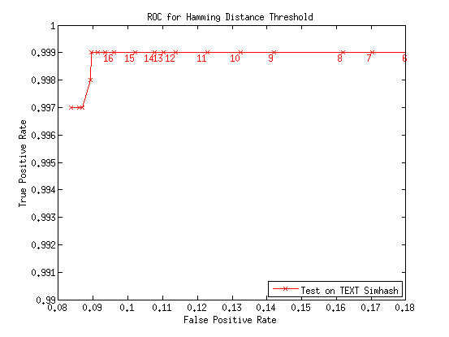
Synthetic data set
H(S_{i}, S_{j}) < H_{T}? Pick Hamming Distance Threshold: H_{TEXT}
Pre-select Standard Deviation Constant: μ+3σ, N_{TEXT} = N_{DOM} = 3

Slide 33
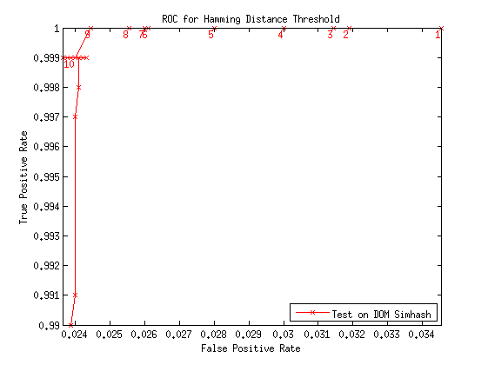
Synthetic data set
H(S_{i}, S_{j}) < H_{T}? Pick Hamming Distance Threshold: H_{DOM}
Pre-select Standard Deviation Constant: μ+3σ, N_{TEXT} = N_{DOM} = 3

Slide 34
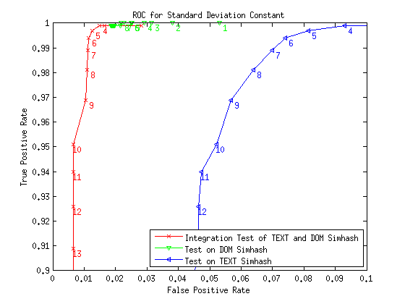
Synthetic data set
μ+Nσ? Pick Standard Deviation Constant: N_{TEXT}, N_{DOM}, N_{TEXT & DOM}
Pre-select Hamming Distance Threshold: H_{TEXT} = 14, H_{DOM} = 3
TEXT & DOM: FPR 0.3%, TPR 84.4%
Notes:
0.3%, 84.4% is useful in two scenarios
1 million landing pages, 3k false positive, use other signals to further narrow down
User submit feedback or report for bad pages, these are just 10k, false positive rate will be 30. Apply the system on these data set will work well

Slide 35
Discussion

Slide 36
Handled Attacks
Attack Model: get simhash, want to find out content
Simhash: One-Wayness
Attacker could not get content
Attack Model: (1) get URL and corresponding simhash, (2) visit URL and do dictionary attack on sensitive field, e.g. name
Collision probability in LSH:
Because feature set is large and difference in several features doesn’t cause the simhash to change

Slide 37
Robustness
Robustness from feature selection
Word and n-gram based
Dom tree structure based
Enforces similarity in text or layout

Slide 38
Limitation
Ad redirects coverage
Currently we can crawl 80% landing pages using curl. Browser or other techniques may have higher coverage.

Slide 39
Q&A

Slide 40
Appendix A – Reveal Different Types of Dynamic Cloaking
Repeat Cloaking
Visit only once
Cloakers blacklist IPs of known IT or AV companies
User Agent and Referrer Cloaking
Forge user agent and referrer
Fingerprint a real browser through API or plugins
E.g. Blackhole exploit kit: PluginDetect
IP Cloaking (this is the hardest kind of cloaking to detect)
Proxies
Detect and block proxies
What is missing from existing solutions?
All solutions pretend to be a normal user to reveal cloaking!
Why not collect information directly from user side?!

Slide 41
Appendix B – Page Similarity Comparison
Term-based methods
Term difference, term frequency difference
Shingle (n-gram) difference
Link-based methods
Link difference
Tag-based methods
Consider one copy of URL as a multiset of a sequence of tags
What is missing from existing solutions?
Too much data to collect
Cannot help protect user privacy

Slide 42
Appendix C – Evaluate Cluster Results
Density: Σ_{i} n_{i}²/N²
For each url, n_{i} is number of observations in i^{th} cluster, N is total
It favors less clusters per url.
Captures how well the clusters capture the similarities within pages of the same url.
Purity: max{m_{i}}/M
For each cluster, m_{i} is the number of observations for i^{th} url, M is size of the cluster
It favor less mis-clustering
Measures how well the clusters capture the differences with pages of different urls.

Slide 43
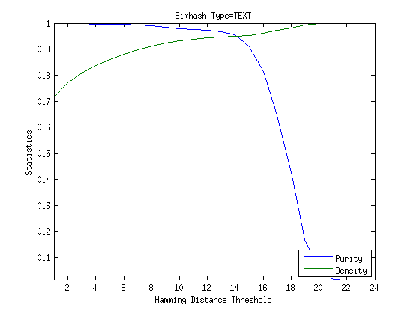
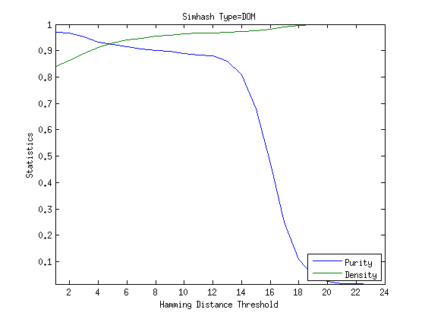
Appendix C – Evaluate Cluster Results (cont’d)

Slide 44
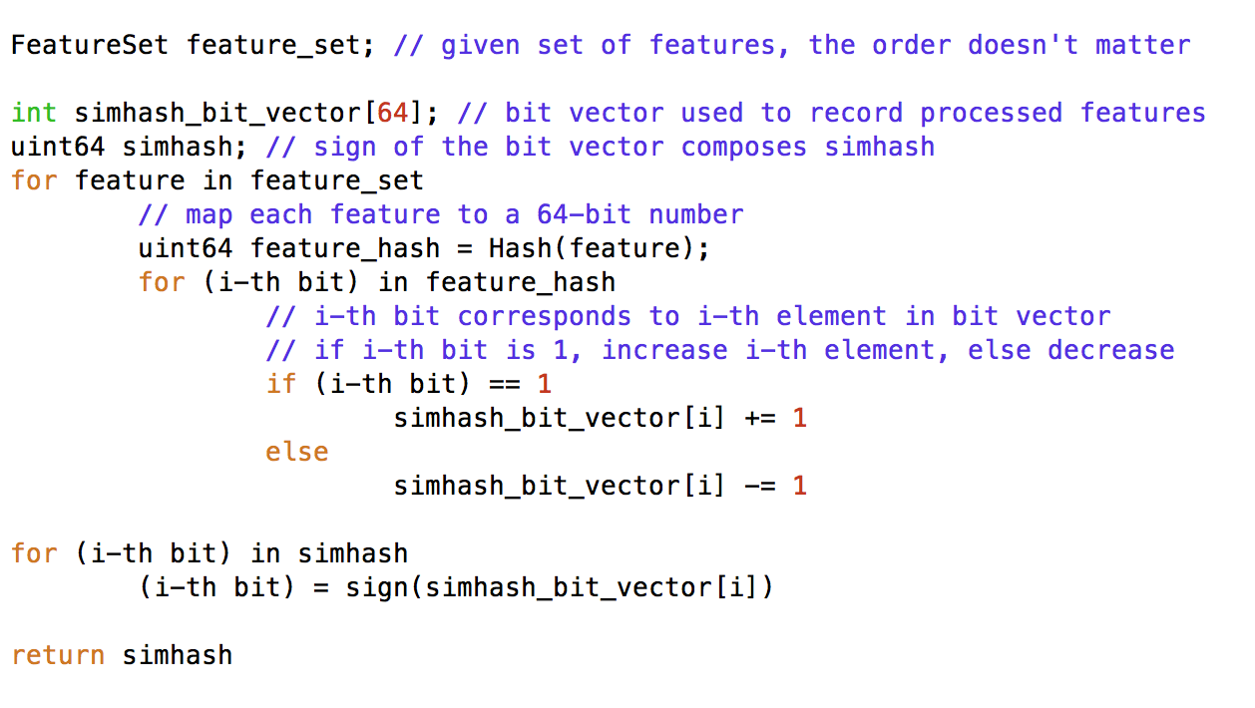
Appendix D – Simhash Computation

