Slide 1
Optimized Group-Rekey
Ohad Rodeh, Kenneth P. Birman, Danny Dolev

Slide 2
Introduction
Increasingly, many applications require multicast services
  teleconferencing, distributed interactive simulation, collaborative work, etc.
To protect multicast message content, such applications require secure multicast

Slide 3
Multicast group protection
A multicast group can be efficiently protected using a single symmetric encryption key
This key is securely communicated to all group members which subsequently use it to encrypt/decrypt group messages
The group-key is securely switched whenever the group membership changes

Slide 4
Multicast group protection II
Old members cannot eavesdrop on current group conversations
The challenge, create a key-switch algorithm that is:
  Efficient and fast
  Can handle large groups
  A high rate of membership changes

Slide 5
Group types
There are several types of group patterns.
Few senders & many receivers
  Up to millions of receivers (potentially)
This is called One-Many.
Many-Many pattern
  100 senders & receivers.

Slide 6
Model
Processes:
  Can send/recv pt-2-pt and multicast messages
  Have access to trusted authentication and authorization services
  Authentication service allows processes to open secure channels
  A secure channel allows the secure exchange of private information
Public key encryption is expesive, symmetric key encryption is cheep.

Slide 7
Numbering and convention
The GCS allows only trusted and authorized members into the group.
Members are numbered m₁.. m_{N}
The group leader is member m₁

Slide 8
A simple solution
S
1
2
3
4
5
6
7
8

Slide 9
The centralized solution
Here we describe a protocol by Wong, Gouda and Lam
A keygraph is defined as a directed tree where the leafs are the group members and the nodes are keys
A member knows all the keys on the way from itself to the root
The keys are distributed using a key-server

Slide 10
The centralized solution
S
K18
K14
K58
K12
K34
K56
K78
1
2
3
4
5
6
7
8

Slide 11
Building the tree
Each member m_{i} shares a key with the server, K_{i}
It also shares keys with subgroups in the tree
The tree is built by the key server S
S initially has secure channels with each of the members
S uses these channels to create the higher level keys

Slide 12
Building the tree
This can be done in a single multicast
K18 is the group key
K1
K2
K12
K3
K4
K34
K14
K5
K6
K56
K7
K8
K78
K58
K18

Slide 13
Join/Leave
The group-key is replaced in case of join/leave
This is performed through key-tree operations

Slide 14
Join
K19
K18
K14
K58
K12
K34
K56
K78
1
2
3
4
5
6
7
8
9

Slide 15
Leave I
K18
K14
K58
K12
K34
K56
K78
1
2
3
4
5
6
7
8

Slide 16
Leave II
K28
K24
K58
K34
K56
K78
2
3
4
5
6
7
8

Slide 17
Cost
Each member stores log n keys
The server keeps a total of n keys
The server uses n secure channels to communicate with the members
It is possible to create the full tree using a single multicast

Slide 18
Extensions and Optimizations
It is possible to use trees of degree larger than 2
Tree rebalancing
  Trees become imbalanced after series of Leave/Join.
  This makes tree operations less efficient

Slide 19
Our solution
The centralized solution is not fault-tolerant
It relies on a centralized server which knows all the keys
We desire a completely distributed solution
Our protocol uses no centralized server, members play symmetric roles
First we describe the basic protocol, then we optimize it

Slide 20
The agree primitive
l chooses KLR
l → r : KLR
l →G(l) : {KLR}KL
r →G(r) :{KLR}KR
KLR
l
r

Slide 21
Merging in log(n) steps
K18
K14
K58
K12
K34
K56
K78
1
2
3
4
5
6
7
8

Slide 22
Optimized solution O
The basic protocol can be improved to achieve latency of 2 rounds
We state the optimized protocol O, and then provide an example run

Slide 23
Choosing keys and pt2pt dissemination
K18
K14
K58
K12
K34
K56
K78
1
2
3
4
5
6
7
8

Slide 24
Stage 2, chained decryption
Each member multicasts the key it receives with the highest key it chose.
{K18}K58
K18
K18
{K58}K78
K14
K58
K58
K18
K12
K56
K78
K78
1
2
3
4
5
6
7
8

Slide 25
Improving the algorithm
One problem is the use of multicasts in the second stage
They are bunched up by the leader, and sent as one message.
Other measures are used as well.

Slide 26
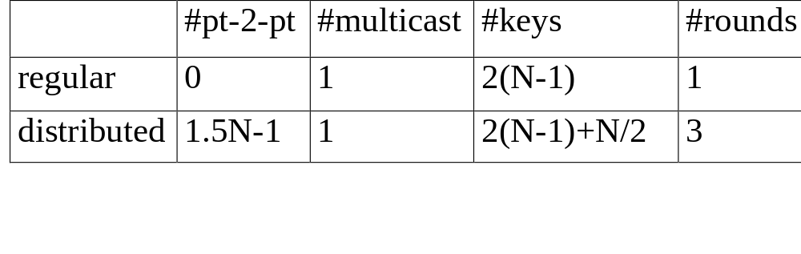
Building the Tree

Slide 27
Conclusions
We have taken a non-fault-tolerant, centralized protocol, and converted it into a protocol that is decentralized and tolerant of failures
The new protocol has nearly the same cost as the original protocol
The new protocol requires a GCS
We are examining the scalability of the GCS

Slide 28
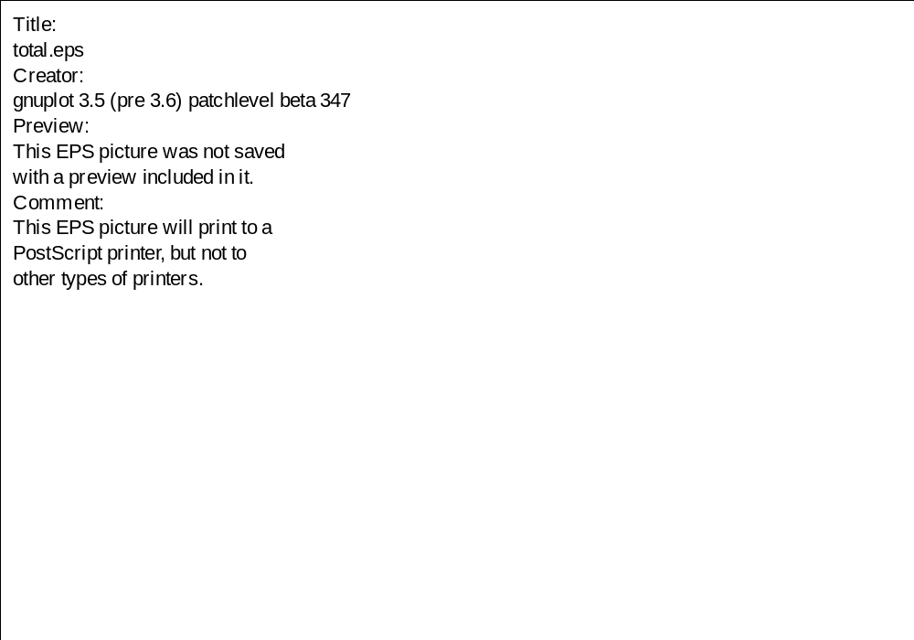
Performance

