Slide 1
An IPSec-based Host Architecture for Secure Internet Multicast
R. Canetti, P-C. Cheng, F.Giraud, D. Pendarakis, J.R. Rao, P. Rohatgi,
IBM Research
D. Saha
Lucent Technologies

Slide 2
Motivation
In today’s Internet the need for efficient and secure multicast communication is growing.
Most works on designing secure multicast mechanisms concentrate on the global architecture and design of group control entities.
We present a host architecture for a member in a secure multicast group.

Slide 3
In this talk:
Background on secure IP multicast:
  Some applications
  Security requirements
  Overall design of secure IP multicast groups (as developed in the IRTF)
Basic design tenets of host architecture
Overview of the design
Outstanding issues

Slide 4
Multicast communication:
Whenever there are multiple recipients
Typical applications:
  File and software updates
  News-feeds
  Video/audio broadcasts
  Virtual conferences, town-hall meetings
  Multiparty video games

Slide 5
Security requirements
Limiting access to group communication:
  Long-term secrecy
  Ephemeral access restriction
Authentication:
  Group
  Source
Anonymity
Availability (against denial of service attacks)

Slide 6
Work done at the
Secure Multicast Group (SMuG) of the IRTF:
Set focus on prominent scenarios and issues
Develop overall architecture for secure IP multicast and research for appropriate protocols that can be standardized

Slide 7
A prominent scenario:
One-to-many communication
Medium to large groups (10-100K)
Centralized group management
No trust in group members
Need source authentication, ephemeral encryption
Dynamic membership

Slide 8
Global architecture for secure multicast (I):
Group center
Group member
(sender/receiver)
Control communication
Data communication

Slide 9
Global architecture for secure multicast (II):
Group controllers
Group member
(sender/receiver)
Control communication
Data communication

Slide 10
Host architecture: Design tenets
The security mechanism should be independent of the routing method.
Separate key management from data handling
Use existing components when possible (In particular, IPSec)
Minimize changes to OS kernel
Maintain ability to plug-in different crypto algorithms

Slide 11
An IPSec-based design
Motivation:
  Build on solid and (soon to be) ubiquitous protocol.
  Provides security in kernel, minimal load on applications.
Drawbacks:
  Tie the design to existing protocols
  Have to deal with compatibility

Slide 12
The architecture at a glance
Control API Data API
Multicast Internet
Key Exchange
Source Authentication
Module
App. space
Multicast Secu-
rity Association
OS kernel
AH/ESP (IPSEC)
Line
(group controller)
Line
(group members)

Slide 13
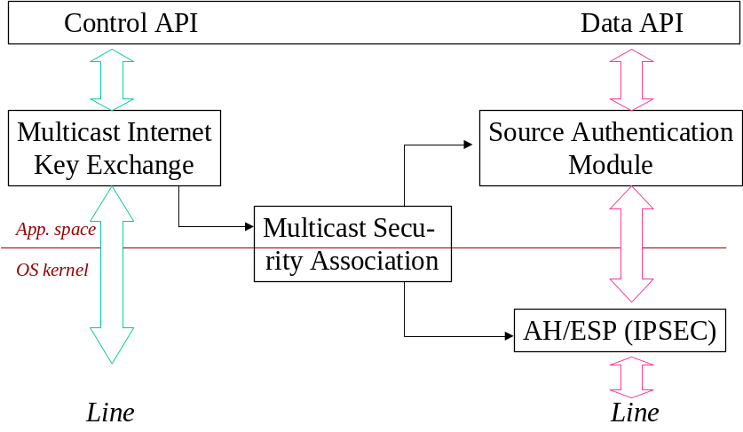
IPSEC transforms (AH/ESP):
-Data encryption with group key
-Group authentication with group key
-Operates on individual packets (No state across packets)

Slide 14
SAM
Signing data efficiently requires:
-Signing data in large chunks
-Keeping state across packets
Therefore, SAM is in transport layer (UDP),
operates on UDP frames.
Possible realizations:
[Wong-Lam 98], [Rohatgi 99], [C+ 99], [Perrig et.al. 00],...

Slide 15
MSA is a database that holds:
- IPSec SA for AH/ESP (group key, algorithms, group address, etc.)
- Information for SAM (Signing/verification keys, algorithms, etc.)
- Re-keying information for MIKE (e.g. path in “LKH tree”)
- Point-to-point SA with the center
Note: MSA is periodically updated by MIKE.

Slide 16
MIKE:
- Invoked by API to join/leave multicast group.
Join/leave interaction done via standard point-to-point
secure connection (such as IPSec, SSL) with the center.
- Receives key updates from controller and updates MSA
-Key updates assume a “reliable multicast shim”.
(Can be implemented by any general RM protocol
or by a special purpose protocol.)

Slide 17
Design of MIKE
Secure 1-1
connection
Registration and de-registration
Use any secure channel prot.
(IPSec/TLS/…)
Create MSA
With center
Periodic key updates
Update MSA
Reliable mcast
From center
Network
Intra-host

Slide 18
Outstanding issues
Handling multi-user hosts: Need to provide intra-host access control.
  MSA must list member applications/users
  Allow only members to listen to group traffic. Can do either:
    In kernel. (More efficient, needs kernel modification)
    Using daemon process (Less efficient, no kernel modification).

Slide 19
Outstanding issues
MSA identification and choice of SPI:
  An IPSec SA is identified by receiver address, SPI, protocol. SPI is chosen by the receiver.
  Here SPI cannot be chosen by receiver.
  Instead it is chosen by the group center.
Replay protection field:
  In IPSec, increasing counter set by sender, receiver free to ignore.
  Unchanged for single sender multicast. With multiple senders receiver must ignore.

Slide 20
Validation of architecture
Implemented the architecture on Red Hat Linux 5.1, using Freeswan version 0.91 implementation of IPSec.
Needed a “patch” to make Fswan work with IP-multicast (class D) packets. (Seems to be a pecularity of Fswan implementation.)
Architecture works smoothly, with good performance.

Slide 21
Conclusion
Described an IPSec-based host architecture for secure multicast.
Architecture is compliant with global architecture as developed in the IRTF.
Can be installed with little or no modification to OS k ernel, with good performance.

