Slide 1


Understanding Risk

Slide 2
Keys To Effective Internet Security
Understand the actual risk
  Threats, vulnerabilities and costs
  Some threats are more likely than others
  Some breaches are more costly than others
Implement a dynamic security strategy
  Rapidly deployed, continuous
  Multi-vendor
  Constantly re-assess and re-evaluate

Slide 3
ICSA.net’s
Six Categories of Risk
Risk = Threat (Rate) * Vulnerability (Index) * Cost
Electronic
  (External / Internal)
  Hacking, Sniffing
  Spoofing
Malicious Code
  Viruses, Worms
  Java, ActiveX
  Trojans
Physical
  Theft
  Perimeter devices
  Terminal hijack
Privacy
  employee
  customer data
  corporate data
DownTime
  DoS attacks
  Bugs, Power
  Civil Unrest
  Natural Disasters
Human Factors
  Non-compliance

Slide 4
Risk =
Threat* Vulnerability*Cost
Threat:
  The likelihood that a security event will happen in a given time span or the rate of occurrence
  Security Event Rate (per month, hour)
  Composed of world-wide rate modified by local Target Index, & other factors

Slide 5
Risk =
Threat* Vulnerability*Cost
Vulnerability:
  A given target is either vulnerable or not to a particular well defined threat (0 or 1)
  A given target is variably vulnerable to a class of threats (Vulnerability between 0 & 1)
  A given organization is composed of numerous targets which, as a group, are variably vulnerable to a given threat category

Slide 6
Risk =
Threat* Vulnerability*Cost
EventCost:
  Security Events result from a threat successfully exercised against a vulnerable system
  The total costs of all of the ramifications of a security event are made up of numerous factors and include both hard and soft costs
  Total sum of all ramifications of a security event called EventCost Dollars per SecurityEvent

Slide 7
Risk =
Threat* Vulnerability*Cost
If Threat = 0
Vulnerability = 0
or EventCost = 0
There is no Risk
Of these, we have:
  Good control over Vulnerability
  Some control over EventCost
  Minimal control over Threat Rate

Slide 8
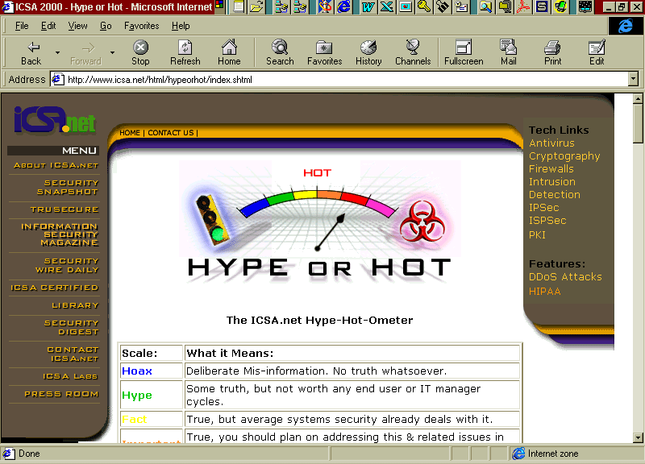
Hype or Hot at www.icsa.net

Slide 9
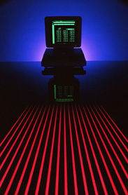
ICSA.net
12379C Sunrise Valley Drive
Reston, VA 20191
703-453-0500
www.icsa.net
Notes:
TruSecure and ICSA.net
Your Information Security Partner

