Slide 1
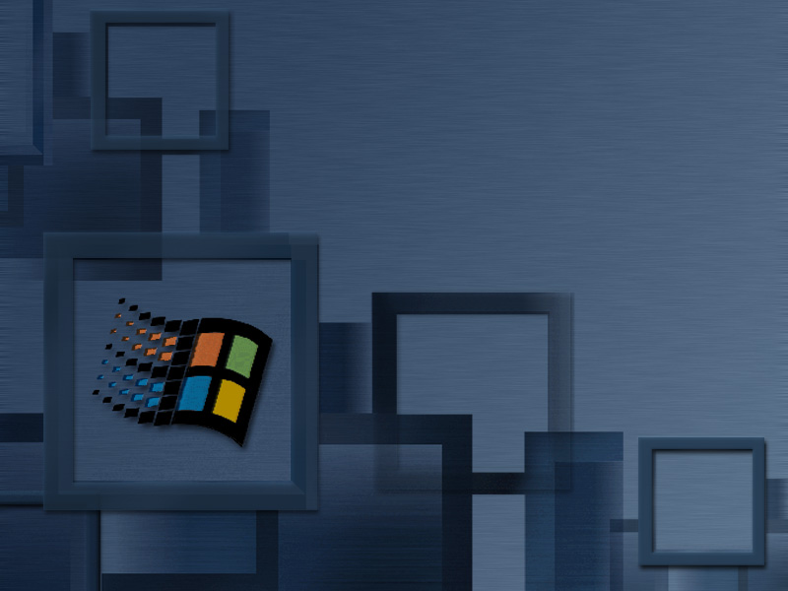
Windows 2000 Security Architecture
Peter Brundrett
Program Manager
Windows 2000 Security
Microsoft Corporation

Slide 2

Topics
Single Sign-on
Kerberos v5 integration
Active Directory security
Delegation of authentication
Public key infrastructure
Encrypting file system
Network security
Security policy
Secure Windows

Slide 3
Platform Security Requirements
Single enterprise logon
Strong authentication
Authorization
Secure communications
Mandatory policy
Auditing
Interoperability
Extensible architecture
Goal: Deliver Windows 2000 as the most secure high volume OS
Notes:
Single Enterprise-wide Login - Users login once to gain access to all network resources in the local network (campus) environment or enterprise-wide services available over public networks.
Decentralized Administration and Large Domains - Allow delegation of administration to smaller organizational units within domains and increase scalability of single master and multi-master domains to much larger organizations.
Integrated with Directory Service - Users and groups are objects in the DS rather than implemented in a separate security database. Security objects are implemented using the same infrastructure for managing computers, services, and other system components.
Multiple Security Authorities - The Security Support Provider Interface based on GSSAPI, isolates applications and NT system services from implementation details of specific security protocols. Windows NT supports targeted authentication services that complement NT authentication.
Authenticated DCOM/RPC - Integrated NT security with core distributed application infrastructure makes Windows NT the best application development platform available anywhere. Support for SSL/PCT by RPC runtime enables secure channel distributed applications based on public key credentials.

Slide 4
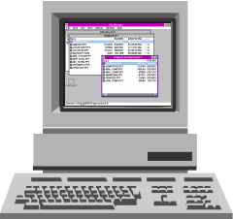


Windows 2000
Single Sign On
Single account store in Active Directory
Key Distribution
Center (KDC)
Integrated Kerberos v5 logon
Protected store for public key credentials
Kerberos,
SSL/TLS,
others
Industry standard network security protocols

Slide 5

Smart Card Logon
1. Insert smart card to reader,
activate card with PIN
2. Private key and certificate
on card authenticates user
to KDC
TGT
3. KDC returns TGT
response protected
by User’s public
key certificate
Windows 2000
Active Directory
Key Distribution
Center (KDC)
4. Account control option
requiring smart card
logon per user
Windows 2000 Domain Controller

Slide 6
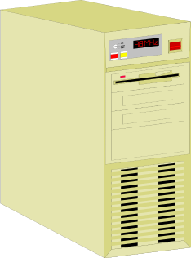
Kerberos V5 Integration
Client
Server
Service ticket authorization data supports NT access control model
Kerberos SSPI provider
manages credentials and security contexts
Windows 2000
Active Directory
KDC relies on the Active Directory as the store for security principals and policy
Key Distribution
Center (KDC)
Windows 2000 Domain Controller

Slide 7
Kerberos Authentication
Mutual Authentication
Application Server (target)
4. Present service ticket
at connection setup
1. Publish Service
Connection Point and SPN
Target
2. Lookup Service,
Compose SPN
Windows 2000
Active Directory
TGT
3. Request service ticket for <spn>
Key Distribution
Center (KDC)
5. Mutual auth using
unique session key
Windows 2000 domain controller

Slide 8
Secure Distributed Services Model
Client request
Secure
Distributed
Service
Authenticate Client
Private Data
Store
Impersonate Client
Get client’s
access token
Get object’s
security
descriptor
Kernel access check
Return response

Slide 9
Remote File Access Check
Client
File application
Token
\\infosrv\share
SMB protocol
Server
Rdr
SSPI
Kerberos SSP
Token
Kerberos SSP
Ticket
NTFS
Access
check
SD
File
KDC

Slide 10
Windows 2000 Integration
Kerberos Authentication Use
LDAP to Active Directory
CIFS/SMB remote file access
Secure dynamic DNS update
System management tools
Host-host IP security using IKE
Secure Intranet web services in IIS
Authenticate certificate request to Enterprise CA
COM+/RPC security provider

Slide 11
Cross-platform Interoperability
Based on Kerberos V5 Protocol
  RFC 1510 and RFC 1964 token format
  Testing with MIT Kerb V5
Windows 2000 hosts the KDC
  UNIX clients to Unix Servers
  UNIX clients to Windows Servers
  NT clients to UNIX Servers
Cross-realm authentication
  UNIX realm to Windows domain

Slide 12
Architecture For Multiple Authentication Services
Internet Explorer,
Internet Information
Server
Directory
enabled apps
using ADSI
Mail, Chat,
News
Remote file
COM+
application
CIFS/SMB
Secure RPC
HTTP
LDAP
POP3, NNTP
SSPI
NTLM/
NTLMv2
Kerberos
SChannel
SSL/TLS
MSV1_0/
SAM
KDC/DS

Slide 13
Windows 2000 Active Directory
Domain hierarchy: domain tree
  Organizational Unit (OU)
  hierarchy within a domain
    Users, groups, machines
    Domain configuration
OU
OU
Users

Slide 14
Active Directory
Authentication and Access Control
LDAP v3 is core directory access protocol
  Authenticate using SASL and Kerberos protocol
  LDAP with SSL/TLS support
Security Descriptor
Bind Request
OU
Every object has a unique ACL
  Like NTFS folders and files
OU
Users

Slide 15
Active Directory
Security administration
Delegation of administration
  Grant permissions at organizational
  unit (OU) level
  Who creates OUs, users, groups, etc.
Fine-grain access control
  Grant or deny permissions on per-property level, or a group of properties
    Read property
    Write property
Per-property auditing

Slide 16
Secure Applications
Connection Authentication
  Establish Credentials
  Mutual authentication of client and server
Secure Communication
  Message privacy and integrity
Impersonation and Delegation
  Assuming client’s identity
Authorization and Auditing
  Using security descriptors

Slide 17
Example: Delegation in Action
1. 401 Access Denied
WWW-Authenticate: Negotiate
4. IIS impersonates client,
invokes ISAPI extension
IIS
SQL
Server
3. WWW-Authenticate:
Negotiate <blob>
ISAPI
2. Ticket
request
to KDC
Server-A
Server-B
5. ASP uses ADO to
query SQL,
integrated security
requests ticket
6. SQL Server
impersonates
original client,
then data access

Slide 18
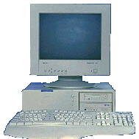
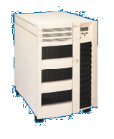
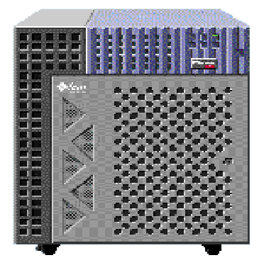
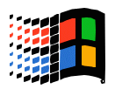
Interoperability
Cross Platform Secure 3-Tier App
Windows 2000 Professional
Smart Card Logon
Windows 2000 Server
Web Server
Solaris
UNIX Server
Oracle DB Application
IIS
App
Service
IE5
ISAPI
Extension
HTTP
TCP
SSPI/Krb
SSPI/Krb
GSS/Krb

Slide 19
Public Key Components
For servers
Key and certificate management
Secure channel with Client authentication
Auto enrollment
For clients
User key and
certificate mgmt
Secure channel
Secure storage
CA enrollment
Windows 2000 Active Directory
Certificate
Server
Enterprise
Certificate services
Trust policy

Slide 20

SSL Client Authentication
Server
ACL

Server
resources
Client certificate
SChannel SSP
Access token
Œ
Ž
Domain
Authentication
service
Org (OU)
Certificate Store
of Trusted CAs

Users
1. Verify user certificate based on trusted CA, CRL
2. Locate user object in directory by subject name
3. Build NT access token based on group membership
4. Impersonate client, object access verification

Slide 21
Crypto API Architecture
Application
Secure channel
Certificate management services
Crypto API 1.0
Certificate
store
RSA base
CSP
Fortezza
CSP
SmartCard
CSP
Key
database
Cryptographic
Service Providers

Slide 22
Encrypting File System
Privacy of data that goes beyond access control
  Protect confidential data on laptops
  Configurable approach to data recovery
Integrated with core operating
system components
  Windows NT File System - NTFS
  Crypto API key management
  LSA security policy
Transparent and very high performance

Slide 23

EFS Architecture
Applications
EFS
service
Win32 layer
Crypto API
User mode
Kernel mode
I/O manager
LPC communication
for all key
management support
NTFS
EFS
Encrypted on-disk data storage

Slide 24
File Encryption
A quick
brown fox
jumped...
File encryption
(DESX)
*#$fjda^j
u539!3t
t389E *&
Data decryption
field generation
(RSA)
DDF
User’s
public key
Data recovery
field generation
(RSA)
DRF
Randomly-
generated
file encryption key
Recovery agent’s
public key
in recovery policy
RNG

Slide 25
File Decryption
*#$fjda^j
u539!3t
t389E *&
File decryption
(DESX)
A quick
brown fox
jumped...
User’s private
key
File encryption
key
DDF extraction
(e.g., RSA)
DDF is decrypted using the private key to get to the file encryption key
DDF contains file encryption key encrypted under user’s public key
DDF

Slide 26
Secure Networking
Internet Protocol Security (IPSec)
Extended Authentication Protocol/PPP
  Token and SmartCard support
Remote Authentication Dial In User
Service (RADIUS)
Kerberos security package
Public key (SSL/TLS) security package

Slide 27
Windows 2000 IPSec
Target Scenarios
Remote Access User to Corporate Network
  Dial Up from Laptop or Home
  Using existing network connectivity to Internet
Laptop or Home PC
IP Tunnel
Corporate Network
A
C
Host
Host
Internet
Service
Provider
Router or
Tunnel Server
B
Internet
Host
Modems

Slide 28
Windows 2000 IPSec Target Scenarios
LAN Edge Gateway to Edge Gateway
of Another LAN
  Across Internet or private network with Windows 2000 <-> Windows 2000 routers using
  IP tunnels
    IPSec Tunnel Mode
    L2TP/IPSec integrated tunneling
Corporate Net in LA
IP Tunnel
Corporate Net in DC
A
B
Host
Router C
Router D
Host
Internet

Slide 29

IP Security
Host-to-host authentication and encryption
  Network layer
IP security policy with domain policy
  Negotiation policies, IP filters
IP Security Policy
PA
PA
Policy Agent
  Downloads IPSEC policy
Source: 157.55.00.00
Dest: 147.20.00.00
Any protocol

Slide 30

IP Security Association using Kerberos Authentication
Used for SMB data
encryption
Windows NT
Directory Server
KDC
157.55.20.100
147.20.10.200
SA
SA
IKE
IKE
TCP
IP
TCP
IP

Slide 31
Managing Security Policy
Security settings in local or
group policy
Local computer policy
  Audit policy, rights, security options
Group Policy in the directory
  Common computer policies
Domain level policies
  Account policies
  Public key trust policies

Slide 32
Hierarchical Policy Settings
1
Domain level policy
2
OU level policy
3
OU level policy
Applied policy for a computer combines multiple policy objects

Slide 33

Enterprise Framework
Integrated with Group Policy
management
  Security settings in group policy
  Settings applied as part of policy
  enforcement on each computer

Slide 34
Secure Windows
Goals
  Secure out-of-the-box
  Definition of secure system settings
  Backward compatible user experience
Clean install of Windows 2000
  Upgrade can apply security configuration
Who can do what?
  Administrators, Power Users, Users
  Group membership defines access

Slide 35
Administrators vs. Users
Administrators
  Full control of the operating system
  Install system components, drivers
  Upgrade or repair the system
Users
  Cannot compromise system integrity
  Read-only access to system resources
  Interactive and network logon rights
  Can shutdown desktop system
  Legacy application issues

Slide 36
Security Features Summary
Single sign on with standard protocols
  Kerberos V5 and X.509 V3 certificates
Public key certificate management
  Enterprise services for PKI rollout
Distributed security for applications
  Authentication, authorization, auditing
Active Directory integration
  Scalable, extensible user account directory

Slide 37
For More Information
White papers
  http://www.microsoft.com/windows2000/library
  Active Directory
  Security Services
Windows 2000 Resource Kit
  Deployment Guide
  Detail technical material
Microsoft Security Advisor
  http://www.microsoft.com/security

Slide 38


