Slide 1
WebWatcher
A Lightweight Tool for Analyzing Web Server Logs
Hervé DEBAR
IBM Zurich Research Laboratory
Global Security Analysis Laboratory
deb@zurich.ibm.com

Slide 2
PROJECT GOALS
To automatically analyze web server logs
To detect compromise attempts through HTTP requests
To have a very small impact in terms of resources
To monitor HTTP servers on as many platforms as possible
To operate both in real time and batch modes
To use our knowledge of malicious HTTP requests signatures
To have a flexible and rich attack signature format
To track hosts exhibiting malicious behavior
To discover and learn new attack signatures
To remove false alarms intelligently

Slide 3
ATTACKS TARGETED
Penetration of the system via HTTP server vulnerabilities
  Vulnerable CGI program requests
  Password guessing
  Access to sensitive information (guessing CGI names, accessing system files)
Denial-of-service attacks
  Repeated accesses to non-existing resources
  Repeated accesses to resources that cause server errors
Legal but undesirable activity
  Borderline use of the HTTP protocol
    e.g. % encoding of normal characters
  Sensitive documents accesses
Policy violation (when used on firewall HTTP proxy)
  External / internal policies governing access to web sites.

Slide 4
TECHNICAL CHOICES
Input: CLF/ECLF format
  host - authenticated_user [date] "request string" status bytes
Implementation language: Perl5
  Portable
  Well accepted in web server environments
  Regular expression matching
Signature language: perl regular expressions
  Easy to create simple signatures
  Possible to create very complex ones to reduce false alarms
Pipelined architecture
  Each filter corresponds to a set of verifications

Slide 5
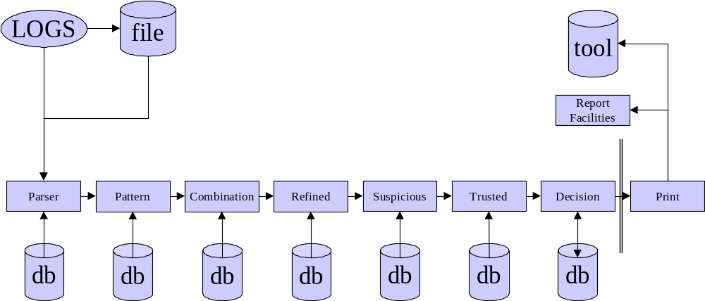
ARCHITECTURE

Slide 6
MODULES
Parser
  Reads the request
  Breaks the log entry into its constituent parts and check integrity
  Refines the URL into its parts and check the format / empty string
  Decodes any encoded characters and verify appropriateness of % characters
Pattern
  Looks for signatures
  Signatures are relevant to fields
  Signatures are grouped into classes
  Negative matching
Combination
  Logical combination of signatures (if sig1 and sig2 then sig3)
Refined
  Signature dependencies (if sig1 then match sig2)

Slide 7
MODULES (2)
Suspicious
  Keeps track of suspicious hosts effectively (not signatures !)
Trusted
  Eliminates alerts based on signatures
Decision
  Ages and updates the tree of suspicious hosts
Print module
  Prints out the alert
    Syslog
    Internal format
HTML Reporting facility
  Overview of the results
  Intended for batch processing

Slide 8
EXPERIMENTS
Data collected from (batch runs)
  2 medium sized commercial sites
  University logs
  1 day of the Nagano Olympics website (Courtesy of Jim Challenger)
Data collected from an apache web server (Real time)
  RS/6000 250 running apache 1.3.3
Initial signature base
  50 vulnerable cgi programs (now 150)
  Directory tricks
  Interpreters in cgi-bin
  Sensitive files
  ...

Slide 9
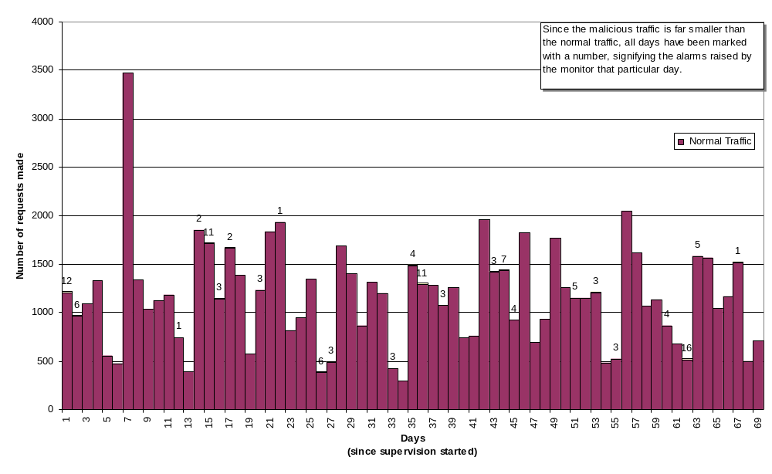
TRAFFIC ANALYSIS

Slide 10
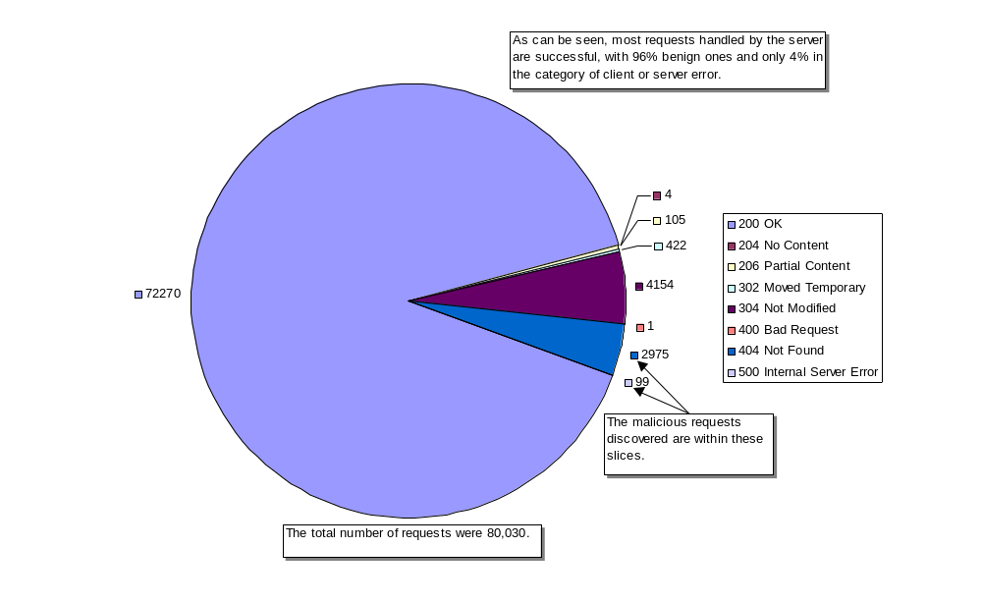
REQUEST TYPE DISTRIBUTION

Slide 11
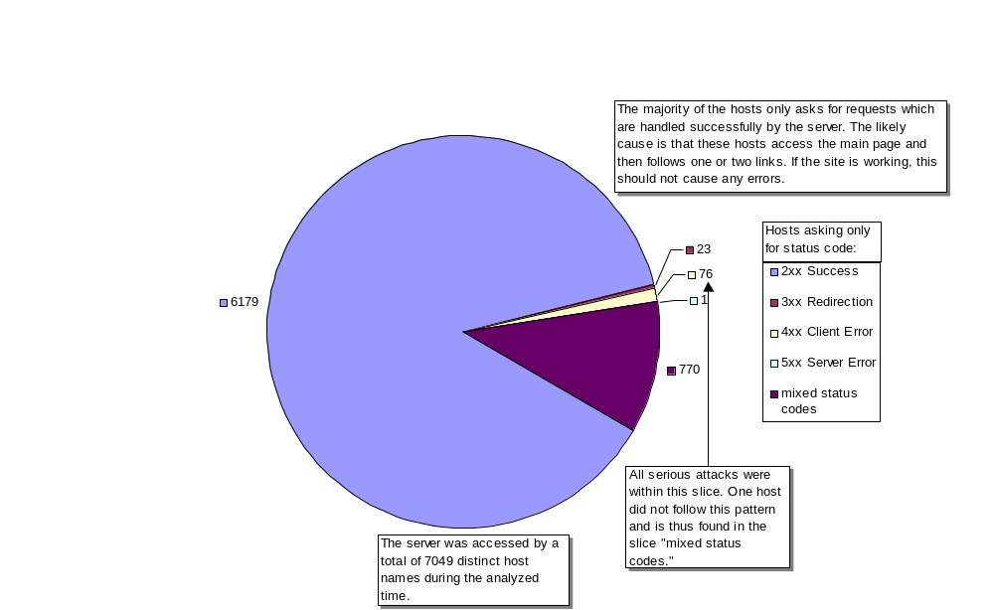
HOSTS AND REQUEST TYPES

Slide 12
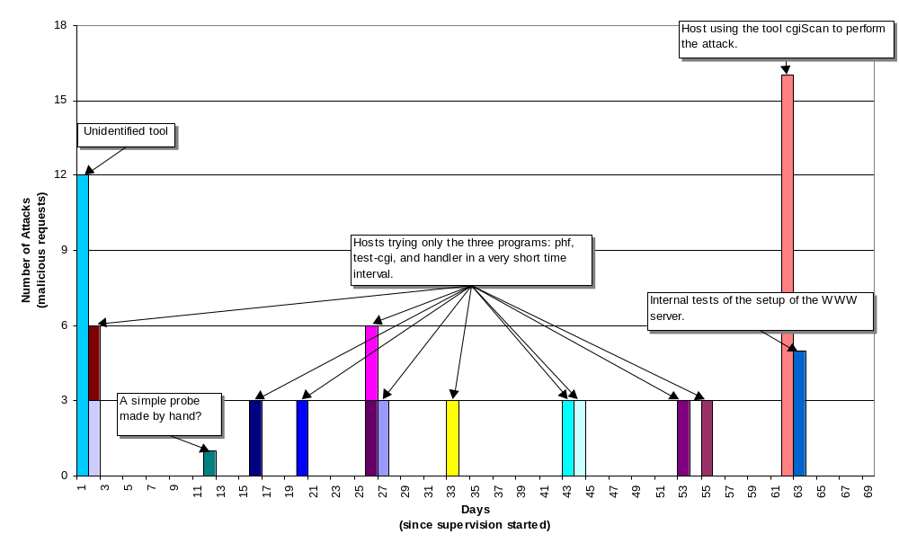
ATTACK PATTERNS

Slide 13
DEPLOYMENT
WebWatcher is in operation for IBM customers
  Batch processing
  Weekly reporting
Many attack attempts detected
  Sites are highly visible and make attractive targets
  WebWatcher signature database is growing richer ….
WebWatcher interacts with the Tivoli Management Framework
  Alerts are sent into the event correlation facility (TEC).
  Alerts follow the IDWG data model definitions.
  Alerts are correlated with ones coming other intrusion-detection systems (network-based).

Slide 14
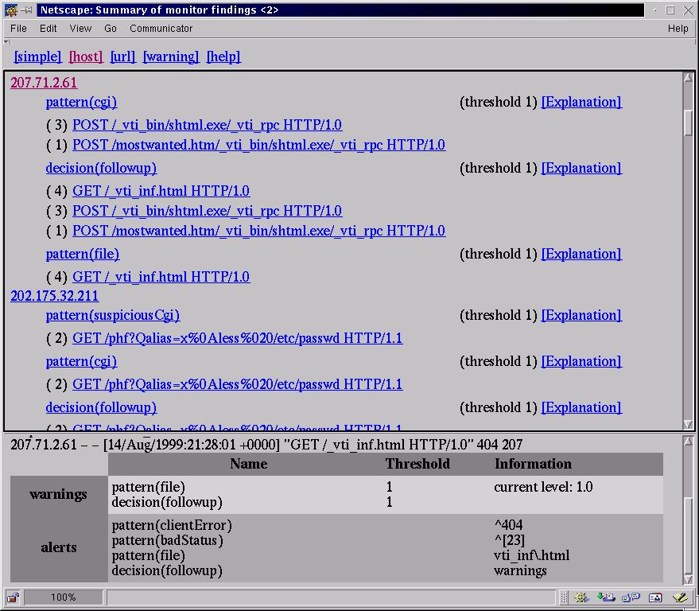
REPORT (1)

Slide 15
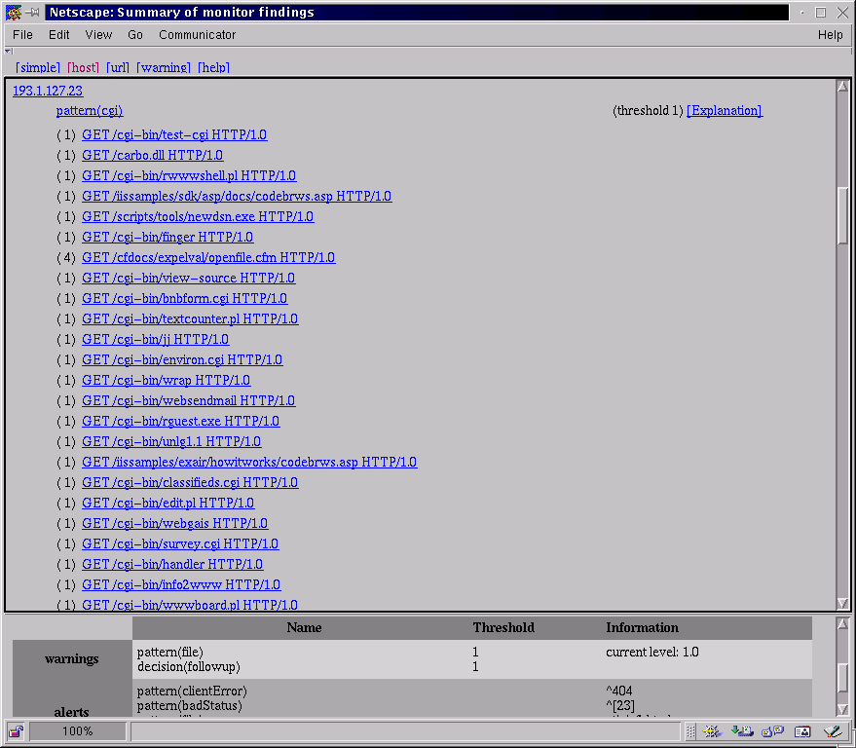
REPORT (2)

Slide 16
FUTURE WORK
Detect denial of service attacks through legitimate requests:
  “The Slashdot effect”.
  Distributed denial of service attacks can be carried out effectively nowadays.
  This requires statistical tracking of legitimate requests -> quite costly.
Deploy in distributed environment:
  Challenge of distributed web servers (clusters, SP2, …).
  The problem of sharing the suspicious hosts tree information is being studied.

